Slide 1
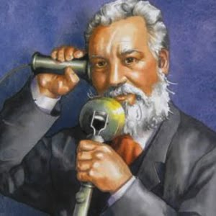
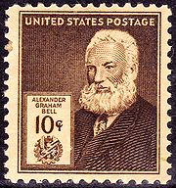
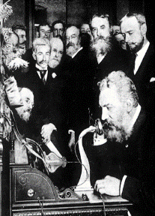
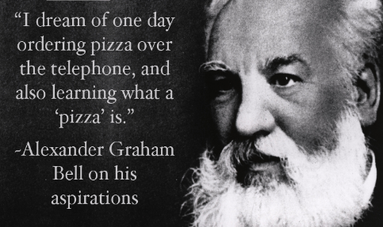
Alexander Graham Bell
By Peggy and Chelsea

Slide 2
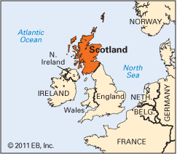
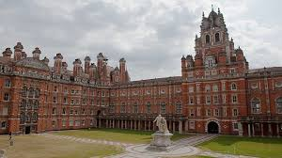
Background
Born in Edinburgh, Scotland, on March 3, 1847
Both his mother and wife were deaf
Both his grandfather and father were experts on the mechanics of voice and elocution
1868, he got into the University of London.

Slide 3
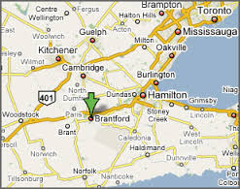
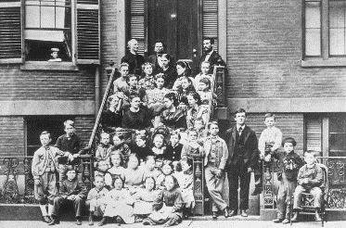
Background
When he was 12 years old, he used rotating paddles and nail brushes built a machine which could remove the husks from the grain easily.
When he was 16 years old, he joined his father with helping the deaf, and soon he was in charge of all his father’s London operations.
In 1970, July, he immigrated to Brantford, Ontario, Canada with his family.
his job was Acoustic physiologist and deaf language teacher.

Slide 4
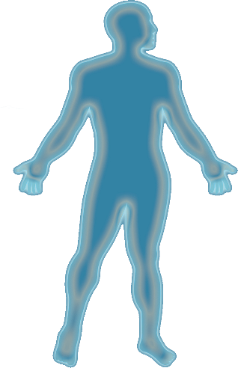
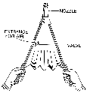
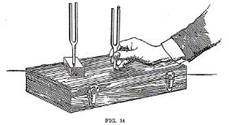
Achievements
Bell and his brother established the Moving head
"Mama"
2.His brother built throat and larynx
It can speak some easy word by adjusting its lip
3. Bell built a realistic skull
→Also, he used the tuning forks to explore resonance .
4. They use a bellows forced air to make it speaks
First experiments with sound

Slide 5
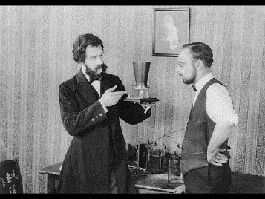
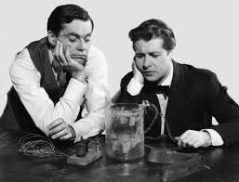
Achievements
In 1871, Alexander Graham Bell moved to Boston, and started work on set to different frequencies with the telegraph transmission of several messages.
Thomas Sanders and Gardiner Hubbard were his local investors.
Between 1873 and 1874, Bell spend a lot of times for trying to perfect the harmonic telegraph.
Alexander Graham Bell cooperated with a skilled electrician, Thomas Watson.

Slide 6
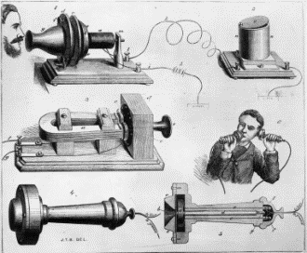
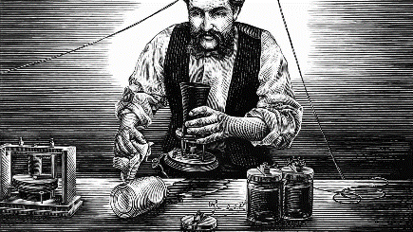
Achievements
Through 1874 and 1875, Bell and Watson worked on both the harmonic telegraph and a voice transmitting device.
Though at first frustrated by the diversion, his investors foresee Business Opportunities this product’s patent.

Slide 7
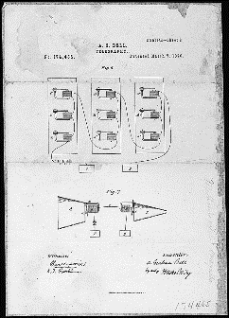

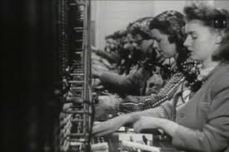
Achievements
on March 7, 1879, U.S. Patent Office award the patent of telephone to Bell.
On March 10, 1876, Bell and Watson invented the first telephone successfully.
The Bell Telephone Company was organized on July 9, 1877, and by 1866. There were more than 150,000 people had their own telephone.

Slide 8
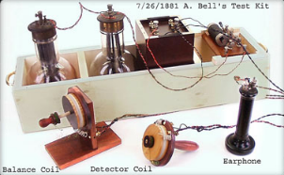
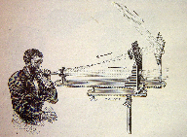
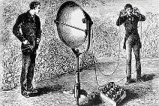
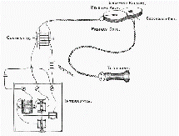
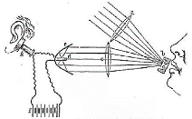
Achievements - inventions
Photophone
A device for the transmission of speech on a beam of light
Invented on February 19, 1880
Metal detector

Slide 9
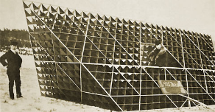
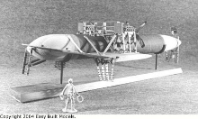
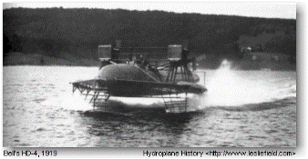
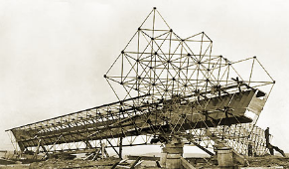
Achievements - inventions
Hydrofoils
A boat made of foils that operate on water
For military uses, sporting and tourism
Aeronautics
Study and design of aircraft machines

Slide 10
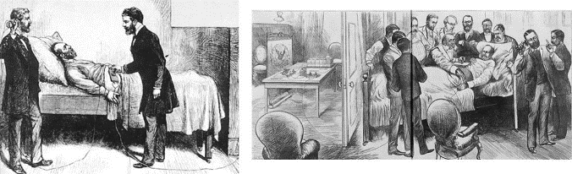
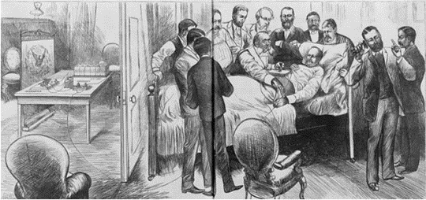
Legacy: metal detector helped president
The metal detector ALMOST saved President Garfield after he was assassinated on July 2, 1881.
This device was designed to locate a bullet lodged in the chest of President Garfield. The metal detector worked correctly, but the attempt was unsuccessful because the metal coil spring bed Garfield was lying on confused the detector.

Slide 11
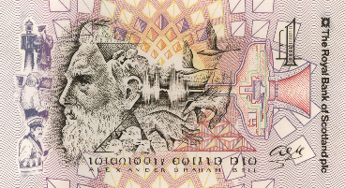
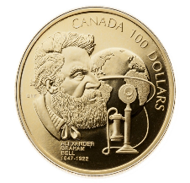
Legacy: image of Bell on coins and notes
At the back of the £1 banknotes produced by the Scotland government, there were illustrations include Bell's face in profile, his signature, and objects from Bell's life and career
In Canada, they remembered his 150th birthday by making commemorative one hundred dollar gold coins.

Slide 12
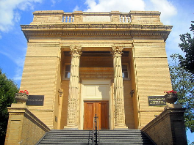
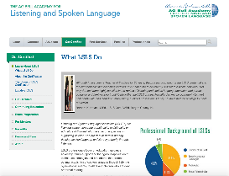
Legacy: organizations formed
Alexander Graham Bell Association for the Deaf and Hard of Hearing helped families, health care providers and education professionals understand childhood hearing loss and the importance of early diagnosis and intervention.
The Alexander Graham Bell Academy for Listening and Spoken Language was created was so that people can specialize in sign language and communicate via handheld communication devices.

Slide 13
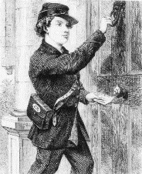
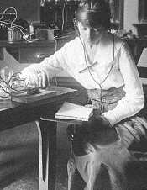
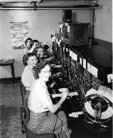
Impact on industrialization: economical & social
Led to development of city centers, office buildings and the concept of an urban worker society
Led to the creation of jobs (for factory workers and sales clerks) and destruction of jobs (for messenger boys, telegraphers and operators)
Changed the pace of business and made the world smaller and more accessible to all
Provided security and help in emergency situations
Improve social relationship
Expanded the range of people one interact with
Made long distance relationships
Kept families and communities together

Slide 14
Works cited
Alexander Graham Bell. The Science Classroom. The Science Classroom, 2016. Web. 24
February 2016.
Alexander Graham Bell. Wikipedia. Wikipedia, 2016. Web. 24 February 2016.
Alexander Graham Bell. FamousScientists. FamousScientists, 2016. Web. 24 February
2016.
Alexander Graham Bell. BBCHistory. BBCHistory, 2016. Web. 24 February
2016.
Industrialization. Rob Wedebrand. Rob Wedebrand, 2015. Web. 24 February 2016.
The Impact of The Telephone on Society. ETEC 540-Research Project. ETEC
540-Research Project, 2016. Web. 24 February 2016.
The Telephone. HistoryOStrich. HistoryOStrich, 2016. Web. 24 February 2016.

Slide 15
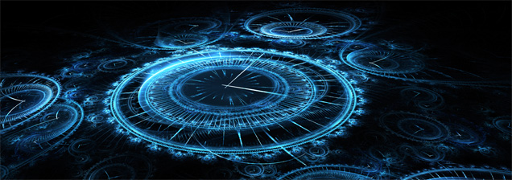
Discussion question!!
If you could go back to Bell’s days, would you join him in making his inventions? Why or why not?

Slide 16

thank you
for
listening~

