Slide 1
Atlatl
C. Darken

Slide 2
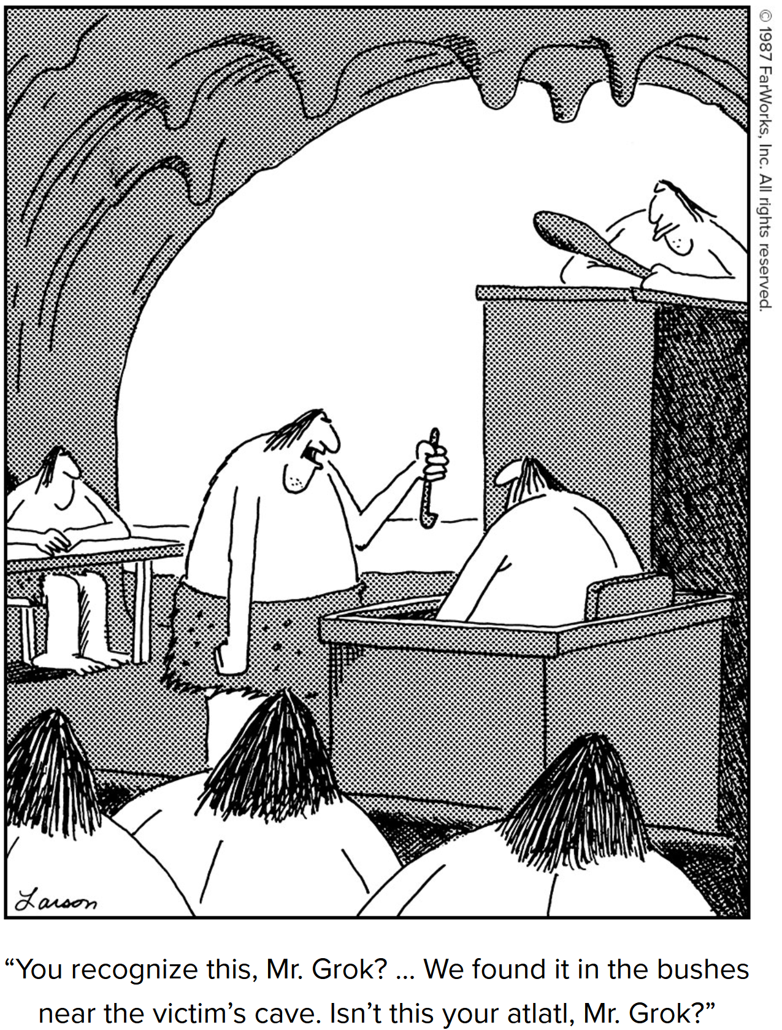
Outline
Introduction
Combat model
Performance scoring
AI observations and actions
Software architecture
Installation
Software use by task
Create scenario
Human vs human battle
Train policy network with reinforcement learning
Test trained network against human opponent
Test trained network against AI
Replay test results

Slide 3
Introduction
Atlatl is a ultra-simple combat model and surrounding infrastructure to support experimentation on controlling the sides with AI
The combat model is deterministic and relatively crude. The simplicity is intentional and meant to facilitate experimentation.
Performance is scored based on kills, losses, and holding urban areas (as a surrogate for all seize and hold operations)
Hooks to interface with a standard reinforcement learning codebase (Stable Baselines 3) are also provided
Human users can play against the AI via a web browser
A browser-based replay capability to view AI vs AI matches is also provided

Slide 4
Motivation
Building experience applying cutting edge AI to tactical problems to learn its strengths and weaknesses
Research questions
To what extent can reinforcement learning and related game theoretic algorithms learn basic military tactics (maneuver and fires)?
What algorithms are best?
What parameters make each algorithm perform at its best?
How much computation is required? I.e. what is the required wall clock time on what type of computer?
Can the algorithms find globally optimal solutions?
How do the algorithms perform against human players?
To what extent are the solutions spatially invariant?
To what extent do results on simple models transfer to DoD workhorse sims?

Slide 5
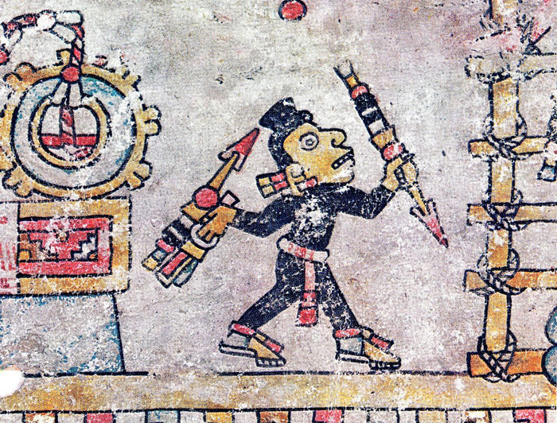
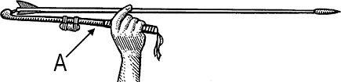
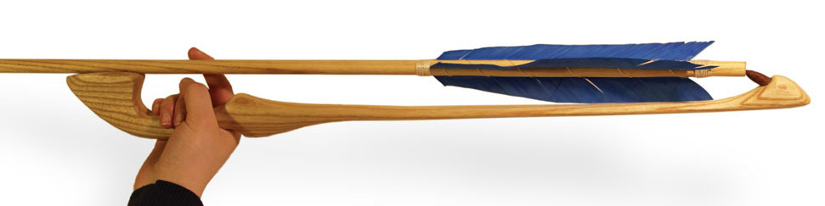

Where does the name “Atlatl” come from?
Atlatl is the Aztecan word for a simple, but highly effective, military tool that dates back to the stone ages. An atlatl can be used to greatly increase the power (and thus the penetration) of a spear or dart. Still in use for hunting today, atlatl competitions are held annually. Throws of nearly 260 m (850 ft) have been recorded.

Slide 6
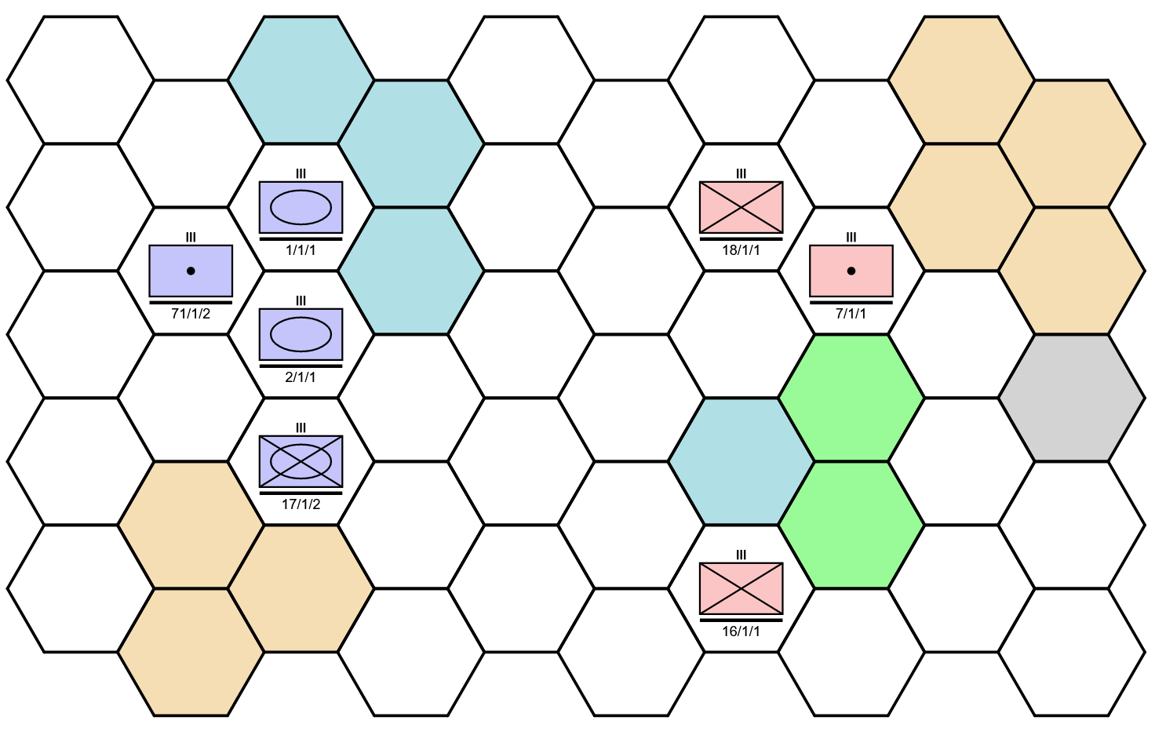
Human Interface View
An Atlatl scenario as it appears in the browser-based human interface showing multiple unit and terrain types

Slide 7
Space
Unit positions are centers of a hexagonal tiling of the plane. See this link for info regarding the use of such tilings.
Hexagonal grids are roughly rectangular (all columns are the same length)
Hexes are “flat side up”
Coordinates used in the project
Offset coordinates: the hex at the upper left is the (0,0) hex. The hex at the top of the second column of hexes would be the (1,0) hex, and the hex at the top of the third column the (2,0) hex etc. The hex below the (0,0) hex is the (0,1) hex, etc.
Grid coordinates: Integral coordinates corresponding to position on the plane, BUT the spacings in x and y are not the same. See under “Size and Spacing” at the link above
SVG coordinates: Floating point coordinates corresponding to position on the SVG element

Slide 8
Time
Model
Each faction (red or blue) takes successive turns
On its turn, a faction may take one action for each of its units
Actions are either moving or shooting
A “setup phase” is sometimes provided to allow forces to begin the game anywhere in a specified zone
Analysis
Defenders get an advantage, since the attacker typically has to move into range and be shot at before he can return fire
Artillery can currently move two hexes, so as things stand, it can “kite” foot-mobile infantry, i.e. shoot and scoot and never take damage (in the absence of other units or slowing terrain)

Slide 9
Terrain
Hexes are probably best conceived as being somewhat less than 10 km across.
Terrain types
Clear (white): good mobility for all unit types
Water (blue): impassible for all unit types
Rough (tan): slow go, good defense for infantry
Marsh (green): slow go, poor defense for most unit types
City (gray): good defense for infantry, may add to score if held
Roads and rivers are not in the simulation, and there is no immediate plan to add them

Slide 10
Units
Four different types: (foot) infantry, motorized/mechanized infantry (“mechinf”), armor (tanks), and artillery
All units except for infantry are considered to have motorized transport, and thus move faster in clear terrain
All units have a range of one hex, except artillery which has two hexes
Entities are high echelon (roughly regimental in scale)
Fires attrit the target according to a deterministic Lanchester equation, with firepower being indexed to the shooter’s type, the target’s type, and the type of terrain occupied by the target
When an entity’s strength goes below 50%, it is considered combat ineffective and is immediately removed from the simulation

Slide 11
Firepower Tables (combat.py)
Target
 | Infantry | Mechinf | Armor | Artillery
Infantry | 1 | 1 | 0.5 | 1.5
MechInf | 1 | 1 | 1.0 | 1.5
Armor | 0.5 | 0.75 | 1.0 | 1.0
Artillery | 1 | 0.75 | 0.5 | 1.5
Shooter
Note: A global modifier of 0.5 is
applied to all fires!
Target’s Terrain
 | Clear | Rough | Marsh | Urban
Infantry | 1 | 0.5 | 1 | 0.5
MechInf | 1 | 1 | 2 | 1
Armor | 1 | 1 | 2 | 1
Artillery | 1 | 1 | 2 | 1
Target

Slide 12
Shooting Example
Armor at 100 strength shoots at mechanized infantry at 100 strength and standing in a marsh.
The raw firepower of the shooter is its strength, here 100
From the shooter/target table, we get a firepower multiplier of 0.75 for armor shooting at mechanized infantry
From the target/terrain table, we get a firepower multiplier of 2.0 for mechanized infantry on marsh terrain
There is a global multiplier of 0.5 that is always applied.
The damage done to the target is the product of the firepower and all multipliers, in this case (100)(0.75)(2.0)(0.5) = 75
Thus the mech infantry will lose 75 points of strength, leaving it with 25 strength. This is less than 50, so the mech infantry unit is destroyed and immediately removed from the simulation.

Slide 13
Mobility Table (mobility.py)
Terrain Entered
 | Clear | Rough | Marsh | Urban
Infantry | 100 | 100 | 100 | 100
MechInf | 50 | 100 | 100 | 100
Armor | 50 | 100 | 100 | 100
Artillery | 50 | 100 | NA | 100
Mover
Values are the percentage of the turn time used to enter one hex.

Slide 14
Model Omissions
Rivers, streams
Roads, paths
Engineering, minefields, fortifications
Supply
Non-trivial command and control
Air support

Slide 15
Scoring
From the perspective of blue
Parameters are adjustable during scenario creation
Default values below
+1 point per red strength point* killed or made combat ineffective
-2 points per point of blue strength point* killed or made combat ineffective
24/num_cities points per city controlled** per phase
*Units start with 100 strength points and if they ever drop below 50 strength points, the unit is removed with the loss of all remaining strength points **Cities start under neither faction’s control. Control switches sides only when a unit from the opposite faction enters the city. Exiting the city does not itself cause loss of control.

Slide 16
Software Architecture
Python simulation engine
Can run as a single process for testing or training (if using machine learning)
JavaScript GUI
Runs on browsers
Has tools for map creation and placement of forces on the map
Supports human players
AI can run in its own process or communicate via sockets
The simulation talks to the AIs via JSON format messages (or the corresponding JavaScript objects or Python dicts that you get by direct conversion from JSON)

Slide 17
Architectural Diagram
training script
gym surrogate
atlatl
client interface
web socket server
fixed AI
Training
AI function server
Gym surrogate AI
web client
atlatl
client interface
web socket server
Human vs AI
AI function server
AI

Slide 18
Browser Graphics
Use SVG (Scalable Vector Graphics)
SVG is the web standard for vector graphics
Vector graphics keep exact coordinates for each part of each object, which is what allows them to be scaled
Often look much crisper than bit graphics

Slide 19
Message Sequence for Blue
parameters <- S
role-request -> S
Repeat indefinitely:
observation <- S
action -> S (if blue is on move and state is non-terminal)
At any time, any player may:
reset-request -> S
S -> reset
At any time, any player may:
next-game-request -> S
Followed by, for all players:
parameters <- S
role-request -> S
When on move and emulating a Gym environment:
gym-pause -> S

Slide 20
Message Structure (JSON format)
parameters
map
hexes
edges
paths (unused)
units
role-request
role
observation
units
status (score, phase, etc.)
action (type)
action (internal property)
type: move
mover: mover ID
destination: hex ID
OR
type: fire
source: shooter ID
target: target ID
reset-request (no content)
next-game (no content)
gym-pause (no content)

Slide 21
Example parameters message
{"type": "parameters", "parameters": {"map": {"hexes": [{"x_offset": 0, "y_offset": 0, "terrain": "clear", "x_grid": 2, "y_grid": 2, "setup": "setup-type-blue", "edges": ["edge-1-1-3-1", "edge-3-1-4-2", "edge-4-2-3-3", "edge-3-3-1-3", "edge-1-3-0-2", "edge-0-2-1-1"]}, {"x_offset": 0, "y_offset": 1, "terrain": "clear", "x_grid": 2, "y_grid": 4, "setup": "setup-type-red", "edges": ["edge-1-3-3-3", "edge-3-3-4-4", "edge-4-4-3-5", "edge-3-5-1-5", "edge-1-5-0-4", "edge-0-4-1-3"]}], "edges": [{"id": "edge-1-1-3-1", "xa_grid": 1, "xb_grid": 3, "ya_grid": 1, "yb_grid": 1, "type": "normal"}, {"id": "edge-3-1-4-2", "xa_grid": 3, "xb_grid": 4, "ya_grid": 1, "yb_grid": 2, "type": "normal"}, {"id": "edge-4-2-3-3", "xa_grid": 4, "xb_grid": 3, "ya_grid": 2, "yb_grid": 3, "type": "normal"}, {"id": "edge-3-3-1-3", "xa_grid": 3, "xb_grid": 1, "ya_grid": 3, "yb_grid": 3, "type": "normal"}, {"id": "edge-1-3-0-2", "xa_grid": 1, "xb_grid": 0, "ya_grid": 3, "yb_grid": 2, "type": "normal"}, {"id": "edge-0-2-1-1", "xa_grid": 0, "xb_grid": 1, "ya_grid": 2, "yb_grid": 1, "type": "normal"}, {"id": "edge-1-3-3-3", "xa_grid": 1, "xb_grid": 3, "ya_grid": 3, "yb_grid": 3, "type": "normal"}, {"id": "edge-3-3-4-4", "xa_grid": 3, "xb_grid": 4, "ya_grid": 3, "yb_grid": 4, "type": "normal"}, {"id": "edge-4-4-3-5", "xa_grid": 4, "xb_grid": 3, "ya_grid": 4, "yb_grid": 5, "type": "normal"}, {"id": "edge-3-5-1-5", "xa_grid": 3, "xb_grid": 1, "ya_grid": 5, "yb_grid": 5, "type": "normal"}, {"id": "edge-1-5-0-4", "xa_grid": 1, "xb_grid": 0, "ya_grid": 5, "yb_grid": 4, "type": "normal"}, {"id": "edge-0-4-1-3", "xa_grid": 0, "xb_grid": 1, "ya_grid": 4, "yb_grid": 3, "type": "normal"}], "paths": []}, "units": [{"type": "infantry", "echelon": "regiment", "name": "1", "longName": "1/1/1", "uniqueId": "blue 1/1/1", "faction": "blue", "currentStrength": 100, "fullStrength": 100, "homeOrgId": null, "taskOrgId": null, "hex": "hex-0-0", "canMove": false, "ineffective": false}, {"type": "infantry", "echelon": "regiment", "name": "10", "longName": "10/1/5", "uniqueId": "red 10/1/5", "faction": "red", "currentStrength": 100, "fullStrength": 100, "homeOrgId": null, "taskOrgId": null, "hex": "hex-0-1", "canMove": false, "ineffective": false}], "score": {"maxPhases": 4, "lossPenalty": -2, "cityScore": 24}}}
Hint: For better reading, copy this and paste into a JSON viewer

Slide 22
Example observation message
{"type": "observation", "observation": {"units": [{"type": "infantry", "faction": "blue", "longName": "1/1/1", "currentStrength": 100, "hex": "hex-0-0", "canMove": true, "ineffective": false, "detected": true}, {"type": "infantry", "faction": "red", "longName": "10/1/5", "currentStrength": 100, "hex": "hex-0-1", "canMove": false, "ineffective": false, "detected": true}], "status": {"cityOwner": {}, "score": 0, "phaseCount": 0, "isTerminal": false, "onMove": "blue", "setupMode": true}}}

Slide 23
Gym Compatibility Layer Details
Reinforcement learners repeatedly pick “actions” based on an “observation” from the environment
Altatl defines an action as an order of a single unit to a target unit (attack) or hex (move)
The next unit moved is fixed by the scenario (this is a limitation of the current Gym compatibility layer)
Actions are integers from 0 to 18, representing all target hexes within a range of two, including the unit’s current hex (for a “do nothing” action)
If dismounted infantry are ordered to move to a hex a distance of two away by a neural net, the move is suppressed and turned into a “hold position” order to Atlatl.

Slide 24
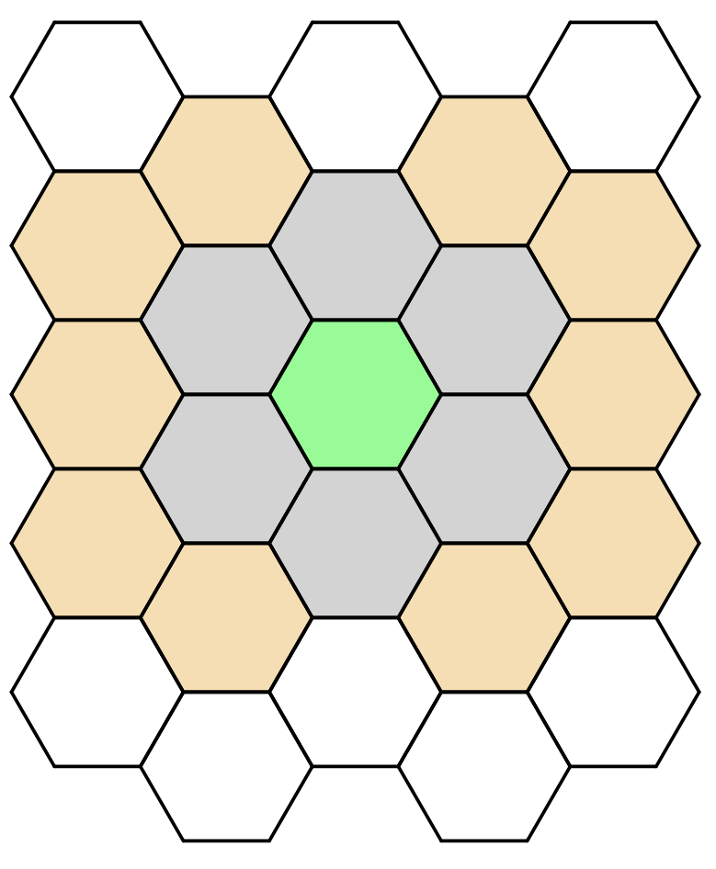
Peculiarity of Y Coordinate Doubling
When rectangular convolution kernels are used, the y coordinates of the hexes are doubled to ensure that the kernels cover the same set of hexes regardless of the hex they are centered on.
A 3x5 convolution kernel centered on the green hex captures data from all grey hexes as well as the green hex (the “megahex” centered on the green hex)
A 5x7 convolution kernel centered on the green hex captures data from all non-white hexes.
Note that the hexes two above and below the green hex are not captured by the 5x7 kernel. A 7x7 kernel would capture those two hexes, but would capture some additional ones as well.
For this reason, 3x5 kernels are recommended for convolutional neural networks with this representation
Even better, use Hexagdly convolution kernels for exact hexagonal convolution

Slide 25
Installation
The base code is pure Python 3 without additional dependencies
For development, a setup such as the below is recommended
WSL=Windows Subsystem for Linux (for Windows only, optional)
Visual Studio Code (optional, may require configuration)
Anaconda (strongly recommended)
Start a Bash shell to type commands into (for WSL/Linux only)
Run “Anaconda Prompt” from Windows menu at lower left (for Windows only)
Create environment with “conda create --name MV4025”
Then (once per session) “conda activate MV4025”
pip (required): “conda install pip”
Stable Baselines 3 (required): “pip install stable-baselines3”
scipy (required): “pip install scipy”
websockets (required): “pip install websockets”
hexagdly (required): “pip install hexagdly”
psutil (required): “pip install psutil”

Slide 26
Running Atlatl with a Pre-Existing AI
Start server via e.g. “python server.py test4.scn --redAI passive --openSocket”
If running any AIs as separate processes, start via e.g. “python passive.py red”.
Start play.html in browser
Click button to request playing red or blue, e.g. if the AI is red, click blue.
Blue now can adjust (“set up”) his forces to be on any hex marked with a blue square
Red does the same
Blue now moves its units (Blue always get the first turn)
Red and blue alternate turns thereafter

Slide 27
GUI Notes
For large maps, shift left clicking zooms the map out, and a second shift left click will zoom in at the mouse’s current location
Attempting GUI inputs on the opponent’s move results in an error being raised, and the simulation exiting immediately. This draconian response is to ensure that AIs are never able to move their opponent’s units
By default, Atlatl currently resets the game automatically as soon as it is complete. This is great for running many AI vs AI battles, but can be a bit frustrating to a human user, who may not get to see the final disposition of the battlefield due to the reset. The final score is visible on the console, however. To avoid this problem, run with –nReps 1
Note that a faction’s phase ends automatically if all units have taken an action. Otherwise the phase must be ended manually with the “End Phase” button.

Slide 28
Create scenario
Run src/browser/map-editor.html in browser
If starting from an existing map, copy into clipboard*, click Load JSON, and paste into window
Otherwise, pick the width and height (rows) of your map
Experiment with clicking “Random” if you like
Use the tool palette at left to paint on terrain and setup zones (initial positions) for the units to be added later
After creating map, click “Copy JSON to Clipboard”
Run src/browser/unit-placement.html in browser
Click “Load Map JSON” and paste in your map
Create order of battle JSON in a text editor, possibly starting from one of the examples in src/doc
Click “Load OoB JSON” and paste in your order of battle*
Place units in their default initial positions by clicking units and hexes
Set time limits and scoring parameters for the scenario by typing in the text boxes at top
Click “Copy Placement JSON to Clipboard”
Paste into yourfilename.scn in src/server/scenarios
*Note that JSON in *.scn files have map and unit fields in the proper format for use as maps and orders of battle

Slide 29
Running the model: server.py
python server.py scenario-generator-or-file optional-arguments
Scenario files end in *.scn and are located in the scenarios subdirectory
Optional arguments:
-v : verbose mode, prints message traffic
--redAI REDAI : AI for red, or omit for human to play via websocket
--blueAI BLUEAI : as above
--blueReplay BLUEREPLAY : capture blue replay to file BLUEREPLAY
--redReplay REDREPLAY : as above
--openSocket : needed to allow humans to play via websocket
--exitWhenTerminal : exit and print score when game is complete
--scenarioSeed SCENARIOSEED: random seed used by scenario generators
--scenarioCycle SCENARIOCYCLE: number of scenarios to generate
--nReps NREPS: number of runs
--redNeuralNet REDNEURALNET: neural net to be used by red AI (if it requires a net)
--blueNeuralNet BLUENEURALNET: neural net to be used by blue AI (if it requires a net)

Slide 30
Human vs human battle
In src/server, run “python server.py YourScenarioName.scn --openSocket”
With the “openSocket” argument, any missing players (blue, red, or both) can connect and play over a websocket.
Run “play.html” in the browser
Press the “Blue” button
Run “play.html” on another browser tab
Press the “Red” button
Begin play

Slide 31
AI vs human battle
In src/server, run “python server.py YourScenarioName.scn –blueAI BLUE_AI_NAME --openSocket” Run “play.html” in the browser
Run “play.html” on a browser tab
Press the “Red” button
Begin play
AI can also play red with human playing blue.

Slide 32
Useful Stock AIs
passive: does nothing
shootback: does not move, but shoots at random targets in range
random: takes a random legal action
field: if no targets in range, moves via potential field algorithm towards opposing forces and cities**
dijkstra: acts as random above, but the code demonstrates shortest path planning via the Dijkstra algorithm**
pass-agg: hand-built AI that is aggressive if it has more strength than its opponent and defensive otherwise. Intended for use with the city-inf-5 scenario generator
burt_reynolds_lab2: best hand-built AI vs pass-agg with city-inf-5 scenario
mandofun_c0: best reinforcement learning AI vs pass-agg with city-inf-5 scenario **Demonstrates use of false terrain coloring as a tool for understanding the AI (visible in replay mode only via playback.html)

Slide 33
Test trained network against AI
Example, assuming policy network was trained to play red on scenario test4.scn and we want to test against “passive” (do nothing) AI over three runs
python server.py test4.scn --blueAI neural --redAI passive –reps 3

Slide 34
Train policy network with reinforcement learning
server/train_lab4.py provides an example of how to train a multilayer perceptron network using the Deep Q Network (DQN) reinforcement learning algorithm.
Note that the details of the network architecture can be specified via the net_arch keyword argument passed to the DQN function. See this SBL3 documentation page
Other server/train_*.py files demonstrate the use of other techniques
The role (blue or red), versusAI (other force’s AI) and scenario to be trained on is hardcoded in the Python files
After training, the resulting network will be automatically saved to server/model_save.zip

Slide 35
Test trained network against human opponent
Example, assuming policy network was trained to play red on scenario test4.scn
Start server python server.py test4.scn --blueAI neural --openSocket
Start client by running src/browser/play.html in the browser and selecting Red

Slide 36
Save and replay games
If we wanted to be able to view the results of the test described above, we would use the -saveReplay flag, i.e. python server.py test4.scn --blueAI neural --redAI passive --nReps 3 --blueReplay replay.js
This would result in the creation of a file src/server/replay.js
To view, move replay.js to the src/browser directory, and run playback.html

Slide 37
RL AI: Recommended Observations
14 image channels matching the map size
Next move (1 on unit whose turn it is to act)
Can move (1 on units still able to move this round)
Legal move (1 on hexes that the unit can move to/fire on)
Blue strength (fractional unit strength between 0.5 and 1)
Red strength (as for blue)
4 unit type features (1 on units of type infantry/mechinf/armor/artillery)
4 terrain type features (1 on hexes of type clear/water/rough/urban)
Phase (constant value over map of 0.9^phase_number)
Implemented as the AI14 class in gym_ai_surrogate.py
Note: no marsh feature as yet, otherwise complete

Slide 38
RL AI: Recommended Reward
Reward structure assumes blue is being trained
Simple increment in score is problematic
Attacking units are always attacked by the defender first
This causes a punishing reward
RL then typically learns to avoid fighting!
Therefore, we instead use an engineered reward or “rewArt” chosen to produce more desirable behavior
Default is the increment in score scaled by the fraction of the original friendly force strength that remains
But if the increment is negative, the reward is zero
A bonus of 25 points scaled by remaining strength is given when state is terminal
Meant to keep RL from moving into opposing unit fires on its very last move
If RL does so anyway, it will take damage and thus receive less bonus
This feature is new! Set terminal_bonus to 0 if it seems to be misbehaving
Implemented in class gym_ai_surrogate.py/BoronReWart

Slide 39
Structure of AIs in Atlatl
Python file contains an object of type AI, which must have this method:
process(message, response_fn=None) message is a JSON message from the server response_fn is only used by one specialized AI to emulate a Gym environment
The message will be turned into a Python dict using json.loads()
The type value of the dict indicates whether the message is a:
“parameters”, which gives the game map, initial disposition of forces, and scoring information
“observation”, which is the most common type and gives an update on the positions and strengths of all units that are in view
“reset”, which indicates that the game will now restart
Note that AIs must be given a name to be selected on the server.py command line. This is done in airegistry.py

Slide 40
Parameters messages
How to extract map and unit information from the message
Create empty map and unit objects with self.mapData = map.MapData() self.unitData = unit.UnitData()
Extract the data from the message into those objects with param = msgD['parameters’] map.fromPortable(param['map'], self.mapData) unit.fromPortable(param['units'], self.unitData, self.mapData)
Lastly, a message selecting the role the AI would like to play is sent back to the server. This should be the one requested by the user in the server.py command line

Slide 41
Observation messages
The content of the message is the value of “observation”, i.e. message[“observation”]
Here is how to update the AIs knowledge of each unit that is currently visible: for unitObs in obs['units’]: uniqueId = unitObs['faction'] + " " + unitObs['longName’ un = self.unitData.unitIndex[ uniqueId ] un.partialObsUpdate( unitObs, self.unitData, self.mapData )

Slide 42
unit.py Overview
UnitData
Props: unitIndex={unitId:unitObj}
units()->[unitObj]
getFaction(faction)->[unitObj]
Unit
type, longName, faction, currentStrength, detected, uniqueId, hex
setHex(hex,unit)
remove(unitData) # removes self
findMoveTargets(mapData, unitData)->[hexObj]
findFireTargets(unitData)->[unitObj]

Slide 43
map.py Overview
MapData (selected methods)
Props: hexIndex={hexId:hexObject}
hexes()->[hexObjects]
getCityHexes()->[cityHexObjects]
getDimensions()->{width, height}
toString()->JSON
toPortable()->{...} # Converts native Python object into JSON-friendly one
Hex
Props: terrain, x_offset, y_offset, id
Functions
getNeighborHexes(hexObj,mapData) ->[neighbors]
directionFrom(hexObjA,hexObjB)->i # i is 0 (north) to 5 (northwest) if neighbor
gridDistance(xA,yA,xB,yB)->float # Euclidean distance between hexes A&B

Slide 44
How to...
Get a list of legal actions
See server/ai/random_actor.py:AI.takeRandomAction()
Determine the terrain in a hex at coordinates (x,y)
mapData.hexIndex[f“hex-{x}-{y}”].terrain
Measure the shortest air path distance between two hexes
If hexes are at (xA,yA) and (xB,yB), use map.gridDistance(xA,yA,xB,yB)
Select an action
Create a dict with type “action” and appropriate action parameters, convert to JSON with json.dumps() and return the string from AI.process()
Iterate over all units
for unit in unitData.units(): # Note we’re invoking a function
Iterate over all hexes
for hex in mapData.hexes(): # Note we’re invoking a function
Determine the legal move distance to a given hex from all other hexes
See server/ai/dijkstra_demo.py:AI.runDijkstra()

Slide 45
pass-agg AI Overview
Always shoots when possible. If stronger than the opponent, favors movement towards cities and opposing forces (“aggressive” movement). Otherwise favors movement towards cities only (“passive” movement)
Stronger or weaker is determined by the sum of the current strengths
The score of a hex is its
Euclidean distance to the nearest city (passive)
Above, plus the Euclidean distance to nearest OPFOR (aggressive)
The hex with the minimum score is chosen

Slide 46
Changes in Version 3
Defensive fire (shooting down incoming missiles) as represented in the salvo model
Support for large maps via shift left click zoom in/zoom out

Slide 47
Changes in Version 2
Simplified messaging protocol
Simpler to understand and write message handlers
Messaging server, game server, and the game itself are explicit classes
Cleaner architecture, easier to use game with game theoretic algorithms
Exact hexagonal convolutions
Via the open source Hexagdly
Removal of dead/unused code (including student code)
There was (and maybe still is) a lot!

