Slide 1
Using a Machine learning classification method to predict the direction of the Nikkei (Japanese stock market index)

Slide 2
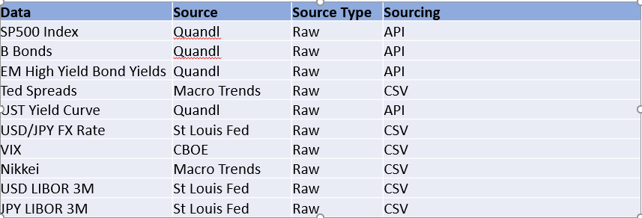
A look at the Japanese stock market
Financial time series forecasting is one of the hardest task given that they usually follow a non-deterministic process but rather a stochastic process (mostly random).
Project Overview
My main goal was to use a Supervised Machine Learning approach to try to predict the direction of the Japanese Stock Market Index (Logistic Regression)
Focus was on classification models
Various market data type was used for the analysis

Slide 3
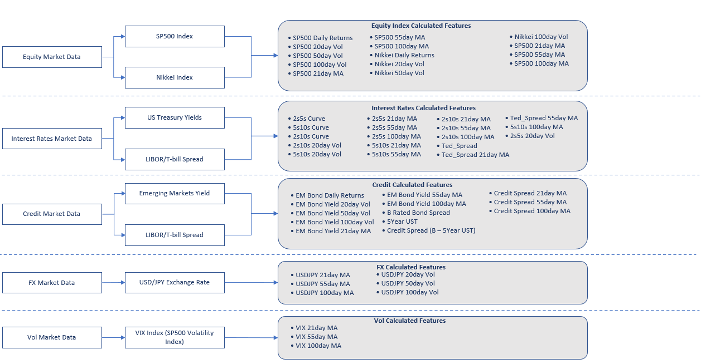
DATA PIPELINE/FEATURE ENGINEERING

Slide 4


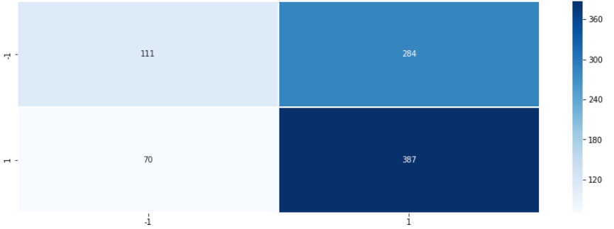
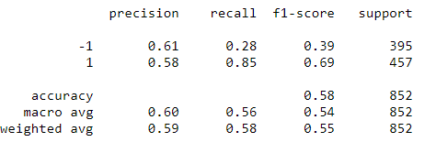
LogiSTIC REGRESSION – feeding all data (Raw + featured)
Using all previous features to predict
Defined a simple trend-following trading strategy such as buy the market (the next day’s open) if today’s close is higher than yesterday’s close.
The assumption behind this strategy is that the market trend will continue
We define the signal (dependent variable) as y(t) = 1 if today’s close > yesterday’s close or -1 (if less)
• 3407 data points in the training data set
• 852 data points in the testing data set

Slide 5
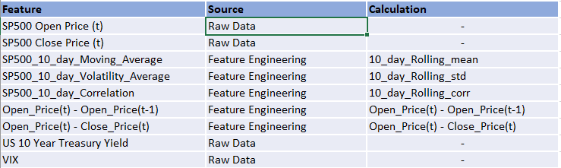
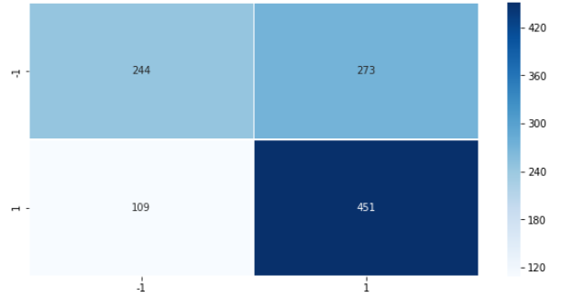
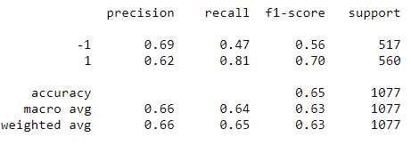
LogiSTIC REGRESSION – shorter time frame
Using domain knowledge and intuition, the below features were used to train this version of the model:
The Nikkei and the S&P500 are highly correlated (as a matter of fact, a lot of stock market indices are correlated to the S&P as it acts as the main driver)
• 3407 data points in the training data set
• 852 data points in the testing data set

