Slide 1
Can Machine Learning be used to predict S&P returns Using historical Commodity returns Data ?
knn classifaction model

Slide 2
Predicting S&P Returns
Deep learning models were developed using commodity futures data and historical historical S&P returns.
Data sourced from Quandl
Metals: Silver 2nd Gold 2nd Copper 2nd Aluminum 2nd
Energy: Crude 2nd Natural Gas 2nd Coal 2nd
Soft/Livestock: Lean Hogs 2nd Soybeans 2nd Cotton 2nd Corn 2nd
Equities: Emini-S&P 2nd CBOE VIX Index
70 different features used
Train had 3,641 rows and Testing had 1,027 rows.
Data calculations and analysis:
Moving Averages (7, 20, and 55 day).
Rolling return correlations over different periods (ie. Gold to S&P).
Standard Deviations of rolling correlations.

Slide 3
Cracking the Code?
This project built upon project 2 where I found mean reversion signals between the Copper Gold Ratio and S&P 500.
Multiple models were run using different features and time horizons to see which performed best.
Features had varying levels of engineering.
Models were fine tuned to get the best performance.

Slide 4
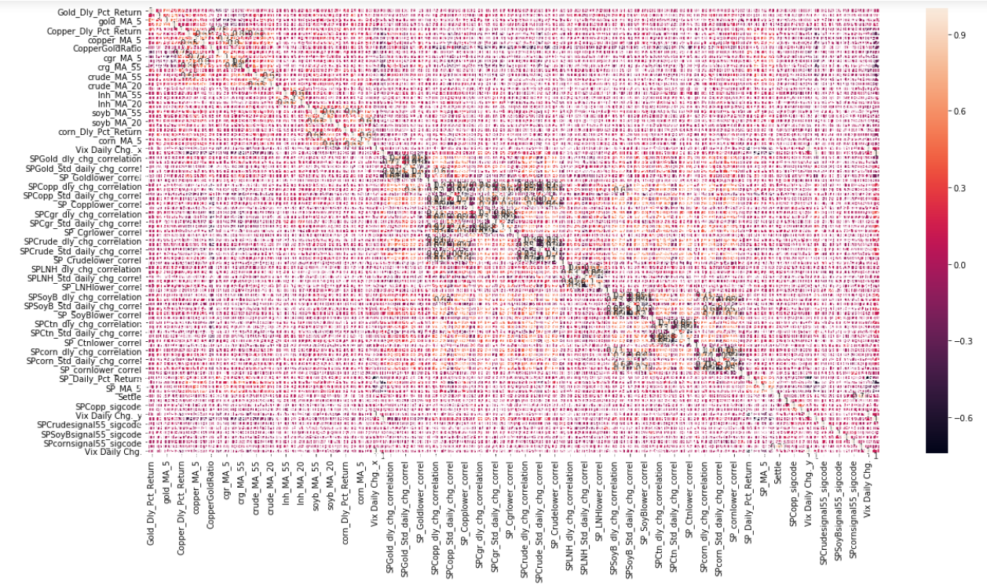
Starting Point: Feature Correlations
Commodities return data is usually not correlated to S&P returns.

Slide 5
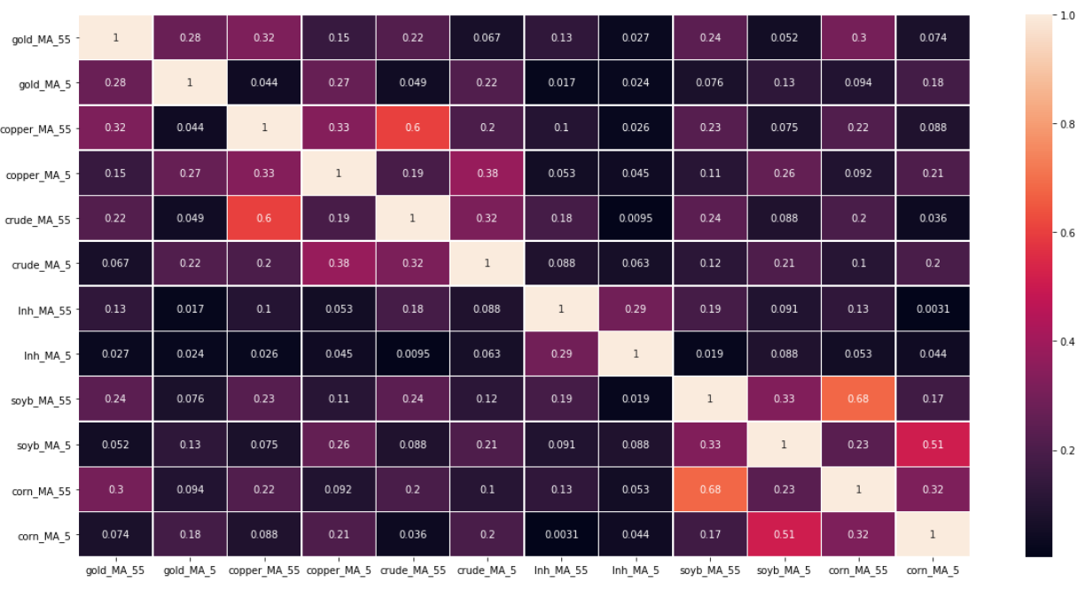
Final Feature Correlation Heat Map

Slide 6
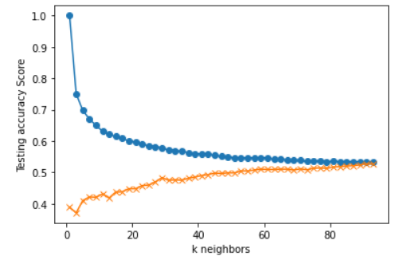
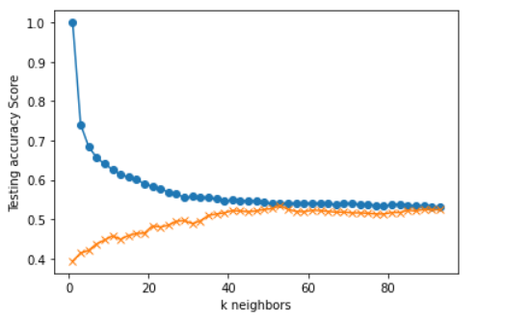
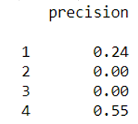
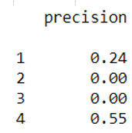
KNN – Model
Features :Gold, Copper, Crude, Lean Hogs, Soybean, Corn. 5 and 55 day moving average
Soft Commodities Hard Commodities
Coefficients:
Corn 55 MA: .177468
Lean Hogs 55: .176039
Soybean 55: .171866
Corn 5: .158879
Lean Hogs 5: .158879
Soybean 5: .156417
1 Day return buckets:
1: < (-.70 %)
2: (-.70%) - 0%
3: 0% - .24%
4: > .24%
Coefficients:
Gold 55 MA: . 1758106
Copper 55: .1710099
Crude 55: . 169868
Crude 5: . 164174
Copper 5: . 161498
Gold 5: . 157638

Slide 7
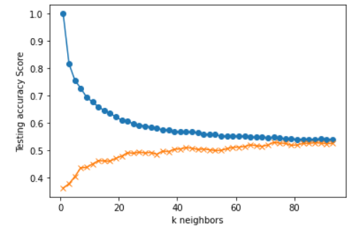
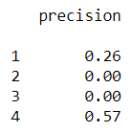
KNN – Model
Features : Gold, Copper, Crude, Lean Hogs, Soybean, Corn. 5 & 55 day moving average
Count of Features: 12 Count of Rows (Train 3,641 & Test 1,027)
Coefficients:
Lean Hog 55: .09309
Gold 55: .08931
Copper 55: .08916
SoyBean 55: .087869
Corn 55: .086408
Crude 55: .084116
SoyBean 5: .080355
Corn 5: .079194
Copper 5: .078197
Crude 5: .07808
Lean Hog 5: .077885
Gold 5: .075718
Return Buckets:
1: < (-.70 %)
2: (-.70%) - 0%
3: 0% - .24%
4: > .24%
Additional features increased the precision of the prediction in the highest return bucket improving the overall performance of the model.
This KNN Model can predict correctly for the highest return bucket, although the rate of success isn’t strong enough to use as a standalone model.
The last 22 years have had low rates, low inflation, and commodity prices have had little impact on risk assets. This model could potentially work better in a more normal environment.

Slide 8
Appendix

Slide 9
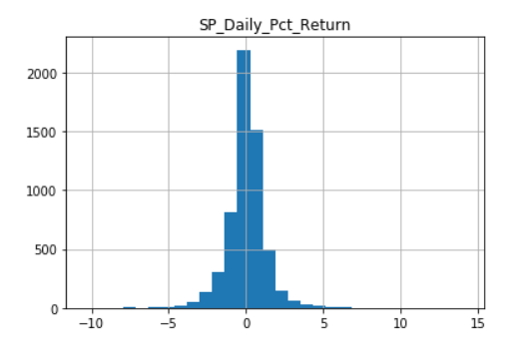
S&P – distribution of daily returns

Slide 10

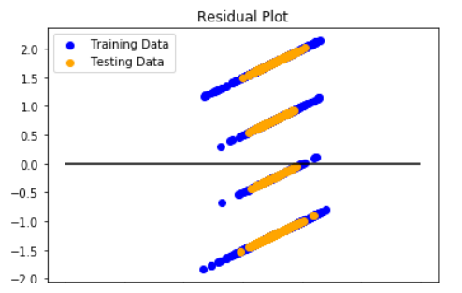
Multi Linear Regression
It was quickly determined that Linear Regression was not the appropriate model given the data.
Note that each line represents the return buckets that were used to categorize the returns:
Data has non-linear features.
Categorizing the returns (5 day forward daily returns):
Return Buckets:
1: < -.7%
2: -.7% to 0
3: 0 to +.24%
4: > +.24%

Slide 11
Random FOREST
Multiple iterations of Random Forest resulted in this lackluster result:
CLF Score: .372
RF Score: .509
Features: 20 day, and 7 moving average return for gold, copper, crude, lean hogs, copper gold ratio, crude, soybeans, and corn
This model found the highest level of success with the least engineered data.
Most interesting result: model gave the most importance to Lean hogs, corn, and soybeans which are thought to have no relationship S&P returns.
[(0.07601478176109237, 'soyb_MA_20'), (0.07590039490081453, 'corn_MA_20'), (0.07537996990618138, 'lnh_MA_20'), (0.07376575829999424, 'gold_MA_20'), (0.07329298281041949, 'crude_MA_20'), (0.0710382995325673, 'crude_MA_5'), (0.07069653142233312, 'corn_MA_5'), (0.0706743163623662, 'soyb_MA_5'), (0.07047566530951188, 'lnh_MA_5'), (0.07041900974103832, 'crg_MA_20'), (0.07033308707515099, 'copper_MA_20'), (0.06827028210033666, 'copper_MA_5'), (0.06727448516134751, 'gold_MA_5'), (0.06646443561684612, 'cgr_MA_5')]

