Slide 1
Using a Machine learning classification method to predict the direction of the Nikkei (Japanese stock market index)

Slide 2
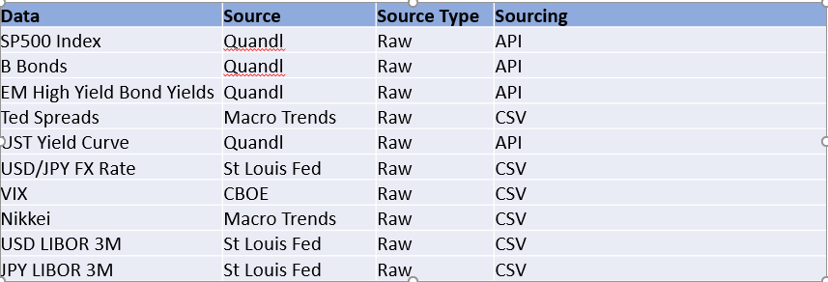
A look at the Japanese stock market
Financial time series forecasting is one of the hardest task given that they usually follow a non-deterministic process but rather a stochastic process (mostly random).
Project Overview
My main goal was to use a Supervised Machine Learning approach to try to predict the direction of the Japanese Stock Market Index (Logistic Regression)
Focus was on classification models
Various market data type was used for the analysis

Slide 3
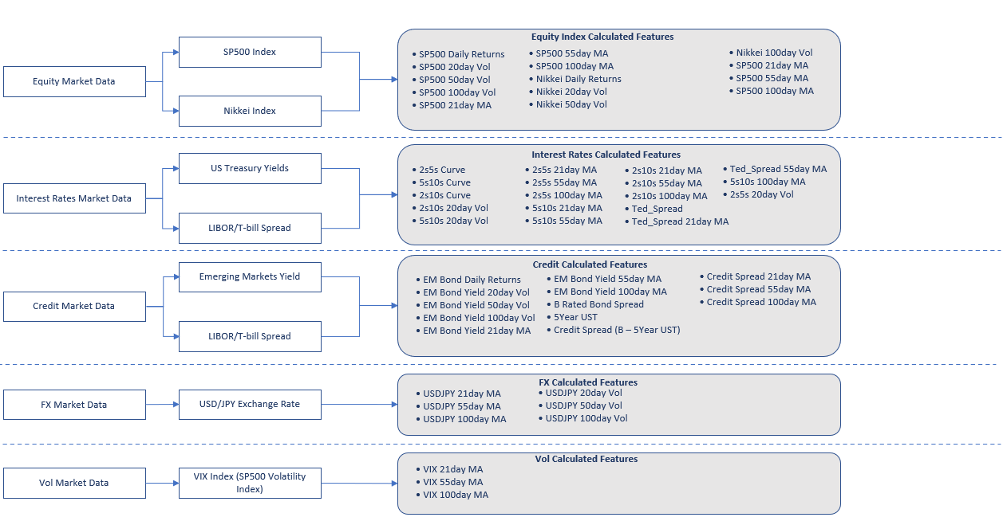
DATA PIPELINE/FEATURE ENGINEERING

Slide 4
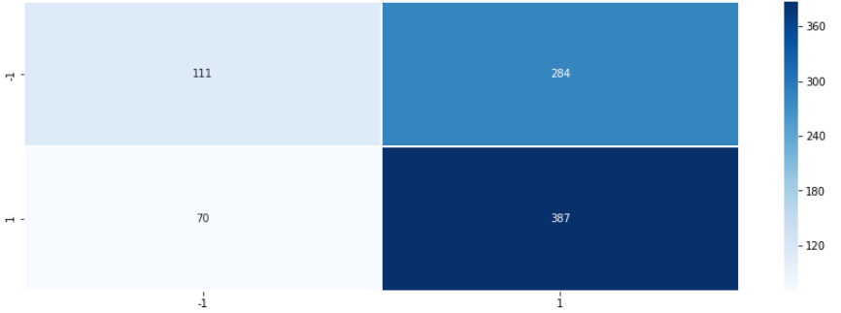
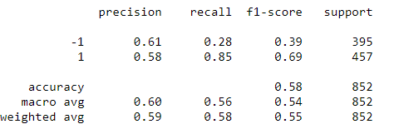
LogiSTIC REGRESSION – feeding all data (Raw + ENGINEERED)
Using all previous features to predict (raw data + feature engineering)
Defined a simple trend-following trading strategy such as buy the market (the next day’s open) if today’s close is higher than yesterday’s close.
The assumption behind this strategy is that the market trend will continue
We define the signal (dependent variable) as y(t) = 1 if today’s close > yesterday’s close or -1 (if less)
Training/Testing data sets have about 3400/850 data points each respectively (75/25 distribution)
Confusion Matrix Results:
• Overall, the model predicts the long/short classes with an accuracy of 59%
• Buy trading signals account for 77% of the correct signals predicted
• Low performance of Sell signals relative to Buy signals with a high score on the False Negative side
Best Features Coefficients:
• SP500 Returns: 0.785
• USDJPY: 0.121
• VIX 21day MA: 0.0585

Slide 5
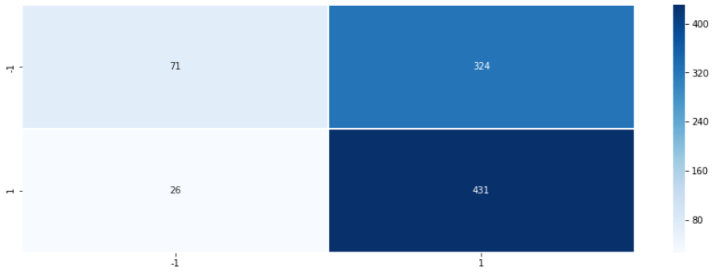
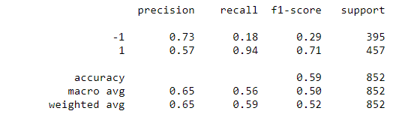
LogiSTIC REGRESSION – Best selected features FROM PREVIOUS MODEL
Building on the previous model, decided to model the signal as a function of the below 3 variables:
SP500 Returns
USDJPY FX Rate
VIX 21day Moving Average
Confusion Matrix Results:
• Overall, the accuracy is the same as the previous model (the one with all the data)
• Higher True Positives but also higher False Negatives
• Adding more data to the model proved to be adding noise instead of value.
• Ability to get a similar score with model containing 3 features instead of 59 !!!

Slide 6
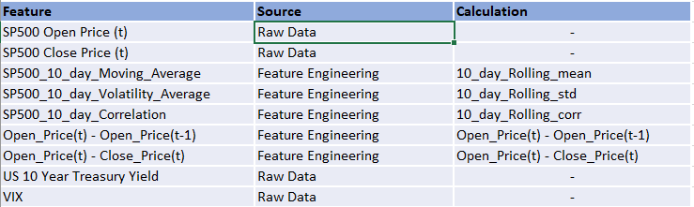
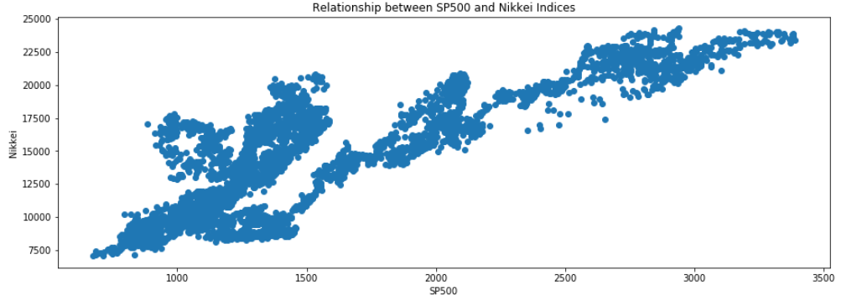
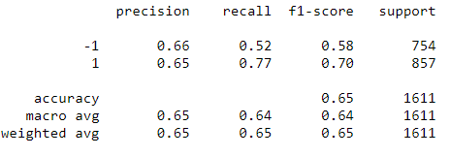
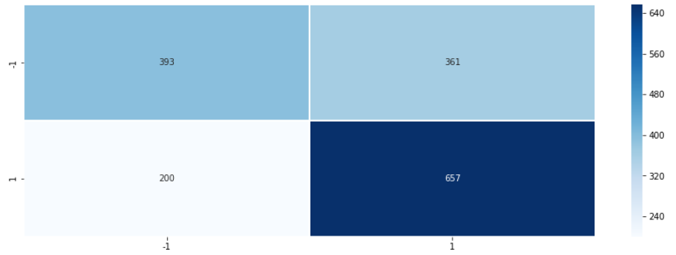
LogiSTIC REGRESSION – ADDING short time indicators
Using domain knowledge and intuition, the below features were used to train this version of the model:
The Nikkei and the S&P500 are highly correlated (the S&P usually acts as the main driver of global stock markets)
• Shorter term indicators used as inputs (shorter Moving Averages, correlation and Intraday data)
• Different training/testing periods were used (shorter training/longer testing)
Confusion Matrix Results:
• Overall, the total accuracy improves compared to the previous models (65% Probability)
• Shorter term indicators capture also tend to improve the Sell signals (number of True Negatives slightly higher than False Negatives)

Slide 7
Promising, but….
While there seems to be some prediction capabilities using certain market data points, it is important to mention that before using such a model in a production environment, a full back test including transaction costs would be required.
Models that worked using past data do not necessarily work in the future (markets constantly change…)
The analysis revealed that Buy signals were generated with consistency. I would add a caveat to that given that markets have been in a significant up-trend since the lows of the global Financial Crisis back in 2009.
Improvements:
While there is some positive, more granular data would be needed (i.e. intraday data)
Imagination is the limit, new data sets could be used and combined to produce alpha
Finally, training a Neural Network would be worth testing.

