Slide 1

Flexible-Size Batched LU for Small Matrices and its Integration into Block-Jacobi Preconditioning
Hartwig Anzt, Jack Dongarra, Goran Flegar, Enrique S. Quintana-Ortí
Scan me for slides!
github.com/gflegar/talks/mpi_magdeburg_2017_06

Slide 2

Problem setting
Sparse linear system
  The majority of coefficients is 0

Slide 3

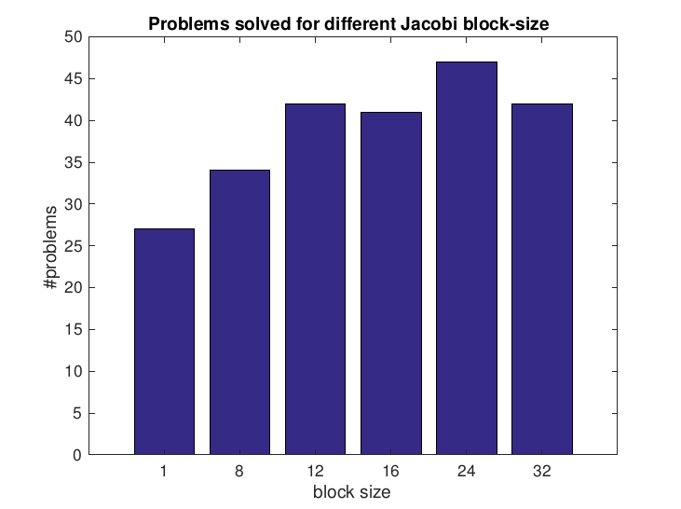
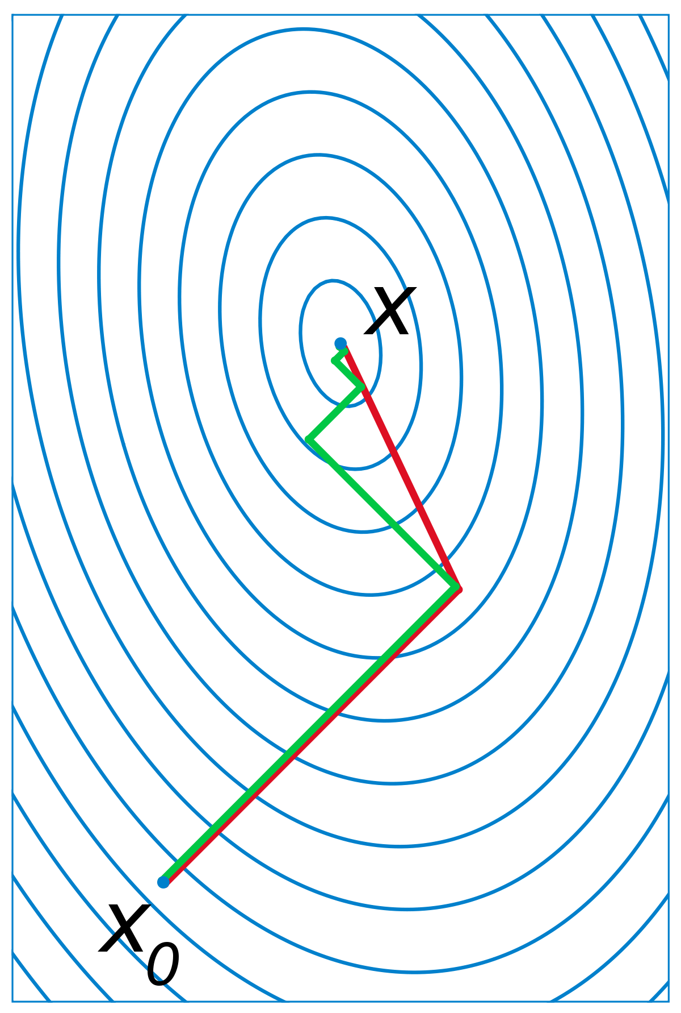

MAGMA-sparse software library
GPU-accelerated sparse linear algebra library focused on solution of Ax = b
  Iterative (Krylov-subspace based) linear solvers
    Each iteration consist of one or more sparse matrix-vector products (SpMV) with the system matrix, and several vector (BLAS-1) operations
  Sparse matrix formats & SpMV – accelerate each iteration of the solver
  Preconditioners – reduce the number of iterations
Joint effort: Innovative Computing Lab at University of Tennessee, Knoxvile, Karlsruhe Institute of Technology, and Univeristat Jaume I

Slide 4





Preconditioning
Replace original system Ax = b, with an equivalent system M^-1 Ax = M^-1b, where M is an approximation of A, such that M^-1 is “easy” to compute
Do not store M^-1 A explicitly – instead break SpMV y := (M^-1 A) x at each step of the Krylov method into: z := A x; y := M^-1 z (preconditioner application)
Usually, M is generated from matrix A only once, and stored in a form suitable for fast preconditioner application (preconditioner setup)
Tradeoff: reduced number of iterations, but increased cost for each iteration

Slide 5

Block-Jacobi Preconditioning
Current focus: improve performance for problems with inherent block structure (usually up to 30 unknowns)
Block-Jacobi preconditioning
  M = diag(D1, …, Dk), where Di are diagonal blocks of matrix A (possibly of different sizes!), conforming to its block structure
  y := M^-1 z can be expressed as yi := Di^-1 zi
    Can be expressed in terms of small linear system solves Di yi = zi
    LU factorization in preconditioner setup, triangular solves in preconditioner application
Solving 30-by-30 systems in sequence on a GPU with several thousand cores wastes a significant amount of computational resources

Slide 6
Batched routines
Instead, use “batched routines”
  Launch single computational kernel which applies an operation to a set of independent data entities in parallel
  Standard BLAS & LAPACK interface under discussion [cite batched BLAS workshops here]
  Most implementations only support problems of equal sizes
  High performance libraries are not optimized for small block sizes
    cuBLAS achieves only XX Gflop/s on P100 (in comparison, MAGMA-sparse SpMV operations achieve XXX Gflop/s even for matrices with irregular sparsity patterns)
    Dense MAGMA has similar performance

Slide 7
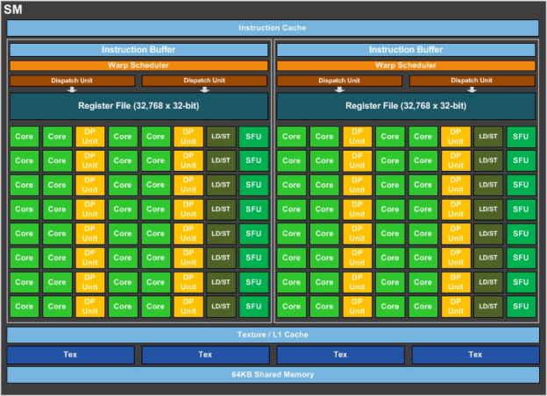

MAGMA-sparse LU & trsv outilne
Assign one warp per problem
  hardware SIMD unit, represented as a group of 32 threads in CUDA
Process each row by a single thread in the warp
  Able to support problems of size up to 32-by-32
  keep the entire row into thread’s local registers
    Only touch memory twice – read from A + write into preconditioner data structure
  Communicate data between rows via warp-shuffles
Use implicit pivoting
  Do not explicitly swap rows, re-assign the threads to avoid this
Use “lazy” triangular solves
  Cast solution vector updates in terms of axpy, not in terms of dot product!
For more details, talk to me during breaks, or take a look at the paper

Slide 8
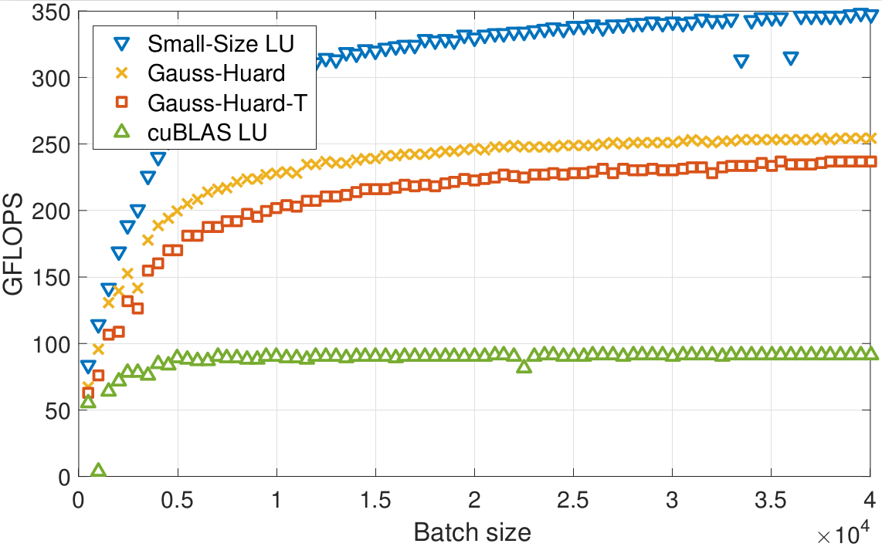
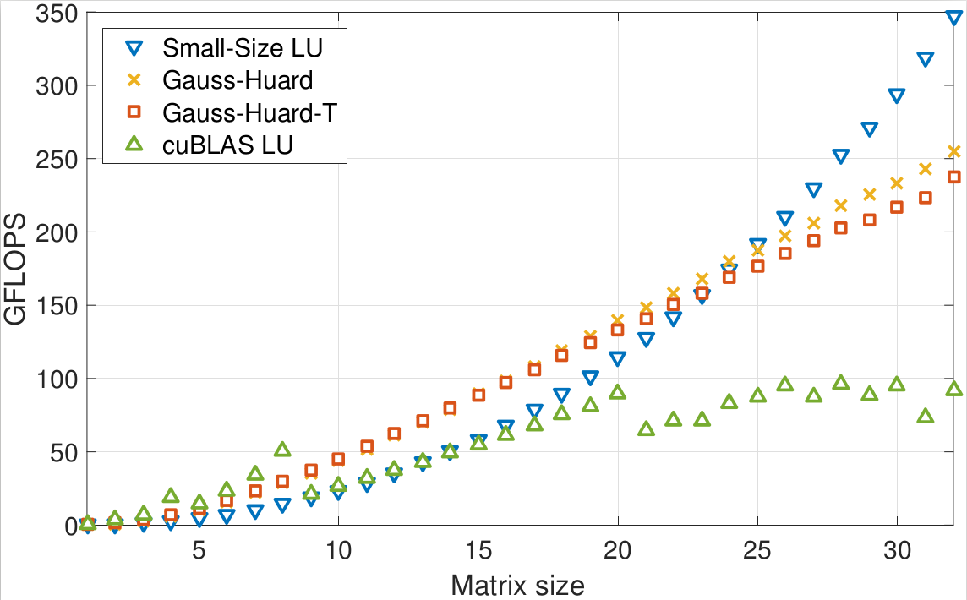
LU performance
Comparisson of MAGMA-sparse vs cuBLAS
GH(-T) is a Gauss-Huard decomposition based solution from ICCS

Slide 9
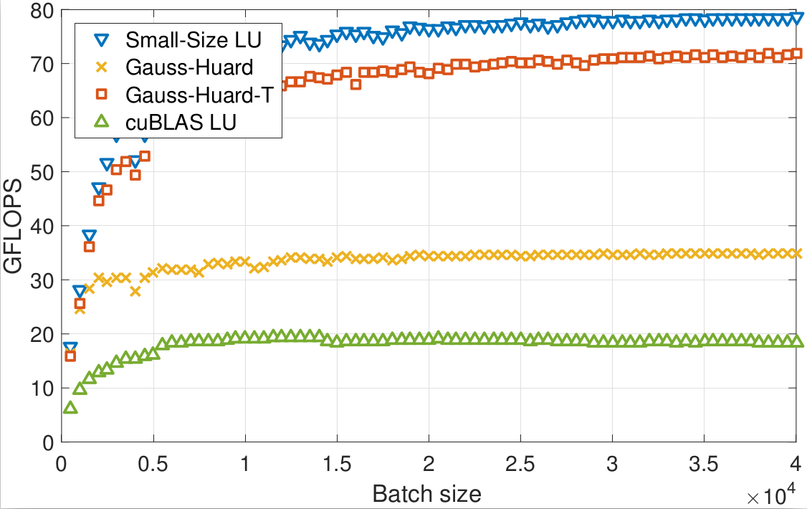
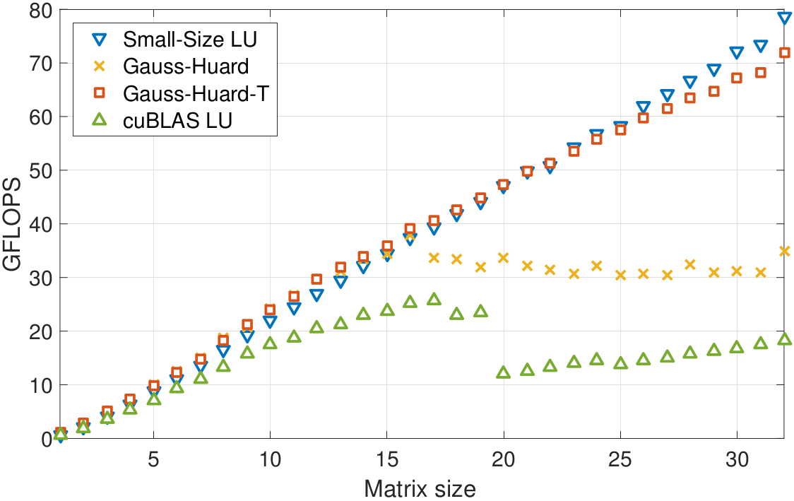
Triangular solve performance
Comparisson of MAGMA-sparse vs cuBLAS
We additionally support variable problem sizes
Can integrate warp-level LU into the same kernel as diagonal block extraction!
On tiny problems MAGMA-sparse is not impressive
  We are still missing an optimization for this – the solution is to assign multiple problems to each warp
  We did it for matrix inversion via Gauss-Jordan elimination [show mpw-GJE performance]
  Can expect the same for LU

Slide 10
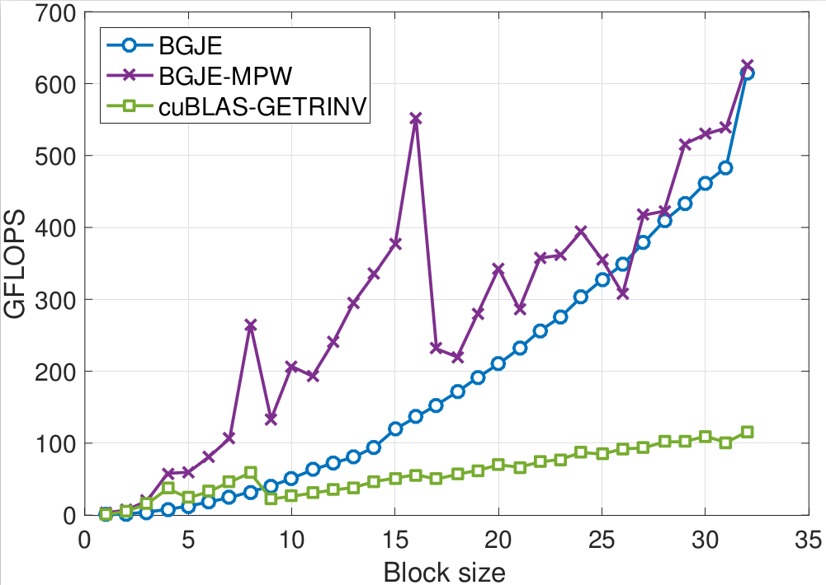
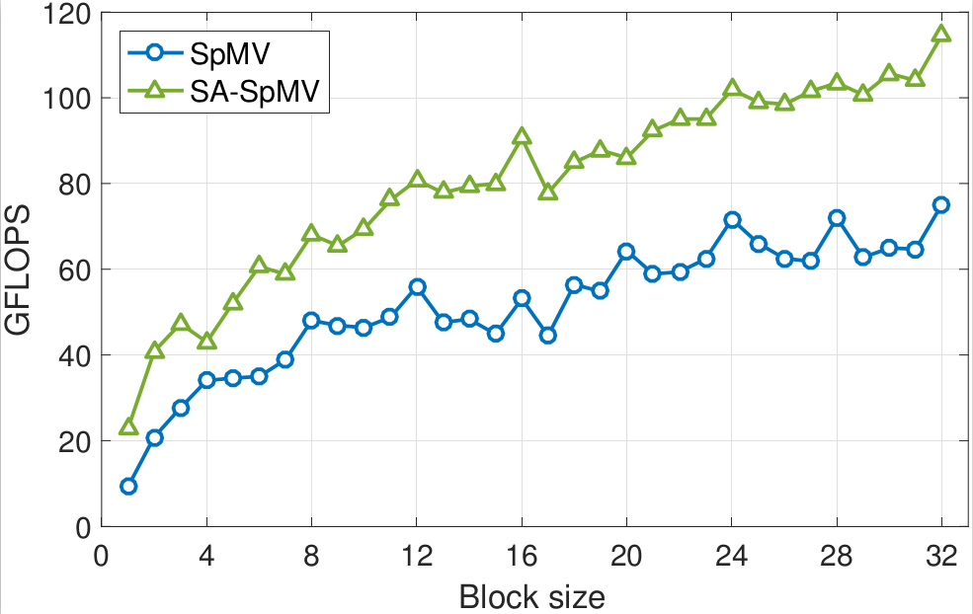

Slide 11
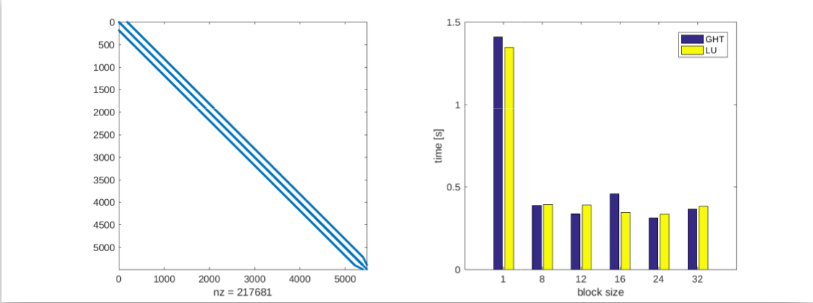
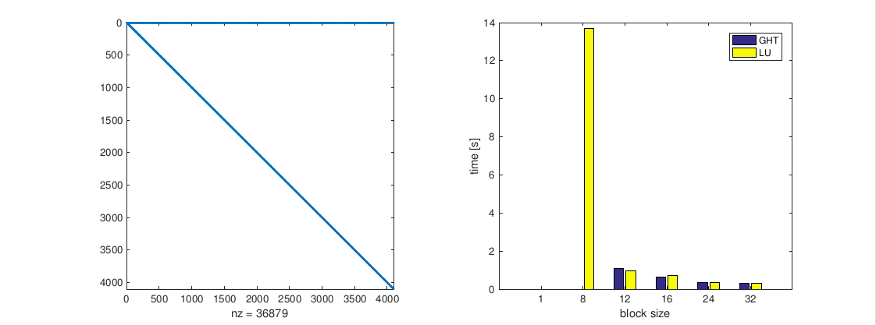
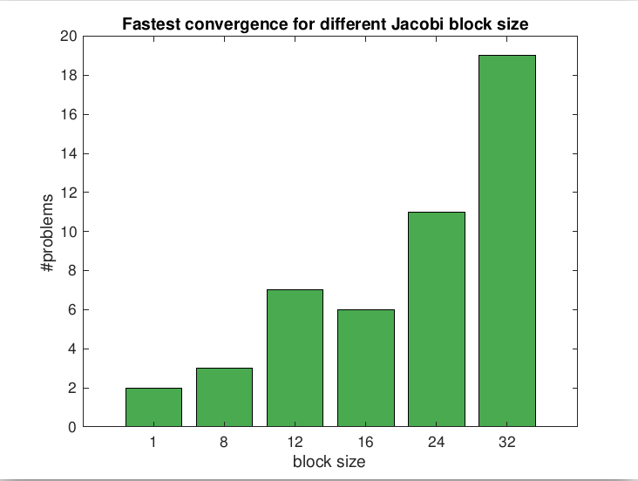
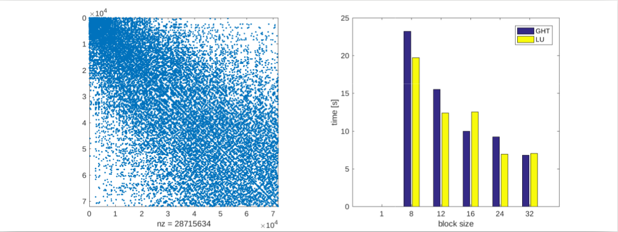
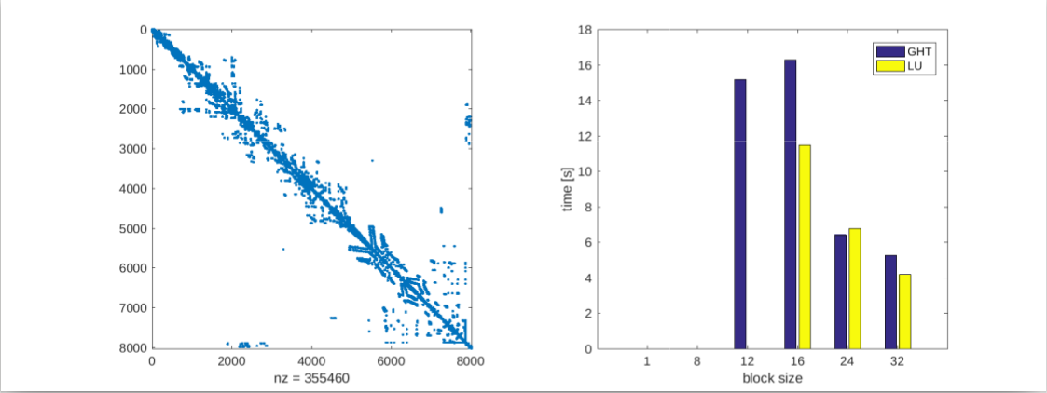
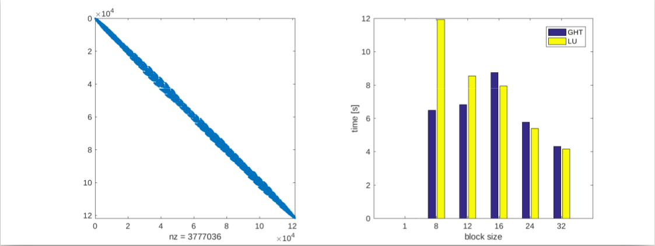
Solver runtime
Block size = maximum allowed block size, smaller blocks are allowed to better conform to natural block size of the problem

Slide 12



Problem setting
Sparse linear system
  The majority of coefficients is 0
  Fluid dynamics, circuit simulation, graph analytics

Slide 13
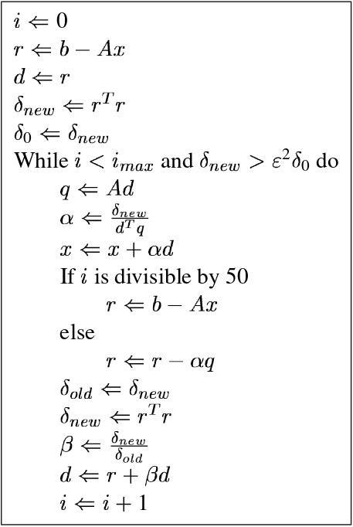
Problem setting
Solve it using an iterative Krylov method
  Vector operations + matrix-vector product
  Convergence related to spectral properties of coef. matrix
Sparse linear system
  The majority of coefficients is 0
  Fluid dynamics, circuit simulation, graph analytics

Slide 14

Preconditioning
Improve convergence by solving a preconditioned system

Slide 15

Preconditioning
Improve convergence by solving a preconditioned system
  Explicitly computing the matrix product causes fill-in

Slide 16
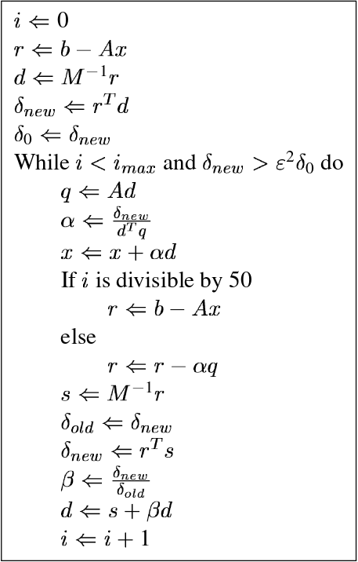
Preconditioning
Improve convergence by solving a preconditioned system
  Explicitly computing the matrix product causes fill-in
  Avoid it by decomposing the application of the product into two steps:
    Sparse matrix-vector product
    Preconditioner application

Slide 17


Preconditioning
Preconditioning split into two steps
  Preconditioner setup
  Preconditioner application
Trade-off:
faster convergence,
but more work per iteration
Want preconditioner which is fast to compute,
and improves convergence.

Slide 18
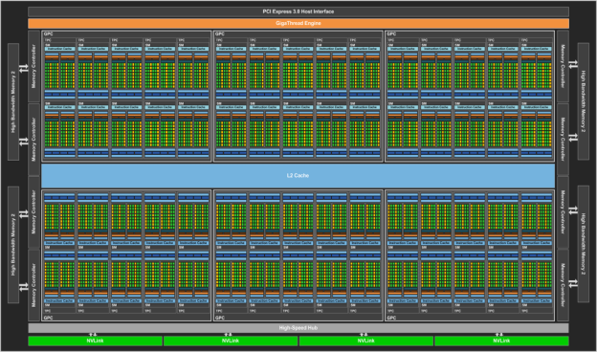
GPU programming 101
NVIDIA P100 GPU
  4.7 TFLOPs DP performance
  Up to 740 GB/s (1 : 51)
  56 SMs x 64 cores = 3584 cores!
source: devblogs.nvidia.com/parallelforall/

Slide 19
GPU programming 101
NVIDIA P100 GPU
  4.7 TFLOPs DP performance
  Up to 740 GB/s (1 : 51)
  56 SMs x 64 cores = 3584 cores!
Hierarchical architecture / programming model:
  Thread
    Basic building block, assigned to 1 core
source: devblogs.nvidia.com/parallelforall/

Slide 20
GPU programming 101
NVIDIA P100 GPU
  4.7 TFLOPs DP performance
  Up to 740 GB/s (1 : 51)
  56 SMs x 64 cores = 3584 cores!
Hierarchical architecture / programming model:
  Thread
    Basic building block, assigned to 1 core
  Warp
    Group of 32 threads
    Perfectly synchronized execution
    Can share values directly from the registers (1KB / thread)
    Cannot execute different instructions (warp divergence)
source: devblogs.nvidia.com/parallelforall/

Slide 21
GPU programming 101
  Block
    Group of several warps (≤ 64)
    Can be explicitly synchronized
    Can share data via shared memory (64KB)
source: devblogs.nvidia.com/parallelforall/

Slide 22
GPU programming 101
  Block
    Group of several warps (≤ 64)
    Can be explicitly synchronized
    Can share data via shared memory (64KB)
  Grid
    Group of blocks
    Cannot synchronize!
    Global memory (12 or 16GB)
    Simple caches
    Atomics
source: devblogs.nvidia.com/parallelforall/

Slide 23
Batched routines
Problem characteristics*
problem size #concurrent problems
~ 10 - 100
~ 1K - 1M
~ 100 - 10K
~ 1 - 1K
~ 10K - 1M
~ 1 - 10
*2016 ICL LA-survey

Slide 24

Batched routines
Problem characteristics*
Hardware characteristics
problem size #concurrent problems
MPI
~ 10 - 100
~ 1K - 1M
Multicore
…
~ 1 - 10 cores
~ 100 - 10K
~ 1 - 1K
Multicore
~ 1 - 10 cores
~ 10K - 1M
~ 1 - 10
Accelerator
~ 1 - 4K cores
*2016 ICL LA-survey

Slide 25
Batched routines
Problem characteristics*
Hardware characteristics
problem size #concurrent problems
MPI
~ 10 - 100
~ 1K - 1M
Multicore
…
~ 1 - 10 cores
~ 100 - 10K
~ 1 - 1K
Multicore
~ 1 - 10 cores
~ 10K - 1M
~ 1 - 10
Solving a 10-100 problem using 1-4K cores?
Loop over items:
Hope items are scheduled in parallel
Hope for efficient data access
Hope kernel launch overhead is small
Accelerator
~ 1 - 4K cores
*2016 ICL LA-survey

Slide 26
Batched routines
Problem characteristics*
Hardware characteristics
problem size #concurrent problems
MPI
~ 10 - 100
~ 1K - 1M
Multicore
…
~ 1 - 10 cores
~ 100 - 10K
~ 1 - 1K
Multicore
~ 1 - 10 cores
~ 10K - 1M
~ 1 - 10
Solving a 10-100 problem using 1-4K cores?
Loop over items:
Hope items are scheduled in parallel
Hope for efficient data access
Hope kernel launch overhead is small
Accelerator
~ 1 - 4K cores
Same computational kernel for
many small independent data items: “Batched” routines
Can achieve good perf. on GPUs
Batched for preconditioning?
*2016 ICL LA-survey

Slide 27
Block-Jacobi preconditioning
Scalar Jacobi
  Scale with inverse of main diagonal

Slide 28
Block-Jacobi preconditioning
Scalar Jacobi
  Scale with inverse of main diagonal
Block-Jacobi
  Scale with inverses of diagonal blocks (possibly of different sizes!)
  Can reflect the block structure of the problem
  Often superior to scalar Jacobi

Slide 29
Block-Jacobi preconditioning
Scalar Jacobi
  Scale with inverse of main diagonal
Block-Jacobi
  Scale with inverses of diagonal blocks (possibly of different sizes!)
  Can reflect the block structure of the problem
  Often superior to scalar Jacobi
Setup: invert / factorize blocks
Application: gemv / triangular solve
Can process each block independently! (Batched routine)

Slide 30
Benefits of block-Jacobi
56 matrices from SuiteSparse
MAGMA-sparse open source library
  IDR solver
  Scalar Jacobi preconditioner
  Supervariable blocking
    Detects block structure of the matrix

Slide 31

Benefits of block-Jacobi
56 matrices from SuiteSparse
MAGMA-sparse open source library
  IDR solver
  Scalar Jacobi preconditioner
  Supervariable blocking
    Detects block structure of the matrix
Improves the robustness of the solver

Slide 32
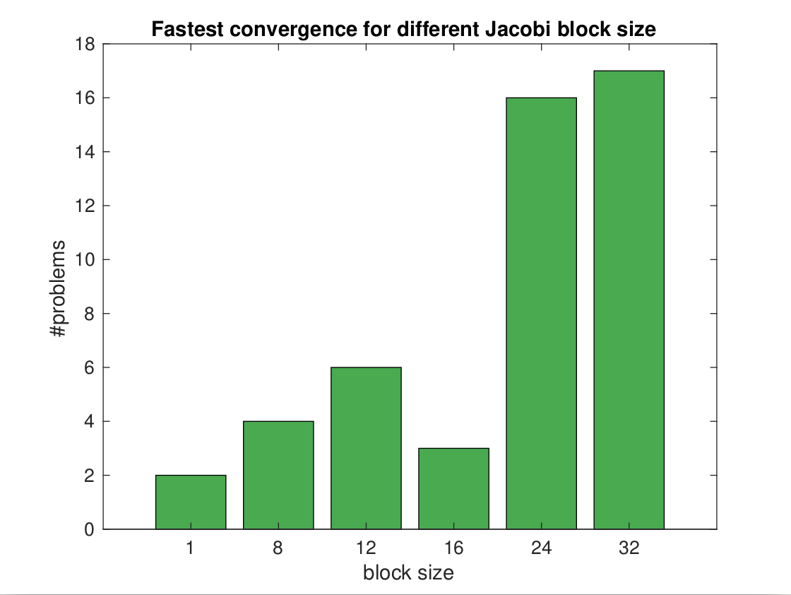
Benefits of block-Jacobi
56 matrices from SuiteSparse
MAGMA-sparse open source library
  IDR solver
  Scalar Jacobi preconditioner
  Supervariable blocking
    Detects block structure of the matrix
Improves the robustness of the solver
Decreases time-to-solution

Slide 33
General Ideas
Restrict block size to 32x32
  Large block sizes require more memory to store the preconditioner matrix

Slide 34
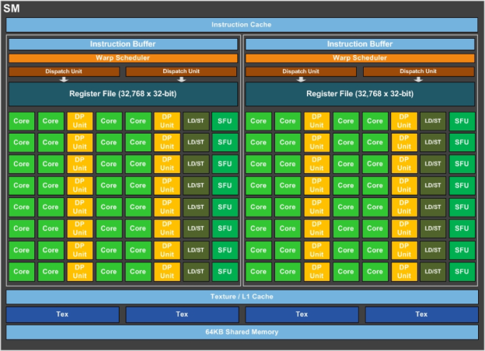
General Ideas
Restrict block size to 32x32
  Large block sizes require more memory to store the preconditioner matrix
Use a single warp to process the whole block (one thread per row / column)
  No need for explicit synchronization

Slide 35
General Ideas
Restrict block size to 32x32
  Large block sizes require more memory to store the preconditioner matrix
Use a single warp to process the whole block (one thread per row / column)
  No need for explicit synchronization
Use the large register file to store the entire block
  Read/write from mem. once
  Comm. via warp shuffles
  Avoids load/store instructions
Do pivoting implicitly (without swapping the rows)

Slide 36



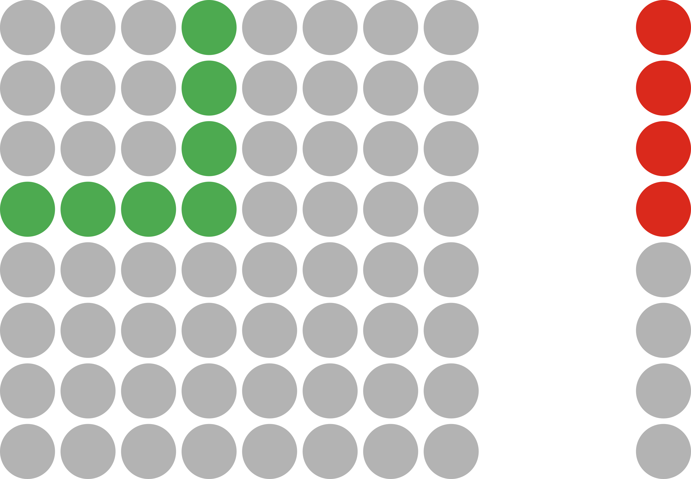
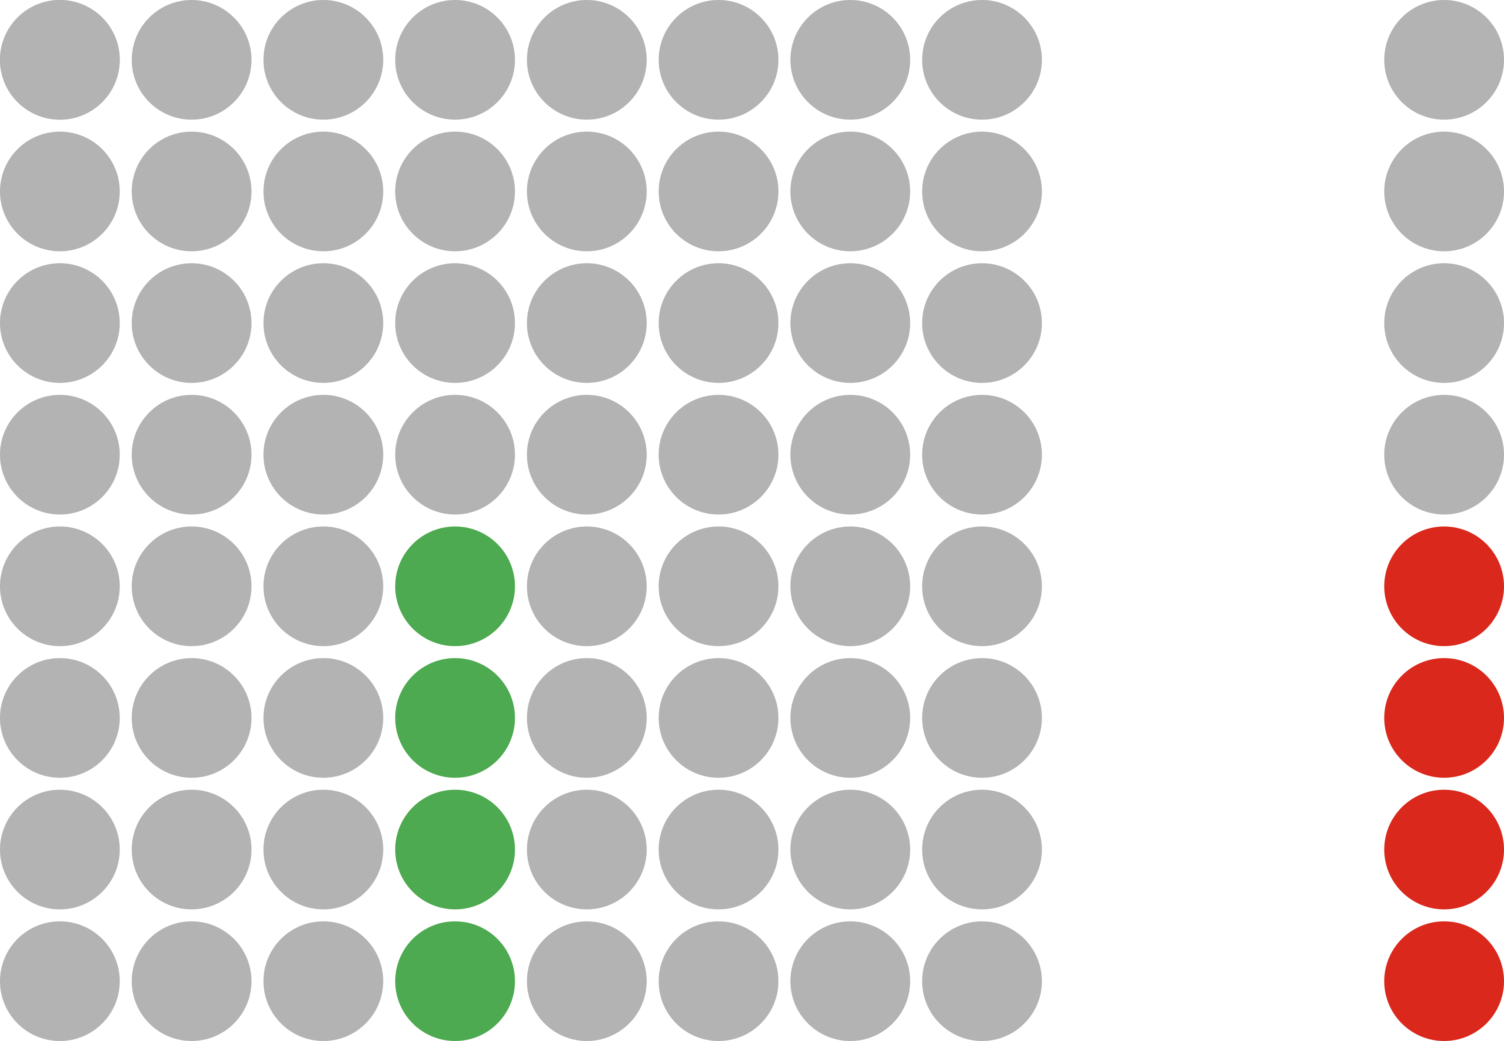


Block-Jacobi setup & application ecosystem
Gauss-Jordan inversion
Gauss-Huard decomposition
LU factorization
Setup
Inversion-based
(2n³ + 2n² FLOPS)
Decomposition-based
(2/3n³ + 2n² FLOPS)
matrix-vector multiply
Gauss-Huard solve
2x triangular solve
Application
H. Anzt et al. “Batched Gauss-Jordan Elimination for
Block-Jacobi Preconditioner Generation on GPUs”, PMAM’17
H. Anzt et al. “Variable-Size Batched Gauss-Huard for Block-Jacobi Preconditioning”, ICCS’17
H. Anzt et al. “Flexible-Size Batched LU for Small Matrices and its Integration into Block-Jacobi Preconditioning”, ICPP’17 (to appear)
- read
- write

Slide 37
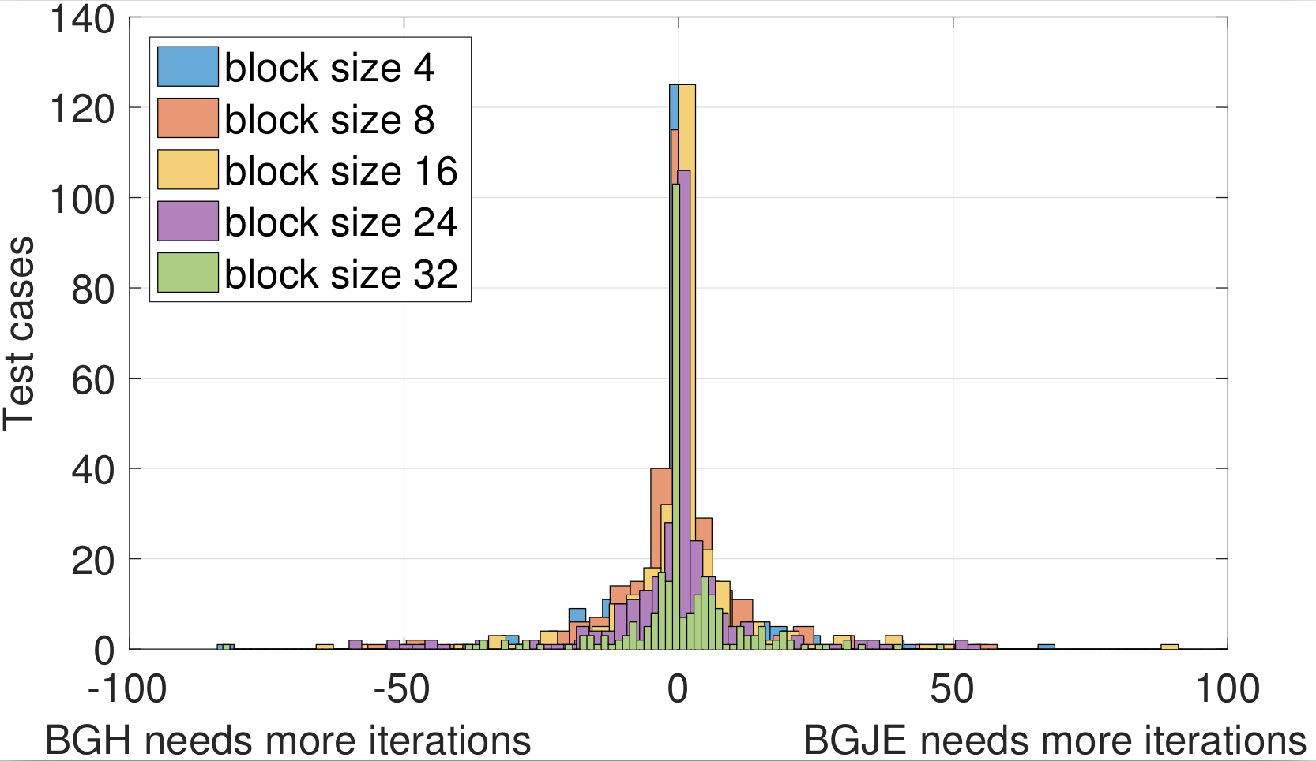
Inversion?!

Slide 38
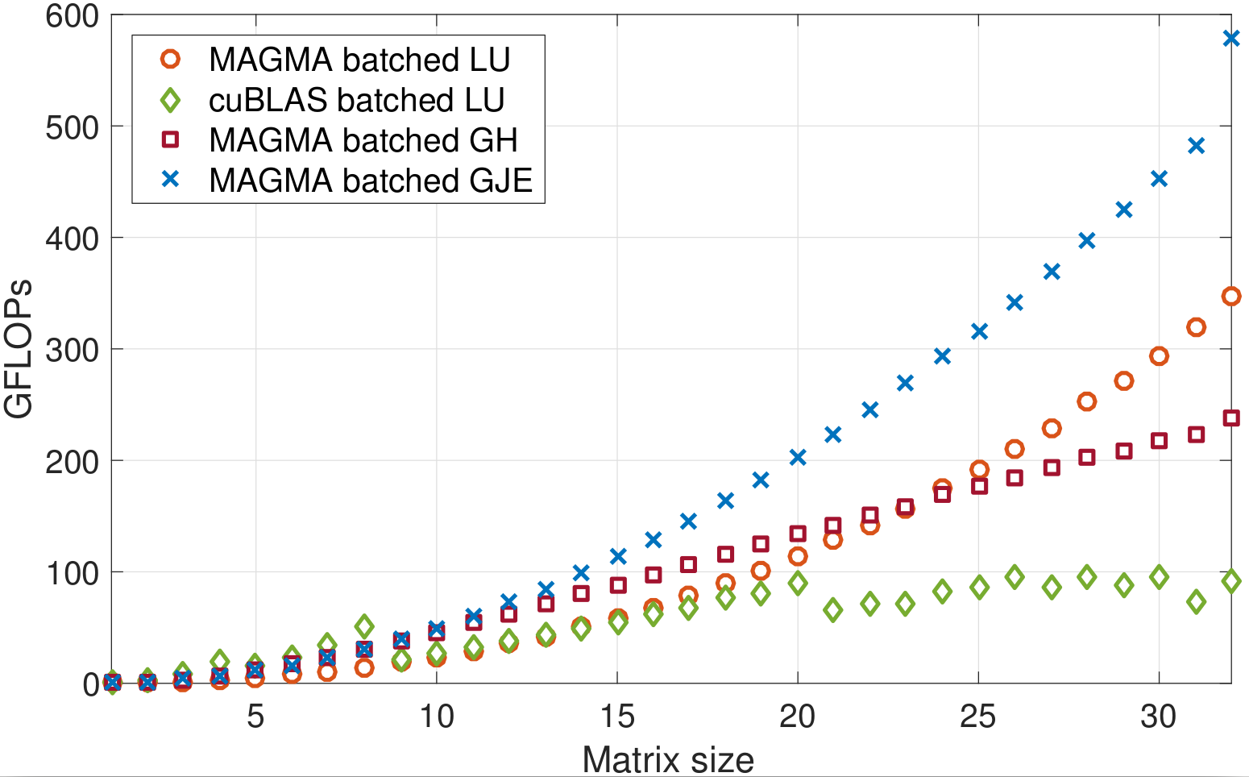
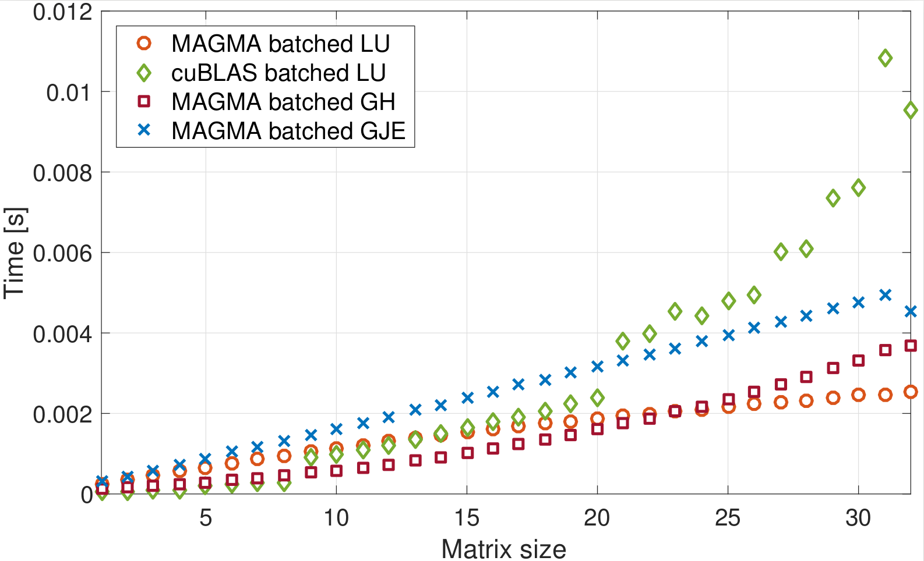
Batched routines performance

Slide 39
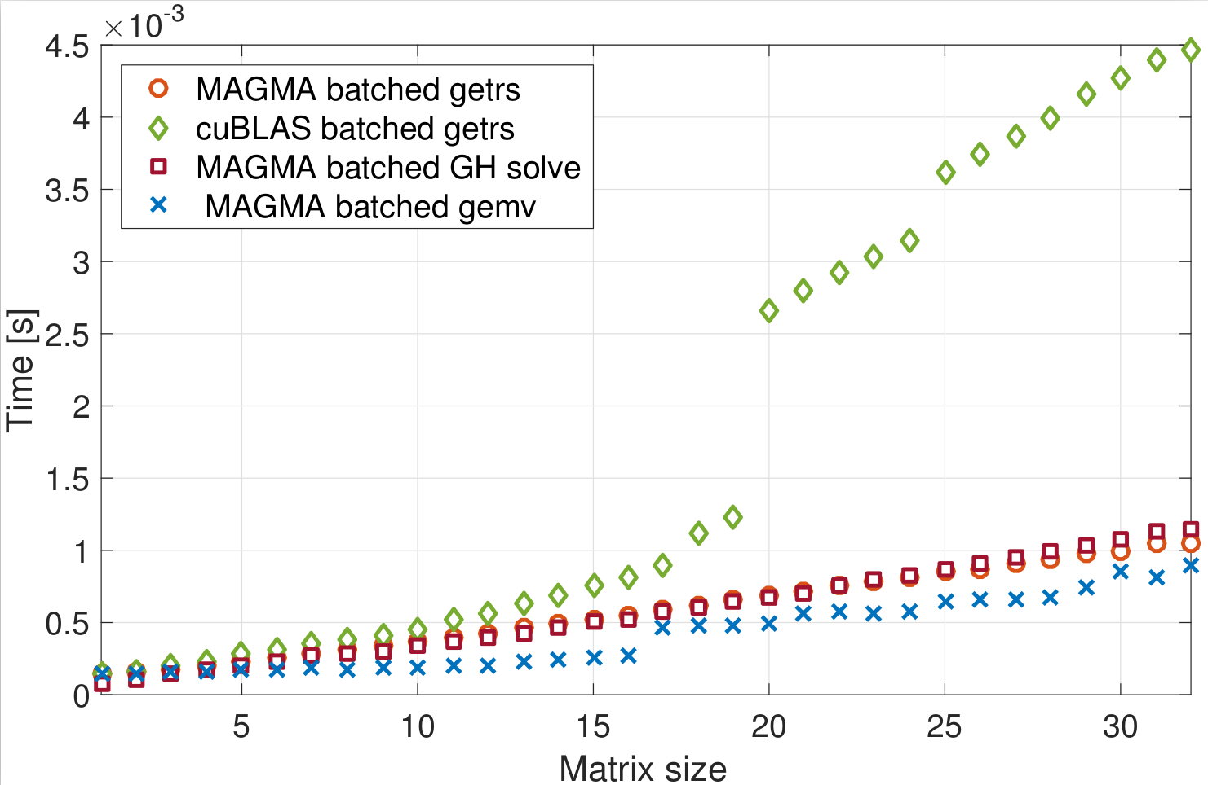
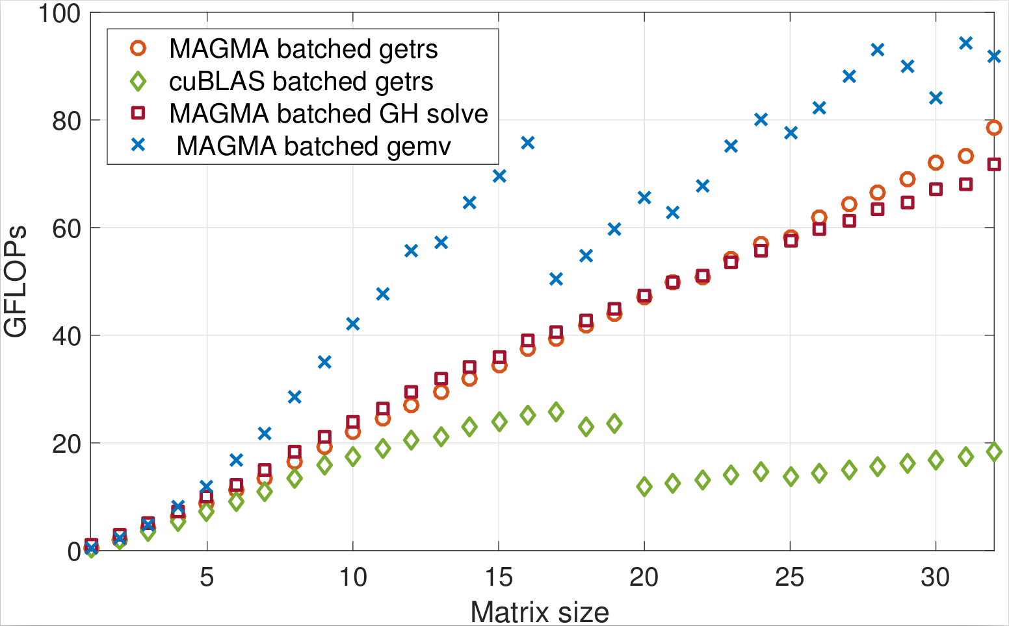
Batched routines performance

Slide 40






Complete solver runtime
s2rmt3m1
Chebyshev3
nd24k
G3_circuit
bcsstk38
ship_003

Slide 41
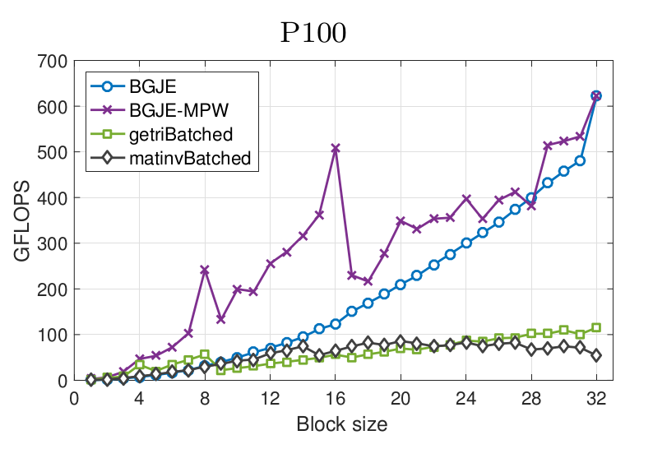
Flexible-size batched routines & future research
Problems can be to small to effectively use one warp
  Solution: assign multiple problems per warp

Slide 42
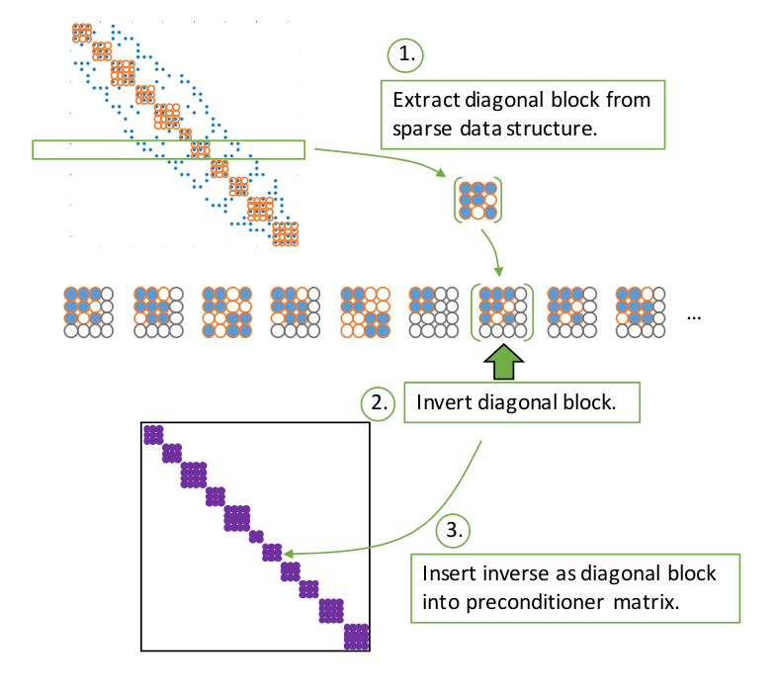
Flexible-size batched routines & future research
Problems can be to small to effectively use one warp
  Solution: assign multiple problems per warp
Allow batches where problems are of different sizes (flexible-size)
  Currently supported, but not yet optimized
  How to combine this with multiple problems per warp?
    Remember: entire warp executes the same instruction!
    Current solution: padding

Slide 43



Thank you! Questions?
All functionalities are part of the MAGMA-sparse project.
Scan me for slides!
github.com/gflegar/talks/mpi_magdeburg_2017_06
http://icl.cs.utk.edu/magma/
This research is based on a cooperation between Hartwig Anzt, Jack Dongarra (University of Tennessee),
Goran Flegar and Enrique S. Quintana-Ortí (Universidad Jaume I).

