Slide 1

Overcoming Load Imbalance for Irregular Sparse Matrices
Goran Flegar, Hartwig Anzt
Scan me for slides!
github.com/gflegar/talks/tree/master/sc_2017

Slide 2










MAGMA-sparse software library
GPU-accelerated sparse linear algebra library
  Focus: linear systems
Joint effort: Innovative Computing Lab at University of Tennessee, Knoxvile; Karlsruhe Institute of Technology; Universidad Jaume I

Slide 3
MAGMA-sparse software library
GPU-accelerated sparse linear algebra library
  Focus: linear systems
  Iterative, Krylov-subspace based linear solvers
    SpMV
    BLAS-1 operations
Joint effort: Innovative Computing Lab at University of Tennessee, Knoxvile; Karlsruhe Institute of Technology; University Jaume I

Slide 4
MAGMA-sparse software library
GPU-accelerated sparse linear algebra library
  Focus: linear systems
  Iterative, Krylov-subspace based linear solvers
    SpMV
    BLAS-1 operations
  Sparse matrix formats & SpMV
    accelerate each iteration of the solver
Joint effort: Innovative Computing Lab at University of Tennessee, Knoxvile; Karlsruhe Institute of Technology; University Jaume I

Slide 5
MAGMA-sparse software library
GPU-accelerated sparse linear algebra library
  Focus: linear systems
  Iterative, Krylov-subspace based linear solvers
    SpMV
    BLAS-1 operations
  Sparse matrix formats & SpMV
    accelerate each iteration of the solver
  Preconditioners
    reduce the number of iterations
Joint effort: Innovative Computing Lab at University of Tennessee, Knoxvile; Karlsruhe Institute of Technology; University Jaume I

Slide 6
MAGMA-sparse software library
GPU-accelerated sparse linear algebra library
  Focus: linear systems
  Iterative, Krylov-subspace based linear solvers
    SpMV
    BLAS-1 operations
  Sparse matrix formats & SpMV
    accelerate each iteration of the solver
  Preconditioners
    reduce the number of iterations
Joint effort: Innovative Computing Lab at University of Tennessee, Knoxvile; Karlsruhe Institute of Technology; University Jaume I

Slide 7
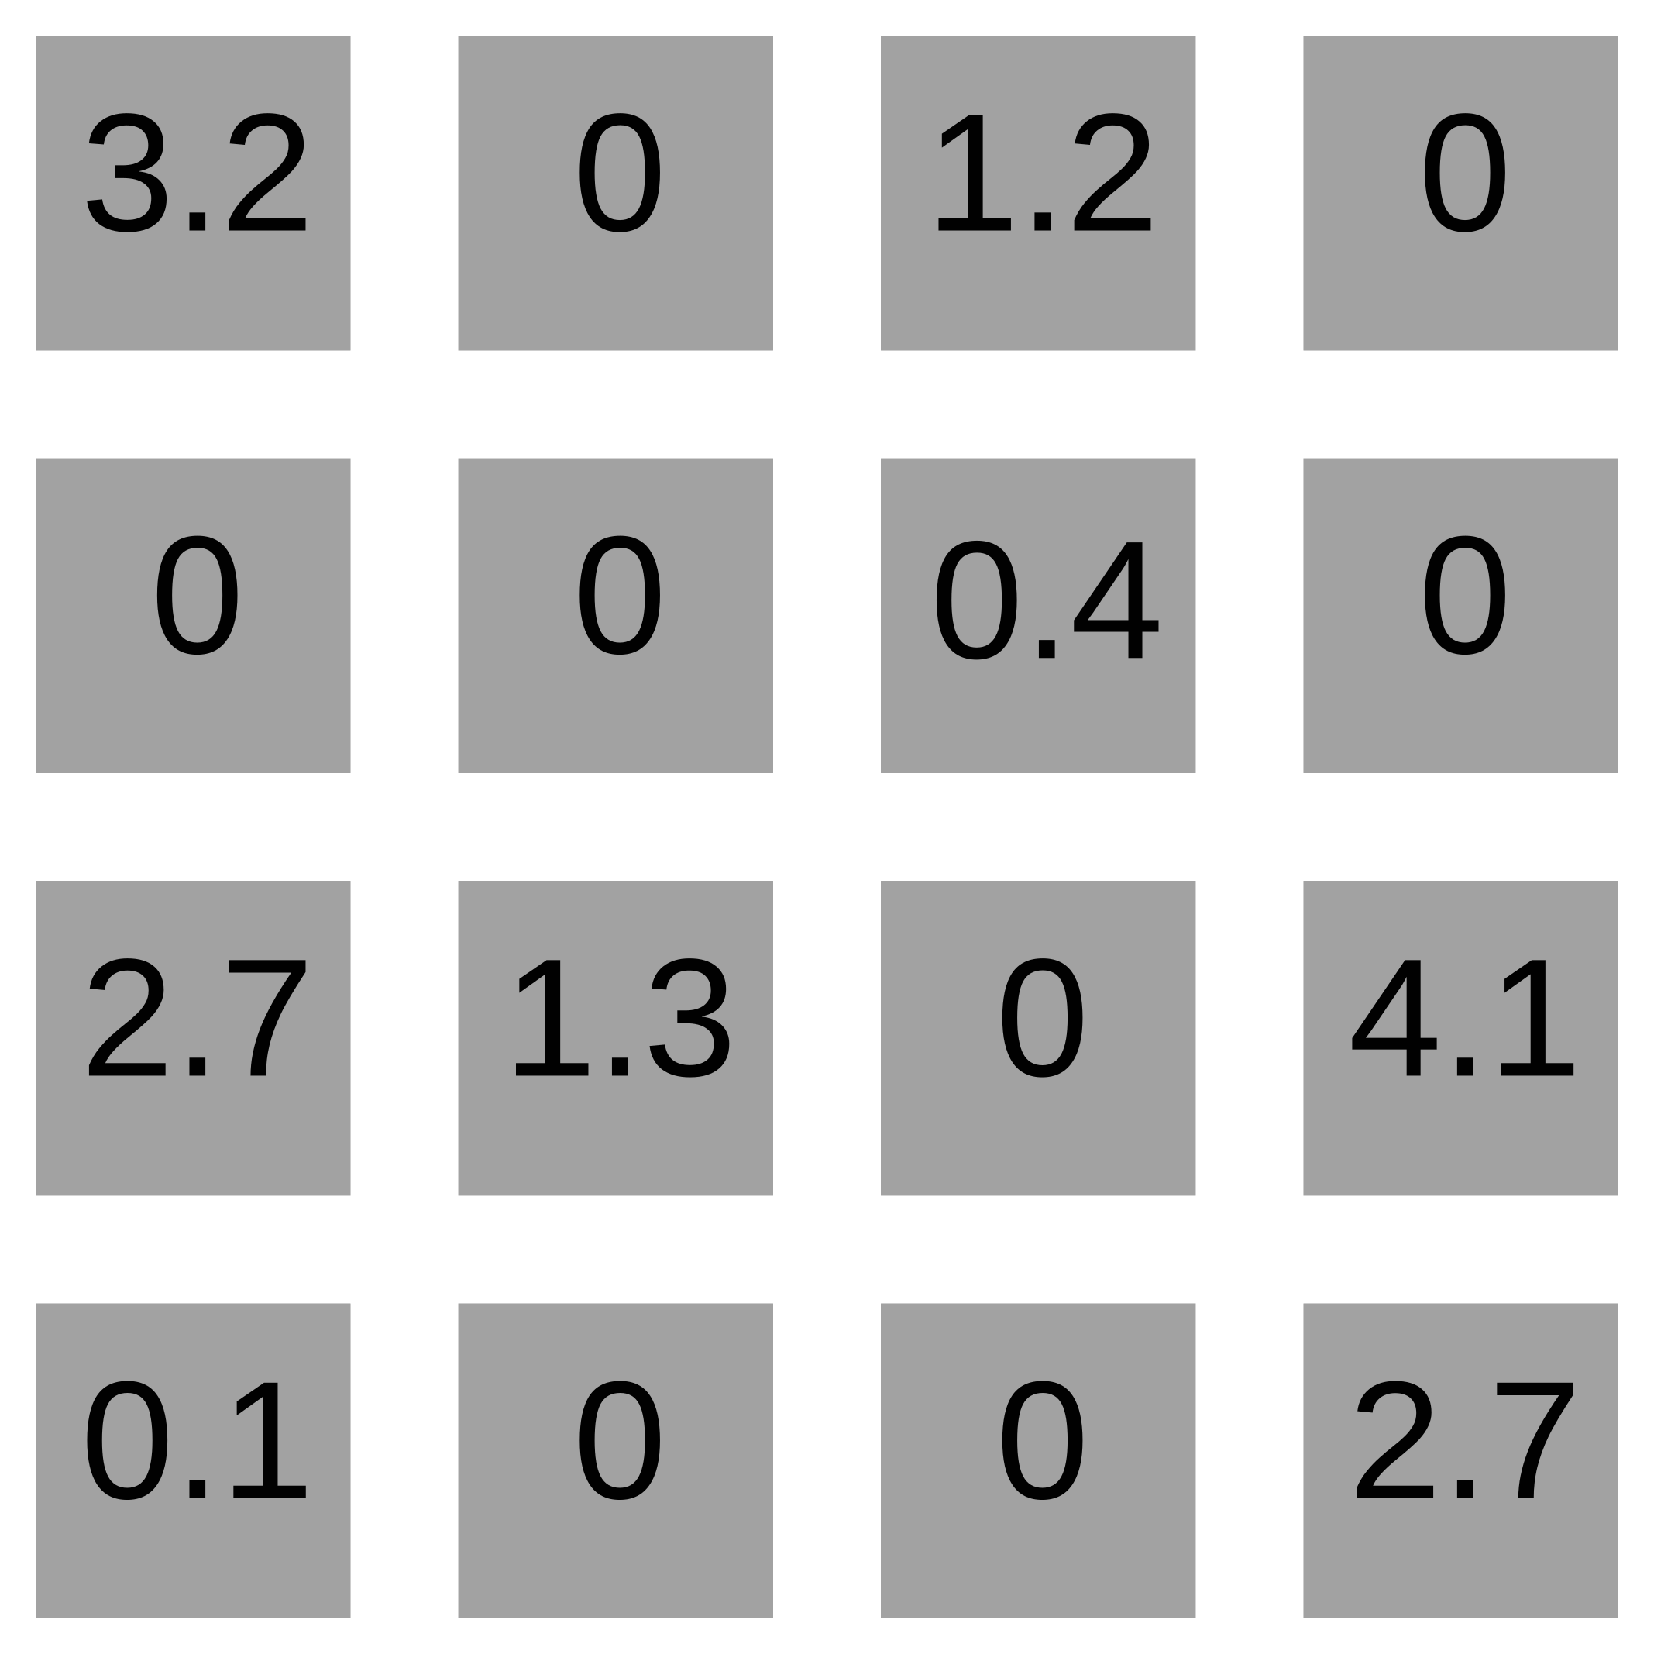
Sparse matrix formats

Slide 8
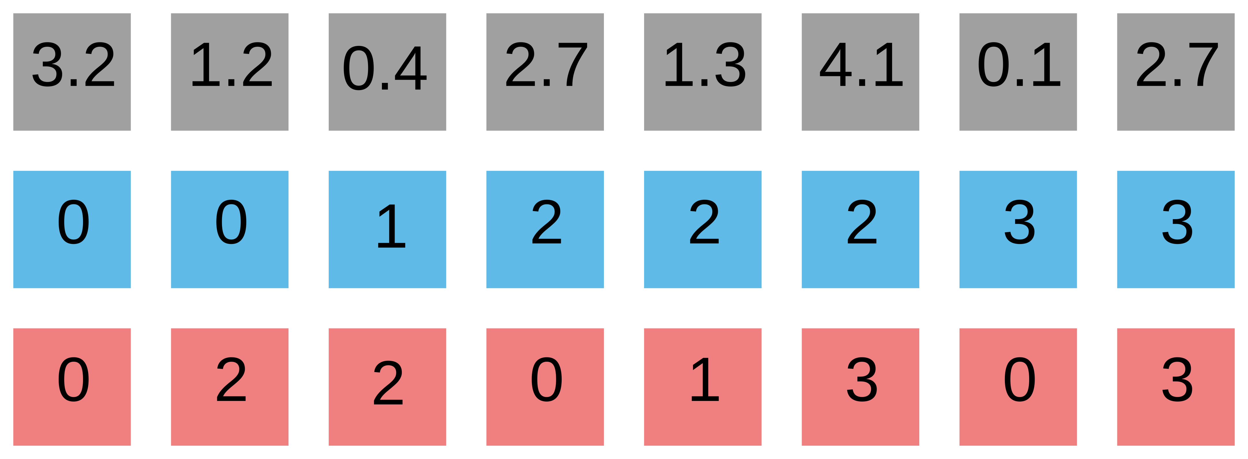
Sparse matrix formats
COO

Slide 9
Sparse matrix formats
row
column
COO

Slide 10
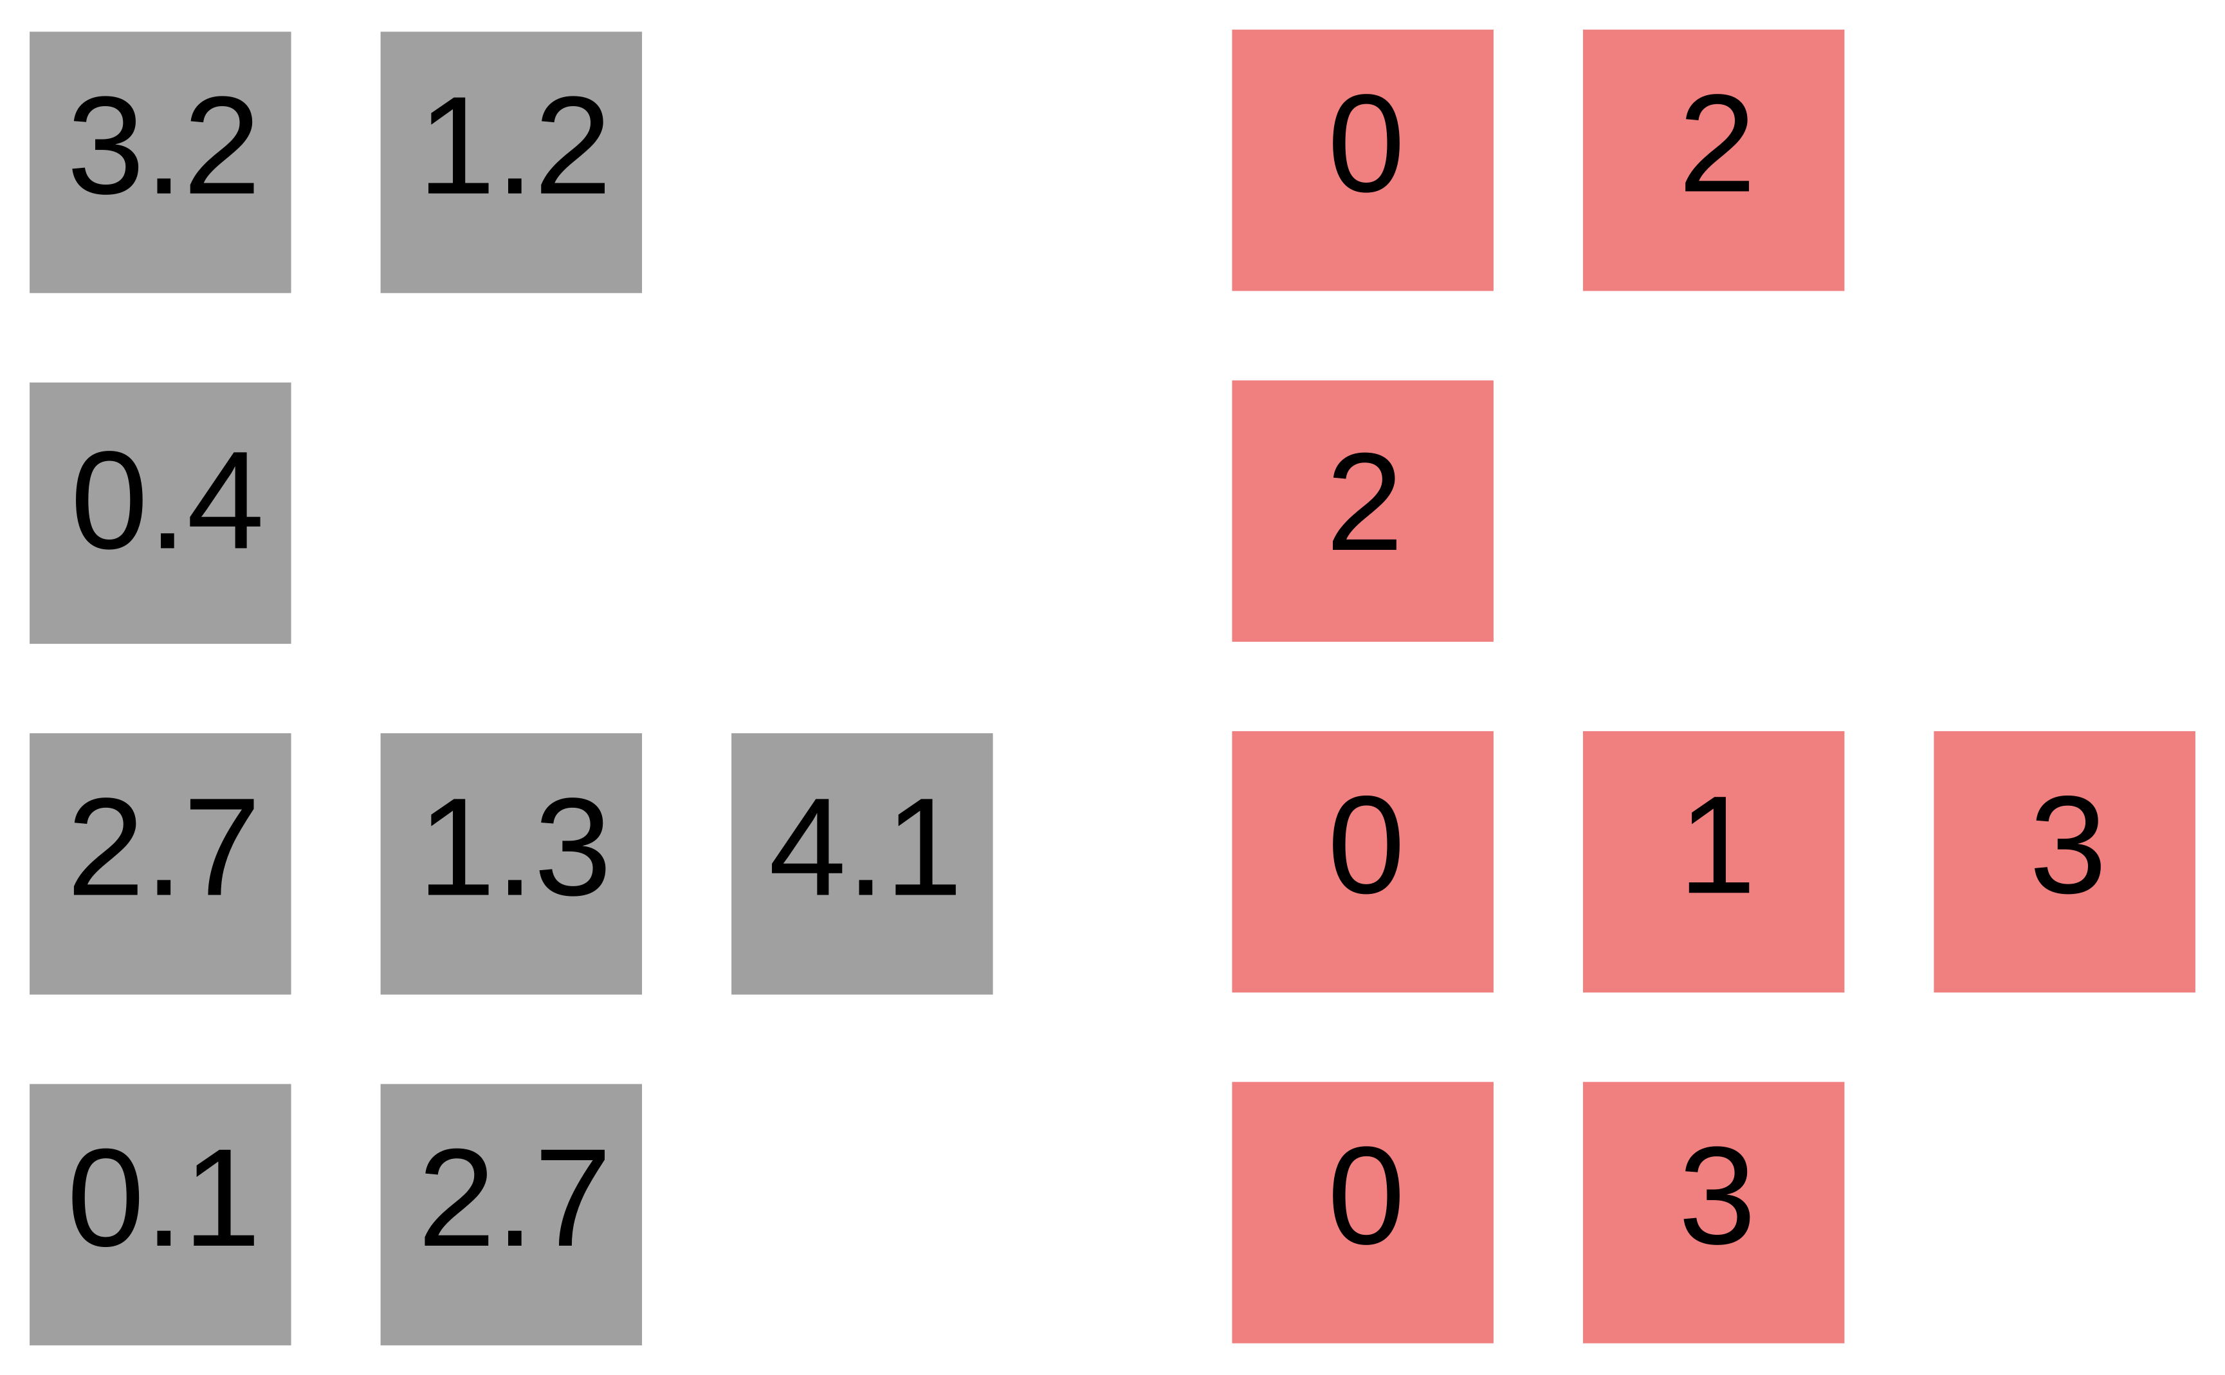
Sparse matrix formats

Slide 11
Sparse matrix formats

Slide 12
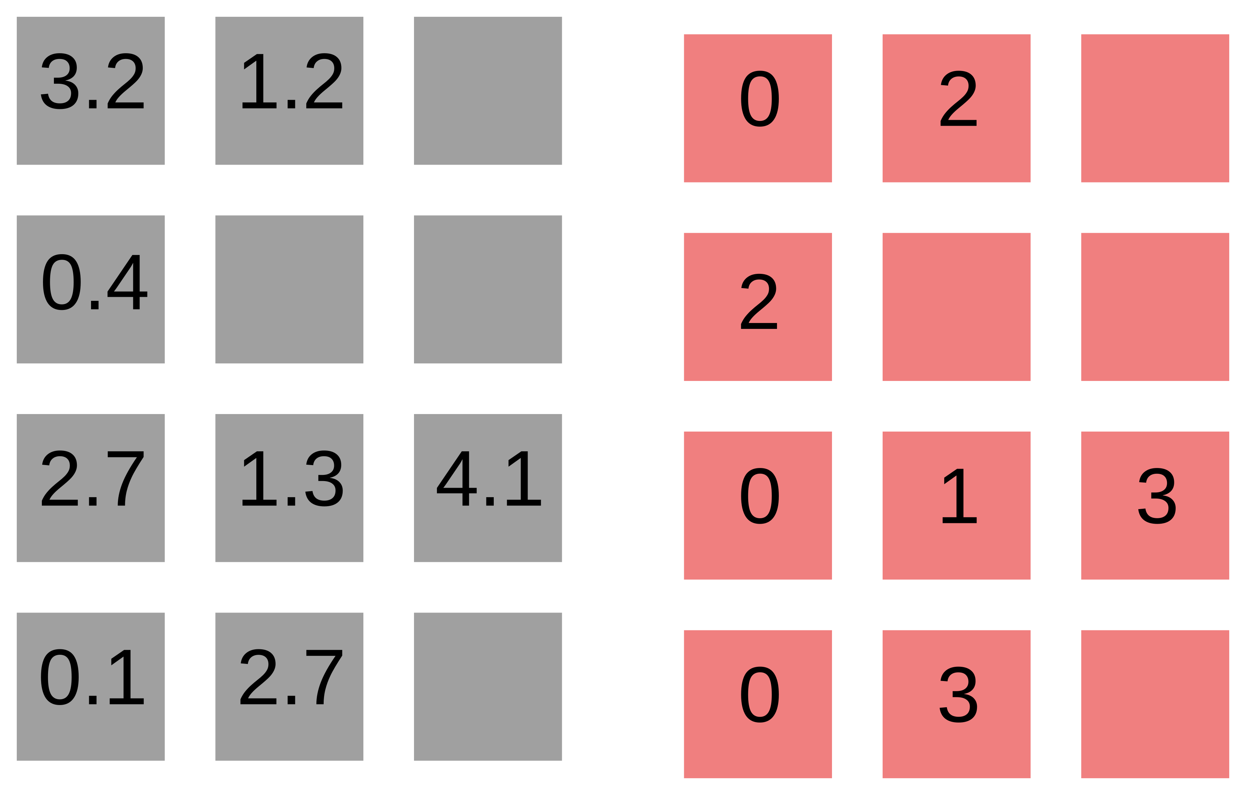
Sparse matrix formats
ELL

Slide 13
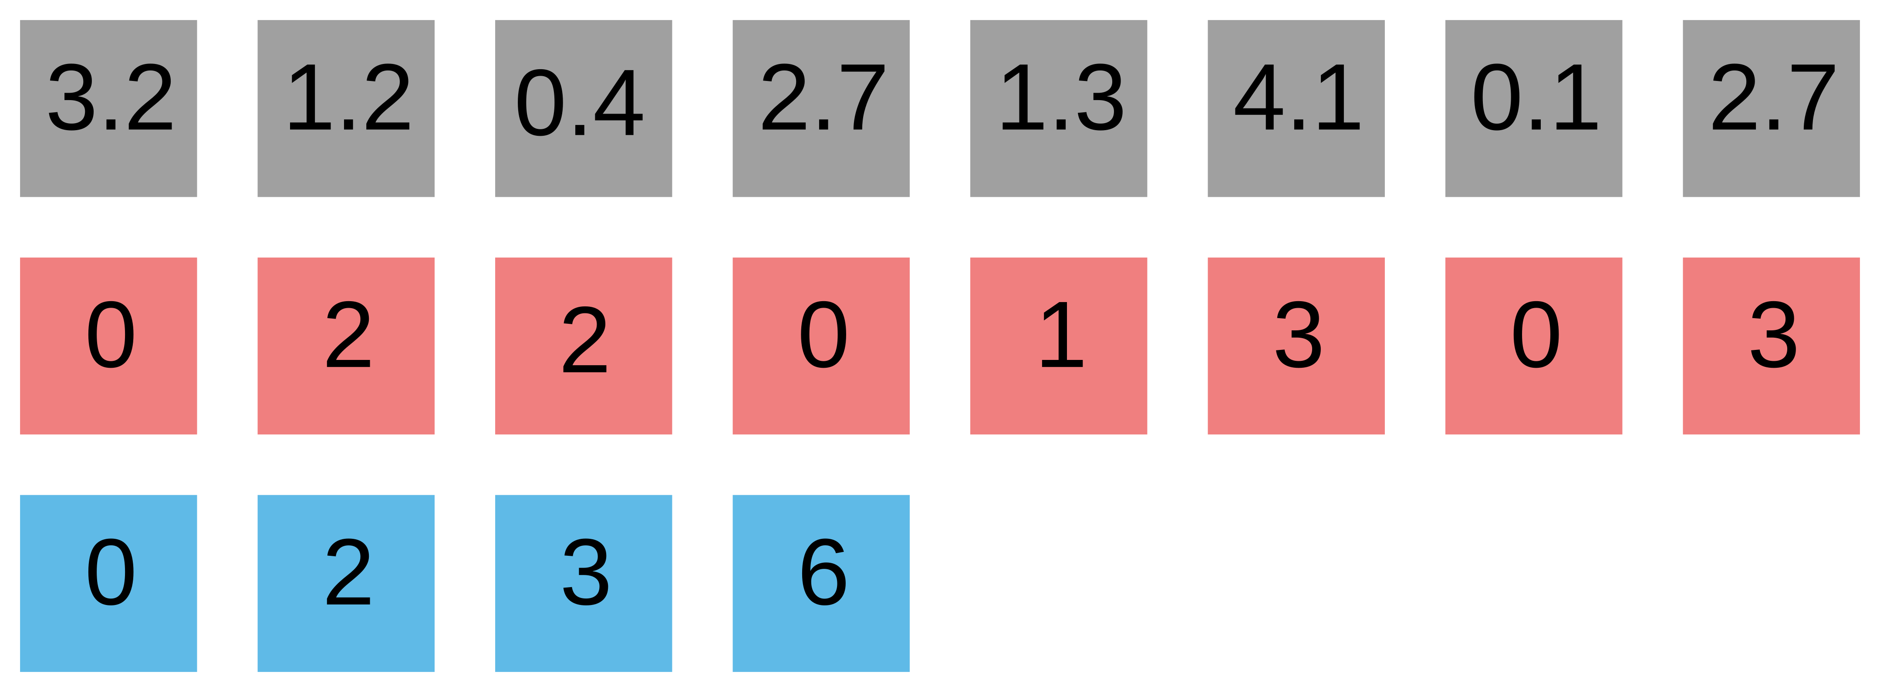
Sparse matrix formats
CSR
ELL

Slide 14
Sparse matrix formats
CSR
ELL

Slide 15
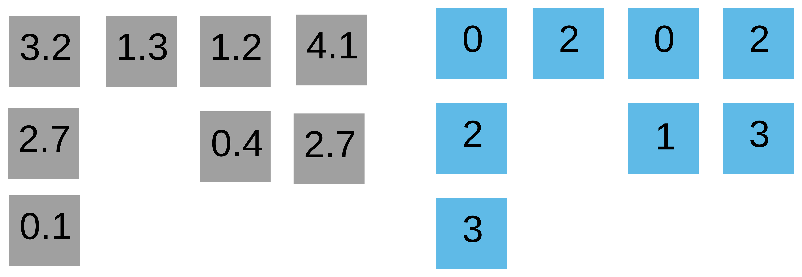
Sparse matrix formats
… leads to CSC

Slide 16
Sparse matrix formats
… leads to CSC
“Standard” approach
CSR
COO
Considered inferior to CSR (memory consumption)

Slide 17
CSR SpMV
Values (val)
Column indexes (colidx)
Row pointers (rowptr)

Slide 18

CSR SpMV
Values (val)
Column indexes (colidx)
Row pointers (rowptr)

Slide 19
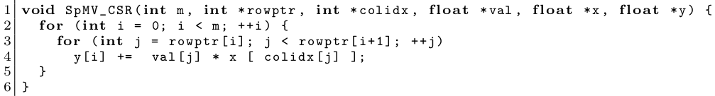
CSR SpMV
Values (val)
Column indexes (colidx)
Row pointers (rowptr)

Slide 20
CSR SpMV
Values (val)
Column indexes (colidx)
Row pointers (rowptr)
Bell & Garland ‘08
  parallelize outer loop
~ cuSPARSE SpMV

Slide 21
CSR SpMV
Values (val)
Column indexes (colidx)
Row pointers (rowptr)
Bell & Garland ‘08
  parallelize outer loop
~ cuSPARSE SpMV
Load imbalance!
Non-coalescence!

Slide 22
CSR SpMV
Values (val)
Column indexes (colidx)
Row pointers (rowptr)
Bell & Garland ‘08
  parallelize outer loop
~ cuSPARSE SpMV
Load imbalance!
Non-coalescence!
Specialized formats
  HYB (ELL + COO) [Nvidia]
  CSR5 [?], CSR-I [Flegar, Quintana ‘17]
  SELL-P – good memory access, parallelizes well
  … a few new ones every year

Slide 23
CSR-I idea

Slide 24
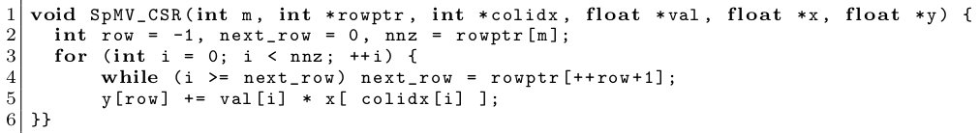
CSR-I idea
Collapse the two loops into one.

Slide 25
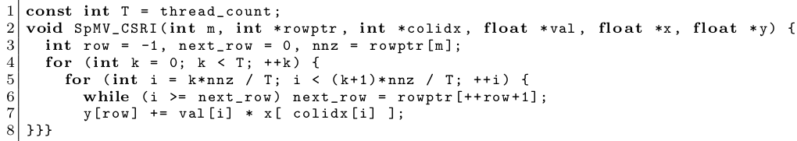
CSR-I idea
Collapse the two loops into one.
Split the loop into equal chunks.

Slide 26
CSR-I idea
Collapse the two loops into one.
Split the loop into equal chunks.
Parallelize this!

Slide 27
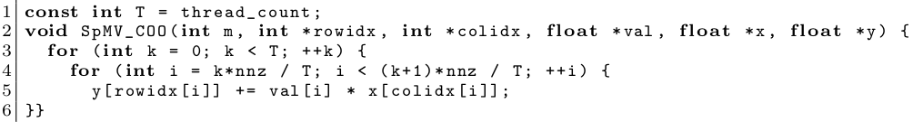
COO SpMV
Values (val)
Row indexes (rowidx)
Column indexes (colidx)
Split the loop into equal chunks.
Parallelize this!

Slide 28
COO vs CSR-I SpMV
COO:
CSR-I:
Use atomics
Accumulate partial result into registers
Race conditions!

Slide 29
Getting good performance on GPUs
CUDA thread = 1 lane of a 32-wide SIMD unit (warp) – share cache lines!
Spreading out threads causes strided memory access.
Assign one warp per chunk.

Slide 30
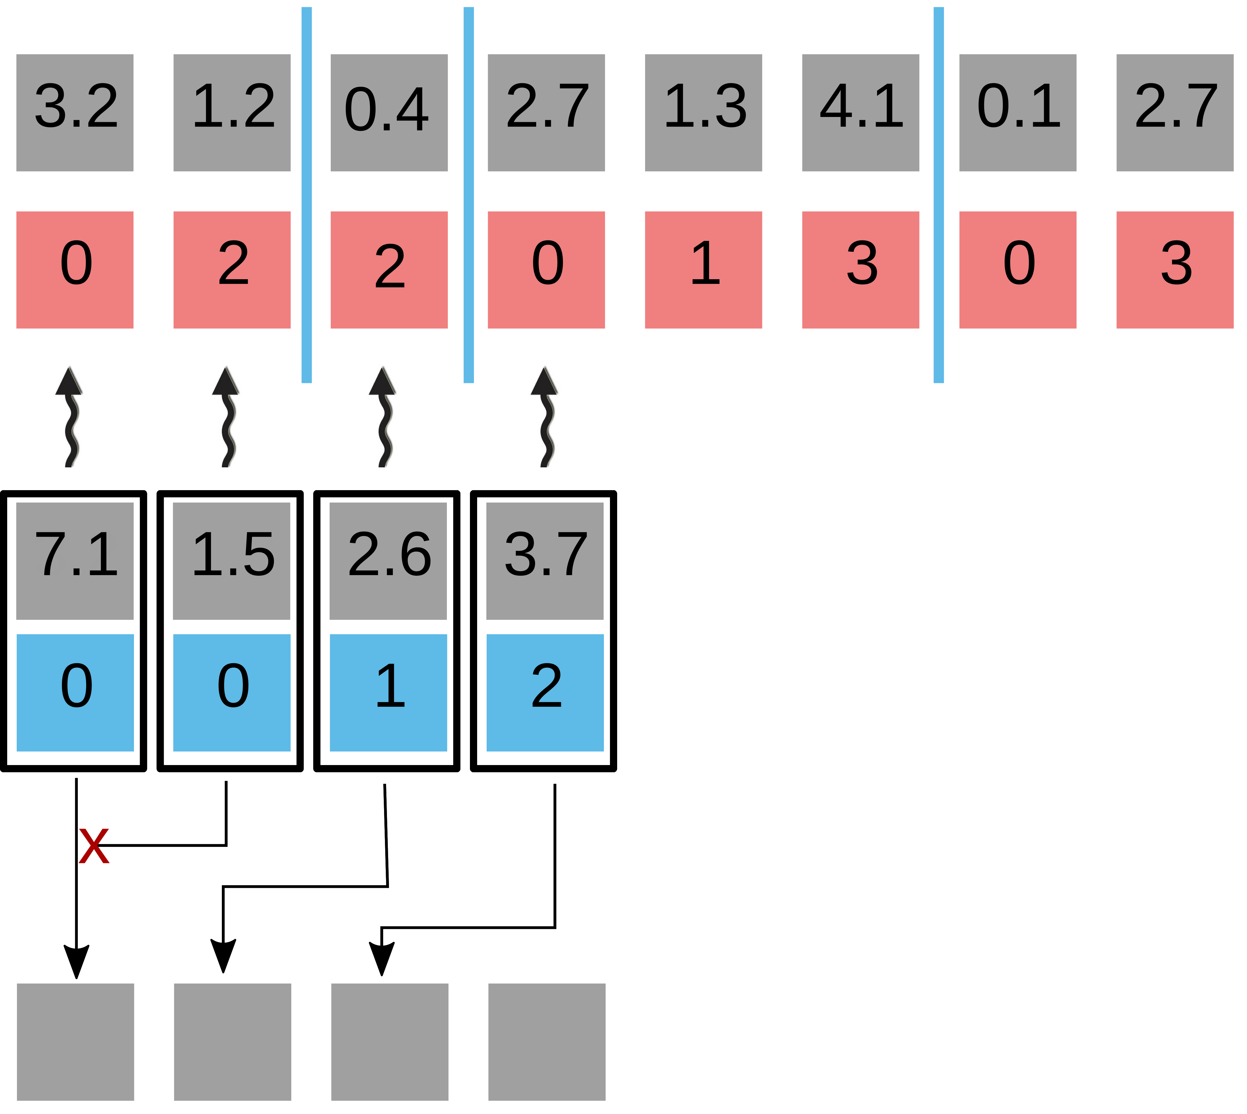
Getting good performance on GPUs
Atomic collision!
y

Slide 31
Getting good performance on GPUs
CUDA thread = 1 lane of a 32-wide SIMD unit (warp)
Spreading out threads causes strided memory access.
Assign one warp per chunk.
Atomic collision!
y

Slide 32
Getting good performance on GPUs
CUDA thread = 1 lane of a 32-wide SIMD unit (warp)
Spreading out threads causes strided memory access.
Assign one warp per chunk.
Atomic collision!
y

Slide 33
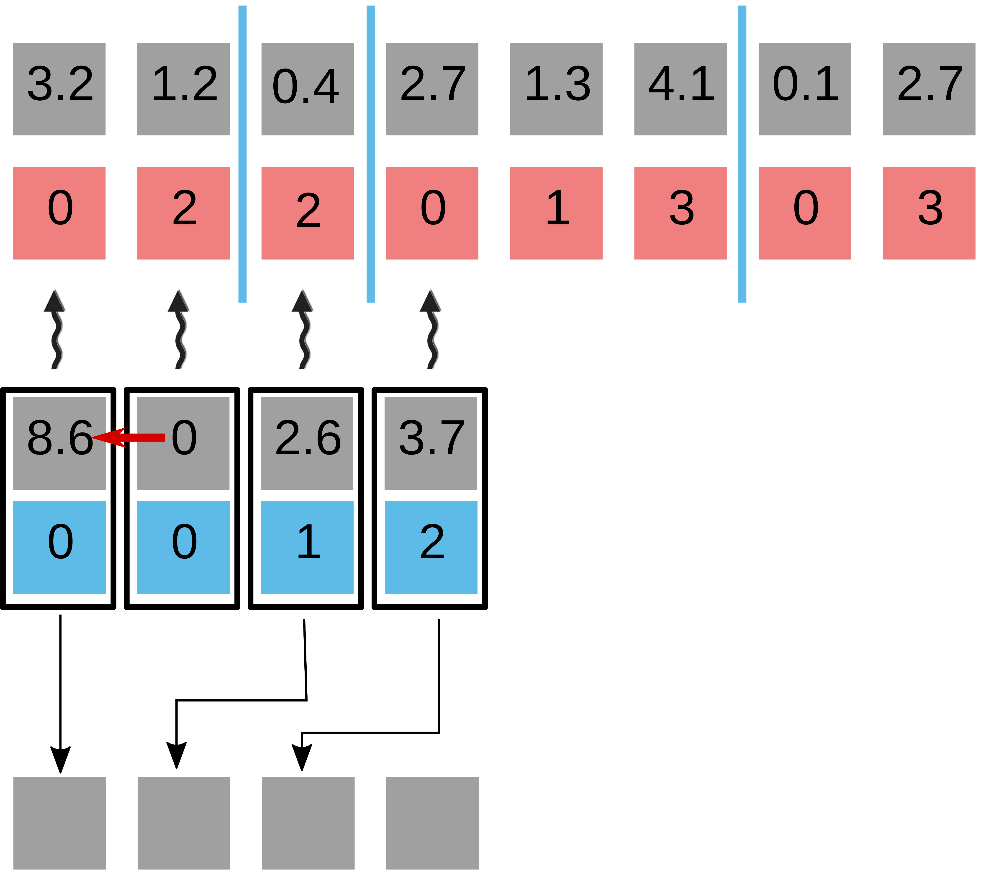
Getting good performance on GPUs
CUDA thread = 1 lane of a 32-wide SIMD unit (warp)
Spreading out threads causes strided memory access.
Assign one warp per chunk.
Warp-level segmented reduction (scan) using shuffles
Atomic collision!
y

Slide 34
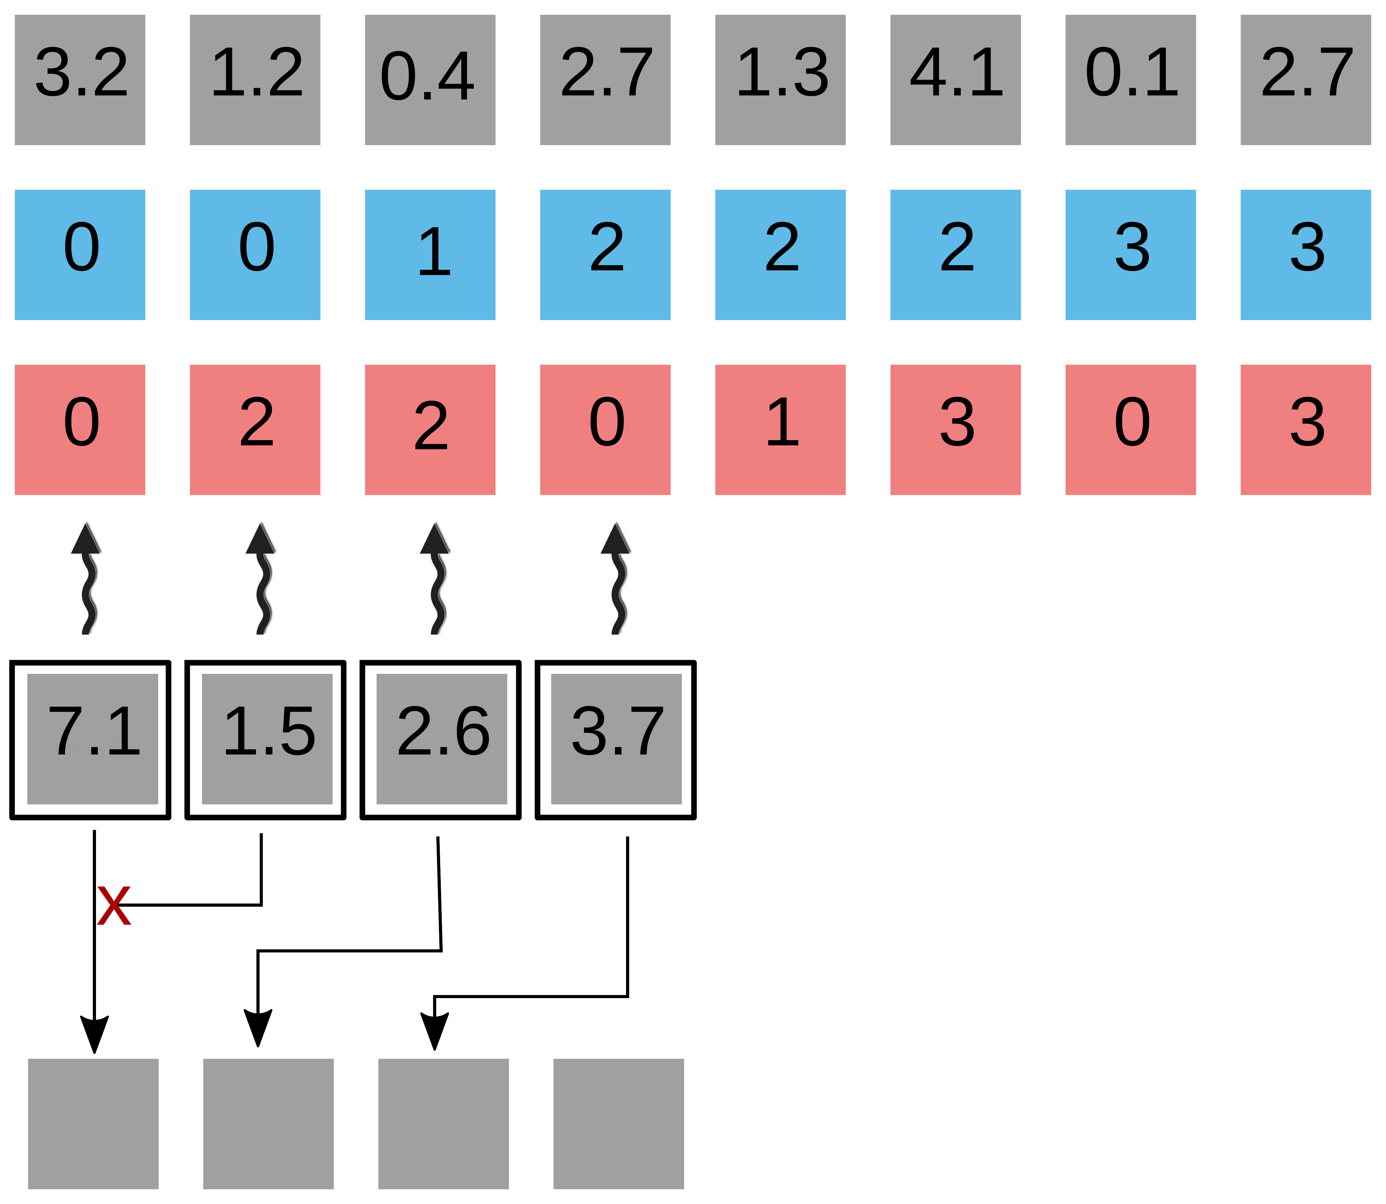
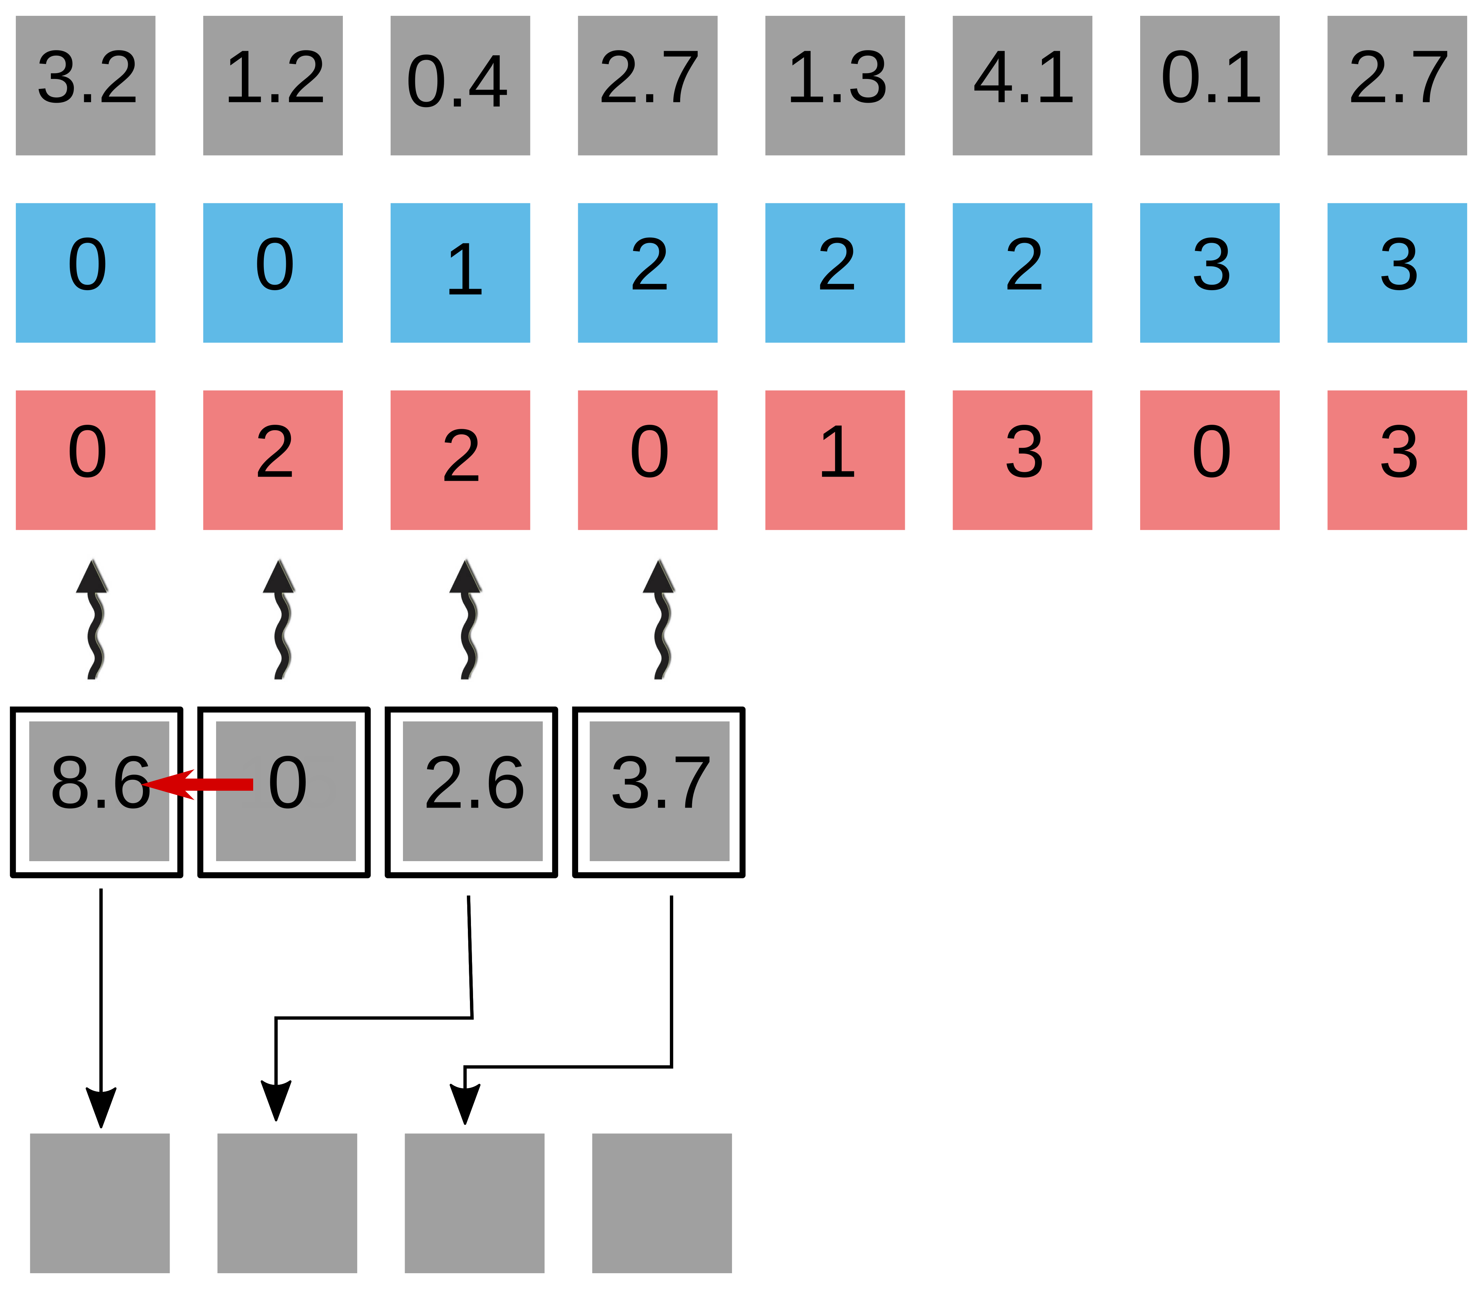
Getting good performance on GPUs
Warp-level segmented reduction (scan) using shuffles
Atomic collision!
y
y
Warp-level segmented reduction (scan) using shuffles
Atomic collision!
y
y

Slide 35
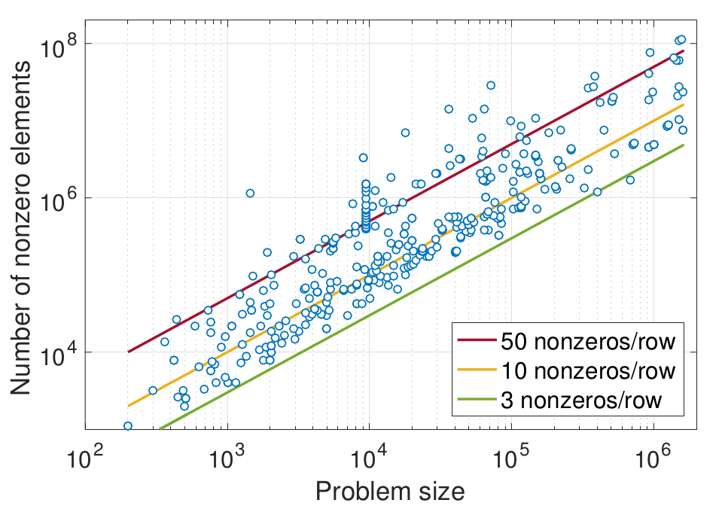
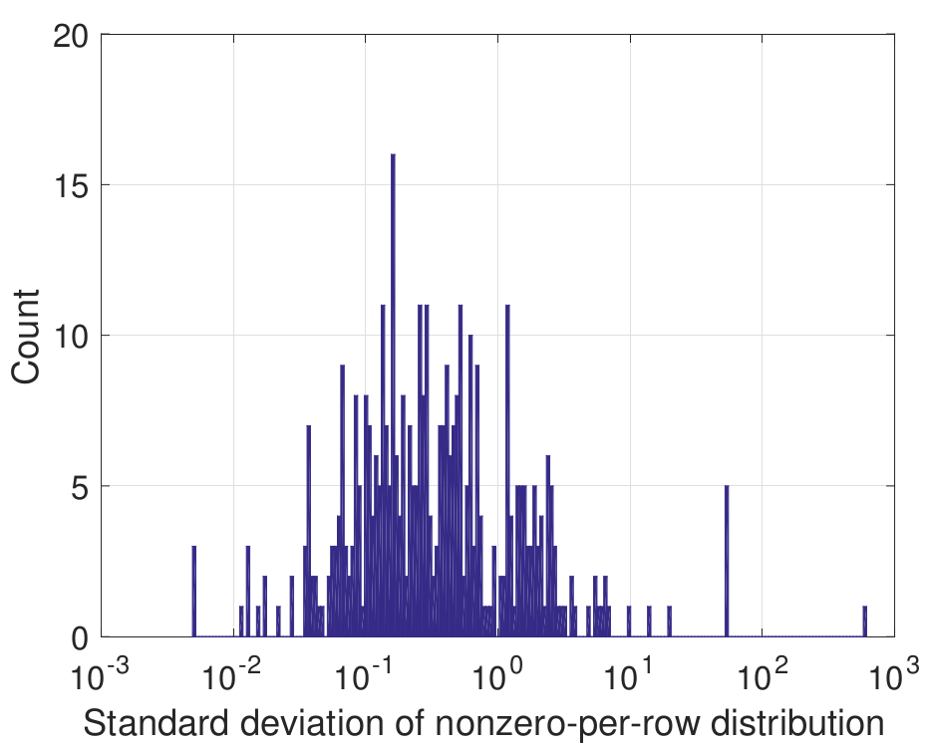
Test Matrices
400 matrices from SuiteSparse
Imbalance

Slide 36
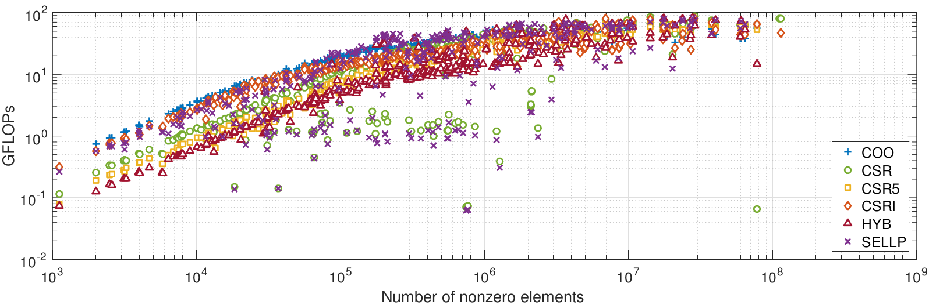
Performance of Different formats
COO always wins for small matrices

Slide 37
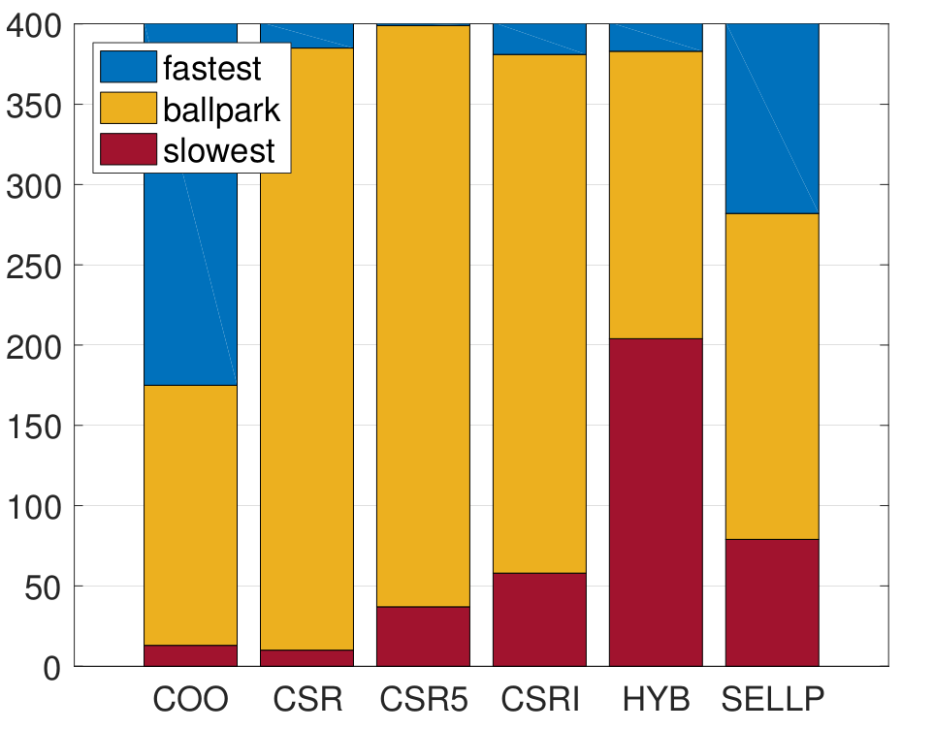
Best Formats Histogram
COO wins most of the cases!

Slide 38
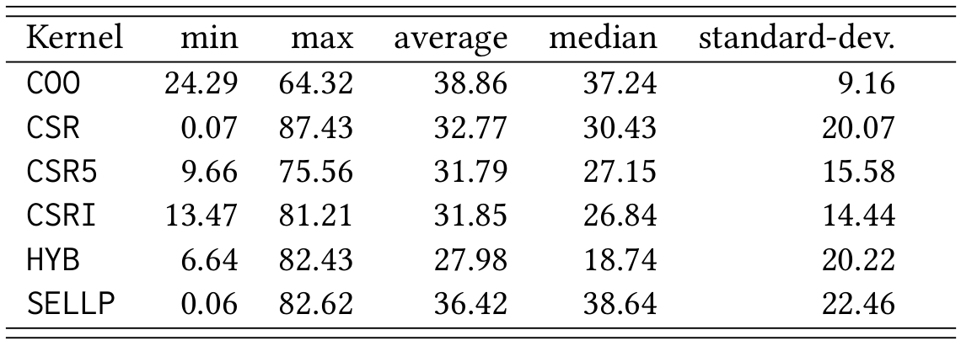
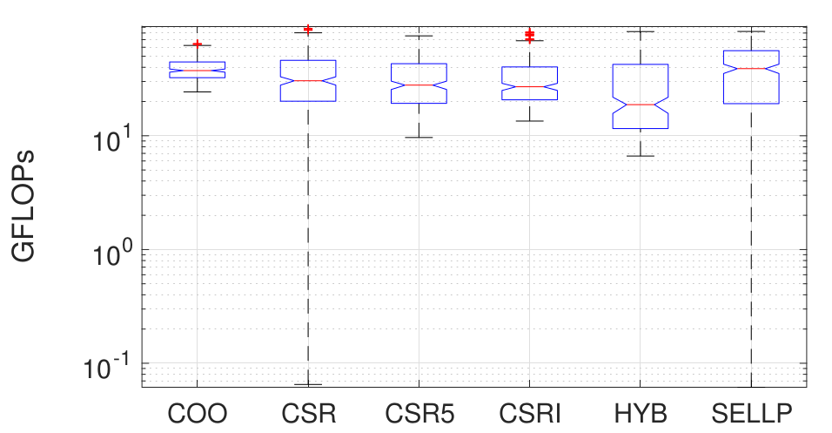
Basic Statistics
COO has good average & small deviation!

Slide 39
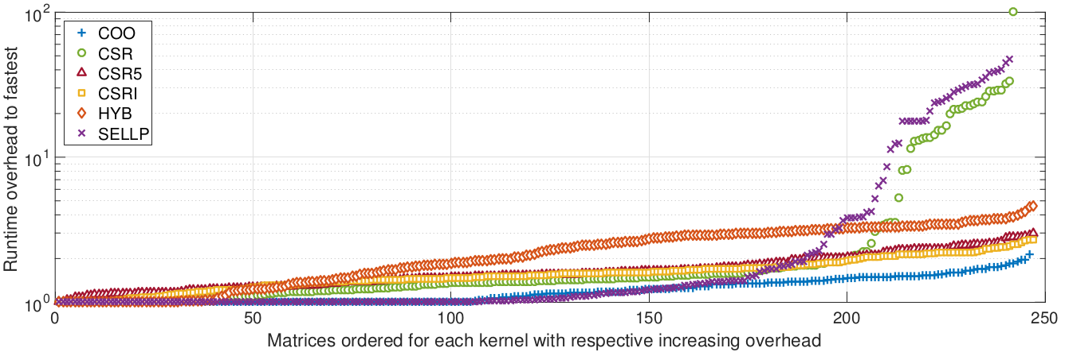
Runtime comparison
COO is never “slow”!

Slide 40
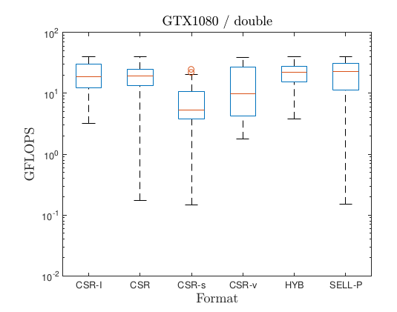
Performance of CSR-I
100 matrices from SuiteSparse

Slide 41
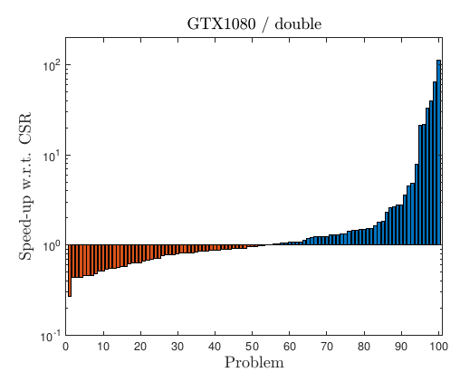
Speed-up / slowdown over cuSPARSE CSR

Slide 42
Speed-up / slowdown over cuSPARSE CSR
No format conversion!
  try both, and use the fastest later on!
  sometimes 1 cuSPARSE SpMV = 100 CSR-I SpMVs

Slide 43
Choosing the winner a priori
CSR-I designed for irregular patterns

Slide 44
Choosing the winner a priori
CSR-I designed for irregular patterns
How to measure irregularity?
Deviation of row lengths from the mean.

Slide 45
Choosing the winner a priori
CSR-I designed for irregular patterns
How to measure irregularity?
Deviation of row lengths from the mean.
Is “5” regular or irregular?
Depends on the density of the matrix (mean #rows)

Slide 46
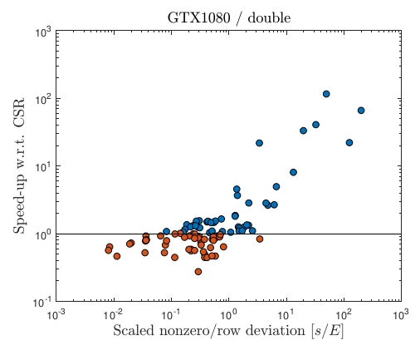
Choosing the winner a priori
CSR-I designed for irregular patterns
How to measure irregularity?
Deviation of row lengths from the mean.
Is “5” regular or irregular?
Depends on the density of the matrix (mean #rows)
Scatter plot of speedup vs normalized std. dev.

Slide 47
Choosing the winner a priori
CSR-I designed for irregular patterns
How to measure irregularity?
Deviation of row lengths from the mean.
Is “5” regular or irregular?
Depends on the density of the matrix (mean #rows)
Scatter plot of speedup vs normalized std. dev.
<0.1 use CSR
>1 use CSR-I
Benchmark both

Slide 48
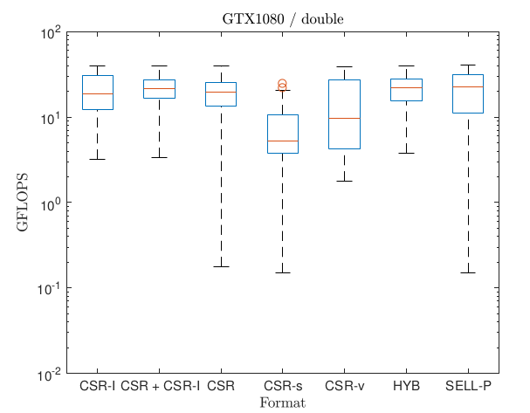
Combining both approaches

Slide 49
Conclusion
Atomics - combined with shuffles – can provide good performance.
Re-visit old algorithms/format (they might work well on new hardware).

Slide 50

Thank you! Questions?
All functionalities are part of the MAGMA-sparse project.
Scan me for slides!
github.com/gflegar/talks/tree/master/sc_2017
http://icl.cs.utk.edu/magma/
This research is based on a cooperation between Hartwig Anzt, Jack Dongarra (University of Tennessee),
Goran Flegar and Enrique S. Quintana-Ortí (Universidad Jaume I).

