Slide 1
Towards Continuous Benchmarking:
An Automated Performance Evaluation Framework for High Performance Software
Anzt, Chen, Cojean, Dongarra, Flegar, Nayak, Quintana-Ortí, Tsai, Wang

Slide 2

A Healthy Software Development Cycle
Developer

Slide 3
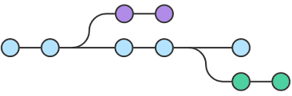
A Healthy Software Development Cycle
Push
Source Code
Repository
Developer
Version control system for tracking changes
and coordinating collaborative development.

Slide 4

A Healthy Software Development Cycle
Push
Source Code
Repository
CI Build
Developer
Version control system for tracking changes
and coordinating collaborative development.
CI Build system continuously checks the compilation
success on different architectures.
Continuous Integration (CI)

Slide 5
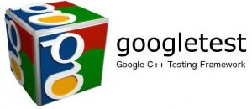
A Healthy Software Development Cycle
Push
Source Code
Repository
CI Build
CI Test
Developer
Version control system for tracking changes
and coordinating collaborative development.
CI Build system continuously checks the compilation
success on different architectures.
Unit tests ensure functionality and validity
of all building blocks.
Continuous Integration (CI)

Slide 6

A Healthy Software Development Cycle
Push
Source Code
Repository
CI Build
CI Test
Developer
Version control system for tracking changes
and coordinating collaborative development.
CI Build system continuously checks the compilation
success on different architectures.
Unit tests ensure functionality and validity
of all building blocks.
Goal: Automated benchmark runs every time
new code is added.
CI Benchmark Tests
Schedule in
Batch System
Continuous Integration (CI)
HPC System

Slide 7
A Healthy Software Development Cycle
Push
Source Code
Repository
CI Build
CI Test
Developer
Version control system for tracking changes
and coordinating collaborative development.
CI Build system continuously checks the compilation
success on different architectures.
Unit tests ensure functionality and validity
of all building blocks.
Goal: Automated benchmark runs every time
new code is added.
CI Benchmark Tests
Schedule in
Batch System
Continuous Integration (CI)
HPC System

Slide 8
A Healthy Software Development Cycle
Push
Source Code
Repository
CI Build
CI Test
Security Thrust!
External code is run on HPC system
Possible point of attack
Developer
Version control system for tracking changes
and coordinating collaborative development.
CI Build system continuously checks the compilation
success on different architectures.
Unit tests ensure functionality and validity
of all building blocks.
Goal: Automated benchmark runs every time
new code is added.
CI Benchmark Tests
Schedule in
Batch System
Continuous Integration (CI)
HPC System

Slide 9

A Healthy Software Development Cycle
Push
Source Code
Repository
Trusted Reviewer
CI Build
CI Test
Code Review
Developer
Merge into
Master Branch
CI Benchmark Tests
Manual code reviews by trusted
reviewers who take responsibility
for executing code on the HPC
system.
Schedule in
Batch System
Continuous Integration (CI)
HPC System

Slide 10
A Healthy Software Development Cycle
Push
Source Code
Repository
Trusted Reviewer
CI Build
CI Test
Code Review
Developer
Merge into
Master Branch
CI Benchmark Tests
Manual code reviews by trusted
reviewers who take responsibility
for executing code on the HPC
system.
How to archive the results and
make them accessible?
Schedule in
Batch System
Continuous Integration (CI)
HPC System

Slide 11

A Healthy Software Development Cycle
Push
Source Code
Repository
Trusted Reviewer
CI Build
CI Test
Code Review
Developer
Merge into
Master Branch
CI Benchmark Tests
Store data in separate repository.
Use JSON data exchange format.
Performance Data Repository
Schedule in
Batch System
Continuous Integration (CI)
HPC System

Slide 12
A Healthy Software Development Cycle
Push
Source Code
Repository
Trusted Reviewer
CI Build
CI Test
Code Review
Developer
Merge into
Master Branch
CI Benchmark Tests
Store data in separate repository.
Use JSON data exchange format.
Cloning a huge repository is
expensive.
”Interest in my experiments, only.”
Performance Data Repository
Schedule in
Batch System
Continuous Integration (CI)
Users
HPC System

Slide 13
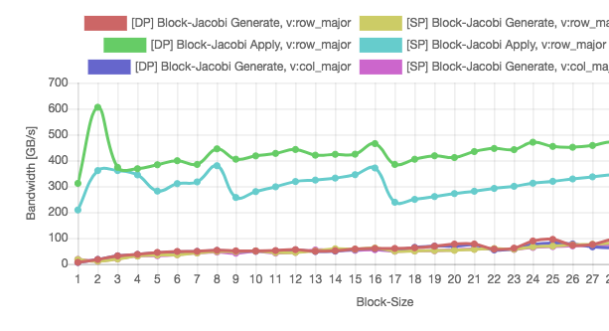
A Healthy Software Development Cycle
Push
Source Code
Repository
Trusted Reviewer
CI Build
CI Test
Code Review
Developer
Merge into
Master Branch
CI Benchmark Tests
Store data in separate repository.
Use JSON data exchange format.
Cloning a huge repository is
expensive.
”Interest in my experiments, only.”
Interactive web-based Ginkgo
Performance Explorer (GPE).
Web-Application
Performance Data Repository
Schedule in
Batch System
Continuous Integration (CI)
Users
HPC System

Slide 14

A Healthy Software Development Cycle
Push
Source Code
Repository
Trusted Reviewer
CI Build
CI Test
Code Review
Developer
Merge into
Master Branch
CI Benchmark Tests
Web-Application
Performance Data Repository
Schedule in
Batch System
Continuous Integration (CI)
Users
GPE
Ginkgo Performance Explorer
HPC System

Slide 15
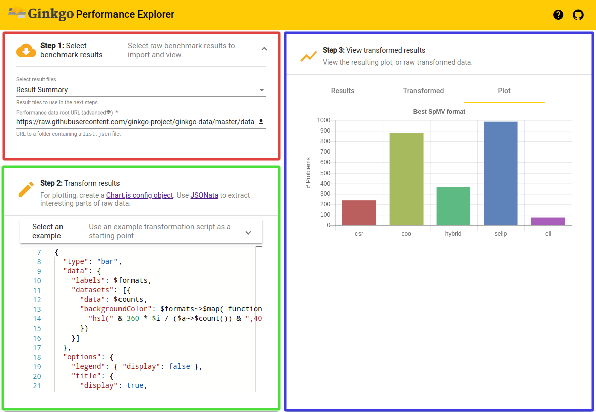
Ginkgo Performance Explorer (GPE)
Data Selection Tab
Data and Plot Viewer
Transformation Script Editor

Slide 16
Ginkgo Performance Explorer (GPE)
Data Selection Tab
Data and Plot Viewer
1.
Select Data in Git repository.
Transformation Script Editor

Slide 17
Ginkgo Performance Explorer (GPE)
Data Selection Tab
Data and Plot Viewer
1.
Select Data in Git repository.
Transformation Script Editor
2.
Write JSONata script to visualize data (examples are provided).

Slide 18
Ginkgo Performance Explorer (GPE)
Data Selection Tab
Data and Plot Viewer
1.
Select Data in Git repository.
3.
Analyze data visually.
Transformation Script Editor
2.
Write JSONata script to visualize data (examples are provided).

Slide 19
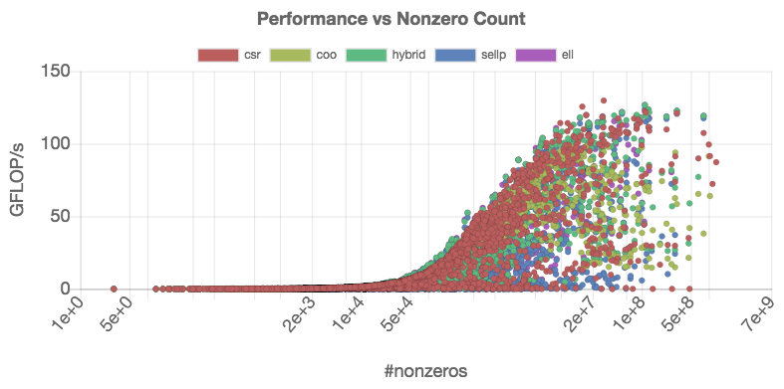
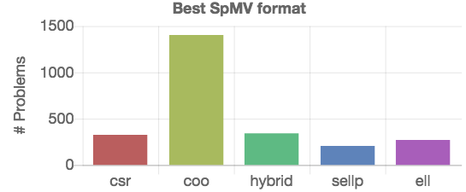
Ginkgo Performance Explorer (GPE)

Slide 20
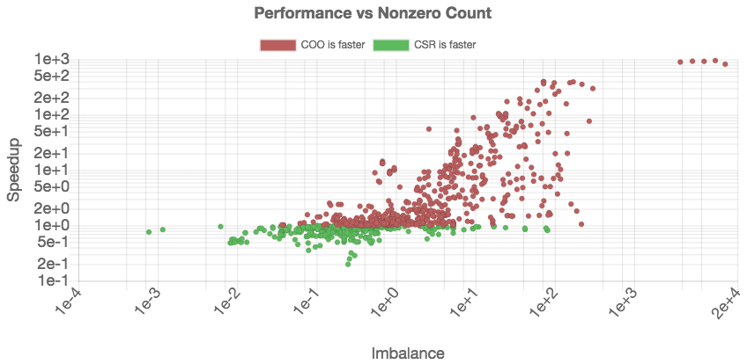
Ginkgo Performance Explorer (GPE)

Slide 21
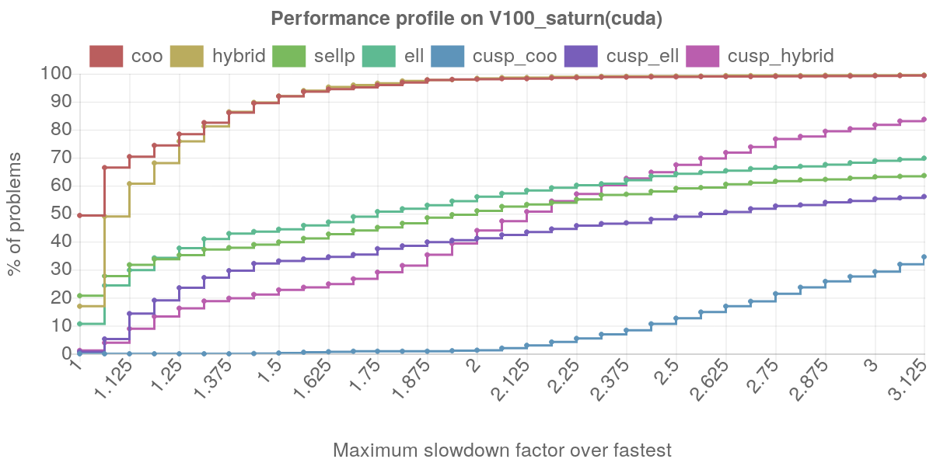
Ginkgo Performance Explorer (GPE)
Dolan & More: Benchmarking optimization software with performance profiles

Slide 22
Ginkgo’s Performance Evaluation Framework
Continuous Benchmarking Benefits
Archiving performance data along with execution parameters ensures full benchmark reproducibility.
Comparing the performance results over the code lifetime identifies performance degradations.
Ease of use: the setup allows to launch benchmark with few clicks.

Slide 23
Ginkgo’s Performance Evaluation Framework
Continuous Benchmarking Benefits
Archiving performance data along with execution parameters ensures full benchmark reproducibility.
Comparing the performance results over the code lifetime identifies performance degradations.
Ease of use: the setup allows to launch benchmark with few clicks.
Ginkgo Performance Explorer (GPE) Benefits
The design of GPE efficiently realizes the analysis as web service, removing the need for downloading performance data to local disk or installing additional software.
External developers without access to HPC systems can test and engineer their codes on HPC resources.
Extensibility: Option to compare performance with other software libraries.

