Slide 1

Balanced CSR Sparse Matrix-Vector Product on Graphics Processors
Goran Flegar, Enrique S. Quintana-Ortí
Scan me for slides!
github.com/gflegar/talks/europar_2017

Slide 2










MAGMA-sparse software library
GPU-accelerated sparse linear algebra library
  Focus: linear systems
Joint effort: Innovative Computing Lab at University of Tennessee, Knoxvile; Karlsruhe Institute of Technology; Universidad Jaume I

Slide 3
MAGMA-sparse software library
GPU-accelerated sparse linear algebra library
  Focus: linear systems
  Iterative, Krylov-subspace based linear solvers
    SpMV
    BLAS-1 operations
Joint effort: Innovative Computing Lab at University of Tennessee, Knoxvile; Karlsruhe Institute of Technology; University Jaume I

Slide 4
MAGMA-sparse software library
GPU-accelerated sparse linear algebra library
  Focus: linear systems
  Iterative, Krylov-subspace based linear solvers
    SpMV
    BLAS-1 operations
  Sparse matrix formats & SpMV
    accelerate each iteration of the solver
Joint effort: Innovative Computing Lab at University of Tennessee, Knoxvile; Karlsruhe Institute of Technology; University Jaume I

Slide 5
MAGMA-sparse software library
GPU-accelerated sparse linear algebra library
  Focus: linear systems
  Iterative, Krylov-subspace based linear solvers
    SpMV
    BLAS-1 operations
  Sparse matrix formats & SpMV
    accelerate each iteration of the solver
  Preconditioners
    reduce the number of iterations
Joint effort: Innovative Computing Lab at University of Tennessee, Knoxvile; Karlsruhe Institute of Technology; University Jaume I

Slide 6
MAGMA-sparse software library
GPU-accelerated sparse linear algebra library
  Focus: linear systems
  Iterative, Krylov-subspace based linear solvers
    SpMV
    BLAS-1 operations
  Sparse matrix formats & SpMV
    accelerate each iteration of the solver
  Preconditioners
    reduce the number of iterations
Joint effort: Innovative Computing Lab at University of Tennessee, Knoxvile; Karlsruhe Institute of Technology; University Jaume I

Slide 7
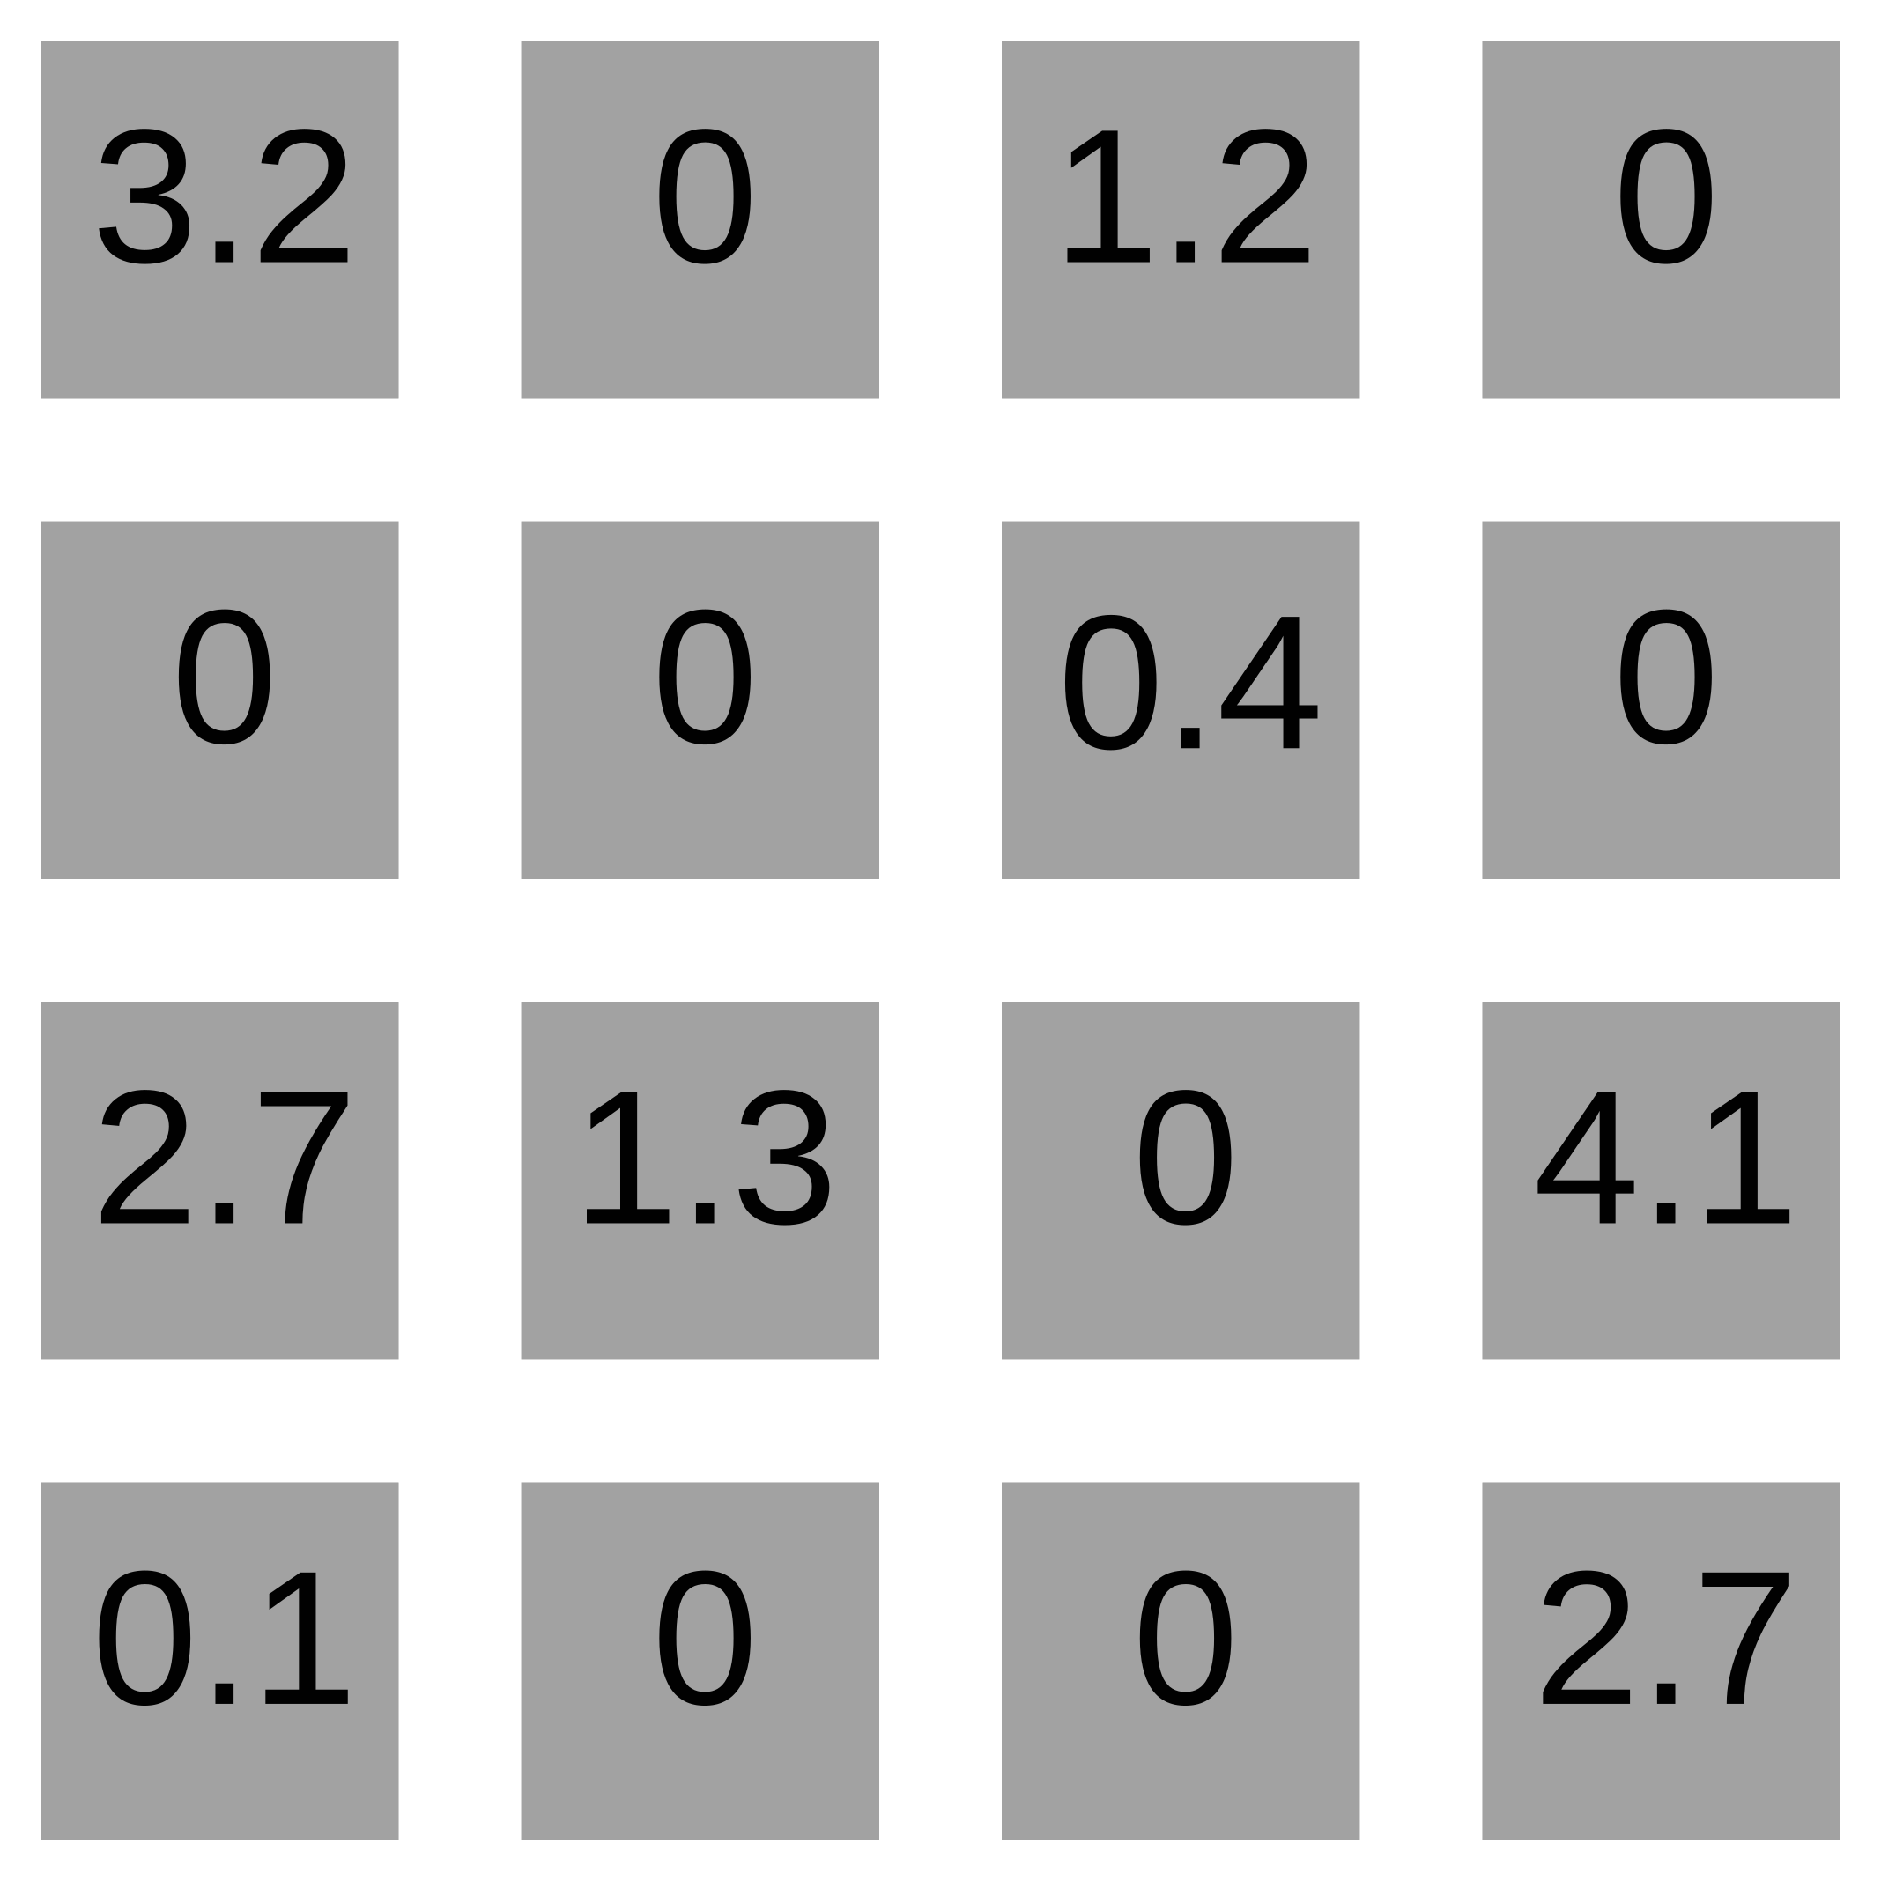
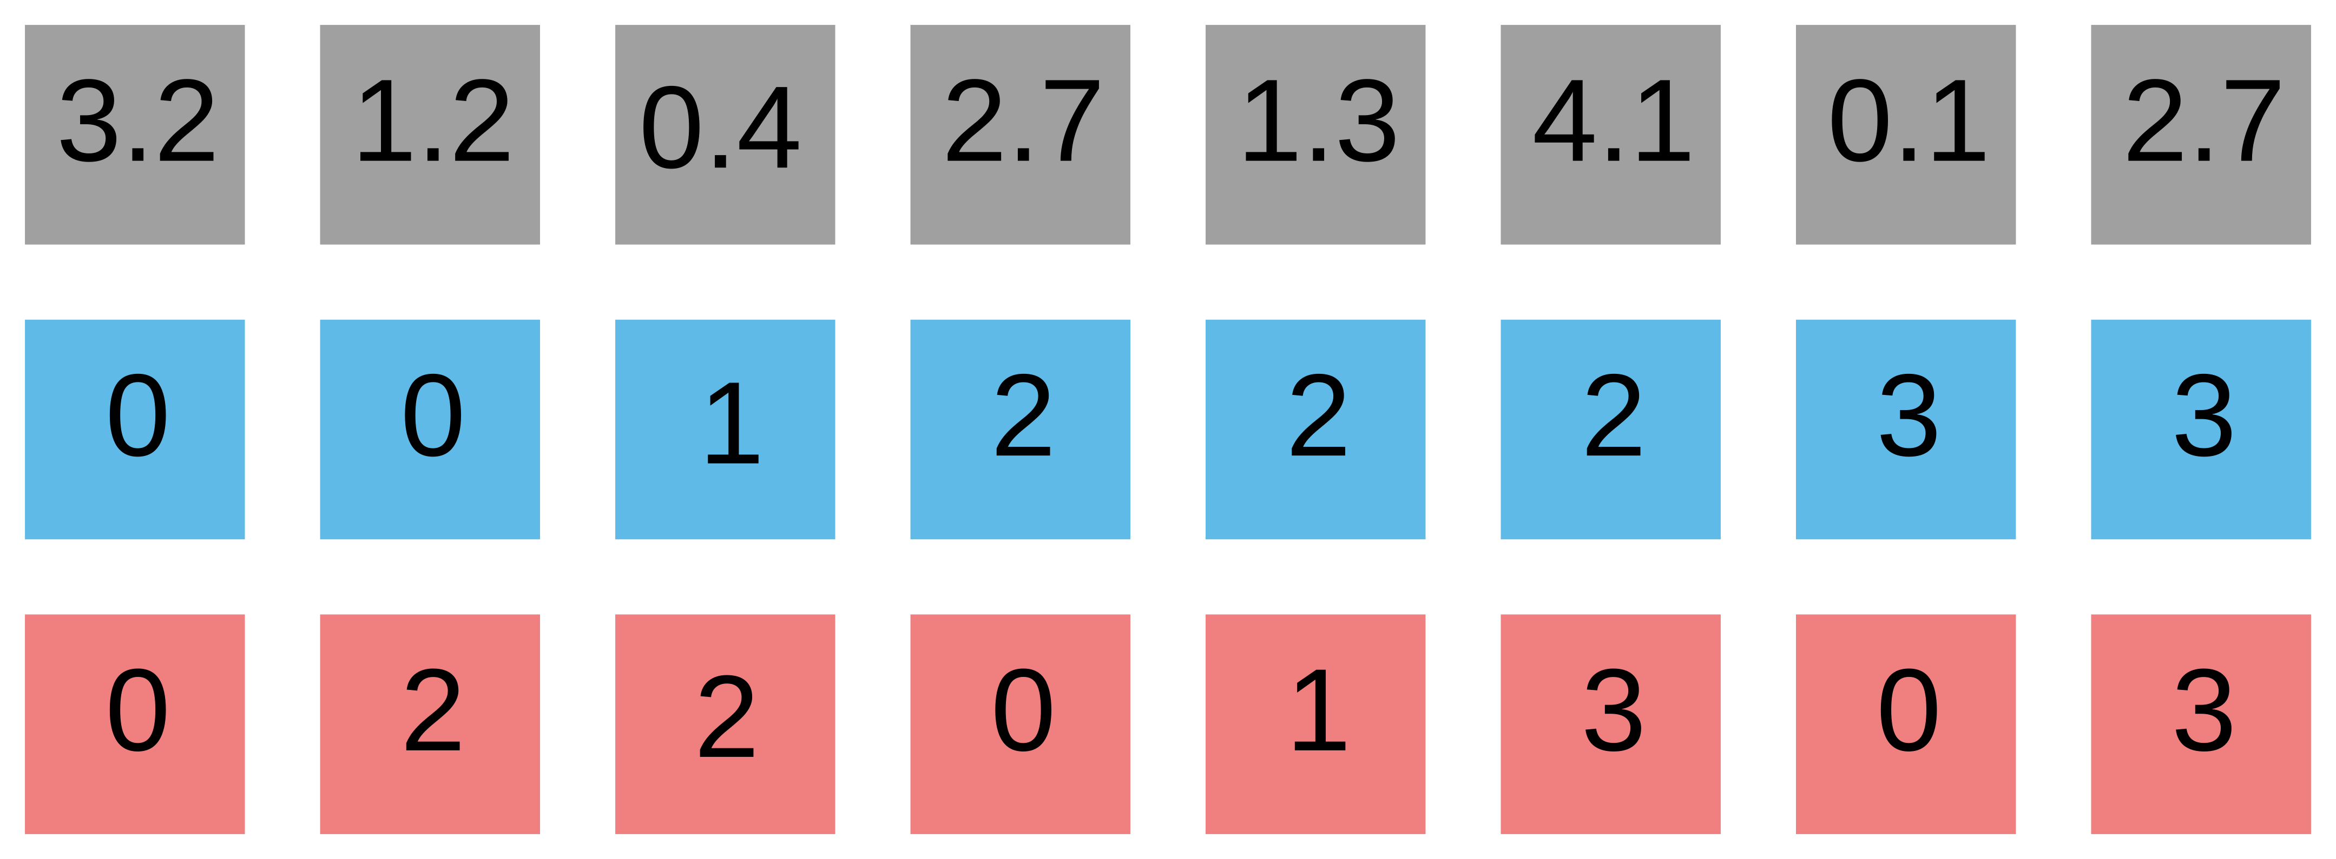
Sparse matrix formats
COO

Slide 8
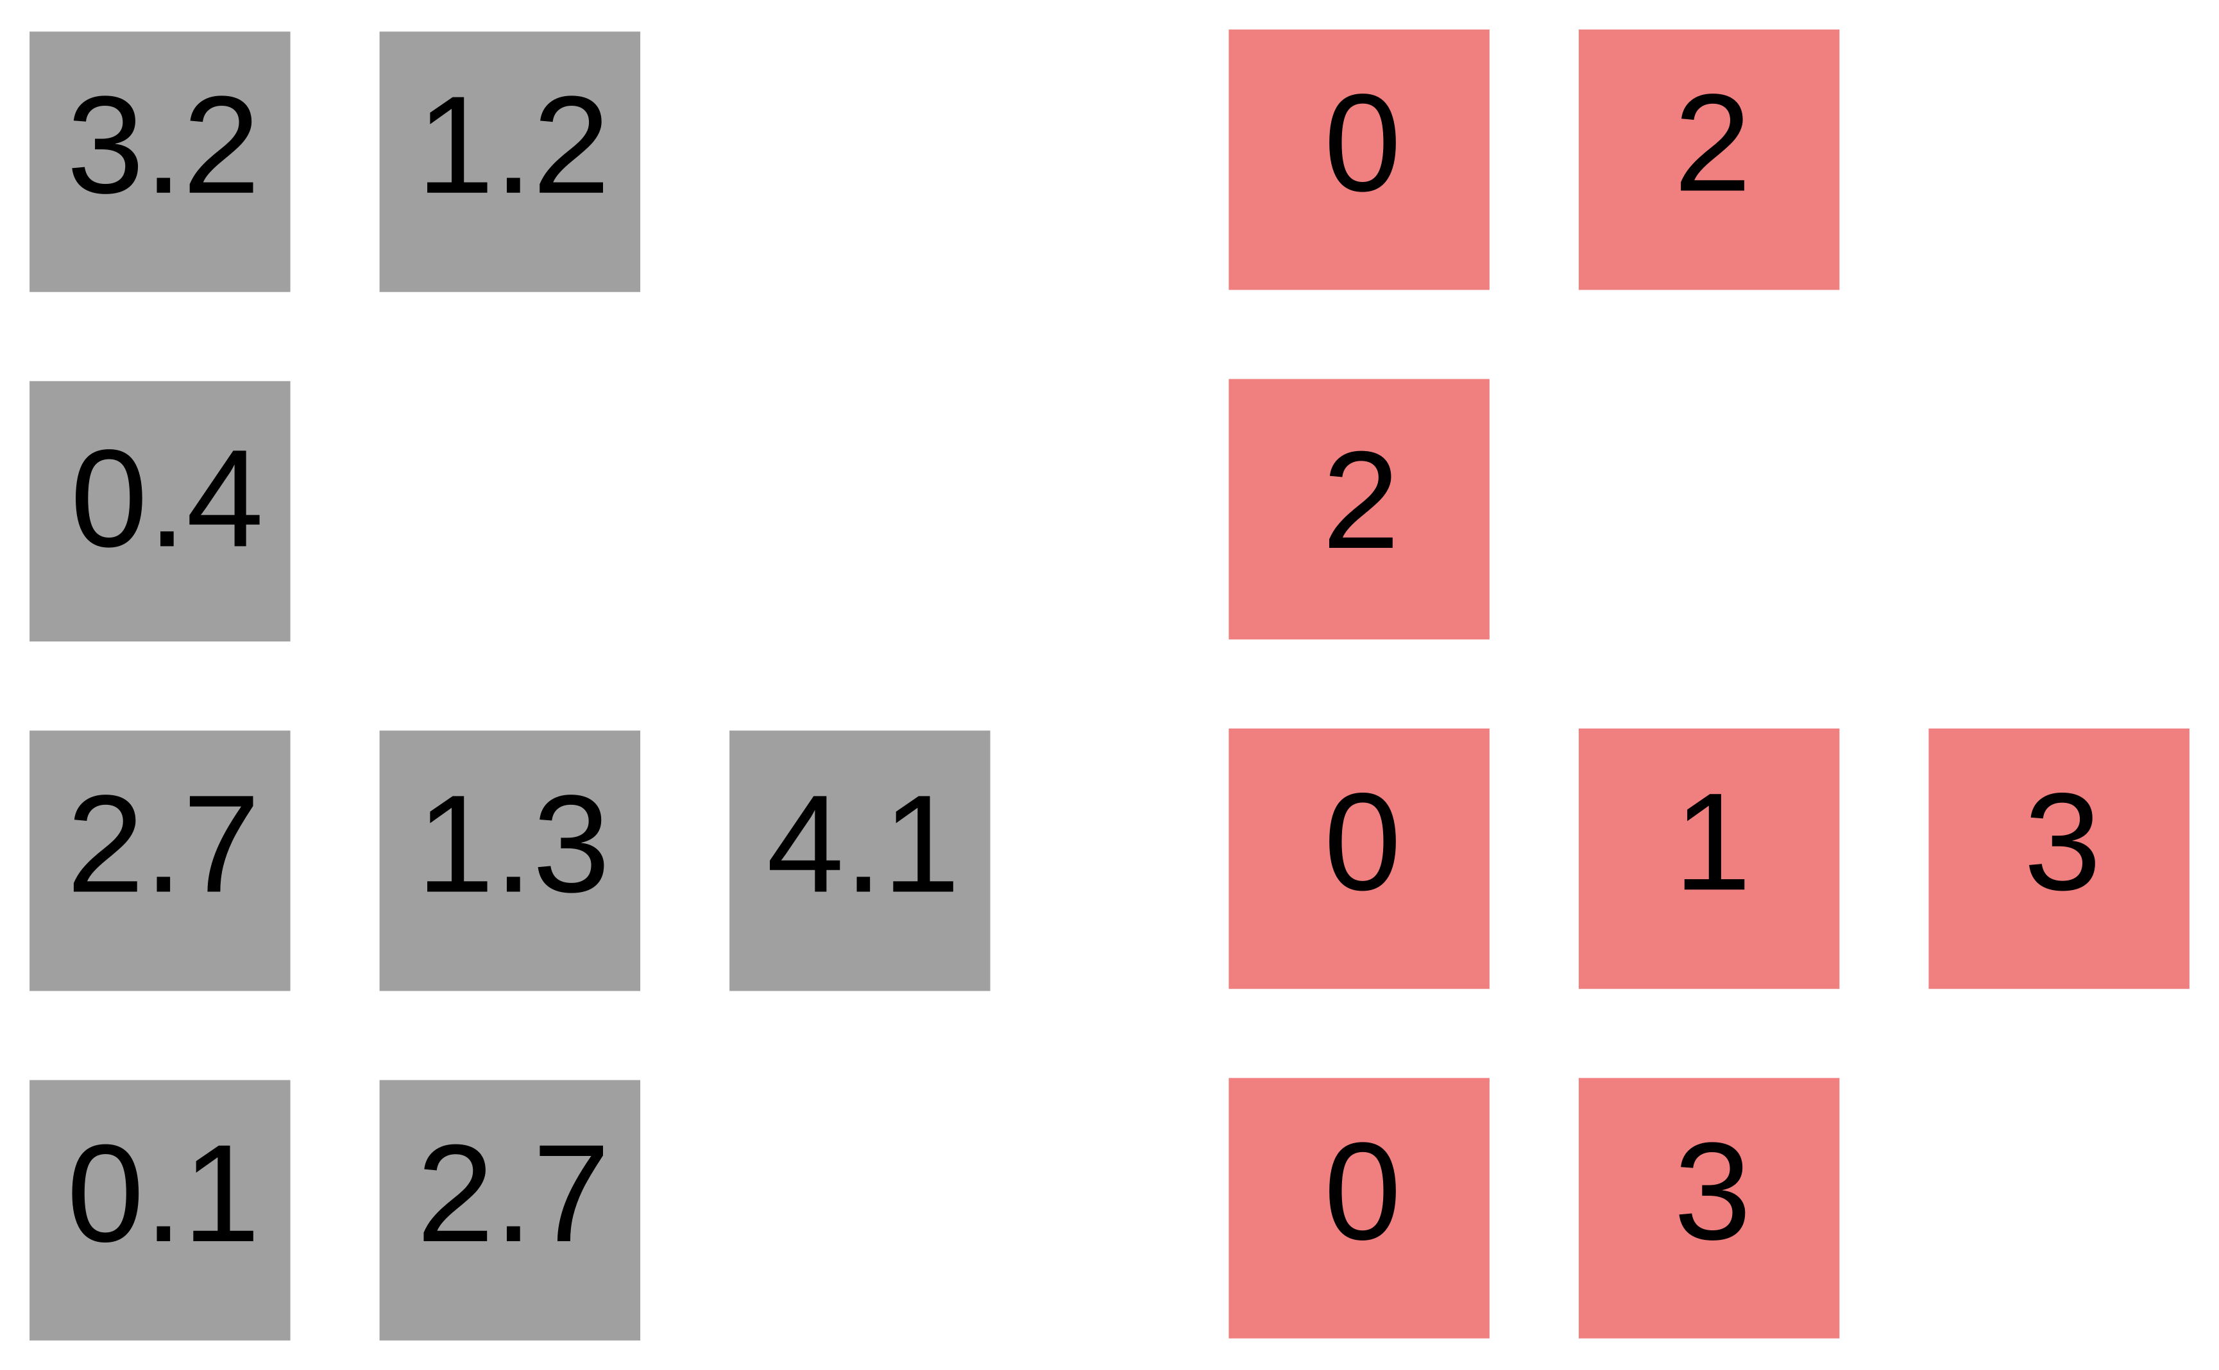
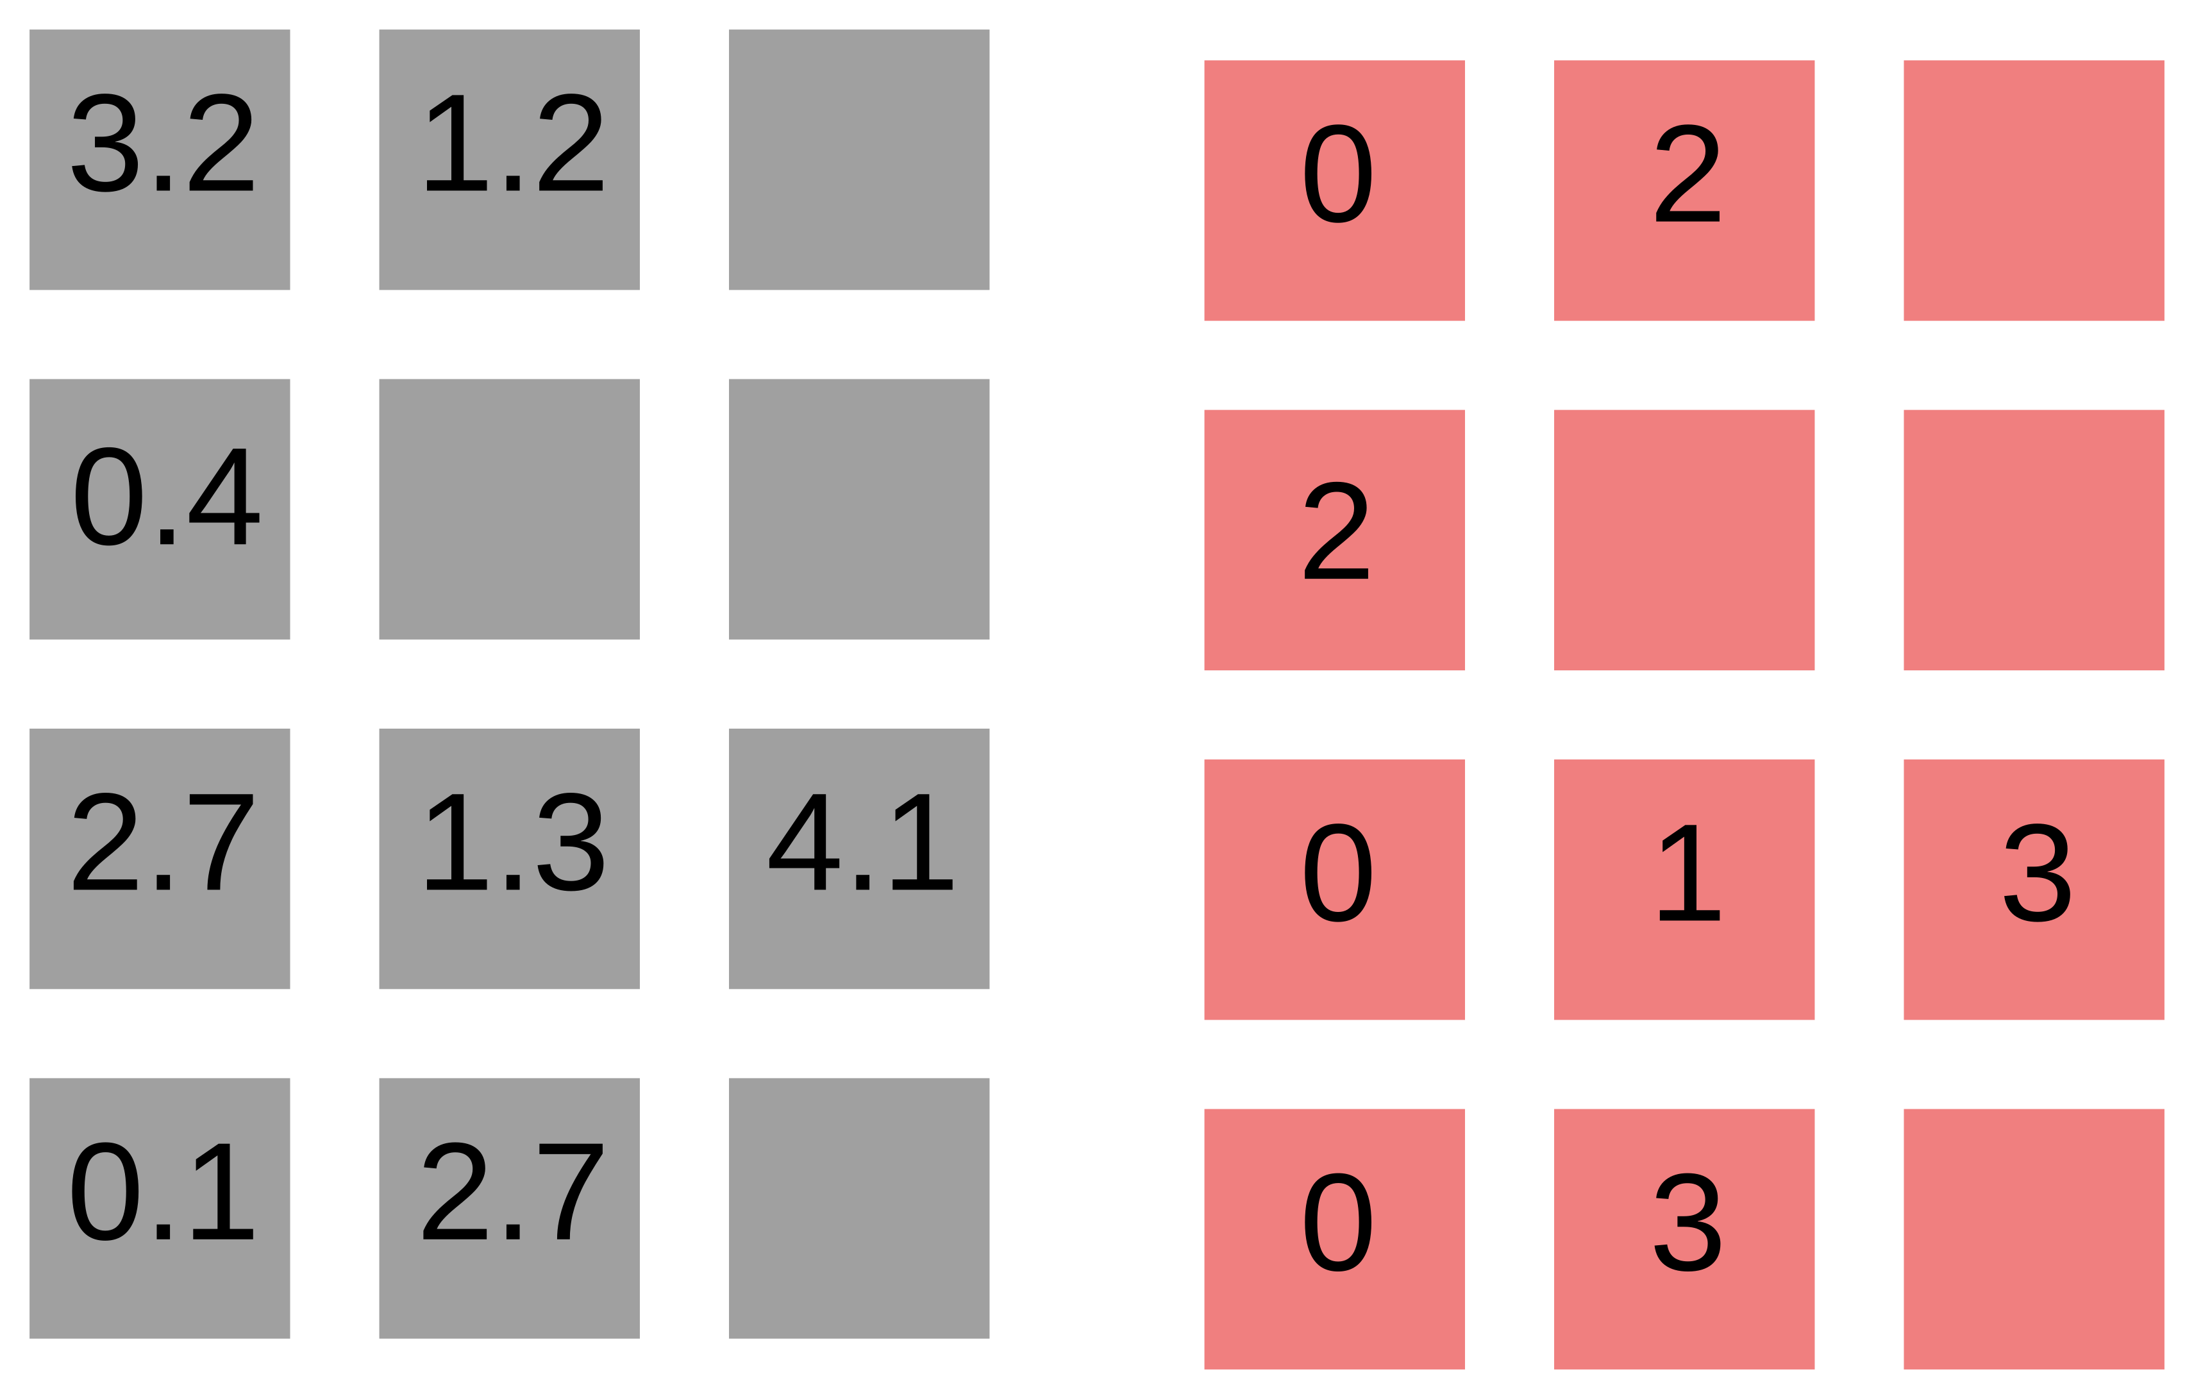
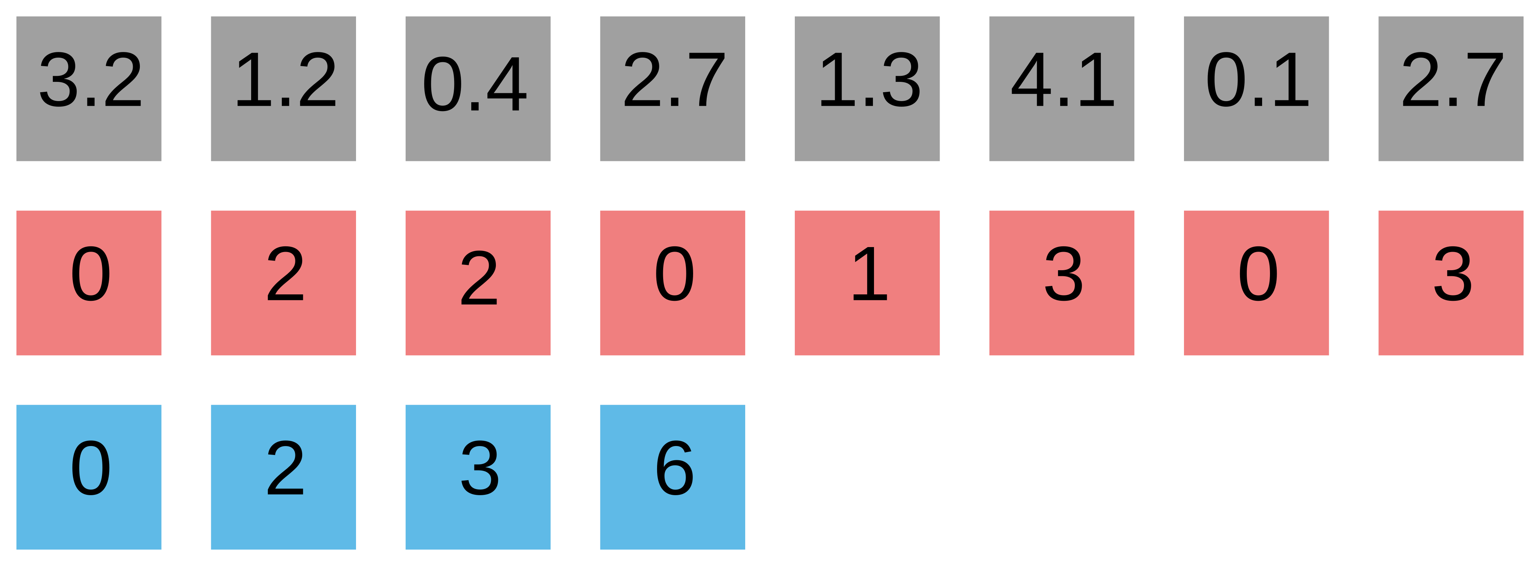
Sparse matrix formats
CSR
ELL

Slide 9
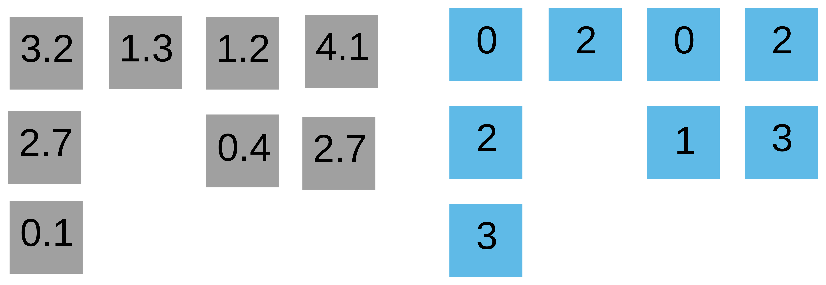
Sparse matrix formats
… leads to CSC
“Standard” approach
CSR

Slide 10

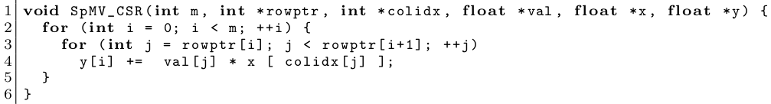
CSR SpMV
Values (val)
Column indexes (colidx)
Row pointers (rowptr)
Bell & Garland ‘08
  parallelize outer loop
~ cuSPARSE SpMV
Load imbalance!
Non-coalescence!
Specialized formats
  HYB – ELL + COO
  SELL-P – good memory access, parallelizes well
  … a few new ones every year
Library code – SpMV is not the only kernel!

Slide 11
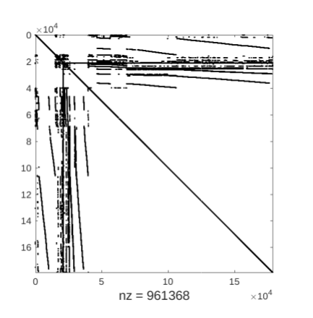
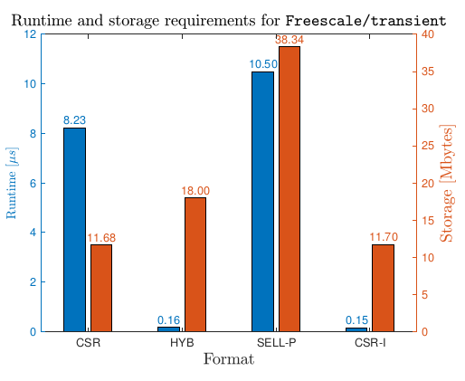
Motivating example
Freescale/transient
Can we do better than HYB using CSR?
55x speedup
YES!
New CSR-I algorithm and format.
No worries – only need to “enrich” vanilla CSR with a constant amount of data for performance.

Slide 12
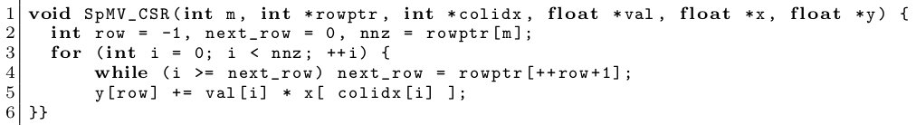
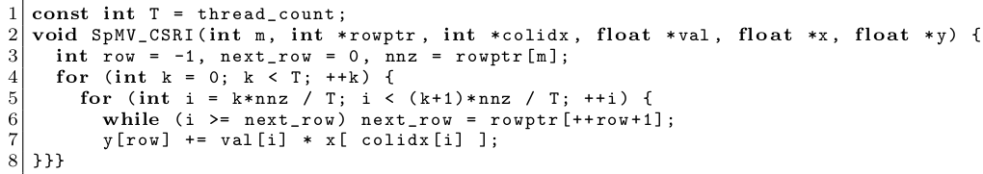
How to do it? By force!
Parallelize this!
State between outer loop iterations!
Use atomics
Accumulate multiple values in registers
Precompute starting value of “row” for each thread.
Race conditions!

Slide 13
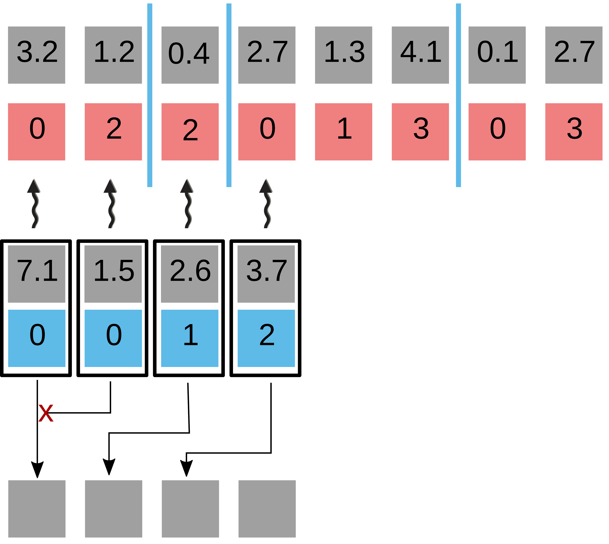
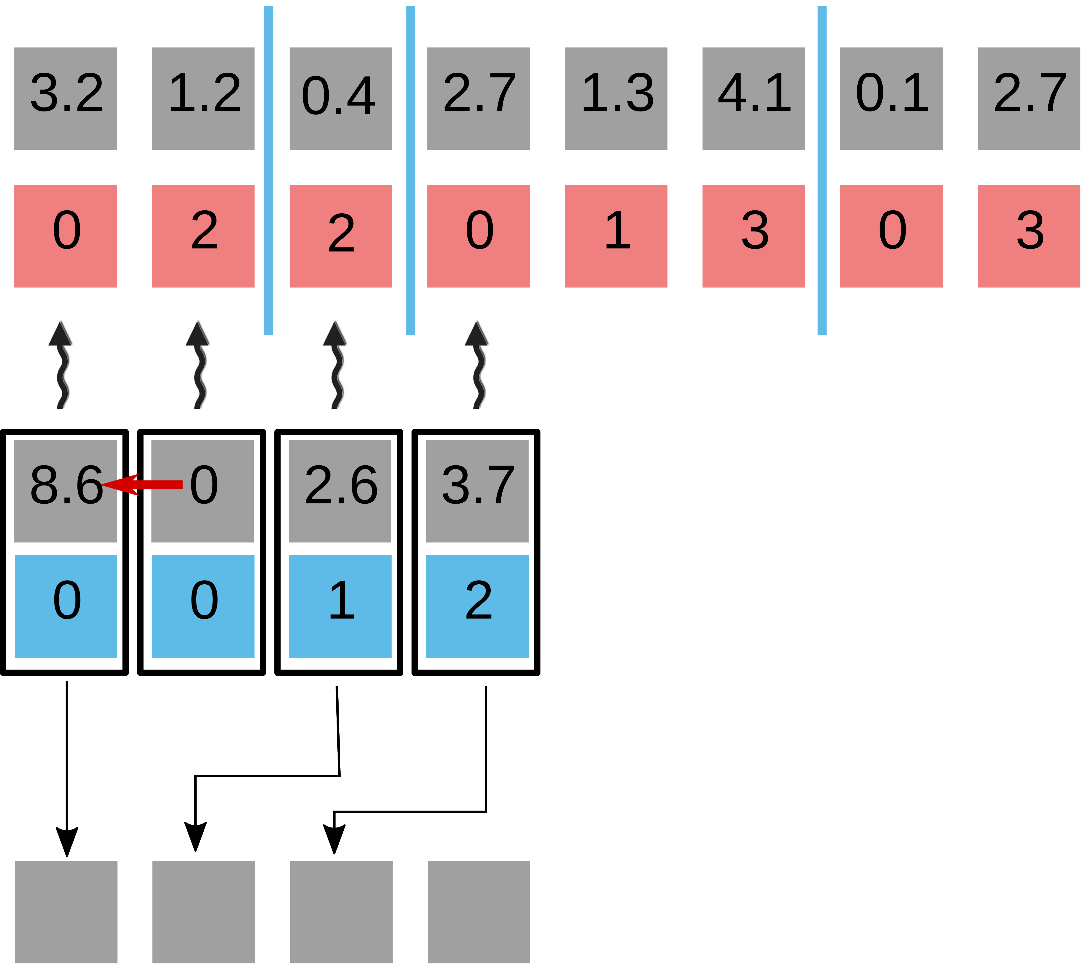
Getting good performance on GPUs
Not trivial!
CUDA Warp = 32-wide SIMD unit
1 lane = CUDA thread
Spreading out threads causes strided memory access.
Assign one warp per chunk.
Warp-level segmented reduction (scan) using shuffles
Atomic collision!

Slide 14
CSR-I
Show standard code
  “Merge” into 1 loop
  Artificialy split into “chunks”: 2 loops
  Assign one “chunk” to each thread
Multiple threads may need to update the same lhs location
  Race conditions
    Atomic operations
  Accumulate intermediate results in registers
  Ony write to global memory when moving to a new row
How to get the starting row for each thread?
  Precompute it and store it in additional data structure – linear in the amount of threads
    Can be parallelized: histogram + scan
    More about that in the paper

Slide 15
CSR-I on NVIDIA GPUs
Distributing one thread per “chunk” causes noncoalesced memory access
Use entire warp for each chunk
  Multiple threads within a warp update the same result
    Atomic collisions
    Instead do a warp-level segmented scan

Slide 16
Performance
100 matrices from SuitSparse with 100 000 <= nnz <= 10 000 000
NVIDIA GTX 1080
Show memory
Show boxplots here
CSR-I has a lower median then CSR, no pathological cases
Show CSR vs CSR-I comparison
CSR-I performance ranges from 3x slower to 100x faster
In an iterative solver environemnt: try both and choose the faster one
Problem: one of the algorithm can be a lot slower than the other
  Can we determine which one is better a priori?
    In a lot of cases – we can!

Slide 17
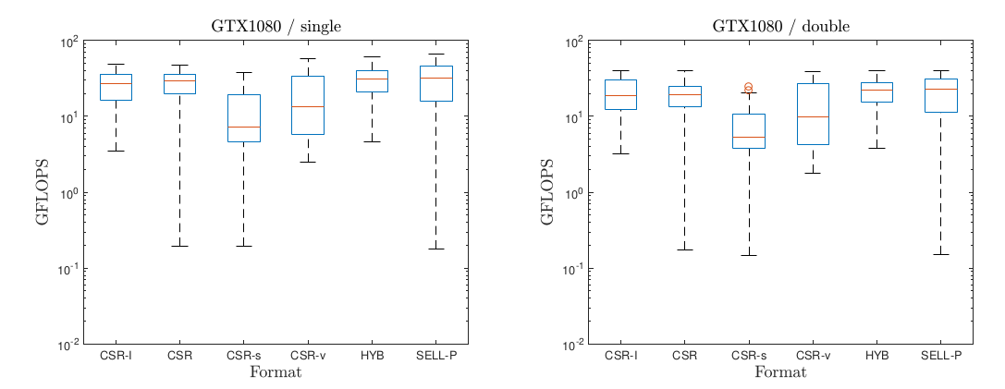
Performance of CSR-I
100 matrices from SuiteSparse

Slide 18
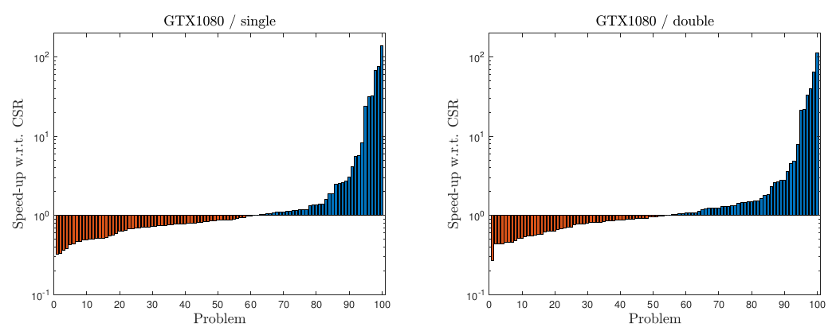
Speedup / slowdown over cuSPARSE CSR
No format conversion!
  try both, and use the fastest later on!
  sometimes 1 cuSPARSE SpMV = 100 CSR-I SpMVs

Slide 19
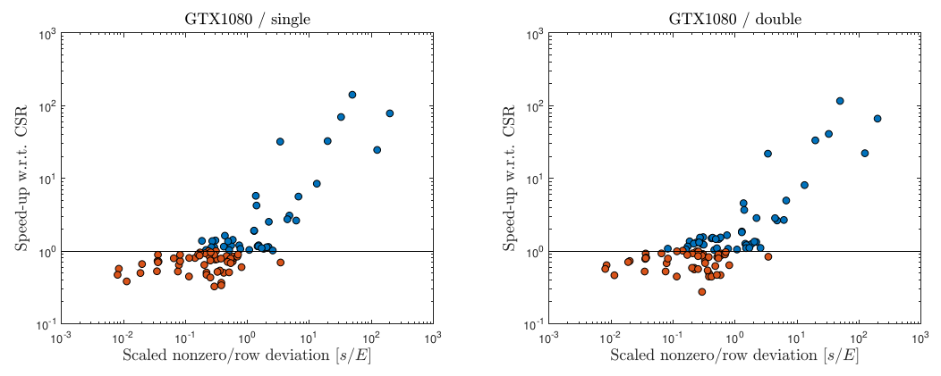
Choosing the winner a priori
CSR-I designed for irregular patterns
How to measure irregularity?
Deviation of row lengths from the mean.
Is “5” regular or irregular?
Depends on the density of the matrix (mean #rows)
Scatter plot of speedup and normalized std. dev.
>1 use CSR-I
<0.1 use CSR
>1 use CSR-I
<0.1 use CSR
>1 use CSR-I
Benchmark both
Benchmark both

Slide 20
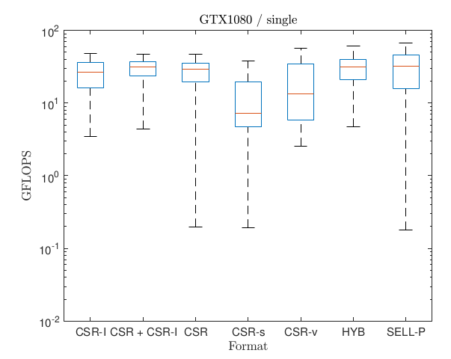
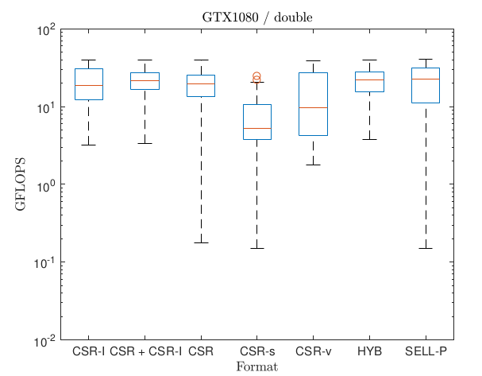
Combining both approaches

Slide 21
Detecting the best format
CSR-I is designed to work well for irregular patterns, and it does that
  It cannot beat cuSPARSE CSR on regular ones
  Measure irregularity of the pattern
    Deviation of nonzeros per row
      e.g. if sigma = 10, is that a regular or irregular pattern?
      Depends on the density of the matrix
  Show scatter plot of sigma / m and performance of CSR-I vs CSR
  For sigma / m >= 1 CSR-I is the better choice
  For sigma / m <= 0.1 CSR wins
  In between chose either (or test both, since the performance difference is not drastic)

Slide 22
Conclusion
Use atomic operations & warp shuffles to tackle irregular patterns
Can determine a priori when these approach will be faster
  Keep performance of cuSPARSE SpMV for regular patterns, while improving it for irregular ones

Slide 23

Preconditioning

Slide 24

Preconditioning
Replace the original system with an equivalent preconditioned system

Slide 25


Preconditioning
Replace the original system with an equivalent preconditioned system

Slide 26

Preconditioning
Replace the original system with an equivalent preconditioned system
Do not compute the preconditioned system matrix explicitly!

Slide 27

Preconditioning
Replace the original system with an equivalent preconditioned system
Do not compute the preconditioned system matrix explicitly!

Slide 28


Preconditioning
Replace the original system with an equivalent preconditioned system
Do not compute the preconditioned system matrix explicitly!
Preconditioner application

Slide 29

Preconditioning
Replace the original system with an equivalent preconditioned system
Do not compute the preconditioned system matrix explicitly!
Generate the preconditioner matrix, and store it in a form suitable for application
Preconditioner setup
Preconditioner application

Slide 30
Preconditioning
Replace the original system with an equivalent preconditioned system
Do not compute the preconditioned system matrix explicitly!
Generate the preconditioner matrix, and store it in a form suitable for application
Preconditioner setup
Preconditioner application
Trade-off:
faster convergence,
but more work per iteration

Slide 31
Block-Jacobi Preconditioning
Current focus: improve performance for problems with inherent block structure
  Usually blocks are smaller than 30x30 (blocks can be of different sizes!)

Slide 32



Block-Jacobi Preconditioning
Current focus: improve performance for problems with inherent block structure
  Usually blocks are smaller than 30x30 (blocks can be of different sizes!)
Block-Jacobi preconditioning
  Use only diagonal blocks for approximation

Slide 33

Block-Jacobi Preconditioning
Current focus: improve performance for problems with inherent block structure
  Usually blocks are smaller than 30x30 (blocks can be of different sizes!)
Block-Jacobi preconditioning
  Use only diagonal blocks for approximation

Slide 34

Block-Jacobi Preconditioning
Current focus: improve performance for problems with inherent block structure
  Usually blocks are smaller than 30x30 (blocks can be of different sizes!)
Block-Jacobi preconditioning
  Use only diagonal blocks for approximation

Slide 35



Block-Jacobi Preconditioning
Current focus: improve performance for problems with inherent block structure
  Usually blocks are smaller than 30x30 (blocks can be of different sizes!)
Block-Jacobi preconditioning
  Use only diagonal blocks for approximation

Slide 36
Block-Jacobi Preconditioning
Current focus: improve performance for problems with inherent block structure
  Usually blocks are smaller than 30x30 (blocks can be of different sizes!)
Block-Jacobi preconditioning
  Use only diagonal blocks for approximation
Setup
Application

Slide 37
Block-Jacobi Preconditioning
Solving 30-by-30 systems in sequence on a GPU with several thousand cores wastes computational resources!

Slide 38

Batched routines
  Launch a single kernel which applies an operation to multiple independent data entities in parallel.
Batched kernel
* Measured on NVIDIA P100

Slide 39
Batched routines
  Launch a single kernel which applies an operation to multiple independent data entities in parallel.
Batched kernel
There is no standard BLAS & LAPACK interface
Most implementations only support problems of equal sizes
High performance libraries are not optimized for small blocks
  cuBLAS batched trsv: ~25 Gflop/s *
  MAGMA-sparse SpMV: 60 – 90 Gflop/s *
* Measured on NVIDIA P100

Slide 40
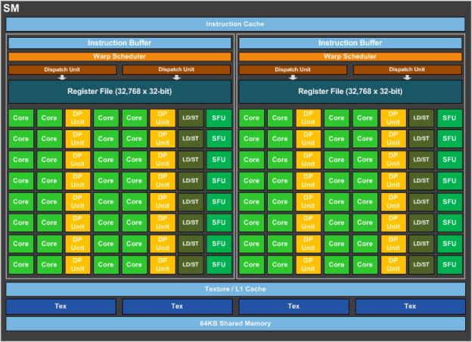
MAGMA-sparse LU & trsv outline
Assign one warp to each problem
  hardware SIMD unit, represented as a group of 32 threads in CUDA

Slide 41
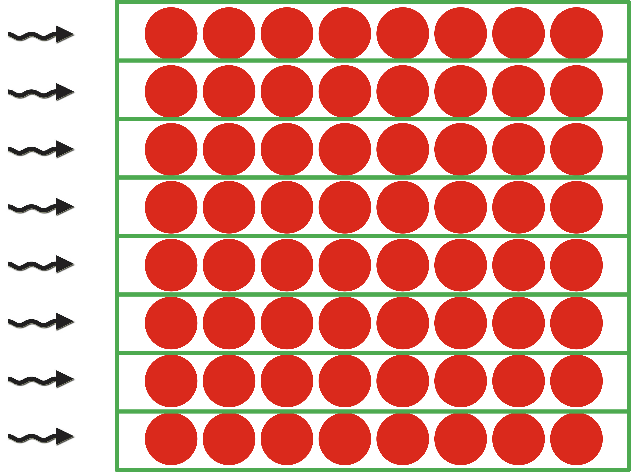
MAGMA-sparse LU & trsv outline
Assign one warp to each problem
  hardware SIMD unit, represented as a group of 32 threads in CUDA
Process each row by a single thread
  Able to support problems of size up to 32-by-32
  keep the entire row in thread’s registers
  Communicate data between rows via warp-shuffles
  Current implementation: use padding for problems of smaller sizes
  Future work: multiple smaller problems per warp

Slide 42
MAGMA-sparse LU & trsv outline
Assign one warp to each problem
  hardware SIMD unit, represented as a group of 32 threads in CUDA
Process each row by a single thread
  Able to support problems of size up to 32-by-32
  keep the entire row in thread’s registers
  Communicate data between rows via warp-shuffles
  Current implementation: use padding for problems of smaller sizes
  Future work: multiple smaller problems per warp
Use implicit pivoting
  Do not explicitly swap rows, “re-assign” the threads instead

Slide 43
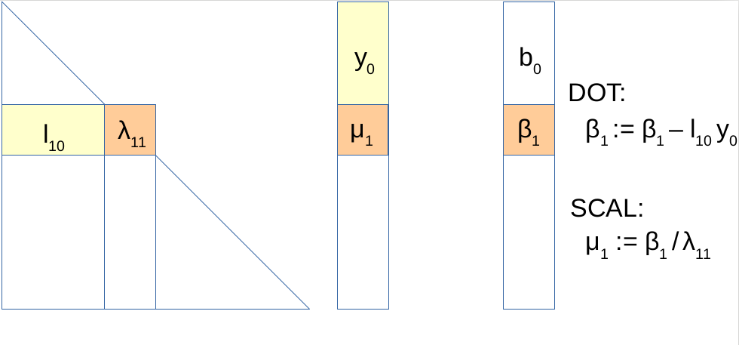
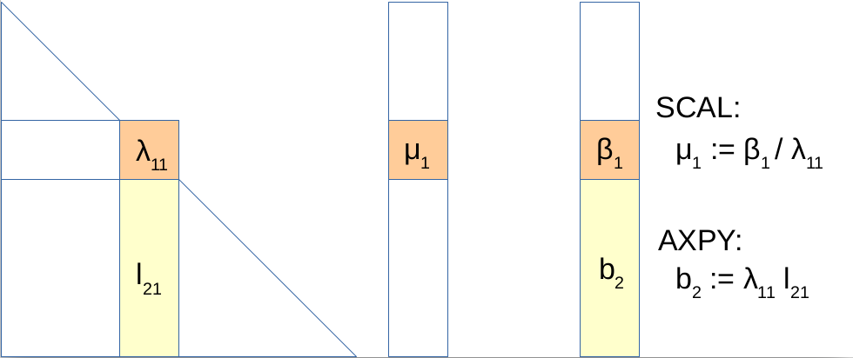
MAGMA-sparse LU & trsv outline
Use “eager” triangular solves
  Cast solution vector updates in terms of axpy, not in terms of dot product!
“Lazy” triangular solve
“Eager” triangular solve

Slide 44
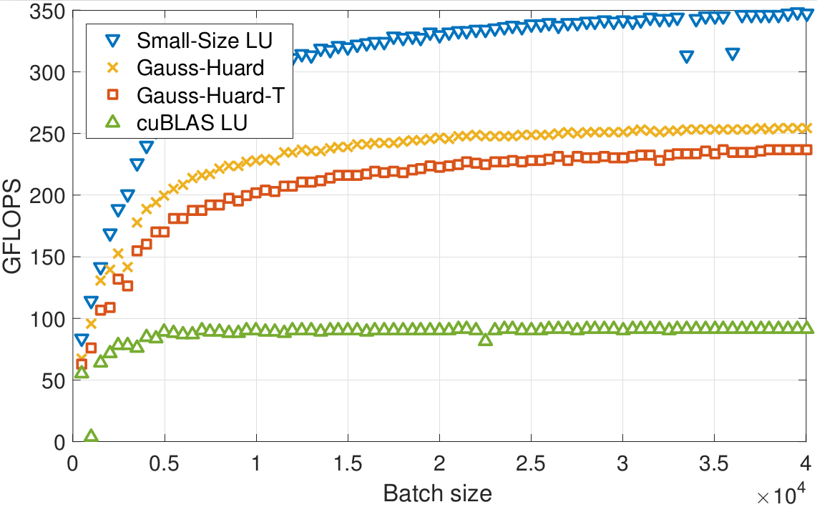
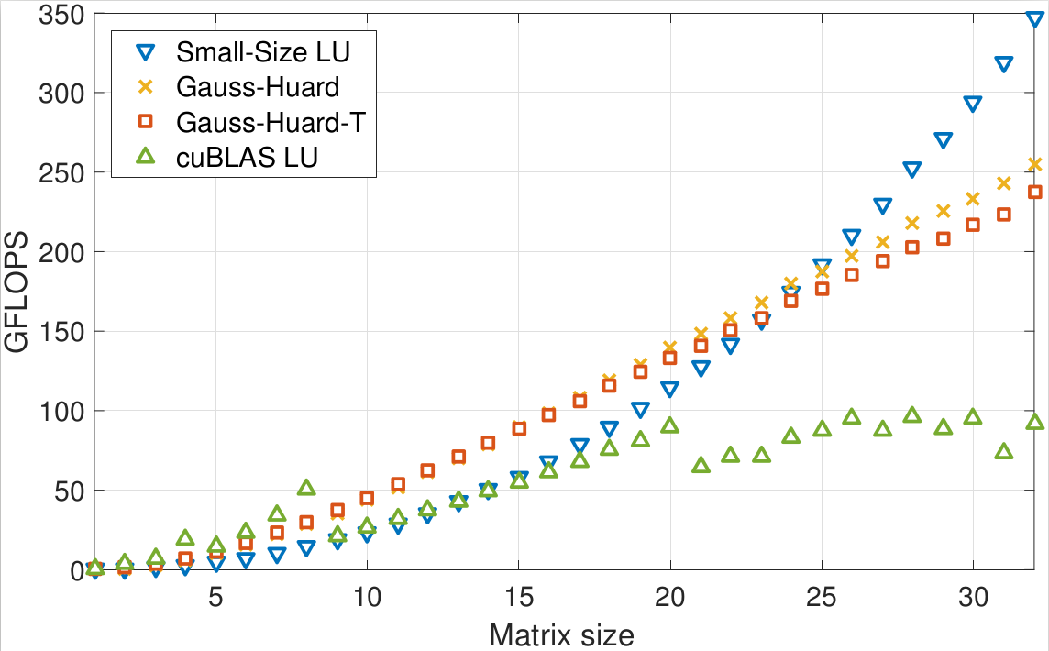
LU decomposition performance
Comparisson of MAGMA-sparse vs cuBLAS batched LU decomposition
Gauss-Huard(-T) is a similar approach, using a different algorithm for decomposition/solves *
Fixed problem size (32)
Fixed batch size (40,000)
* Anzt et al., Variable-Size Batched Gauss-Huard for Block-Jacobi Preconditioning, ICCS’17

Slide 45
LU decomposition performance
Comparisson of MAGMA-sparse vs cuBLAS batched LU decomposition
Gauss-Huard(-T) is a similar approach, using a different algorithm for decomposition/solves*
Fixed problem size (32)
Fixed batch size (40,000)
MAGMA-sparse LU can also:
  Handle problems of different sizes
  Integrate diagonal block extraction and diagonal block decomposition into a single kernel
* Anzt et al., Variable-Size Batched Gauss-Huard for Block-Jacobi Preconditioning, ICCS’17

Slide 46
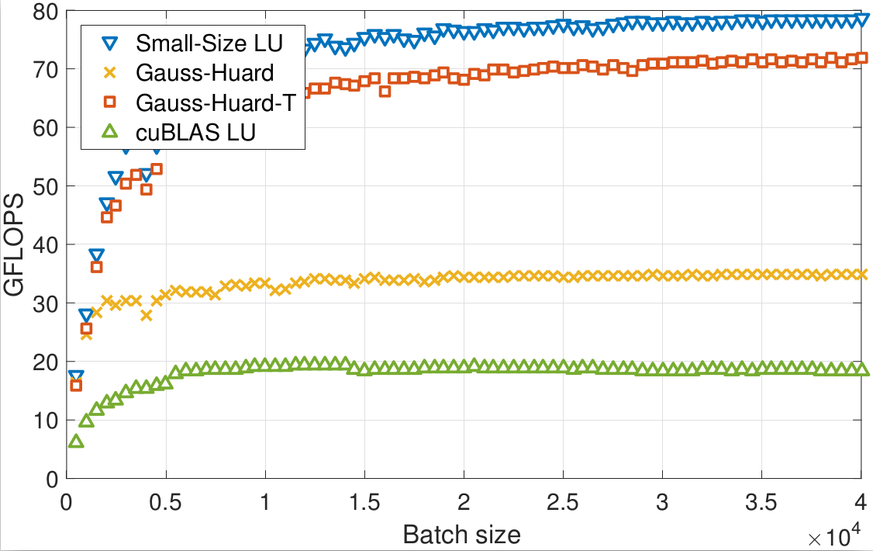
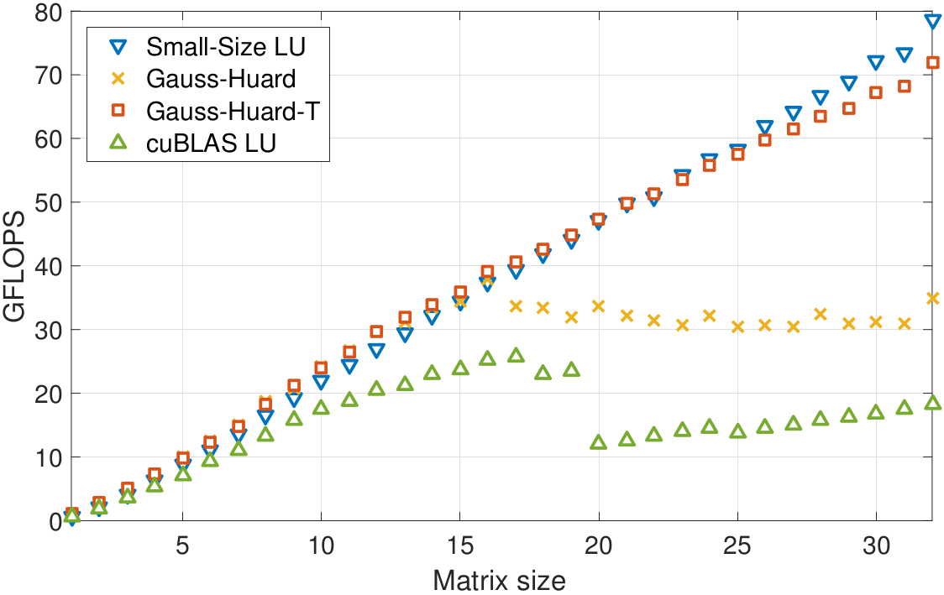
Triangular solve performance
Comparisson of MAGMA-sparse vs cuBLAS batched triangular solves
Gauss-Huard(-T) is a similar approach, using a different algorithm for decomposition/solves*
Fixed problem size (32)
Fixed batch size (40,000)

Slide 47
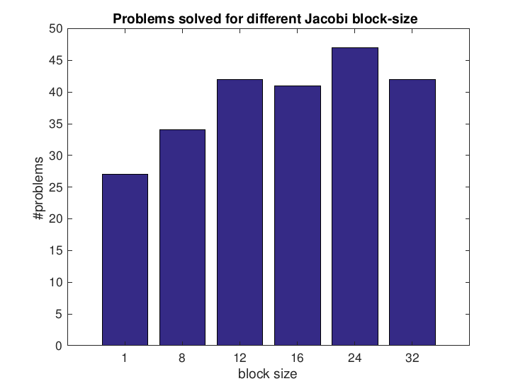
Complete solver runtime
56 problems from SuitSparse

Slide 48
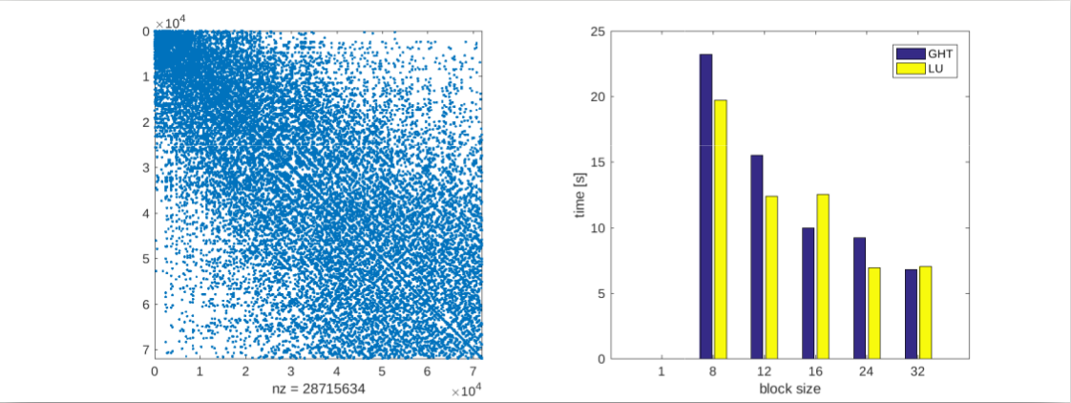
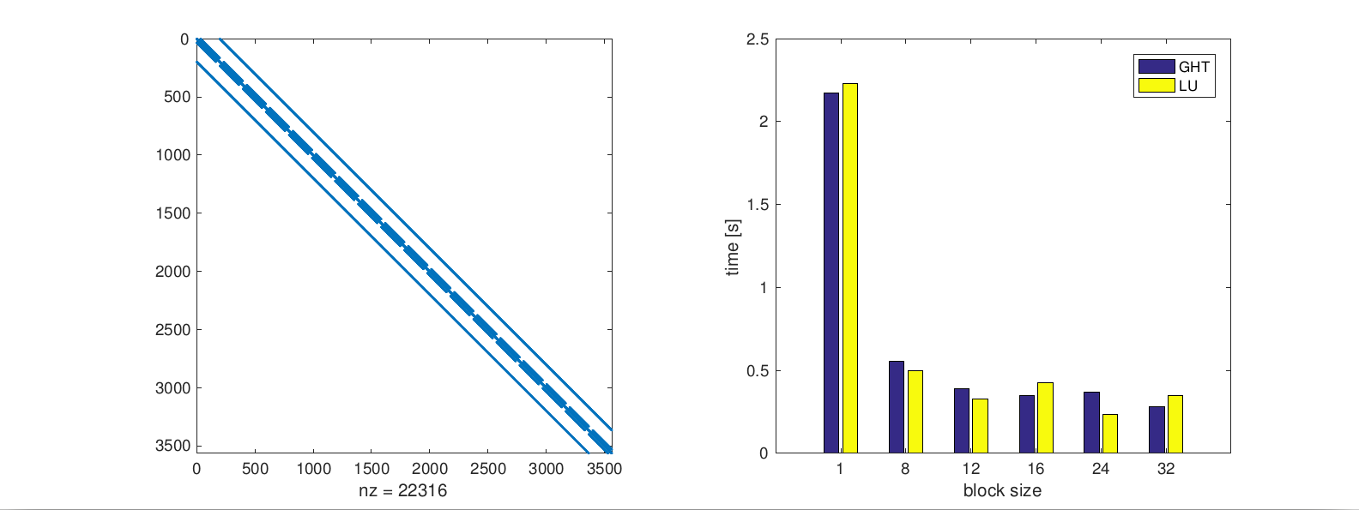
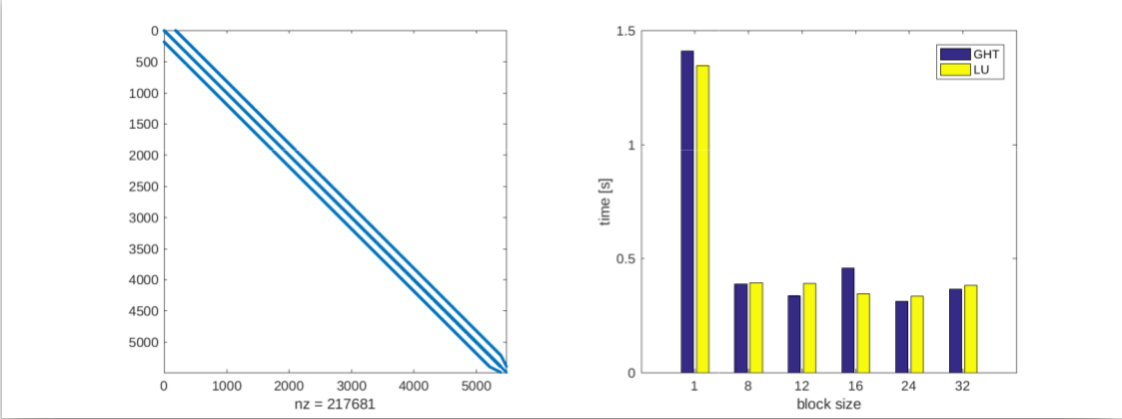
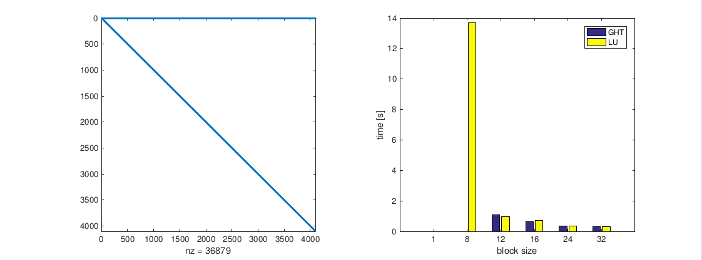
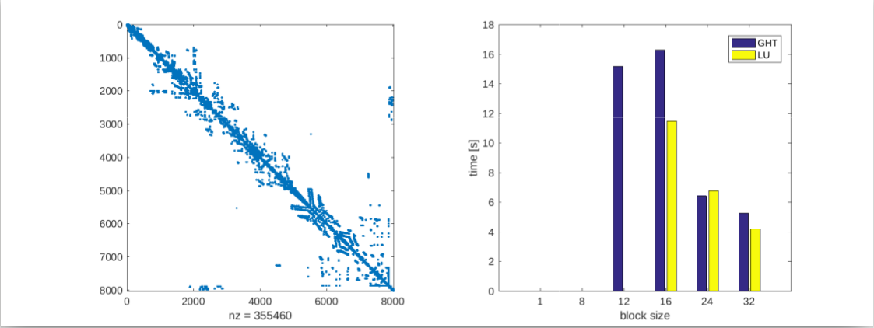
Complete solver runtime
56 problems from SuitSparse
nd24k
saylr4
s2rmt3m1
Chebyshev3
bcsstk38

Slide 49
Conclusion
“Solving many small problems in sequence on manycore hardware wastes computational resources!
We can design batched routines which apply the same operation on a set of independent data entities.”
Workshop on batched BLAS*
  Effort to standardize the batched BLAS interface
* http://bit.ly/Batch-BLAS-2017

Slide 50
Conclusion
“Solving many small problems in sequence on manycore hardware wastes computational resources!
We can design batched routines which apply the same operation on a set of independent data entities.”
Workshop on batched BLAS*
  Effort to standardize the batched BLAS interface
What is small?
  Can we design a single routine that can handle both 8-by-8 and 500-by-500 matrices?
  Or should we have more routines?
* http://bit.ly/Batch-BLAS-2017

Slide 51
Conclusion
“Solving many small problems in sequence on manycore hardware wastes computational resources!
We can design batched routines which apply the same operation on a set of independent data entities.”
Workshop on batched BLAS*
  Effort to standardize the batched BLAS interface
What is small?
  Can we design a single routine that can handle both 8-by-8 and 500-by-500 matrices?
  Or should we have more routines?
Does batched BLAS / LAPACK solve the problem?
  Even with efficient implementation, cannot “merge” with diagonal block extraction.
  Batched gemm proposal has 16 input arguments!
  Global synchronization between two batched calls.
* http://bit.ly/Batch-BLAS-2017

Slide 52
Conclusion
“Solving many small problems in sequence on manycore hardware wastes computational resources!
We can design batched routines which apply the same operation on a set of independent data entities.”
Workshop on batched BLAS*
  Effort to standardize the batched BLAS interface
What is small?
  Can we design a single routine that can handle both 8-by-8 and 500-by-500 matrices?
  Or should we have more routines?
Does batched BLAS / LAPACK solve the problem?
  Even with efficient implementation, cannot “merge” with diagonal block extraction.
  Batched gemm proposal has 16 input arguments!
  Global synchronization between two batched calls.
Instead provide BLAS which operates on a part of memory/core hierarchy?
  E.g. block, warp, thread level BLAS for CUDA.
  Let users build their own batched routines from these building blocks.
* http://bit.ly/Batch-BLAS-2017

Slide 53

Thank you! Questions?
All functionalities are part of the MAGMA-sparse project.
Scan me for slides!
github.com/gflegar/talks/europar_2017
http://icl.cs.utk.edu/magma/
This research is based on a cooperation between Hartwig Anzt, Jack Dongarra (University of Tennessee),
Goran Flegar and Enrique S. Quintana-Ortí (Universidad Jaume I).

