Slide 1

How to Solve a Linear System
Goran Flegar
W/: Hartwig Anzt, Yen-Chen Chen, Terry Cojean, Pratik Nayak, Enrique S. Quintana-Ortí, Mike Tsai
Scan me for slides!
github.com/gflegar/talks/tree/master/rwth_aachen_2018_09

Slide 2



Sources of linear systems
Real-world problem transformed into a linear system via:
  PDE discretizations, graph representations
  Large number of unknowns (1M+, full matrix 8TB)
  Most matrix elements are zero

Slide 3


Sources of linear systems
Real-world problem transformed into a linear system via:
  PDE discretizations, graph representations
  Large number of unknowns (1M+, full matrix 8TB)
  Most matrix elements are zero
Possible approach: iterative methods
  Krylov-subspace based linear solvers
    SpMV
    BLAS-1 operations
  Sparse matrix formats & SpMV
    accelerate each iteration of the solver
  Preconditioners
    reduce the number of iterations

Slide 4

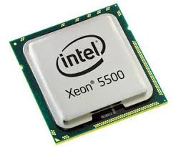
Sources of linear systems
Real-world problem transformed into a linear system via:
  PDE discretizations, graph representations
  Large number of unknowns (1M+, full matrix 8TB)
  Most matrix elements are zero
Possible approach: iterative methods
  Krylov-subspace based linear solvers
    SpMV
    BLAS-1 operations
  Sparse matrix formats & SpMV
    accelerate each iteration of the solver
  Preconditioners
    reduce the number of iterations
  Special hardware (e.g. GPUs)
  Probably not a good idea to implement everything from scratch…

Slide 5

Sources of linear systems
Real-world problem transformed into a linear system via:
  PDE discretizations, graph representations
  Large number of unknowns (1M+, full matrix 8TB)
  Most matrix elements are zero
Possible approach: iterative methods
  Krylov-subspace based linear solvers
    SpMV
    BLAS-1 operations
  Sparse matrix formats & SpMV
    accelerate each iteration of the solver
  Preconditioners
    reduce the number of iterations
  Special hardware (e.g. GPUs)
  Probably not a good idea to implement everything from scratch…
  Use a library instead:

Slide 6
Sources of linear systems
Real-world problem transformed into a linear system via:
  PDE discretizations, graph representations
  Large number of unknowns (1M+, full matrix 8TB)
  Most matrix elements are zero
Possible approach: iterative methods
  Krylov-subspace based linear solvers
    SpMV
    BLAS-1 operations
  Sparse matrix formats & SpMV
    accelerate each iteration of the solver
  Preconditioners
    reduce the number of iterations
  Special hardware (e.g. GPUs)
  Probably not a good idea to implement everything from scratch…
  Use a library instead:

Slide 7



The Ginkgo library
Linear operator algebra library:
  Matrix formats, preconditioners, (Krylov) solvers
Joint effort: Innovative Computing Lab at University of Tennessee, Knoxvile; Karlsruhe Institute of Technology; University Jaume I

Slide 8
The Ginkgo library
Linear operator algebra library:
  Matrix formats, preconditioners, (Krylov) solvers
Goals:
  Backends for various devices (executors)
  Easy composability – even when using building blocks from a different category (e.g. using a matrix or a solver as a preconditioner)
  Easy extensibility
  Support for matrix-free methods
Joint effort: Innovative Computing Lab at University of Tennessee, Knoxvile; Karlsruhe Institute of Technology; University Jaume I

Slide 9

Core idea
Matrix-vector product

Slide 10


Core idea
Matrix-vector product
Preconditioner

Slide 11

Core idea
Matrix-vector product
Preconditioner

Slide 12

Core idea
Matrix-vector product
Preconditioner
Solver

Slide 13


Core idea
Matrix-vector product
Preconditioner
Solver

Slide 14

Core idea
Matrix-vector product
Preconditioner
Solver

Slide 15

Core idea
Matrix-vector product
Preconditioner
Solver
All of them can be expressed as:
  applications of linear operators* (LinOp)
* can be realized as a (non-linear) approximation

Slide 16

Core idea
Matrix-vector product
Preconditioner
Solver
All of them can be expressed as:
  applications of linear operators* (LinOp)
  (non-linear) transformations applied to linear operators (Factory)
* can be realized as a (non-linear) approximation

Slide 17
Example
Solving a symmetric positive definite linear system using the conjugate gradient (CG) solver, preconditioned with a block-Jacobi (BJ) preconditioner, with a system matrix stored in CSR format

Slide 18



Example
Solving a symmetric positive definite linear system using the conjugate gradient (CG) solver, preconditioned with a block-Jacobi (BJ) preconditioner, with a system matrix stored in CSR format
Read the system matrix operator, right hand side and initial guess from file, standard input, or use existing data from the application

Slide 19

Example
Solving a symmetric positive definite linear system using the conjugate gradient (CG) solver, preconditioned with a block-Jacobi (BJ) preconditioner, with a system matrix stored in CSR format
Read the system matrix operator, right hand side and initial guess from file, standard input, or use existing data from the application
Build the block-Jacobi preconditioner factory (no computation, binding parameters)

Slide 20

Example
Solving a symmetric positive definite linear system using the conjugate gradient (CG) solver, preconditioned with a block-Jacobi (BJ) preconditioner, with a system matrix stored in CSR format
Read the system matrix operator, right hand side and initial guess from file, standard input, or use existing data from the application
Build the block-Jacobi preconditioner factory (no computation, binding parameters)
Use the preconditioner factory to build the preconditioned conjugate gradient factory (no computation, binding parameters)

Slide 21

Example
Solving a symmetric positive definite linear system using the conjugate gradient (CG) solver, preconditioned with a block-Jacobi (BJ) preconditioner, with a system matrix stored in CSR format
Read the system matrix operator, right hand side and initial guess from file, standard input, or use existing data from the application
Build the block-Jacobi preconditioner factory (no computation, binding parameters)
Use the preconditioner factory to build the preconditioned conjugate gradient factory (no computation, binding parameters)
Generate the solver operator from the system matrix using the solver factory (preprocessing needed for the solver and preconditioner)

Slide 22

Example
Solving a symmetric positive definite linear system using the conjugate gradient (CG) solver, preconditioned with a block-Jacobi (BJ) preconditioner, with a system matrix stored in CSR format
Read the system matrix operator, right hand side and initial guess from file, standard input, or use existing data from the application
Build the block-Jacobi preconditioner factory (no computation, binding parameters)
Use the preconditioner factory to build the preconditioned conjugate gradient factory (no computation, binding parameters)
Generate the solver operator from the system matrix using the solver factory (preprocessing needed for the solver and preconditioner)
Solve the system (actual computation)

Slide 23
Example source code
int main() {
// Instantiate a CUDA executor
auto gpu = gko::CudaExecutor::create(0, gko::OmpExecutor::create());
// Read data
auto A = gko::read<gko::matrix::Csr<>>(std::cin, gpu);
auto b = gko::read<gko::matrix::Dense<>>(std::cin, gpu);
auto x = gko::read<gko::matrix::Dense<>>(std::cin, gpu);
// Create the solver
auto solver = gko::solver::Cg<>::build()
.with_preconditioner(
gko::preconditioner::Jacobi<>::build().with_max_block_size(32).on(gpu))
.with_criteria(
gko::stop::Iteration::build().with_max_iters(20u).on(gpu),
gko::stop::ResidualNormReduction<>::build()
.with_reduction_factor(1e-15).on(gpu))
.on(gpu);
// Solve system
solver->generate(give(A))->apply(lend(b), lend(x));
// Write result
write(std::cout, lend(x));
}

Slide 24
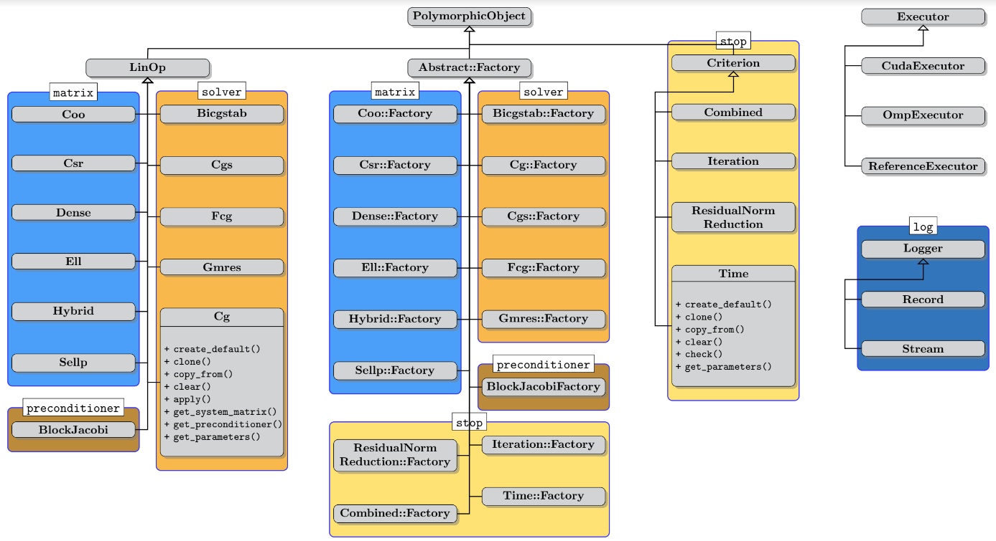
Library features

Slide 25
Library features: extensibility
users can provide new matrices, solvers, preconditioners, stopping criteria, loggers
Without recompiling the library!

Slide 26
Sources of linear systems
Real-world problem transformed into a linear system via:
  PDE discretizations, graph representations
  Large number of unknowns (1M+, full matrix 8TB)
  Most matrix elements are zero
Possible approach: iterative methods
  Krylov-subspace based linear solvers
    SpMV
    BLAS-1 operations
  Sparse matrix formats & SpMV
    accelerate each iteration of the solver
  Preconditioners
    reduce the number of iterations
  Special hardware (e.g. GPUs)
  Probably not a good idea to implement everything from scratch…
  Use a library instead:

Slide 27

Preconditioning

Slide 28

Preconditioning
Replace the original system with an equivalent preconditioned system

Slide 29


Preconditioning
Replace the original system with an equivalent preconditioned system

Slide 30

Preconditioning
Replace the original system with an equivalent preconditioned system
Do not compute the preconditioned system matrix explicitly!

Slide 31

Preconditioning
Replace the original system with an equivalent preconditioned system
Do not compute the preconditioned system matrix explicitly!

Slide 32


Preconditioning
Replace the original system with an equivalent preconditioned system
Do not compute the preconditioned system matrix explicitly!
Preconditioner application

Slide 33

Preconditioning
Replace the original system with an equivalent preconditioned system
Do not compute the preconditioned system matrix explicitly!
Generate the preconditioner matrix, and store it in a form suitable for application
Preconditioner setup
Preconditioner application

Slide 34
Preconditioning
Replace the original system with an equivalent preconditioned system
Do not compute the preconditioned system matrix explicitly!
Generate the preconditioner matrix, and store it in a form suitable for application
Generation via factory
Linear operator application
linear operator abstraction

Slide 35



Example: Block-Jacobi preconditioning
Block-Jacobi preconditioning
  Use only diagonal blocks for approximation
Anzt, Dongarra, Flegar, Quintana-Ortí, Variable-size batched Gauss–Jordan elimination for block-Jacobi preconditioning on graphics processors, ParCo

Slide 36

Benefits of block-Jacobi
56 matrices from SuiteSparse with inherent block structure
MAGMA-sparse open source library
  IDR solver
  Supervariable agglomeration
    Detects block structure of the matrix
Improves the robustness of the solver

Slide 37
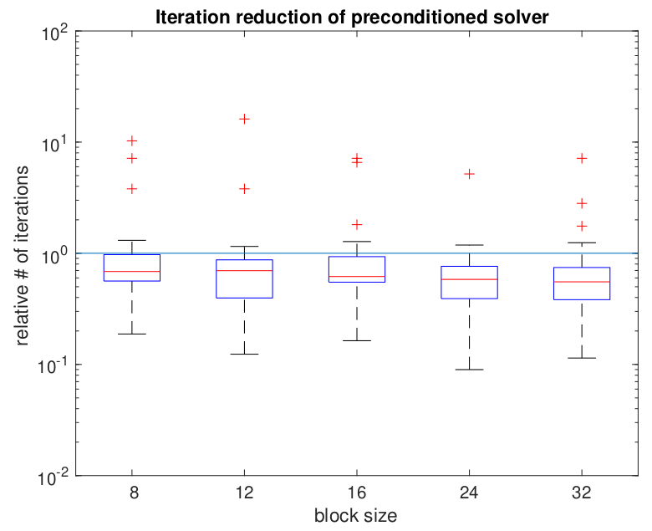
Benefits of block-Jacobi
56 matrices from SuiteSparse with inherent block structure
MAGMA-sparse open source library
  IDR solver
  Supervariable agglomeration
    Detects block structure of the matrix
Improves the robustness of the solver
Improves convergence of the solver

Slide 38






Complete solver runtime
s2rmt3m1
Chebyshev3
nd24k
G3_circuit
bcsstk38
ship_003

Slide 39

Current Research: Adaptive precision block-Jacobi
Preconditioner is an approximation of the system matrix
  Applying a preconditioner inherently carries an error
  For block-Jacobi the relative error of z is usually around 0.01 – 0.1

Slide 40
Current Research: Adaptive precision block-Jacobi
Preconditioner is an approximation of the system matrix
  Applying a preconditioner inherently carries an error
  For block-Jacobi the relative error of z is usually around 0.01 – 0.1
Preconditioner application is memory bounded
  Most of the cost comes from reading the matrix from memory
  Idea: use lower precision to store the matrix

Slide 41
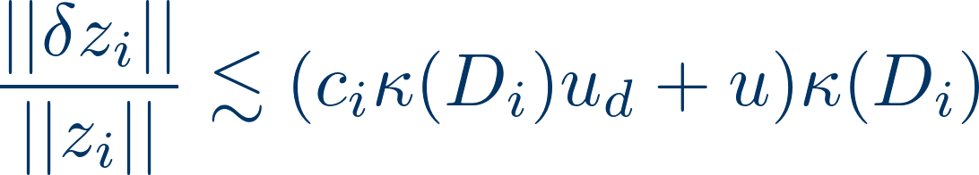
Current Research: Adaptive precision block-Jacobi
Preconditioner is an approximation of the system matrix
  Applying a preconditioner inherently carries an error
  For block-Jacobi the relative error of z is usually around 0.01 – 0.1
Preconditioner application is memory bounded
  Most of the cost comes from reading the matrix from memory
  Idea: use lower precision to store the matrix
Adaptive precision in inversion-based block-Jacobi:
  All computation is done in double precision
  Preconditioner matrix is stored in lower precision, with roundoff error “u”
  Error bound:

Slide 42
Current Research: Adaptive precision block-Jacobi
Preconditioner is an approximation of the system matrix
  Applying a preconditioner inherently carries an error
  For block-Jacobi the relative error of z is usually around 0.01 – 0.1
Preconditioner application is memory bounded
  Most of the cost comes from reading the matrix from memory
  Idea: use lower precision to store the matrix
Adaptive precision in inversion-based block-Jacobi:
  All computation is done in double precision
  Preconditioner matrix is stored in lower precision, with roundoff error “u”
  Error bound:
Assuming the preconditioner block is relatively well conditioned
  The error is determined by the product of u, and the condition number
  Choose the precision for each block independently, such that at least 1 digit of the result is correct

Slide 43
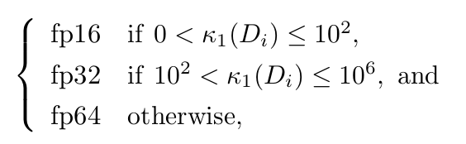
Experimental results
Determining the precision:

Slide 44
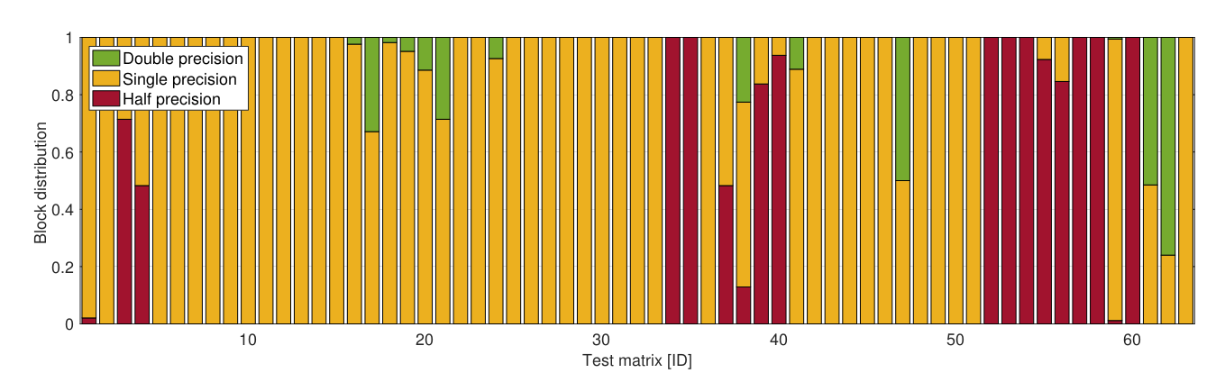
Experimental results
Determining the precision:
% of diagonal blocks stored in each precision *:
* Prototype implementation in MATLAB,
Results on 63 matrices from SuiteSparse

Slide 45
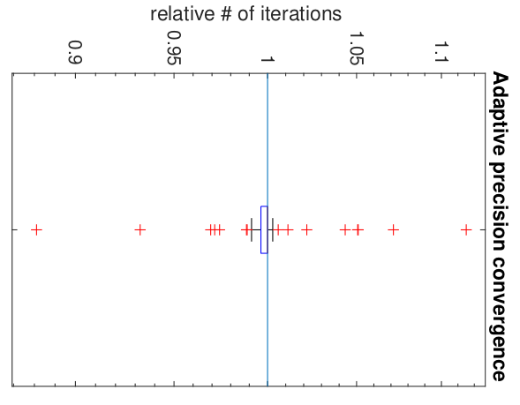
Experimental results
Determining the precision:
Usually < 5% iteration increase
% of diagonal blocks stored in each precision *:
* Prototype implementation in MATLAB,
Results on 63 matrices from SuiteSparse

Slide 46
Energy efficiency of adaptive precision block-Jacobi
Memory access is an order of magnitude more expensive than computation! [Shalf 2013]

Slide 47
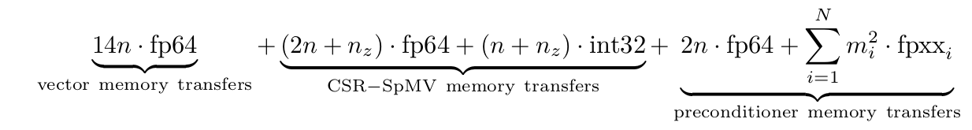
Energy efficiency of adaptive precision block-Jacobi
Memory access is an order of magnitude more expensive than computation! [Shalf 2013]
Energy model assumptions:
Accessing 1 bit of data has a cost of 1 (energy unit)
Disregard energy cost of arithmetic operations
Total energy cost of each iteration:

Slide 48
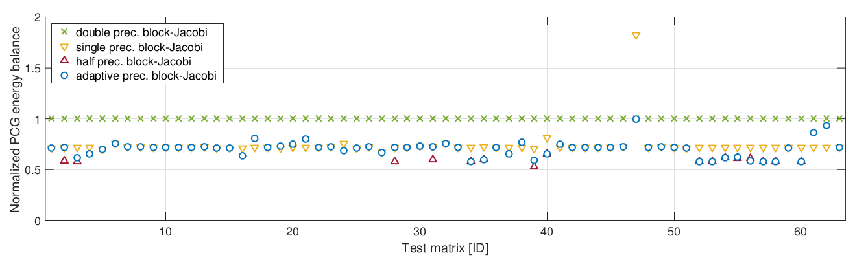
Energy efficiency of adaptive precision block-Jacobi
Memory access is an order of magnitude more expensive than computation! [Shalf 2013]
Energy model assumptions:
Accessing 1 bit of data has a cost of 1 (energy unit)
Disregard energy cost of arithmetic operations
Total energy cost of each iteration:
Predicted energy savings of adaptive precision block-Jacobi:

Slide 49
Overflow and underflow
Storing the block in lower precision can cause underflow or overflow in some values.
This is not accounted for by the numerical analysis shown in the previous slides

Slide 50
Overflow and underflow
Storing the block in lower precision can cause underflow or overflow in some values.
This is not accounted for by the numerical analysis shown in the previous slides
Two possible solutions:
  Check the condition number of the low precision block to verify there were no catastrophic overflows or underflows.

Slide 51
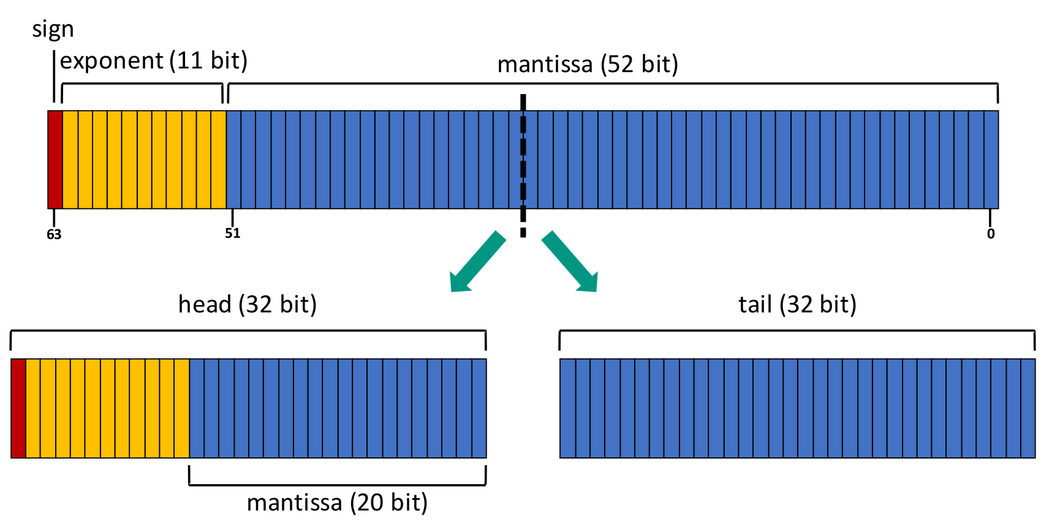
Overflow and underflow
Storing the block in lower precision can cause underflow or overflow in some values.
This is not accounted for by the numerical analysis shown in the previous slides
Two possible solutions:
  Check the condition number of the low precision block to verify there were no catastrophic overflows or underflows.
  Use a custom storage format that preserves the number of exponent bits:

Slide 52
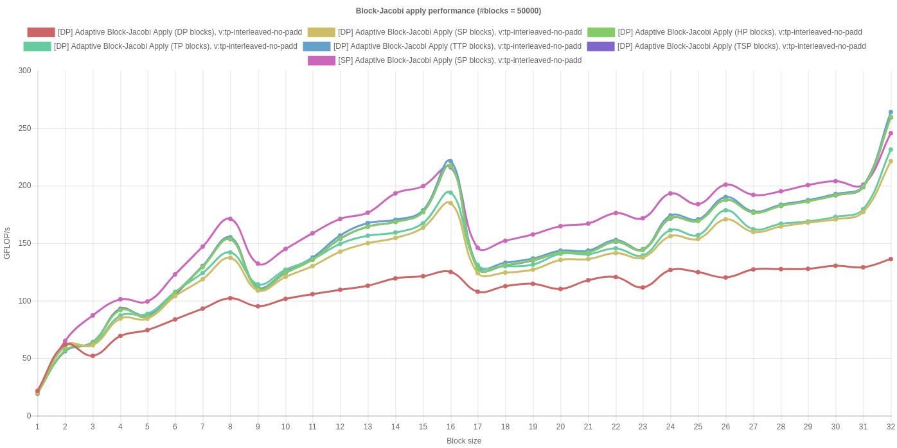
Initial GPU implementation

Slide 53
Sources of linear systems
Real-world problem transformed into a linear system via:
  PDE discretizations, graph representations
  Large number of unknowns (1M+, full matrix 8TB)
  Most matrix elements are zero
Possible approach: iterative methods
  Krylov-subspace based linear solvers
    SpMV
    BLAS-1 operations
  Sparse matrix formats & SpMV
    accelerate each iteration of the solver
  Preconditioners
    reduce the number of iterations
  Special hardware (e.g. GPUs)
  Probably not a good idea to implement everything from scratch…
  Use a library instead:

Slide 54
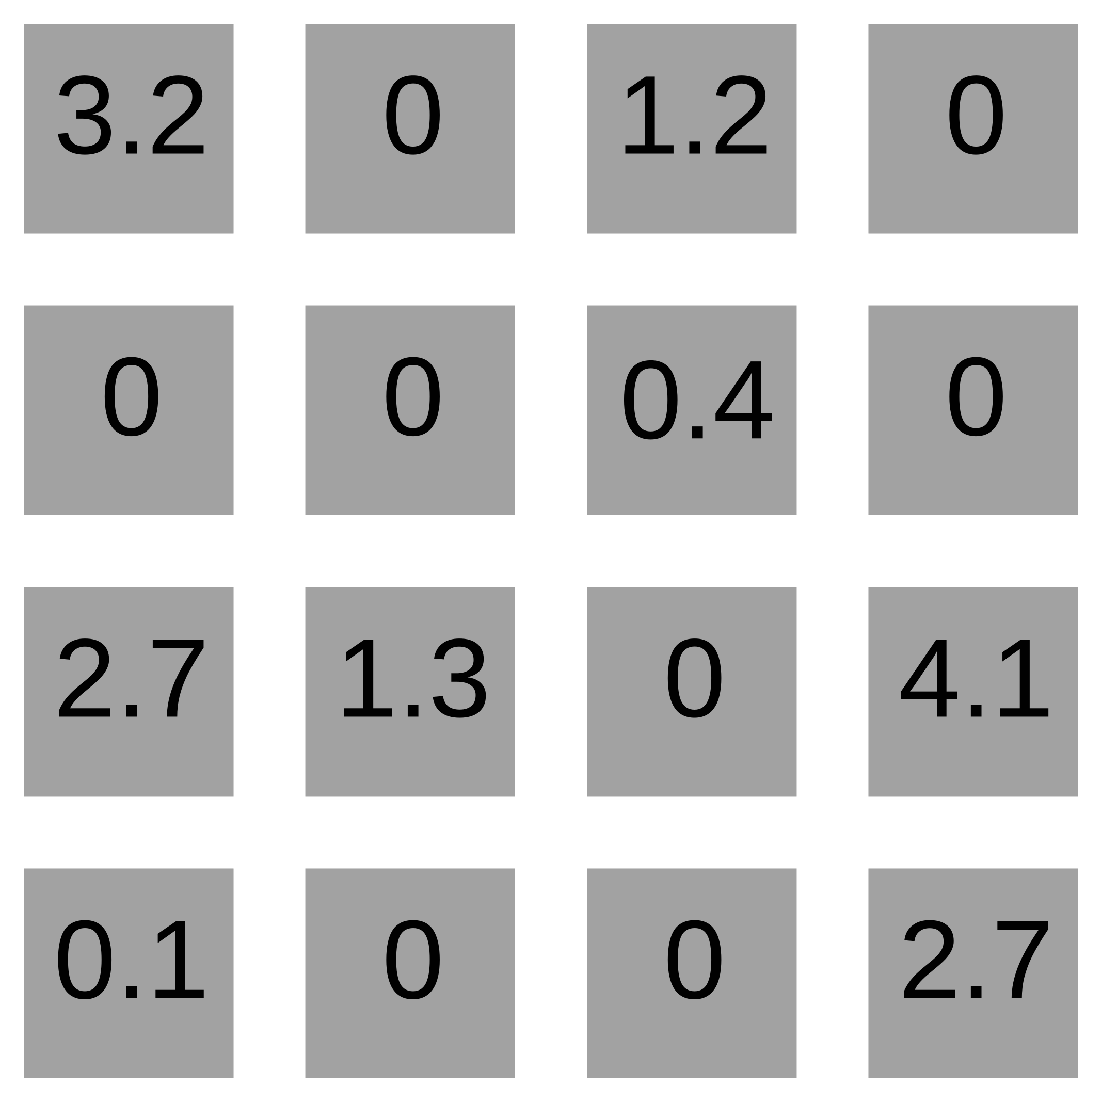
Sparse matrix formats

Slide 55
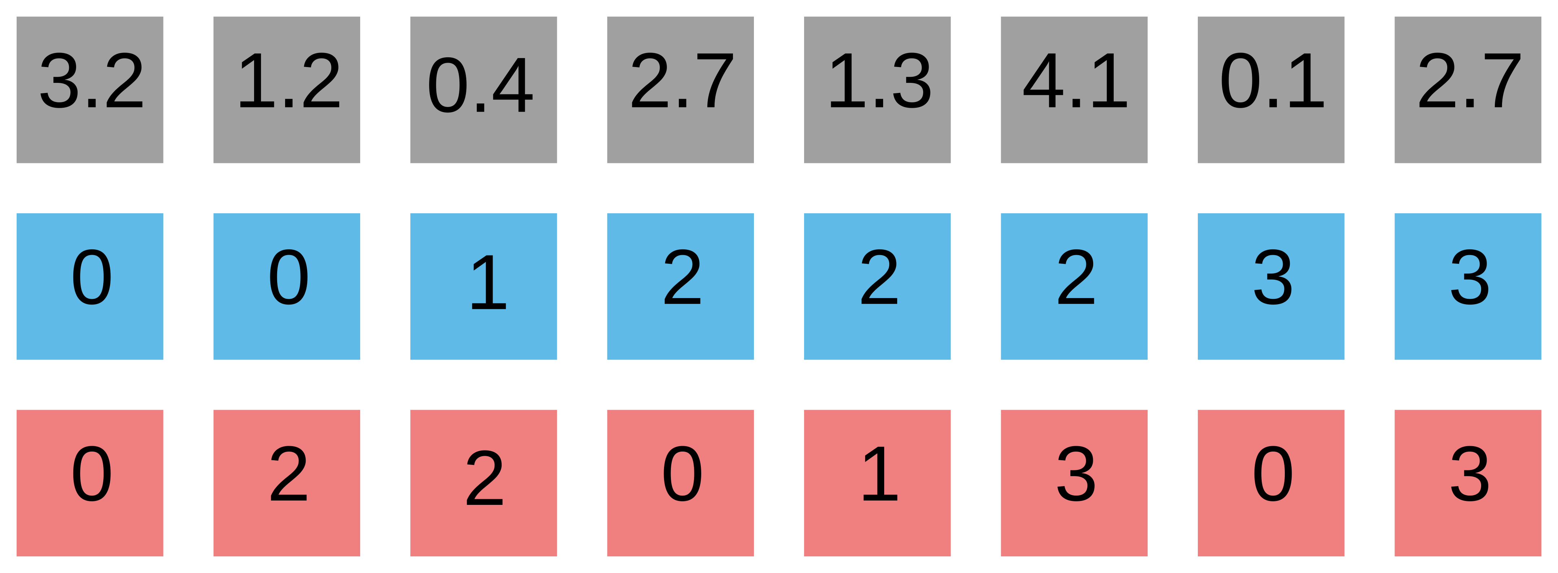
Sparse matrix formats
COO

Slide 56
Sparse matrix formats
row
column
COO

Slide 57
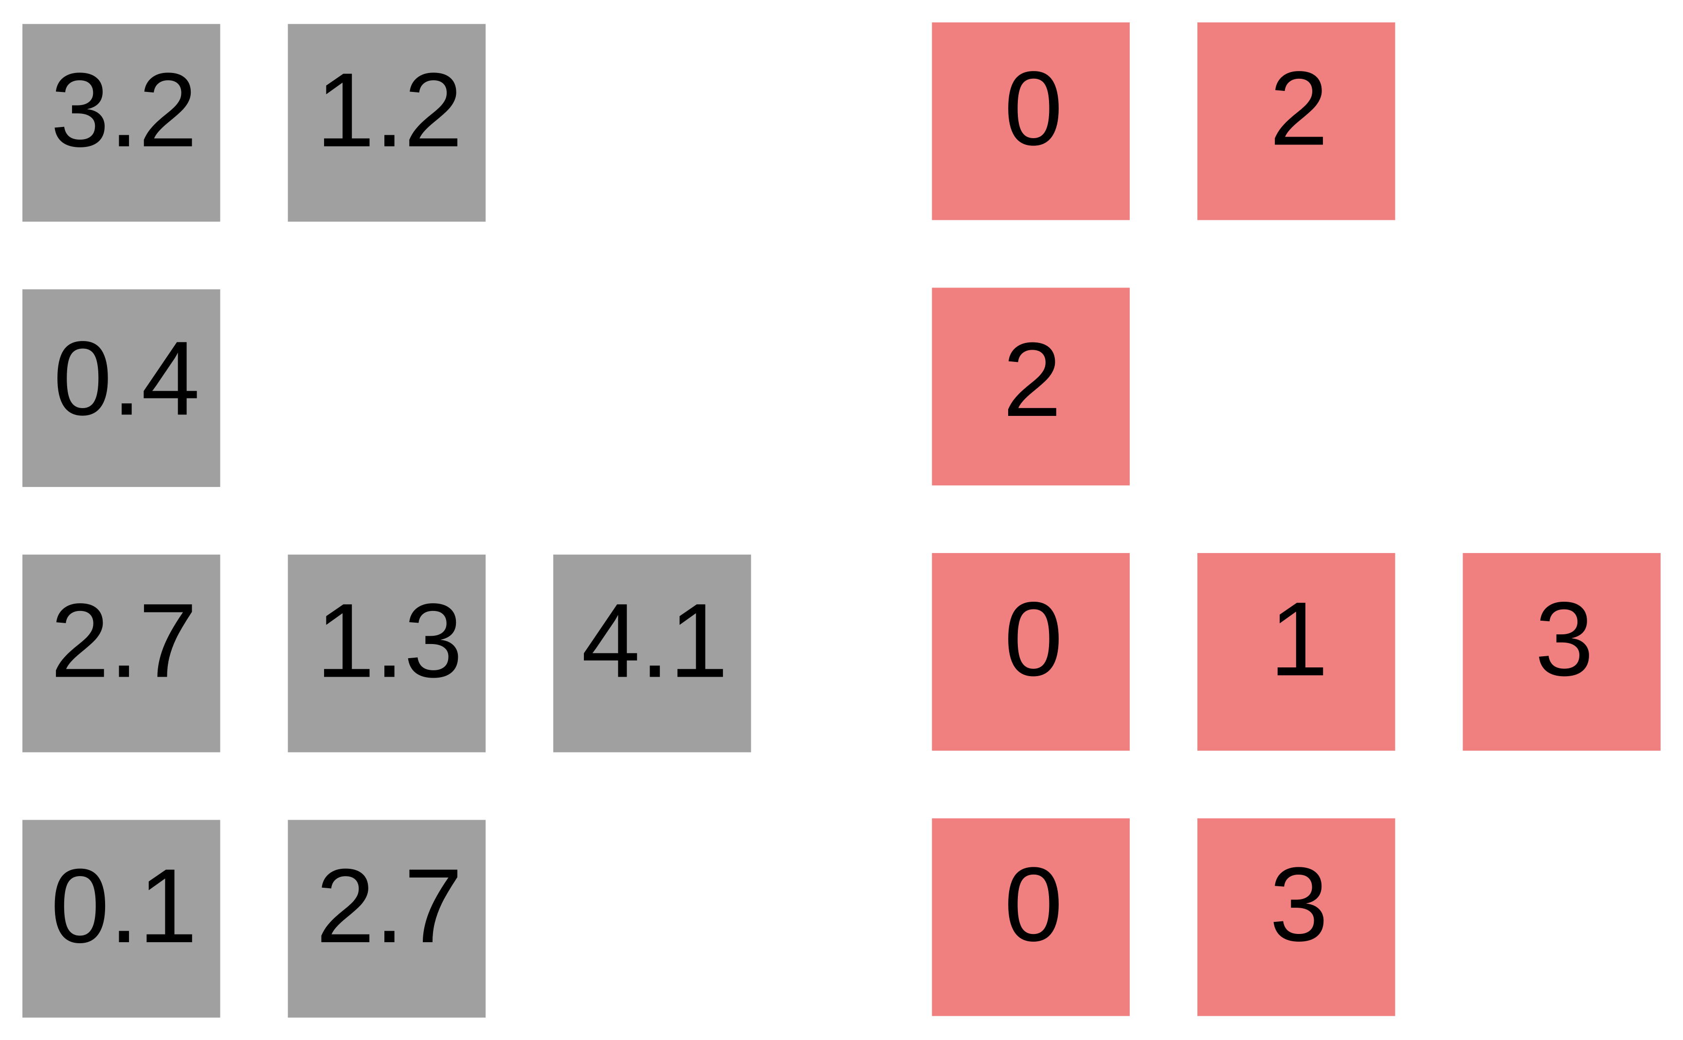
Sparse matrix formats

Slide 58
Sparse matrix formats

Slide 59
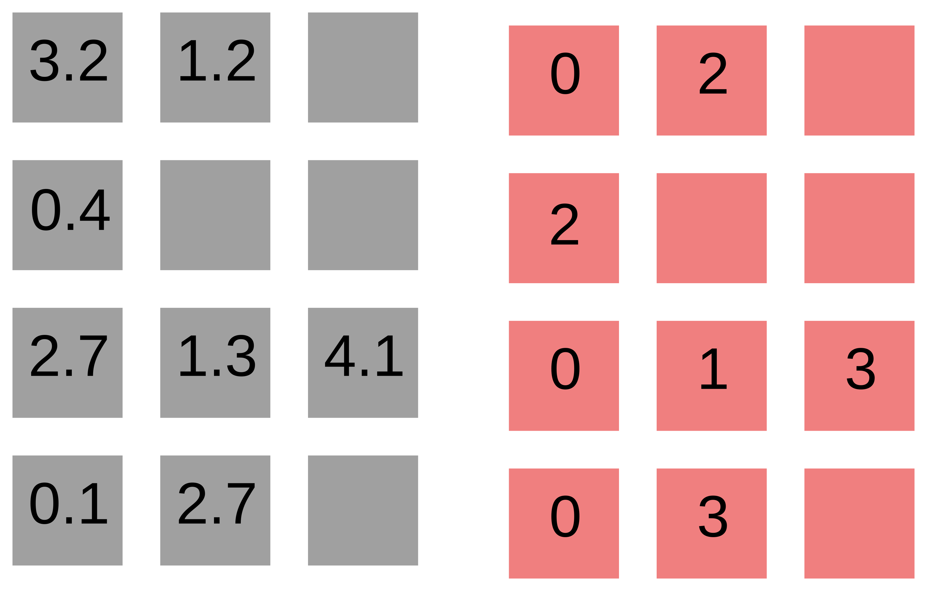
Sparse matrix formats
ELL

Slide 60
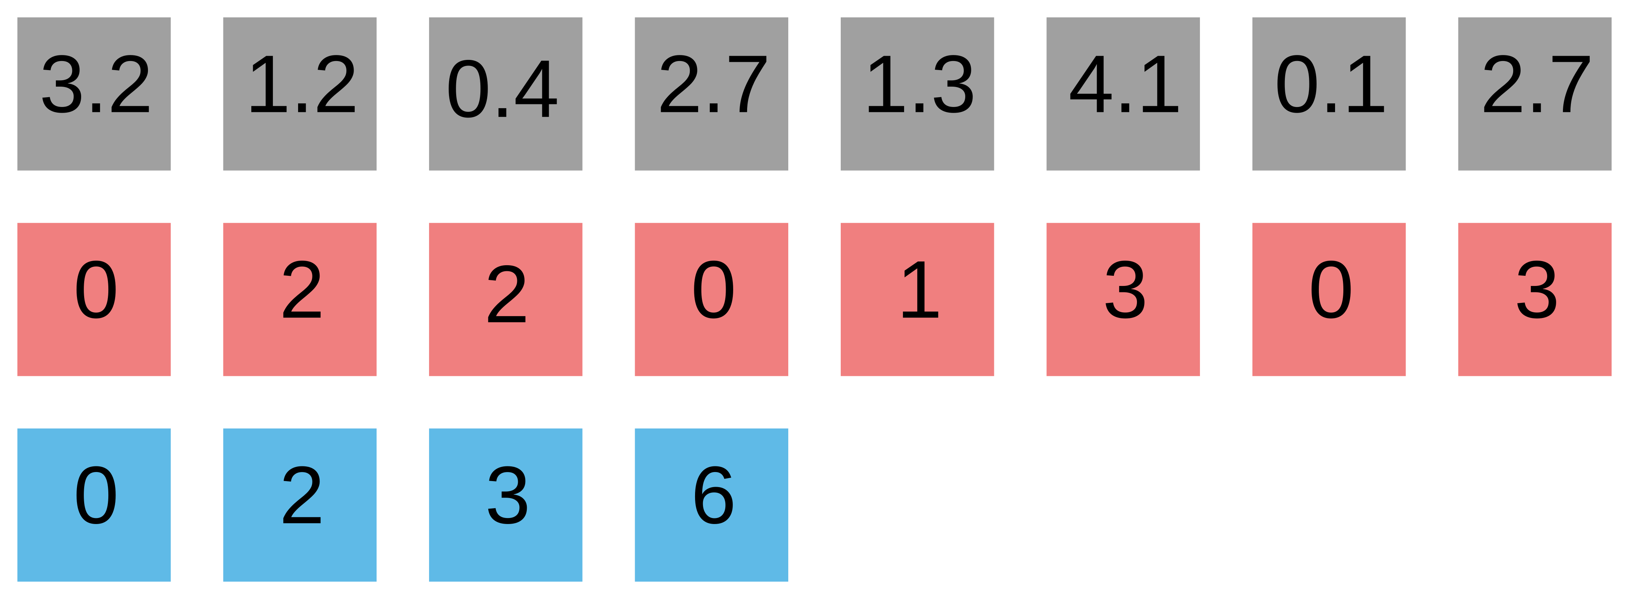
Sparse matrix formats
CSR
ELL

Slide 61
Sparse matrix formats
CSR
ELL

Slide 62
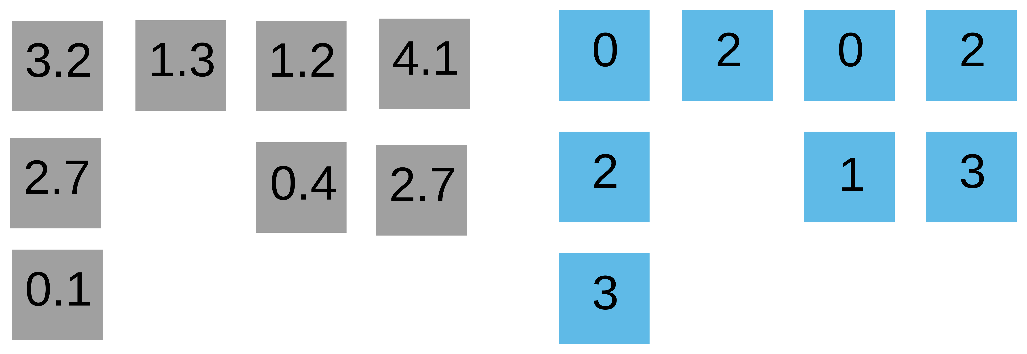
Sparse matrix formats
… leads to CSC

Slide 63
Sparse matrix formats
… leads to CSC
“Standard” approach
CSR

Slide 64
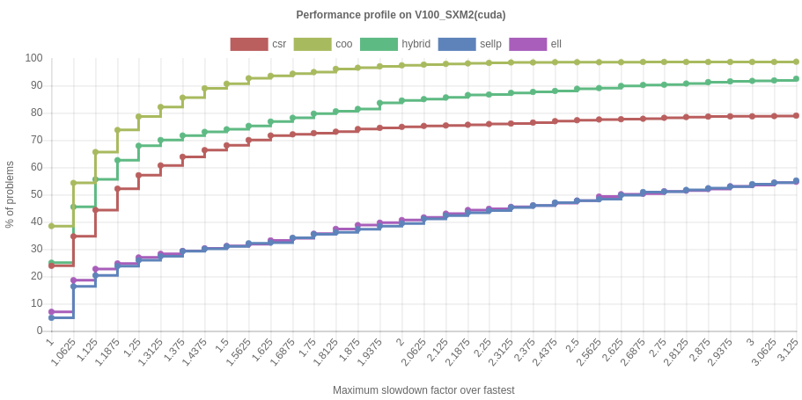
First things first
THERE IS NO “BEST” SPARSE MATRIX FORMAT / SpMV ALGORITHM

Slide 65
CSR SpMV
Values (val)
Column indexes (colidx)
Row pointers (rowptr)

Slide 66

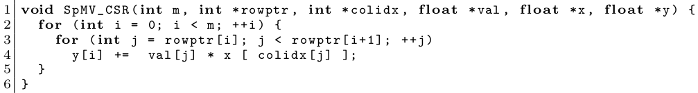
CSR SpMV
Values (val)
Column indexes (colidx)
Row pointers (rowptr)

Slide 67
CSR SpMV
Values (val)
Column indexes (colidx)
Row pointers (rowptr)
Bell & Garland ‘08
  parallelize outer loop
~ cuSPARSE SpMV

Slide 68
CSR SpMV
Values (val)
Column indexes (colidx)
Row pointers (rowptr)
Bell & Garland ‘08
  parallelize outer loop
~ cuSPARSE SpMV
Load imbalance!

Slide 69
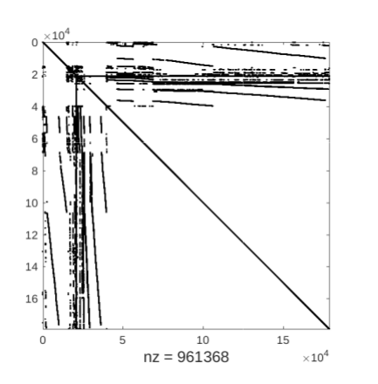
Example
Freescale/transient

Slide 70
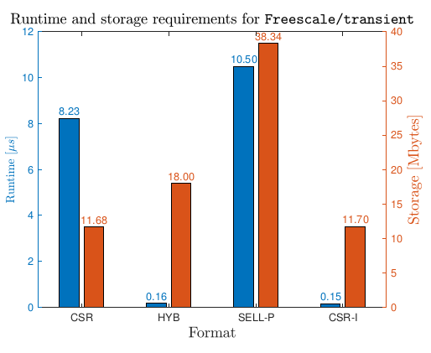
Example
* GTX 1080
Freescale/transient
Can we do better than HYB using CSR?

Slide 71
Example
* GTX 1080
Freescale/transient
Can we do better than HYB using CSR?
55x speedup
YES!
Flegar, Anzt, Overcoming Load Imbalance for Irregular Sparse Matrices, IA3’17
Flegar, Quintana-Ortí, Balanced CSR Sparse Matrix-Vector Product on Graphics Processors, Euro-Par’17

Slide 72
How to do it

Slide 73
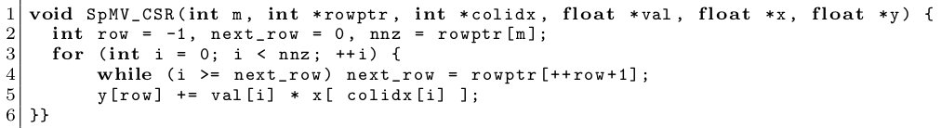
How to do it
Merge the two loops into one.

Slide 74
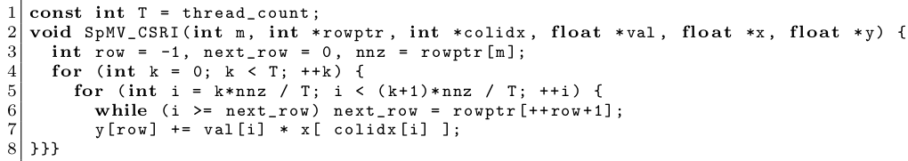
How to do it
Merge the two loops into one.
Split the loop into equal chunks.

Slide 75
How to do it
Merge the two loops into one.
Split the loop into equal chunks.
Parallelize this!

Slide 76
How to do it
Merge the two loops into one.
Split the loop into equal chunks.
Parallelize this!
Race conditions!

Slide 77
How to do it? By force!
Merge the two loops into one.
Split the loop into equal chunks.
Parallelize this!
Use atomics
Accumulate partial result in the registers
Race conditions!

Slide 78
How to do it? By force!
Merge the two loops into one.
Split the loop into equal chunks.
Parallelize this!
State between outer loop iterations!
Use atomics
Accumulate partial result in the registers
Race conditions!

Slide 79
How to do it? By force!
Merge the two loops into one.
Split the loop into equal chunks.
Parallelize this!
State between outer loop iterations!
Use atomics
Accumulate partial result in the registers
Precompute starting value of “row” for each thread.
Race conditions!

Slide 80
Getting good performance on GPUs
CUDA thread = 1 lane of a 32-wide SIMD unit (warp)

Slide 81
Getting good performance on GPUs
CUDA thread = 1 lane of a 32-wide SIMD unit (warp)
Spreading out threads causes strided memory access.
Assign one warp per chunk.

Slide 82
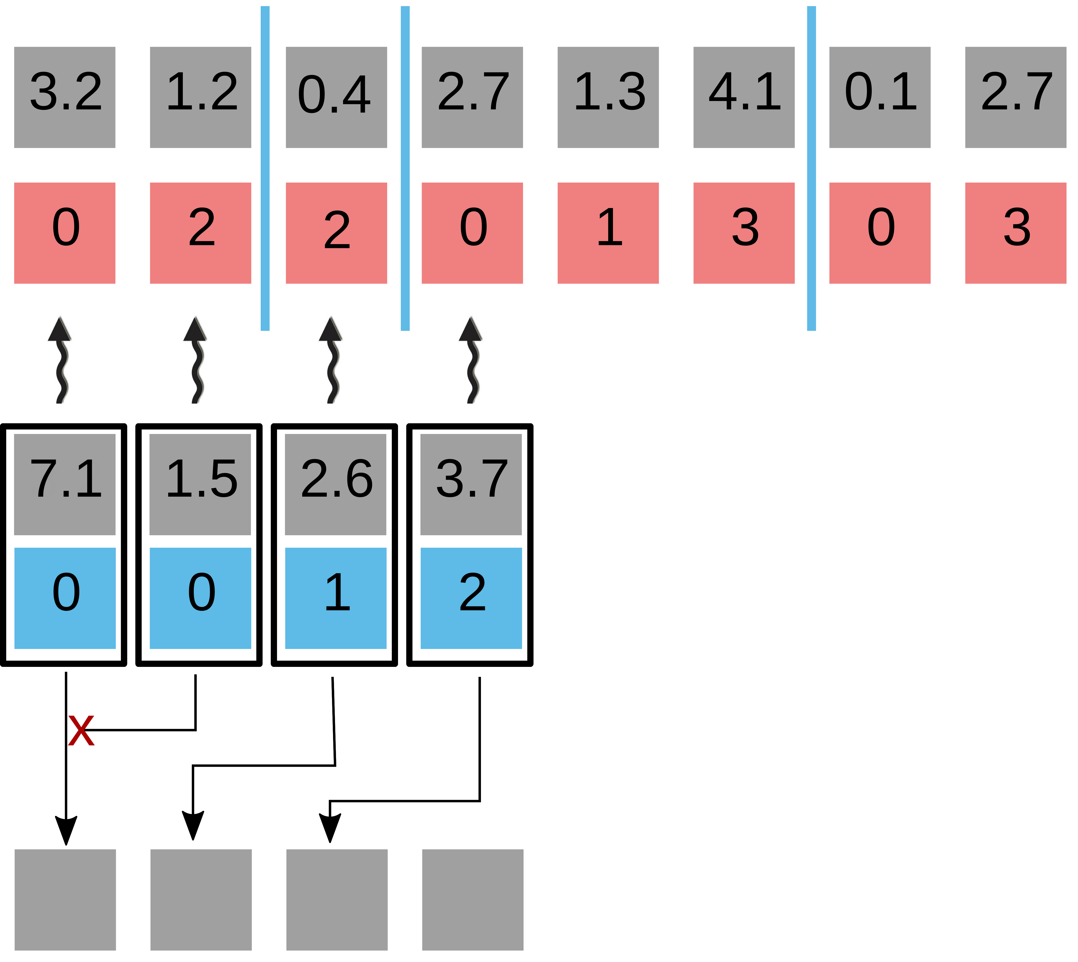
Getting good performance on GPUs
CUDA thread = 1 lane of a 32-wide SIMD unit (warp)
Spreading out threads causes strided memory access.
Assign one warp per chunk.
Atomic collision!
y

Slide 83
Getting good performance on GPUs
CUDA thread = 1 lane of a 32-wide SIMD unit (warp)
Spreading out threads causes strided memory access.
Assign one warp per chunk.
Atomic collision!
y

Slide 84
Getting good performance on GPUs
CUDA thread = 1 lane of a 32-wide SIMD unit (warp)
Spreading out threads causes strided memory access.
Assign one warp per chunk.
Atomic collision!
y

Slide 85
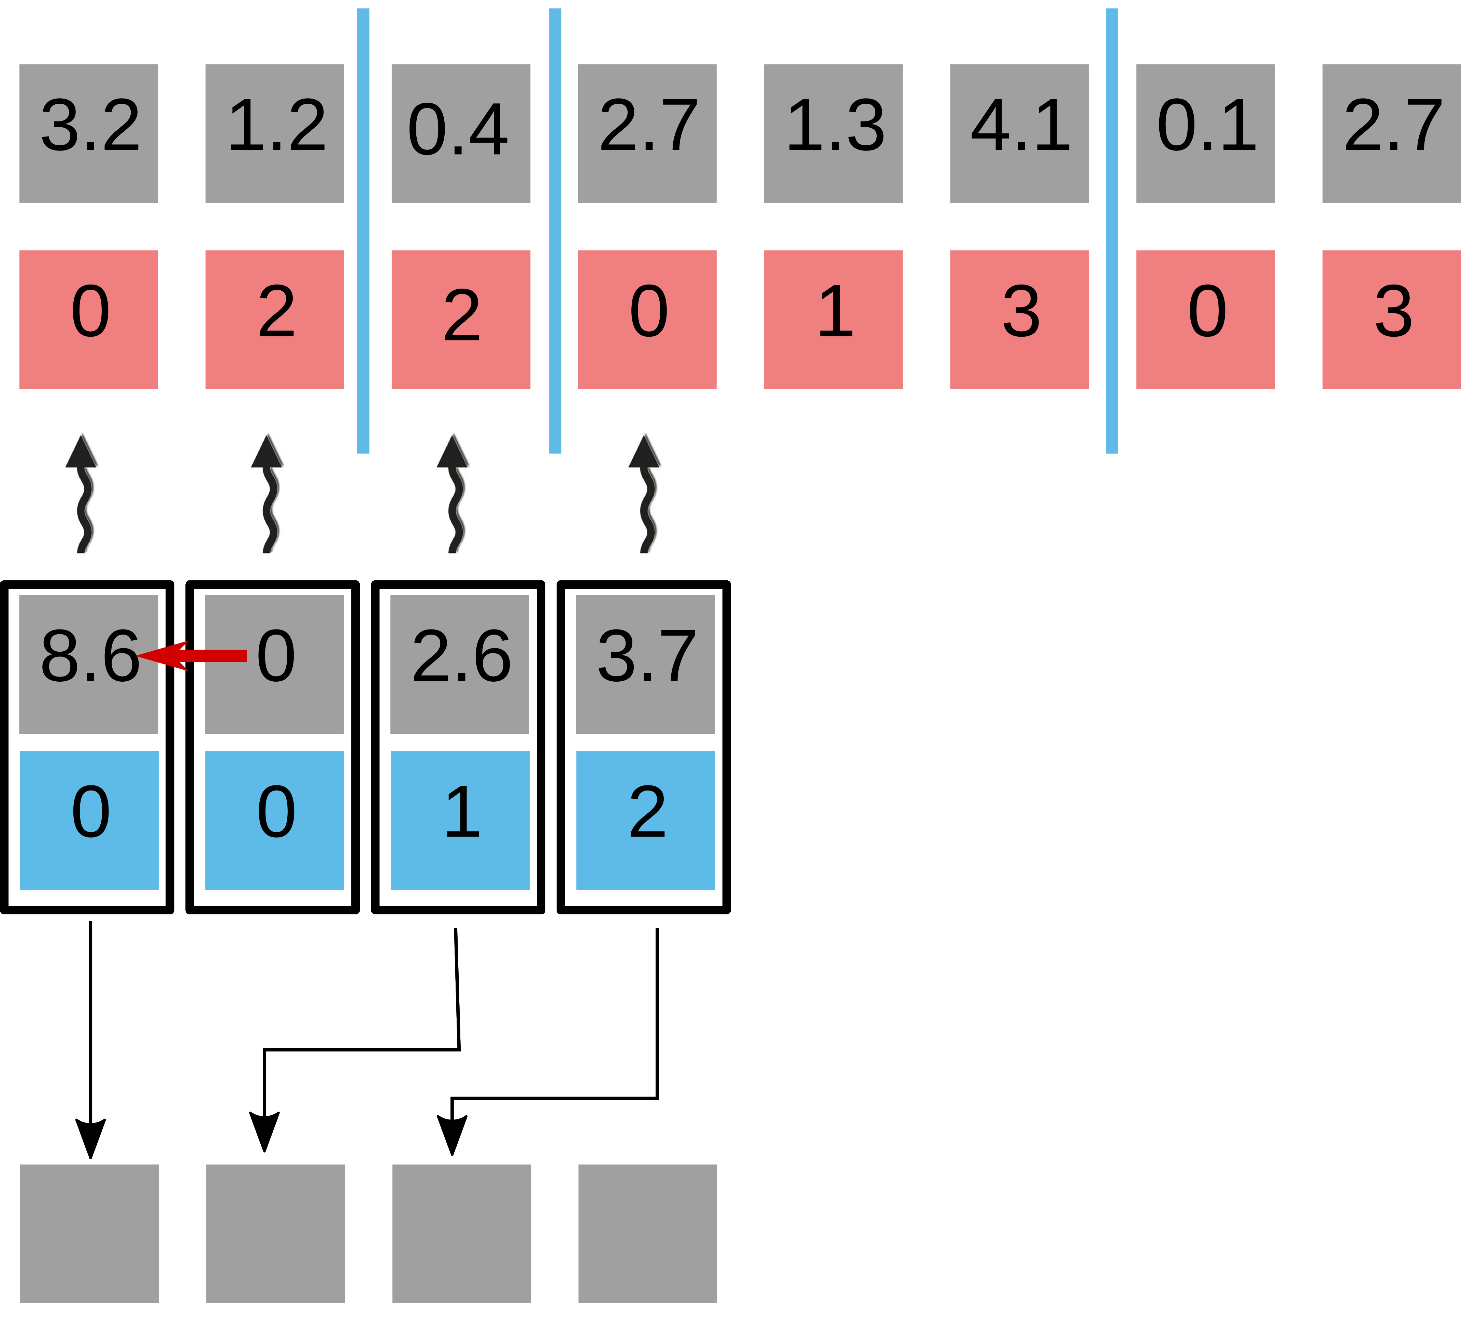
Getting good performance on GPUs
CUDA thread = 1 lane of a 32-wide SIMD unit (warp)
Spreading out threads causes strided memory access.
Assign one warp per chunk.
Warp-level segmented reduction (scan) using shuffles
Atomic collision!
y

Slide 86
Getting good performance on GPUs
CUDA thread = 1 lane of a 32-wide SIMD unit (warp)
Spreading out threads causes strided memory access.
Assign one warp per chunk.
Warp-level segmented reduction (scan) using shuffles
Atomic collision!
y

Slide 87
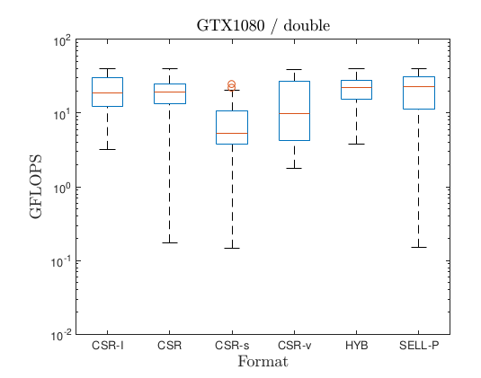
Performance of CSR-I
100 matrices from SuiteSparse

Slide 88
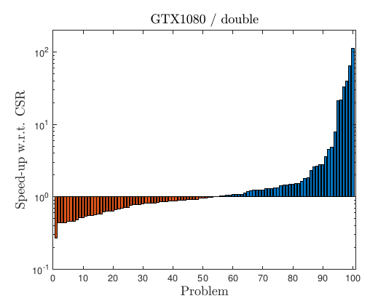
Speed-up / slowdown over cuSPARSE CSR

Slide 89
Speed-up / slowdown over cuSPARSE CSR
No format conversion!
  try both, and use the fastest later on!
  sometimes 1 cuSPARSE SpMV = 100 CSR-I SpMVs

Slide 90
Choosing the winner a priori
CSR-I designed for irregular patterns

Slide 91
Choosing the winner a priori
CSR-I designed for irregular patterns
How to measure irregularity?
Deviation of row lengths from the mean.

Slide 92
Choosing the winner a priori
CSR-I designed for irregular patterns
How to measure irregularity?
Deviation of row lengths from the mean.
Is “5” regular or irregular?
Depends on the density of the matrix (mean #rows)

Slide 93
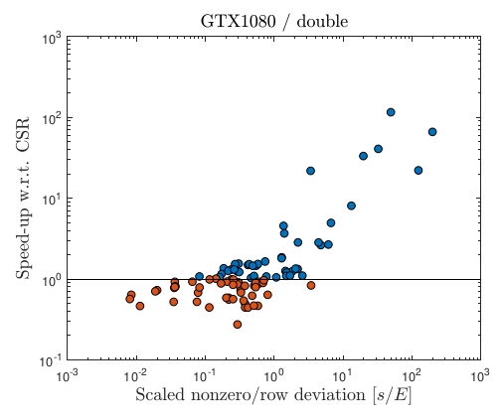
Choosing the winner a priori
CSR-I designed for irregular patterns
How to measure irregularity?
Deviation of row lengths from the mean.
Is “5” regular or irregular?
Depends on the density of the matrix (mean #rows)
Scatter plot of speedup vs normalized std. dev.

Slide 94
Choosing the winner a priori
CSR-I designed for irregular patterns
How to measure irregularity?
Deviation of row lengths from the mean.
Is “5” regular or irregular?
Depends on the density of the matrix (mean #rows)
Scatter plot of speedup vs normalized std. dev.
<0.1 use CSR
>1 use CSR-I
Benchmark both

Slide 95
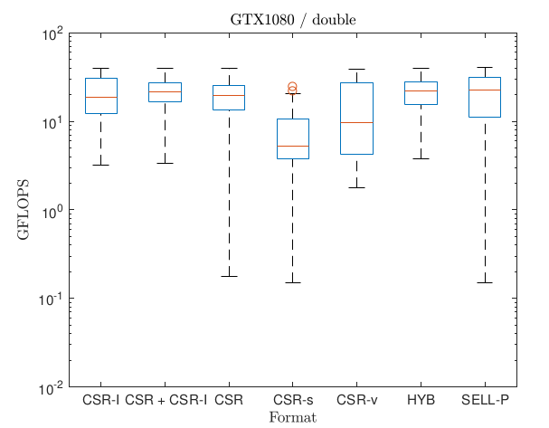
Combining both approaches

Slide 96
Choosing the winner a priori
CSR-I designed for irregular patterns
How to measure irregularity?
Deviation of row lengths from the mean.
Is “5” regular or irregular?
Depends on the density of the matrix (mean #rows)
Scatter plot of speedup vs normalized std. dev.

Slide 97
Choosing the winner a priori
CSR-I designed for irregular patterns
How to measure irregularity?
Deviation of row lengths from the mean.
Is “5” regular or irregular?
Depends on the density of the matrix (mean #rows)
Scatter plot of speedup vs normalized std. dev.
<0.1 use CSR
>1 use CSR-I
Benchmark both

Slide 98
Combining both approaches

Slide 99
Outlook
Choosing the correct combination of
matrix format
solver
preconditioner
… requires expert knowledge or significant trial and error.
Design a tool that does it (semi-)automatically?

Slide 100
Thank you! Questions?
Krylov-subspace based linear solvers
  Performance depends on SpMV and Preconditioners
Sparse matrix formats & SpMV
  There is no “holy grail” - best format depends on the problem
Preconditioners
  Accelerate the solution of the solver
  Only an approximation, can use lower precision storage
Do not implement from scratch, use a library. For example:
github.com/ginkgo-project/ginkgo
Open source license (BSD-3)
Modern C++
High performance GPU backend
reference CPU implementation
High performance CPU backend on the way

