Slide 1

How to Solve a Linear System
Goran Flegar
Joint work with: Mike Tsai, Yen-Chen Chen, Terry Cojean, Hartwig Anzt, Enrique S. Quintana-Ortí
Scan me for slides!
github.com/gflegar/talks/tree/master/ibm_zurich_2017_09

Slide 2










MAGMA-sparse software library
GPU-accelerated sparse linear algebra library
  Focus: linear systems
  Iterative, Krylov-subspace based linear solvers
    SpMV
    BLAS-1 operations
  Sparse matrix formats & SpMV
    accelerate each iteration of the solver
  Preconditioners
    reduce the number of iterations
Joint effort: Innovative Computing Lab at University of Tennessee, Knoxvile; Karlsruhe Institute of Technology; University Jaume I

Slide 3
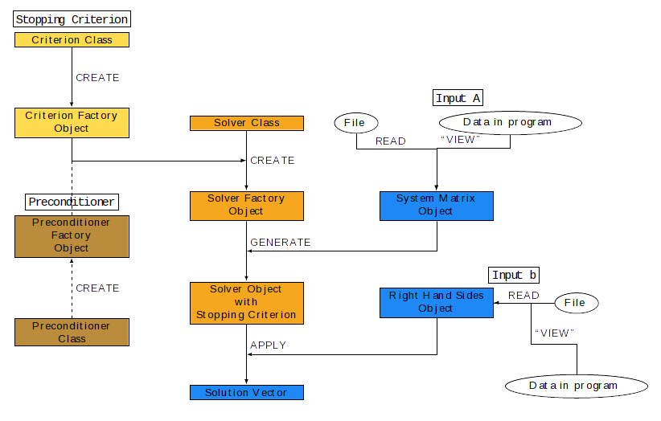
The Ginkgo Library
Linear operator library
  Matrices, preconditioners, (Krylov) solvers
Supports execution on different devices
  GPU
  Sequential reference CPU
  OpenMP under development
  Plans for multi GPU, CPU + GPU, full node

Slide 4
int main()
{
// Instantiate a CUDA executor
auto exec = gko::CudaExecutor::create(0, gko::OmpExecutor::create());
// Read data
auto A = gko::read<gko::matrix::Csr<>>(std::cin, exec);
auto b = gko::read<gko::matrix::Dense<>>(std::cin, exec);
auto x = gko::read<gko::matrix::Dense<>>(std::cin, exec);
// Create the solver
auto solver = gko::solver::Cg<>::Factory::create()
.with_preconditioner(
gko::preconditioner::BlockJacobiFactory<>::create(exec, 32))
.with_criterion(gko::stop::Combined::Factory::create()
.with_criteria(
gko::stop::Iteration::Factory::create()
.with_max_iters(20u)
.on_executor(exec),
gko::stop::ResidualNormReduction<>::Factory::create()
.with_reduction_factor(1e-15)
.on_executor(exec))
.on_executor(exec))
.on_executor(exec);
// Solve system
solver->generate(give(A))->apply(lend(b), lend(x));
// Write result
write(std::cout, lend(x));
}

Slide 5
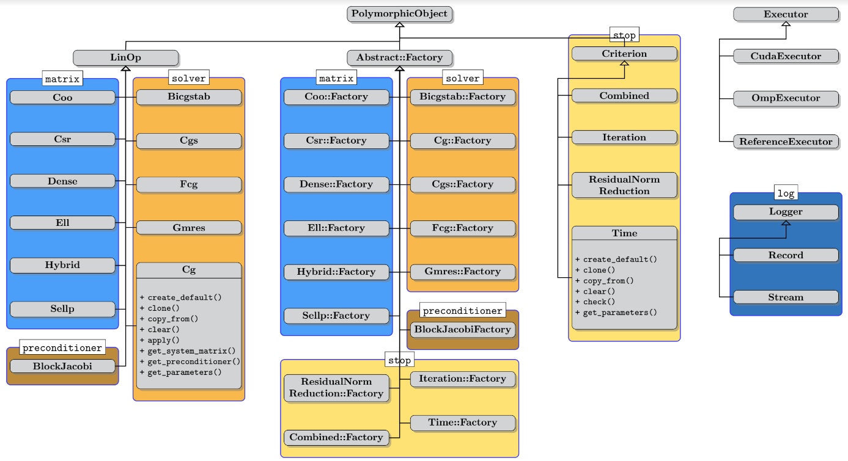
Features
Extensibility: users can provide new matrices, solvers, preconditioners, stopping criteria, loggers
Without recompiling the library!

Slide 6

Preconditioning

Slide 7

Preconditioning
Replace the original system with an equivalent preconditioned system

Slide 8


Preconditioning
Replace the original system with an equivalent preconditioned system

Slide 9

Preconditioning
Replace the original system with an equivalent preconditioned system
Do not compute the preconditioned system matrix explicitly!

Slide 10

Preconditioning
Replace the original system with an equivalent preconditioned system
Do not compute the preconditioned system matrix explicitly!

Slide 11


Preconditioning
Replace the original system with an equivalent preconditioned system
Do not compute the preconditioned system matrix explicitly!
Preconditioner application

Slide 12

Preconditioning
Replace the original system with an equivalent preconditioned system
Do not compute the preconditioned system matrix explicitly!
Generate the preconditioner matrix, and store it in a form suitable for application
Preconditioner setup
Preconditioner application

Slide 13
Preconditioning
Replace the original system with an equivalent preconditioned system
Do not compute the preconditioned system matrix explicitly!
Generate the preconditioner matrix, and store it in a form suitable for application
Preconditioner setup
Preconditioner application
Trade-off:
faster convergence,
but more work per iteration

Slide 14
Block-Jacobi preconditioning
Current focus: improve performance for problems with inherent block structure
  Usually blocks are smaller than 30x30 (blocks can be of different sizes!)

Slide 15



Block-Jacobi preconditioning
Current focus: improve performance for problems with inherent block structure
  Usually blocks are smaller than 30x30 (blocks can be of different sizes!)
Block-Jacobi preconditioning
  Use only diagonal blocks for approximation

Slide 16
Benefits of block-Jacobi
56 matrices from SuiteSparse
MAGMA-sparse open source library
  IDR solver
  Scalar Jacobi preconditioner
  Supervariable agglomeration
    Detects block structure of the matrix

Slide 17

Benefits of block-Jacobi
56 matrices from SuiteSparse
MAGMA-sparse open source library
  IDR solver
  Scalar Jacobi preconditioner
  Supervariable agglomeration
    Detects block structure of the matrix
Improves the robustness of the solver

Slide 18
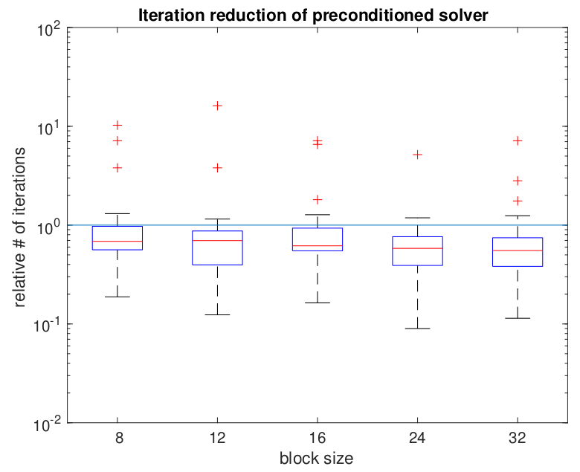
Benefits of block-Jacobi
56 matrices from SuiteSparse
MAGMA-sparse open source library
  IDR solver
  Scalar Jacobi preconditioner
  Supervariable agglomeration
    Detects block structure of the matrix
Improves the robustness of the solver
Improves convergence of the solver

Slide 19






Complete solver runtime
s2rmt3m1
Chebyshev3
nd24k
G3_circuit
bcsstk38
ship_003

Slide 20

Adaptive precision block-Jacobi
Preconditioner is an approximation of the system matrix
  Applying a preconditioner inherently carries an error
  For block-Jacobi the relative error of z is usually around 0.01 – 0.1

Slide 21
Adaptive precision block-Jacobi
Preconditioner is an approximation of the system matrix
  Applying a preconditioner inherently carries an error
  For block-Jacobi the relative error of z is usually around 0.01 – 0.1
Preconditioner application is memory bounded
  Most of the cost comes from reading the matrix from memory
  Idea: use lower precision to store the matrix

Slide 22
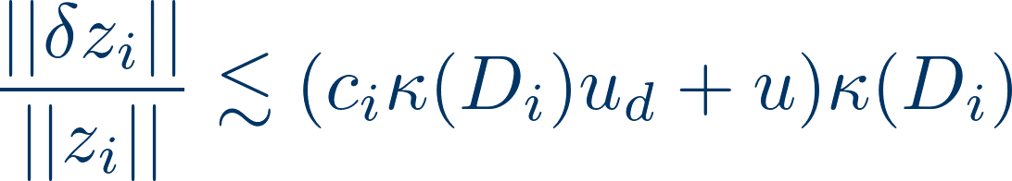
Adaptive precision block-Jacobi
Preconditioner is an approximation of the system matrix
  Applying a preconditioner inherently carries an error
  For block-Jacobi the relative error of z is usually around 0.01 – 0.1
Preconditioner application is memory bounded
  Most of the cost comes from reading the matrix from memory
  Idea: use lower precision to store the matrix
Adaptive precision in inversion-based block-Jacobi:
  All computation is done in double precision
  Preconditioner matrix is stored in lower precision, with roundoff error “u”
  Error bound:

Slide 23
Adaptive precision block-Jacobi
Preconditioner is an approximation of the system matrix
  Applying a preconditioner inherently carries an error
  For block-Jacobi the relative error of z is usually around 0.01 – 0.1
Preconditioner application is memory bounded
  Most of the cost comes from reading the matrix from memory
  Idea: use lower precision to store the matrix
Adaptive precision in inversion-based block-Jacobi:
  All computation is done in double precision
  Preconditioner matrix is stored in lower precision, with roundoff error “u”
  Error bound:
Assuming the preconditioner block is relatively well conditioned
  The error is determined by the product of u, and the condition number
  Choose the precision for each block independently, such that at least 1 digit of the result is correct

Slide 24
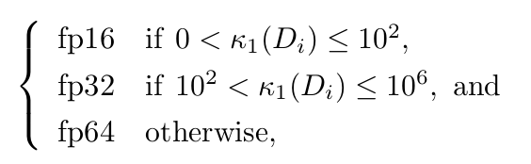
Experimental results
Determining the precision:

Slide 25
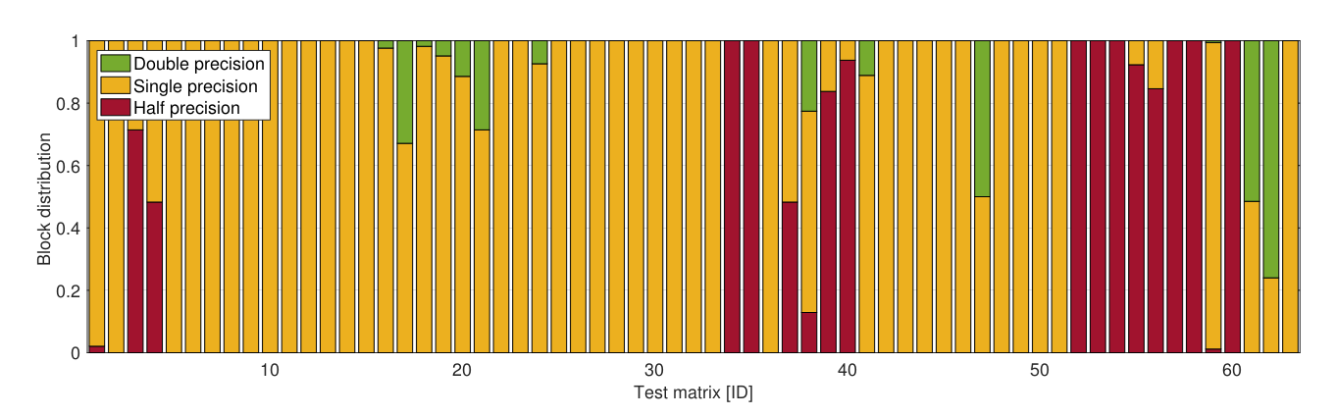
Experimental results
Determining the precision:
% of diagonal blocks stored in each precision *:
* Prototype implementation in MATLAB,
Results on 63 matrices from SuiteSparse

Slide 26
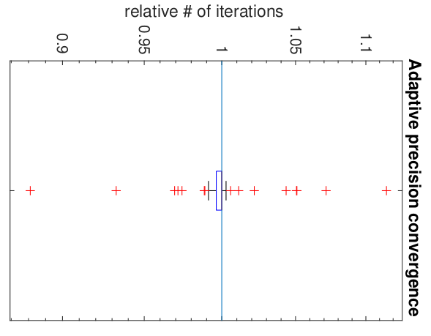
Experimental results
Determining the precision:
Usually < 5% iteration increase
% of diagonal blocks stored in each precision *:
* Prototype implementation in MATLAB,
Results on 63 matrices from SuiteSparse

Slide 27
Energy efficiency of adaptive precision block-Jacobi
Memory access is an order of magnitude more expensive than computation! [Shalf 2013]

Slide 28
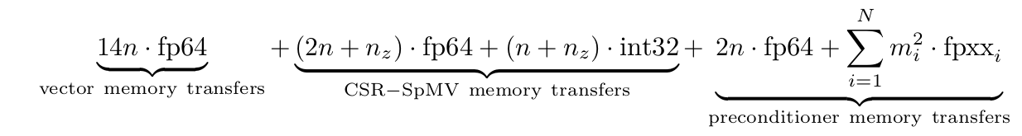
Energy efficiency of adaptive precision block-Jacobi
Memory access is an order of magnitude more expensive than computation! [Shalf 2013]
Energy model assumptions:
Accessing 1 bit of data has a cost of 1 (energy unit)
Disregard energy cost of arithmetic operations
Total energy cost of each iteration:

Slide 29
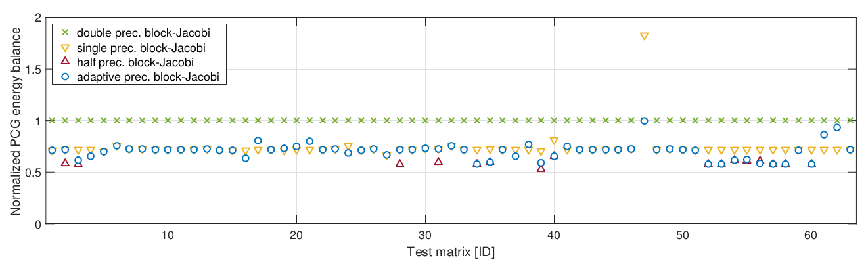
Energy efficiency of adaptive precision block-Jacobi
Memory access is an order of magnitude more expensive than computation! [Shalf 2013]
Energy model assumptions:
Accessing 1 bit of data has a cost of 1 (energy unit)
Disregard energy cost of arithmetic operations
Total energy cost of each iteration:
Predicted energy savings of adaptive precision block-Jacobi:

Slide 30
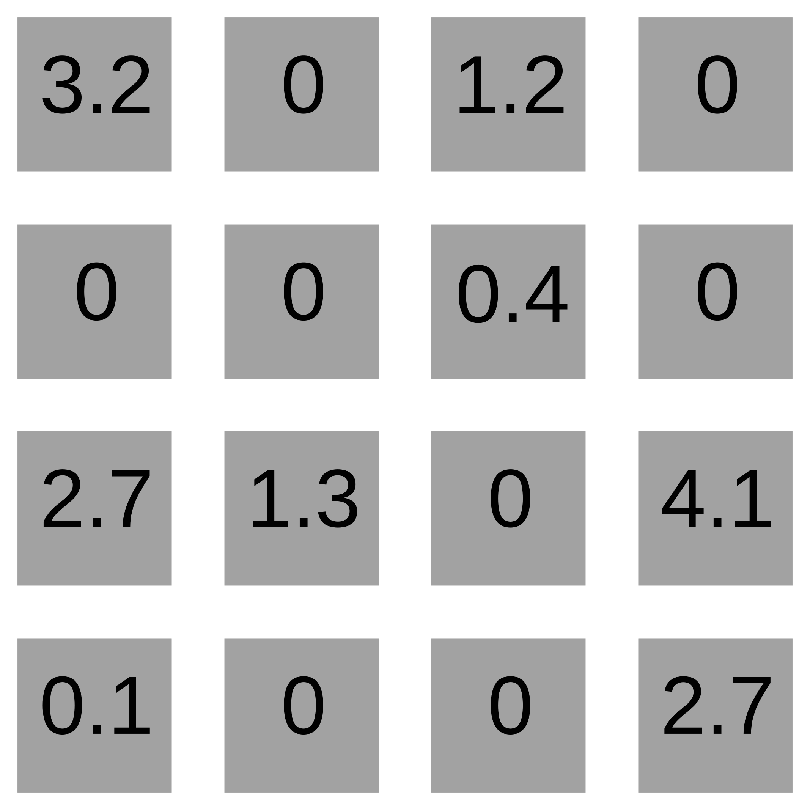
Sparse matrix formats

Slide 31
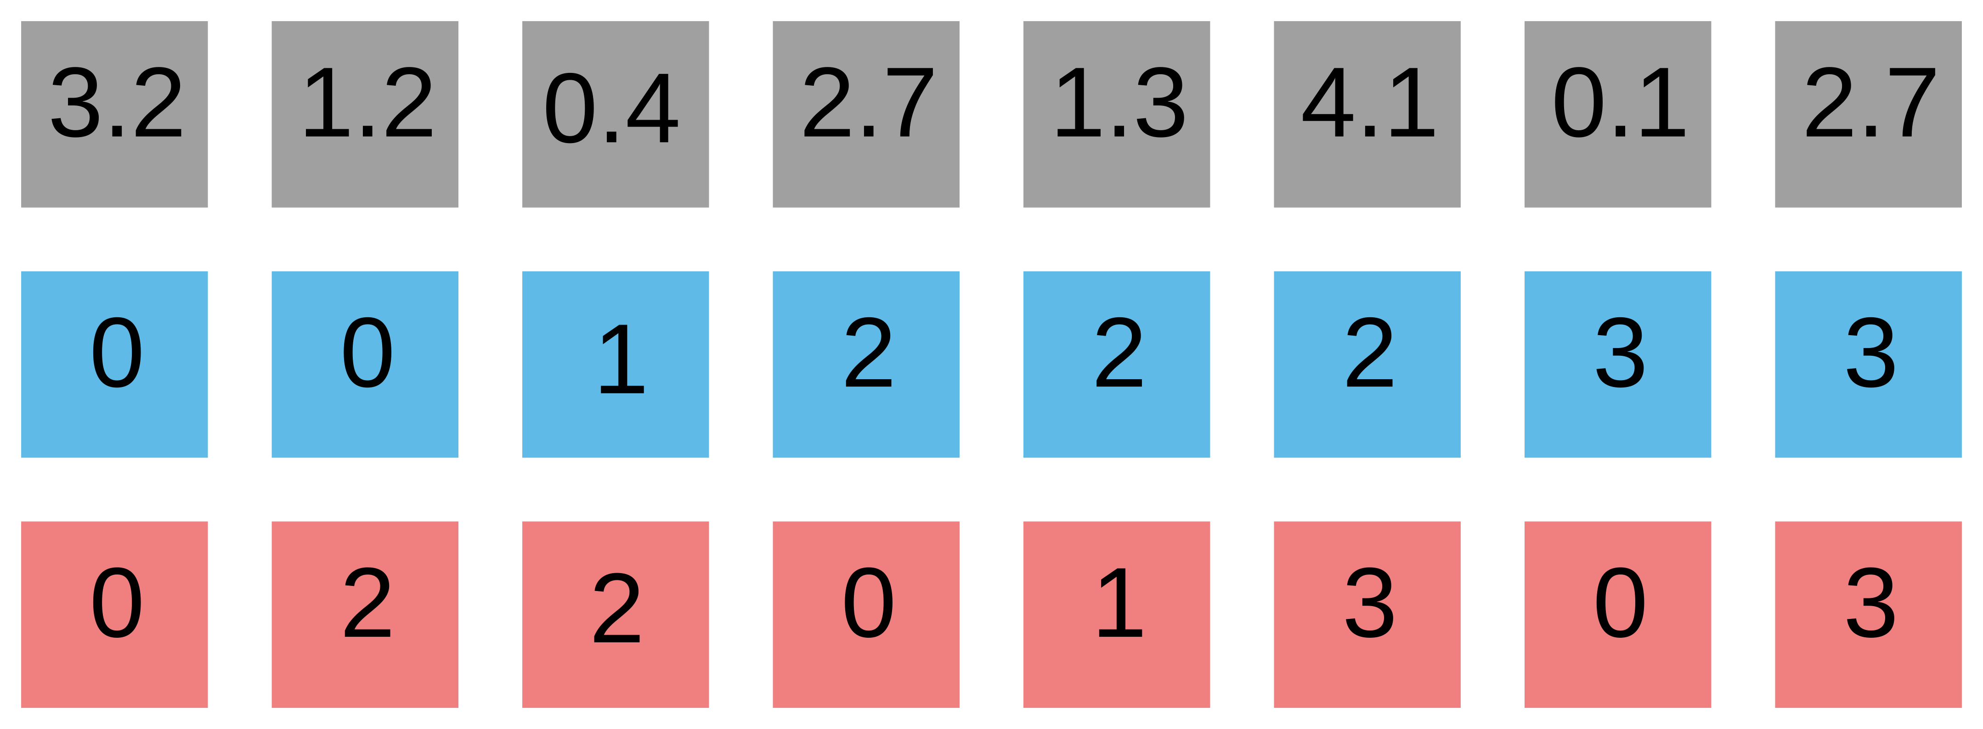
Sparse matrix formats
COO

Slide 32
Sparse matrix formats
row
column
COO

Slide 33
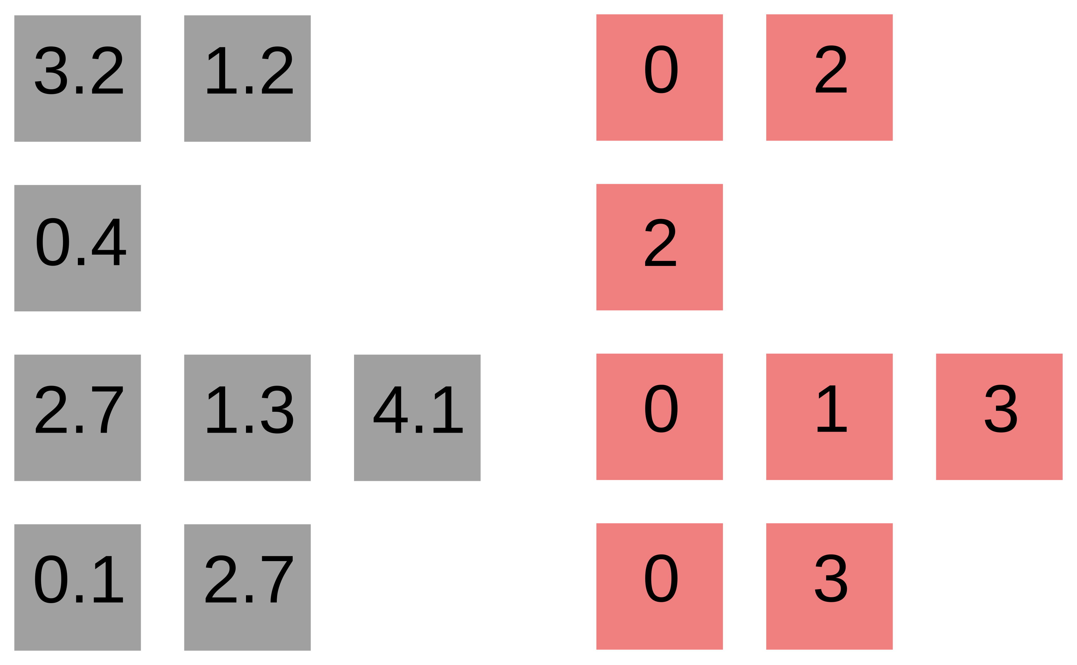
Sparse matrix formats

Slide 34
Sparse matrix formats

Slide 35
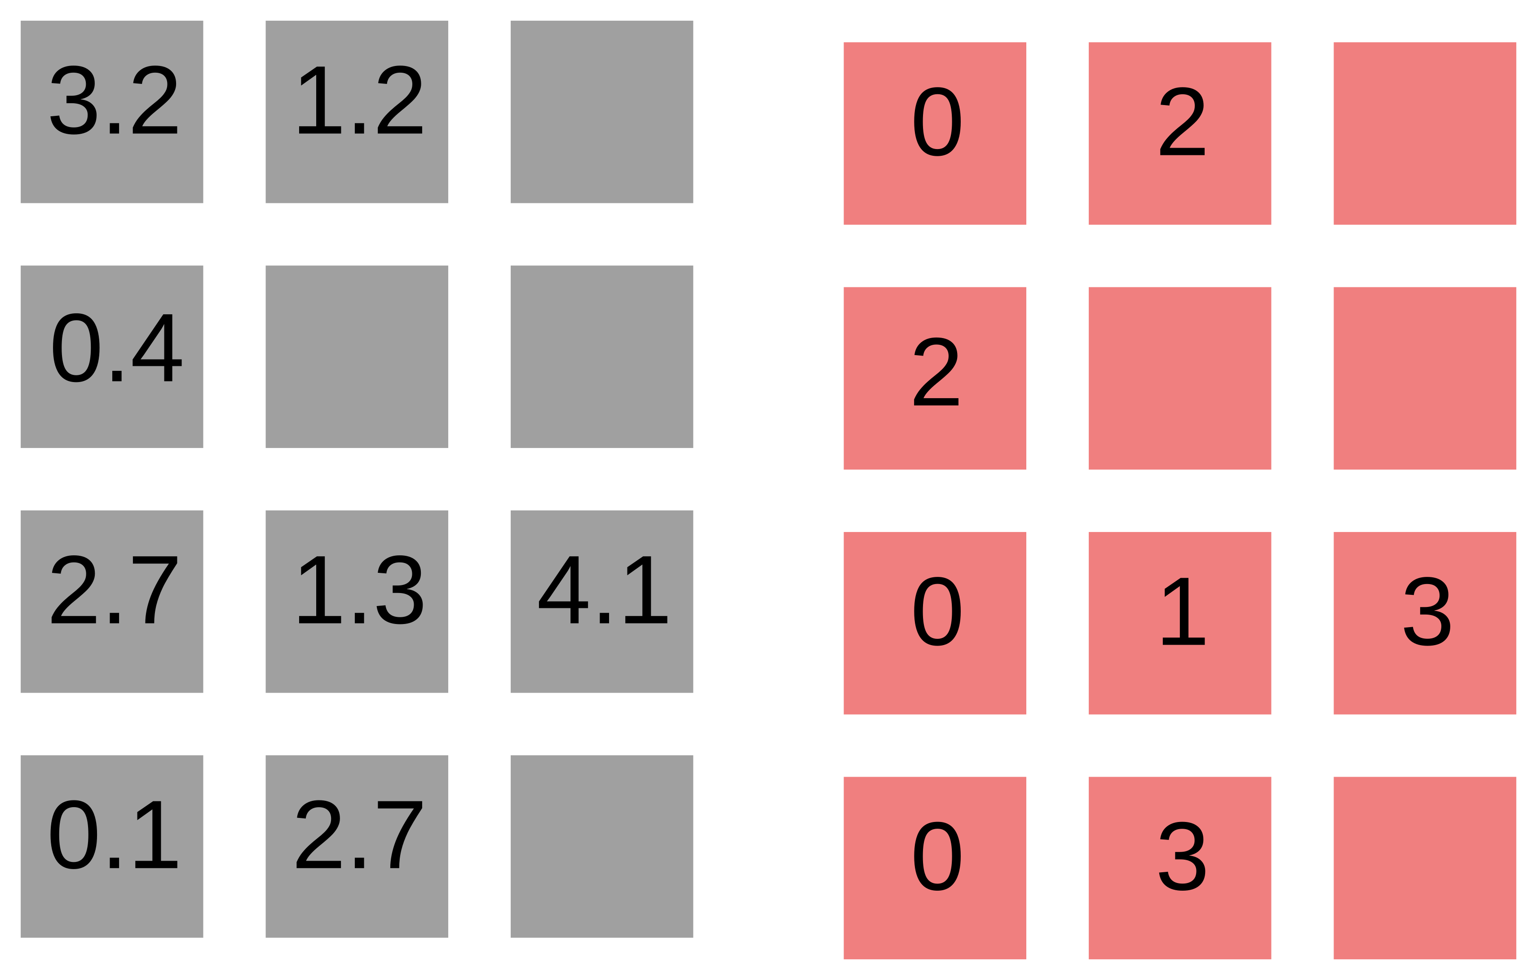
Sparse matrix formats
ELL

Slide 36
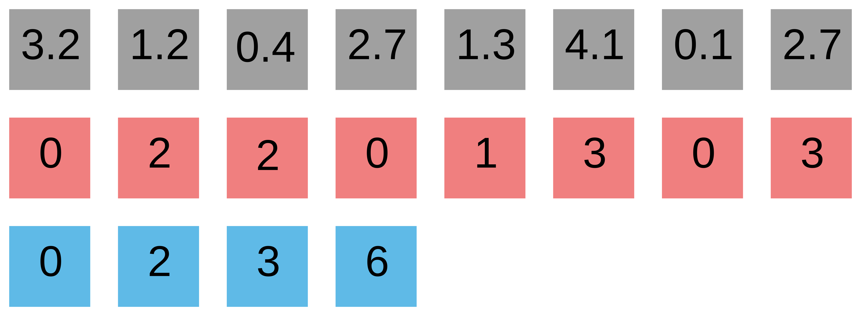
Sparse matrix formats
CSR
ELL

Slide 37
Sparse matrix formats
CSR
ELL

Slide 38
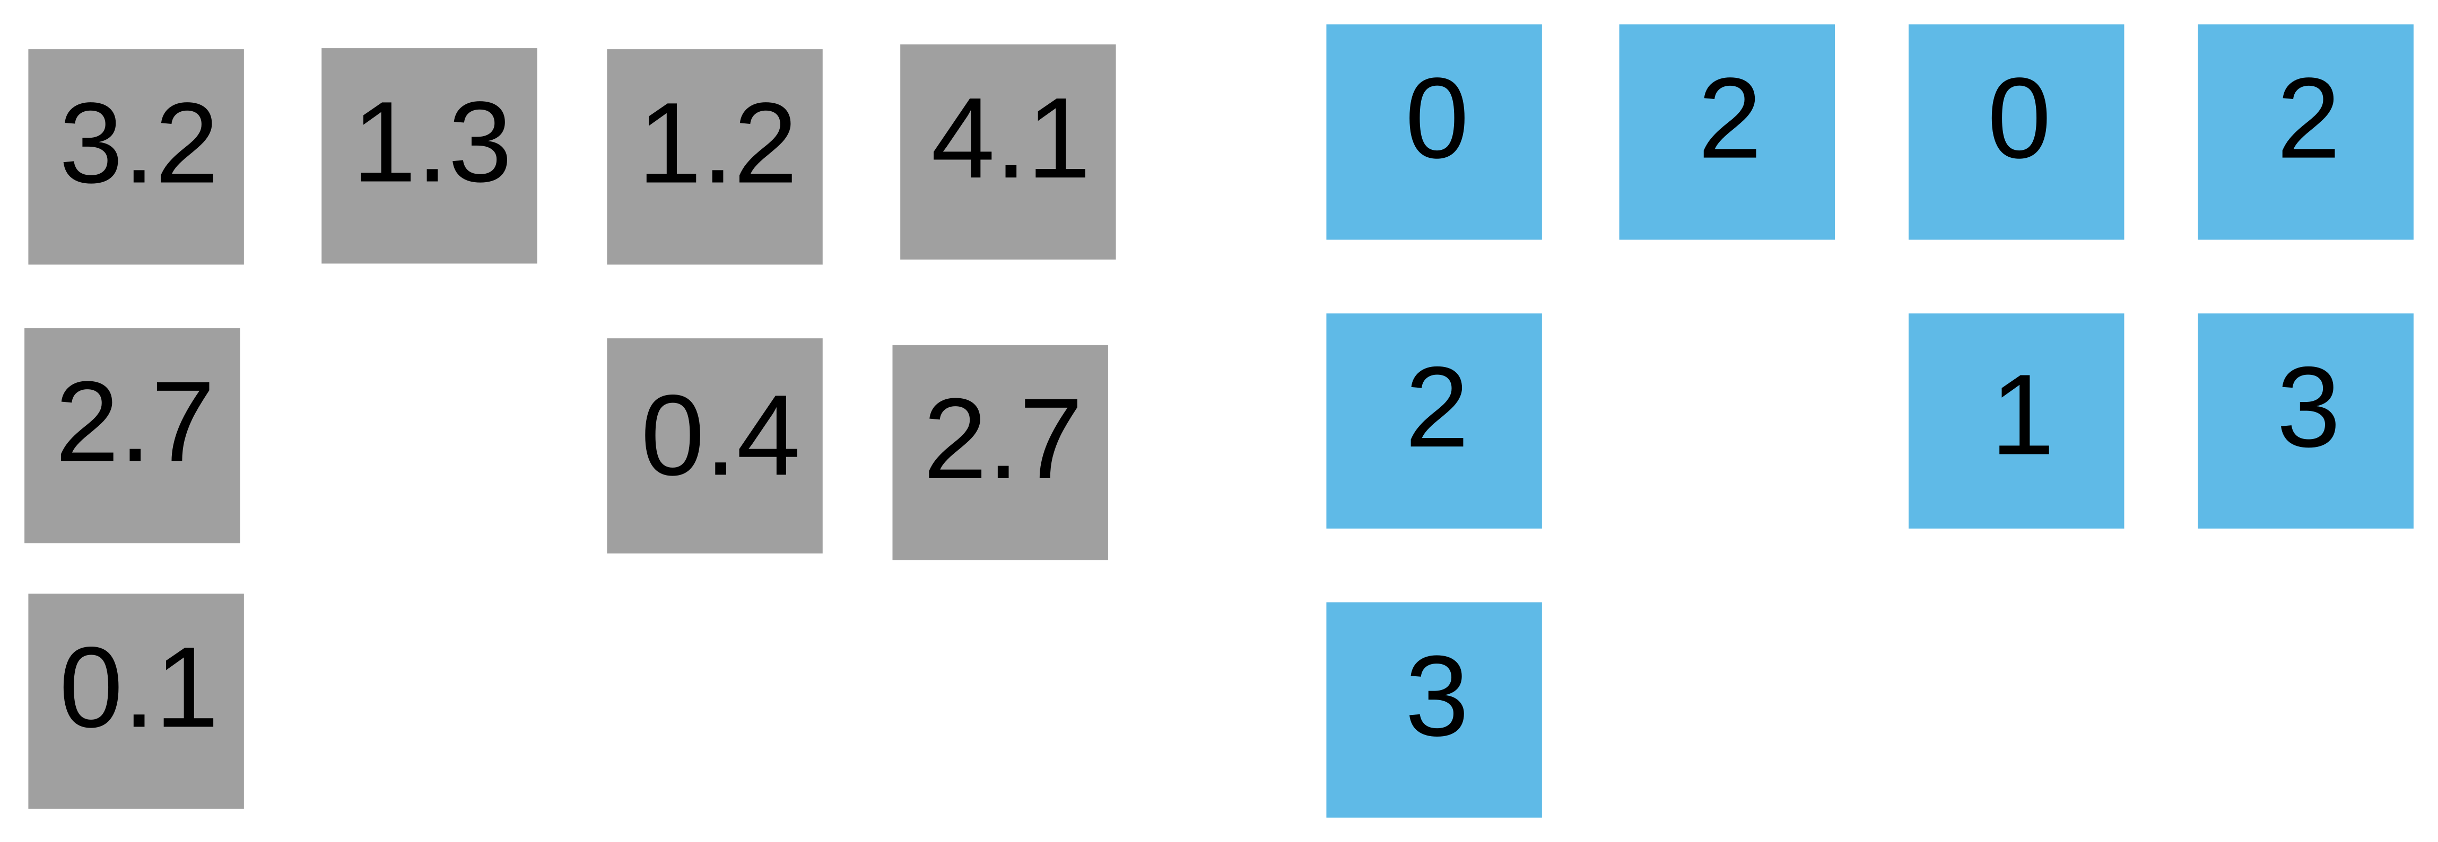
Sparse matrix formats
… leads to CSC

Slide 39
Sparse matrix formats
… leads to CSC
“Standard” approach
CSR

Slide 40
CSR SpMV
Values (val)
Column indexes (colidx)
Row pointers (rowptr)

Slide 41

CSR SpMV
Values (val)
Column indexes (colidx)
Row pointers (rowptr)

Slide 42
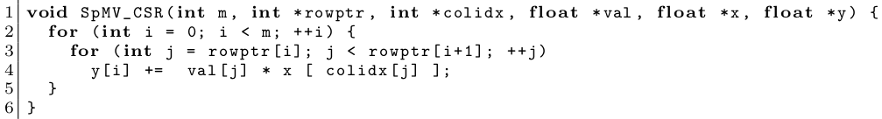
CSR SpMV
Values (val)
Column indexes (colidx)
Row pointers (rowptr)

Slide 43
CSR SpMV
Values (val)
Column indexes (colidx)
Row pointers (rowptr)
Bell & Garland ‘08
  parallelize outer loop
~ cuSPARSE SpMV

Slide 44
CSR SpMV
Values (val)
Column indexes (colidx)
Row pointers (rowptr)
Bell & Garland ‘08
  parallelize outer loop
~ cuSPARSE SpMV
Load imbalance!
Non-coalescence!

Slide 45
CSR SpMV
Values (val)
Column indexes (colidx)
Row pointers (rowptr)
Bell & Garland ‘08
  parallelize outer loop
~ cuSPARSE SpMV
Load imbalance!
Non-coalescence!
Specialized formats
  HYB – ELL + COO
  SELL-P – good memory access, parallelizes well
  … a few new ones every year

Slide 46
CSR SpMV
Values (val)
Column indexes (colidx)
Row pointers (rowptr)
Bell & Garland ‘08
  parallelize outer loop
~ cuSPARSE SpMV
Load imbalance!
Non-coalescence!
Specialized formats
  HYB – ELL + COO
  SELL-P – good memory access, parallelizes well
  … a few new ones every year
Library code – SpMV is not the only kernel!

Slide 47
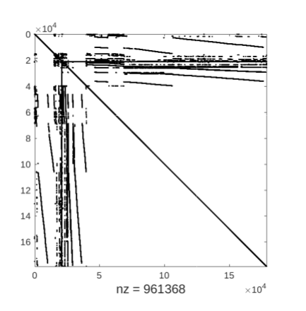
Motivating example
Freescale/transient

Slide 48
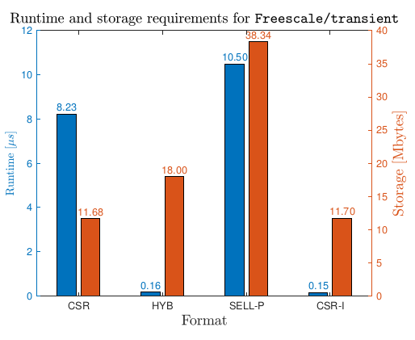
Motivating example
* GTX 1080
Freescale/transient
Can we do better than HYB using CSR?

Slide 49
Motivating example
* GTX 1080
Freescale/transient
Can we do better than HYB using CSR?
55x speedup
YES!

Slide 50
How to publish an SpMV paper
<irony>
Think of a “new” algorithm / format for sparse matrix-vector product
  Does not have to be great, can do stuff in software that the hardware will already do automatically, or not have to even give correct results (no one checks)
Find 10 - 20 matrices from the SuiteSparse collection where your algorithm is faster than any other algorithms / formats you compare
  Not that difficult, there’s 3000 matrices with different properties, no algorithm handles all the corner cases properly
Write a paper claiming that your algorithm is “on average 50% faster than the competitors”, on a “representative” subset.
Send it to a conference / journal and hope the reviewers do not know a lot about SpMV (most likely true).
Victory!
</irony>
Copyright notice: the “<irony>” tag was shamelessly stolen from Georg Hager’s “Thirteen modern ways to fool the masses with performance results on parallel computers”, https://blogs.fau.de/hager/archives/category/fooling-the-masses

Slide 51
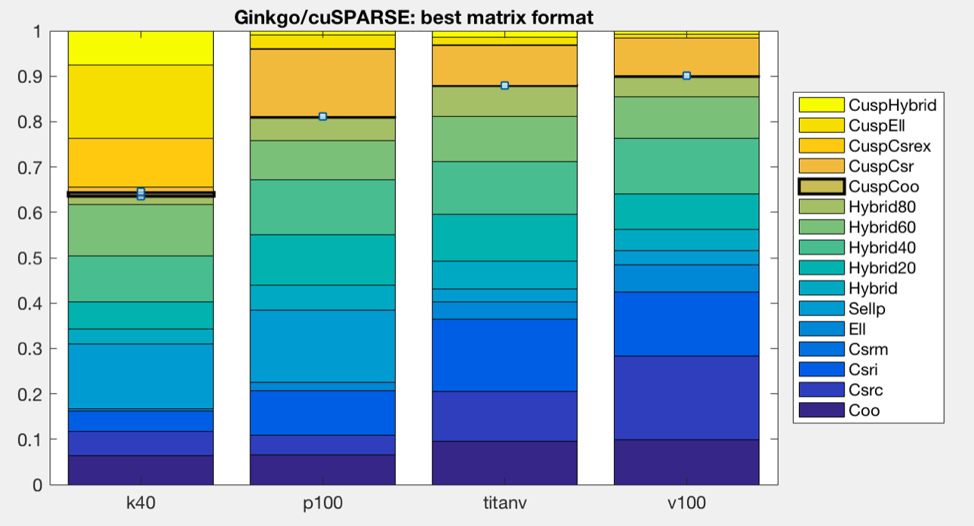
The real world
THERE IS NO “BEST” SPARSE MATRIX FORMAT / SpMV ALGORITHM
Can we figure out which format is going to give best performance for a given problem?
Maybe...

Slide 52
Motivating example
* GTX 1080
Freescale/transient
55x speedup

Slide 53
Choosing the winner a priori
CSR-I designed for irregular patterns

Slide 54
Choosing the winner a priori
CSR-I designed for irregular patterns
How to measure irregularity?
Deviation of row lengths from the mean.

Slide 55
Choosing the winner a priori
CSR-I designed for irregular patterns
How to measure irregularity?
Deviation of row lengths from the mean.
Is “5” regular or irregular?
Depends on the density of the matrix (mean #rows)

Slide 56
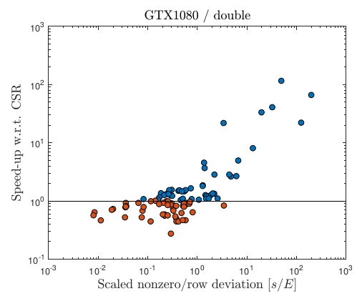
Choosing the winner a priori
CSR-I designed for irregular patterns
How to measure irregularity?
Deviation of row lengths from the mean.
Is “5” regular or irregular?
Depends on the density of the matrix (mean #rows)
Scatter plot of speedup vs normalized std. dev.

Slide 57
Choosing the winner a priori
CSR-I designed for irregular patterns
How to measure irregularity?
Deviation of row lengths from the mean.
Is “5” regular or irregular?
Depends on the density of the matrix (mean #rows)
Scatter plot of speedup vs normalized std. dev.
<0.1 use CSR
>1 use CSR-I
Benchmark both

Slide 58
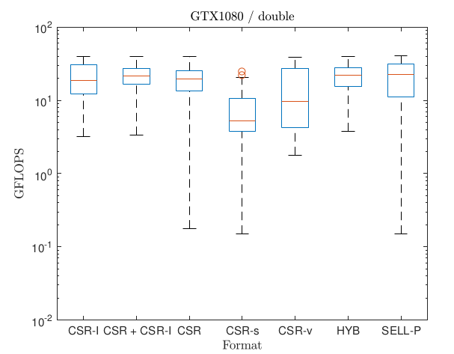
Combining both approaches

Slide 59
Outlook
Choosing the correct combination of
matrix format
solver
preconditioner
… requires expert knowledge or significant trial and error.
Can we create a tool that does it (semi-)automatically?

Slide 60

Thank you! Questions?
All functionalities are part of the MAGMA-sparse project.
Scan me for slides!
github.com/gflegar/talks/tree/master/ibm_zurich_2017_09
http://icl.cs.utk.edu/magma/
This research is based on a cooperation between Hartwig Anzt (Karlsruhe Institute of Technology),
Jack Dongarra (University of Tennessee), Nicholas Higham (University of Manchester), Goran Flegar and Enrique S. Quintana-Ortí (Universidad Jaume I).

