Slide 1
Batched Generation of Block-Jacobi Preconditioners for Iterative Sparse Linear System Solvers on GPUs
Hartwig Anzt, Jack Dongarra, Goran Flegar,
Enrique S. Quintana-Ortí, Andrés E. Tomás
ICCS 2017, Zürich, Switzerland

Slide 2
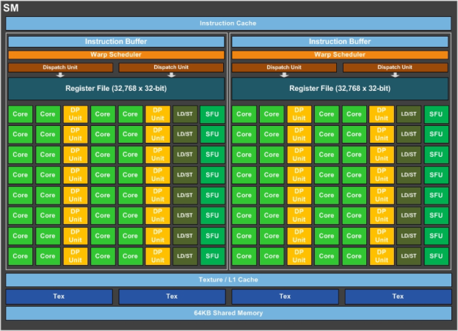
Iterative linear system solvers
Goal: solve linear system using an iterative Krylov method
Convergence typically benefits from using a preconditioner
ILU-based preconditioners offer limited concurrency
  Their use on GPUs is an area of active research
Need high degree of parallelism to use a GPU effectively
source: devblogs.nvidia.com/parallelforall/

Slide 3
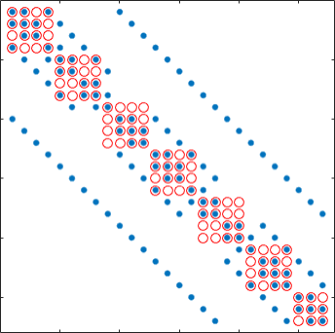
Block-Jacobi Preconditioning
Scalar Jacobi
  Scale with inverses of diagonal elements
Block-Jacobi
  Scale with inverses of diagonal blocks (possibly of different sizes!)
  Can reflect the block structure of the problem
  Often superior to scalar Jacobi
Can proces each block independently
  Suitable for GPUs

Slide 4
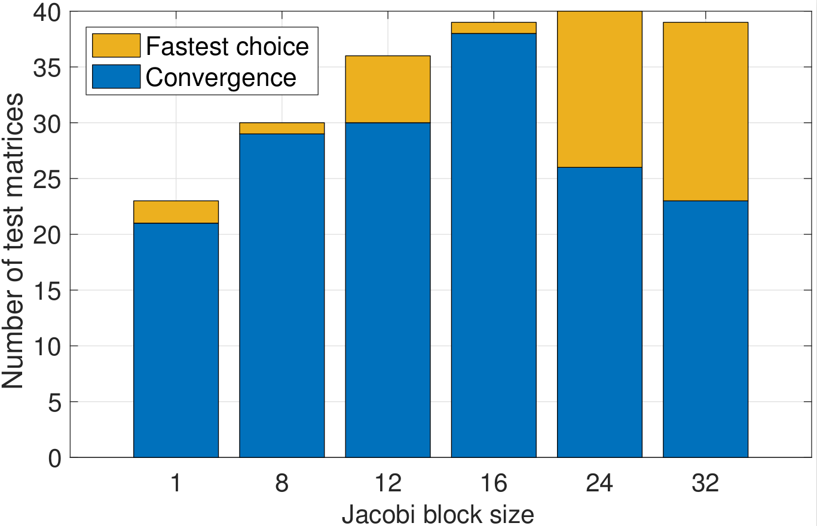
Benefits of block-Jacobi
40 matrices from SuiteSparse
MAGMA-sparse open source library
  IDR solver
  Jacobi preconditioner
  Supervariable blocking
Block-Jacobi improves the robustness of the solver
  More problems converge
Decreases time-to-solution

Slide 5
General Ideas
Restrict block size to 32x32
  Larger block-sizes require more memory to store the preconditioner
  More efficient implementation

Slide 6
General Ideas
Restrict block size to 32x32
  Larger block-sizes require more memory to store the preconditioner
  More efficient implementation
Use a single warp to process the whole block
  No need for explicit synchronization

Slide 7
General Ideas
Restrict block size to 32x32
  Larger block-sizes require more memory to store the preconditioner
  More efficient implementation
Use a single warp to process the whole block
  No need for explicit synchronization
Use the large register file to store the entire block
  Read/write from global memory
  No load/store instructions
  Com. via warp shuffles

Slide 8
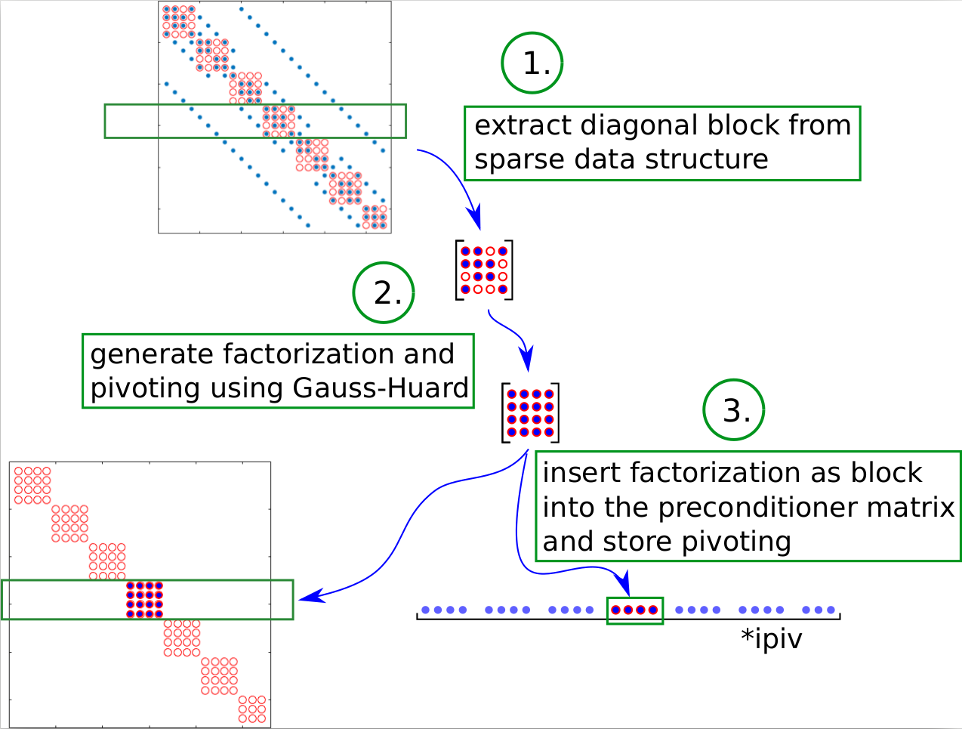
Different options
Inversion in preconditioner setup + matrix-vector product in application
  (2n³ + 2n² FLOPS)
  H. Anzt et all., “Batched Gauss-Jordan Elimination for Block-Jacobi Preconditioner Generation on GPUs”, PMAM’17
Matrix decomposition in setup + solve in application
  (2/3n³ + 2n² FLOPS)
  Gauss-Huard decomposition

Slide 9
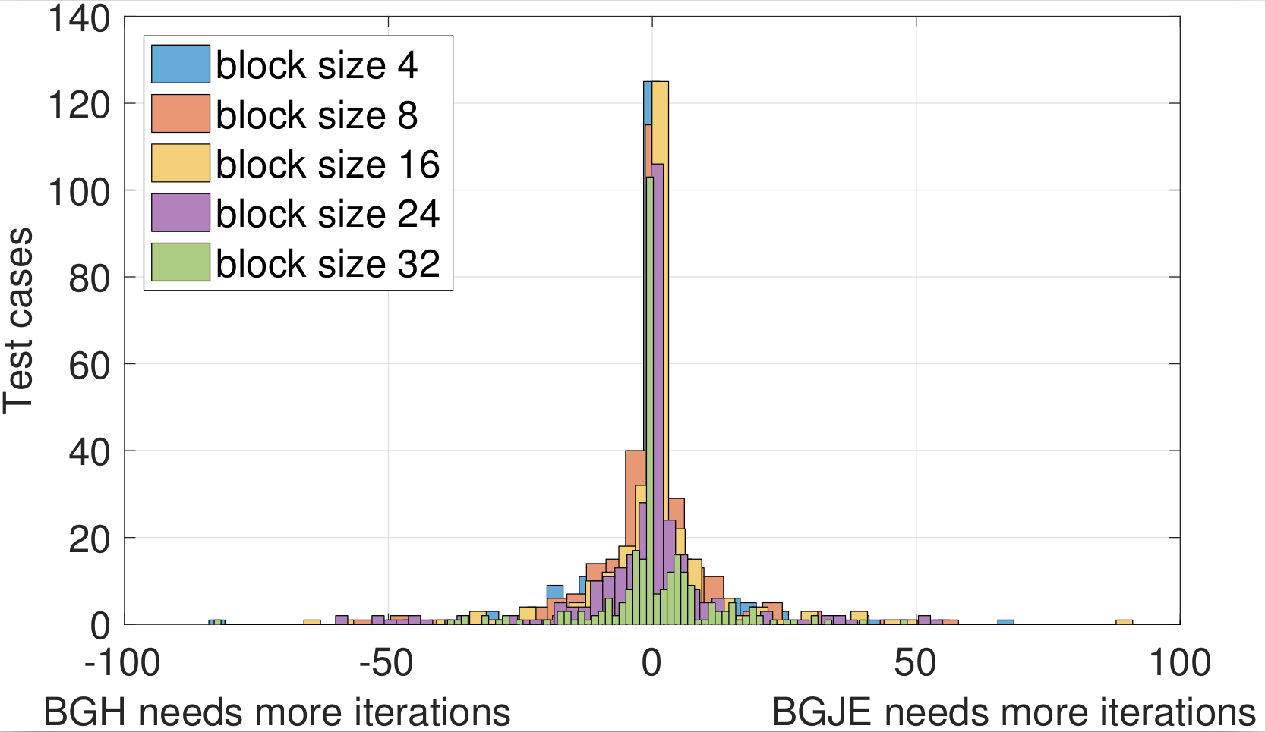
Inversion?!

Slide 10
Gauss-Huard decomposition
Decomposition
  GEMV (DOT at each thread)
  GER (AXPY at each thread)
  Column pivoting
    Do not swap the columns, just remember which thread holds which column of the result
Solve
  Store only the solution vector into regs.
  DOT (reduction)
  AXPY (map)
  Store lower part transposed wrp. to anti-diagonal for coalesced mem. access

Slide 11
Gauss-Jordan elimination
Inversion
  SCAL (map)
  GER (axpy at each thread)
GEMV
  AXPY (map)

Slide 12
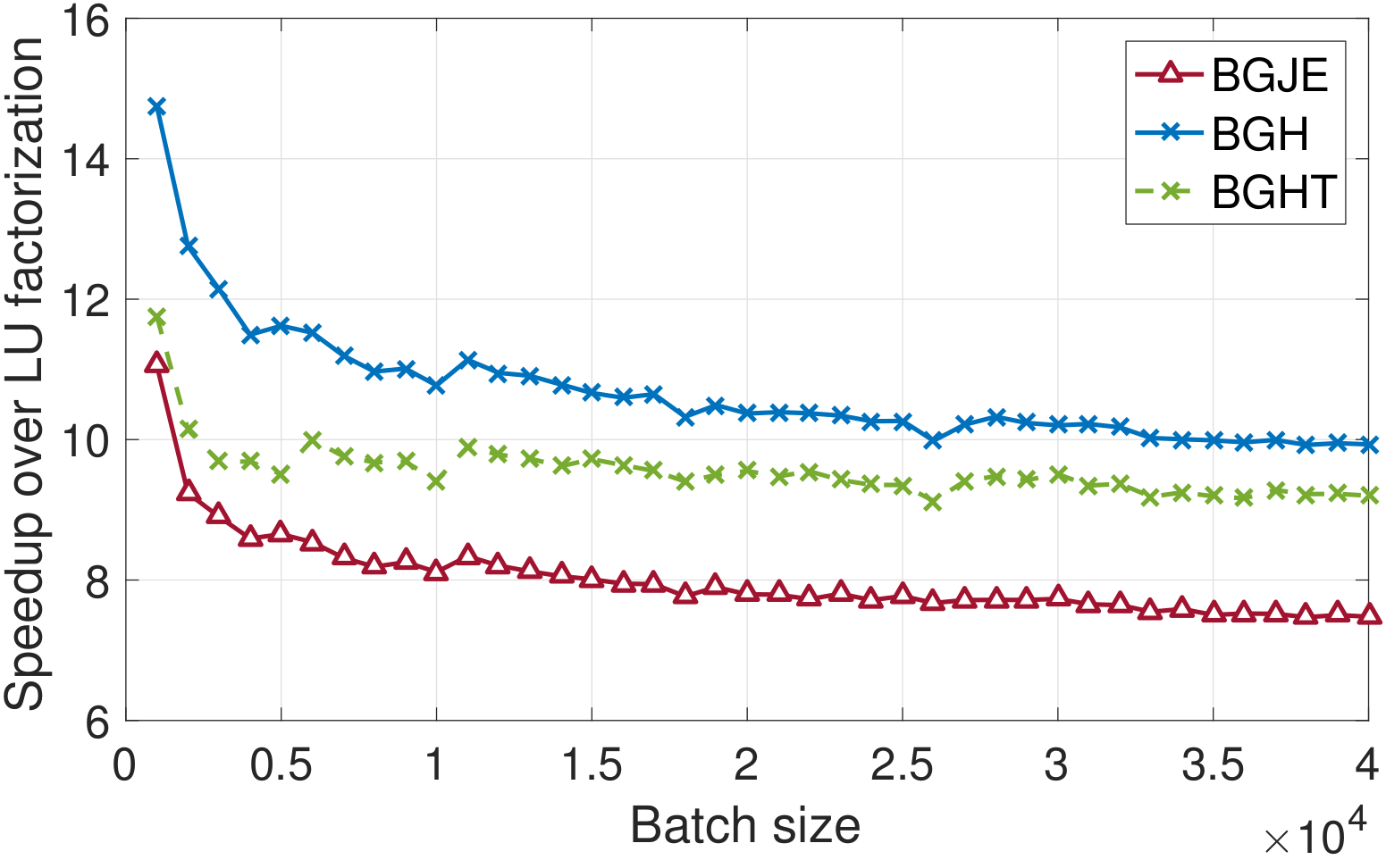
Comparison to batched LU (MAGMA)

Slide 13
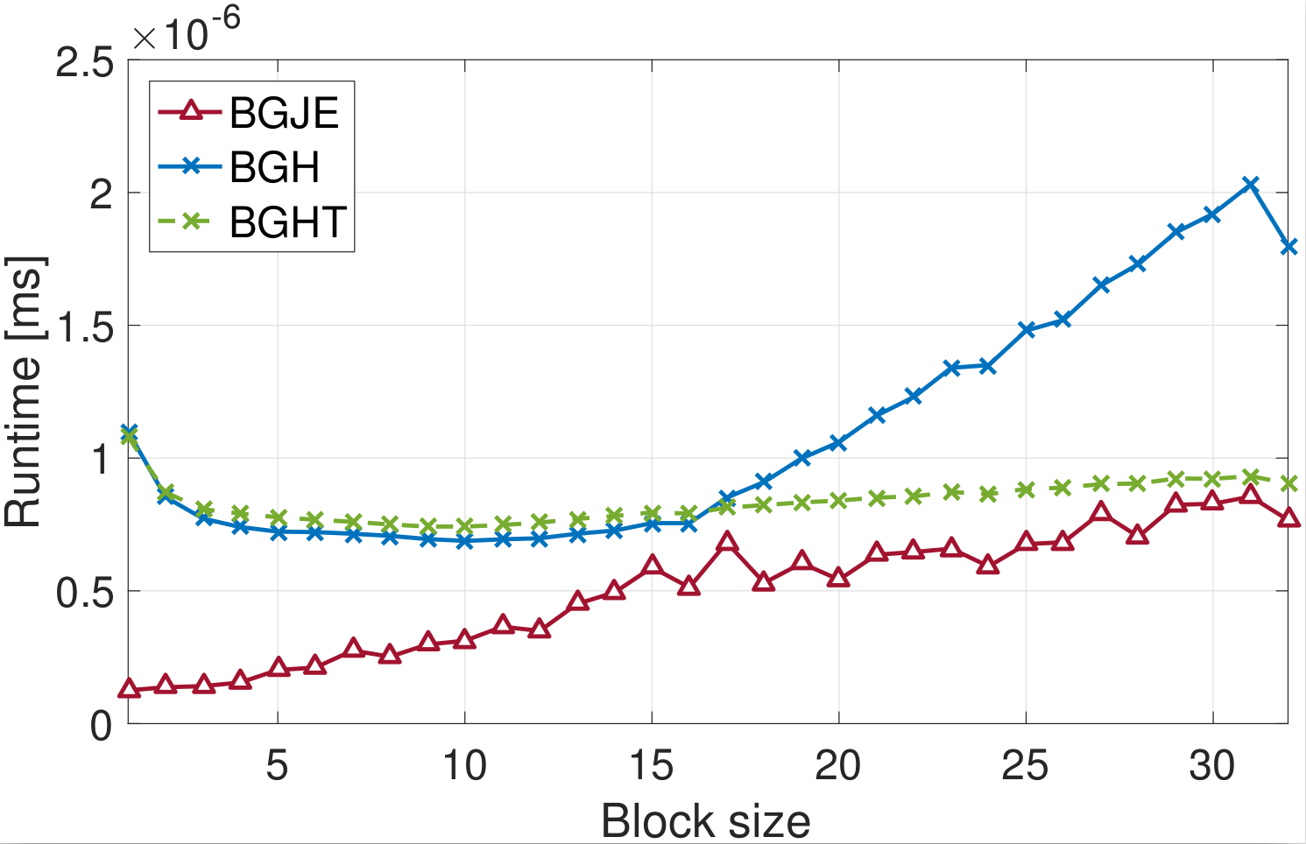
Application time

Slide 14
Inversion- vs factorization-based block-Jacobi

Slide 15
Total runtime of the solver

Slide 16
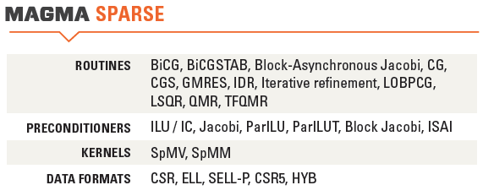


Thank you! Questions?
All functionalities are part of the MAGMA-sparse project.
This research is based on a cooperation between Hartwig Anzt, Jack Dongarra (University of Tennessee),
Goran Flegar, Enrique S. Quintana-Ortí and Adrés E. Tomás (Universidad Jaume I)

Slide 17
Colors

