Slide 1

Flexible-Size Batched Inversion and Factorization Routines for Block-Jacobi preconditioning on GPUs
Goran Flegar
Joint work with Hartwig Anzt, Enrique S. Quintana Ortí

Slide 2

Problem setting
Sparse linear system
  Majority of coefficients is 0
  Fluid dynamics, circuit simulation, graph analytics,
Solve it using an iterative Krylov method

Slide 3

Preconditioning
Improve convergence by solving a preconditioned system
  Explicitly computing the matrix product causes fill-in
  Avoid it by decomposing the application of the resulting operator into two parts:
    Sparse matrix-vector product
    Preconditioner application
Preconditioning split into two parts
  Preconditioner generation
  Preconditioner application
Trade-off: faster convergence, but more work in each iteration

Slide 4
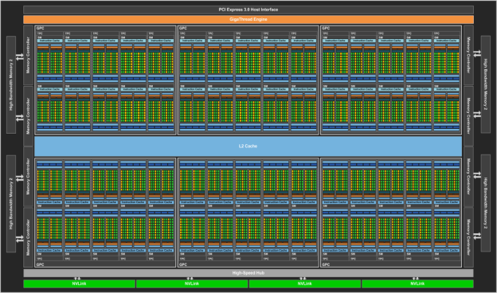
GPU programming 101
NVIDIA P100 GPU
  4.7 TFLOPs DP performance
  732 / 549 GB/s (1 : 59 ratio)
  56 SMs x 64 cores = 3584 cores!
Programming model:
  Thread
    assigned to 1 core (but possible to assign multiple threads to 1 core)
  Warp
    Group of 32 threads
    Perfectly synchronized execution
    Can share values directly from the registers (1KB / thread)
    Cannot execute different instructions (warp divergence)
source: devblogs.nvidia.com/parallelforall/

Slide 5
GPU programming 101
Programming model:
  Block
    Group of several warps (at most 64)
    Can be explicitly synchronized
    Can share data via shared memory (64KB)
  Grid
    Group of blocks
    Cannot synchronize!
    Global memory (12 or 16GB)
    Simple caches
    Atomics
source: devblogs.nvidia.com/parallelforall/

Slide 6
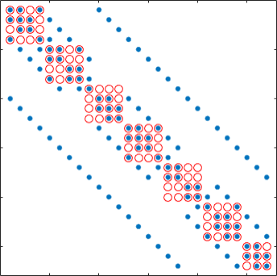
Block-Jacobi preconditioning
Scalar Jacobi
  Scale with inverse of main diagonal
Block-Jacobi
  Scale with inverses of diagonal blocks (possibly of different sizes!)
  Can reflect the block structure of the problem
  Often superior to scalar Jacobi
Can process each block independently!

Slide 7
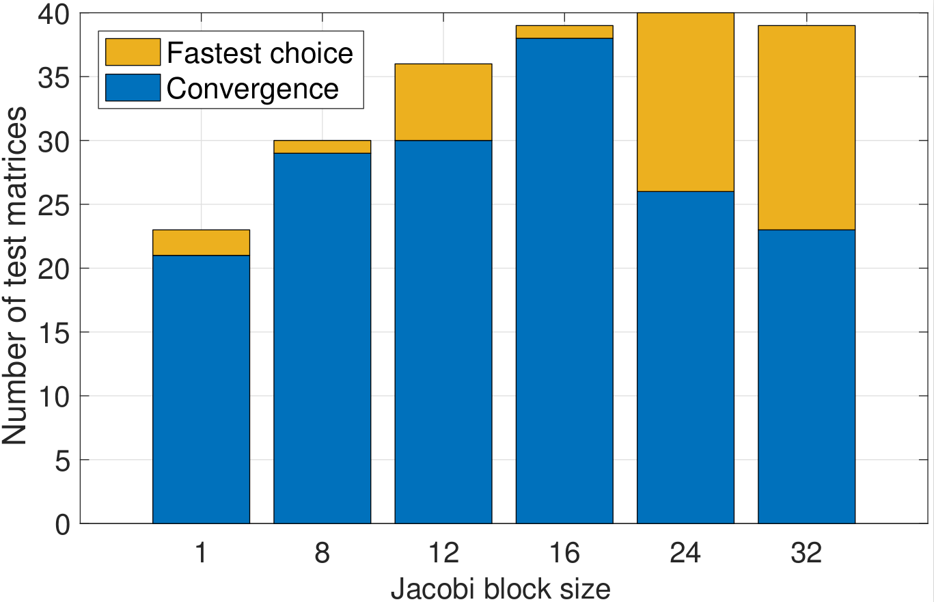
Benefits of block-Jacobi
40 matrices from SuiteSparse
MAGMA-sparse open source library
  IDR solver
  Jacobi preconditioner
  Supervariable blocking
Block-Jacobi improves the robustness of the solver
  More problems converge
Decreases time-to-solution

Slide 8
General Ideas
Restrict block size to 32x32
  Large block sizes require more memory to store the preconditioner matrix

Slide 9
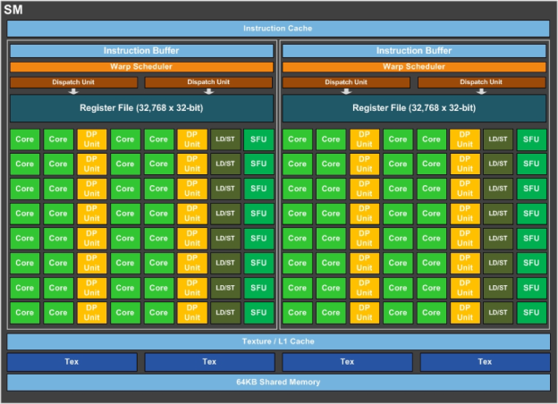
General Ideas
Restrict block size to 32x32
  Large block sizes require more memory to store the preconditioner matrix
Use a single warp to process the whole block (one thread per column)
  No need for explicit synchronization

Slide 10
General Ideas
Restrict block size to 32x32
  Large block sizes require more memory to store the preconditioner matrix
Use a single warp to process the whole block (one thread per column)
  No need for explicit synchronization
Use the large register file to store the entire block
  Read/write from mem. once
  Comm. via warp shuffles
  Avoids load/store instructions

Slide 11
Implementation options
Inversion in preconditioner setup + matrix-vector product in application
  (FLOPS: 2n³ setup, 2n² app.)
  Batched Gauss-Jordan elimination (BGJE)
    Each step consists of column scaling and a rank-1 update of the whole matrix
    Easily achievable load balancing
  H. Anzt et al., “Batched Gauss-Jordan Elimination for Block-Jacobi Preconditioner Generation on GPUs”, PMAM’17

Slide 12
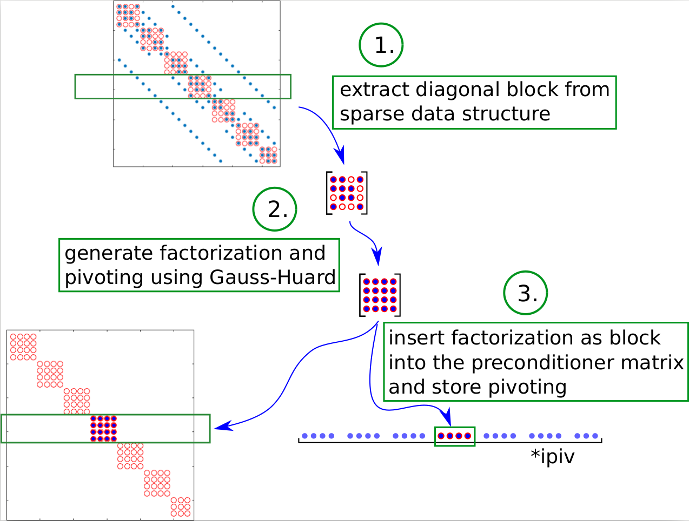
Implementation options
Matrix decomposition in setup + solve in application
  (FLOPS: 2/3n³ setup, 2n² app.)
  Gauss-Huard decomposition

Slide 13
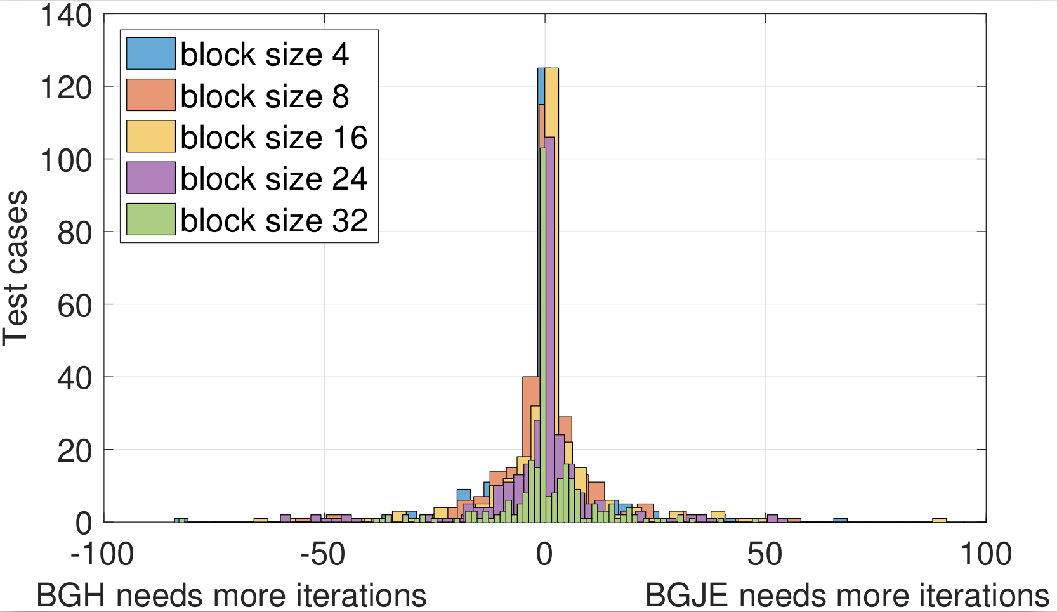
Inversion?!

Slide 14

Gauss-Huard decomposition
Decomposition
  GEMV (G = G - RR)
  SCAL (O = O / B)
  GER (L = L - BO)
  Column pivoting
    Do not swap the columns, just remember which thread holds which column of the result

Slide 15

Gauss-Huard decomposition
Decomposition
  GEMV (G = G - RR)
  SCAL (O = O / B)
  GER (L = L - BO)
  Column pivoting
    Do not swap the columns, just remember which thread holds which column of the result
Solve
  Load only the solution vector into registers
  DOT (G = G – RR)
  SCAL (O = O / B)
  AXPY (L = L - BO)
  Write lower part transposed wrp. to anti-diagonal for coalesced mem. access (GHT)

Slide 16
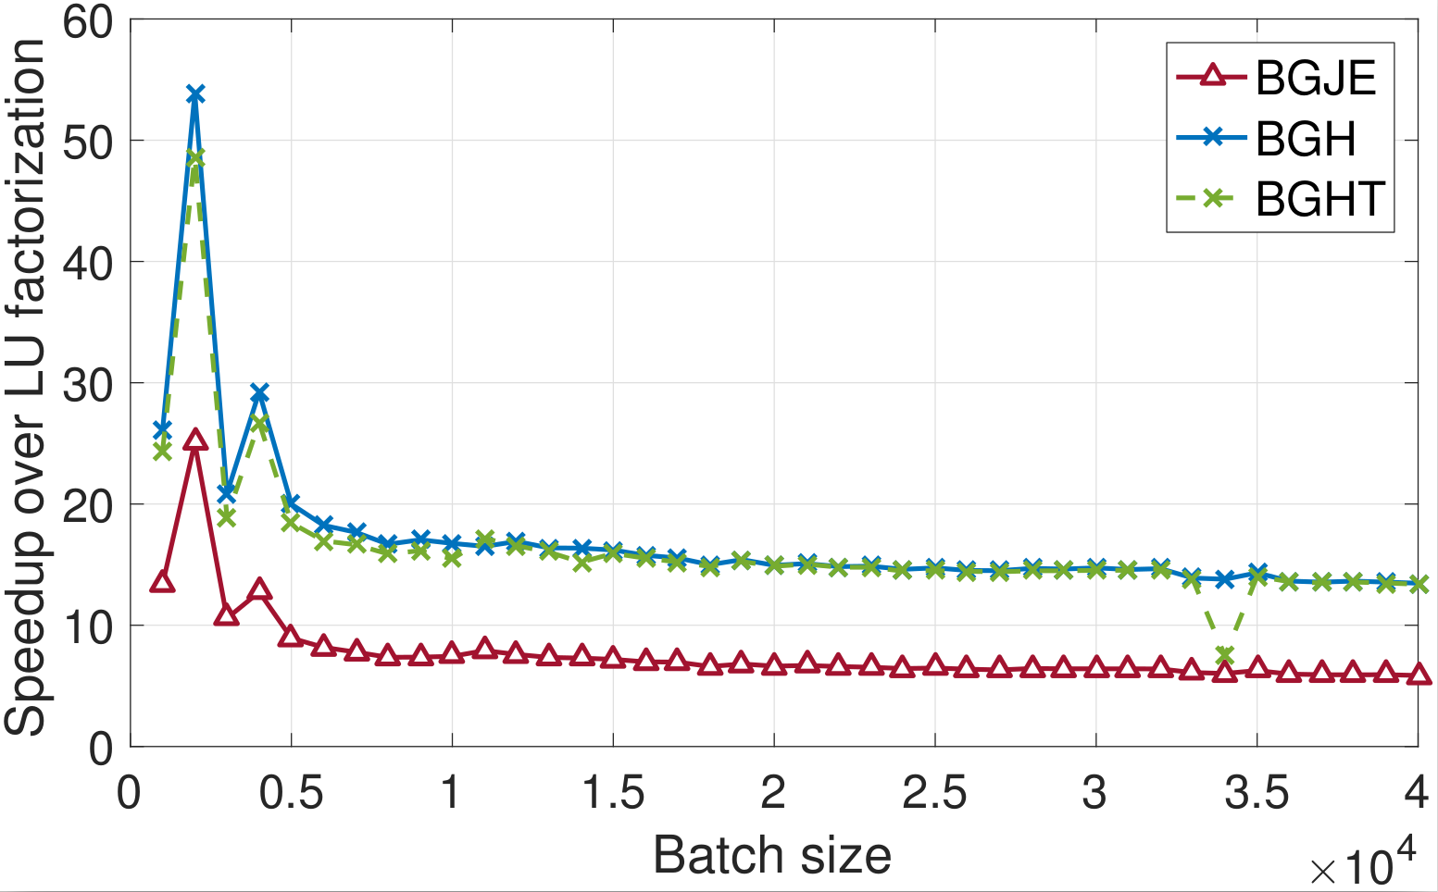
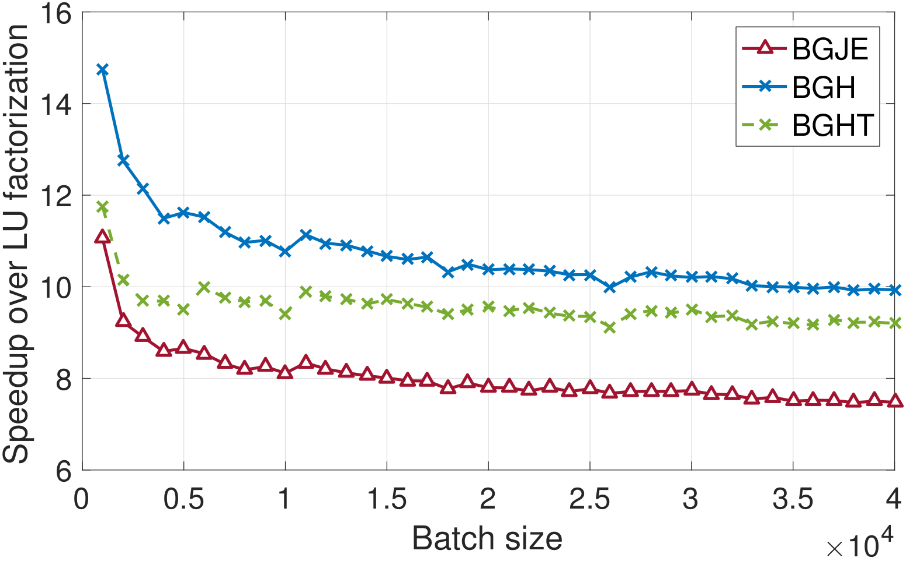
Decomposition comparison to batched LU (MAGMA)
Block size 16
Block size 32

Slide 17
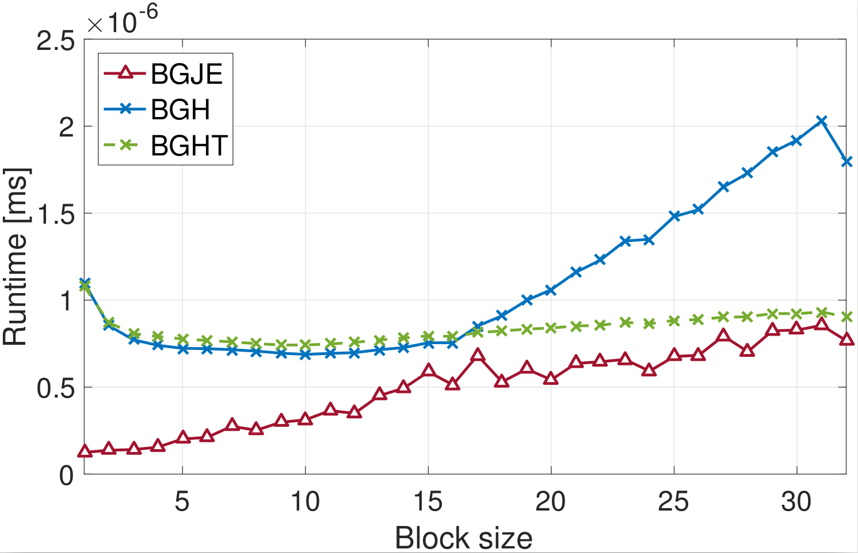
Application time
1,000,000 unknowns

Slide 18
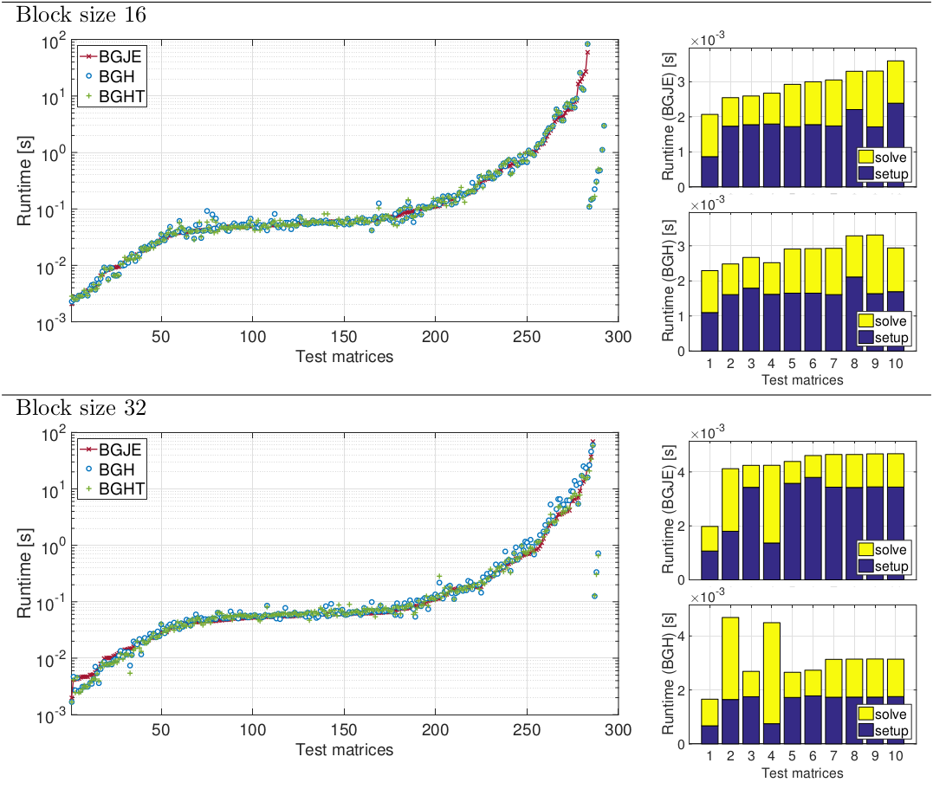
Total runtime of block-Jacobi preconditioned BiCGSTAB

Slide 19
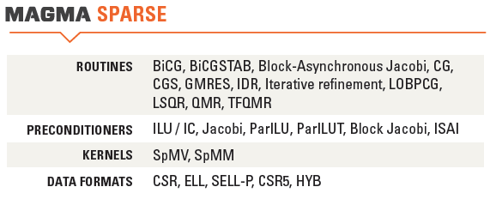


Thank you! Questions?
All functionalities are part of the MAGMA-sparse project.
http://icl.cs.utk.edu/magma/
This research is based on a cooperation between Hartwig Anzt, Jack Dongarra (University of Tennessee),
Goran Flegar, Enrique S. Quintana-Ortí and Adrés E. Tomás (Universidad Jaume I).

