Slide 1

Accelerating the Solution of Sparse Linear Systems Using GPUs
Goran Flegar
Joint work with: Hartwig Anzt, Nicholas Higham, Enrique S. Quintana-Ortí
Scan me for slides!
github.com/gflegar/talks/tree/master/pmf_zagreb_2017_12

Slide 2










MAGMA-sparse software library
GPU-accelerated sparse linear algebra library
  Focus: linear systems
Joint effort: Innovative Computing Lab at University of Tennessee, Knoxvile; Karlsruhe Institute of Technology; Universidad Jaume I

Slide 3
MAGMA-sparse software library
GPU-accelerated sparse linear algebra library
  Focus: linear systems
  Iterative, Krylov-subspace based linear solvers
    SpMV
    BLAS-1 operations
Joint effort: Innovative Computing Lab at University of Tennessee, Knoxvile; Karlsruhe Institute of Technology; University Jaume I

Slide 4
MAGMA-sparse software library
GPU-accelerated sparse linear algebra library
  Focus: linear systems
  Iterative, Krylov-subspace based linear solvers
    SpMV
    BLAS-1 operations
  Sparse matrix formats & SpMV
    accelerate each iteration of the solver
Joint effort: Innovative Computing Lab at University of Tennessee, Knoxvile; Karlsruhe Institute of Technology; University Jaume I

Slide 5
MAGMA-sparse software library
GPU-accelerated sparse linear algebra library
  Focus: linear systems
  Iterative, Krylov-subspace based linear solvers
    SpMV
    BLAS-1 operations
  Sparse matrix formats & SpMV
    accelerate each iteration of the solver
  Preconditioners
    reduce the number of iterations
Joint effort: Innovative Computing Lab at University of Tennessee, Knoxvile; Karlsruhe Institute of Technology; University Jaume I

Slide 6
MAGMA-sparse software library
GPU-accelerated sparse linear algebra library
  Focus: linear systems
  Iterative, Krylov-subspace based linear solvers
    SpMV
    BLAS-1 operations
  Sparse matrix formats & SpMV
    accelerate each iteration of the solver
  Preconditioners
    reduce the number of iterations
Joint effort: Innovative Computing Lab at University of Tennessee, Knoxvile; Karlsruhe Institute of Technology; Universitat Jaume I

Slide 7

Preconditioning

Slide 8

Preconditioning
Replace the original system with an equivalent preconditioned system

Slide 9


Preconditioning
Replace the original system with an equivalent preconditioned system

Slide 10

Preconditioning
Replace the original system with an equivalent preconditioned system
Do not compute the preconditioned system matrix explicitly!

Slide 11

Preconditioning
Replace the original system with an equivalent preconditioned system
Do not compute the preconditioned system matrix explicitly!

Slide 12


Preconditioning
Replace the original system with an equivalent preconditioned system
Do not compute the preconditioned system matrix explicitly!
Preconditioner application

Slide 13

Preconditioning
Replace the original system with an equivalent preconditioned system
Do not compute the preconditioned system matrix explicitly!
Generate the preconditioner matrix, and store it in a form suitable for application
Preconditioner setup
Preconditioner application

Slide 14
Preconditioning
Replace the original system with an equivalent preconditioned system
Do not compute the preconditioned system matrix explicitly!
Generate the preconditioner matrix, and store it in a form suitable for application
Preconditioner setup
Preconditioner application
Trade-off:
faster convergence,
but more work per iteration

Slide 15
Block-Jacobi preconditioning
Current focus: improve performance for problems with inherent block structure
  Usually blocks are smaller than 30x30 (blocks can be of different sizes!)

Slide 16



Block-Jacobi preconditioning
Current focus: improve performance for problems with inherent block structure
  Usually blocks are smaller than 30x30 (blocks can be of different sizes!)
Block-Jacobi preconditioning
  Use only diagonal blocks for approximation

Slide 17
Benefits of block-Jacobi
56 matrices from SuiteSparse
MAGMA-sparse open source library
  IDR solver
  Scalar Jacobi preconditioner
  Supervariable agglomeration
    Detects block structure of the matrix

Slide 18

Benefits of block-Jacobi
56 matrices from SuiteSparse
MAGMA-sparse open source library
  IDR solver
  Scalar Jacobi preconditioner
  Supervariable agglomeration
    Detects block structure of the matrix
Improves the robustness of the solver

Slide 19
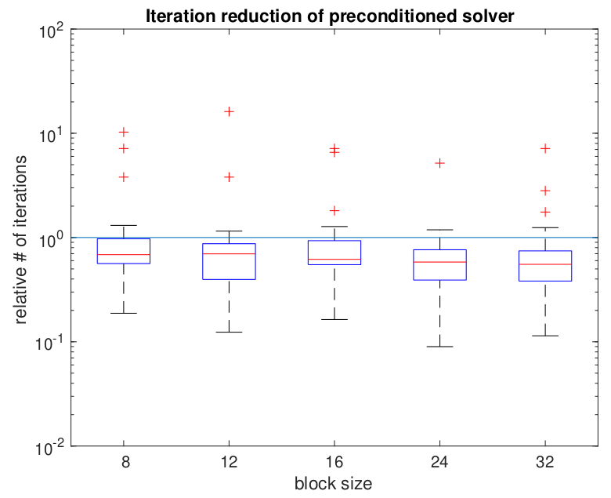
Benefits of block-Jacobi
56 matrices from SuiteSparse
MAGMA-sparse open source library
  IDR solver
  Scalar Jacobi preconditioner
  Supervariable agglomeration
    Detects block structure of the matrix
Improves the robustness of the solver
Improves convergence of the solver

Slide 20

Block-Jacobi preconditioning
Current focus: improve performance for problems with inherent block structure
  Usually blocks are smaller than 30x30 (blocks can be of different sizes!)
Block-Jacobi preconditioning
  Use only diagonal blocks for approximation

Slide 21


Block-Jacobi preconditioning
Current focus: improve performance for problems with inherent block structure
  Usually blocks are smaller than 30x30 (blocks can be of different sizes!)
Block-Jacobi preconditioning
  Use only diagonal blocks for approximation
inv = Gauss-Jordan elimination

Slide 22
Block-Jacobi preconditioning
Current focus: improve performance for problems with inherent block structure
  Usually blocks are smaller than 30x30 (blocks can be of different sizes!)
Block-Jacobi preconditioning
  Use only diagonal blocks for approximation
Setup
Inversion-based block-Jacobi
Application
inv = Gauss-Jordan elimination

Slide 23

Block-Jacobi preconditioning
Current focus: improve performance for problems with inherent block structure
  Usually blocks are smaller than 30x30 (blocks can be of different sizes!)
Block-Jacobi preconditioning
  Use only diagonal blocks for approximation

Slide 24



Block-Jacobi preconditioning
Current focus: improve performance for problems with inherent block structure
  Usually blocks are smaller than 30x30 (blocks can be of different sizes!)
Block-Jacobi preconditioning
  Use only diagonal blocks for approximation

Slide 25
Block-Jacobi preconditioning
Current focus: improve performance for problems with inherent block structure
  Usually blocks are smaller than 30x30 (blocks can be of different sizes!)
Block-Jacobi preconditioning
  Use only diagonal blocks for approximation
Setup
Application
Decomposition-based block-Jacobi

Slide 26

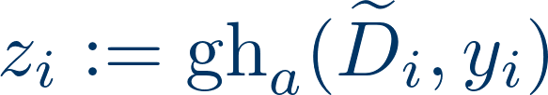
Block-Jacobi preconditioning
Current focus: improve performance for problems with inherent block structure
  Usually blocks are smaller than 30x30 (blocks can be of different sizes!)
Block-Jacobi preconditioning
  Use only diagonal blocks for approximation
gh = Gauss-Huard decomposition / application

Slide 27
Block-Jacobi preconditioning
Current focus: improve performance for problems with inherent block structure
  Usually blocks are smaller than 30x30 (blocks can be of different sizes!)
Block-Jacobi preconditioning
  Use only diagonal blocks for approximation
Setup
Application
Decomposition-based block-Jacobi

Slide 28



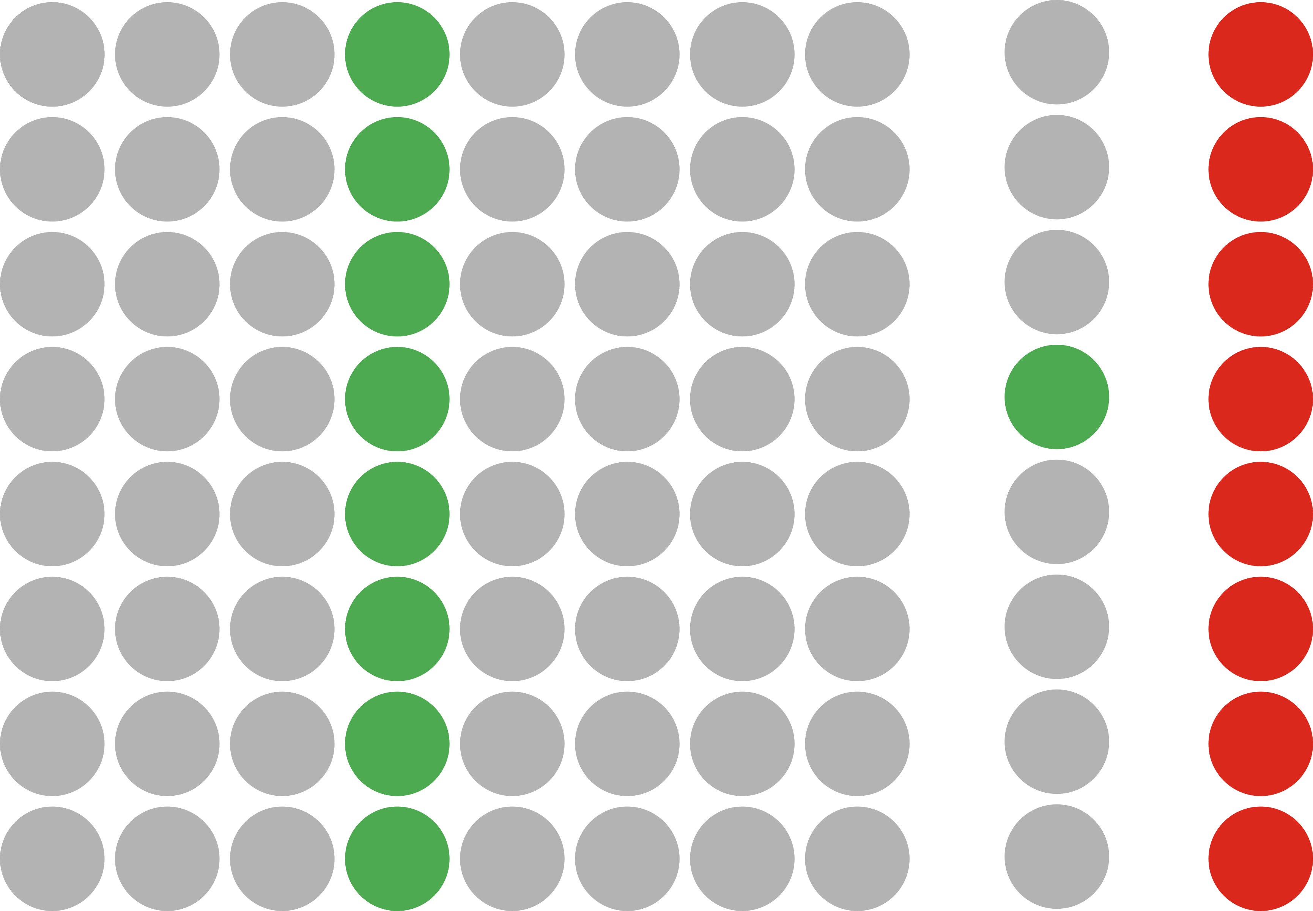
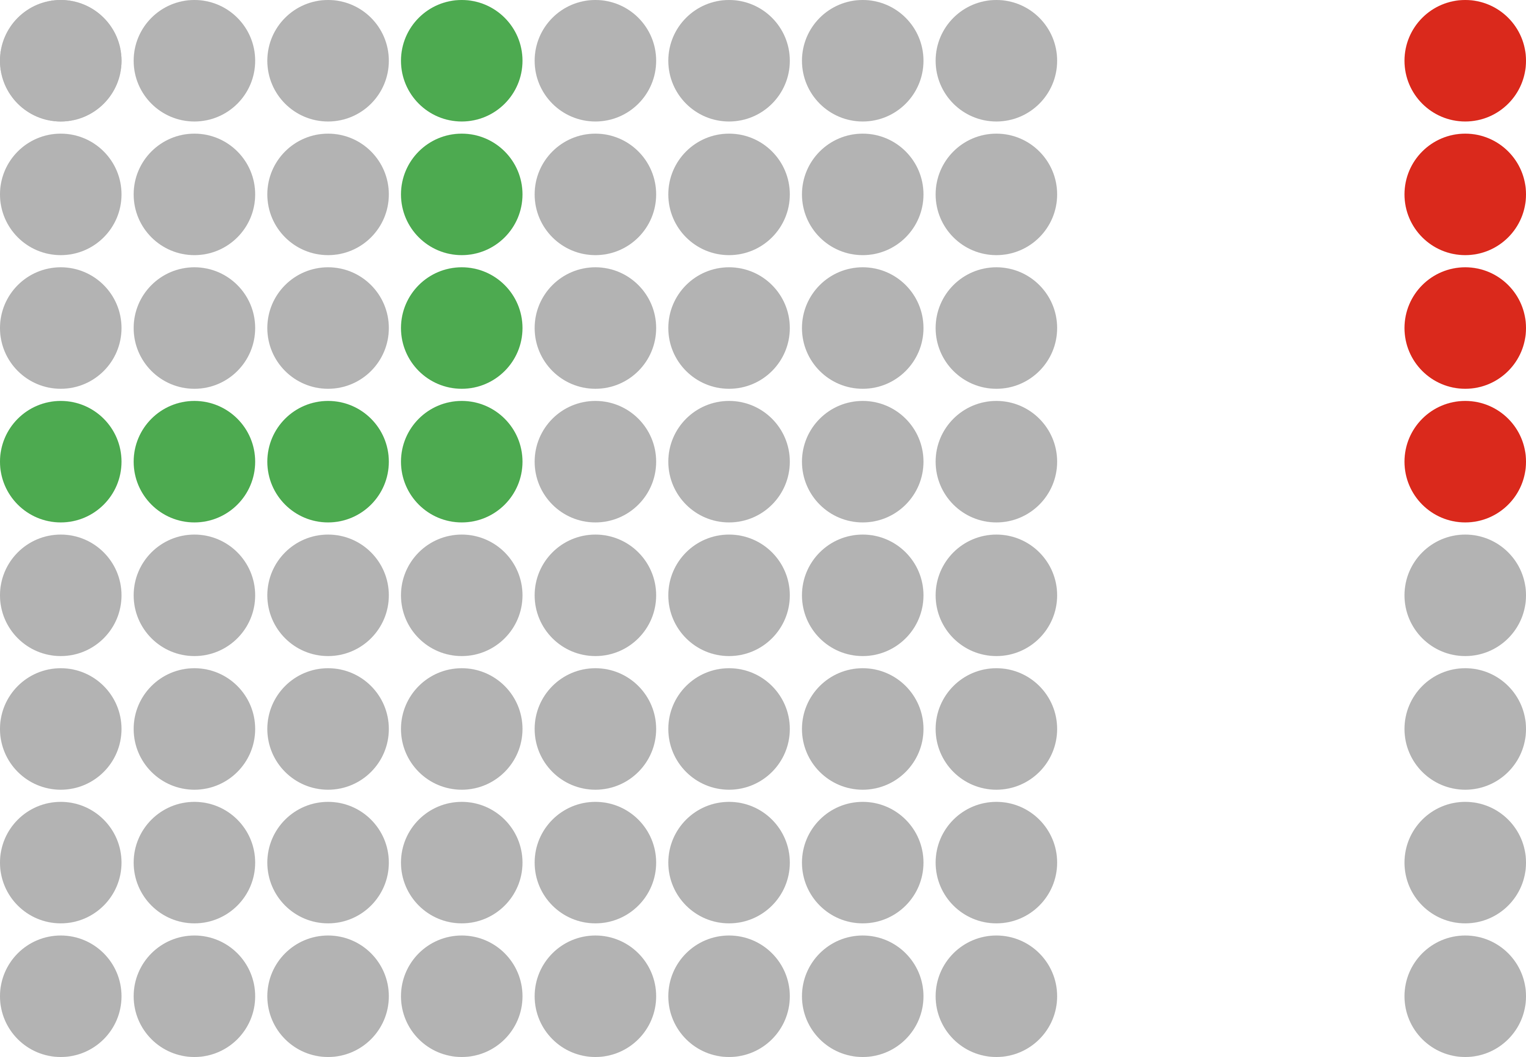
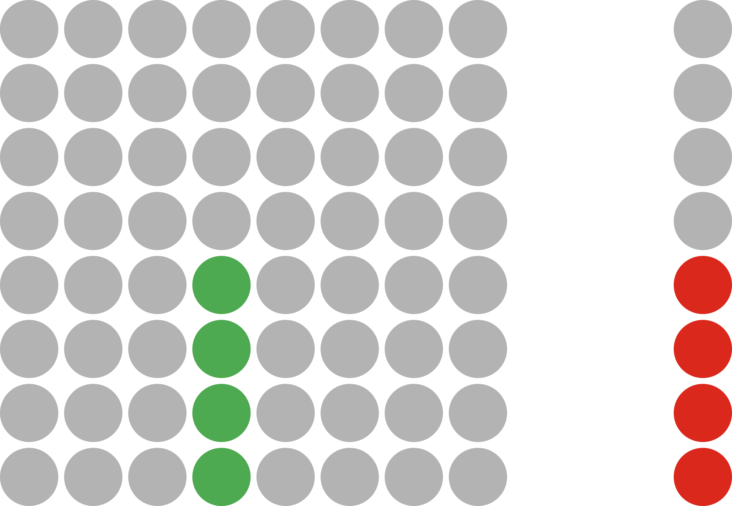


Block-Jacobi setup & application ecosystem
Gauss-Jordan inversion
Gauss-Huard decomposition
LU factorization
Setup
Inversion-based
(2n³ + 2n² FLOPS)
Decomposition-based
(2/3n³ + 2n² FLOPS)
matrix-vector multiply
Gauss-Huard solve
2x triangular solve
Application
H. Anzt et al. “Batched Gauss-Jordan Elimination for
Block-Jacobi Preconditioner Generation on GPUs”, PMAM’17
H. Anzt et al. “Variable-Size Batched Gauss-Huard for Block-Jacobi Preconditioning”, ICCS’17
H. Anzt et al. “Flexible-Size Batched LU for Small Matrices and its Integration into Block-Jacobi Preconditioning”, ICPP’17
- read
- write

Slide 29
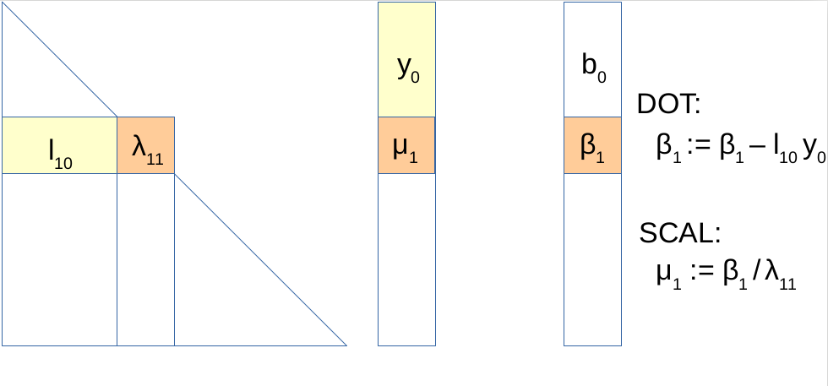
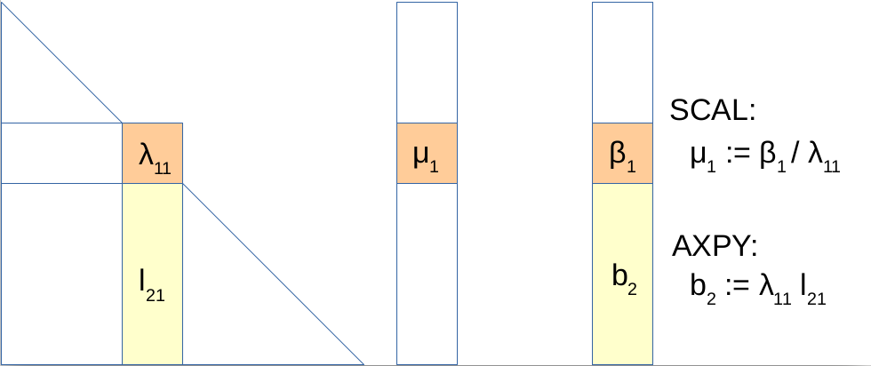
MAGMA-sparse triangular solves
Use “eager” triangular solves
  Cast solution vector updates in terms of axpy, not in terms of dot product!
“Lazy” triangular solve
“Eager” triangular solve

Slide 30
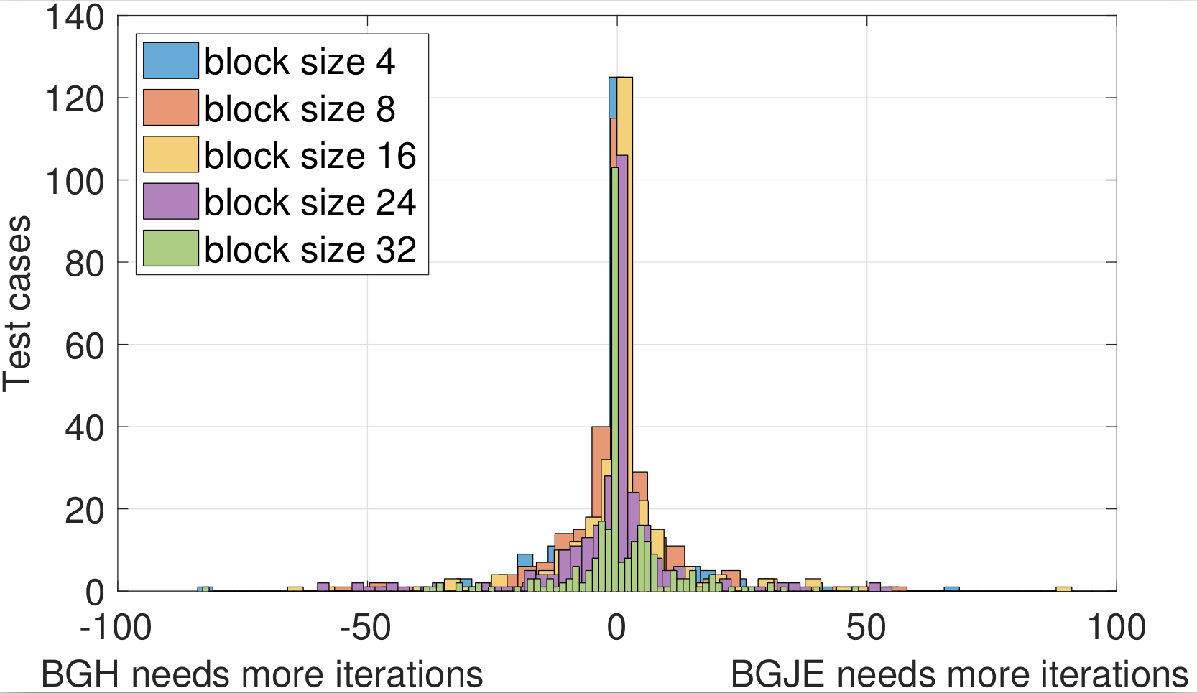
Inversion?!

Slide 31
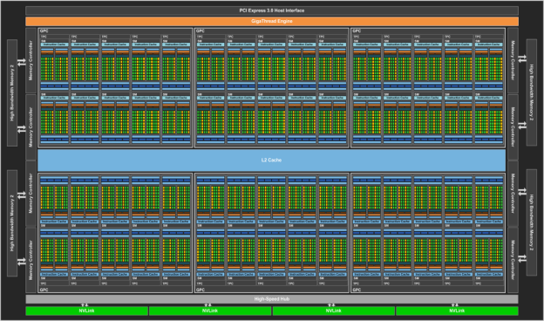
GPU programming 101
NVIDIA P100 GPU
  4.7 TFLOPs DP performance
  Up to 740 GB/s (1 : 51)
  56 SMs x 64 cores = 3584 cores!
source: devblogs.nvidia.com/parallelforall/

Slide 32
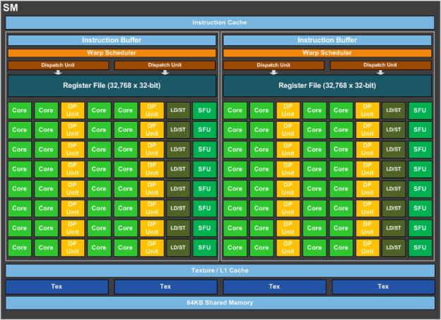
GPU programming 101
NVIDIA P100 GPU
  4.7 TFLOPs DP performance
  Up to 740 GB/s (1 : 51)
  56 SMs x 64 cores = 3584 cores!
Hierarchical architecture / programming model:
  Thread
    Basic building block, assigned to 1 core
source: devblogs.nvidia.com/parallelforall/

Slide 33
GPU programming 101
NVIDIA P100 GPU
  4.7 TFLOPs DP performance
  Up to 740 GB/s (1 : 51)
  56 SMs x 64 cores = 3584 cores!
Hierarchical architecture / programming model:
  Thread
    Basic building block, assigned to 1 core
  Warp
    Group of 32 threads
    Perfectly synchronized execution
    Can share values directly from the registers (1KB / thread)
    Cannot execute different instructions (warp divergence)
source: devblogs.nvidia.com/parallelforall/

Slide 34
GPU programming 101
  Block
    Group of several warps (≤ 64)
    Can be explicitly synchronized
    Can share data via shared memory (64KB)
source: devblogs.nvidia.com/parallelforall/

Slide 35
GPU programming 101
  Block
    Group of several warps (≤ 64)
    Can be explicitly synchronized
    Can share data via shared memory (64KB)
  Grid
    Group of blocks
    Cannot synchronize!
    Global memory (12 or 16GB)
    Simple caches
    Atomics
source: devblogs.nvidia.com/parallelforall/

Slide 36
Block-Jacobi preconditioning
Solving 30-by-30 systems in sequence on a GPU with several thousand cores wastes computational resources!
N x GEMM vs batched GEMM comparison: https://devblogs.nvidia.com/parallelforall/cublas-strided-batched-matrix-multiply

Slide 37
Batched routines
  Launch a single kernel which applies an operation to multiple independent data entities in parallel.
Batched kernel
* Measured on NVIDIA P100

Slide 38
Batched routines
  Launch a single kernel which applies an operation to multiple independent data entities in parallel.
Batched kernel
There is no standard BLAS & LAPACK interface
Most implementations only support problems of equal sizes
High performance libraries are not optimized for small blocks
  cuBLAS batched trsv: ~25 Gflop/s *
  MAGMA-sparse SpMV: 60 – 90 Gflop/s *
* Measured on NVIDIA P100

Slide 39
MAGMA-sparse batched system solves
Assign one warp to each problem
  hardware SIMD unit, represented as a group of 32 threads in CUDA

Slide 40
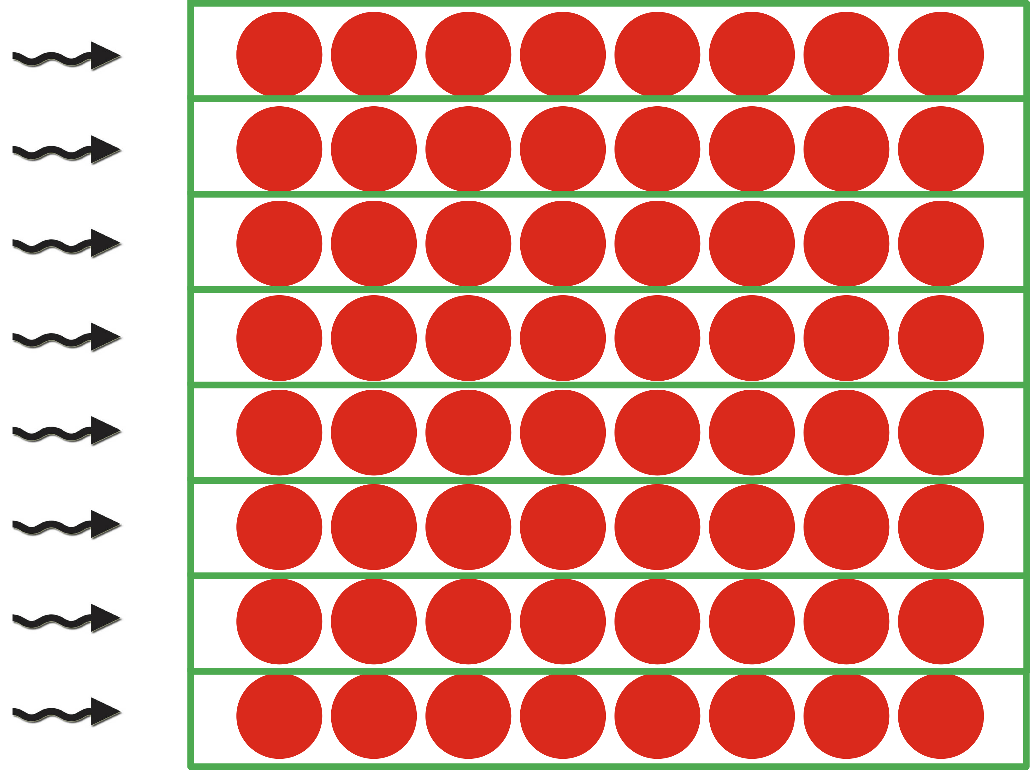
MAGMA-sparse batched system solves
Assign one warp to each problem
  hardware SIMD unit, represented as a group of 32 threads in CUDA
Process each row (column) by a single thread
  Able to support problems of size up to 32-by-32
  keep the entire row (column) in thread’s registers
  Communicate data between rows via warp-shuffles
  Current implementation: use padding for problems of smaller sizes
  Future work: multiple smaller problems per warp

Slide 41
MAGMA-sparse batched system solves
Assign one warp to each problem
  hardware SIMD unit, represented as a group of 32 threads in CUDA
Process each row (column) by a single thread
  Able to support problems of size up to 32-by-32
  keep the entire row (column) in thread’s registers
  Communicate data between rows via warp-shuffles
  Current implementation: use padding for problems of smaller sizes
  Future work: multiple smaller problems per warp
Use implicit pivoting
  Do not explicitly swap rows (column), “re-assign” the threads instead

Slide 42
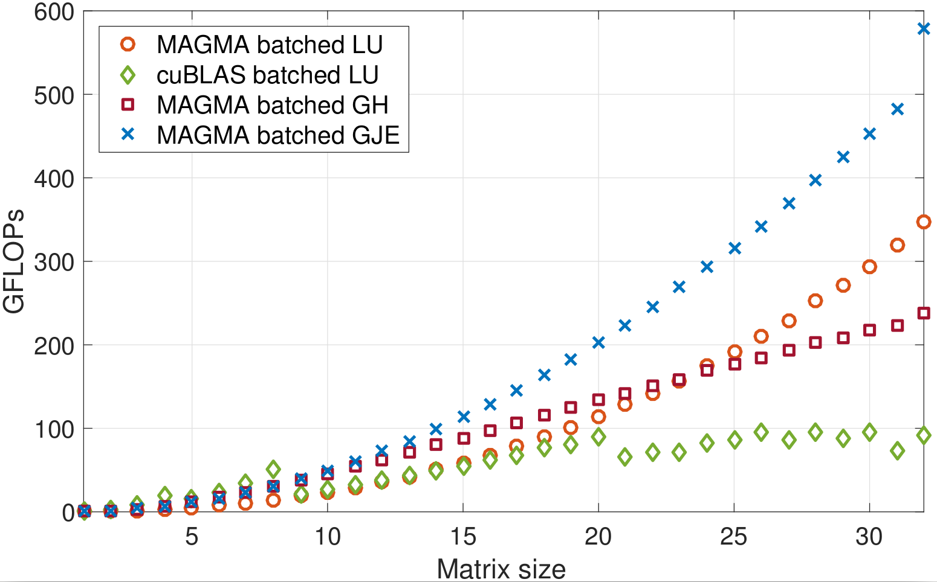
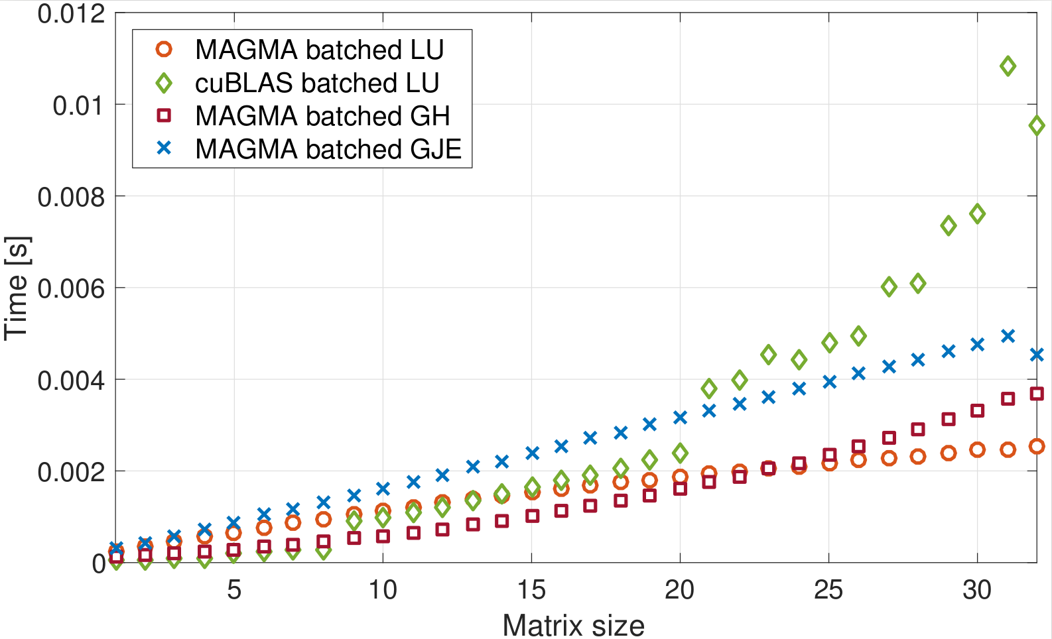
Batched routines performance

Slide 43
Batched routines performance
MAGMA-sparse routines can also:
  Handle problems of different sizes
  Integrate diagonal block extraction and diagonal block decomposition / inversion into a single kernel

Slide 44
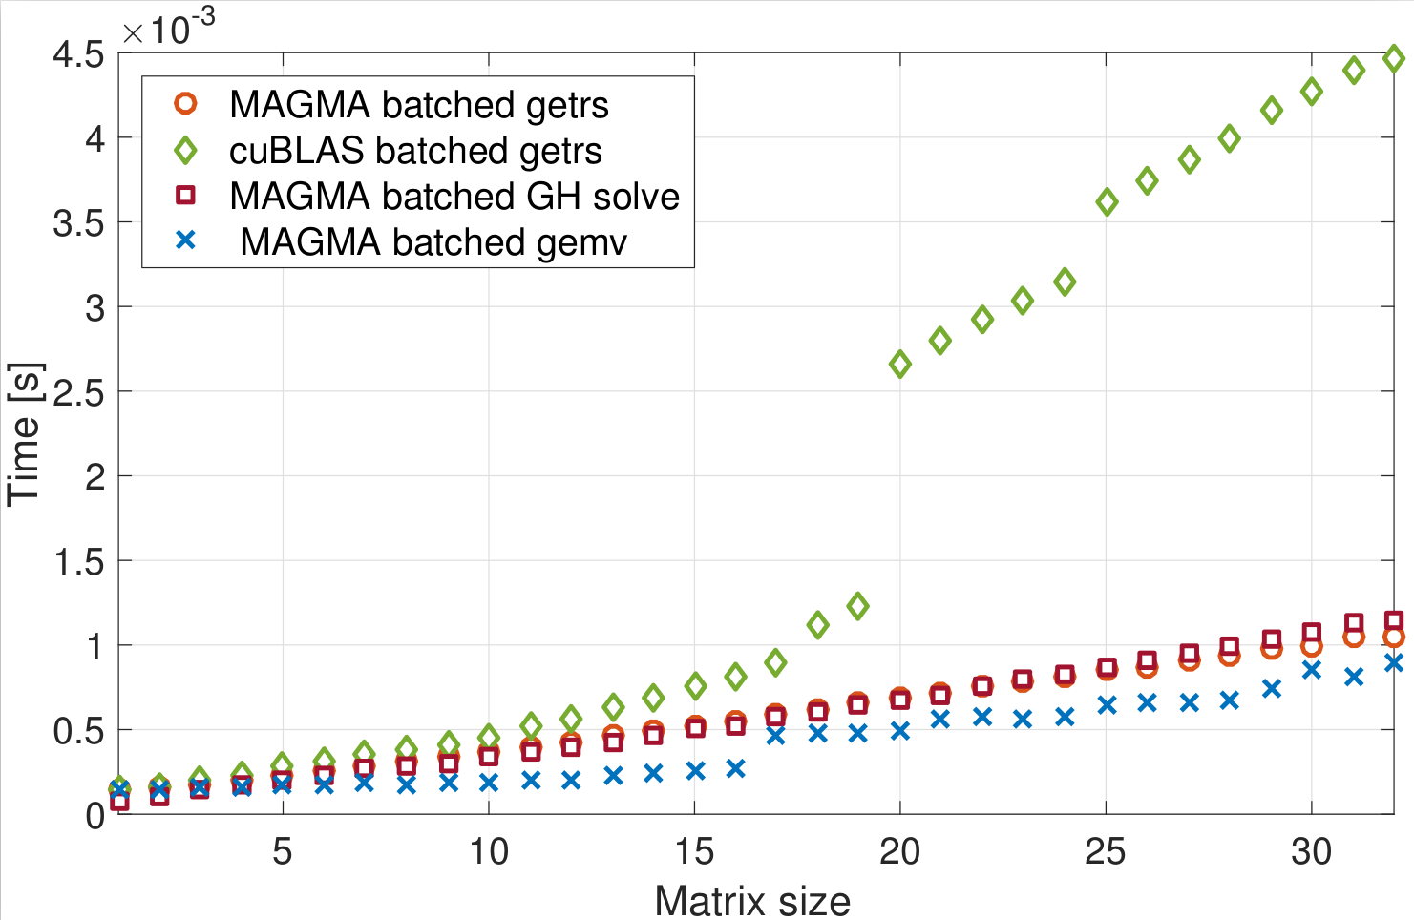
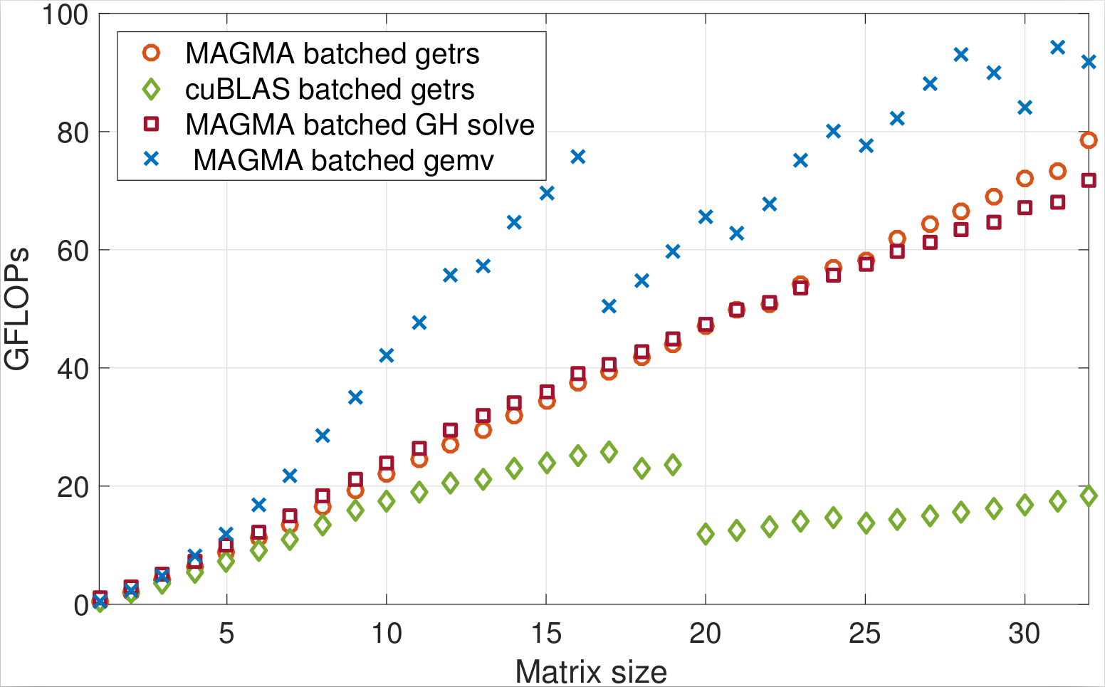
Batched routines performance

Slide 45






Complete solver runtime
s2rmt3m1
Chebyshev3
nd24k
G3_circuit
bcsstk38
ship_003

Slide 46
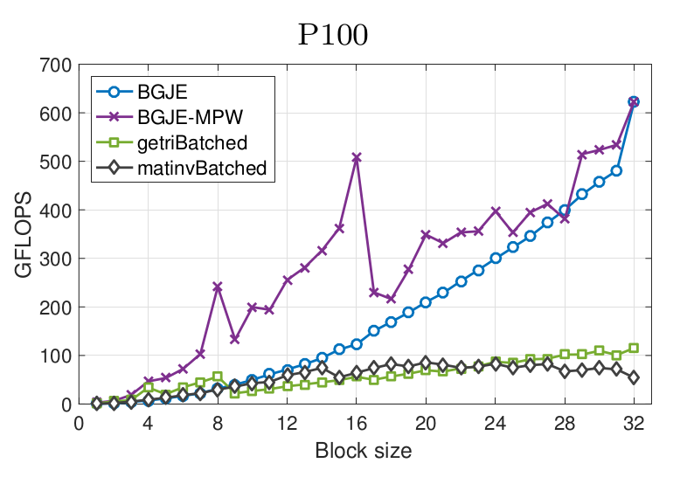
Flexible-size batched routines & future research
Problems can be to small to effectively use one warp
  Solution: assign multiple problems per warp

Slide 47
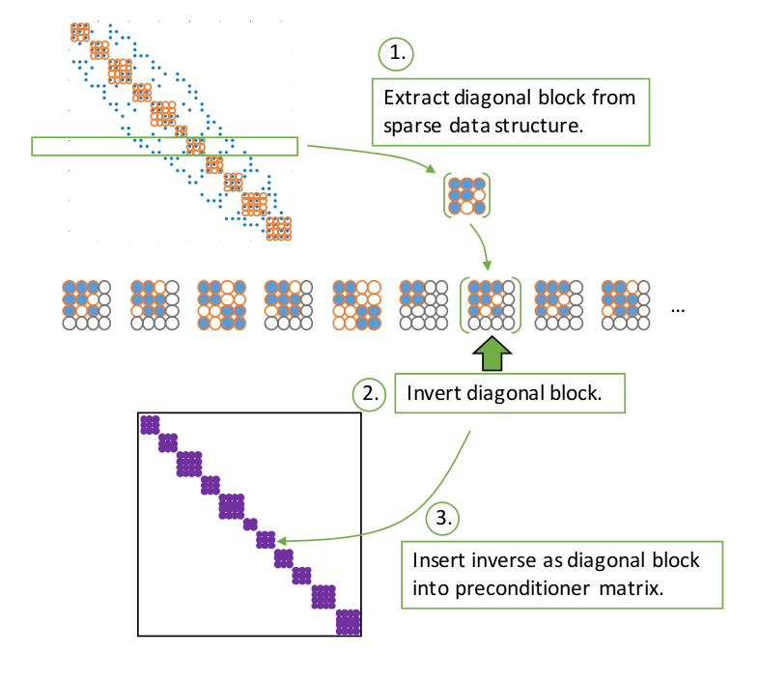
Flexible-size batched routines & future research
Problems can be to small to effectively use one warp
  Solution: assign multiple problems per warp
Allow batches where problems are of different sizes (flexible-size)
  How to combine this with multiple problems per warp?
    Remember: entire warp executes the same instruction!
    Current solution: padding

Slide 48

Adaptive precision block-Jacobi
Preconditioner is an approximation of the system matrix
  Applying a preconditioner inherently carries an error
  For block-Jacobi the relative error of z is usually around 0.01 – 0.1

Slide 49
Adaptive precision block-Jacobi
Preconditioner is an approximation of the system matrix
  Applying a preconditioner inherently carries an error
  For block-Jacobi the relative error of z is usually around 0.01 – 0.1
Preconditioner application is memory bounded
  Most of the cost comes from reading the matrix from memory
  Idea: use lower precision to store the matrix

Slide 50
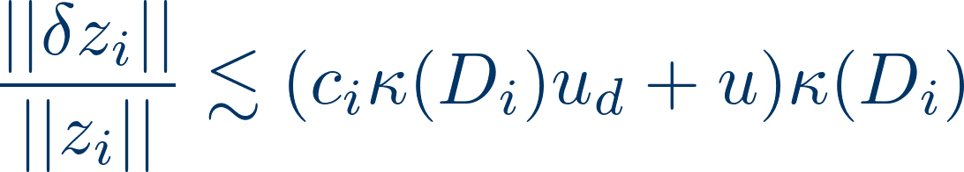
Adaptive precision block-Jacobi
Preconditioner is an approximation of the system matrix
  Applying a preconditioner inherently carries an error
  For block-Jacobi the relative error of z is usually around 0.01 – 0.1
Preconditioner application is memory bounded
  Most of the cost comes from reading the matrix from memory
  Idea: use lower precision to store the matrix
Adaptive precision in inversion-based block-Jacobi:
  All computation is done in double precision
  Preconditioner matrix is stored in lower precision, with roundoff error “u”
  Error bound:

Slide 51
Adaptive precision block-Jacobi
Preconditioner is an approximation of the system matrix
  Applying a preconditioner inherently carries an error
  For block-Jacobi the relative error of z is usually around 0.01 – 0.1
Preconditioner application is memory bounded
  Most of the cost comes from reading the matrix from memory
  Idea: use lower precision to store the matrix
Adaptive precision in inversion-based block-Jacobi:
  All computation is done in double precision
  Preconditioner matrix is stored in lower precision, with roundoff error “u”
  Error bound:
Assuming the preconditioner block is relatively well conditioned
  The error is determined by the product of u, and the condition number
  Choose the precision for each block independently, such that at least 1 digit of the result is correct

Slide 52
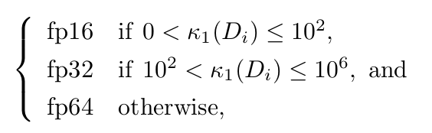
Experimental results
Determining the precision:

Slide 53
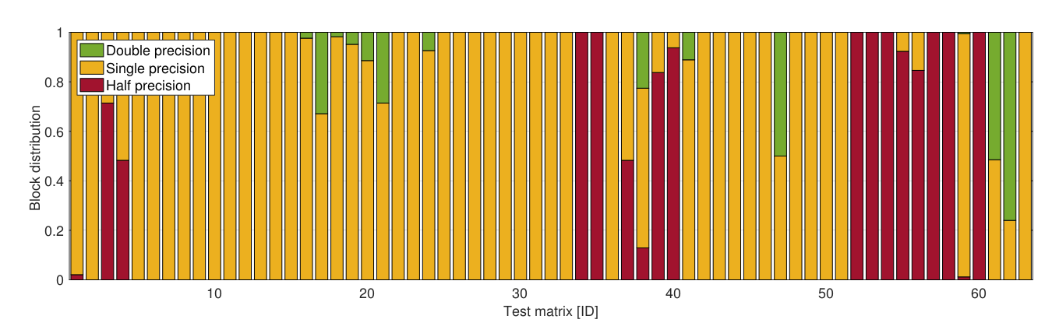
Experimental results
Determining the precision:
% of diagonal blocks stored in each precision *:
* Prototype implementation in MATLAB,
Results on 63 matrices from SuiteSparse

Slide 54
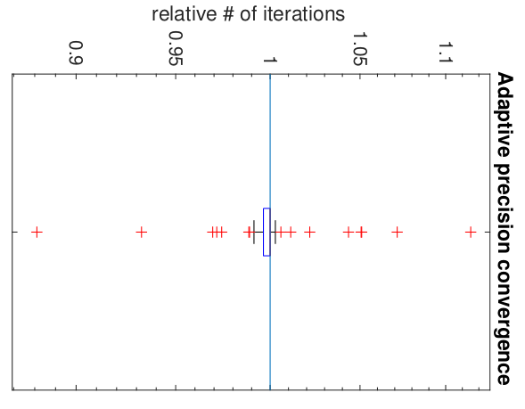
Experimental results
Determining the precision:
Usually < 5% iteration increase
% of diagonal blocks stored in each precision *:
* Prototype implementation in MATLAB,
Results on 63 matrices from SuiteSparse

Slide 55
Energy efficiency of adaptive precision block-Jacobi
Memory access is an order of magnitude more expensive than computation! [Shalf 2013]

Slide 56
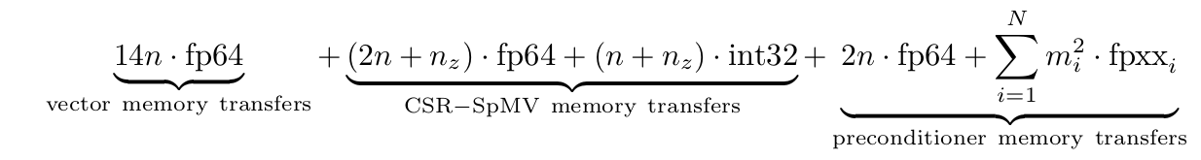
Energy efficiency of adaptive precision block-Jacobi
Memory access is an order of magnitude more expensive than computation! [Shalf 2013]
Energy model assumptions:
Accessing 1 bit of data has a cost of 1 (energy unit)
Disregard energy cost of arithmetic operations
Total energy cost of each iteration:

Slide 57
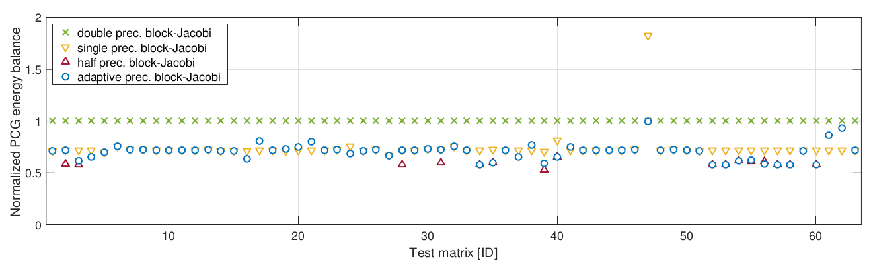
Energy efficiency of adaptive precision block-Jacobi
Memory access is an order of magnitude more expensive than computation! [Shalf 2013]
Energy model assumptions:
Accessing 1 bit of data has a cost of 1 (energy unit)
Disregard energy cost of arithmetic operations
Total energy cost of each iteration:
Predicted energy savings of adaptive precision block-Jacobi:

Slide 58

Thank you! Questions?
All functionalities are part of the MAGMA-sparse project.
Scan me for slides!
github.com/gflegar/talks/tree/master/pmf_zagreb_2017_12
http://icl.cs.utk.edu/magma/
This research is based on a cooperation between Hartwig Anzt (Karlsruhe Institute of Technology),
Jack Dongarra (University of Tennessee), Nicholas Higham (University of Manchester), Goran Flegar and Enrique S. Quintana-Ortí (Universidad Jaume I).

