Slide 1
Block-Jacobi preconditioning in Ginkgo
Goran Flegar

Slide 2
Introduction
I’m assuming we are all familiar with:
  Iterative solution of linear systems
    Why it’s useful
    Operations within Krylov solvers (BLAS 1, SpMV, preconditioning)
  Preconditioning
    Replacing the original system with the preconditioned system
    Changes needed within the Krylov solver to incorporate preconditioning

Slide 3
Block-Jacobi preconditioning
Improve performance for problems with inherent block structure
  Usually blocks are smaller than 30x30 (blocks can be of different sizes!)

Slide 4



Block-Jacobi preconditioning
Improve performance for problems with inherent block structure
  Usually blocks are smaller than 30x30 (blocks can be of different sizes!)
Block-Jacobi preconditioning
  Use only diagonal blocks for approximation

Slide 5
Benefits of block-Jacobi
56 matrices from SuiteSparse
MAGMA-sparse open source library
  IDR solver
  Scalar Jacobi preconditioner
  Supervariable agglomeration
    Detects block structure of the matrix
M. Goetz and H. Anzt, "Machine Learning-Aided Numerical Linear Algebra: Convolutional Neural Networks for the Efficient Preconditioner Generation," 2018 IEEE/ACM 9th Workshop on Latest Advances in Scalable Algorithms for Large-Scale Systems (scalA), Dalla, TX, USA, 2018, pp. 49-56.

Slide 6

Benefits of block-Jacobi
56 matrices from SuiteSparse
MAGMA-sparse open source library
  IDR solver
  Scalar Jacobi preconditioner
  Supervariable agglomeration
    Detects block structure of the matrix
Improves the robustness of the solver
M. Goetz and H. Anzt, "Machine Learning-Aided Numerical Linear Algebra: Convolutional Neural Networks for the Efficient Preconditioner Generation," 2018 IEEE/ACM 9th Workshop on Latest Advances in Scalable Algorithms for Large-Scale Systems (scalA), Dalla, TX, USA, 2018, pp. 49-56.

Slide 7
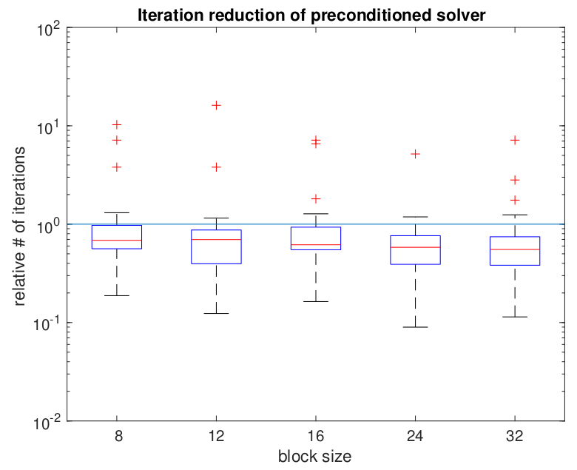
Benefits of block-Jacobi
56 matrices from SuiteSparse
MAGMA-sparse open source library
  IDR solver
  Scalar Jacobi preconditioner
  Supervariable agglomeration
    Detects block structure of the matrix
Improves the robustness of the solver
Improves convergence of the solver
M. Goetz and H. Anzt, "Machine Learning-Aided Numerical Linear Algebra: Convolutional Neural Networks for the Efficient Preconditioner Generation," 2018 IEEE/ACM 9th Workshop on Latest Advances in Scalable Algorithms for Large-Scale Systems (scalA), Dalla, TX, USA, 2018, pp. 49-56.

Slide 8


Block-Jacobi preconditioning
Improve performance for problems with inherent block structure
  Usually blocks are smaller than 30x30 (blocks can be of different sizes!)
Block-Jacobi preconditioning
  Use only diagonal blocks for approximation

Slide 9
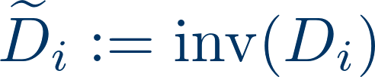

Block-Jacobi preconditioning
Improve performance for problems with inherent block structure
  Usually blocks are smaller than 30x30 (blocks can be of different sizes!)
Block-Jacobi preconditioning
  Use only diagonal blocks for approximation
inv = Gauss-Jordan elimination

Slide 10
Block-Jacobi preconditioning
Improve performance for problems with inherent block structure
  Usually blocks are smaller than 30x30 (blocks can be of different sizes!)
Block-Jacobi preconditioning
  Use only diagonal blocks for approximation
Setup
Inversion-based block-Jacobi
Application
inv = Gauss-Jordan elimination

Slide 11

Block-Jacobi preconditioning
Current focus: improve performance for problems with inherent block structure
  Usually blocks are smaller than 30x30 (blocks can be of different sizes!)
Block-Jacobi preconditioning
  Use only diagonal blocks for approximation

Slide 12



Block-Jacobi preconditioning
Current focus: improve performance for problems with inherent block structure
  Usually blocks are smaller than 30x30 (blocks can be of different sizes!)
Block-Jacobi preconditioning
  Use only diagonal blocks for approximation

Slide 13
Block-Jacobi preconditioning
Current focus: improve performance for problems with inherent block structure
  Usually blocks are smaller than 30x30 (blocks can be of different sizes!)
Block-Jacobi preconditioning
  Use only diagonal blocks for approximation
Setup
Application
Decomposition-based block-Jacobi

Slide 14
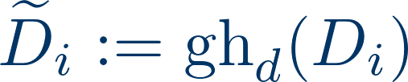
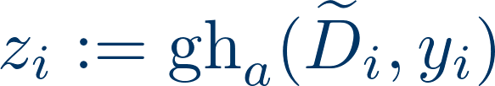
Block-Jacobi preconditioning
Current focus: improve performance for problems with inherent block structure
  Usually blocks are smaller than 30x30 (blocks can be of different sizes!)
Block-Jacobi preconditioning
  Use only diagonal blocks for approximation
gh = Gauss-Huard decomposition / application

Slide 15
Block-Jacobi preconditioning
Current focus: improve performance for problems with inherent block structure
  Usually blocks are smaller than 30x30 (blocks can be of different sizes!)
Block-Jacobi preconditioning
  Use only diagonal blocks for approximation
Setup
Application
Decomposition-based block-Jacobi

Slide 16



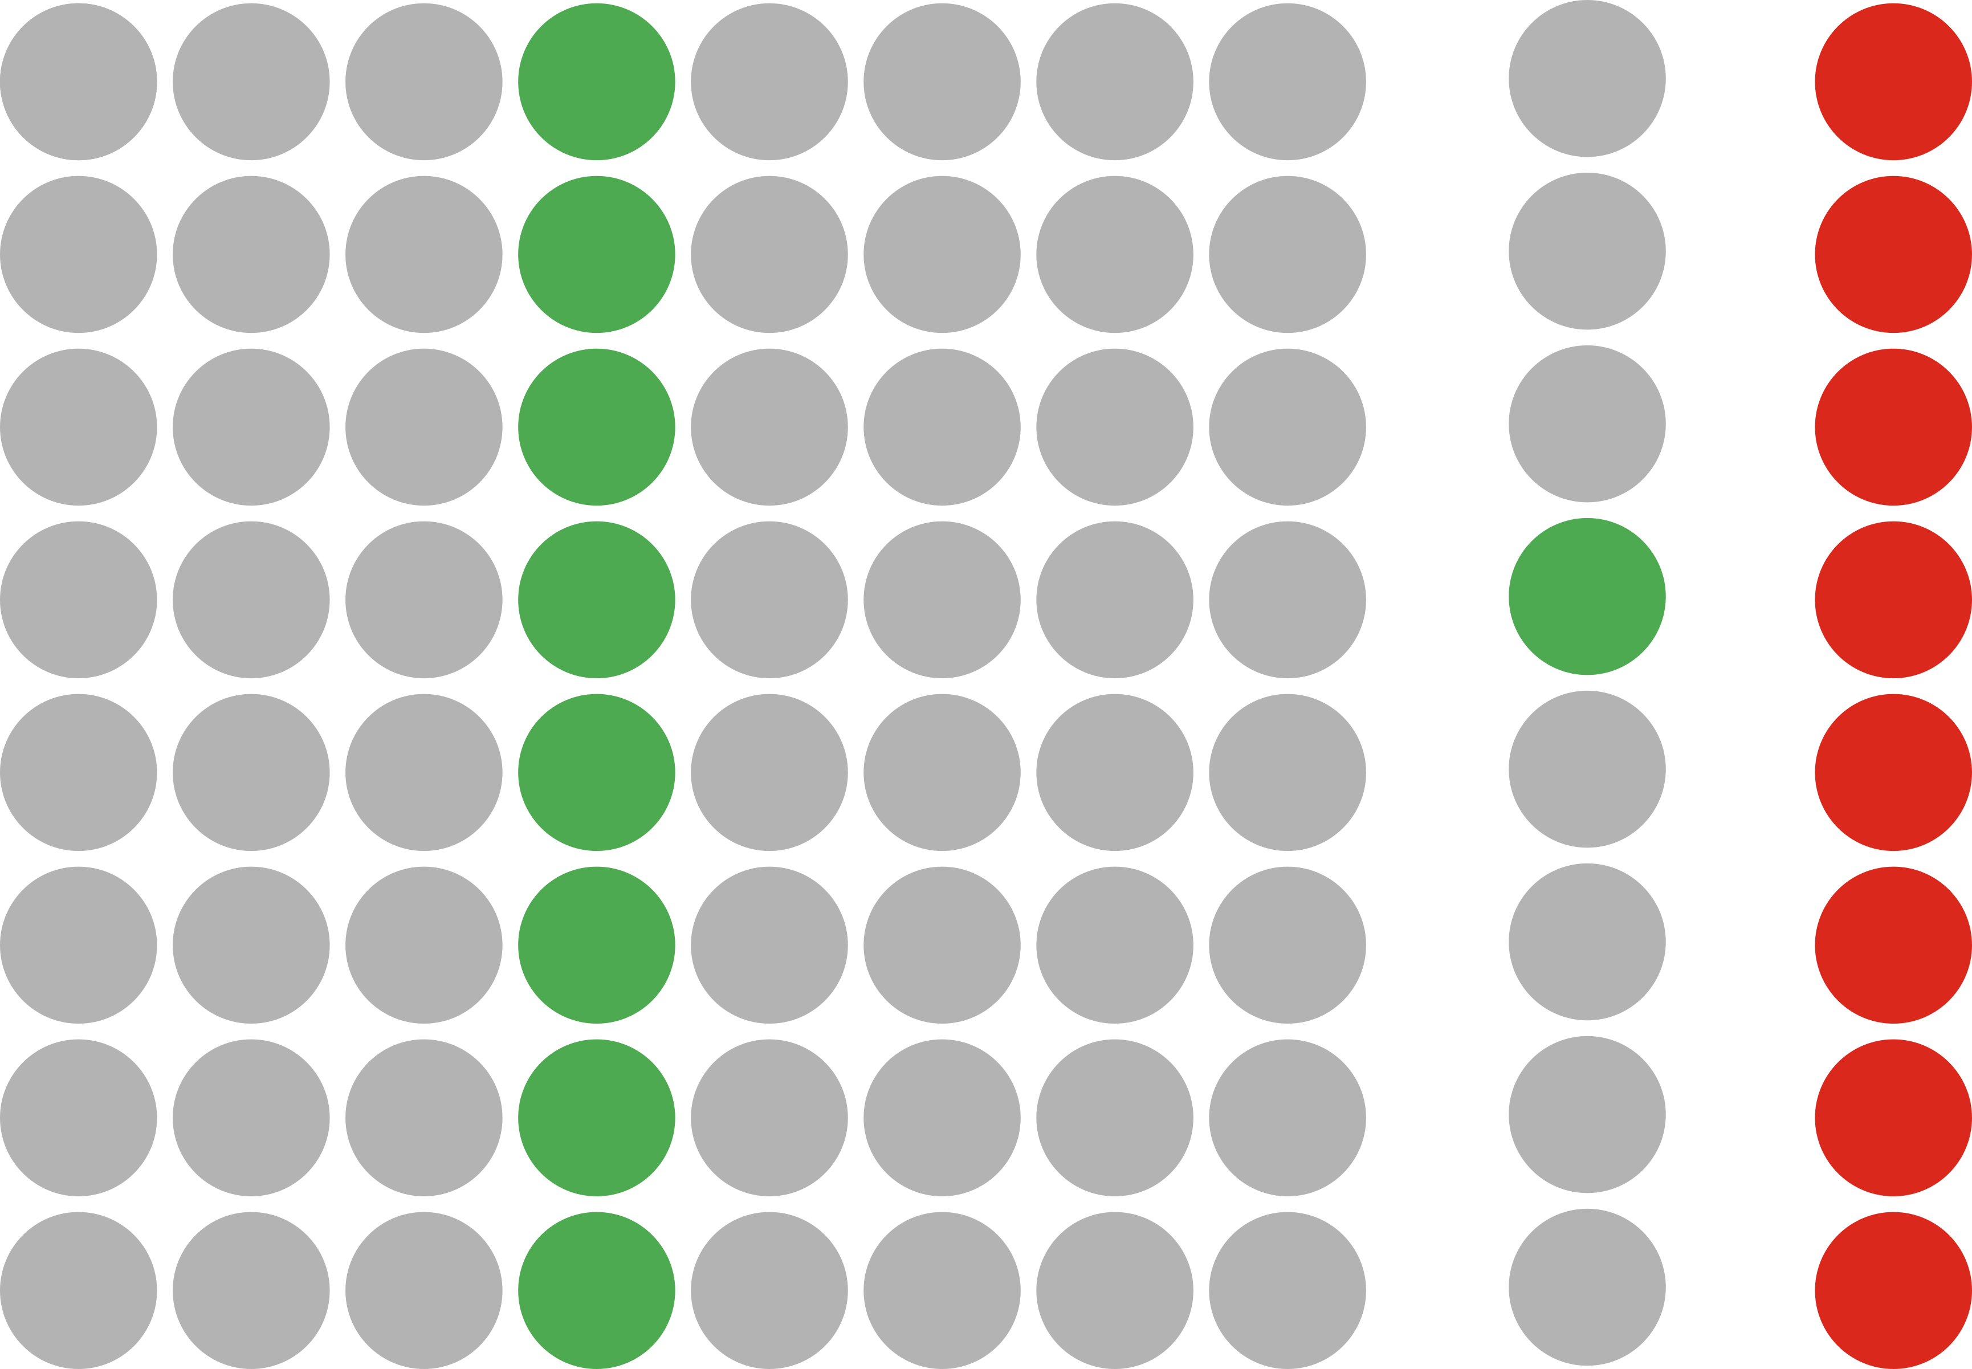
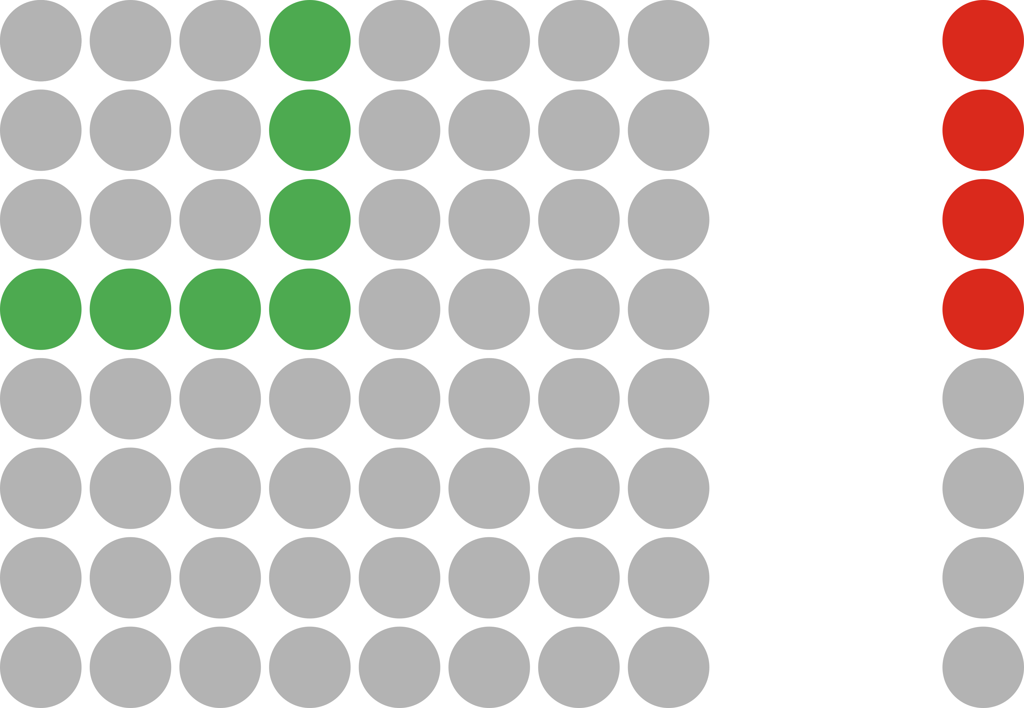
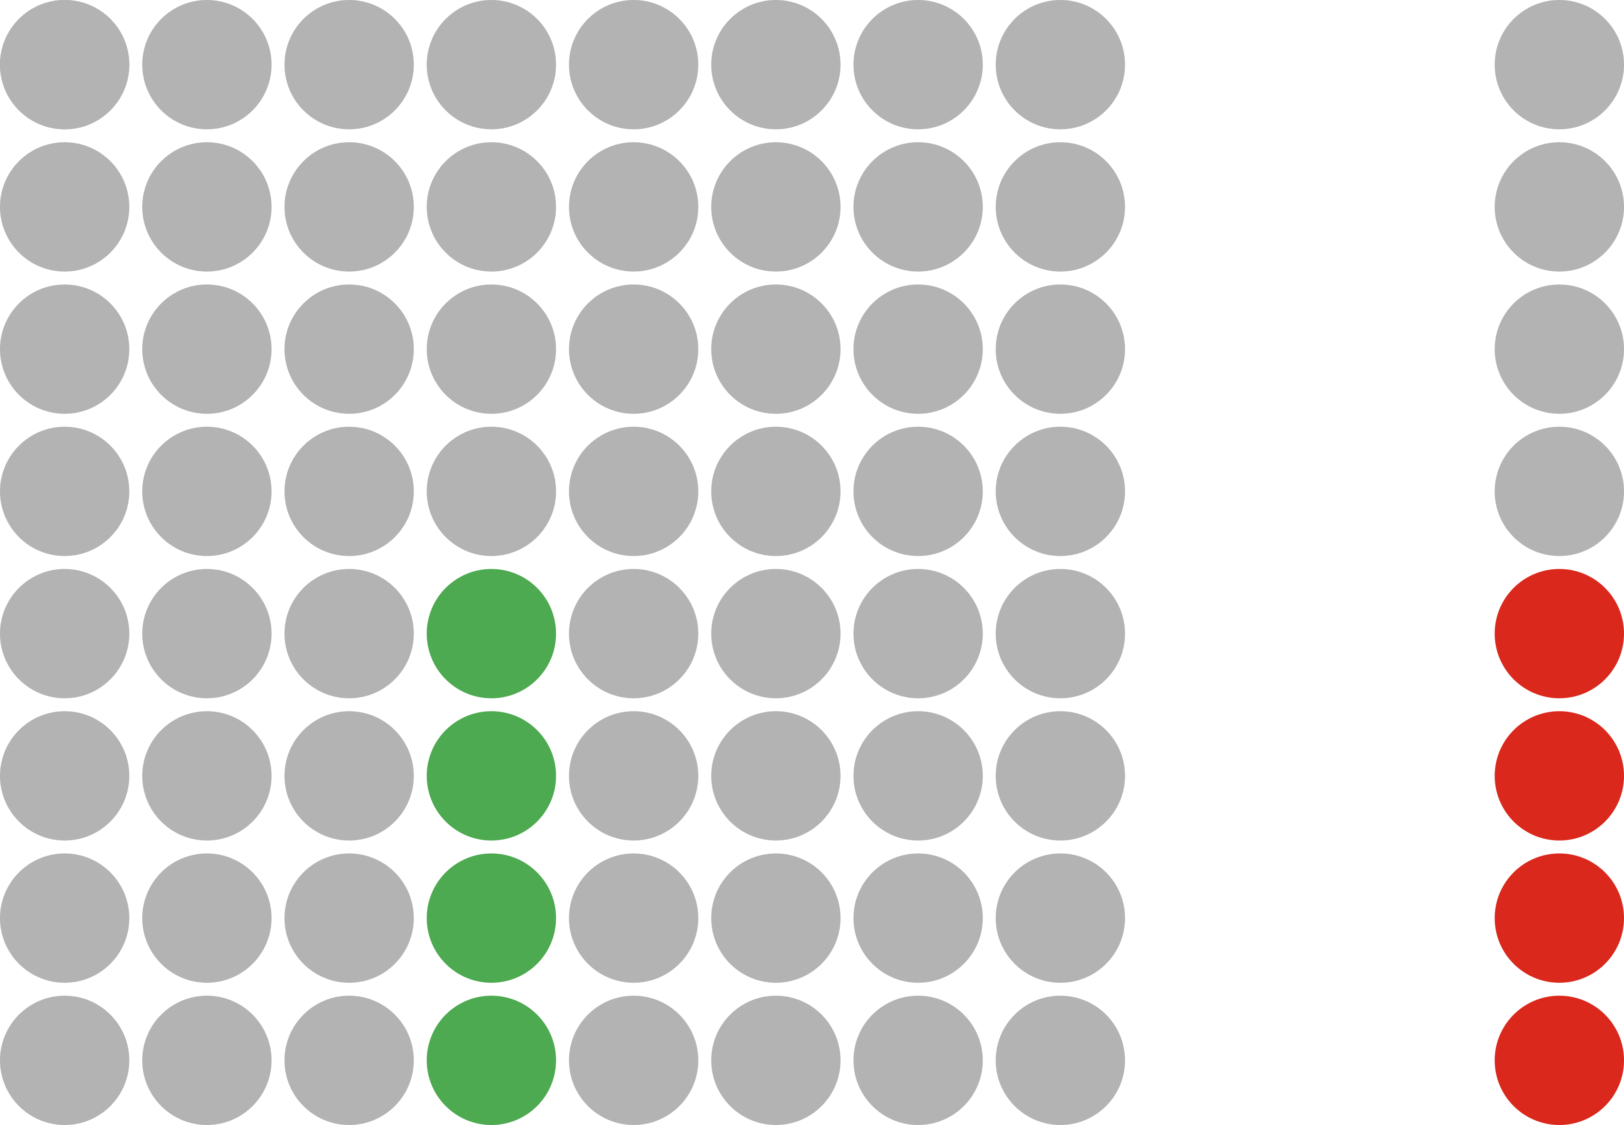


Block-Jacobi setup & application ecosystem
Gauss-Jordan inversion
Gauss-Huard decomposition
LU factorization
Setup
Inversion-based
(2n³ + 2n² FLOPS)
Decomposition-based
(2/3n³ + 2n² FLOPS)
matrix-vector multiply
Gauss-Huard solve
2x triangular solve
Application
H. Anzt et al. “Variable-size batched Gauss–Jordan elimination for block-Jacobi preconditioning on graphics processors”, ParCo’19
H. Anzt et al. “Variable-Size Batched Gauss-Huard for Block-Jacobi Preconditioning”, ICCS’17
H. Anzt et al. “Flexible-Size Batched LU for Small Matrices and its Integration into Block-Jacobi Preconditioning”, ICPP’17
- read
- write

Slide 17
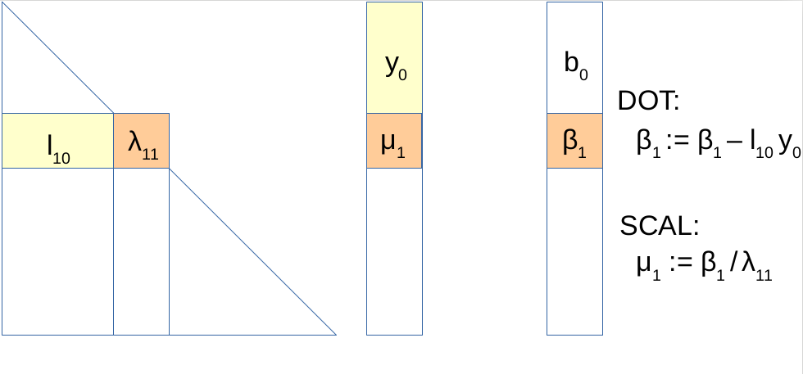
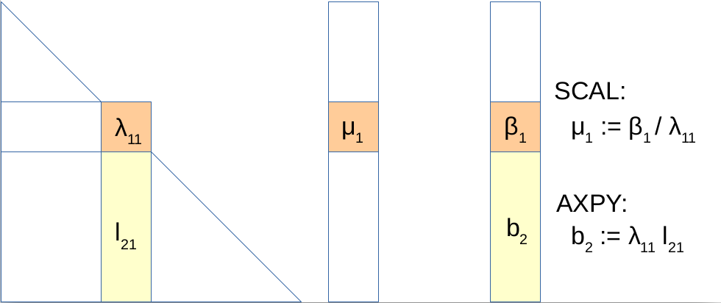
Triangular solves
Use “eager” triangular solves
  Cast solution vector updates in terms of axpy, not in terms of dot product!
“Lazy” triangular solve
“Eager” triangular solve

Slide 18
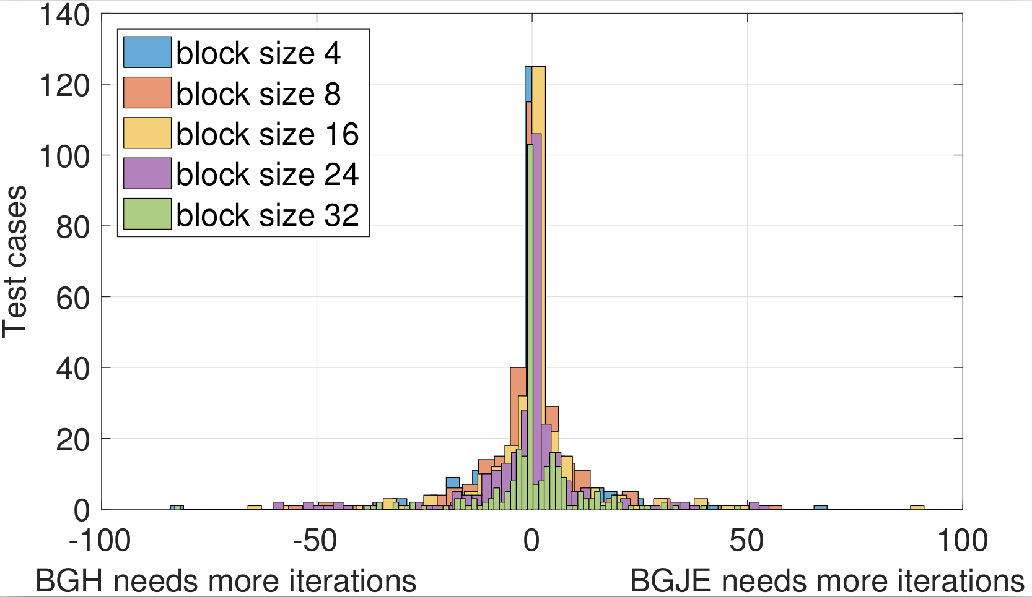
No signs of instability in practice

Slide 19
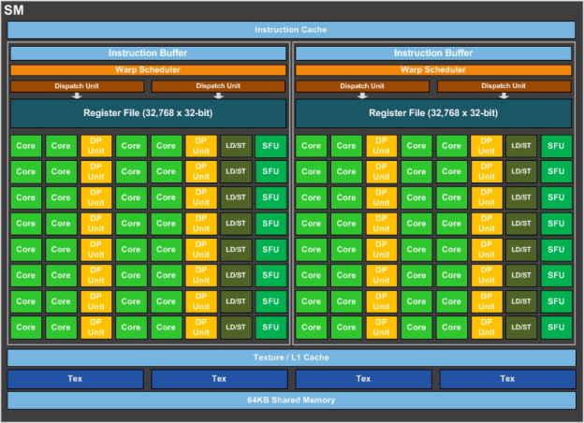
Batched inversion and decomposition
Assign one warp to each problem
  hardware SIMD unit, represented as a group of 32 threads in CUDA

Slide 20
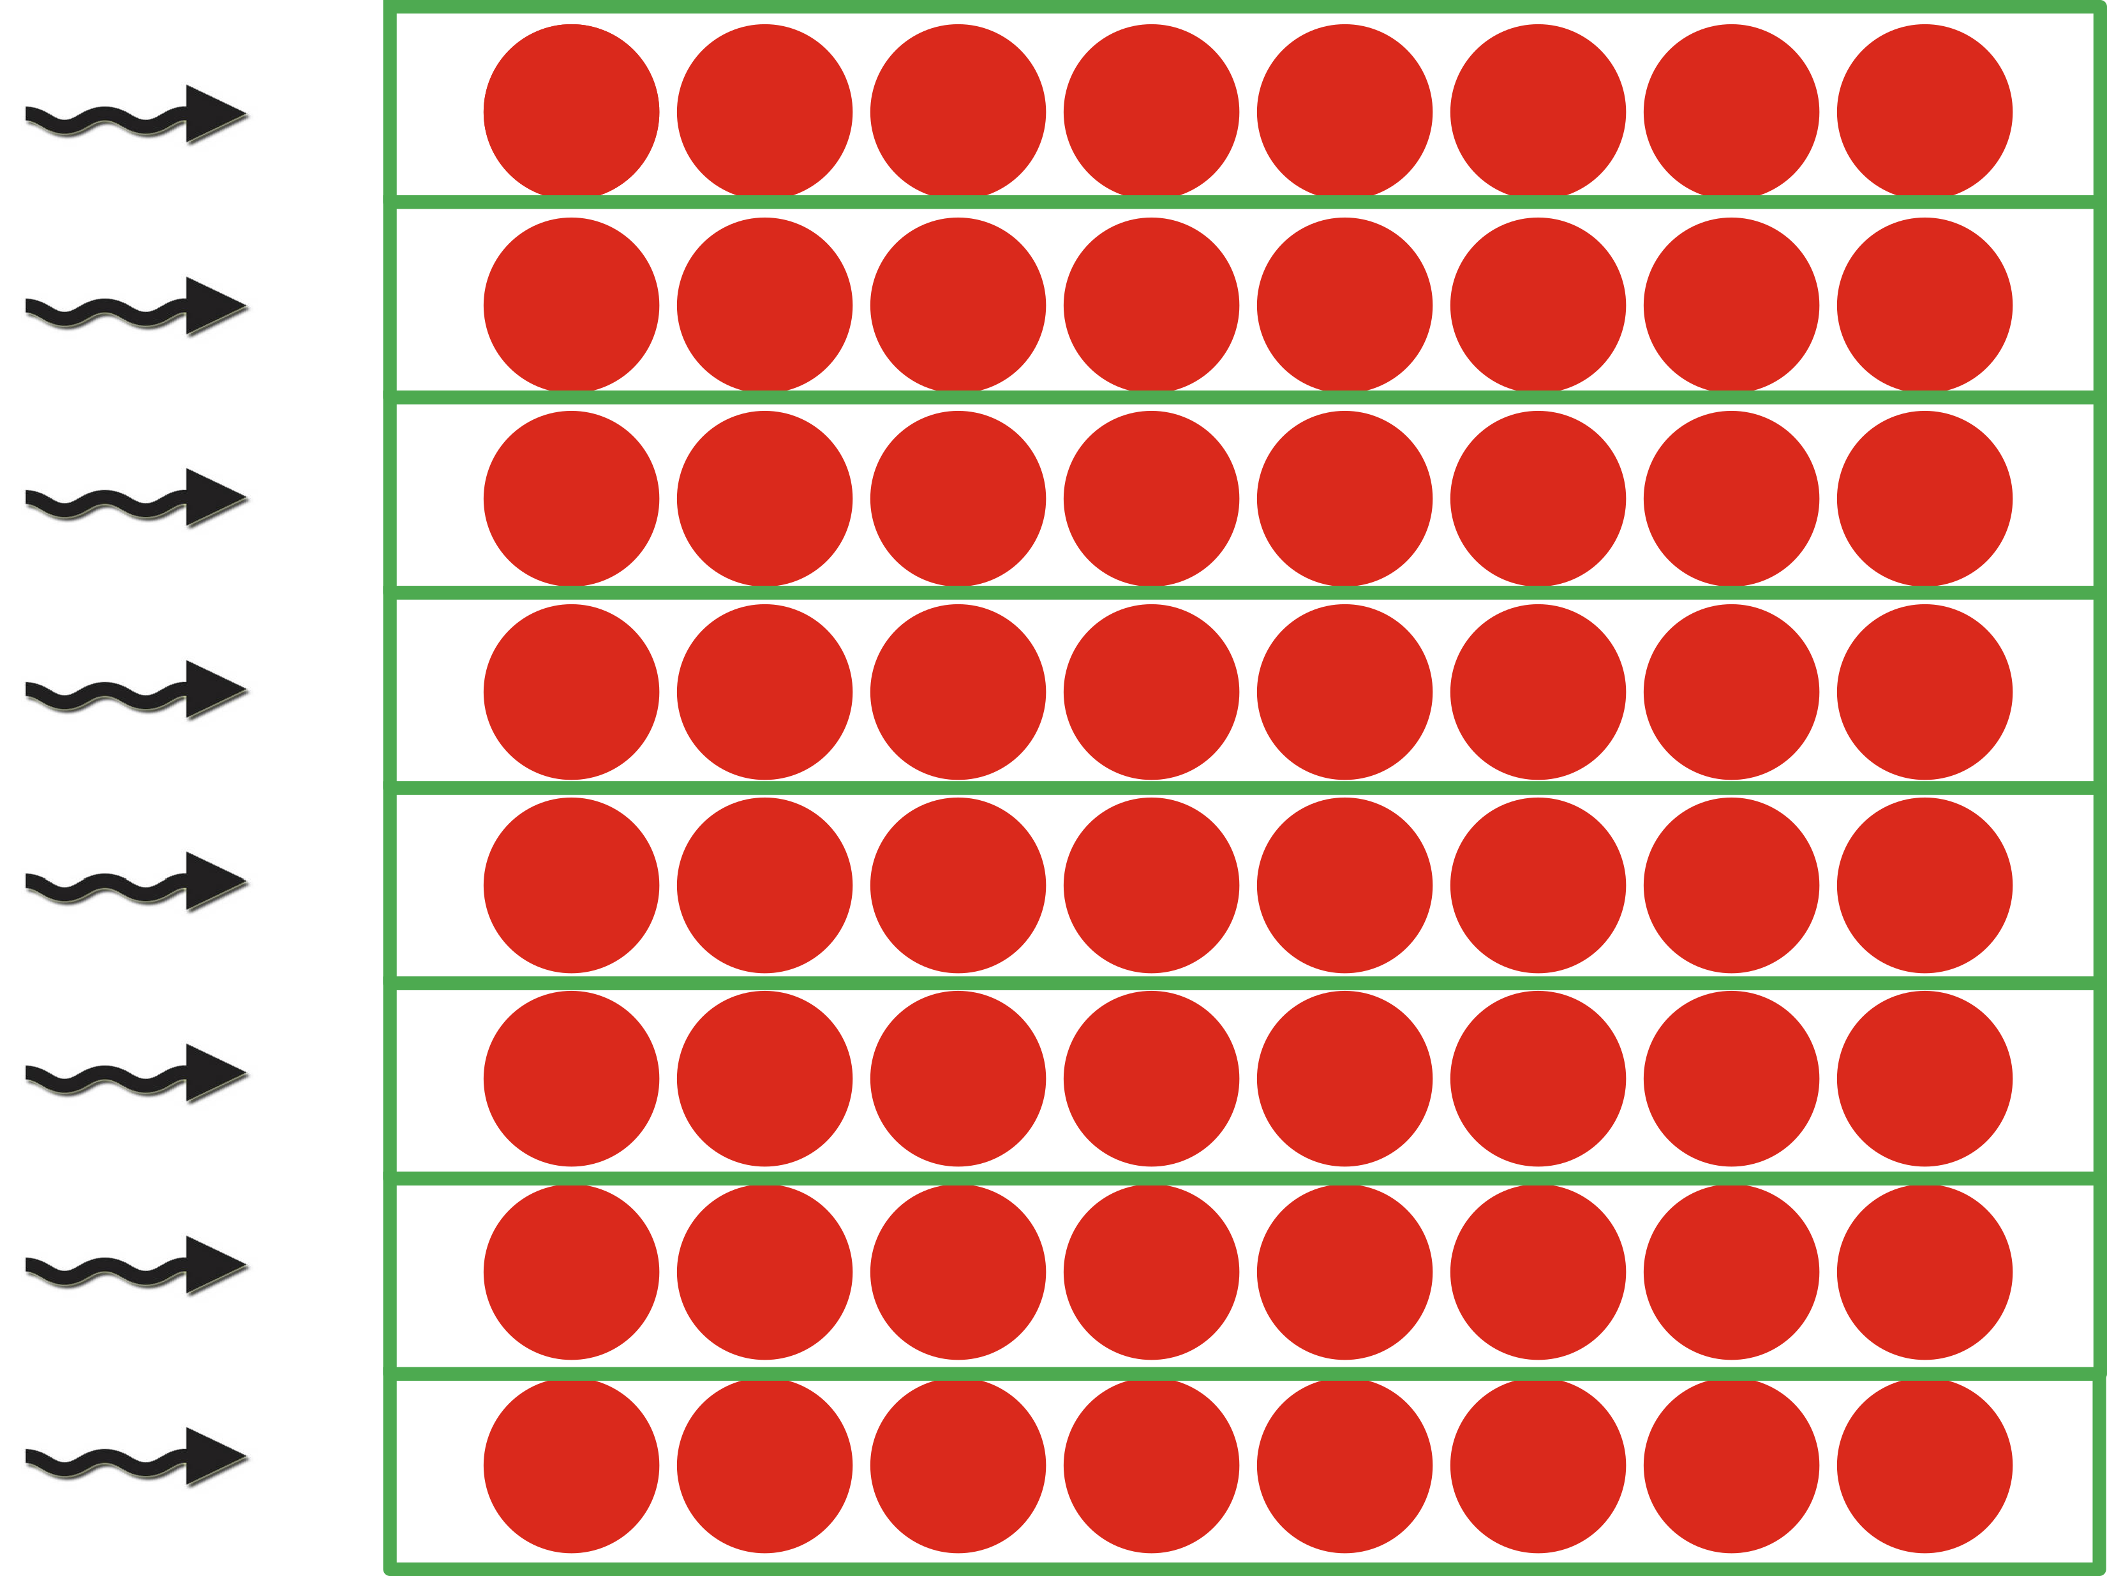
Batched inversion and decomposition
Assign one warp to each problem
  hardware SIMD unit, represented as a group of 32 threads in CUDA
Process each row (column) by a single thread
  Able to support problems of size up to 32-by-32
  Keep the entire row (column) in thread’s registers
  Communicate data between rows via warp-shuffles
  Current implementation: use padding for problems of smaller sizes
  Future work: multiple smaller problems per warp

Slide 21
Batched inversion and decomposition
Assign one warp to each problem
  hardware SIMD unit, represented as a group of 32 threads in CUDA
Process each row (column) by a single thread
  Able to support problems of size up to 32-by-32
  Keep the entire row (column) in thread’s registers
  Communicate data between rows via warp-shuffles
  Current implementation: use padding for problems of smaller sizes
  Future work: multiple smaller problems per warp
Use implicit pivoting
  Do not explicitly swap rows (column), “re-assign” the threads instead

Slide 22
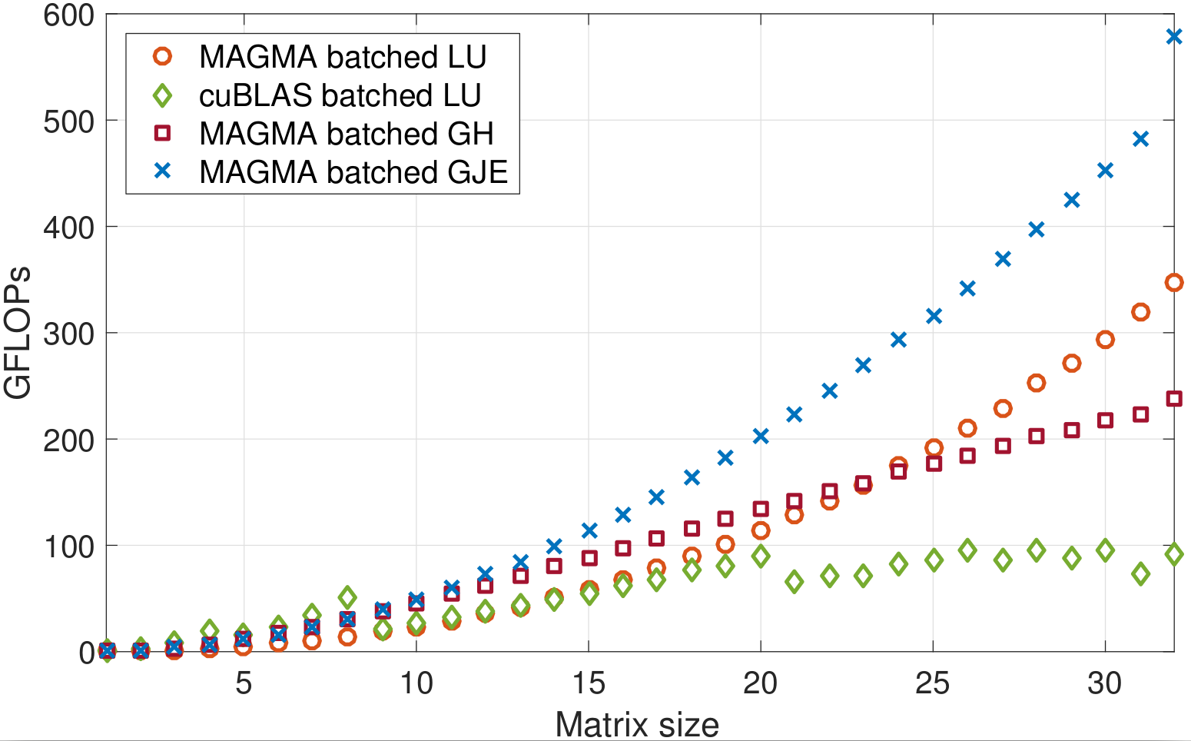
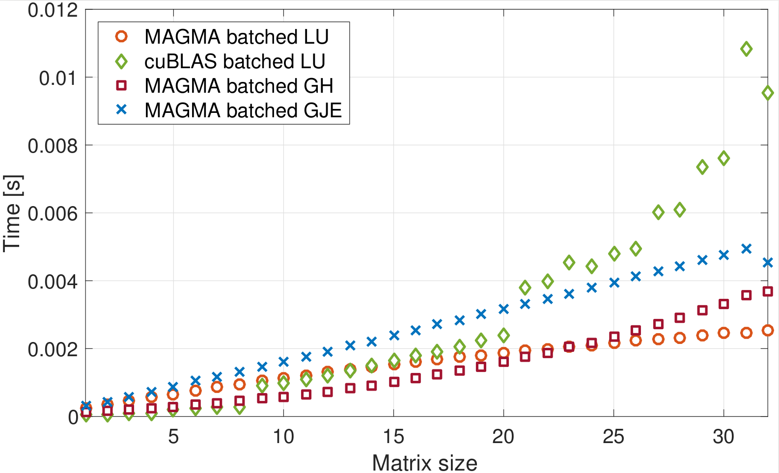
Batched routines performance

Slide 23
Batched routines performance
MAGMA-sparse routines can also:
  Handle problems of different sizes
  Integrate diagonal block extraction and diagonal block decomposition / inversion into a single kernel

Slide 24
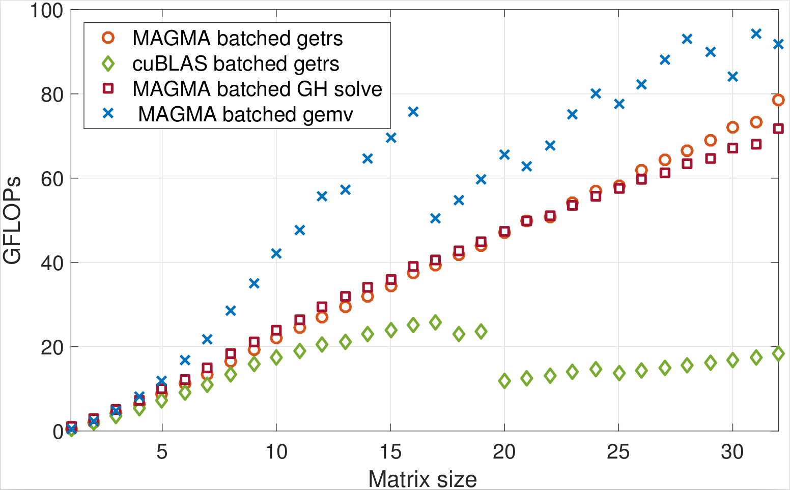
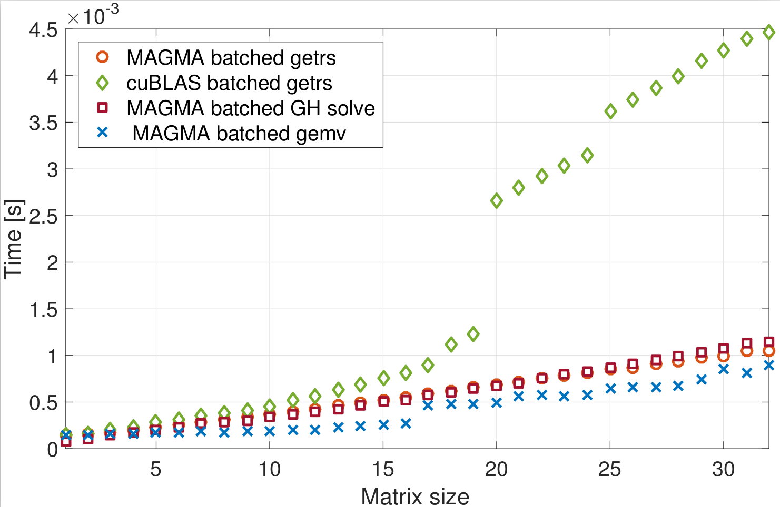
Batched routines performance

Slide 25






Complete solver runtime
s2rmt3m1
Chebyshev3
nd24k
G3_circuit
bcsstk38
ship_003

Slide 26
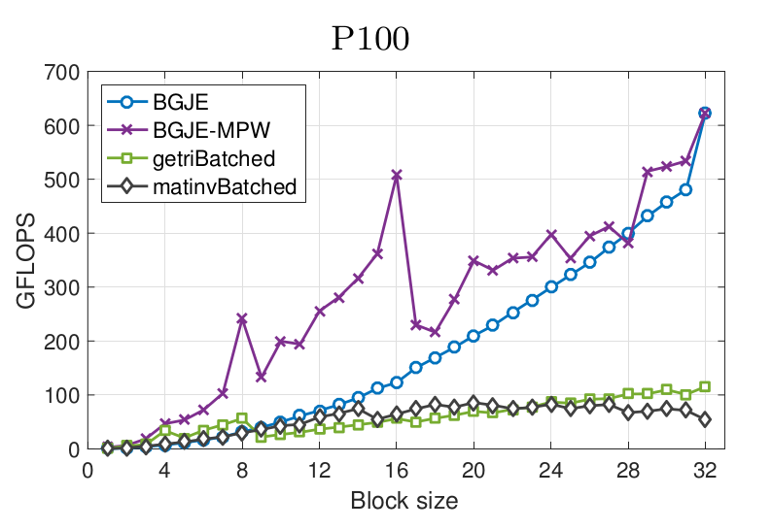
Flexible-size batched routines
Problems can be to small to effectively use one warp
  Solution: assign multiple problems per warp

Slide 27
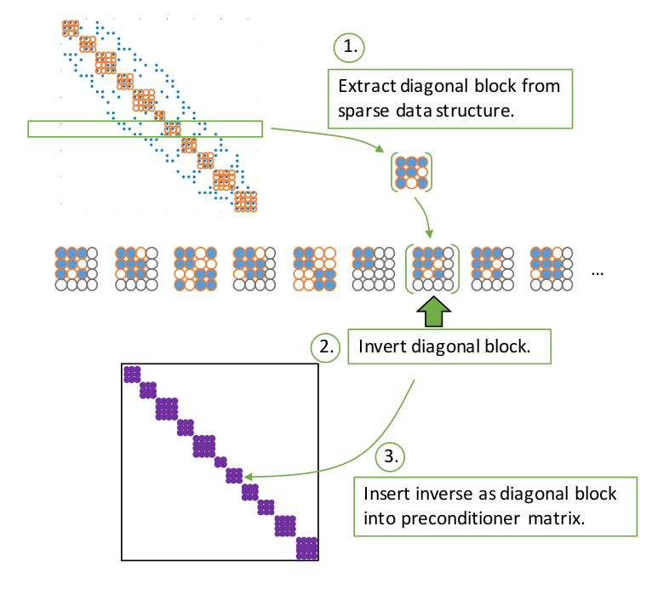
Flexible-size batched routines
Problems can be to small to effectively use one warp
  Solution: assign multiple problems per warp
Allow batches where problems are of different sizes (flexible-size)
  How to combine this with multiple problems per warp?
    Remember: entire warp executes the same instruction!
    Current solution: padding

Slide 28

Adaptive precision block-Jacobi
Preconditioner is an approximation of the system matrix
  Applying a preconditioner inherently carries an error
  For block-Jacobi the relative error of z is usually around 0.01 – 0.1
Anzt, et al. "Adaptive precision in block‐Jacobi preconditioning for iterative sparse linear system solvers." Concurrency and Computation: Practice and Experience 31.6 (2019): e4460.

Slide 29
Adaptive precision block-Jacobi
Preconditioner is an approximation of the system matrix
  Applying a preconditioner inherently carries an error
  For block-Jacobi the relative error of z is usually around 0.01 – 0.1
Preconditioner application is memory bounded
  Most of the cost comes from reading the matrix from memory
  Idea: use lower precision to store the matrix
Anzt, et al. "Adaptive precision in block‐Jacobi preconditioning for iterative sparse linear system solvers." Concurrency and Computation: Practice and Experience 31.6 (2019): e4460.

Slide 30
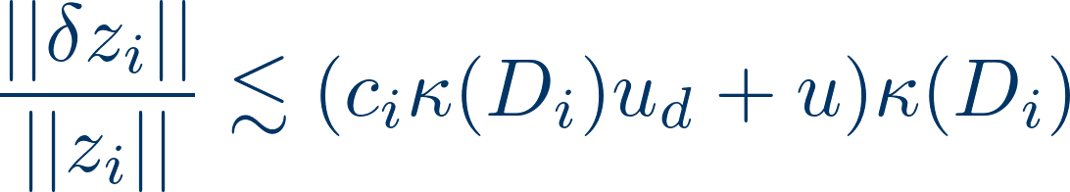
Adaptive precision block-Jacobi
Preconditioner is an approximation of the system matrix
  Applying a preconditioner inherently carries an error
  For block-Jacobi the relative error of z is usually around 0.01 – 0.1
Preconditioner application is memory bounded
  Most of the cost comes from reading the matrix from memory
  Idea: use lower precision to store the matrix
Adaptive precision in inversion-based block-Jacobi:
  All computation is done in double precision
  Preconditioner matrix is stored in lower precision, with roundoff error “u”
  Error bound:
Anzt, et al. "Adaptive precision in block‐Jacobi preconditioning for iterative sparse linear system solvers." Concurrency and Computation: Practice and Experience 31.6 (2019): e4460.

Slide 31
Adaptive precision block-Jacobi
Preconditioner is an approximation of the system matrix
  Applying a preconditioner inherently carries an error
  For block-Jacobi the relative error of z is usually around 0.01 – 0.1
Preconditioner application is memory bounded
  Most of the cost comes from reading the matrix from memory
  Idea: use lower precision to store the matrix
Adaptive precision in inversion-based block-Jacobi:
  All computation is done in double precision
  Preconditioner matrix is stored in lower precision, with roundoff error “u”
  Error bound:
Assuming the preconditioner block is relatively well conditioned
  The error is determined by the product of u, and the condition number
  Choose the precision for each block independently, such that at least 1 digit of the result is correct

Slide 32
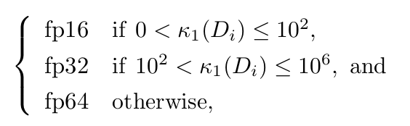
Experimental results
Determining the precision:

Slide 33
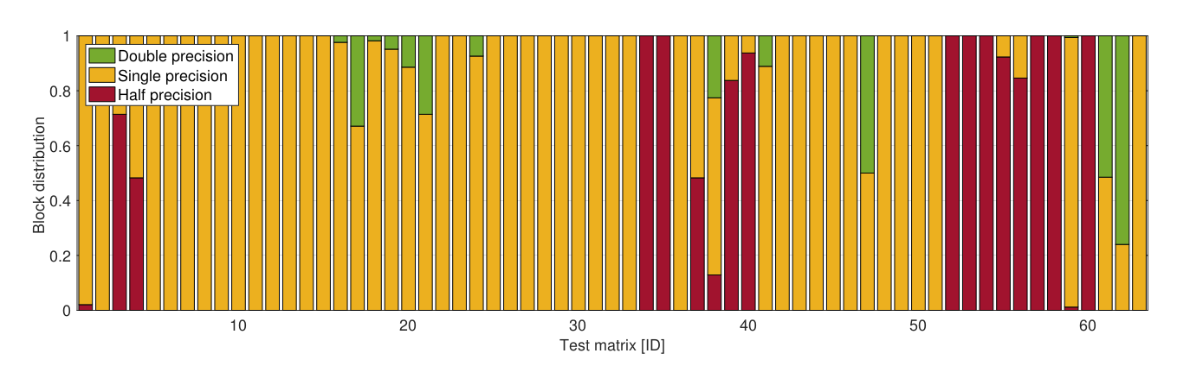
Experimental results
Determining the precision:
% of diagonal blocks stored in each precision *:
* Prototype implementation in MATLAB,
Results on 63 matrices from SuiteSparse

Slide 34
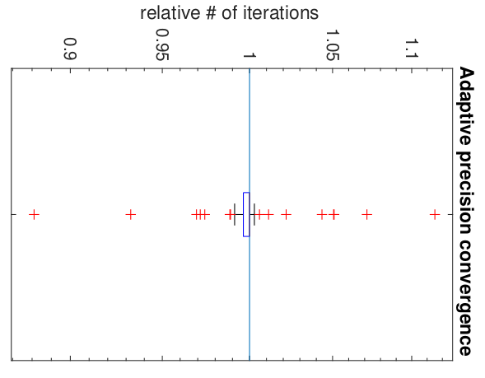
Experimental results
Determining the precision:
Usually < 5% iteration increase
% of diagonal blocks stored in each precision *:
* Prototype implementation in MATLAB,
Results on 63 matrices from SuiteSparse

Slide 35
Overflow and underflow
Storing the block in lower precision can cause underflow or overflow in some values.
This is not accounted for by the numerical analysis shown in the previous slides

Slide 36
Overflow and underflow
Storing the block in lower precision can cause underflow or overflow in some values.
This is not accounted for by the numerical analysis shown in the previous slides
Two possible solutions:
  Check the condition number of the low precision block to verify there were no catastrophic overflows or underflows.

Slide 37
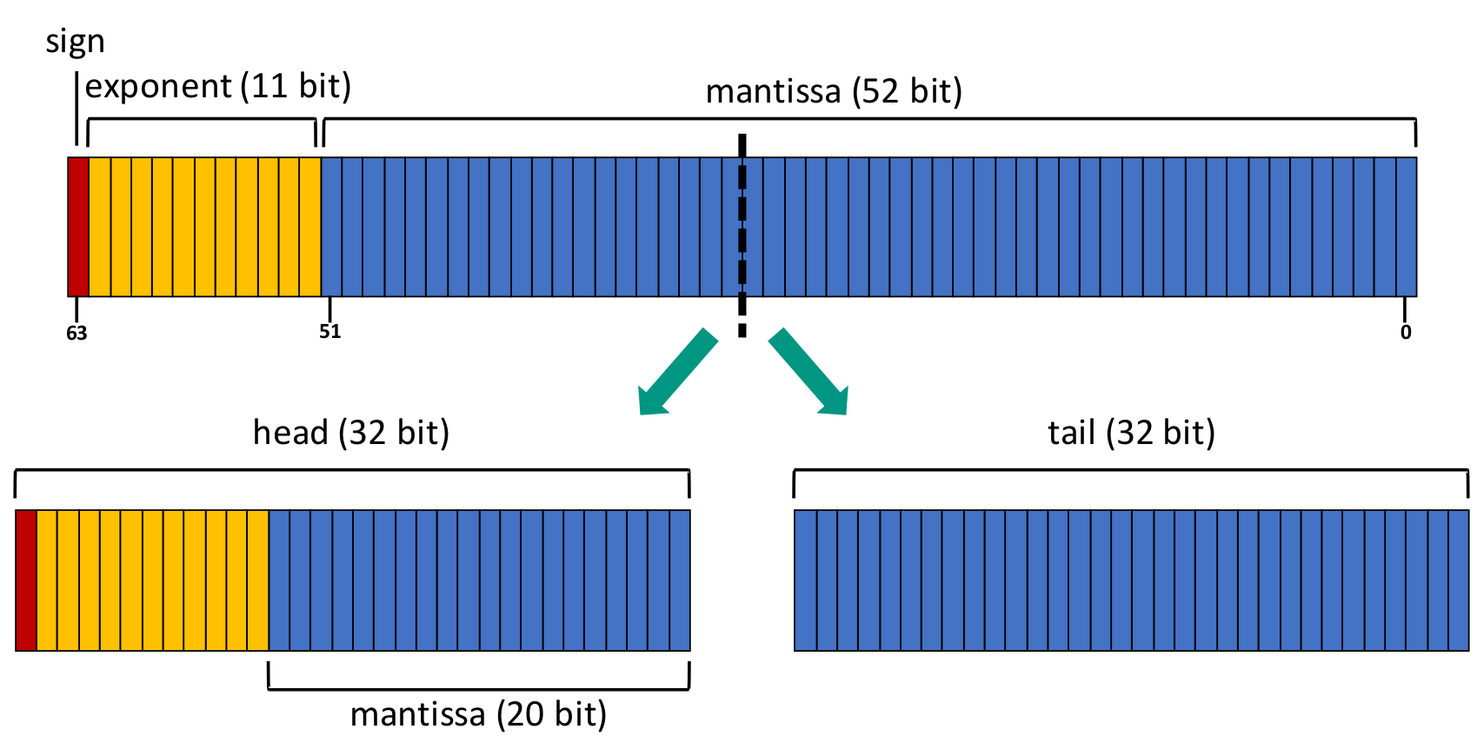
Overflow and underflow
Storing the block in lower precision can cause underflow or overflow in some values.
This is not accounted for by the numerical analysis shown in the previous slides
Two possible solutions:
  Check the condition number of the low precision block to verify there were no catastrophic overflows or underflows.
  Use a custom storage format that preserves the number of exponent bits:

Slide 38
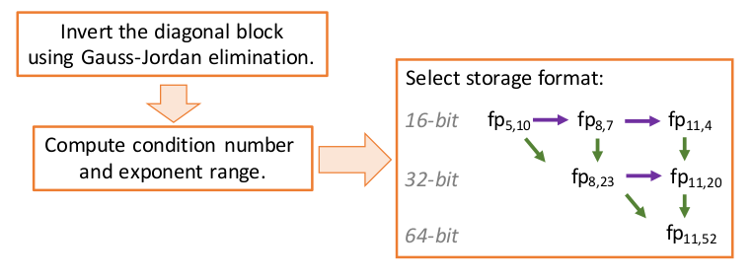
Adaptive BJ preconditioner generation

Slide 39
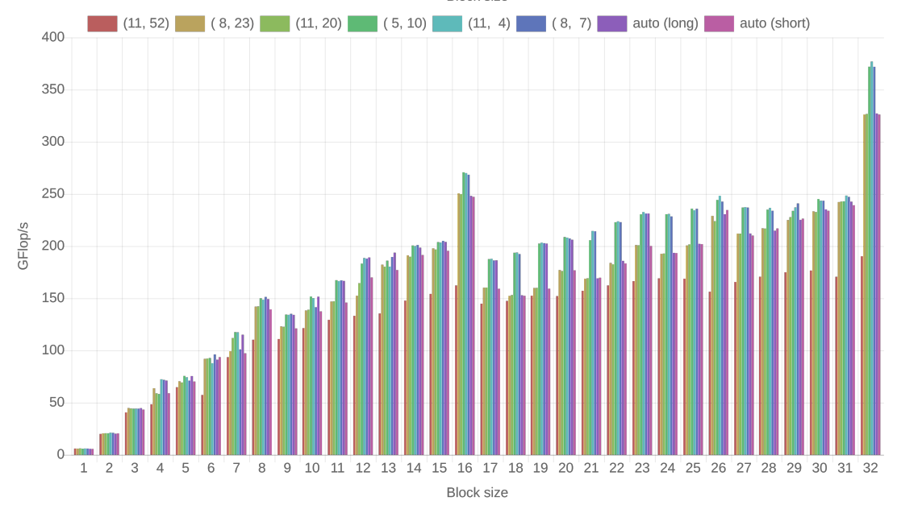
Preconditioner application performance

Slide 40
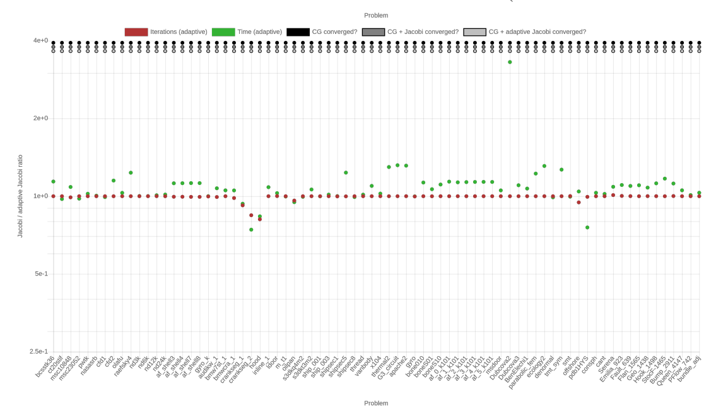
Time-to-solution, adaptive- vs full-precision BJ

Slide 41
Summary
Employ inherently parallel preconditioning schemes on accelerator hardware
Trade more computation for better access patterns
Take advantage of large register field of NVIDIA GPUs
Avoid data exchange by “renaming” CUDA threads
Take advantage of low precision to accelerate preconditioner application
Independently select precision for each subproblem to preserve preconditioner quality

Slide 42
Linear systems, Ginkgo

Slide 43





Sources of linear systems
Real-world problem transformed into a linear system via:
  PDE discretizations, graph representations
  Large number of unknowns (1M+, full matrix 8TB)
  Most matrix elements are zero
Possible approach: iterative methods
  Krylov-subspace based linear solvers
    SpMV
    BLAS-1 operations
  Sparse matrix formats & SpMV
    accelerate each iteration of the solver
  Preconditioners
    reduce the number of iterations

Slide 44

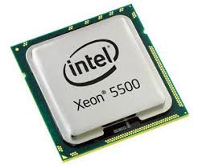
Sources of linear systems
Real-world problem transformed into a linear system via:
  PDE discretizations, graph representations
  Large number of unknowns (1M+, full matrix 8TB)
  Most matrix elements are zero
Possible approach: iterative methods
  Krylov-subspace based linear solvers
    SpMV
    BLAS-1 operations
  Sparse matrix formats & SpMV
    accelerate each iteration of the solver
  Preconditioners
    reduce the number of iterations
  Special hardware (e.g. GPUs)
  Probably not a good idea to implement everything from scratch…

Slide 45

Sources of linear systems
Real-world problem transformed into a linear system via:
  PDE discretizations, graph representations
  Large number of unknowns (1M+, full matrix 8TB)
  Most matrix elements are zero
Possible approach: iterative methods
  Krylov-subspace based linear solvers
    SpMV
    BLAS-1 operations
  Sparse matrix formats & SpMV
    accelerate each iteration of the solver
  Preconditioners
    reduce the number of iterations
  Special hardware (e.g. GPUs)
  Probably not a good idea to implement everything from scratch…
  Use a library instead:

Slide 46
Preconditioning

Slide 47

Preconditioning

Slide 48

Preconditioning
Replace the original system with an equivalent preconditioned system

Slide 49


Preconditioning
Replace the original system with an equivalent preconditioned system

Slide 50

Preconditioning
Replace the original system with an equivalent preconditioned system
Do not compute the preconditioned system matrix explicitly!

Slide 51

Preconditioning
Replace the original system with an equivalent preconditioned system
Do not compute the preconditioned system matrix explicitly!

Slide 52

Preconditioning
Replace the original system with an equivalent preconditioned system
Do not compute the preconditioned system matrix explicitly!
Preconditioner application

Slide 53

Preconditioning
Replace the original system with an equivalent preconditioned system
Do not compute the preconditioned system matrix explicitly!
Generate the preconditioner matrix, and store it in a form suitable for application
Preconditioner setup
Preconditioner application

Slide 54
Preconditioning
Replace the original system with an equivalent preconditioned system
Do not compute the preconditioned system matrix explicitly!
Generate the preconditioner matrix, and store it in a form suitable for application
Preconditioner setup
Preconditioner application
Trade-off:
faster convergence,
but more work per iteration

