Slide 1
Segmentation – Robótica y percepción computacional
Luciano Garcia-Giordano (150245)
Gonzalo Flórez Arias (150048)
Salvador González Gerpe (150044)

Slide 2
Dataset generation
Video frames
5D + 6D tensors
4D tensor (training + test set)
Training set and test set
Number of images, X-Y coordinates, HS channels
Number of pixels annotated, HS channels, Label
Features: H and S channels
90% training
10% test
15 frames
Width: 320 px
Height: 240 px
Scoring
Accuracy
Confusion matrix

Slide 3
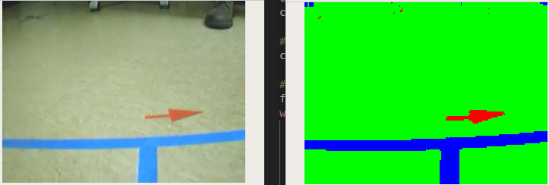
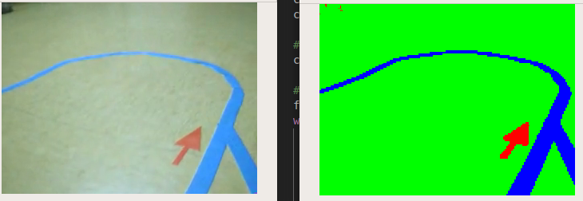
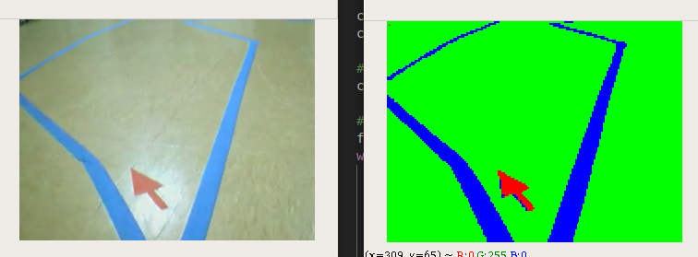
Classifiers
Classifier | Result
Distance-based classifier (Euclidean distance) | Bad results, poor learning
Gaussian Naïve-Bayes | Bad results, poor learning
2-layer MLP (8,8) | Overfit
2-layer MLP (4,3), ReLU activation | Very poor learning (underfit)
2-layer MLP (4,3), identity activation | Very poor learning (underfit)
2-layer MLP (4,3), sigmoid activation, regularization | Best until now
Accuracy: 0.99
Confusion matrix:
[[ 2069 15 0]
[ 8 27005 1]
[ 2 5 220]]
S
H
F
S
L

Slide 4
Problems
Symbol data is difficult to obtain
Segmentation is still poor. Factors still to enhance:
Dropout
Other activations
More data of symbols (red)
Parallelization of the classifier

