Slide 1
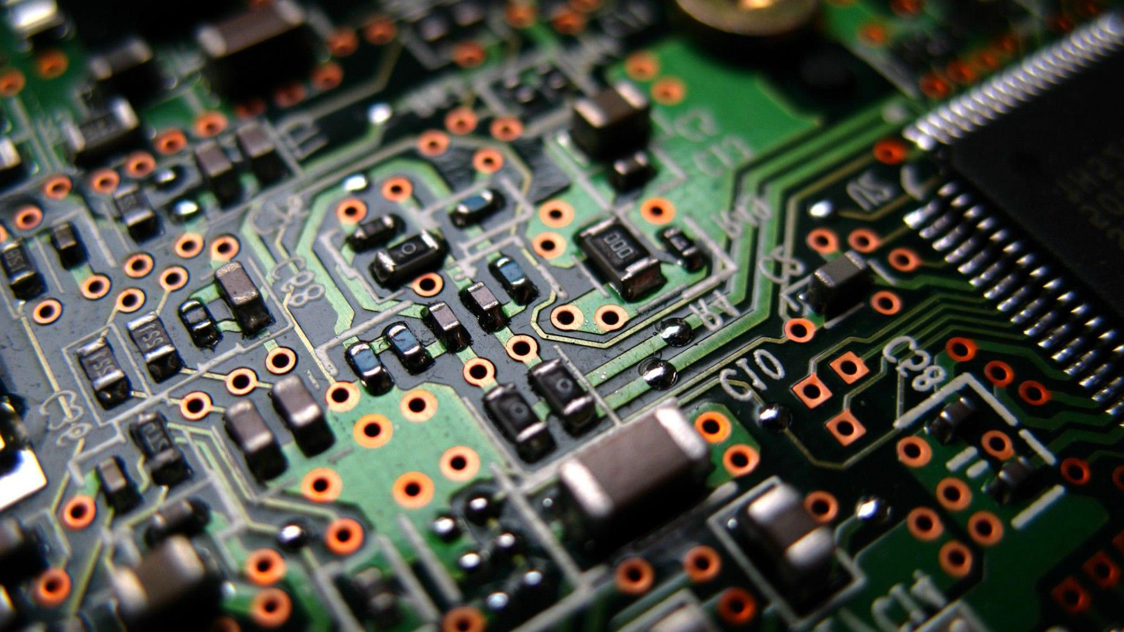
PCB
Images…
Under Development…

Slide 2
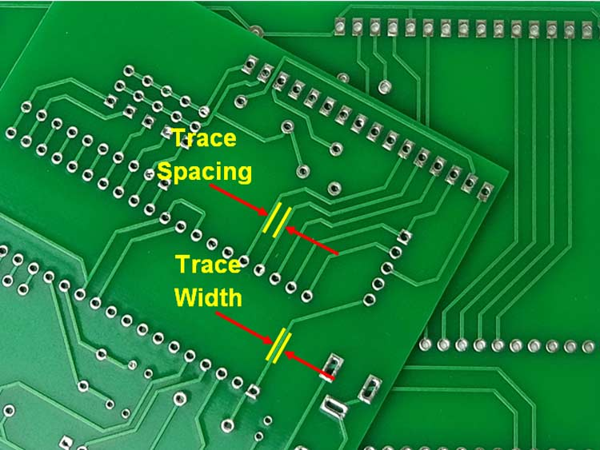
Notes:
https://www.proto-electronics.com/

Slide 3
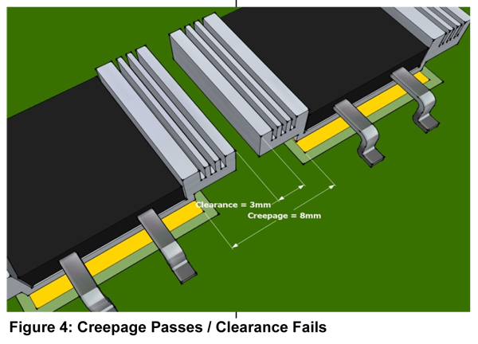

Slide 4
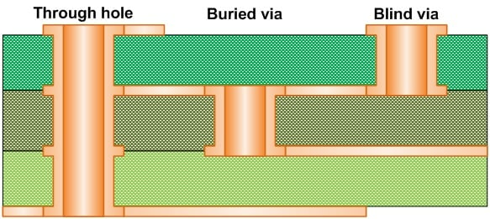

Slide 5
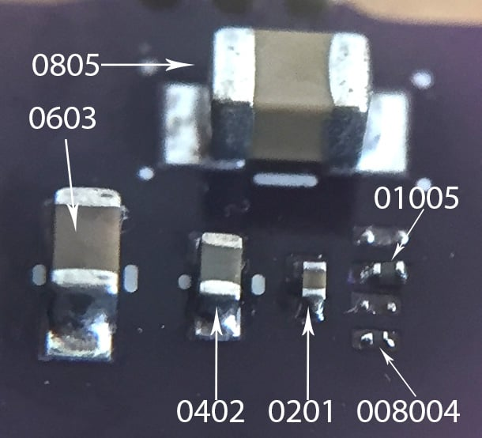

Slide 6
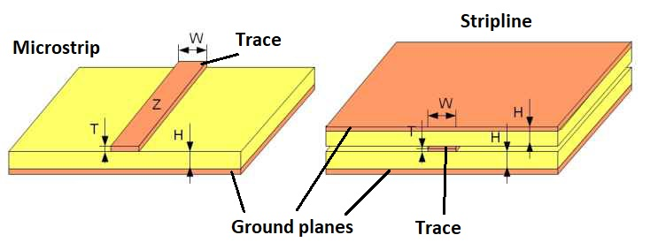

Slide 7
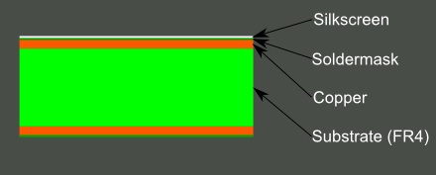
Notes:
https://learn.sparkfun.com/tutorials/pcb-basics/all

