Slide 1

KSQLDB
Real-time SQL on Kafka Streams

Slide 2
What is ksqlDB?
A streaming database that lets you use SQL to process Kafka data in real time
Built for Apache Kafka
SQL syntax - no Java required
Works with streams and tables
Used for analytics, alerts, and automations

Slide 3
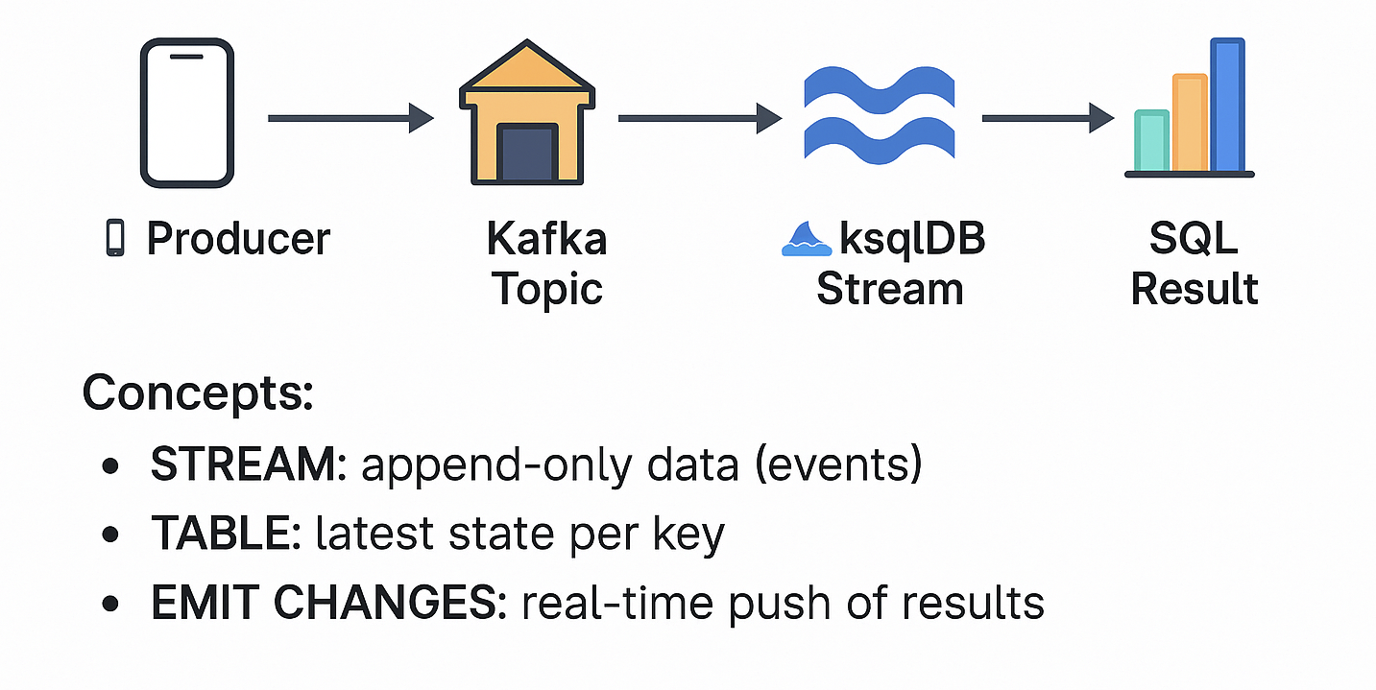
How it Works

Slide 4
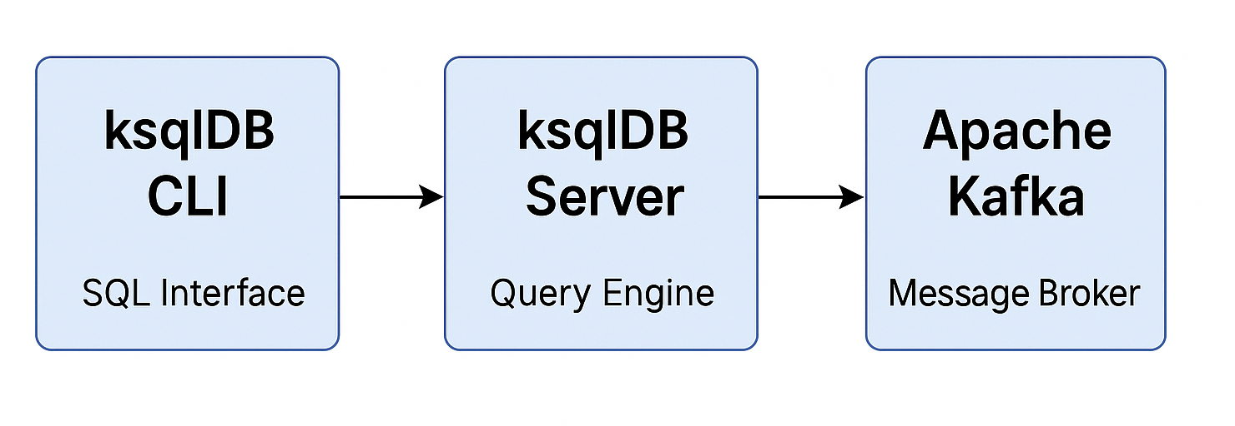
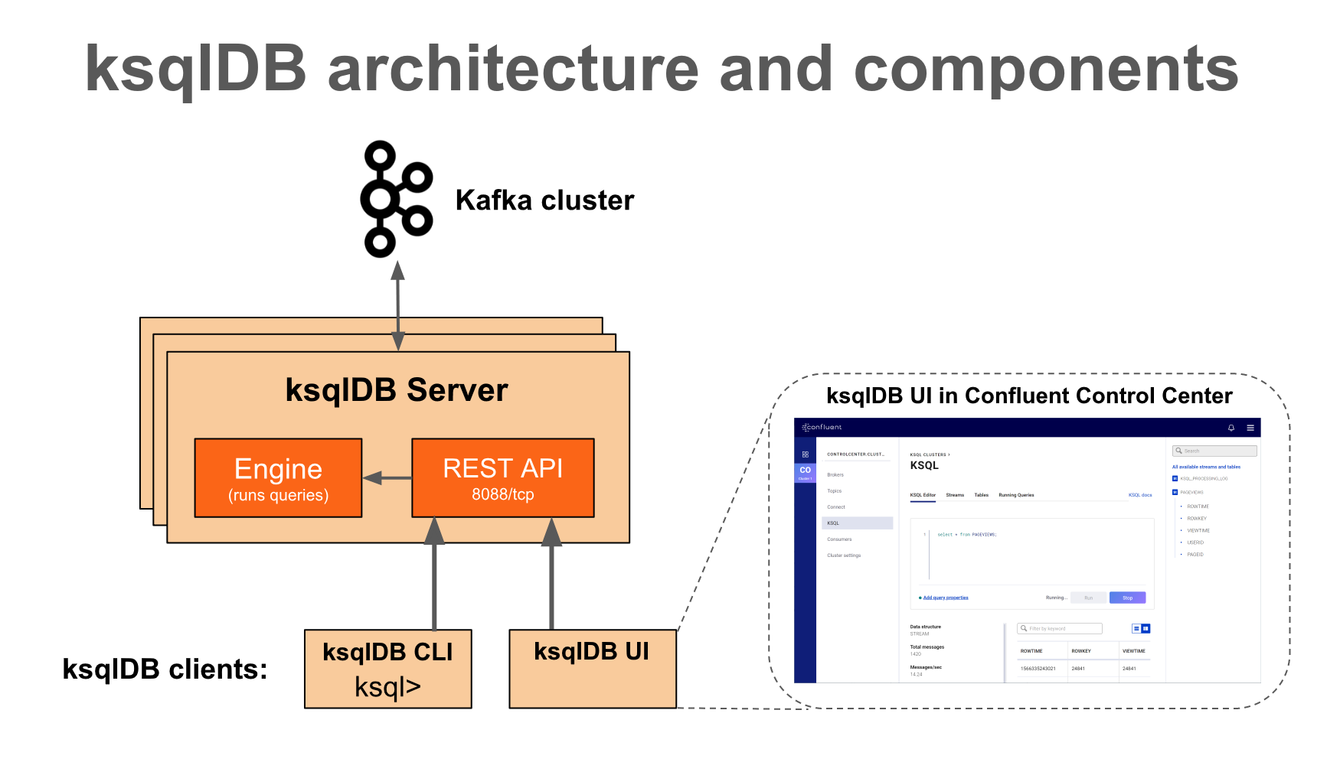
Internal Architecture

Slide 5
Pros & Cons
Pros & Cons
Simple SQL syntax
Real-time event processing
No backend code needed
Scales via Kafka
Only works with streaming
Limited SQL features
Harder to debug distributed queries
Tight Kafka dependency

Slide 6
Comparison
Pros & Cons
 | ksqlDB | Flink | Kafka Streams
Language | SQL | Java/Scala | Java
Learning Curve | Easy | Hard | Medium
SQL Support | Native | Partial | ❌
Deployment | Server | Cluster | Library-based

Slide 7

Demo: Fraud Detection

Slide 8
Guilherme Nogueira
Thank you!

