Slide 1

Marquez
The complete OpenLineage solution

Slide 2
WHAT IS MARQUEZ?
• Open-source metadata & lineage service
• Reference implementation of OpenLineage
• Web UI + API + Postgres
• “Google Maps for your data pipelines”

Slide 3
HOW IT WORKS
(Spark/dbt)
(OpenLineage)
(+ Postgres)
Data Jobs
Events
API
Graph
UI
Real-time & automatic

Slide 4
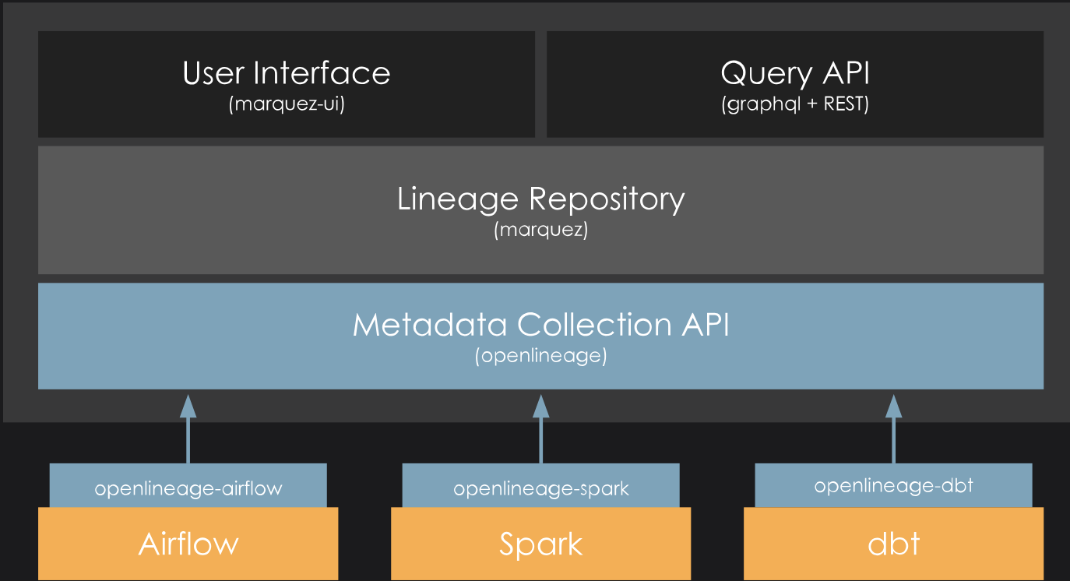
ARCHITECTURE
• API (ingest & query)
• DB (Postgres)
• Web UI (graph, runs, datasets)

Slide 5
USE CASES
• Lineage & impact analysis
• Governance & auditing
• Debugging with run history
• Team alignment on one source of truth

Slide 6
TRADE-OFFS
PROS
CONS
• Open-source (Apache 2.0)
• Native OpenLineage compliance
• Real-time lineage
• Active community
• Needs instrumentation in jobs
• UI simpler than commercial tools
• Scale/storage to manage
• No enterprise support out-of-box

Slide 7
COMPARISON
 | Marquez | DataHub | Apache Atlas
Focus | Operational lineage, real-time | Data discovery & catalog | Enterprise governance & compliance
Strengths | Native OpenLineage, simple setup, active OSS | Rich UI, search & tags, strong discovery | Deep Hadoop integration, policy & security
Best for | Data engineers debugging pipelines | Enterprises needing catalog & discovery | Large orgs w/ strict compliance

Slide 8


Slide 9
Thank You!
Guilherme Nogueira

Slide 10

Thanks!
Guilherme Nogueira

