Slide 1
Network Data Flow analysis
Capstone Project Proposal

Slide 2
DO YOU KNOW YOUR NETWORK
How are your application (by guest OS) distributed across your network
How many services do applications on your network provide
What type of traffic consumes your network resources
How much network is required by each application (by guest OS)
What is the probability that the top talkers will continue to utilize the network

Slide 3
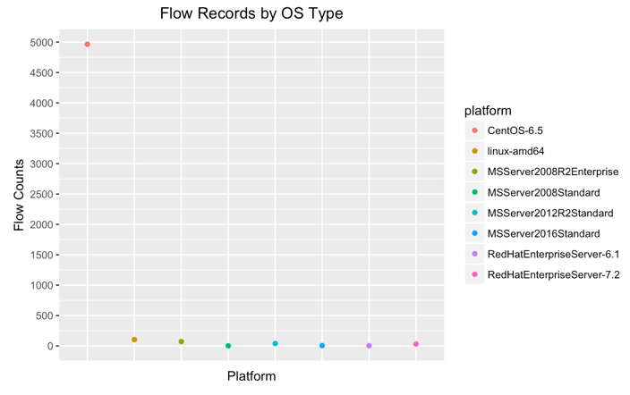
Guest OS Distribution
CENTOS-6.5
The clear choice of system developers for application distribution
5000 of the 5200 flows captures are CentOS

Slide 4
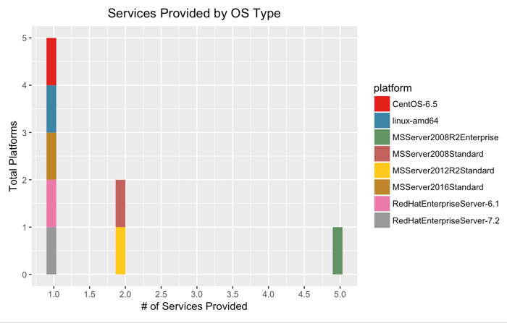
Application Services Provided
Services
Majority of the applications provide only a Single service to the user community
Applications are dedicated per host OS instance

Slide 5
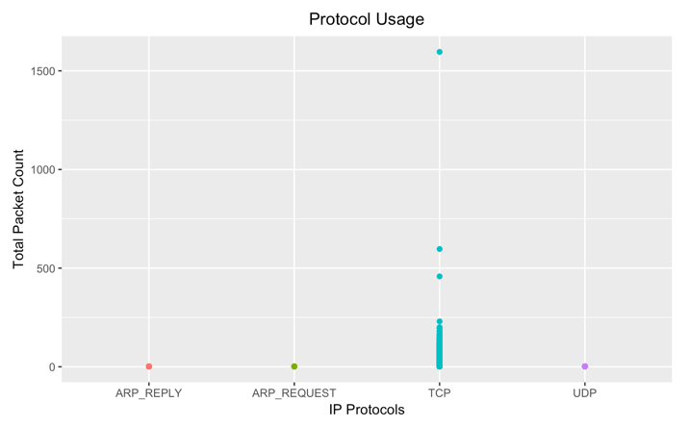
Protocol consumption
Protocol Usage
Multiple protocols exist on the network for overall application performance
TCP is the protocol of choice for application development

Slide 6
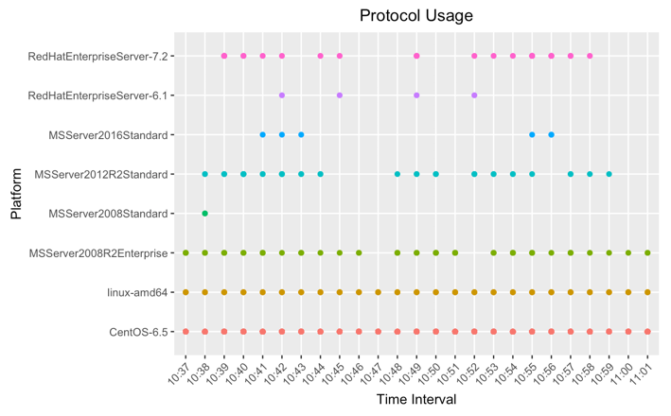
Network consumption
Network Usage
Linux application usage consumes network resources throughout the collected data set
Consistent usage per data collection periods

Slide 7
Summary
In summary, we are now able to confirm the following:
Linux guest OS distribution CentOS 6.5 plays a major role in the overall application architecture.
The applications are designed to utilize TCP for network connectivity
The application usage is consistent across the network over time

