Slide 1
校園行政管理系統
Requirement
N98991069 許任銘
P96997028 陳冠偉
N98971124 馮治平

Slide 2
Use Cases Diagram
教務行政
學籍資料
成績處理
課程助教處理
系上職員
註冊組職員
處理選課
學生輔導
課務組職員
課程資訊
印成績
選課
老師
登入/簽出
學生

Slide 3
Finding Use Cases
The goal of each actor ©
  For 老師
  授課資訊及學生輔導記錄
  For 系上職員
  產生每門 課程的助教
  For 學生
  選課及成績列印
11/07/10

Slide 4
Use Case Diagram---系上職員
登入/登出
選課處理
<<exclude>>
系上職員
助教徵選公告
課程助教處理
<<include>>
<<include>>
課程助教登錄
<<include>>
助教資格審合
<<include>>
<<include>>
歷年記錄
訓練時數

Slide 5
Use Case Description---系上職員
Use Case name: | 課程助教處理
Scope: | 處理課程助教處理相關業務
Level: | 完成課程助教處理業務
Primary Actor: | 系上職員
Stakeholder and interests: | 系主任、老師、學生
Preconditions: | 必須為系上承辦相關業務之人員
Success guarantee: (Post conditions) | 收集各課程的學期開課資料表，並發出徵選公告。 於徵選期間結束後，進行資格審核，合格條件如下： 無重大不良紀錄。 參與助教相關訓練課程需達至少30小時。 於對應課程登錄助教資料。
Main success scenario: | 系上職員 |  | 系統
 | 1.登入系統 |  | 2.顯示登入成功，顯示課程助教處理系統
 | 3.開啟課程助教處理系統 |  | 4.顯示三個子功能
 | 5.選擇所需操作之子功能 |  | 6.回應所選取之功能內容
 | 7.作業完成，登出系統 |  | 8.顯示已登出
Extensions: | Step | condition |  | handling
 | 1 | 相關業務使用者 |  | 系統拒絕操作
Special requirements: | 系統反應時間需小於或等於七秒
Technology and data variation list: | 所有項目使用鍵盤或滑鼠進行輸入
Frequency of occurrence: | 可被持續使用
open issue: | 超過10分鐘不使用可系統可將使用者逕行登出？

Slide 6
Use Case Diagram---系上職員
Use Case name: | 助教徵選公告
Scope: | 處理助教徵選公告
Level: | 完成處理助教徵選公告
Primary Actor: | 系上職員
Stakeholder and interests: | 系主任、老師、學生
Preconditions: | 必須為系上承辦相關業務之人員
Success guarantee: (Post conditions) | 於系統公告助教徵選相關事宜。
Main success scenario: | 系上職員 |  | 系統
 | 1.選擇助教徵選公告子系統 |  | 2.顯示助教徵選公告表格
 | 3.填寫助教徵選公告並存檔發佈 |  | 4.顯示存檔發佈成功，回學助教徵選公告子系統
 | 5.作業完成
Extensions: | Step | condition |  | handling
 | 3 | 必要欄位均需填寫完成 |  | 系統拒絕存檔
Special requirements: | 系統反應時間需小於或等於七秒
Technology and data variation list: | 所有項目使用鍵盤或滑鼠進行輸入
Frequency of occurrence: | 可被持續使用
open issue: | 超過10分鐘不使用可系統可將使用者逕行登出？

Slide 7
Use Case Diagram---系上職員
Use Case name: | 課程助教登錄
Scope: | 處理課程助教登錄
Level: | 完成處理課程助教登錄
Primary Actor: | 系上職員
Stakeholder and interests: | 系主任、老師、學生
Preconditions: | 必須為系上承辦相關業務之人員
Success guarantee: (Post conditions) | 於系統登錄各課程之助教。
Main success scenario: | 系上職員 |  | 系統
 | 1.選擇課程助教登錄子系統 |  | 2.顯示課程助教登錄表格
 | 3.填寫課程助教登錄並存檔 |  | 4.顯示存檔成功，回學課程助教登錄子系統
 | 5.作業完成
Extensions: | Step | condition |  | handling
 | 3 | 必要欄位均需填寫完成 |  | 系統拒絕存檔
Special requirements: | 系統反應時間需小於或等於七秒
Technology and data variation list: | 所有項目使用鍵盤或滑鼠進行輸入
Frequency of occurrence: | 可被持續使用
open issue: | 超過10分鐘不使用可系統可將使用者逕行登出？

Slide 8
Use Case Diagram---student
Login
Transcript
student
View Transcript
<<exclude>>
Register Course
Course Catalog
<<exclude>>
Update personal info

Slide 9
Use Case Name | Login
Brief Description | This use case describes how a user logs into the Course Registration System
Student |  | System
1. Chooses Login 3. Enters name and password |  | 2. Requests the actor enters his/her name and password 4. Validates the entered name and password: If invalid name or password, the system displays error message Else logs the actor into the system

Slide 10
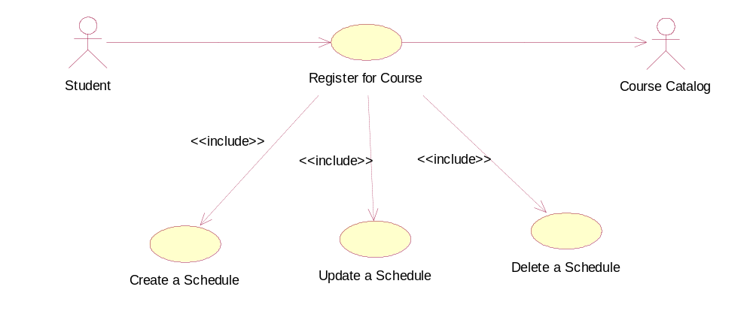
Register for Courses
Use Case Name | Register for Courses
Brief Description | This use case allows a Student to register for course offerings in the current semester. The student can also update or delete courses selections if change are made within the add/drop period at the beginning of the semester. The Course Catalog provides a list of all the courses offerings for the current semester
Student |  | System
1. Chooses Register for Courses 3. Choose one subfunction |  | 2. Display three subfunctions for choosing (Create/Update/Delete A Schedule) 4. The corresponding subfunction is executed

Slide 11
Use Case Name | Create a Schedule
Brief Description | This use case allows a Student to create a schedule which is a list of selected courses
Student |  | System
1. Chooses Create a Schedule 3. Selects course offerings from the list and save Schedule |  | 2. Retrieves a list of available course offerings from the Course Catalog System and displays the list to the Student 4. Creates a schedule for the Student containing the selected course offerings

Slide 12
Use Case Name | Update a Schedule
Brief Description | This use case allows a Student to update a schedule if registration in progress
Student |  | System
1. Chooses Update a Schedule 3. Update the course selections by deleting or adding new course offerings and save Schedule |  | 2. Displays the Student’s current schedule (the schedule for the current semester) Retrieves and displays a list of available course offerings from Course Catalog System 4. Updates the schedule for the Student.

Slide 13
Use Case Name | Delete a Schedule
Brief Description | This use case allows a Student to delete a schedule if registration in progress
Student |  | System
1. Chooses Delete a Schedule 3. Chooses Delete the current schedule 5. Verifies the deletion |  | 2. Displays the Student’s current schedule (the schedule for the current semester) 4. Prompts the Student to confirm the deletion of the schedule 5. Deletes the schedule

Slide 14
Use Case Name | View Transcript
Brief Description | This use case allows Students to view scores of all courses that they have taken, and allows Professors to view scores of all students who they have taught
Student |  | System
1. Chooses View Transcript |  | 2. Retrieves a list of scores from the Transcript System and displays the list to the Student

Slide 15
Use Case Name | Update Personal Information
Brief Description | This use case allows Students to update their personal information
Student |  | System
1. Chooses Update Personal Information 3. Enter desired changes to the student information (not includes student id) and save |  | 2. Display personal information of the student 4. Update the student information

Slide 16
Use Cases Diagram - 老師
教學評量
<<include>>
老師
課程資訊
開課一覽
<<include>>
課表查詢
<<include>>
學生輔導
<<include>>
<<include>>
<<include>>
簡訊發送
輔導填報
教師留校時間
11/07/10

Slide 17
Use Case Description: 老師
Use case name: 課程資訊
Primary Actor: 老師
scenario
Actor’s Action
System Responsibility
1. Choose 課程資訊
2. Display 3 subfunctions for choosing
3.Choose one subfunction
4. Process the corresponding subfunction.
11/07/10

Slide 18
Use Case Description - 老師
Use case name: 學生輔導
Primary actor: 老師
system
1. Choose 學生輔導
2. Display 3 subfunctions for choosing
3. Choose one subfunction
4. Process the corresponding subfunction.
11/07/10

