Slide 1
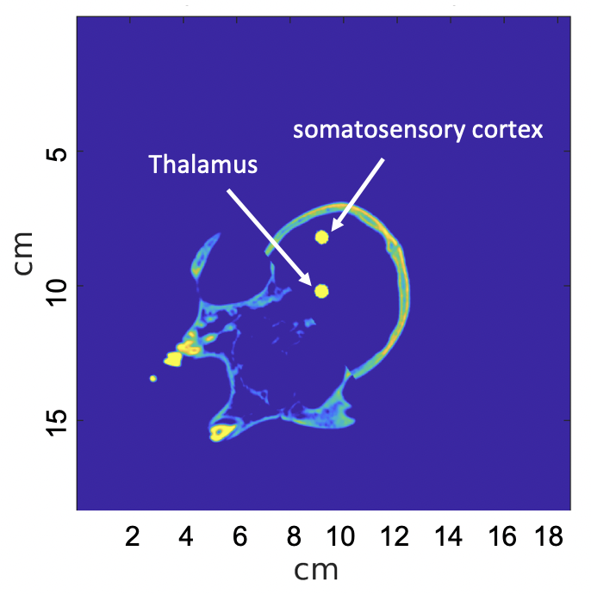
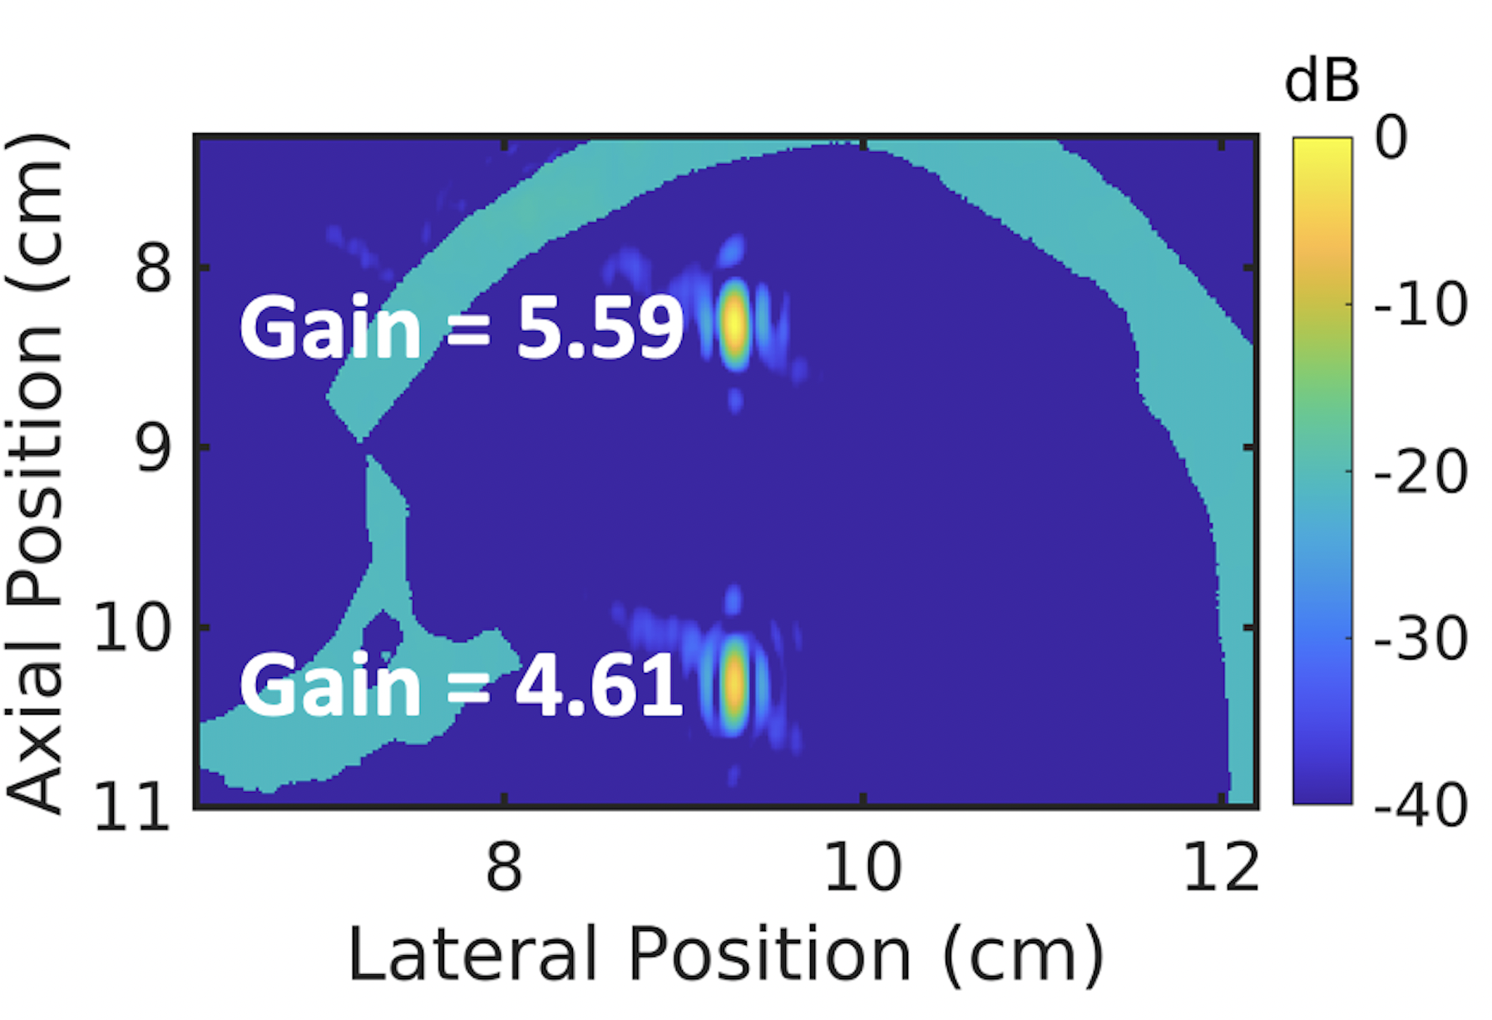
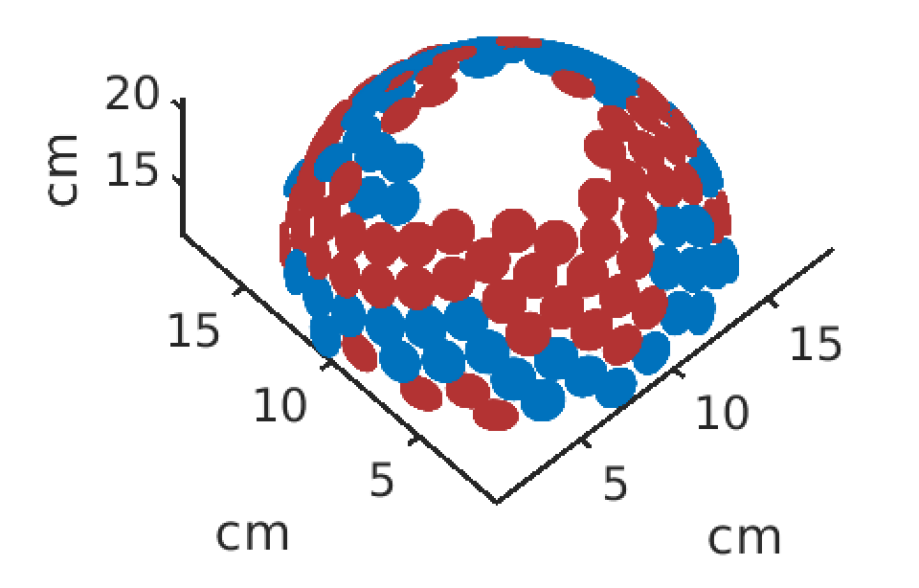
Rotated towards Somatosensory Cortex
Points towards Thalamus
Imaging Aperture
Gain = 5.19
Gain = 4.45

Slide 2
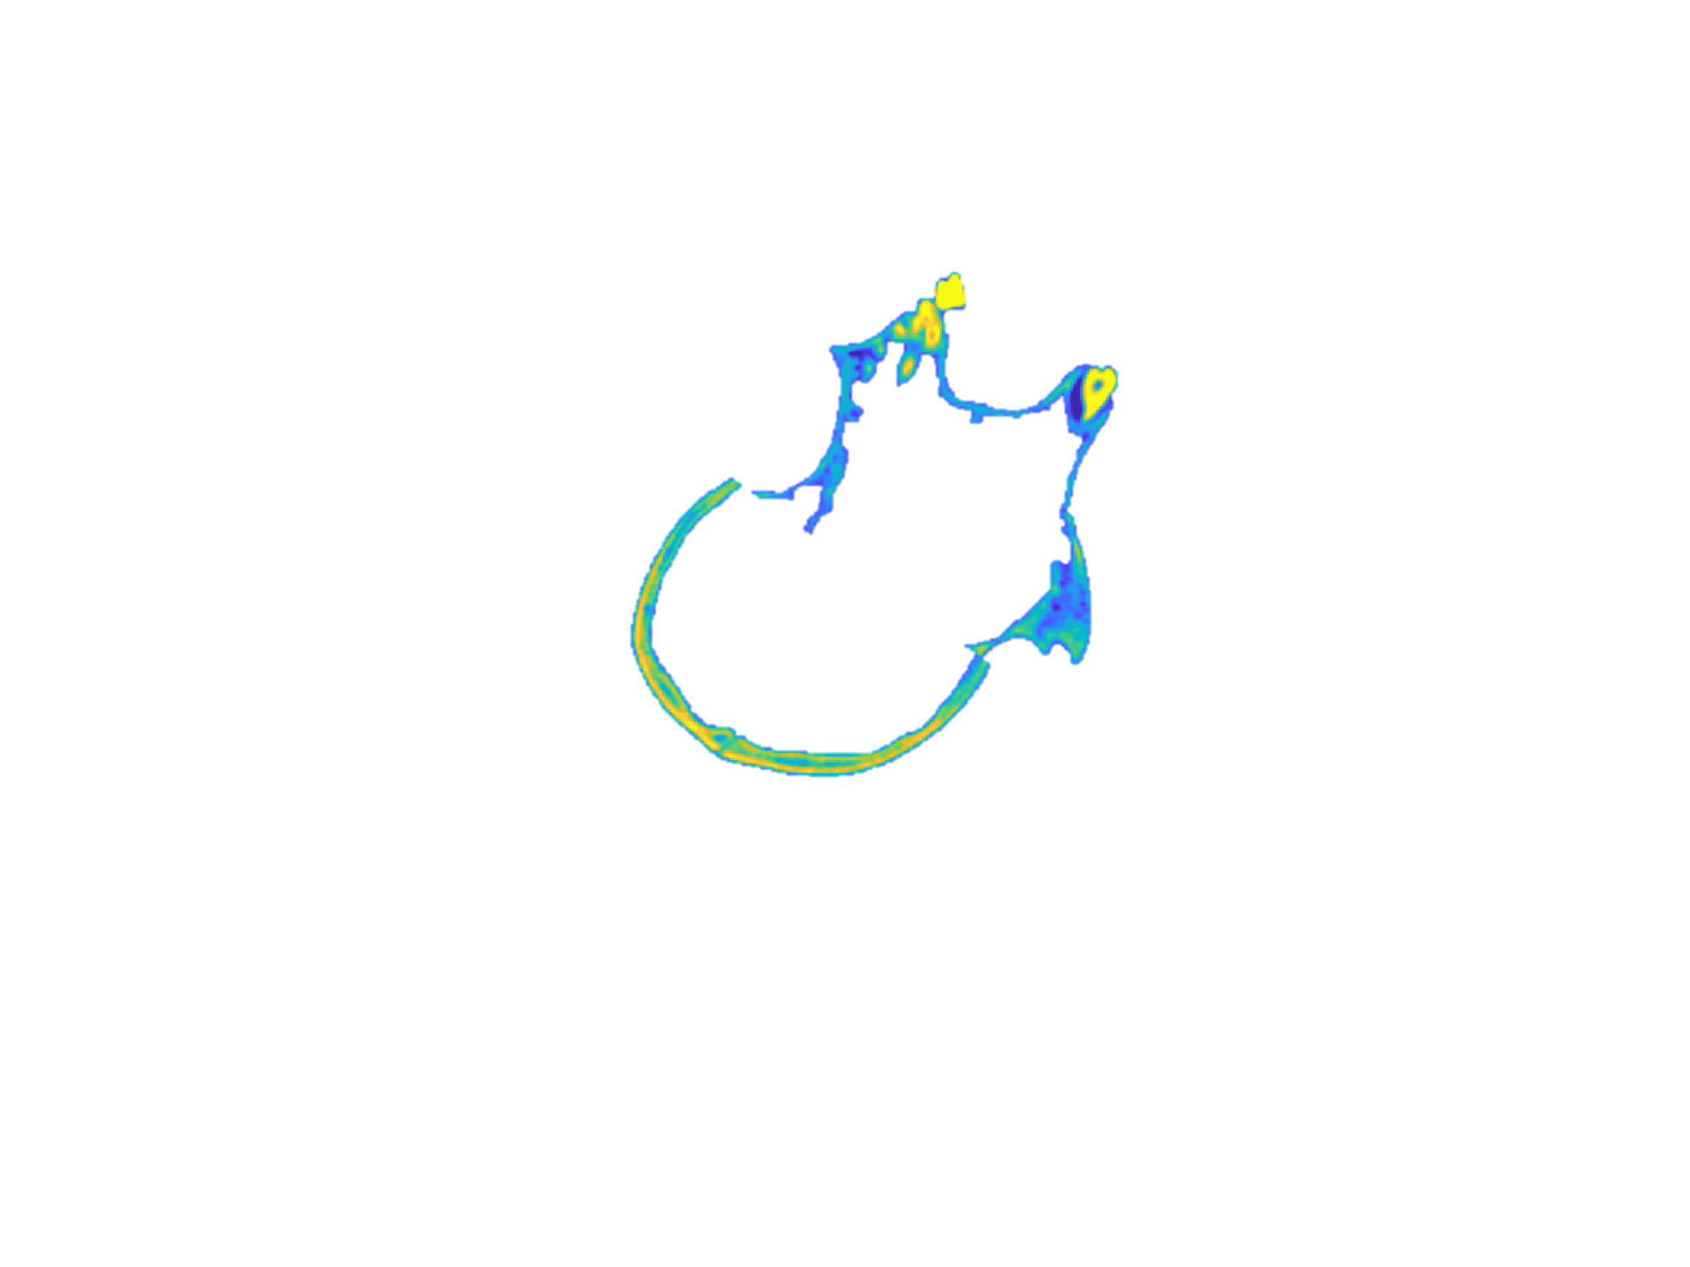
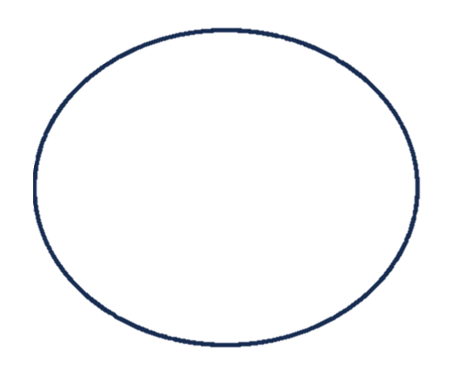

Slide 3
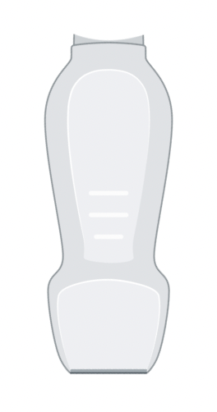
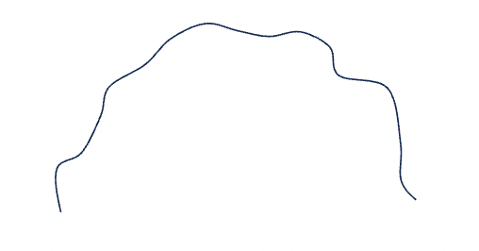
Imaging Aperture
Imaging Transducer
Neuromodulation Array Elements
Propagating Sound Waves
Focal Point
Non-human Primate Skull

Slide 4
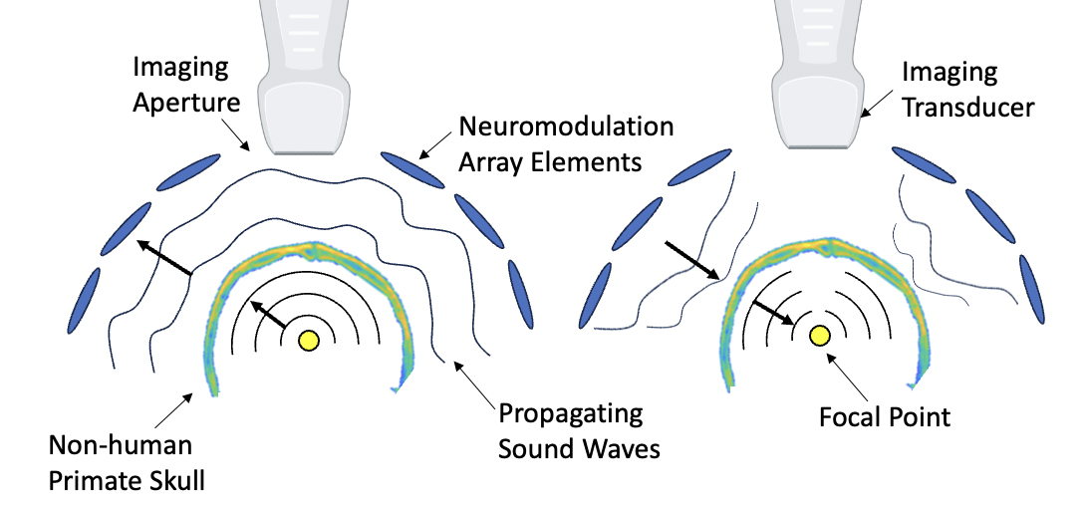
a)
b)
Rotated towards Somatosensory Cortex
Points towards Thalamus
c)
d)

