Slide 1
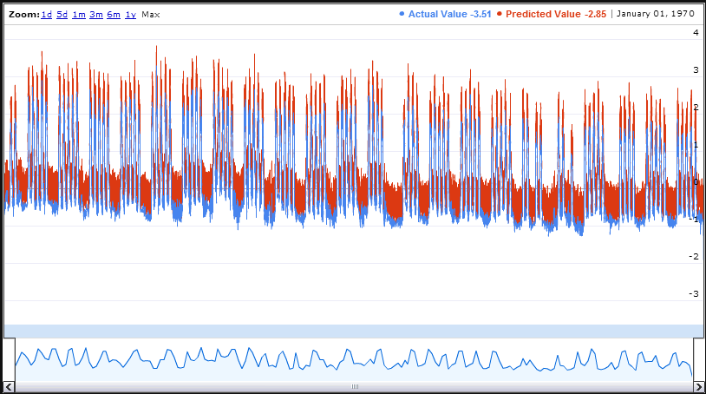
Time Series Data Mining Tool
Samir, Satvik, Vaishakh
Dept. Of CSE, RVCE

Slide 2
INTRODUCTION
A time series is a sequence of data points, measured typically at successive points in time spaced at uniform time intervals.
Time series analysis comprises methods for analyzing time series data in order to extract meaningful statistics and other characteristics of the data.

Slide 3
In the context of data mining, pattern recognition and machine learning time series analysis can be used for clustering, classification, query by content, anomaly detection as well as forecasting.

Slide 4
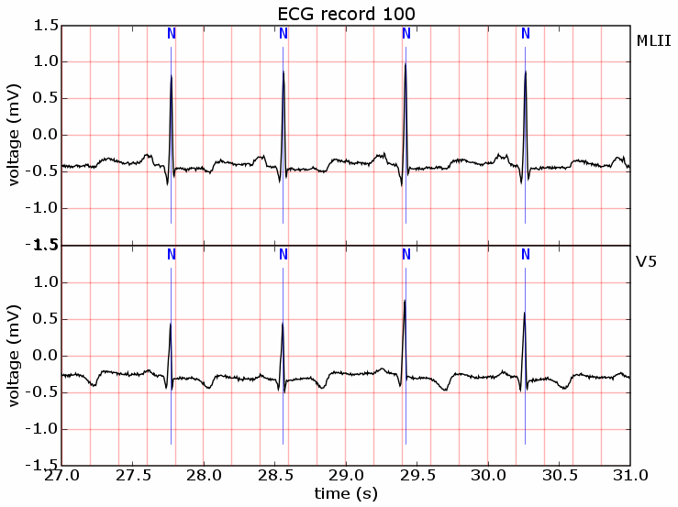
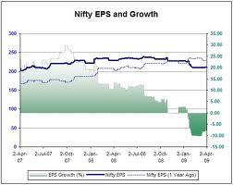
EXAMPLES OF TIME SERIES DATA

Slide 5
DATA SETS CONSIDERED IN THIS PROJECT
Rainfall Data from Bhramhavara collection point in Sita Nadi. (Monthly Data)
Sea Level Data Set
Electricity Consumption Data Set
ECG Data Set

Slide 6
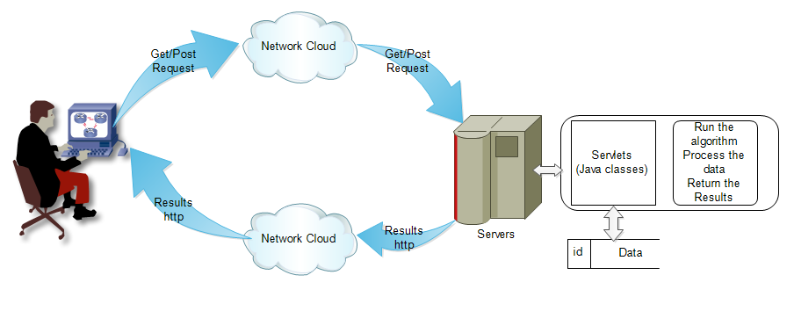
High Level Design Of the TSDM Tool
TSDM Tool implemented in Java and JSP

Slide 7
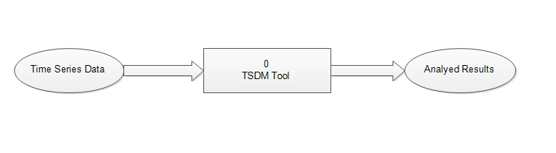
DFD Level 0

Slide 8
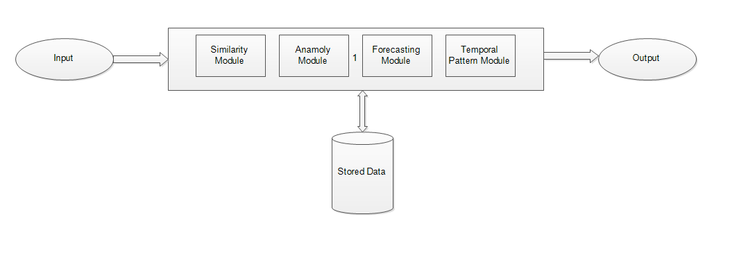
DFD Level 1

Slide 9
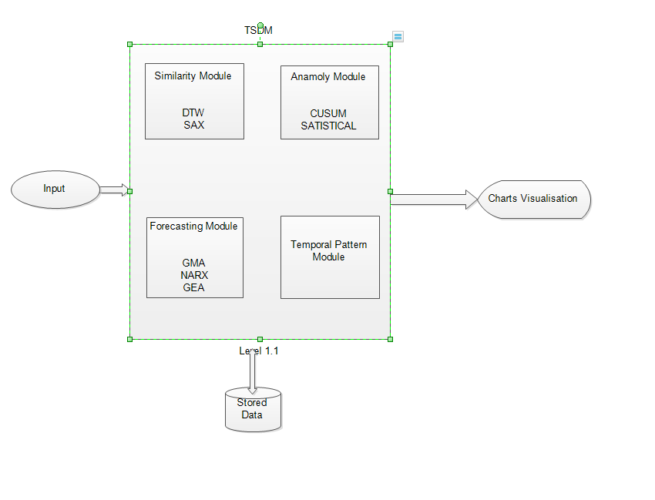
DFD Level 1.1

Slide 10
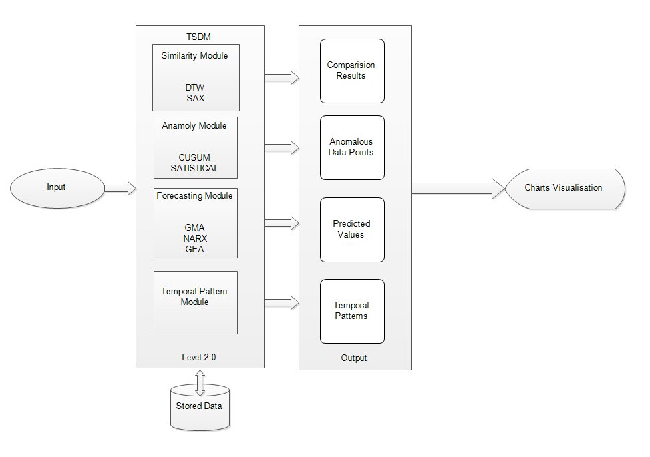
DFD Level 2.0

Slide 11
MODULES Description
The Different Modules are :
GUI module
Similarity Detection Module
Forecasting Module
Anomaly Detection Module
Temporal Pattern Detection Module

Slide 12
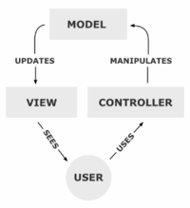
GUI MODULE
Jsp and Servlets are are used.
A MVC Model is built
Ajax and JQuery UI
for dynamic updation
Google Charts API
for charting

Slide 13
Anomaly Detection
Anomaly detection, (outlier detection) refers to detecting patterns in a given data set that do not conform to an established normal behavior. The patterns thus detected are called anomalies and often translate to critical and actionable information in several application domains. Anomalies are also referred to as outliers, change, deviation, surprise, aberrant, peculiarity, intrusion, etc.

Slide 14
Anomaly Detection - CUSUM VMASK
APPROACH
Samples, each of size n, and compute the mean of each sample. Then the cumulative sum (CUSUM) control chart is formed by plotting one of the following quantities:

Slide 15
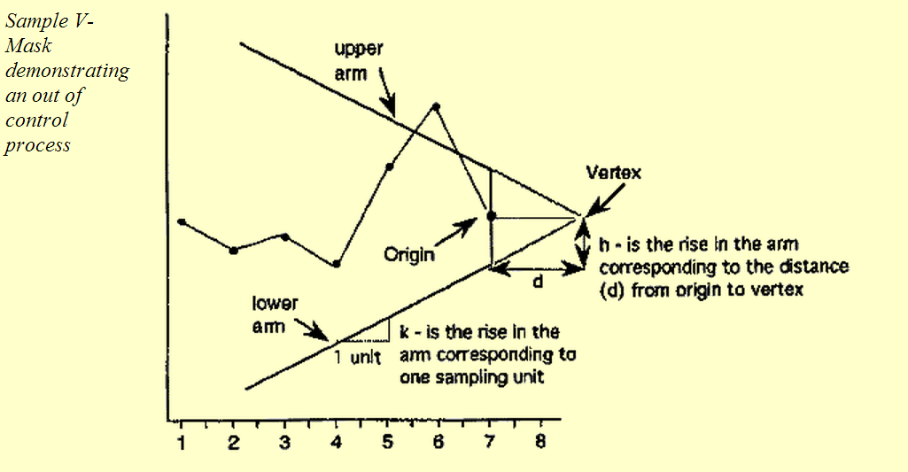

Slide 16
ANOMALY DETECTION-STATISTICAL APPROACH
Dealt with by Statistical Quality Control
Record the mean and standard deviation up the the current time.
Signal an alarm if the process goes outside 3 sigmas

Slide 17
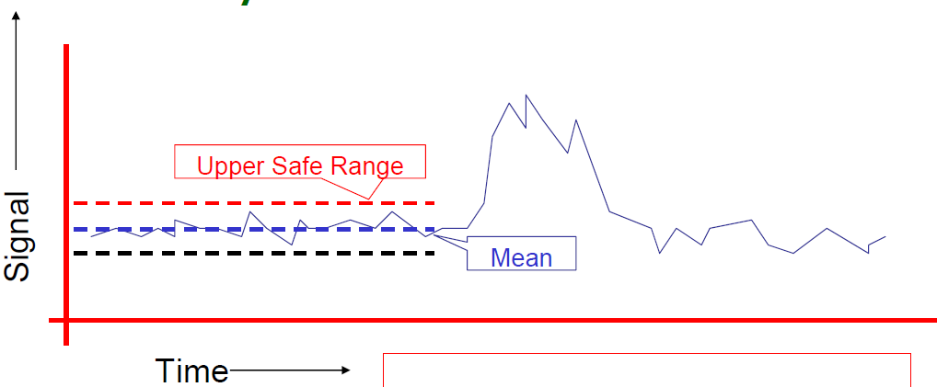

Slide 18
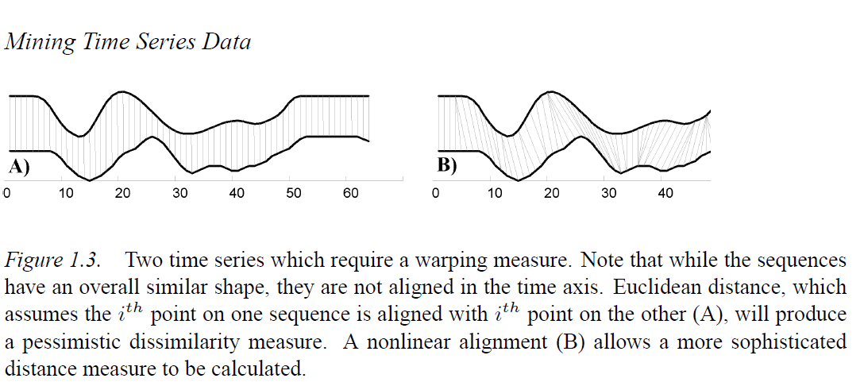
Similarity Detection
Given a query time series Q, a similarity finder will find the most similar time series in a given collection of time series. With Clustering, natural groupings of time series can be obtained.

Slide 19
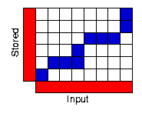
SIMILARITY FINDER - DTW ALGORITHM
In general, DTW is a method that allows a computer to find an optimal match between two given sequences (e.g. time series) with certain restrictions.
The sequences are "warped" non-linearly in the time dimension to determine a measure of their similarity independent of certain non-linear variations in the time dimension. This sequence alignment method is often used in time series classification.

Slide 20
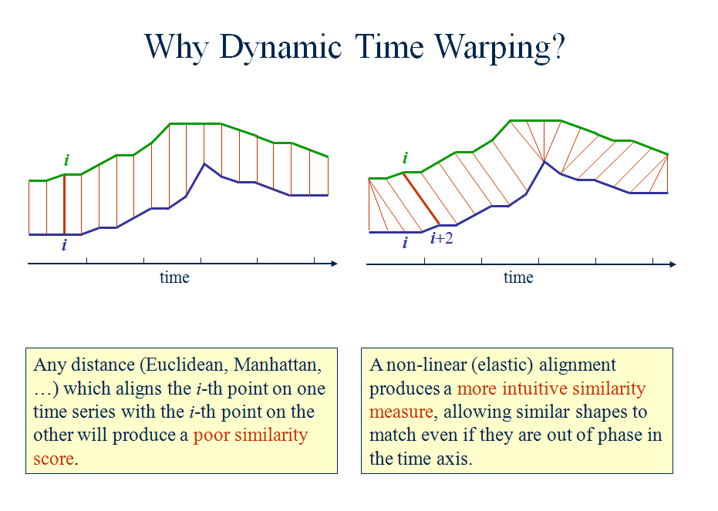

Slide 21
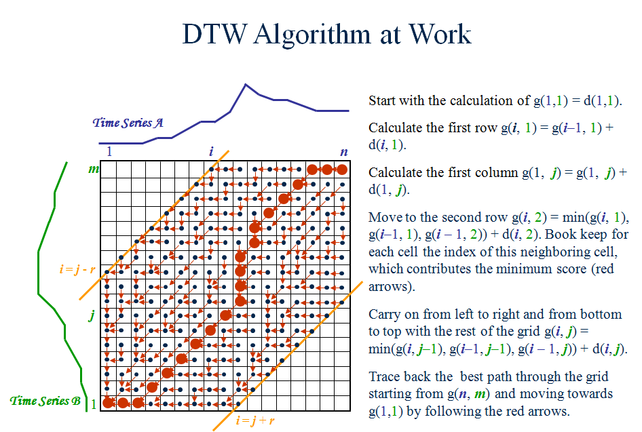

Slide 22
SIMILARITY - SAX ALGORITHM
SAX transforms a time-series X of length n into the string of arbitrary length
The SAX algorithm consist of two steps: during the first step it transforms the original time-series into a PAA representation and this intermediate representation gets converted into a string during the second step. Use of PAA at the first step brings the advantage of a simple and efficient dimensionality reduction.
The second step, actual conversion of PAA coefficients into letters.

Slide 23
Time Series Forecasting
Time series forecasting is the use of a model to predict future values based on previously observed values.

Slide 24
Forecasting/Smoothing Approaches
Moving Average
Moving Exponential Average
Moving Geometric Average
The Geometric moving average calculates the geometric mean of the previous N bars
The geometric mean on the other hand is calculated by multiplying the time series' N previous values and then taking the N'th root.
These algorithms are just legacy algorithms and do not really yield promising results. Hence, the NARX NN Is Used.

Slide 25
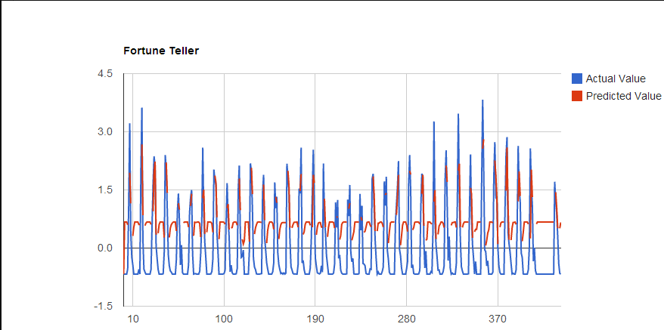
Example : Moving geometric on Rainfall Data
The predicted value is very close to the actual value.
Final Predicted : 1.44
Final Actual : 1.7
Error : 17% (Error percentage changes for different data sets)

Slide 26
Forecasting - NARX NN
In time series modeling, a nonlinear autoregressive exogenous model (NARX) is a nonlinear autoregressive model which has exogenous inputs. This means that the model relates the current value of a time series which one would like to explain or predict to both:
past values of the same series; and
current and past values of the driving (exogenous) series — that is, of the externally determined series that influences the series of interest.

Slide 27
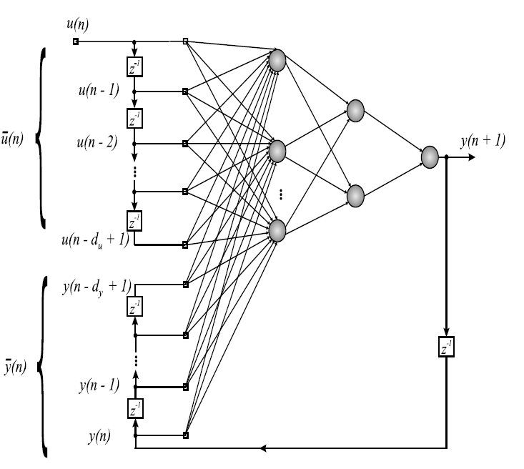

Slide 28
Temporal Pattern Mining
• Revels hidden patterns that are
characteristic and predictive time series
events
• Traditional analysis is unable to identify
complex characteristics (complex, non non-
periodic, irregular, chaotic)

Slide 29
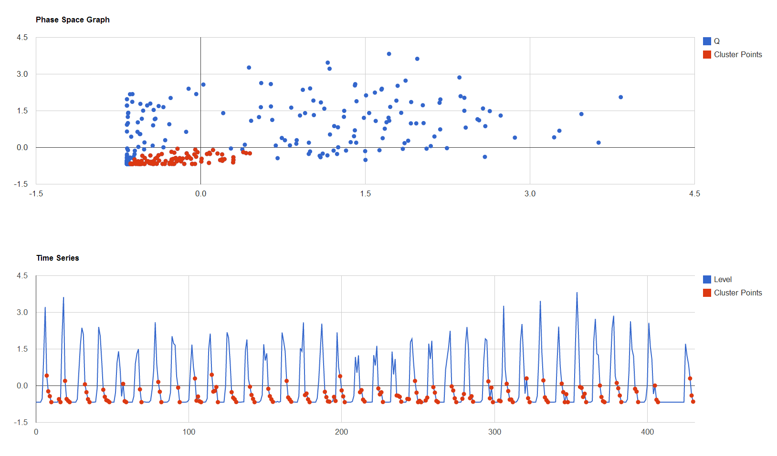
Results – Temporal Patterns

Slide 30
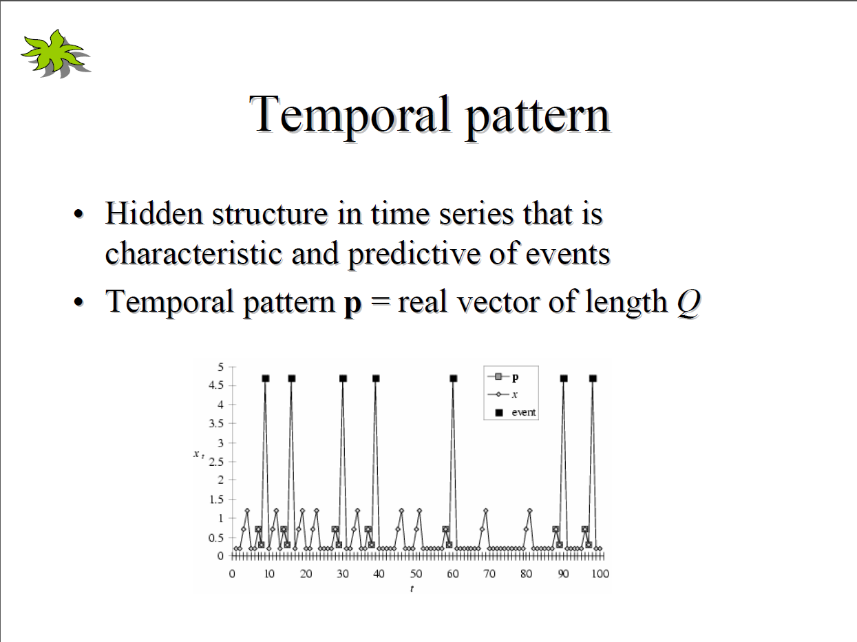

Slide 31
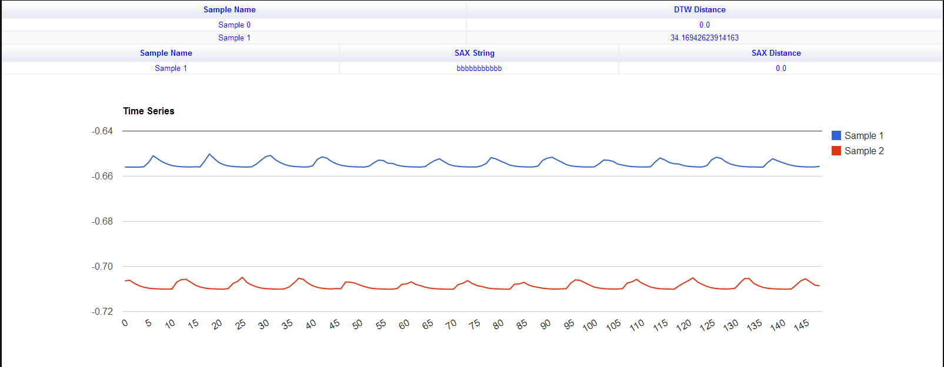
Results
SIMILARITY DETECTION

Slide 32
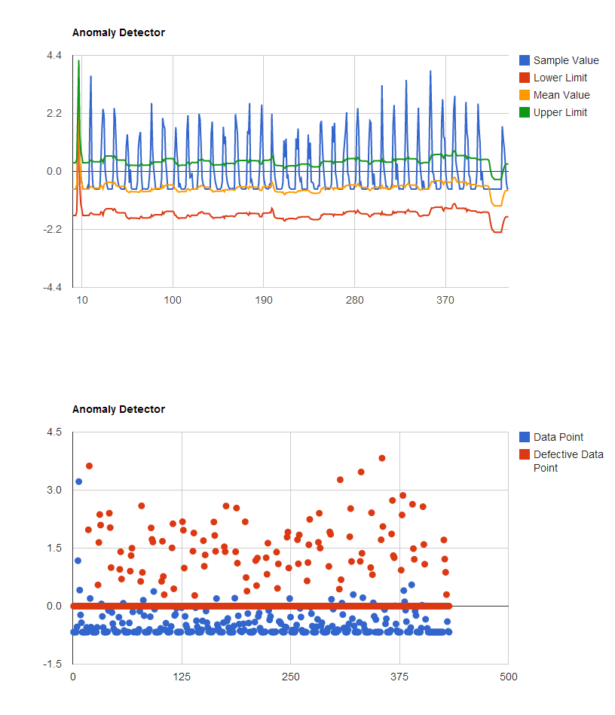
Results – Anomaly Detection

Slide 33
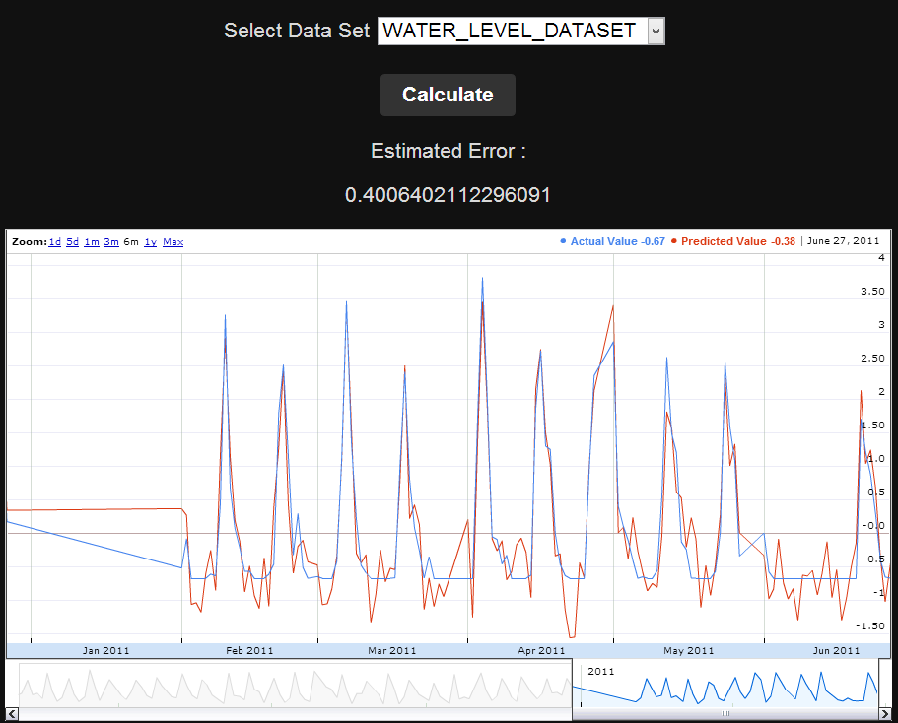
Results – Forecasting/Prediction
NARX Neural Network

Slide 34
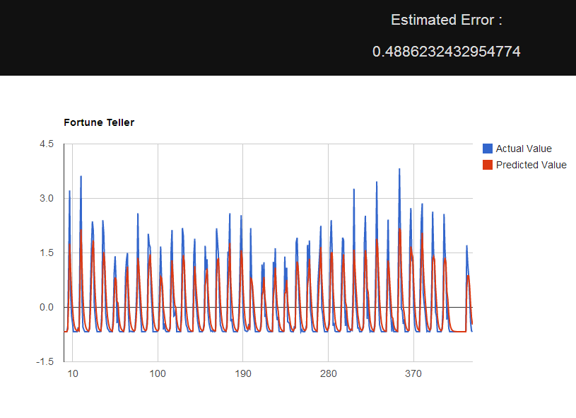
Results
Moving Exponential Average Method

Slide 35
FURTHER ENHANCEMENTS
The size of the time series data analyzed is in terms of Mega Bytes. For larger dataset(In terms of GBs) or big data, distributed computing technologies like Hadoop can be used.
The application can be extended to analyze multi variate time series data.

Slide 36
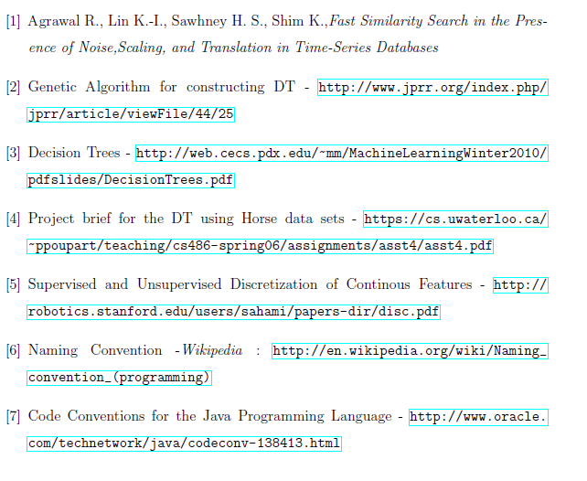
References

Slide 37

Questions ?

Slide 38

THANK YOU
Source code available at https://github.com/nsatvik/ts-datamining
© 2013,Code Kshetra. (Satvik, Vaishakh, Samir) ☺

