Slide 1
Van der Pol Oscillator
Parametric Dynamics and Surrogate Modeling
CIS 568 · Final Visualization Project
Gustavo Franco Reynoso
7 Interactive Visualizations · D3.js · RK4 · Chebyshev / Barycentric Interpolation

Slide 2
What Is the Van der Pol Oscillator?
Think of a swing that keeps swinging forever on its own.
Normal swings slow down from friction or fly off with too much push. The Van der Pol oscillator finds a perfect middle ground: a self-sustaining rhythm called a limit cycle.
The magic knob: mu (μ)
Small μ: smooth, round waves (like a gentle pendulum).
Large μ: slow charge-up then a hard snap-back (like a heartbeat).
The equation, in plain English:
ẍ − μ(1 − x²)ẋ + x = 0
x = position | ẋ = speed | ẍ = acceleration | μ = nonlinearity strength
When |x| < 1: the middle term pumps energy in. When |x| > 1: it pulls energy out. The result is that the system locks onto a stable loop on its own.

Slide 3
Why Does This Matter? Real-World Applications
Science and Engineering
Cardiac rhythms: the heart self-oscillates just like this model
Neuroscience: neuron firing patterns match Van der Pol dynamics
Electrical circuits: invented to describe vacuum-tube radio oscillators
Mechanical systems: vibration isolation, MEMS devices
Climate and Economics
El Nino oscillations follow a similar nonlinear ODE structure
Business cycles have been modeled as nonlinear oscillators
Why study the parameter μ?
In real applications you rarely know the exact parameter. You need to see how behavior shifts across a whole range of μ.
Why use surrogate models?
Running the full ODE for every μ gets expensive. A surrogate lets you precompute once and query instantly.
This project does both:
Explores μ visually AND tests how well surrogates approximate the true solution.

Slide 4
How the Visualization Is Built (Technical Overview)
Step 1: Solve the ODE with RK4
4th-order Runge-Kutta re-checks trajectory direction 4x per step so small errors do not compound over time.
Step 2: Choose smart sample points (nodes)
Equispaced: simple, like measuring every inch. Chebyshev: denser near the edges where polynomials tend to blow up.
Step 3: Interpolate between samples
Barycentric Lagrange interpolation fills in values between sample points. It is fast, stable, and numerically well-behaved.
Step 4: Link everything with D3.js
Seven interactive pages, each showing a different angle on the data. Move one slider and every linked chart updates instantly.
7 Pages: Effect of μ · Time Evolution · Basin of Attraction · Vector Field + Nullclines · Amplitude & Period · Barycentric Interpolation · Parametric Surrogate

Slide 5
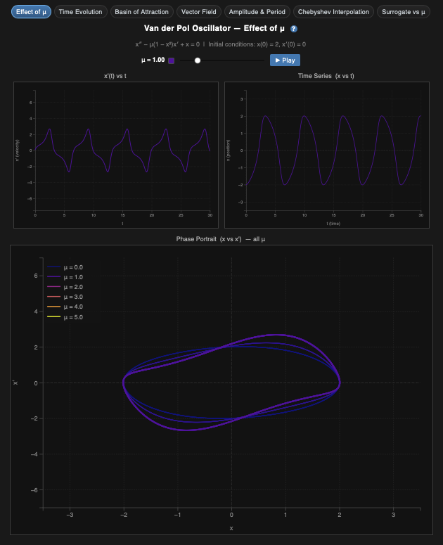
Visualization 1: Effect of μ
How does changing μ transform the oscillator's behavior?
WHAT
Side-by-side plots of velocity, position, and phase-portrait loops, all colored by μ. A bottom panel overlays limit cycles from multiple μ values at once.
WHY
It shows the big picture. One glance lets you see how the oscillator shifts from smooth sine waves at small μ to sharp relaxation oscillations at large μ.
HOW
RK4 solves the ODE for each μ. D3 renders three linked panels using a plasma color scale. The μ slider updates all three panels at the same time.

Slide 6
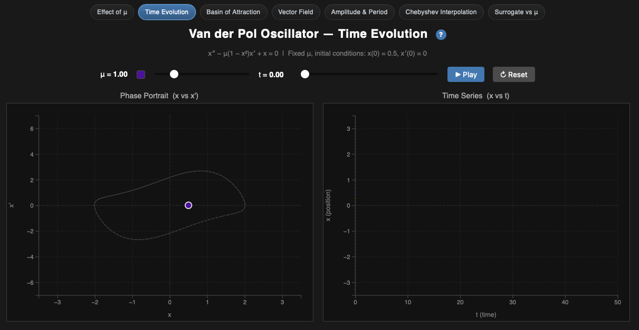
Visualization 2: Time Evolution
Watch a single trajectory settle from any starting point onto its steady cycle
WHAT
An animated dot moves through phase space on the left while the matching time signal builds up on the right. A dashed curve marks the target limit cycle.
WHY
Most systems start out messy and calm down over time. This animation makes that settling visible. You can watch the system literally forget where it started.
HOW
The ODE integrates step by step. Each frame draws the next segment of the path in both panels. There is a play/pause button and a μ selector for full control.

Slide 7
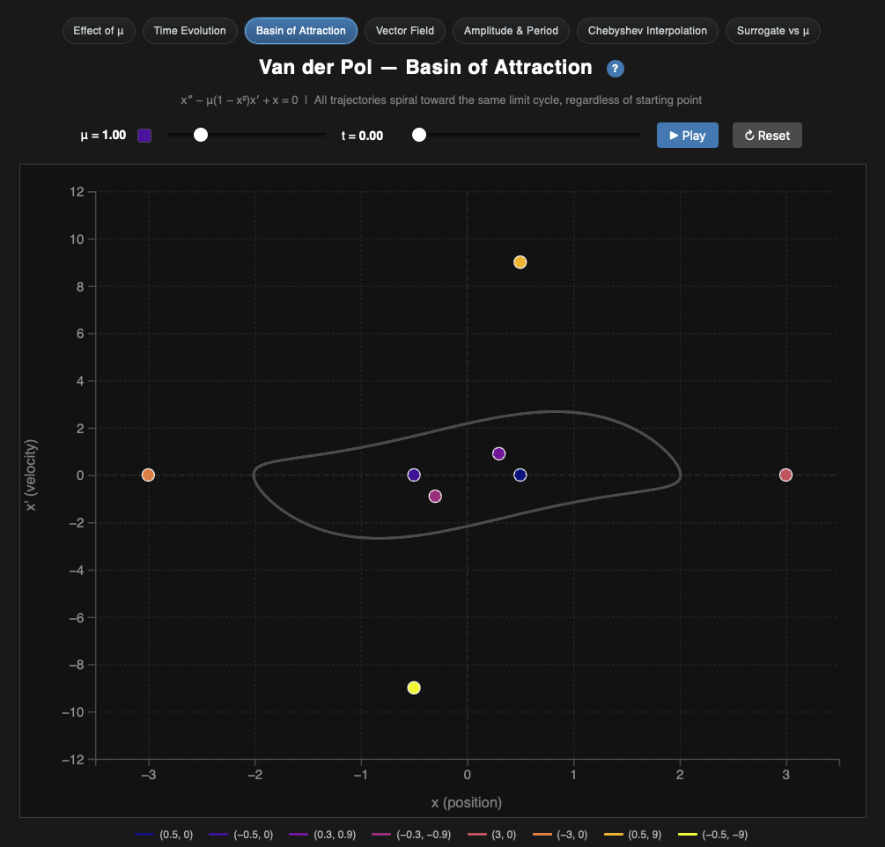
Visualization 3: Basin of Attraction
Does the starting position matter? Short answer: no.
WHAT
Eight trajectories start at different positions, some inside the limit cycle and some outside. All of them are animated at the same time in phase space.
WHY
A global attractor means every starting point ends up in the same place. Watching all eight paths converge onto the same dashed oval makes that concrete.
HOW
Eight initial conditions are integrated in parallel, each with a unique color. The limit cycle is overlaid as a dashed reference curve.

Slide 8
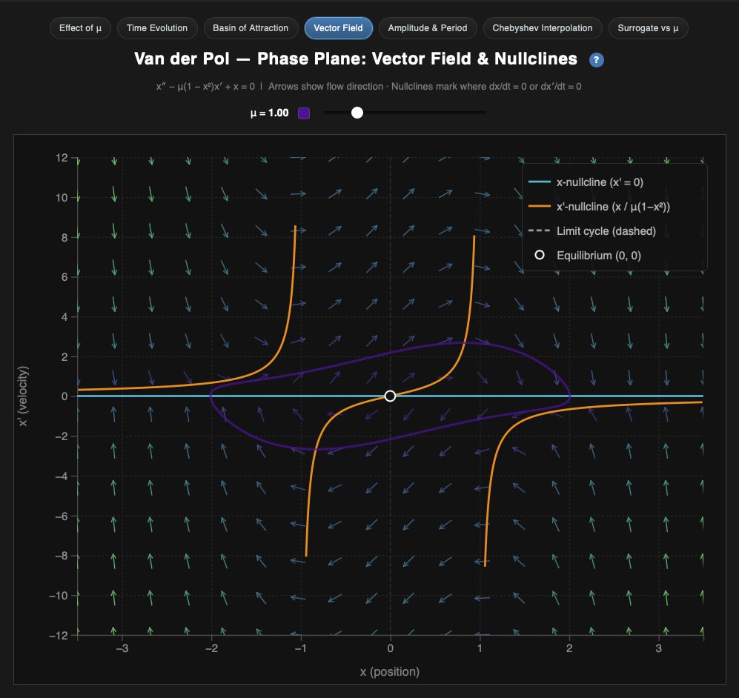
Visualization 4: Vector Field + Nullclines
What forces are pushing the system at every point in phase space?
WHAT
A grid of arrows shows the direction and speed of flow at every point in phase space. Two curves called nullclines mark where each derivative equals zero.
WHY
Instead of following one trajectory, you see the full terrain. Arrows show where things are headed and nullclines mark the ridges that separate regions of different behavior.
HOW
Arrow direction comes from f(x, x') evaluated on a grid. Nullclines are derived analytically. Brightness encodes speed. The numerical limit cycle is drawn on top.

Slide 9
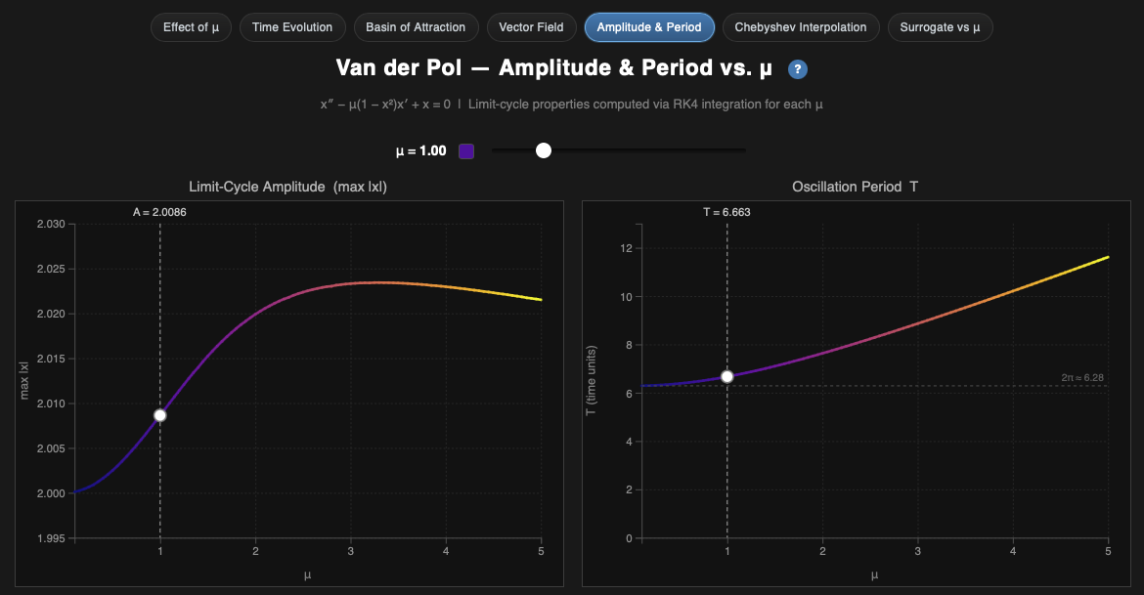
Visualization 5: Amplitude & Period vs μ
How do the size and timing of oscillations change with μ?
WHAT
Two line charts: amplitude (max |x|) on top and period (T) on the bottom, both plotted against μ. A dashed line marks the linear harmonic period of 2π.
WHY
Instead of just looking at shapes, you get actual numbers. You can pinpoint exactly where the linear approximation starts to break down, which matters a lot for real-world use.
HOW
For each μ, RK4 runs past the transient. Amplitude is max|x| after the transient. Period is measured from successive zero-crossings. Both are plotted as connected segments.

Slide 10
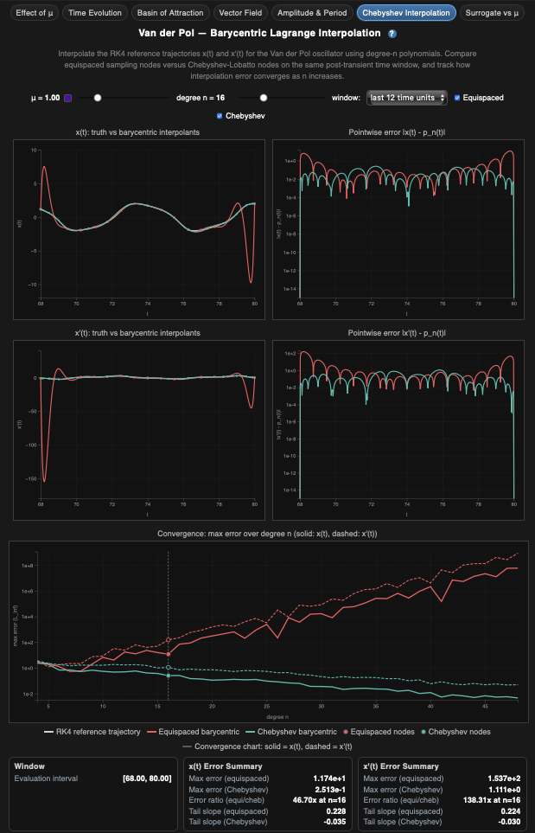
Visualization 6: Barycentric Lagrange Interpolation
Can we reconstruct x(t) without solving the ODE from scratch every time?
WHAT
Four panels: interpolated x(t) and x'(t) compared to RK4 truth, pointwise error on a log scale, and max-error convergence vs polynomial degree n. Red is equispaced, teal is Chebyshev.
WHY
Running the full ODE at every time step is expensive. Interpolation rebuilds the signal from a small number of key samples. This page shows which node strategy works better and where each one breaks down.
HOW
RK4 truth is sampled at n points. Barycentric weights are computed and the interpolant is evaluated on a dense grid. Error = |truth minus interpolant|. The degree slider updates all four panels live.

Slide 11
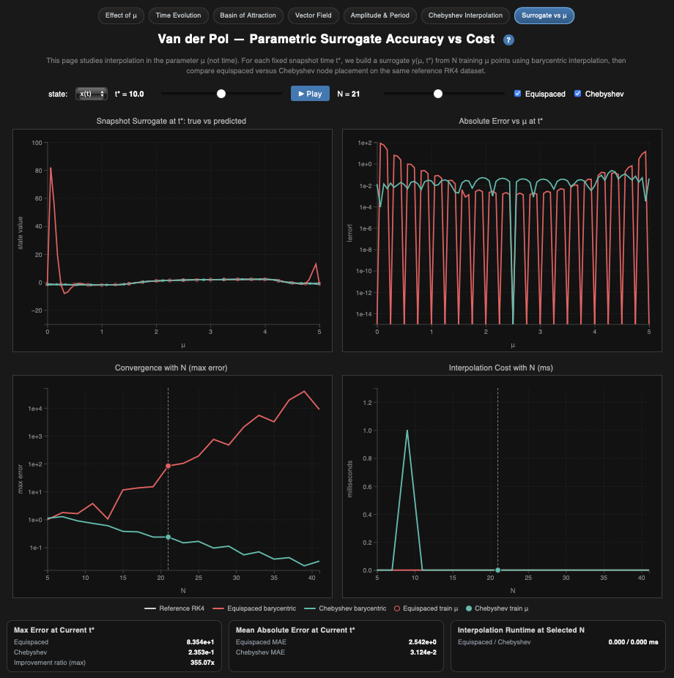
Visualization 7: Parametric Surrogate vs μ
Can we predict x(t*) at any μ without running the ODE at all?
WHAT
Four panels: surrogate vs truth across μ, absolute error vs μ, max error vs training size N, and runtime vs N. Red is equispaced, teal is Chebyshev.
WHY
The practical payoff: run N training solves once, then query any μ instantly. The page shows both accuracy and cost in one place so you can make an informed choice.
HOW
N ODE solutions are run at chosen μ nodes. Barycentric surrogates are built and evaluated on a dense μ grid. Error and runtime are logged vs N. All panels update when you change N, node type, or snapshot time t*.

Slide 12
Key Findings
1. μ is the master switch
One parameter shifts the system from smooth sine waves to sharp relaxation oscillations. You can see it on every page.
2. The limit cycle is a global attractor
No matter where you start, every trajectory ends on the same closed orbit. The system is predictable regardless of initial conditions.
3. Chebyshev nodes beat equispaced nodes
Equispaced nodes at high polynomial degree cause Runge's phenomenon: wild oscillations near the boundaries. Chebyshev clustering avoids this and converges exponentially.
4. Cost vs accuracy is a real tradeoff
More training nodes means lower surrogate error but longer precomputation. Visualization 7 shows exactly how steep that tradeoff is.
5. Linked views beat isolated charts
One μ slider updating phase portrait, time series, error, and cost at once reveals connections that separate plots would hide.

Slide 13
Conclusion
What this project built
A seven-page interactive suite that takes the Van der Pol oscillator from first principles all the way to surrogate modeling, running entirely in the browser with no installation needed.
The main takeaway
You do not need calculus to build intuition for nonlinear dynamics. A good visualization makes parameter sensitivity, attractors, vector fields, and interpolation error click, even for someone seeing this for the first time.
Things that worked well
Linked views beat isolated charts. The μ slider connects all seven pages.
Animation shows time structure that a static plot cannot (see Basin of Attraction).
Plasma color scale works well for a continuous parameter like μ.
Log-scale error axes are necessary. Linear scale makes all differences look the same.
vs other tools
Wolfram and MATLAB are more powerful numerically but need software and are not as easy to link across views. This project trades some speed for browser-native interactivity and clarity.

Slide 14
Possible Improvements
Better Surrogate Models
Add cubic splines, RBF, and Gaussian Process surrogates. GPs give you uncertainty bands around predictions, not just point estimates.
Adaptive Node Placement
Automatically refine sampling near μ values where behavior changes fast. Could cut the number of ODE solves roughly in half.
Stochastic Extension
Add noise to the ODE. Show how clean limit cycles blur into probability clouds, which is what happens in real physical systems.
Web Workers for Computation
Move the ODE solving to a background thread so the UI stays responsive during heavy parameter sweeps.
Coupled Oscillators
Two coupled Van der Pol oscillators with separate μ knobs. Opens up synchronization and near-chaos, a much richer parameter space.
Data Export
Let users download trajectory data, surrogate parameters, and error tables as CSV or JSON to use in their own pipelines.
Accessibility and Mobile
Add ARIA labels, keyboard navigation, and responsive layouts so it works on tablets and with screen readers.
Side-by-Side Comparison
Lock two μ values at once so you can compare phase portraits and metrics directly without toggling back and forth.

