Slide 1

VxWorks Operating System
by Michele Gaetani
EEL 6897 – Software Development for Real-Time Engineering Systems
Fall 2007
Happy Halloween!

Slide 2
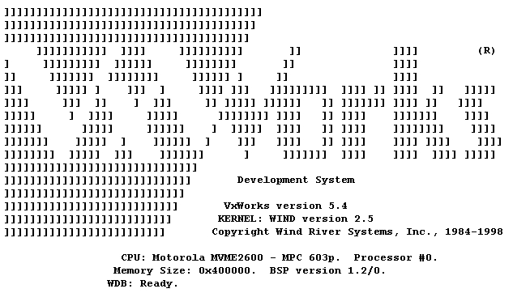
Description
Origin of the name “VxWorks”
Its major distinguishing features
Marketed products using this OS
Other similar real-time operating systems

Slide 3

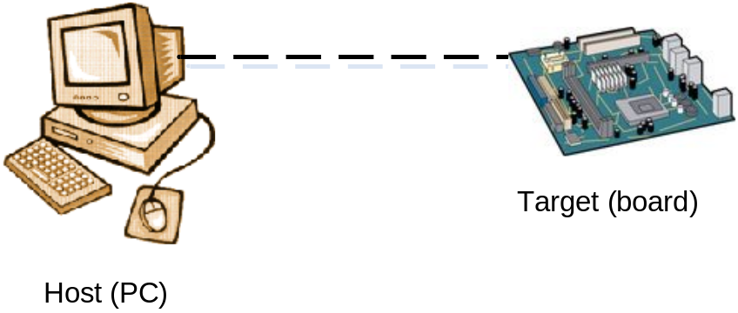
Description
Real-time operating system by Wind River Systems of Alameda, CA
Generally used in embedded systems
How VxWorks development is done

Slide 4

Origin of the Name
Ready Systems “VRTX”
VRTX didn’t work very well
Rights to VRTX were acquired by WindRiver Systems

Slide 5
Major Distinguishing Features
Flat memory model
Priority pre-emptive scheduling
Multitasking kernel
Interrupt-driven
Tornado IDE
Mutual exclusion via locking/semaphores
Intertask communication with message queues
Watchdog timers
User-interface shell

Slide 6
Flat memory model
No virtual memory or page swapping
VX_VMI
Each task has own context
Single common address space

Slide 7
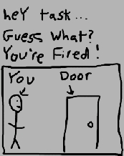
Priority pre-emptive scheduling
“scheduler” software handles priorities
Pre-emptive = forcibly removing tasks
It is the default for VxWorks
Highest priority task runs
Round-robin scheduling

Slide 8
Priority pre-emptive scheduling
“scheduler” software handles priorities
Pre-emptive = forcibly removing tasks
It is the default for VxWorks
Highest priority task runs
Round-robin scheduling

Slide 9
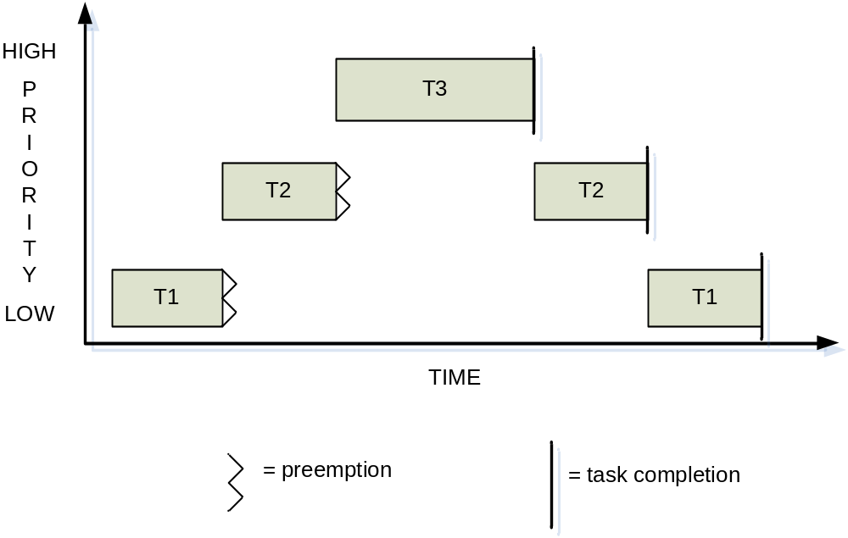
Priority pre-emptive scheduling

Slide 10

Multitasking kernel
Fast context switching between tasks to seem like simultaneous task execution
Kernel’s scheduling algorithms determine who goes next
Task control block (TCB)
One process, many tasks

Slide 11
Interrupt driven
Interrupts generated by an asynchronous event
To perform context switches
Service hardware/external signals
Low latency

Slide 12

Integrated development environment
Called Tornado
Tools to build applications
Workbench Eclipse technology
Multilanguage support
Third-party or user’s own plug-ins
VxSim

Slide 13

Mutual Exclusion
To protect shared memory
Provide exclusive access to resources
Interrupt locks
Pre-emption disabling
Semaphores

Slide 14
Message queues
Task communication
Client/server model
Read, perform, reply

Slide 15
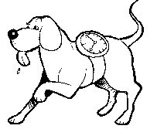
Watchdog timers
Time delayed interrupts/function calls
System clock

Slide 16
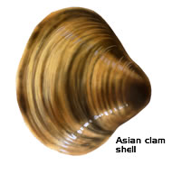
VxWorks shell
Command-line interface
Direct operating system interaction
Great for debugging, performance monitoring
Interprets C-like commands
Only one can be running at any given time

Slide 17
Shell commands
Command Description
------- -----------
i Show information on all running tasks
cd Change Directory; just like UNIX cd
pwd Print Working Directory; just like UNIX pwd
ls List directory contents
ll Long listing of directory contents; like UNIX "ls -l"
ld Load a module
sp(FUNCPTR func, int arg1..9) Spawns a new task with the entry point given
by func, passing the given arguments to the function
(arg1..9 optional)
devs List all devices
inetstatShow Show network connections (like netstat on UNIX)
memShow( int type ) Show free memory summary; additional details if
argument is non-zero

Slide 18
“i” command
NAME ENTRY TID PRI STATUS PC SP ERRNO DELAY
---------- ------------ -------- --- ------ -------- -------- ------- -----
tExcTask _excTask 3dc2f4 0 PEND 5a83c 3dc25c 3006b 0
tLogTask _logTask 3d99f4 0 PEND 5a83c 3d9958 0 0
tShell _shell 3a85f4 1 READY 46f08 3a82d0 3d0001 0
tRlogind _rlogind 3b72dc 2 PEND a2a0 3b70e0 0 0
tTelnetd _telnetd 3b5438 2 PEND a2a0 3b5368 0 0
scanEvent 30da20 299184 41 PEND a2a0 29913c 0 0
gpibLink 2c99b2 2bb5e4 47 PEND a2a0 2bb590 0 0
tNetTask _netTask 3d5668 50 PEND a2a0 3d5610 0 0
scanPeriod 30d676 29ba44 53 DELAY 46772 29b9f8 0 4CA

Slide 19

“spy” command
NAME ENTRY TID PRI total % (ticks) delta % (ticks)
-------- -------- ----- --- --------------- ---------------
tExcTask excTask bddba8 0 0% ( 0) 0% ( 0)
tLogTask logTask bdb230 0 0% ( 0) 0% ( 0)
tShell shell b56140 1 0% ( 26) 0% ( 0)
tSpyTask spyComTask b07a28 5 5% ( 163) 5% ( 29)
tRdbTask rdbTask a6dc78 20 0% ( 0) 0% ( 0)
tNetTask netTask a8c928 50 0% ( 4) 0% ( 3)
tPortmapd portmapd a71e28 100 0% ( 0) 0% ( 0)
EthernetTask OSThreadEn a6a818 128 0% ( 2) 0% ( 0)
MonitorTask OSThreadEn a58ca8 128 3% ( 87) 2% ( 17)
SystemContro OSThreadEn a44570 128 11% ( 329) 11% ( 66)
UITask OSThreadEn a202c0 128 22% ( 655) 20% ( 118)
KERNEL 2% ( 83) 3% ( 18)
INTERRUPT 9% ( 269) 10% ( 61)
IDLE 25% ( 715) 28% ( 162)
TOTAL 93% ( 2851) 93% ( 569)

Slide 20
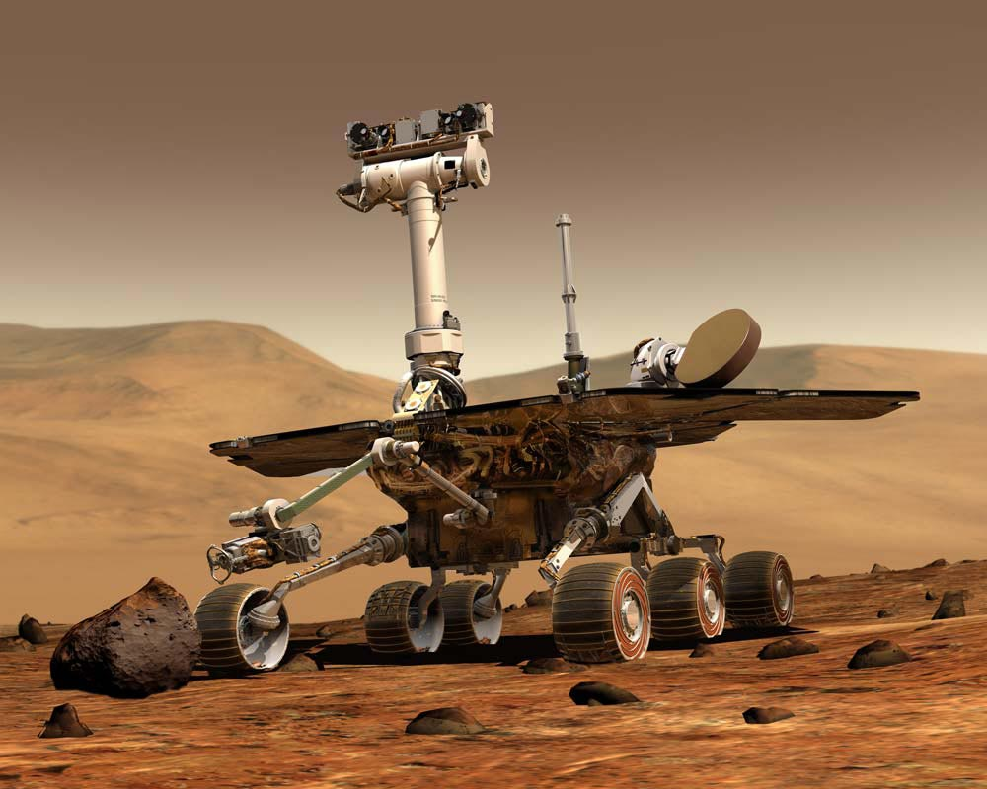
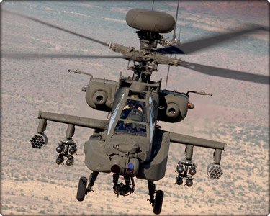
Marketed VxWorks Products
“Spirit” and “Opportunity” Mars Exploration Rovers
Boeing 787 airliner
BMW iDrive system
Apache Longbow (AH-64)
Linksys wireless routers

Slide 21
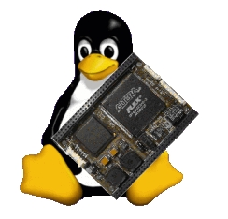
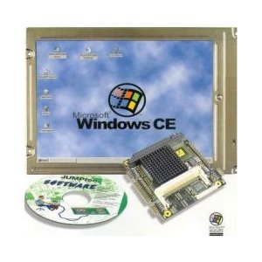
Other Similar Operating Systems
Embedded Linux
Nucleus RTOS
OS-9
Windows CE

Slide 22
Other Similar Operating Systems
Embedded Linux
Nucleus RTOS
OS-9
Windows CE

Slide 23

The End
Questions can be asked via WebCT
Thank you!

Slide 24
The End
Questions can be asked via WebCT
Thank you!

