Slide 1
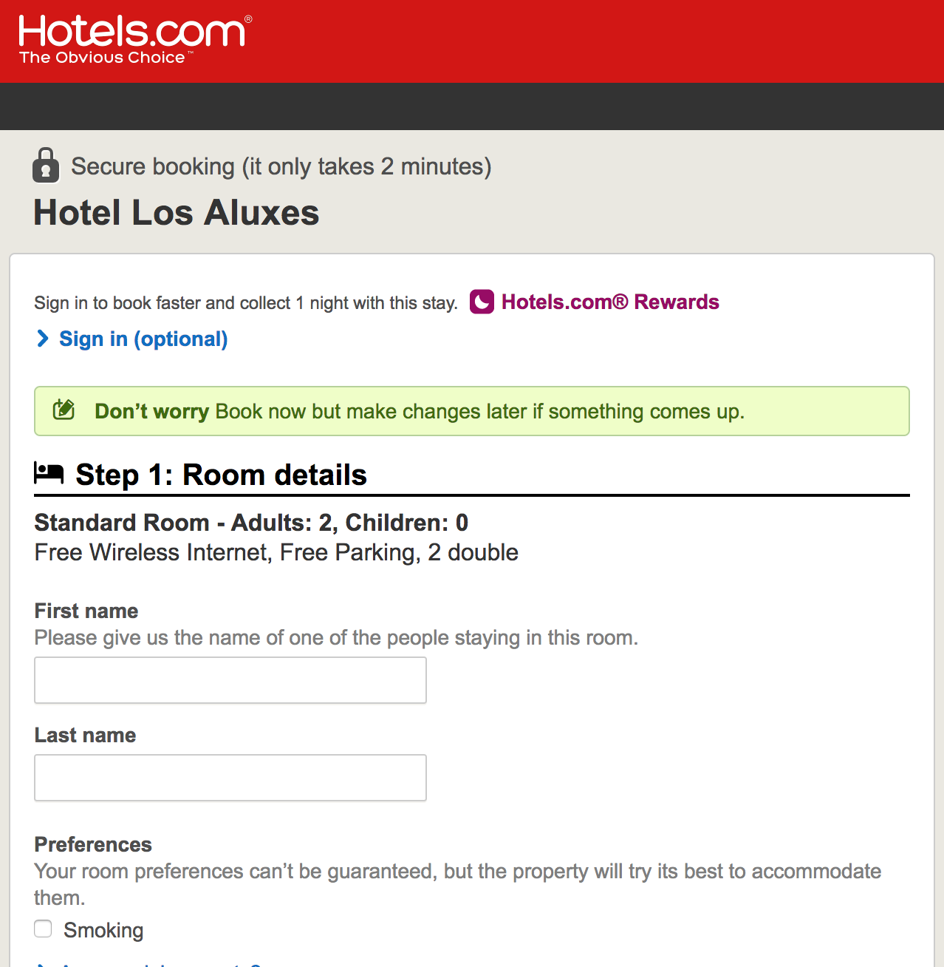
STAGING
JS/CSS
JS/CSS
DA
DOCKER@LOCAL
NGNIX
STYX
CONFIG
DIONYSUSSTYX PLUGIN
HTML
SOYs
MVT
HTML
BA
JSON
LOC
MOCKs
CHECKITO
…

Slide 2
STAGING
DOCKER@LOCAL
LOCAL
JS/CSS
DA
SOYs
JS/CSS
APACHE
CONFIG
BA
DIO
PLUGIN
HTML
MVT
HTML
LOC
MOCKs
CHECKITO
…

