Slide 1
Handwritten Optical Character Recognition
Team Members:
George Samson
Pablo Duque

Slide 2
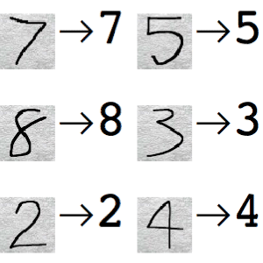
Overview: Handwritten digit recognition

Slide 3
Algorithim
- Pre-processing – Clean up image before analysis
- Segmentation – Separate individual characters/digits
- Feature extraction – Detect distinctive character features
- Classification and recognition – Use extracted features to identify character

Slide 4
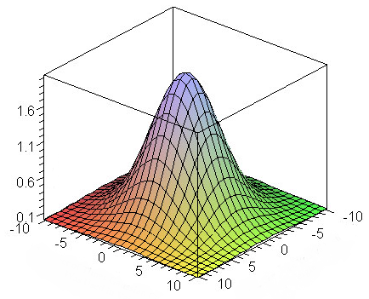
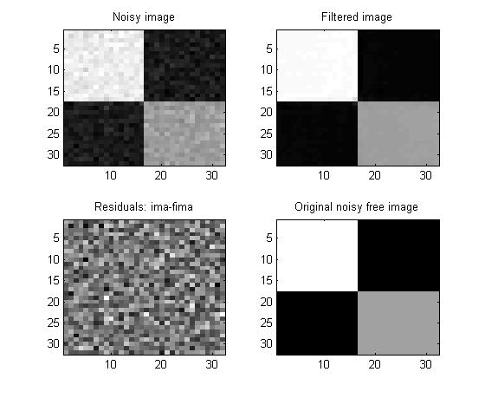
Pre-Processing
If necessary a Non-local means denoising or Gaussian filter smoothing can be applied (or both)

Slide 5
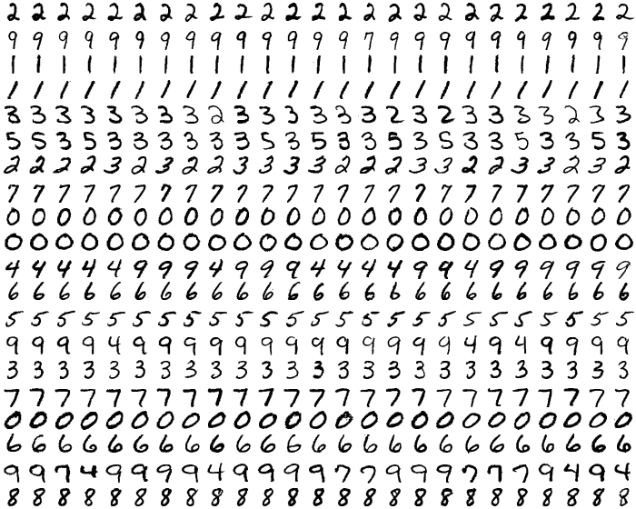
Segmentation
For this test we use images where digits are spread out evenly on a grid.

Slide 6
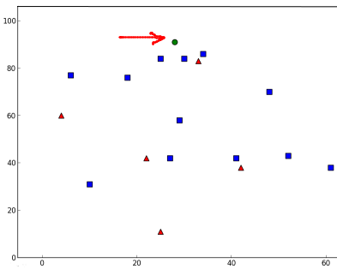
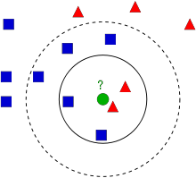
Features extraction 1: kNN
Using pixel intensity on gray scale images
Classification: Divide data into classes/families
New-comer: highest total weights of k nearest neighbors gives class to new comer

Slide 7
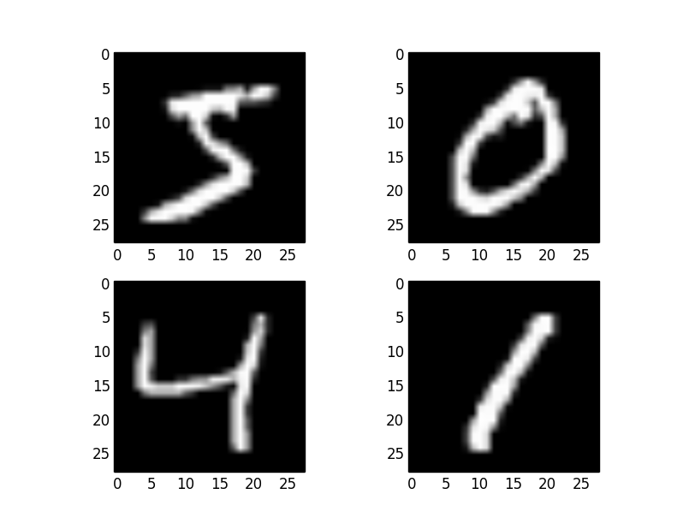
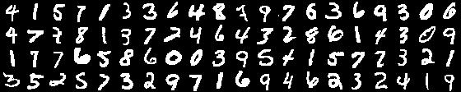
Segmentation: SVM
MNIST dataset are 28x28 pixel images of single numbers.
Use opencv findContours() and boundingRect() functions to segment individual characters

Slide 8
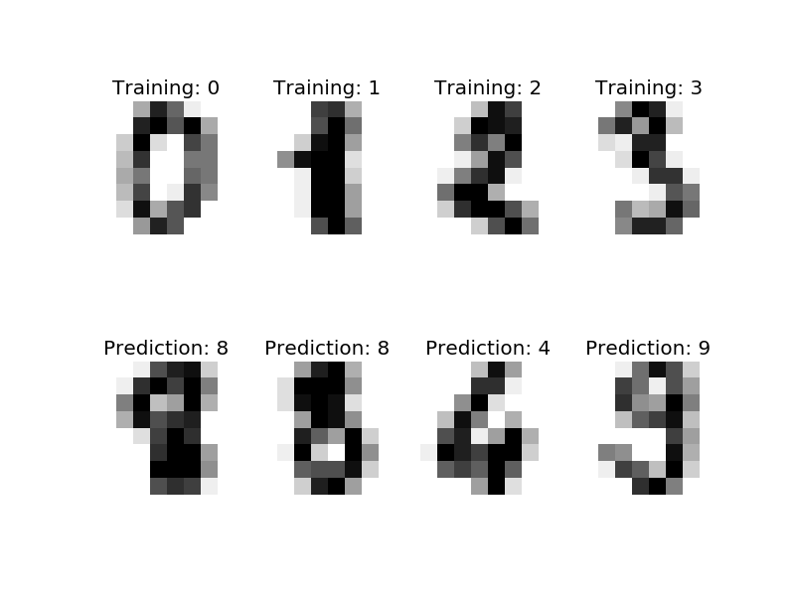
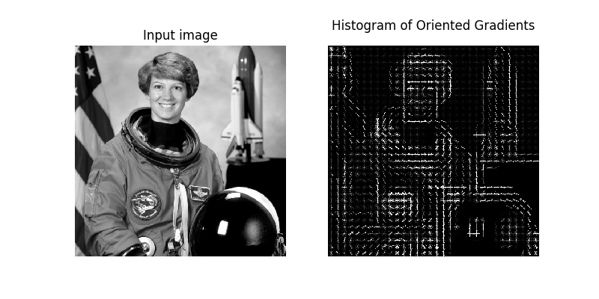
Feature extraction 2: HOG
Histogram of Oriented Gradient features: uses the concentration of gradient orientations in localized portions to describe an image.

Slide 9
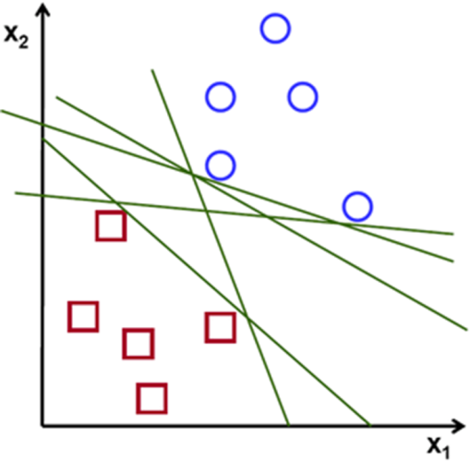
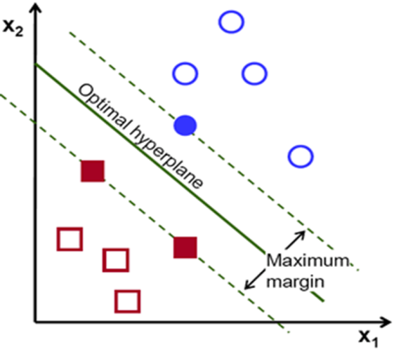
Classification: SVM
Support Vector Machines: algorithm that uses vectors of data and labels corresponding to the data to make a classifier to compare future data against
HOG Features loaded into a vector and used to train SVM

Slide 10
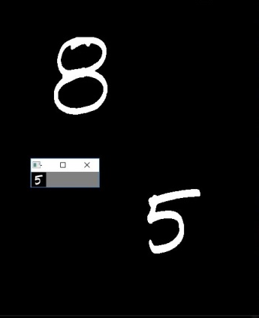
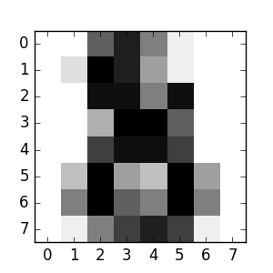
Recognition
The area segmented by boundingRect() is selected as a Region of Interest (ROI) and is padded to 28x28 pixels to match the template of the classifier.
Calculate the HOG features of ROI and use that to predict the character
Selected ROI

Slide 11
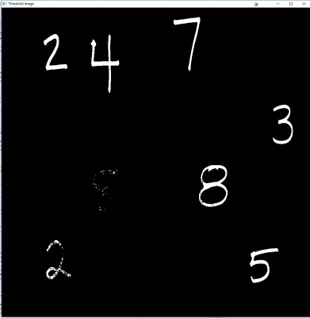
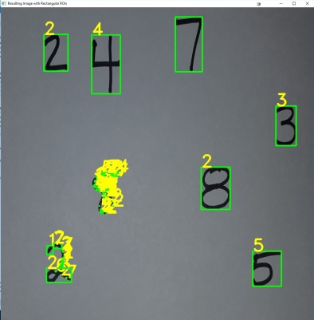
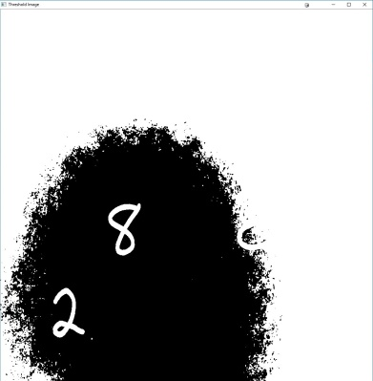
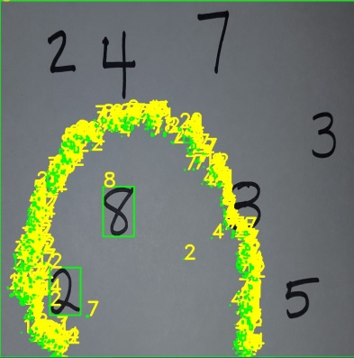
Results
Thresholding Errors:
Threshold = 30
Threshold = 120

Slide 12
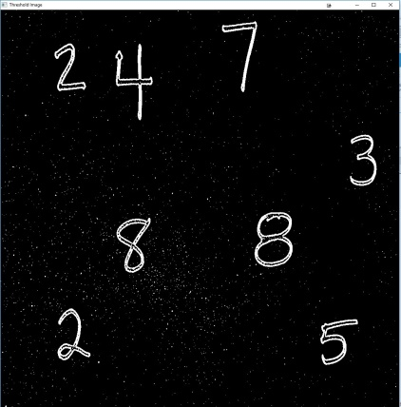
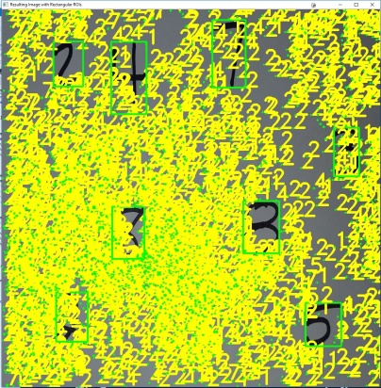
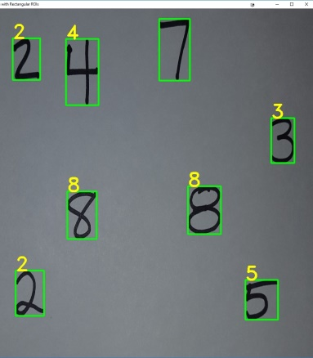
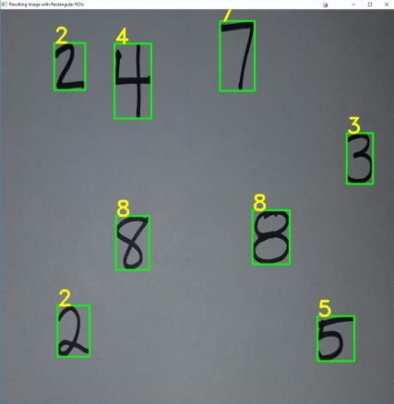
Results (cont.)
Adaptive Threshold
Boundary Error: 7 not predicted because ROI could not be selected due to attempting to pick some out of bounds pixels (fixed with padding)
Fixed!

Slide 13
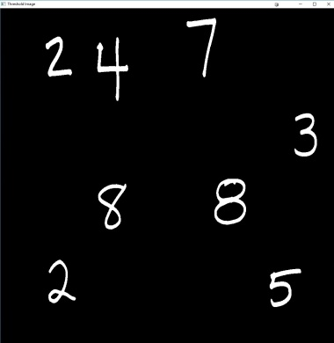
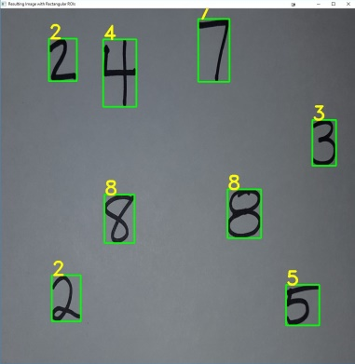
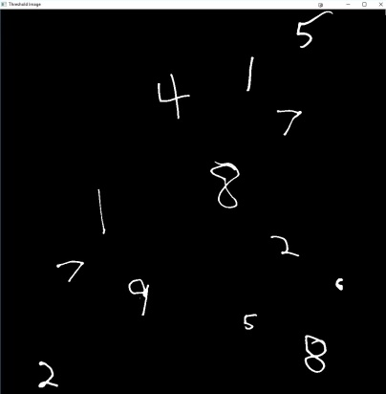
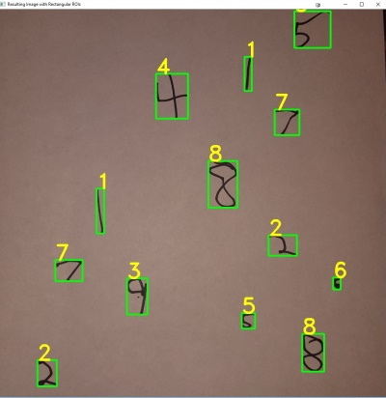
Results (cont.)
Final Results: @threshold = 60 we get good results
Tested on a handwriting of family members with ok results
Threshold = 60

