Slide 2
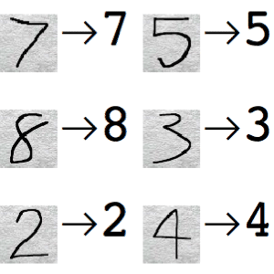
Overview: Handwritten digit recognition

Slide 3
Algorithim
- Pre-processing – Clean up image before analysis
- Segmentation – Separate individual characters/words
- Feature extraction – Detect distinctive character features
- Classification and recognition – Use extracted features to identify character

Slide 4
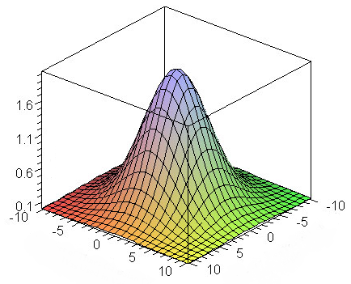
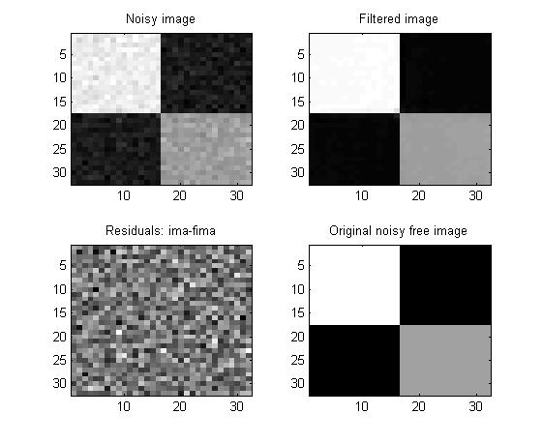
Pre-Processing
If necessary a Non-local means denoising or Gaussian filter smoothing can be applied (or both)

Slide 5
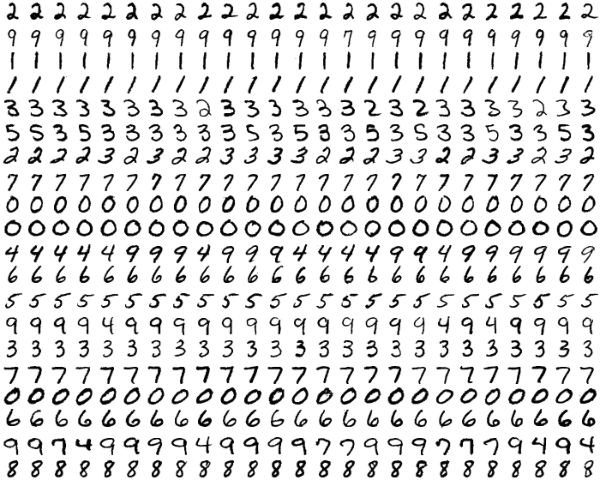
Segmentation
For this test we use images where digits are spread out evenly on a grid.

Slide 6
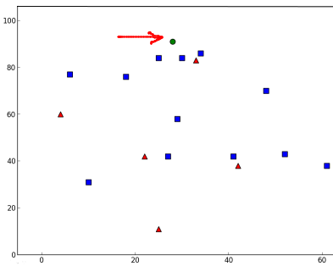
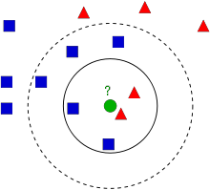
Features extraction 1: kNN
Using pixel intensity on gray scale images
Classification: Divide data into classes/families
New-comer: highest total weights of k nearest neighbours gives class to new comer

Slide 7
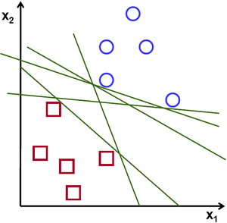
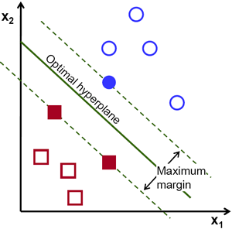
Feature extraction 2: SVM of HOG

Slide 8
Classification and recognition

