Slide 1
Mobile Robot Dynamic Control
Griffin Tabor

Slide 2
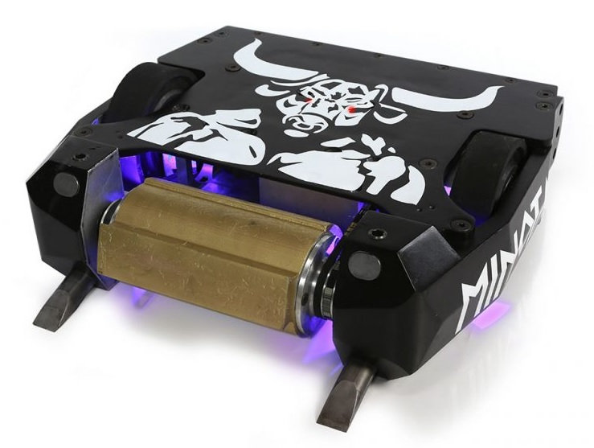
Combat Robot
Radio control robot
Designed to be maneuverable

Slide 3
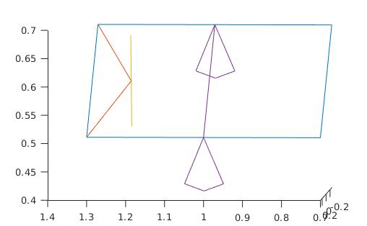
Internal representation

Slide 4
Symbolic Energy Calculations
[k1,p1] = Dynamics(jacob_chassis,world_to_robot,chassis_mass,state_dot);
[k2,p2] = Dynamics(jacob_weapon_front,wep_front_transform,weapon_mass/2,state_dot);
[k3,p3] = Dynamics(jacob_weapon_back,wep_back_transform,weapon_mass/2,state_dot);
Lagrange = simplify(k1 + k2 + k3 - p1 -p2 - p3);

Slide 5
Fully Symbolic Dynamics
Lagrange_dstate = jacobian(Lagrange,state);
Lagrange_dstate_dot = jacobian(Lagrange,state_dot);
torque = diff(subs(Lagrange_dstate_dot,[state,state_dot],[state_t,diff(state_t,t)])) - subs(Lagrange_dstate,[state,state_dot],[state_t,diff(state_t,t)]);o add Text

Slide 6
Simulation
Rotated in place
Weapon spin up to 10,000 rpm
Robot results in tipping over sideways

