Slide 1
Does money buy happiness?
The Happiness Hunters
David Nassif - DataFrame Framer
Vaishall Pradeepkumar - The Calculator
Solicia Xu - Visualization Expert

Slide 2
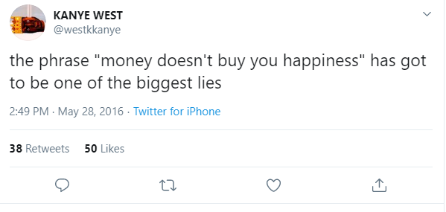
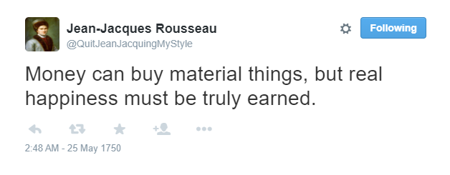
Old School vs New Age

Slide 3
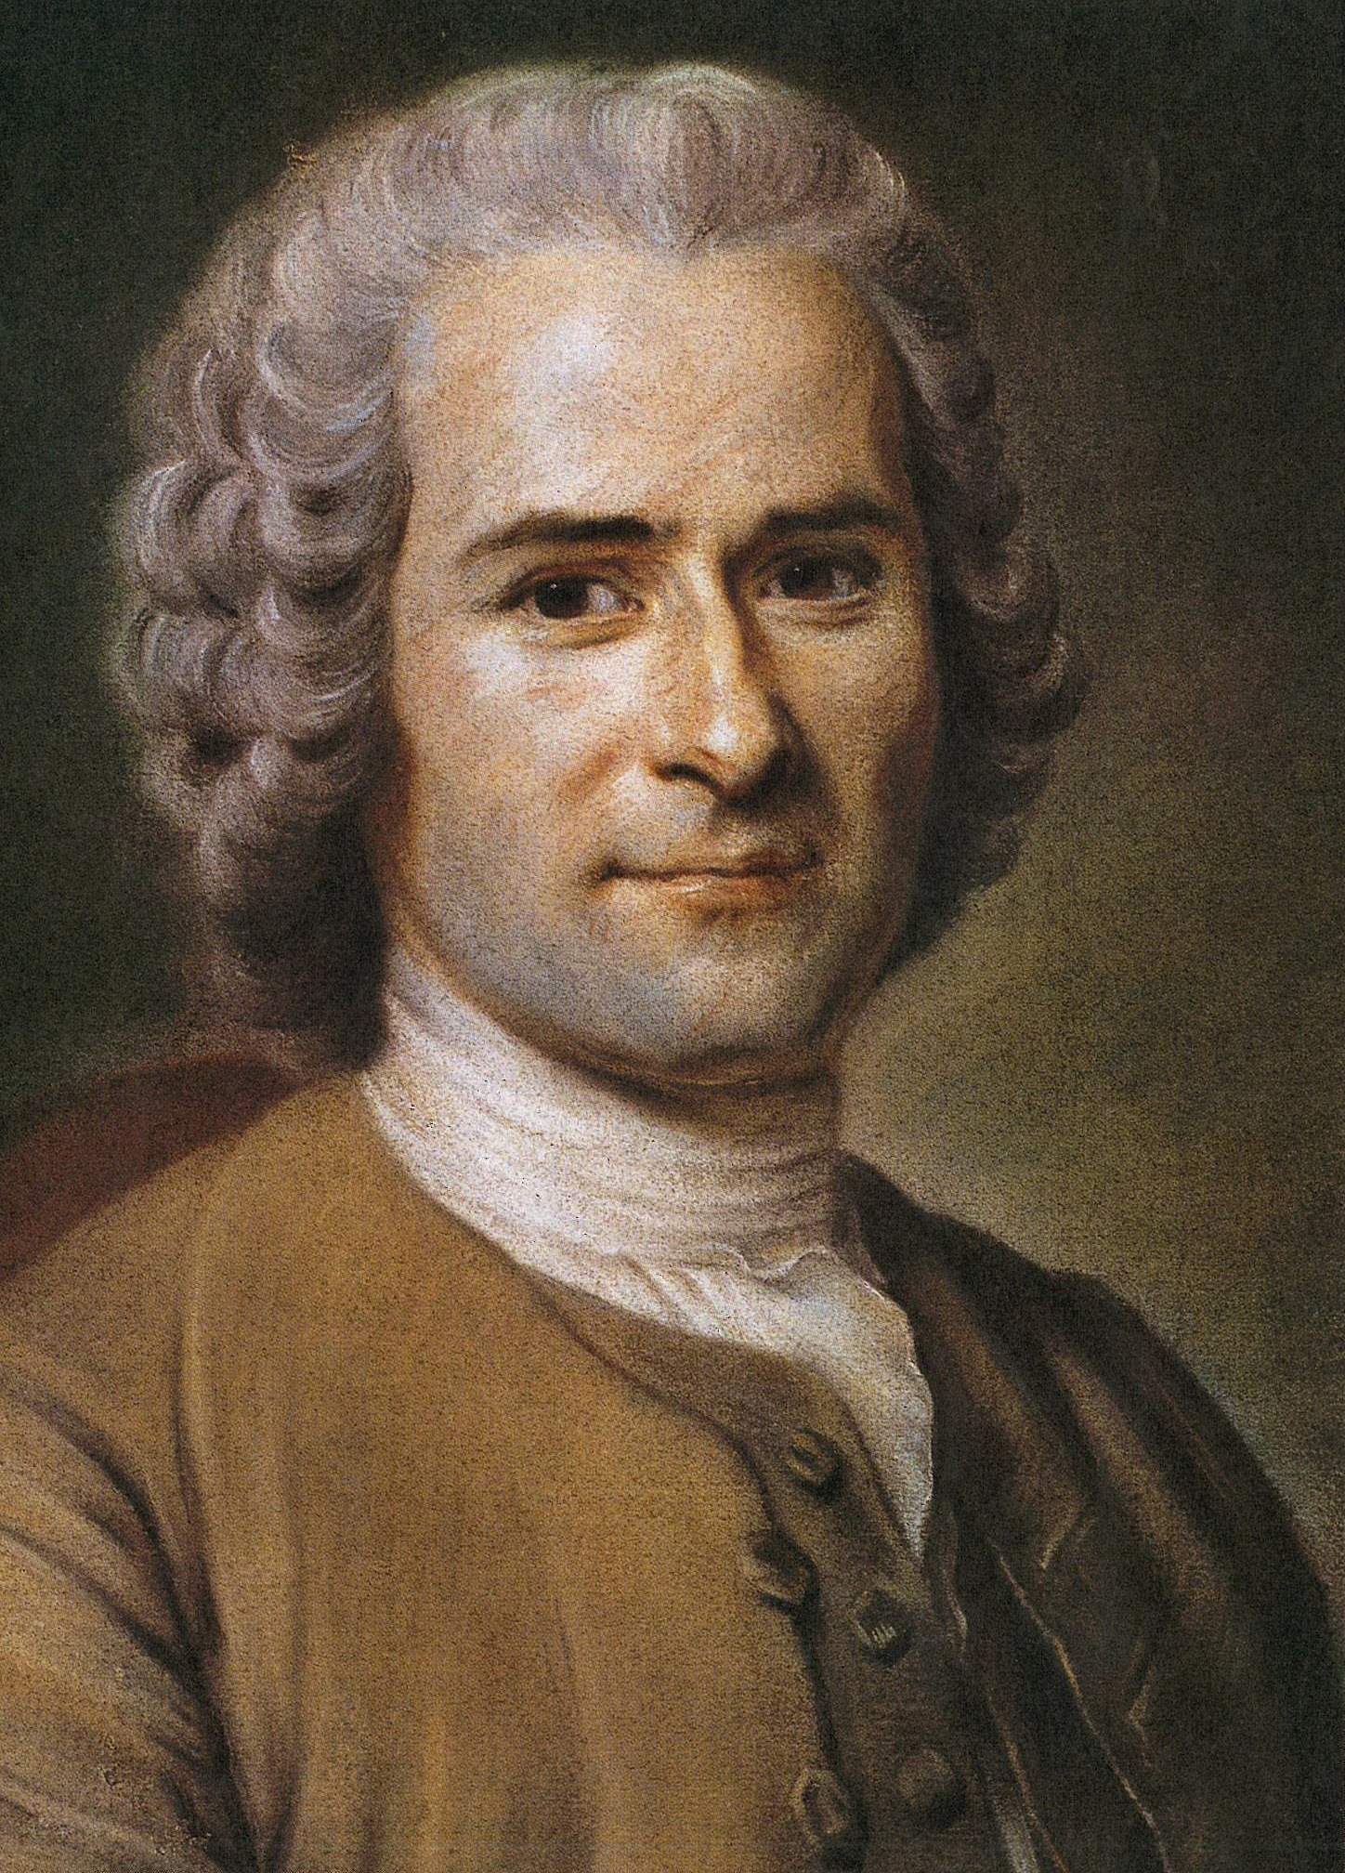
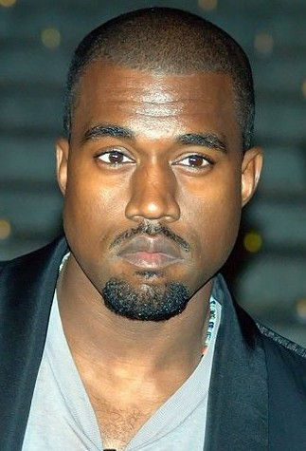
To answer this age-old question….
…….we use Python.

Slide 4
Questions that challenged us…

Slide 5
Data sources used

Slide 6
Question 1

Slide 7
Question 2

Slide 8
Question 3

Slide 9
Question 4

