Slide 1
Intel XPU Backend for Triton
Eikan Wang(eikan.wang@intel.com)

Slide 2
Current Status
Triton (OpenAI Triton + Intel GPU Backend)
Intel GPU Backend has landed in OpenAI/Triton
https://github.com/openai/triton/tree/main/third_party
https://github.com/intel/intel-xpu-backend-for-triton
Functionality read for Element-wise & Reduction Operations
Passed 90% of UT w/ 99.3% for FP32
Functionality for GEMM is WIP(tl.dot)
PyTorch Inductor (Stock PyTorch + IPEX + Triton)
Passed 94.1% of Inductor UT
Inductor Hugging Face Benchmark(46 Models)
FP32: Passed 97.80% for Inference, 95.00% for Training
FP16: Passed 93.48% for Inference, 86.36% for Training
Inductor TIMM Benchmark(62 Models)
FP32: Passed 91.93% for Inference
FP16: Passed 94.91% for Inference
Inductor TorchBench Benchmark(65 Models)
FP32: Passed 78.46% for Inference
FP16: Passed 70.76% for Inference
Performance Optimization is WIP
Notes:
TorchBench commit: 4e9d86ecbf41748bf0a1f29a21e2cd97569ef653
Pytorch 2.0.1 + ipex 2.0.1

Slide 3
PyTorch Inductor + Triton HF Performance

Slide 4
Configurations
 | Single tile of 4X PVC OAM (MAX 1550 GPU）
Workload & version | Transformers 4.32.0.dev0
Software Stack | Intel® oneAPI Base Toolkit 2023.2 LLVM / Intel xpu beckend for Triton / Triton / IPEX GPU
Framework | Pytorch 2.0.1 + patches
GPU driver | https://dgpu-docs.intel.com/releases/stable_647_21_20230714.html
AMC SW | AMC Firmware Version: 6.5.0.0
System | Intel Corporation D50DNP
Baseboard | Intel Corporation D50DNP
Chassis | D50DNP1MFFALLCS Rack Mount Chassis
CPU Model | Intel(R) Xeon(R) Platinum 8480+
Microarchitecture | SPR_XCC
Sockets | 2
Cores per Socket | 56
Hyperthreading | Enabled
CPUs | 224
Intel Turbo Boost | Enabled
Base Frequency | 2.0GHz
All-core Maximum Frequency | 3.0GHz
Maximum Frequency | 3.8GHz
NUMA Nodes | 2
Prefetchers | L2 HW, L2 Adj., DCU HW, DCU IP
PPINs | 7199ec1b21c83cfb,7191e61b27c92def
Accelerators | DLB:2, DSA:2, IAX:2, QAT (on CPU):2, QAT (on chipset):0
Installed Memory | 1024GB (16x64GB DDR5 4800 MT/s [4800 MT/s])
Hugepagesize | 2048 kB
Transparent Huge Pages | madvise
Automatic NUMA Balancing | Enabled
NIC | 1x Ethernet Controller X710 for 10GBASE-T
Disk | 1x 1.8T WDC WDS200T2B0B, 1x 931.5G INTEL SSDPELKX010T8
BIOS | SE5C7411.86B.9525.D19.2303151347
Microcode | 0x2b0001b0
OS | Ubuntu 22.04.2 LTS
Kernel | 5.15.0-76-generic
TDP | 350 watts
Power & Perf Policy | Balanced
Frequency Governor | performance
Frequency Driver | intel_pstate
Max C-State | 9

Slide 5
Open
Which OS is used to build the wheel package?
Intel GPU Backend binary size is about ~140M. Will it impact the wheel package upload to PyPI? Any concern?
Intel GPU Backend depends on another LLVM version; it will download online when building the wheel package. Any concern?
Intel GPU backend has not supported ARM build yet. Any concern?
Is it possible to release another 2.0.0 version and include other backends?
triton 2.0.0.post2?

Slide 6
CPU Backend for Triton

Slide 7
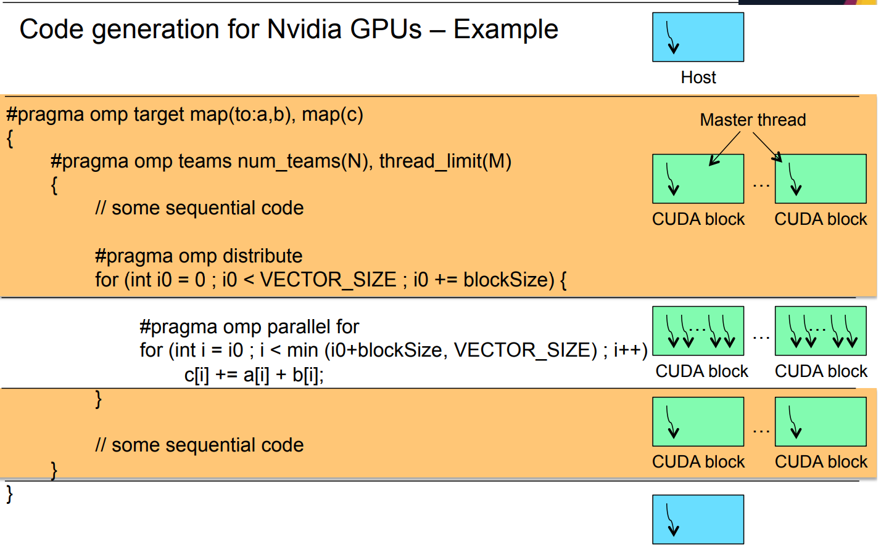
OMP Support For GPU Parallelism
OMP target
Instructs the compiler to generate a target task
Execute the enclosed block of code on that device
OMP target map
to: Copy data from the host to the target device
from: Copy data from the target device to the host
tofrom: Copy data to the target device and then copy it back to the host device
OMP teams num_teams: number of blocks
OMP teams thread_limit: OMP thread per team
Notes:
https://www.ibm.com/docs/en/xl-c-and-cpp-linux/16.1.0?topic=parallelization-pragma-omp-target-data

Slide 8
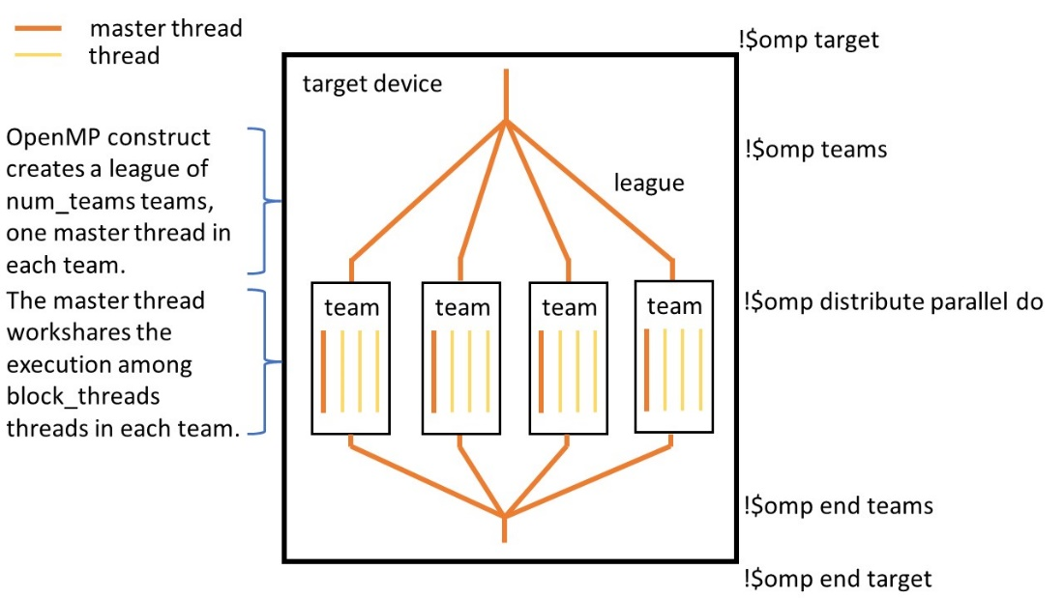
OMP Key Concepts for Triton CPU Backend
Parallel Programming Model
Team
A set of one or more threads participating in the execution of a parallel region
To orchestrate OMP threads
Map Triton CTA to OMP Team
Thread
An execution entity with a stack and associated static memory
Map Triton Warp to OMP Thread
SIMD/SIMD Lane
A software or hardware mechanism capable of processing one data element from a SIMD instruction
Map Triton Thread to OMP SIMD Lane
Notes:
https://www.openmp.org/wp-content/uploads/OpenMP-API-Specification-5.0.pdf
https://www.nas.nasa.gov/hecc/assets/pdf/training/OpenMP4.5_3-20-19.pdf
https://wiki.cdot.senecacollege.ca/wiki/GPU621/GPU_Targeters
https://www.intel.com/content/www/us/en/developer/articles/technical/solve-heterogeneous-programming-challenges.html

Slide 9
OMP Key Concepts for Triton CPU Backend
Synchronization
Barrier
A point in the execution of a program encountered by a team of threads
Map Triton Barrier to OMP Barrier
NOTE: Triton Mbarrier => OMP N/A
Fence
N/A: OpenMP does not support Fence
Atomic
OpenMP provides atomic read/write/rmw
LLVM also provides some atomic operations
Might convert Triton atomic operations to LLVM atomic operations

Slide 10
OMP for Triton CPU Backend - Conclusion
OMP can support Triton parallelism programming for CPU
OMP Directives can support both CPU and GPU parallelism programming
Triton is on the top of GPU parallelism programming
Technical Solution: Triton dialect => LLVM dialect + OMP dialect
Convert Triton dialect computation operations to LLVM dialect directly
Convert Triton dialect indexing-* operations(program id, thread id, etc) to OMP dialect directly
Convert Triton dialect sync-* operations(Barrier, Atomic, etc) to LLVM/OMP dialect directly
Translation
Conversion
MLIR
CPU
OMP + LLVM Dialect
LLVM IR
Triton Kernel(Python)
Triton Dialect
Triton GPU Dialect
MLIR GPU Dialect
Intel GPU
SPIRV Dialect
SPIRV
Notes:
https://passlab.github.io/OpenMPProgrammingBook/MultiCoreMultiCPU/1_MIMDArchitecture.html

Slide 11
OMP for CPU – C++ Example
void add(float a, float* x, float* y, int sz) {
int max_thrds = 2;
int number_blocks = 2;
#pragma omp teams thread_limit(max_thrds) num_teams(number_blocks)
{
int num_teams = omp_get_num_teams();
int bs = sz / omp_get_num_teams();
int last_bs = sz - bs * (num_teams - 1);
#pragma omp distribute
for (int i = 0; i < sz; i += bs) {
int block_size = (i + bs <= sz) ? bs : last_bs;
#pragma omp parallel for simd firstprivate(i, block_size)
for (int ii = i; ii < i + block_size; ii++) {
y[ii] = a * x[ii] + y[ii]; }
}
}
}
number_teams: 2 OMP thread blocks
thread_limit: 2 OMP threads per team(OMP thread block)
Parallelize the for to 2 OMP Blocks
Parallelize the for to 2 OMP threads within a particular team

