Slide 1
Triton-Shared
3rd-party plug-in for Triton
ian Bearman
Microsoft, AI Platform
Oct. 25, 2023

Slide 2
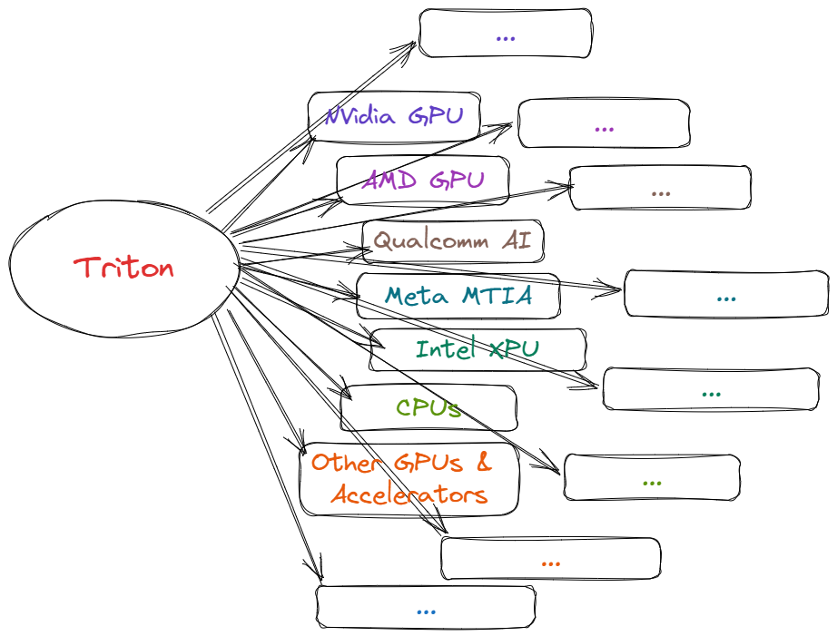
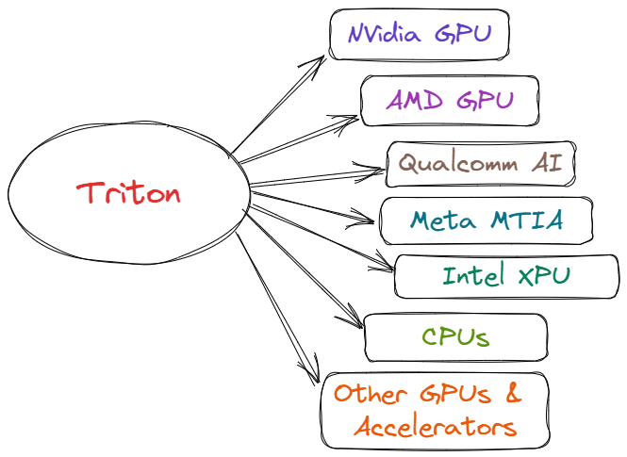
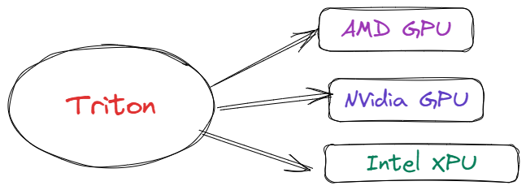
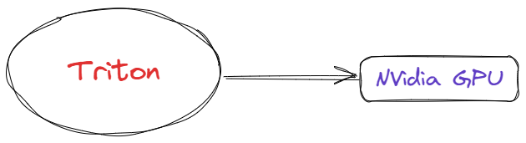

Triton for All
Notes:
Triton started off as a way to write high-performance CUDA. But we want to grow to support more back-ends. So how do we go from here [click] to here [click] and beyond [click]

Slide 3
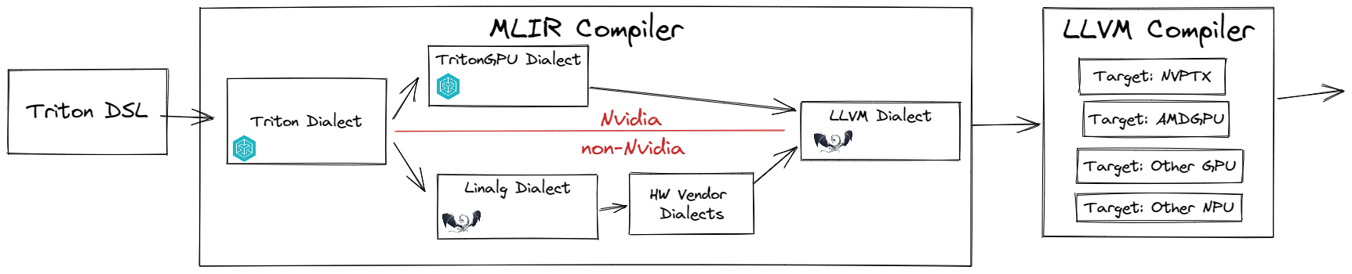
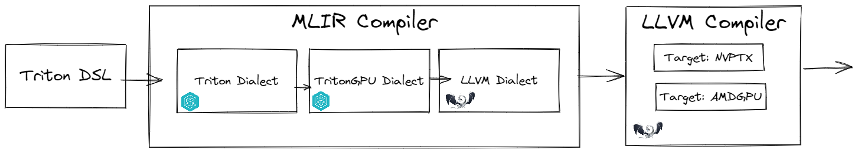
The Middle Layer
Not tied to a front-end, not tied to a back-end
A place to build shared analysis, transforms, and optimizations

Slide 4
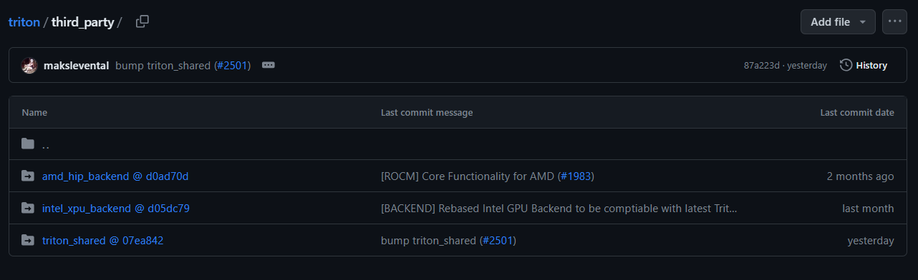
Triton-Shared Repo
https://github.com/microsoft/triton-shared/
Triton Plug-in
https://github.com/openai/triton

Slide 5
How it Works
See triton-shared/README.md for details
Builds inside the Triton Repo
Enable with TRITON_CODEGEN_TRITON_SHARED=1
Test drive with `triton-shared-opt`
e.g., `triton-shared-opt --triton-to-linalg %file`
Designed to be included in a 3rd party back-end

Slide 6
Contributions
Contributions Welcome!
Use GitHub issues and discussions for communication
MIT License
Goal: No-fail conversions
Potential Upcoming Work
Reported issues
Support partial conversion
“Tensor-Pointer” as middle layer between tt.ptr and memref
Scatter/gather
Breadth… handling more Triton IR
Corner cases

Slide 7
Technical Overview
Pointer Anlaysis
Use Anlaysis
Mask Analysis
Convert triton memory references to Memref Dialect
Convert triton tensors to Tensor + Linalg Dialect

Slide 8
Pointer & Mask Analysis
Converts array-of-pointers to pointer-to-array
This maps well for contiguous memory accesses (common case)
TBD: Gather/Scatter support for true non-contiguous access
Detects contiguous mask and replaces it with bounds checks
Use Analysis
Determines if an op is address, data, or both
Throw away address-only ops after conversion

Slide 9
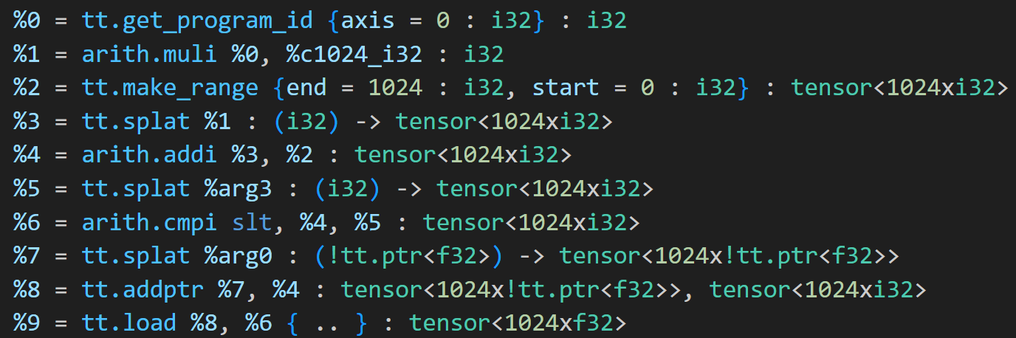
Pointer Analysis
%arg0
Base:
Offset:
Stride:
Length:
n/a
1024
Notes:
The actual code is a forward pass, but its easier to think about as a backwards pass

Slide 10
Pointer Analysis
%arg0
Base:
Offset:
Stride:
Length:
0
+
PID * 1024
n/a
1024
Notes:
The actual code is a forward pass, but its easier to think about as a backwards pass

Slide 11
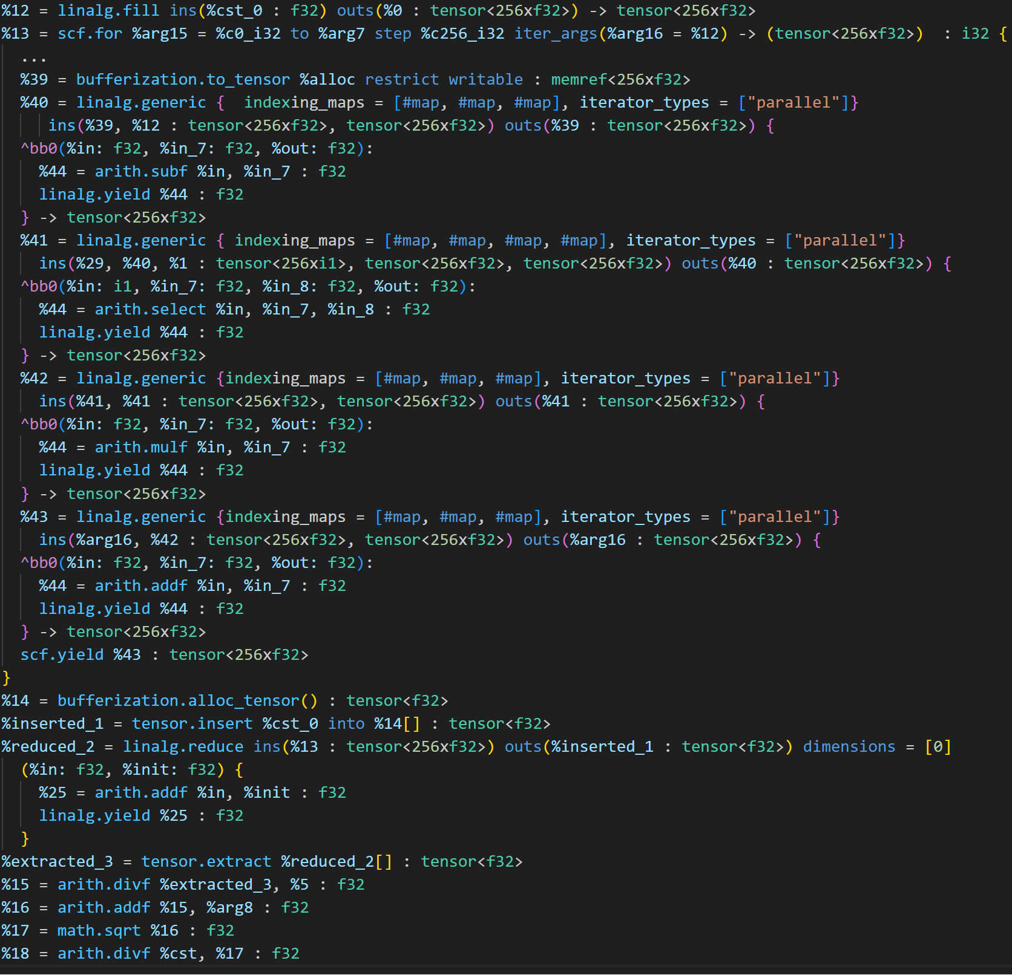
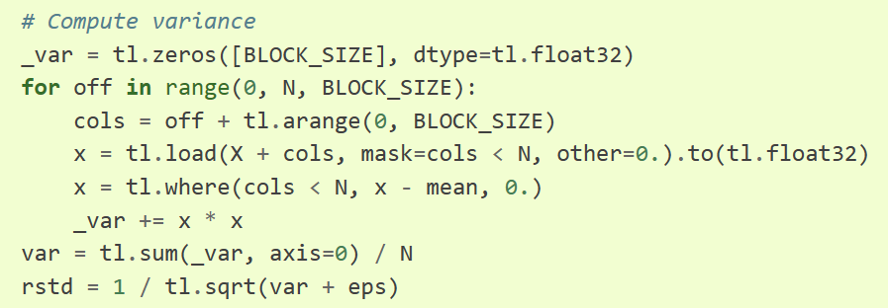
Layernorm
Conversion
Notes:
Example from layernom

