Slide 1
SGLang Double Sparsity
Shuo Yang<andy_yang@berkeley.edu>

Slide 2
Outlines
1. Introduction to Double Sparsity
2. SGLang with Double Sparsity
3. Future Work

Slide 3
1. Introduction to Double Sparsity

Slide 4
Background: Long Context Inference
Long context is popular
Llama3.1 has 128k context length
GPT-o1 has extremely long Chain-of-Thought
Long context is memory-bounded
Memory access accounts for more than 80% of the total serving time when serving 16 8k requests
GPT-o1 is really slow

Slide 5
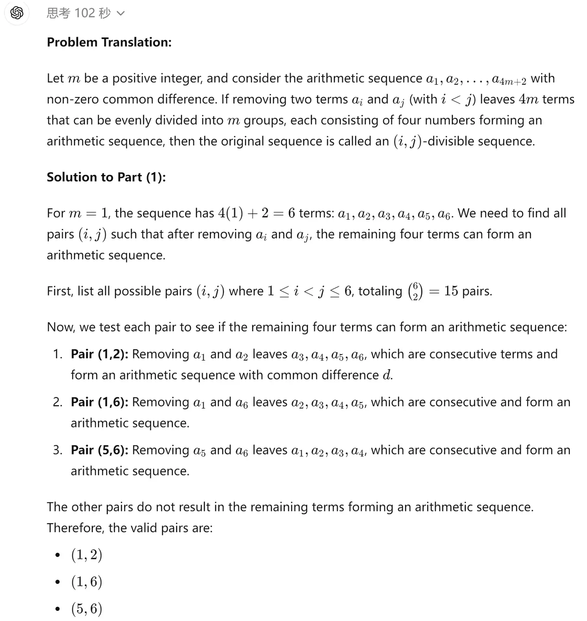
Background: Long Context Inference
Long context is popular
Llama3.1 has 128k context length
GPT-o1 has extremely long Chain-of-Thought
Long context is memory-bounded
Memory access accounts for more than 80% of the total serving time when serving 16 8k requests
GPT-o1 is really slow

Slide 6
Background: Sparse Attention
Goal: Reduce Total Memory Access
Observation
Tokens are not equally important for decoding
Heavy Hitter Oracle (H2O)
Scissorhand
StreamingLLM
We can use a part of channels to predict the important tokens
AWQ
SparQ

Slide 7
Double Sparsity: 14.1x Attention Speedup with no Loss
Core Design
Determine Important Channels: Offline Calibration (before decoding)
Store Important Channels’ Values in Label Cache (decoding)
Compute Approximate Attention with Label Cache (decoding)
Select Top-k Tokens based on Approximate Attention (decoding)
Compute Attention over Top-k Tokens (decoding)

Slide 8
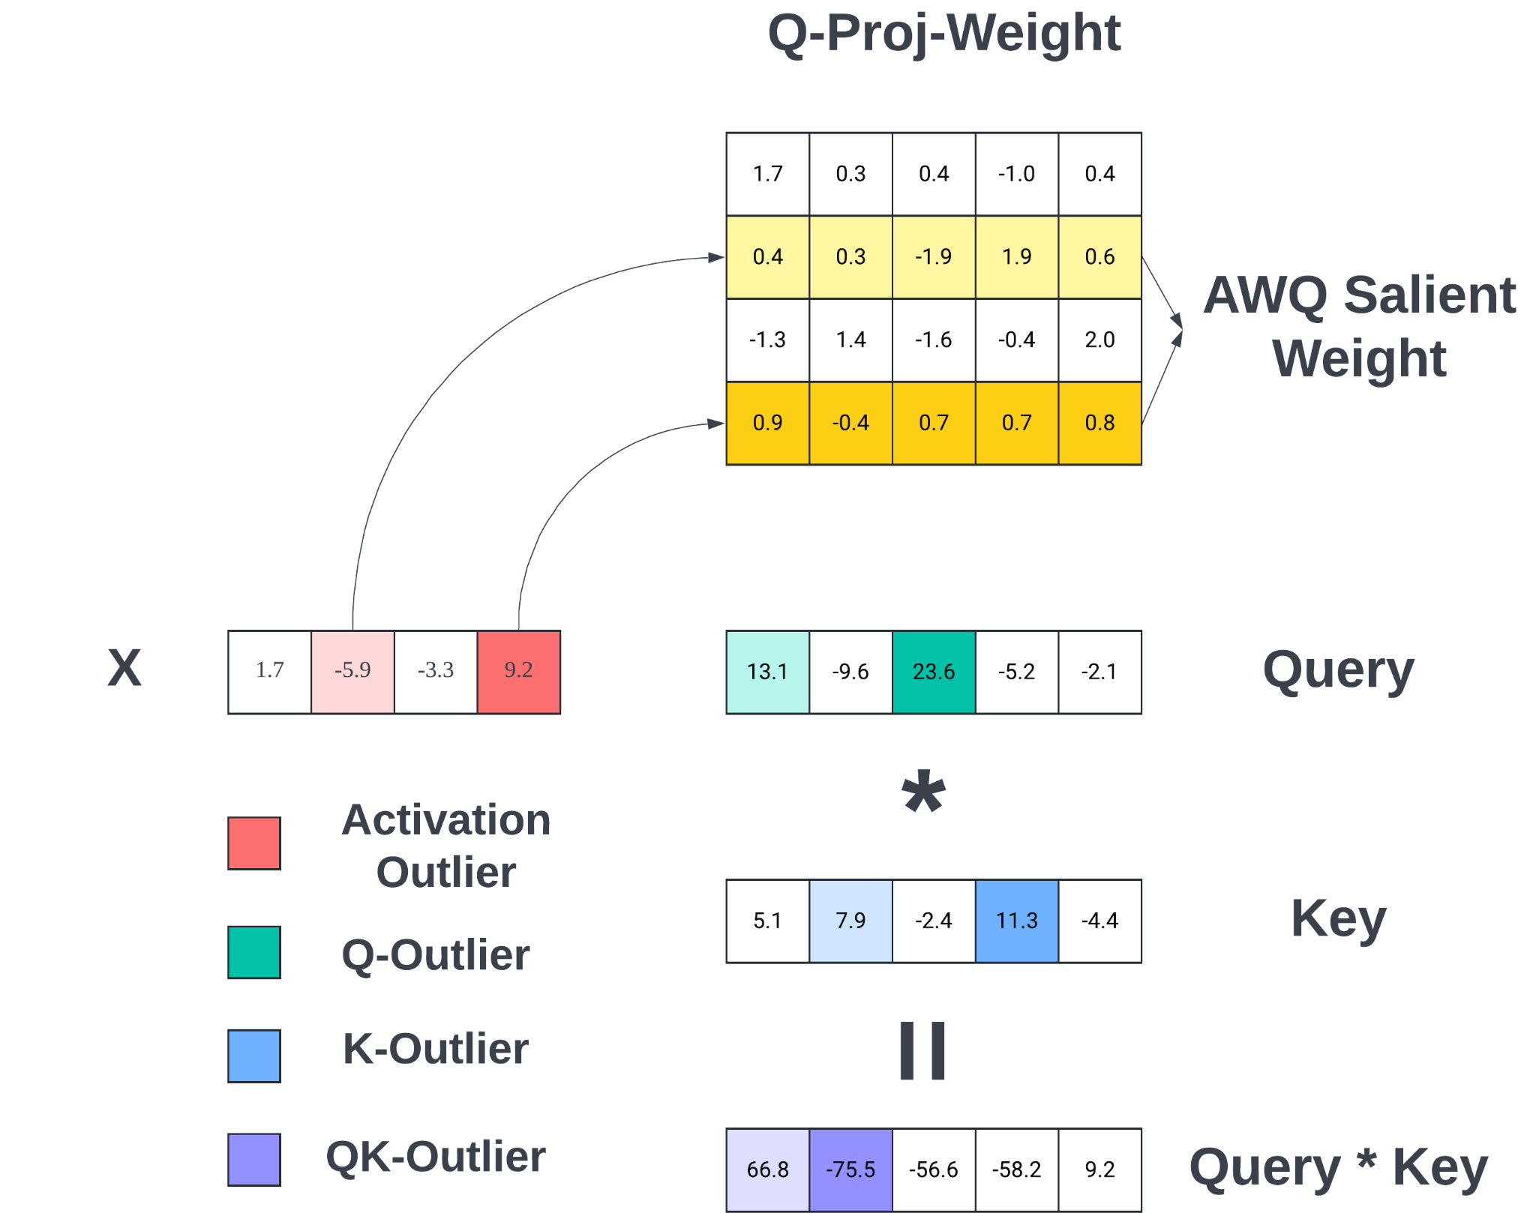
Double Sparsity: 14.1x Attention Speedup with no Loss
Offline Calibration
Important tokens are dynamic
Important channels are static
Label Cache
Bandwidth-friendly
Higher L1/L2 cache hit rate

Slide 9
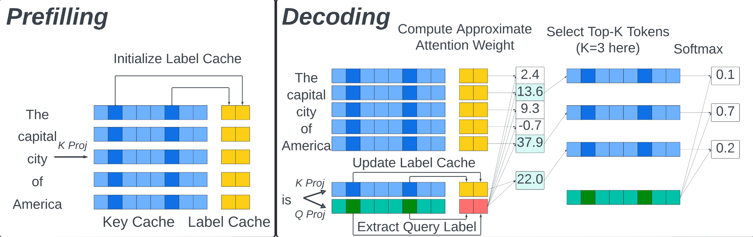
Double Sparsity: 14.1x Attention Speedup with no Loss

Slide 10
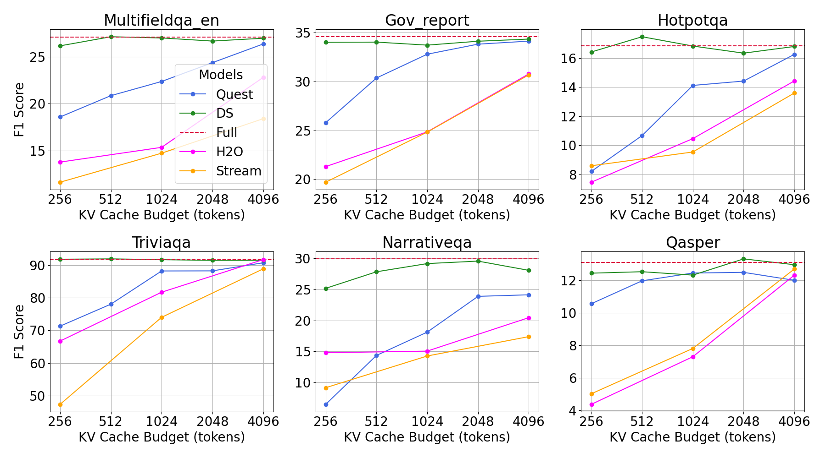
Double Sparsity: 14.1x Attention Speedup with no Loss

Slide 11
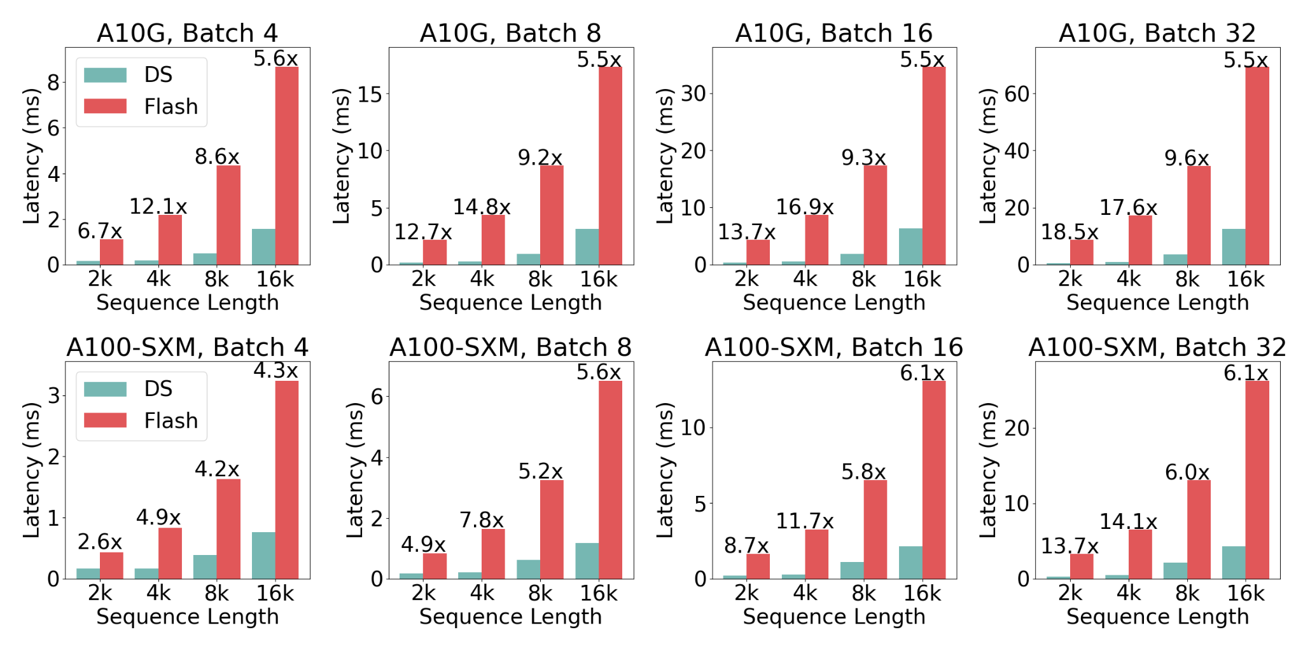
Double Sparsity: 14.1x Attention Speedup with no Loss

Slide 12
2. SGLang with Double Sparsity

Slide 13
Page Attention with Double Sparsity
Implementation
Add label cache to page memory pool
Support page approximate attention
Label cache and KV cache share the same mapping

Slide 14
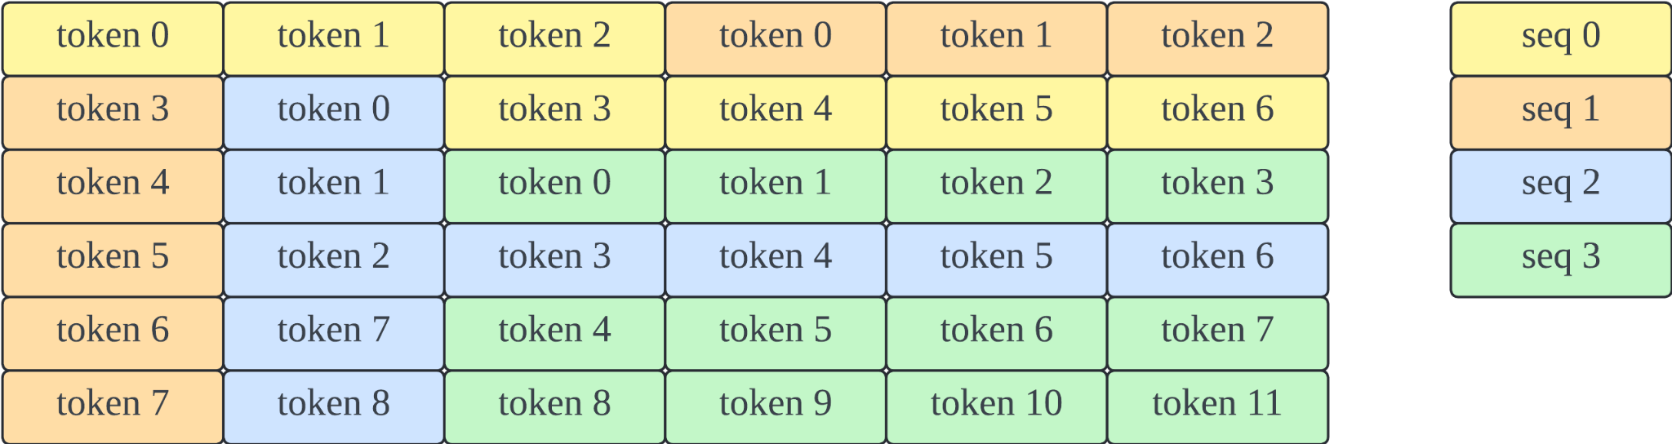
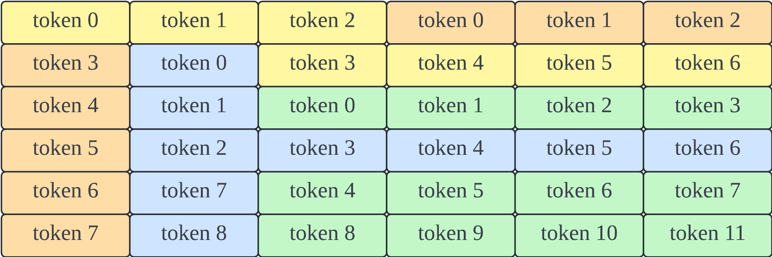
Page Attention with Double Sparsity
class DoubleSparseTokenToKVPool(BaseTokenToKVPool):
def __init__(
self,
size: int,
dtype: torch.dtype,
head_num: int,
head_dim: int,
layer_num: int,
heavy_channel_num: int,
):
super().__init__(size)
# [size, head_num, head_dim] for each layer
self.k_buffer = [
torch.empty((size + 1, head_num, head_dim))
for _ in range(layer_num)
]
self.v_buffer = [
torch.empty((size + 1, head_num, head_dim))
for _ in range(layer_num)
]
# [size, head_num, heavy_channel_num] for each layer
self.label_buffer = [
torch.empty((size + 1, head_num, heavy_channel_num))
for _ in range(layer_num)
]
KV Cache
Label Cache

Slide 15
Page Attention with Double Sparsity
def decode_sparse_attention_fwd( q, k_buffer, v_buffer, label_buffer,
Req_to_tokens,):
# Step 1: BGEMV approximate attention (page implementation)
att_out_approx = _decode_approximate_attn_m_fwd(
q,
label_buffer,
Req_to_tokens,
)
# Step 2: TopK token selection
topk_token_indices = torch.topk(att_out_approx, k, dim=-1).indices
Req_to_tokens_topk = torch.gather(
Req_to_tokens, 2, topk_token_indices)
# Step 3: Full attention over TopK tokens
out = _decode_attn_m_fwd_topk(
q,
k_buffer,
v_buffer,
Req_to_tokens_topk,
)
KV Cache
Label Cache

Slide 16
3. Future Work

Slide 17
Future Work
Double Sparsity-Offload
torch.compile & CUDA Graph
1-bit Tensor core approximate attention

Slide 18
Welcome to join our Slack and use SGLang!

