Slide 1
浅聊并发
创研技术分享论坛
易居创研中心
2017年05月

Slide 2
引言
并发 VS. 并行
几种并发模型
引用文档
转折点

Slide 3
引言
软件 VS. 硬件
硬件（CPU）结构发生变化
自 OOP 之后又一次重大“revolution”

Slide 4

转折点

Slide 5
转折点
之前：
clock speed
execution optimization
cache
之后：
hyperthreading
multicore
cache

Slide 6
转折点
more cores in a DIE
more DIEs in a server
more servers for a system
systems are getting more complicated

Slide 7
并发 VS. 并行
“In programming, concurrency is the composition of independently executing processes, while parallelism is the simultaneous execution of (possibly related) computations. Concurrency is about dealing with lots of things at once. Parallelism is about doing lots of things at once.” - Rob Pike

Slide 8
并发 VS. 并行
并发是一种构建软件的方式，是一种组织软件的方式；
并行是指同时执行；
两者相关但不是一回事情；
The gopher example from Rob Pike:
https://talks.golang.org/2012/waza.slide#12

Slide 9
并发 VS. 并行
A complex problem can be broken down into easy-to-understand components.
The pieces can be composed concurrently.
The result is easy to understand, efficient, scalable, and correct.
Maybe even parallel.

Slide 10
几种并发模型
Lock based concurrency
CSP
Actor
Asynchronous callback/promise

Slide 11
Locked based concurrency
共享可变状态；
Low-level primitives, such as lock.
锁太大或太多会造成性能问题；
锁太少会不能保护 critical section；
锁的顺序不对导致死锁；

Slide 12
Communicating sequential processes
golang
do not communicate by sharing memory ; instead, share memory by communicating
Go primitives: goroutines, channels, and the select statement.

Slide 13
Goroutines
Goroutines are like lightweight threads;
They start with tiny stacks and resize as needed;
Go programs can have hundreds of thousands of them;
Start a goroutine using the go statement:
go f(args);
The Go runtime schedules goroutines onto OS threads;
Blocked goroutines don't use a thread;

Slide 14
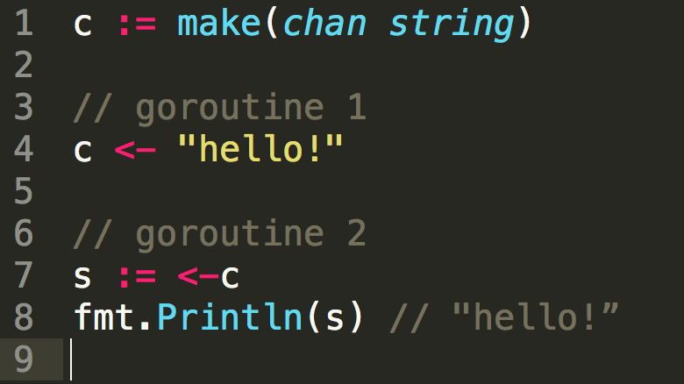
Channels
Channels provide communication between goroutines.

Slide 15
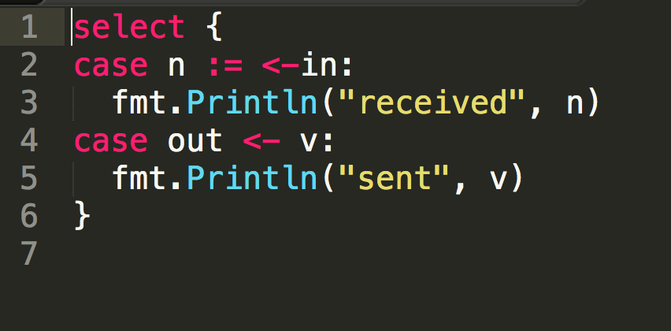
Select
A select statement blocks until communication can proceed.

Slide 16
Actor - Erlang
everything is a process.
process are strongly isolated.
process creation and destruction is a lightweight operation.
message passing is the only way for processes to interact.
processes have unique names.
if you know the name of a process you can send it a message.
processes share no resources.
error handling is non-local.
processes do what they are supposed to do or fail.
-- Joe Armstrong

Slide 17
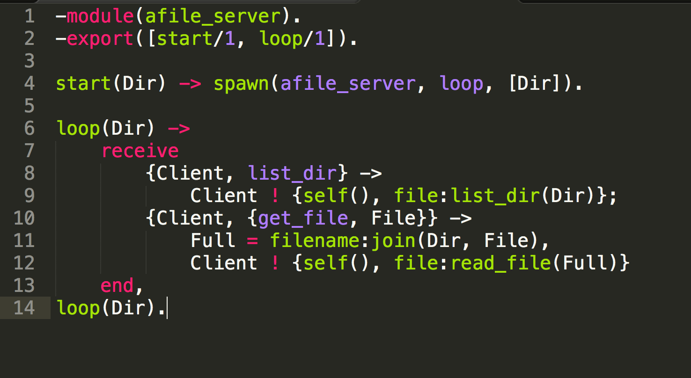
afile_server.erl

Slide 18
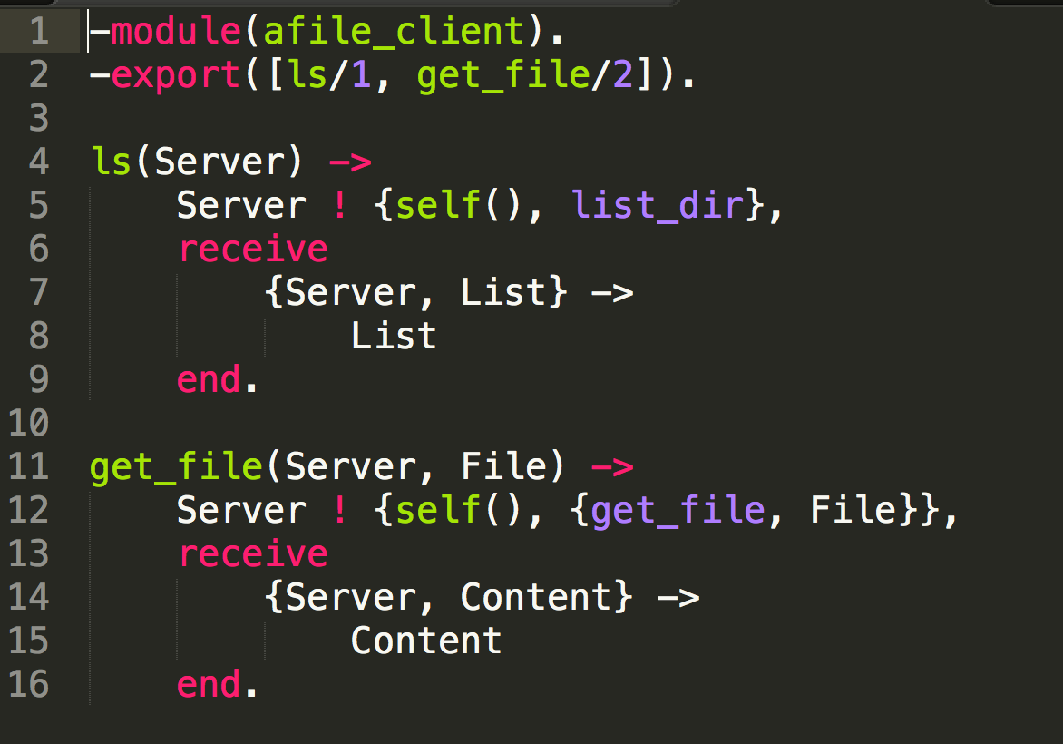
afile_client.erl

Slide 19
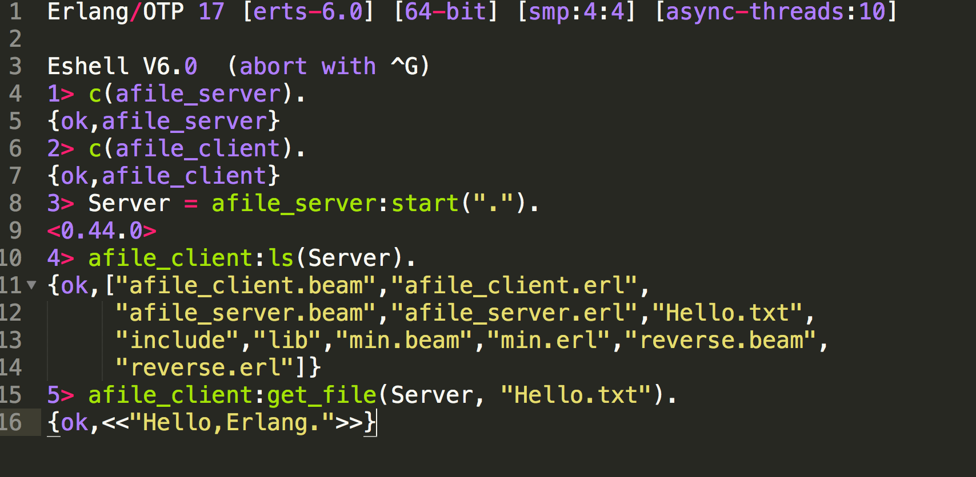
Eshell 模拟调用

Slide 20
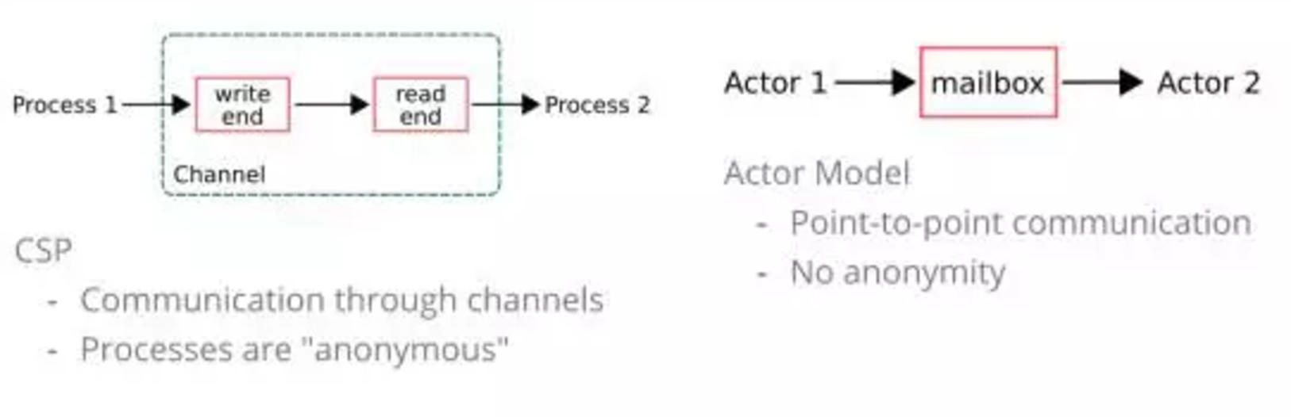
CSP VS. Actor

Slide 21
Javascript/Node
单线程；
异步I/O；
事件驱动；

Slide 22
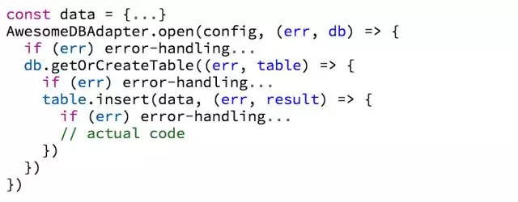
Javascript/Node
callback hell

Slide 23
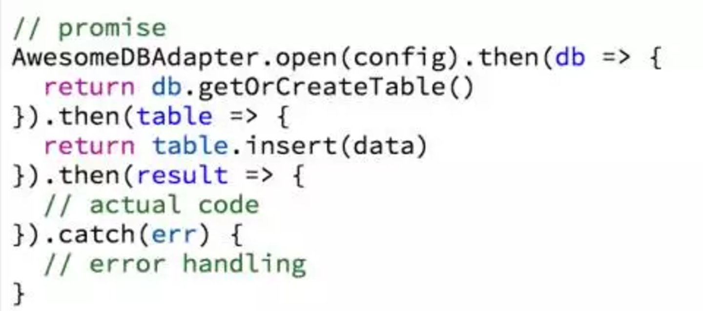
Javascript/Node
可以将异步操作以同步操作的流程表达出来，避免了层层嵌套的回调函数；
Promise对象提供统一的接口，使得控制异步操作更加容易

Slide 24
其他几种
STM(Software Transactional Memory)
Observable

Slide 25
引用
The Free Lunch Is Over: A Fundamental Turn Toward Concurrency in Software
Concurrency is not Parallelism
https://www.youtube.com/watch?v=cN_DpYBzKso
An Introduction to Programming with Threads.
Javascript异步编程的4种方法
Promise: 给我一个承诺，我还你一个承诺
ECMAScript 6 Promise 对象
部落图鉴之Go：爹好还这么努力？
Erlang程序设计（第2版）

Slide 26
Thank You !

