Slide 1
Song Popularity Analysis
By Cecilia Iacometta, Nicholas Tiveron, Ginevra Cepparulo

Slide 2
ROADMAP
Introduction and RQ
Methodology
Conclusions
1
3
5
2
4
6
Variables
Analysis
References

Slide 3
What is our project about?
1

Slide 4
Popularity of songs and song metrics.
Relationship between

Slide 5
“The underlying assumption behind HSS is that popular songs are similar with respect to a set of features that make them appealing to a majority of people. These features could then be exploited by learning machines in order to predict whether a song will rise to a high position in the chart” - someone

Slide 6
Why we are interested and why is it important?
Relevance: for musicians, music listeners as well as streaming platforms and industry
Did you ever wonder what characterizes top songs in the billboards?
Spotify pays record companies loyalties based on how many streams they produce.
Insights about musical tastes of the population from which the data is drawn.

Slide 7

Why Spotify?
200 mil users
The platform totally dominates the streaming market.
That’s a lot of users following artists, browsing top charts and hunting for music.

Slide 8
To what extent can a song’s popularity be explained by its audio features?
Research Question:

Slide 9
Variables
2

Slide 10
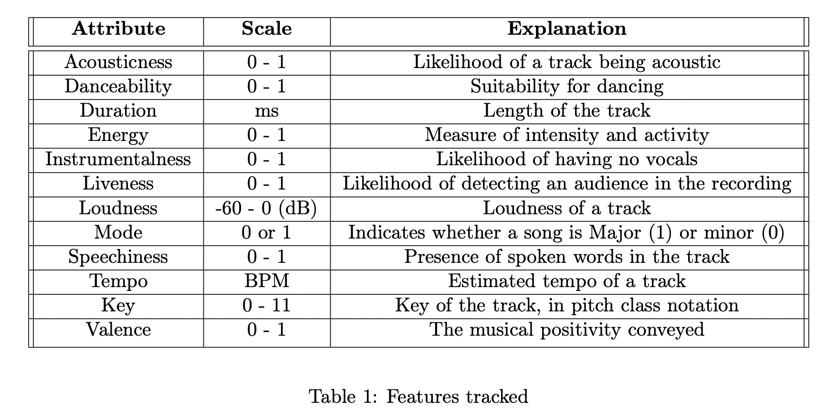
Independent Variables

Slide 11
Dependent variable: Popularity
Spotify metric for song popularity 0-100 based
total number of plays the track has
how recent those plays are
Songs that are being played a lot now have a higher popularity than songs that were played a lot in the past.

Slide 12



LET’S HYPOTHESIZE
H1: Acousticness is negatively correlated to song popularity.
Given the high current trend in electronic music in Italy in recent years it is believed that acousticness will show negative relationship with popularity.
💃
H2: Danceability is positively correlated to song popularity
Since electronic music is generally also danceable, it is believed that danceability will show a positive relationship with popularity.
H3: Duration is negatively correlated to song popularity
Most songs today are within a restricted range; those that last beyond generally have lower popularity.
H4: Energy is positively correlated to song popularity
Since today music is in many times an accompaniment to physical activities it makes sense that many popular songs are energetic.
🎻
H5: Instrumentalness is negatively correlated to song popularity.
Given that lyrics allow the person to sing along to the song and hence to remember it more easily it is expected to be inversely related to song popularity.
🎶
H6: G, C and E are positively correlated to song popularity.
Experts say that the keys G,C and E are most commonly used and will therefore be seen in popular songs.

Slide 13

…some more HYPOTHESES
🏟
H7: Liveness is negatively correlated to song popularity.
Since the presence of an audience and hence background noise is thought to lower the quality of the audio recording, it is believed that liveness will be negatively correlated with song popularity.
🔊
H8: Loudness is positively correlated to song popularity.
It is thought that loudness is the most common way to show expressiveness so we could then assume that the louder the song the more popular.
🎼
H9: The Major mode is positively correlated to song popularity
Songs written in major scales are cheerful whereas ones written in minor scales tend to be sad. It is believed that most people prefer to listen to happy music.
🎙
H10: Speechiness is negatively correlated to song popularity
It is believed that a medium level of speechiness is most popular nowadays and hence that speechiness is negatively correlated to song popularity.
H11: Tempo is not correlated to song popularity.
Given the assumption that there are both hip-hop and ballad tracks in the top charts, we believe that this variable will not show a correlation to song popularity.
😃
H12: Valence is positively correlated to song popularity.
Since it is believed that cheerful songs are more popular, it is hypothesized that popularity correlates positively with respect to song popularity.

Slide 14
Methodology
3

Slide 15

Sample and Data collection
A single song could be labelled with more than one genre, leading to 468 songs total.
50 top songs for each of the 10 most popular genres in the Italian market for the year 2021.

Slide 16
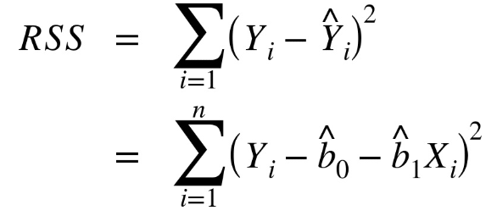
Ordinary Least Squares
Minimizes SSE

Slide 17
Assumptions of the linear model
Multivariate normality
The distribution of popularity was plotted and it showed to closely resemble a normal distribution.
No multicollinearity
Checked that each of the explanatory variables we chose did not have high correlation coefficients with any other variable with some exceptions.
Linear Relationships
Checked by the entire analysis process which concludes that it is respected by conducting several tests.
Homoscedasticity
Observed vs residuals plots all showed the final linear model, which violates it.
No auto-correlation
Auto-correlation is only an issue in the case of time series.
Notes:
Ricordare modifica

Slide 18
Analysis
4

Slide 19
Correlation analysis
Exploratory data analysis
Regression analysis

Slide 20
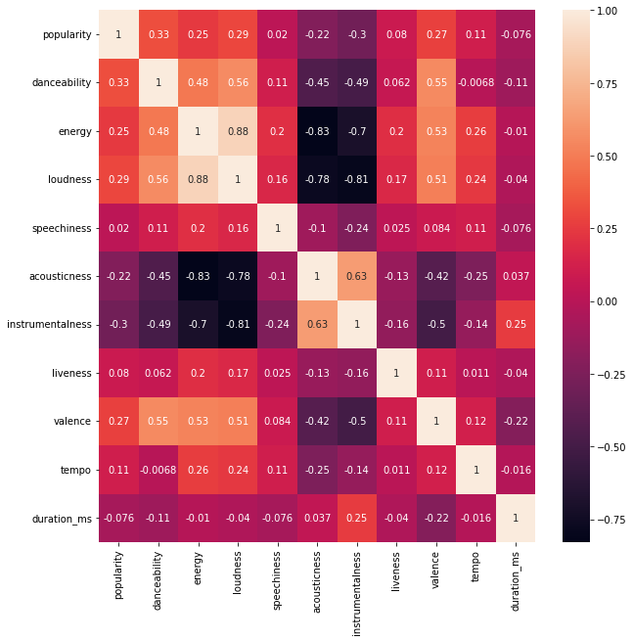
Correlation Matrix

Slide 21
CHOSEN VARIABLES
Correlation coefficients for the variables we chose:
Danceability: 0.32
Energy: 0.24
Loudness: 0.29
Valence: 0.27
Instrumentalness: -0.3

Slide 22
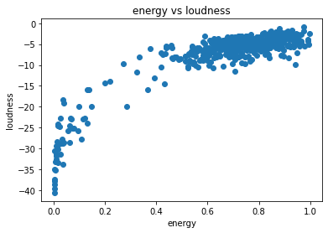
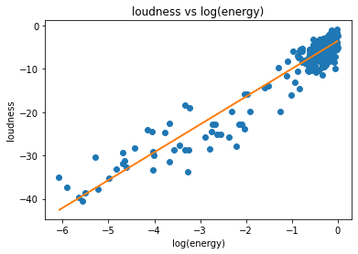
Loudness vs Energy

Slide 23
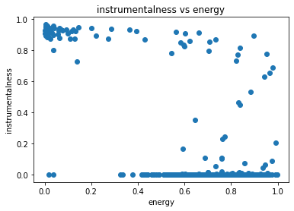
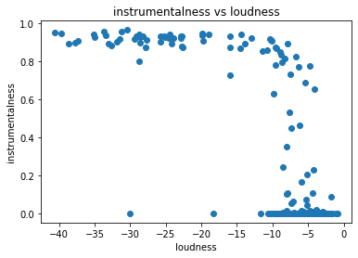
Instrumentalness vs Energy
Instrumentalness vs Loudness

Slide 24
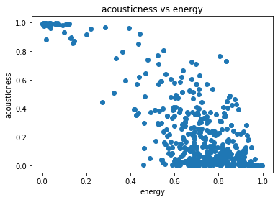
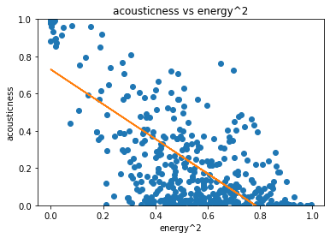
Acousticness vs Energy

Slide 25
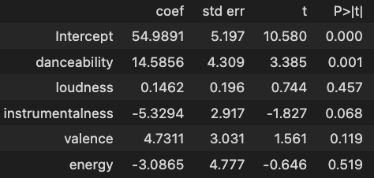
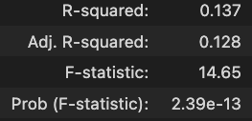
First model’s results

Slide 26
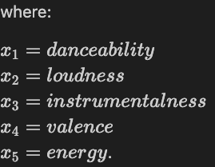
First model’s results

Slide 27
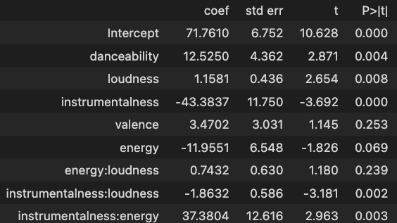
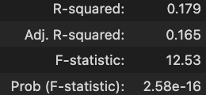

Second model’s results

Slide 28
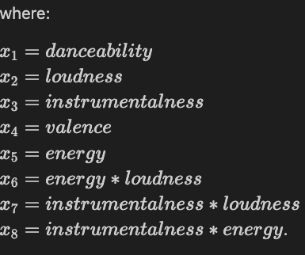
Second model’s results

Slide 29
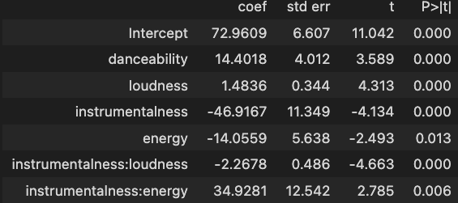
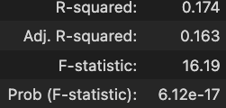

Third model’s results

Slide 30
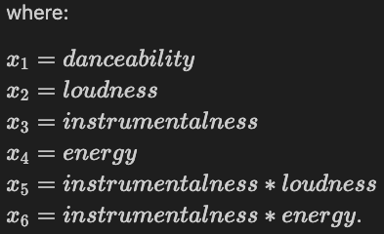
Third model’s results

Slide 31
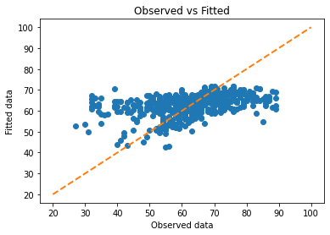
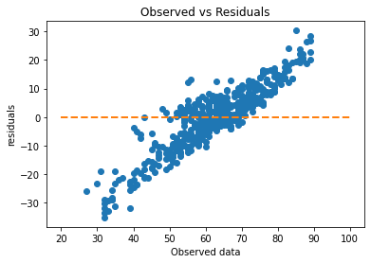
Second model’s evaluation

Slide 32
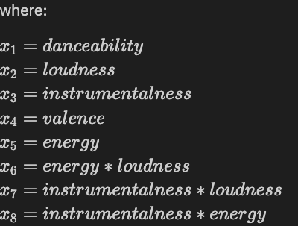
The final model (standardized coefficients)

Slide 33
CI’s for the final model
95% confidence interval of (61.50, 63.56) for the mean of popularity
95% prediction interval of (40.22, 84.85) for a new observation Y₀

Slide 34
Conclusion
5

Slide 35
To sum up…
Given our model, it is concluded that it was not possible to explain a song’s popularity by the analysis of its audio features.
Reasons:
the metric used to describe a song’s Popularity
transformations for some independent variables
genre focused analysis would have been better

Slide 36
Implications
Further research:
other models other than OLS
prediction models such as Random Forests or SVM, song popularity for out-of-sample data.
very significant for music streaming platforms such as Spotify as well as the music Industry in general

Slide 37
References
6

Slide 38
Nijkamp, Rutger.Prediction of Product Success: Explaining Song Popularity by Audio Features from Spotify Data, University of Twente, 10 July 2018, https://essay.utwente.nl/75422/1/NIJKAMP_BA_IBA.pdf.Accessed 6 Sept. 2022.
Çimen, Ahmet, and Enis Kayış. A Longitudinal Model for Song Popularity Prediction, Ozyegin University, 2021, https://www.scitepress.org/Papers/2021/106077/106077.pdf. Accessed 6 Sept. 2022.
Suh, Brendan Joseph. International Music Preferences: An Analysis of the Determinants of Song Popularity on Spotify for the U.S., Norway, Taiwan, Ecuador, and Costa Rica, Claremont Colleges, 29 Apr. 2019, https://core.ac.uk/download/pdf/216833222.pdf. Accessed 6 Sept. 2022.
“F Statistic / F Value: Simple Definition and Interpretation.” Statistics How To, 20 Nov. 2021, https://www.statisticshowto.com/probability-and-statistics/f-statistic-value-test/. Accessed 6 Sept. 2022.
Fogarty, Taylor, et al. “Predicting the Future of Music.” Towards Data Science, 24 May 2019, https://towardsdatascience.com/predicting-the-future-of-music-c2ca274aea9f. Accessed 6 Sept. 2022.
Frost, Jim. “How to Interpret p-Values and Coefficients in Regression Analysis.” Statistics By Jim, Jim Frost, 22 July 2022, https://statisticsbyjim.com/regression/interpret-coefficients-p-values-regression/ Accessed 6 Sept. 2022.
Pham, James, et al. Predicting Song Popularity, http://cs229.stanford.edu/proj2015/140_report.pdf . Accessed 6 Sept. 2022.
Watts, Cameron. “Extracting Song Data from the Spotify API Using Python.” Extracting Song Data from the Spotify API Using Python, Towards Data Science, 10 Feb. 2022, https://towardsdatascience.com/extracting-song-data-from-the-spotify-api-using-python-b1e79388d50. Accessed 6 Sept. 2022.
Ni, Y., Santos-Rodriguez, R., Mcvicar, M., & De Bie, T. (2015). Hit song science once again a science?, 1-2.

Slide 39
THANKS!
Any questions?

