Slide 1
Lending Club Case Study
Group Members:
Gaurav Gupta
Shreyash Kumar Nangnurwar

Slide 2
Abstract
Lending club is the largest online loan marketplace, facilitating personal loans,
business loans, and financing of medical procedures.
Borrowers can easily access lower interest rate loans through a fast online interface.
When the company receives a loan application, the company has to make a decision for loan approval based on the applicant’s profile.

Slide 3
Business Objective
Like most other lending companies, lending loans to ‘risky’ applicants is the largest source of financial loss (called credit loss). The credit loss is the amount of money lost by the lender when the borrower refuses to pay or runs away with the money owed. In other words, borrowers who default cause the largest amount of loss to the lenders.
Objective is to identify the risky loan applicants at the time of loan application so that such loans can be reduced thereby cutting down the amount of credit loss. Identification of such applicants using EDA is the aim of this case study.
In other words, to understand the driving factors (or driver variables) behind loan default, i.e. the variables which are strong indicators of default. The company can utilize this knowledge for its portfolio and risk assessment. And thus minimize the risk of losing money while lending to customers.

Slide 4

Problem solving methodology
Data Cleaning
Data Understanding
Univariate Analysis
Segmented Univariate Analysis
Analysing the continuous data columns with respect to the categorical column
Bivariate Analysis
Recommendations
Removing the null valued columns, unnecessary variables and checking the null value percentage and removing the respective rows.
Working with the Data Dictionary and getting knowledge of all the columns and their domain speciﬁc uses
Analysing each column, plotting the distributions of each column.
Analysing the two variable behaviour like term and loan status with respect to loan amount.
Analysing all plots and recommendations for reducing the loss of business by detecting columns best which contribute to loan defaulters.

Slide 5
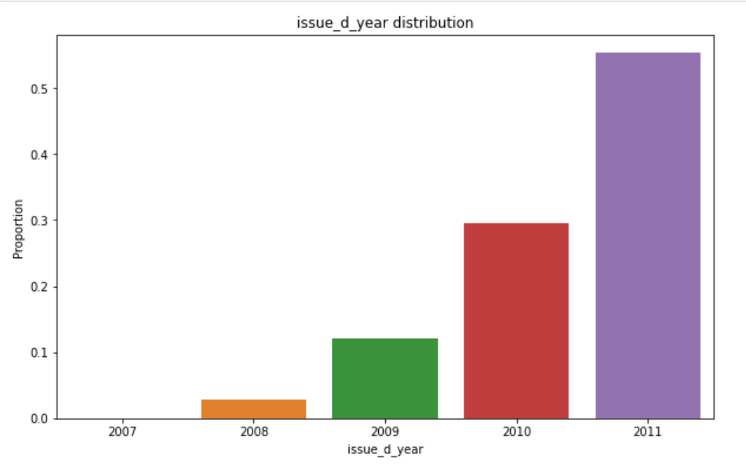
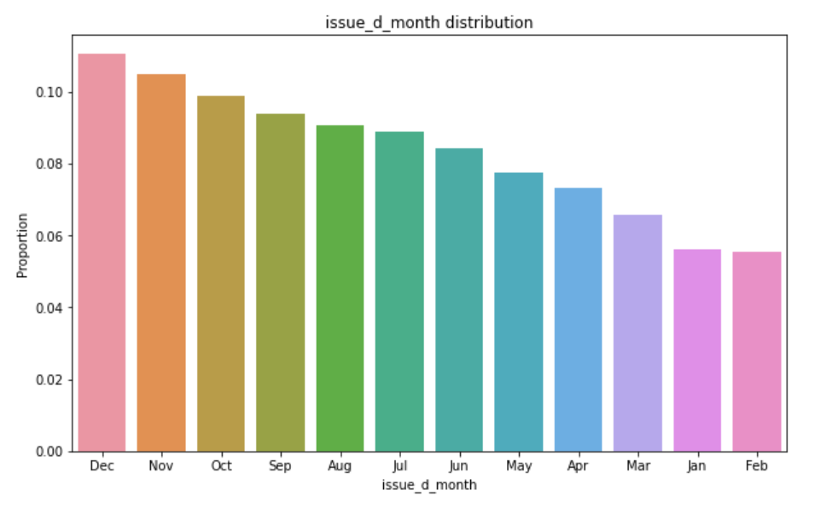
Analysis
Lending club has really expanded year by year, the number of loan issued are doubled every year.
Also the issued month of loans is also increasing from January to December. In the final quarter of year there are more loans issued this could be because of vacation and christmas.

Slide 6
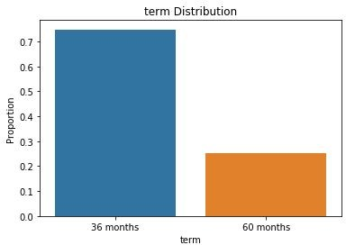
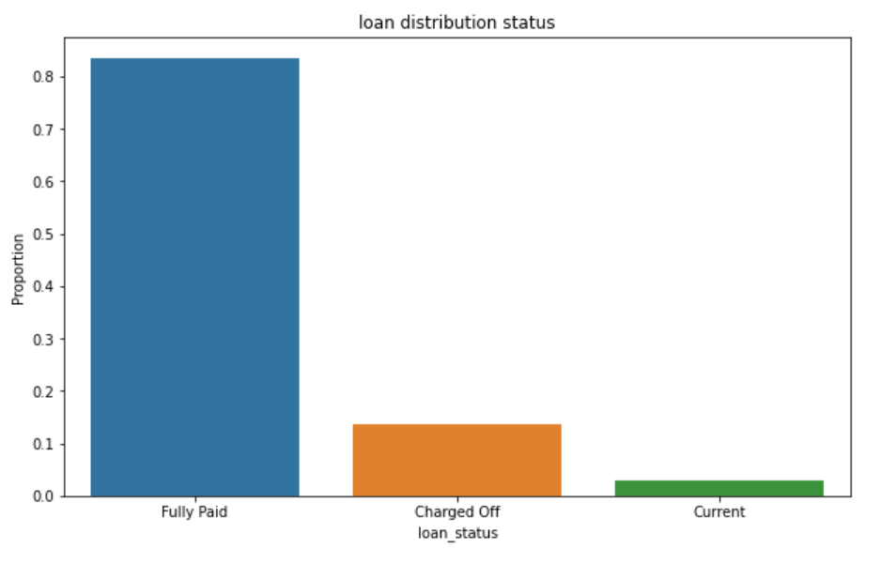
Analysis
There are only two loan terms 36 and 60 months. Around 75% borrowers took loans with 36 months term.
The charged off borrowers are around 12-13% and fully paid is around 82-83% in the given data set.

Slide 7
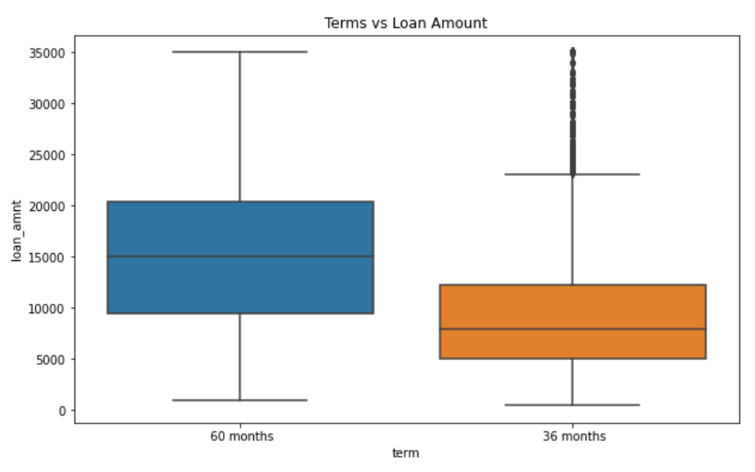
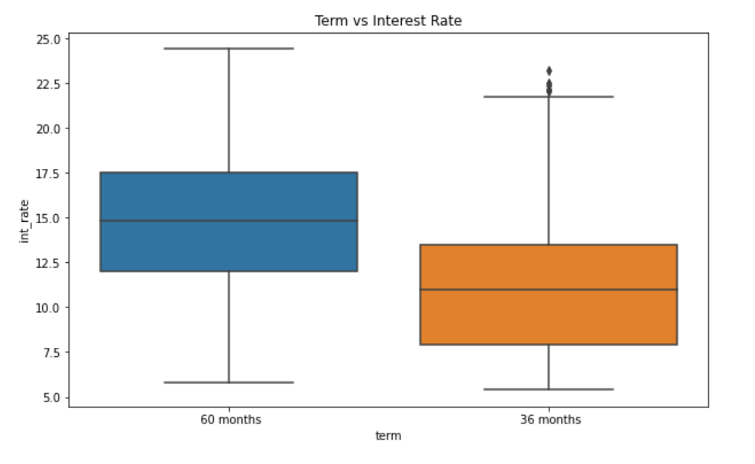
Analysis
The default rate is high in 60 months tenure because most people took high loan amount with high interest rate in it and they faced difficulties in returning the sum to bank.

Slide 8
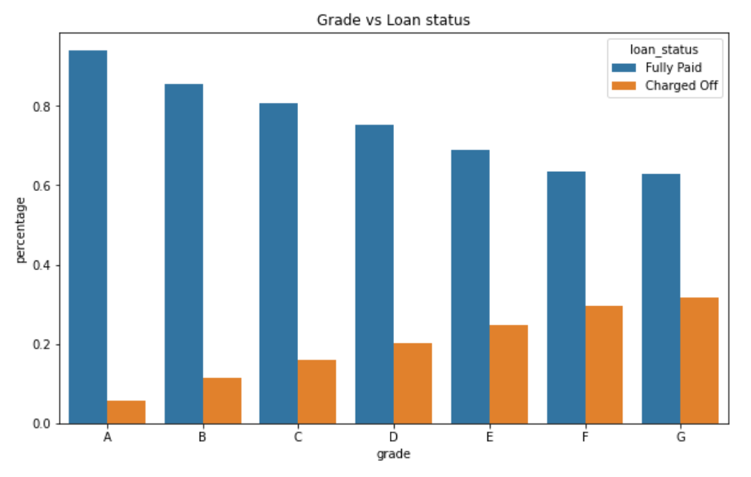
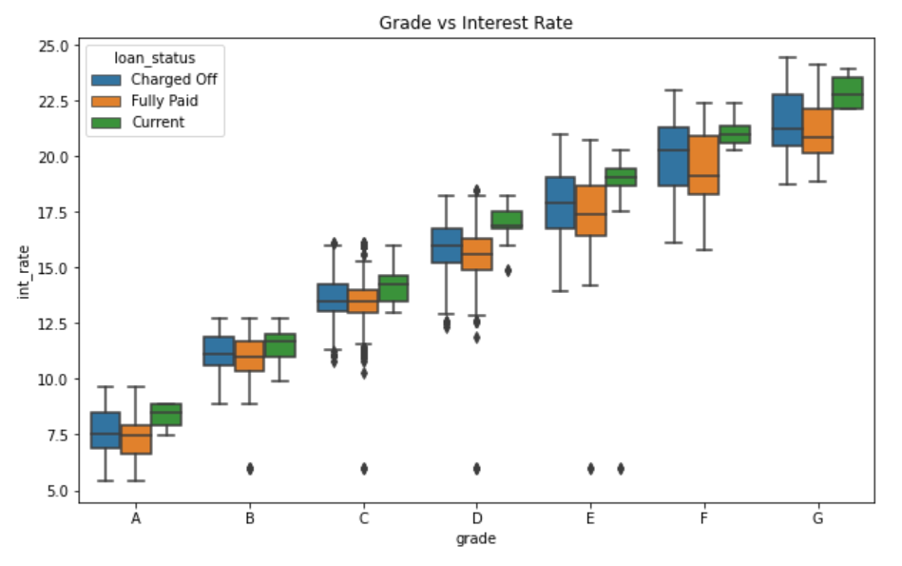
Analysis
The Lower grades(E,F,G) have higher chances of defaulting the loan than Higher ones(A,B)
Lower grades are getting loans for higher interest rates

Slide 9
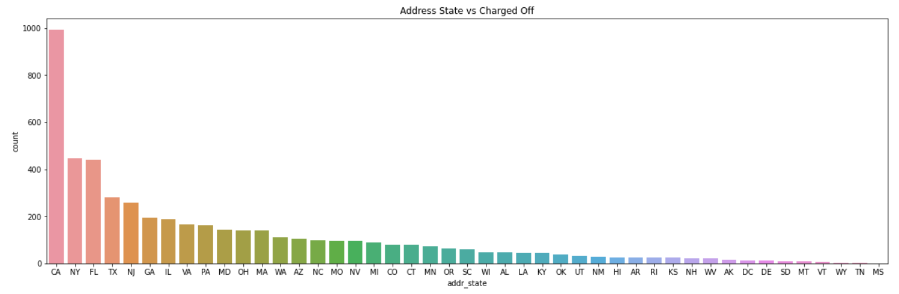
Analysis
The loans which are given for CA, FL and TX state borrower’s are defaulted more than other states.

Slide 10
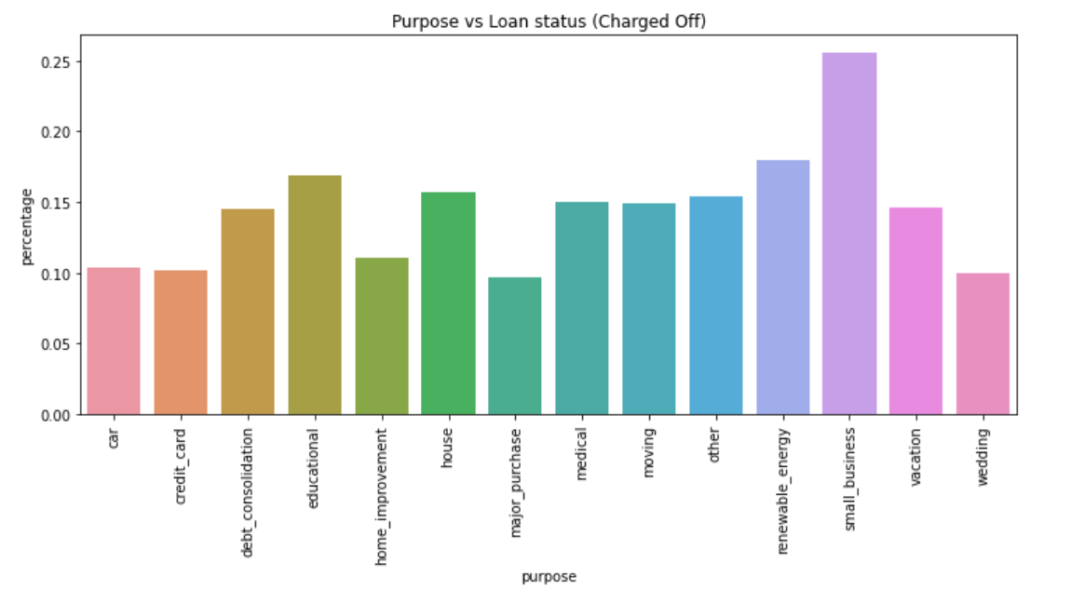
Analysis
Borrower’s who took loans for small business purpose have defaulted more.

Slide 11
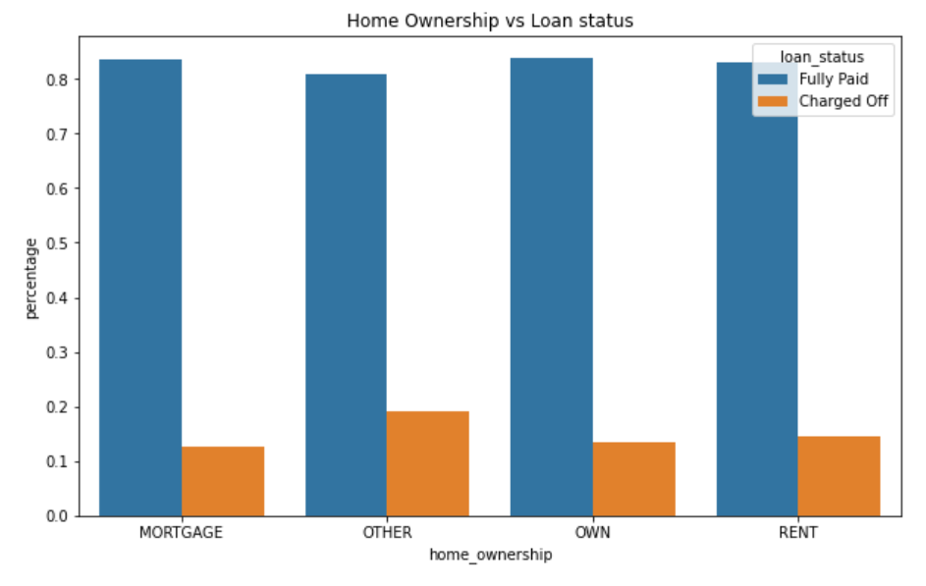
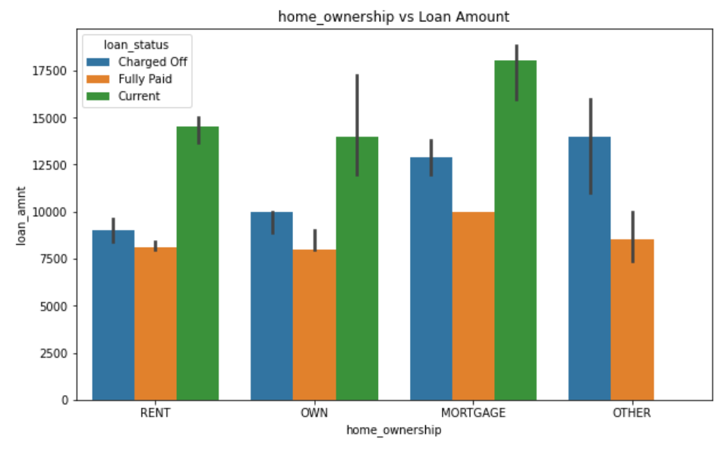
Analysis
There is around 20% chance of loan default in each home ownership category.
From the 2nd plot we can see the people with higher loan amounts in mortgage home ownership has high default rate than others.

Slide 12
Conclusions
Lending club should reduce the high interest loans for 60 months tenure, they are prone to loan default.
Grades are good metric for detecting defaulters. Lending club should examine more information from borrowers before issuing loans to Low grade (G to A).
Lending Club should control their number of loan issues to borrowers who are from CA, FL and NY to make profits.
Small business loans are defaulted more. Lending club should stop/reduce issuing the loans to them.
Borrowers with mortgage home ownership are taking higher loans and defaulting the approved loans. Lending club should stop giving loans to this category when loan amount requested is more than 12000.

