Slide 1
HR ANALYTICS
Employee Retention
Data Analysis Project
Datasets: HR_1 & HR_2 | 50,000 records each
Domain: HR Analytics • Employee Retention

Slide 2
GROUP 6
HR Analytics — Employee Retention
TEAM MEMBERS
Hemaram
Ganesh
Nadhini
Amit
Vaseem
Suma
Sanjana

Slide 3
Project Overview
Understanding employee retention using HR data
100,000
Source rows
50,000
Matched employees
36
Combined fields
50.21%
Overall attrition
Goal: identify patterns associated with employee attrition and retention.
HR_1 contains demographic, department, satisfaction and job information.
HR_2 contains income, overtime, tenure, promotion and work-life balance information.
The two datasets were joined using EmployeeNumber from HR_1 and Employee ID from HR_2.

Slide 4
Data Preparation
Combining the two HR datasets
Loaded HR_1 and HR_2 Excel datasets.
Verified the employee identifier fields and matched all 50,000 employees.
Merged the datasets into one analysis table containing 36 columns.
Created derived fields such as Monthly Income bands for comparison.
Calculated KPI measures using employee-level records.
50,000
Successful employee matches

Slide 5
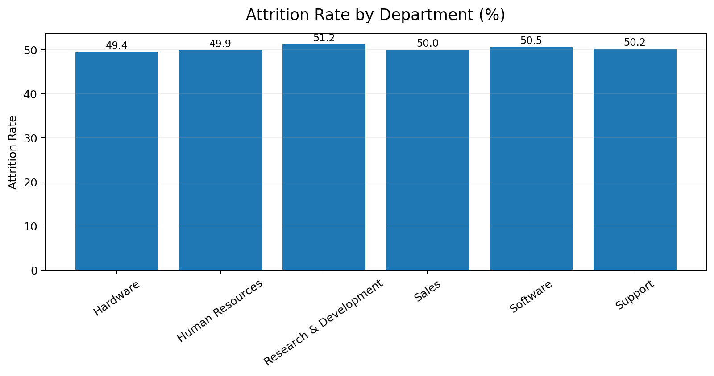
KPI 1 — Attrition Rate by Department
The project brief asks for attrition analysis across departments
50.21%
Overall attrition rate
50.21%
Average of department rates
Highest: Research & Development (51.21%).
Lowest: Hardware (49.44%).
Department rates are tightly clustered around 50%, so department alone shows limited separation in this dataset.

Slide 6
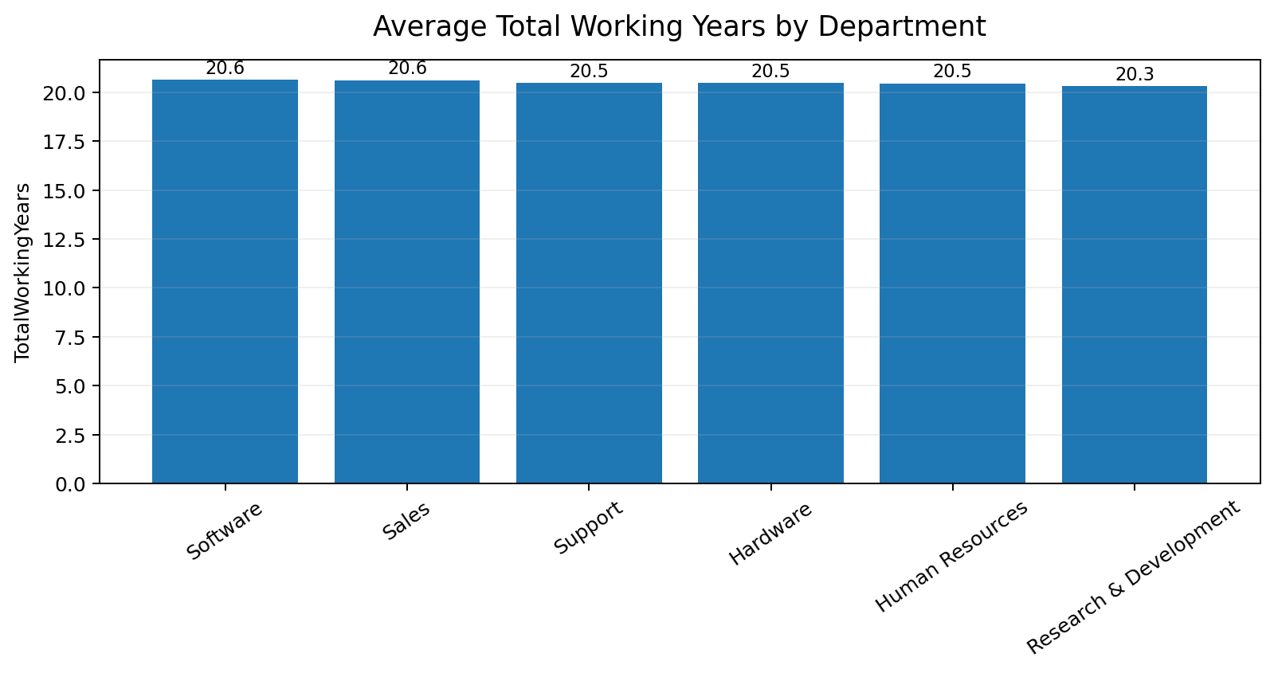
KPI 2 — Male Research Scientist Hourly Rate
Average hourly rate for the specified employee segment
114.45
Average hourly rate
Male Research Scientists
2,589
Employees in this segment
Hourly rate is analyzed from HR_1.
The left chart also shows average total working years by department as the next project KPI.

Slide 7
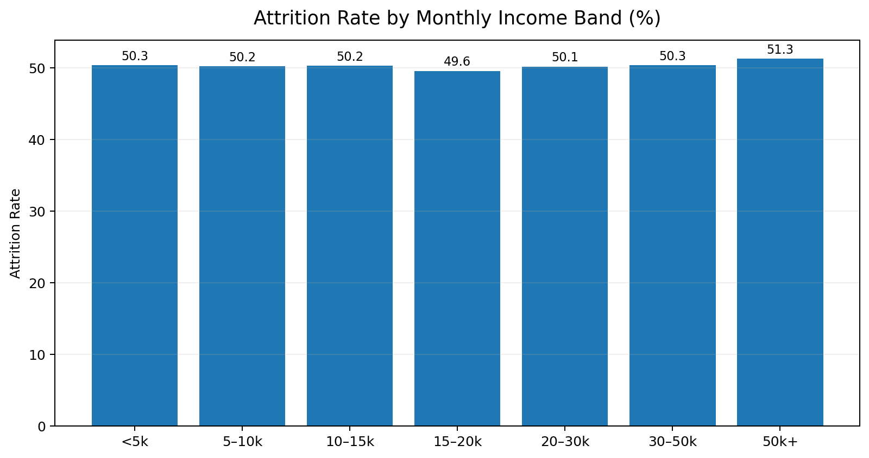
KPI 3 — Attrition vs Monthly Income
Comparing attrition across monthly-income bands
51.26%
Highest income-band attrition
49.55%
Lowest income-band attrition
Highest observed band: 50k+.
Lowest observed band: 15–20k.
Attrition remains close to 50% across bands, indicating a weak standalone relationship in this dataset.

Slide 8
KPI 4 — Average Working Years by Department
Average TotalWorkingYears for each department
20.65 yrs
Highest: Software
20.30 yrs
Lowest: Research & Development
Working-year averages are also closely grouped.
Sales and Software are marginally higher than the other departments.

Slide 9
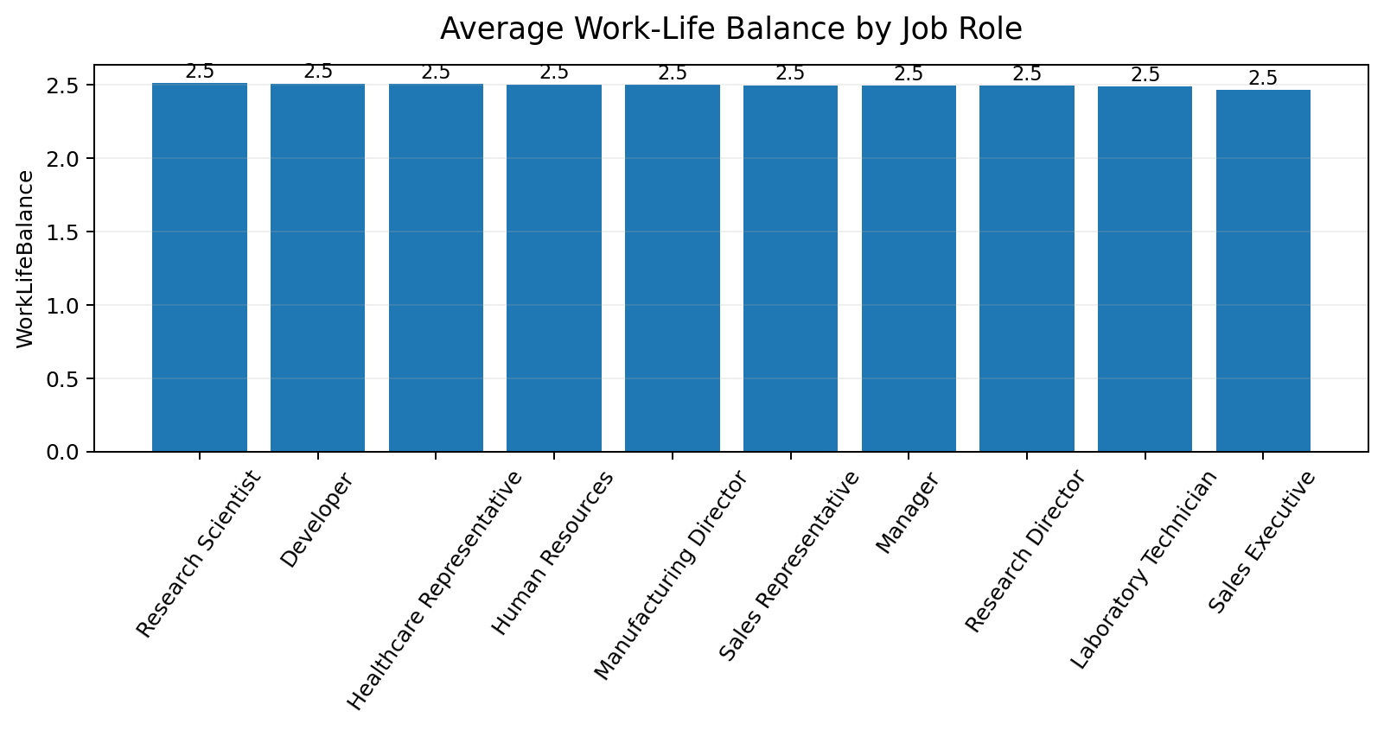
KPI 5 — Job Role vs Work-Life Balance
Average WorkLifeBalance score by job role
2.51
Highest: Research Scientist
2.47
Lowest: Sales Executive
The score is based on the dataset's 1–4 WorkLifeBalance scale.
Differences between roles are small, with averages near 2.5.

Slide 10
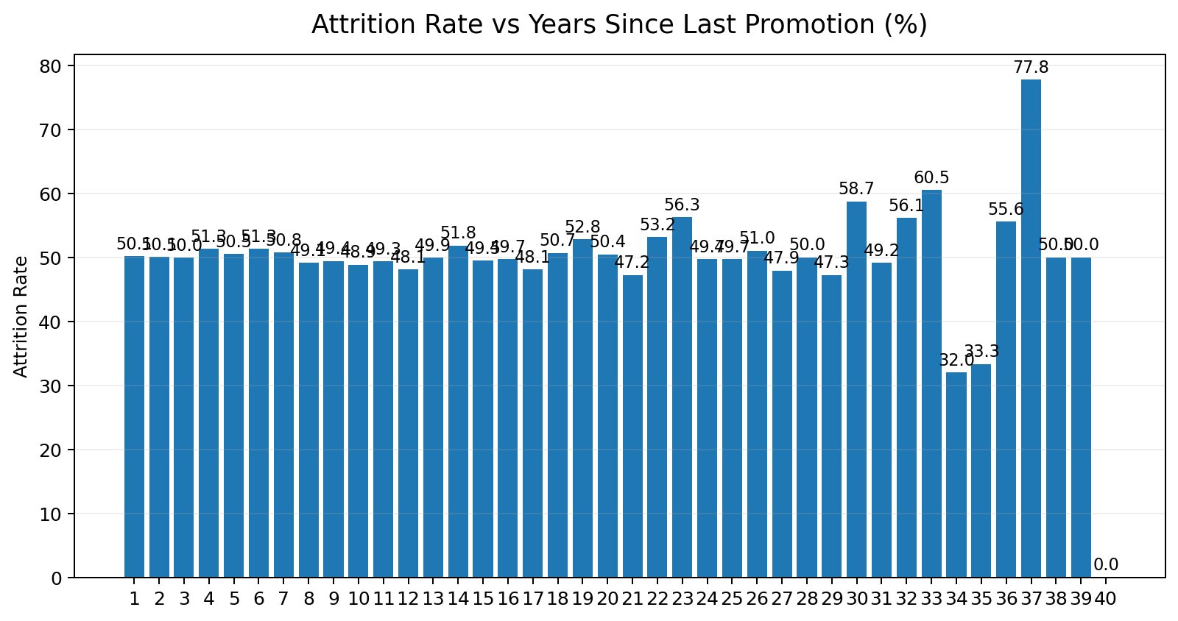
KPI 6 — Attrition vs Years Since Last Promotion
Examining whether promotion timing separates attrition
77.78%
Highest: 37 years
0.00%
Lowest: 40 years
Most observations occur in the 1–5 year range.
Attrition fluctuates rather than showing a simple upward or downward trend.
Promotion timing alone is not a strong separator in this dataset.

Slide 11
Key Findings
What the analysis tells us
Overall attrition is 50.21%, almost evenly split between Yes and No.
Department-level attrition rates are tightly clustered, with only small differences.
Monthly income bands also show attrition rates close to 50%.
Average total working years are similar across departments.
Work-life balance averages are close across job roles.
Years since last promotion shows fluctuations rather than a clear linear attrition pattern.
Main takeaway
No single KPI strongly explains attrition on its own.

Slide 12
Recommendations
How HR teams could use these findings
Combine multiple HR factors rather than relying on one KPI to predict attrition.
Use employee-level dashboards to drill into department, role, income, overtime and tenure together.
Flag unusual combinations such as high overtime + low satisfaction + long time since promotion.
Track attrition trends over time and compare them with HR interventions.
Use the analysis as a starting point for deeper predictive modeling.

Slide 13
Conclusion
The HR dataset provides a broad view of employee retention.
The six required KPIs reveal patterns, but attrition is not strongly separated by any single factor.
Thank You
Questions & Discussion

Slide 14
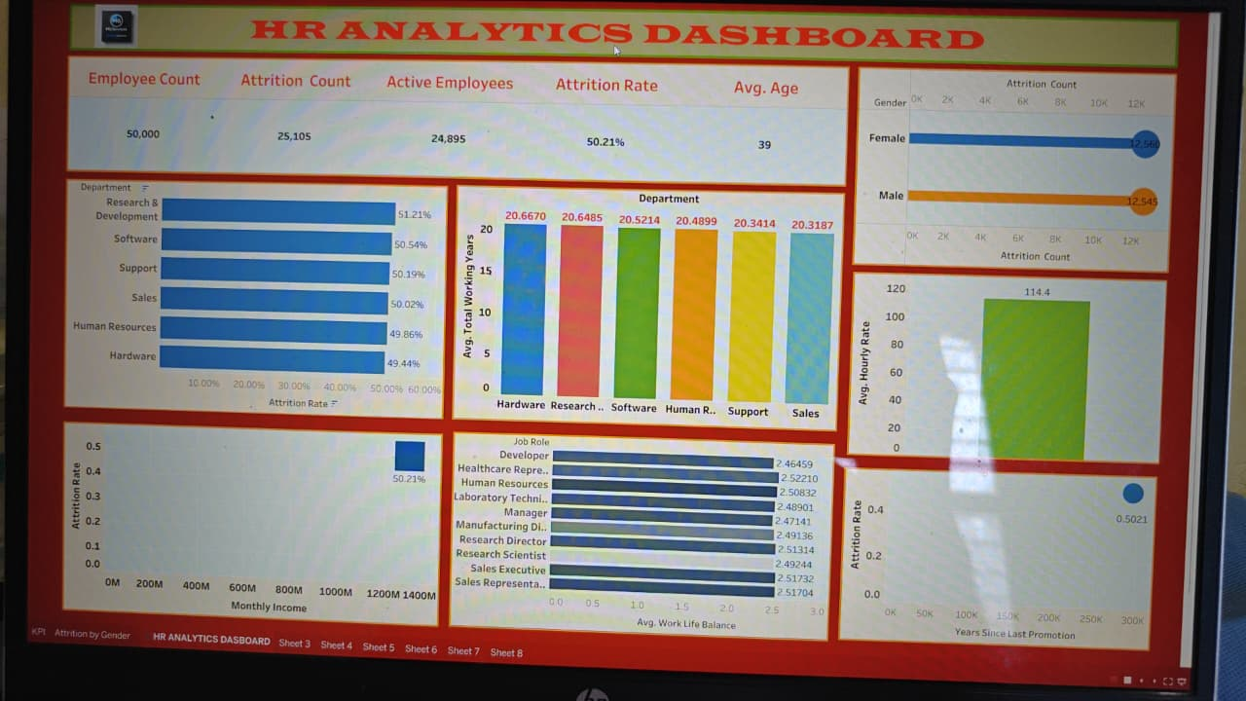
Tableau Dashboard
Interactive HR Analytics dashboard built from the Employee Retention dataset
Dashboard highlights: employee count, attrition, active employees, department, gender, hourly rate, work-life balance and promotion analysis.

Slide 15
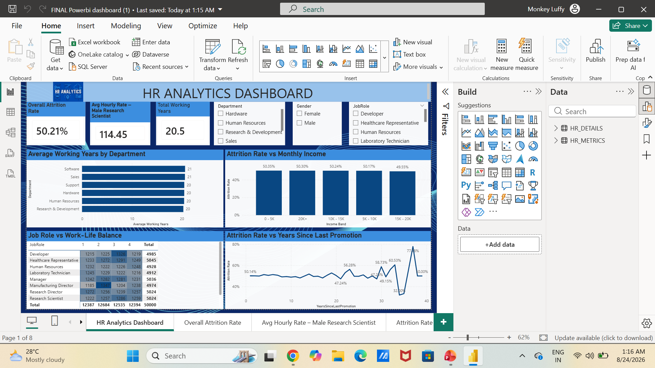
Power BI Dashboard
Interactive Power BI dashboard for KPI monitoring and HR analysis
Dashboard highlights: 50.21% attrition, 114.45 average hourly rate for male research scientists, department and income analysis.

Slide 16
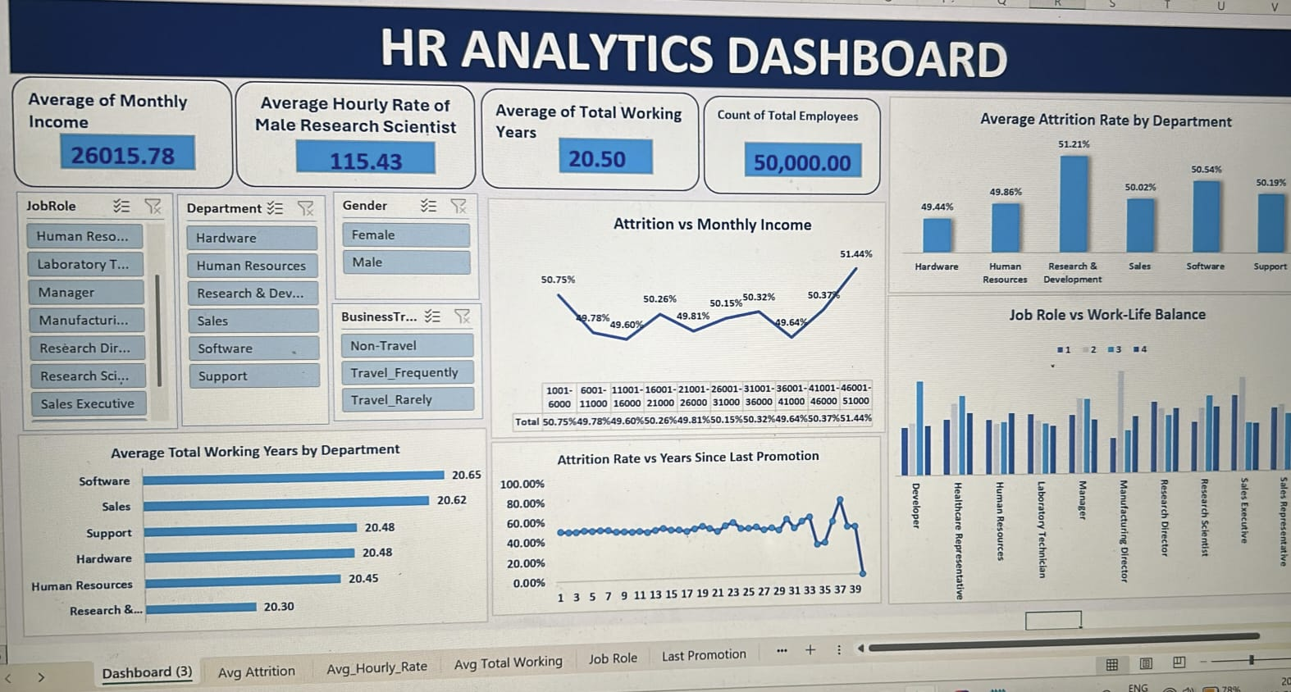
Excel Dashboard
Interactive Power BI dashboard for KPI monitoring and HR analysis

Slide 17
End-to-End Project Workflow
1
2
3
4
Excel
Tableau
Power BI
Insights
Data preparation & KPI analysis
Interactive visual exploration
Dashboard & business monitoring
Interpretation & recommendations
The same HR dataset is analyzed from multiple perspectives to support employee-retention decisions.

