Slide 1
Kitapyurdu presentation

Slide 2
Dataset ozellikleri
Datasetin son hali: 19.330 kitap
Temel değişkenler: Toplamda 50 ye yakin degiskenden olusuyor. Fakat onemli olanlar
fiyat, yorum_sayısı, satın_alma_sayısı (hedef değişken), favori_sayısı
okuma_listesi (bayrak), yıldız_puanı, kategori, yayıncı, vb.
Hedef değişken: satın_alma_sayısı (kitap satışlarının bir göstergesi olarak kullanıldı)
Veri toplama süreci:
Web kazıma (web scraping) ile iki farklı veri kümesi indirildi:
Liste görünümü: Yaklaşık 197.000 kitap
Kitap detay sayfaları: Yaklaşık 27.000 giriş (zaman kısıtı nedeniyle)
Temizlenip birleştirildikten sonra elde edilen nihai veri kümesi: 19.330 benzersiz kitap
Cogu ozellik oldukca carpik(skew)

Slide 3
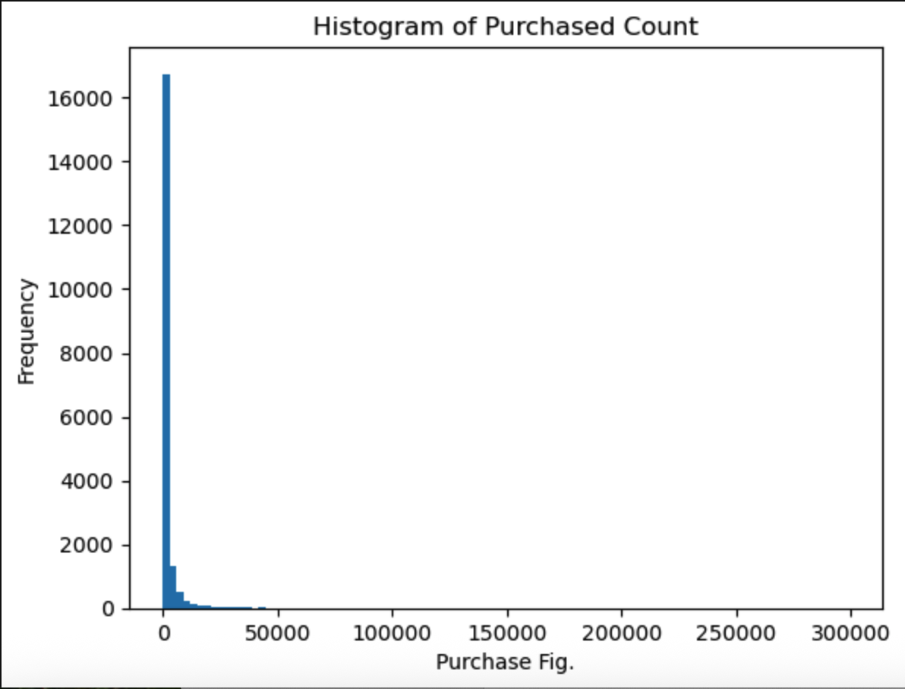
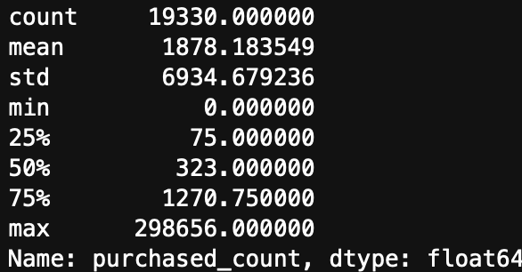
Training set: 2025 oncesi satislari kapsiyor.
Test set: 2025 teki kitap satislari
Satis miktarlarina bakarsak datasetimiz oldukca carpik.(Skew function sonucu 15.976)

Slide 4
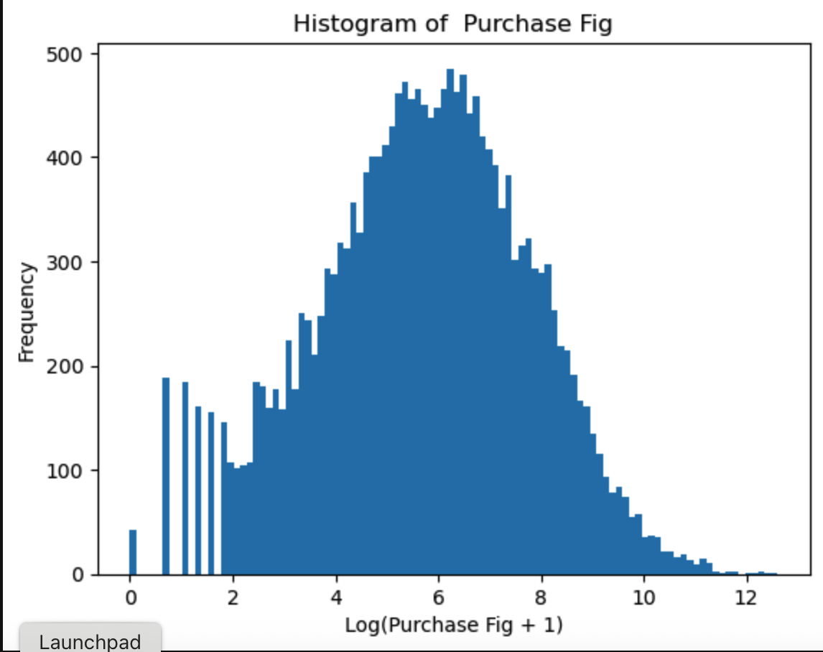
Log1p sonrasi

Slide 5
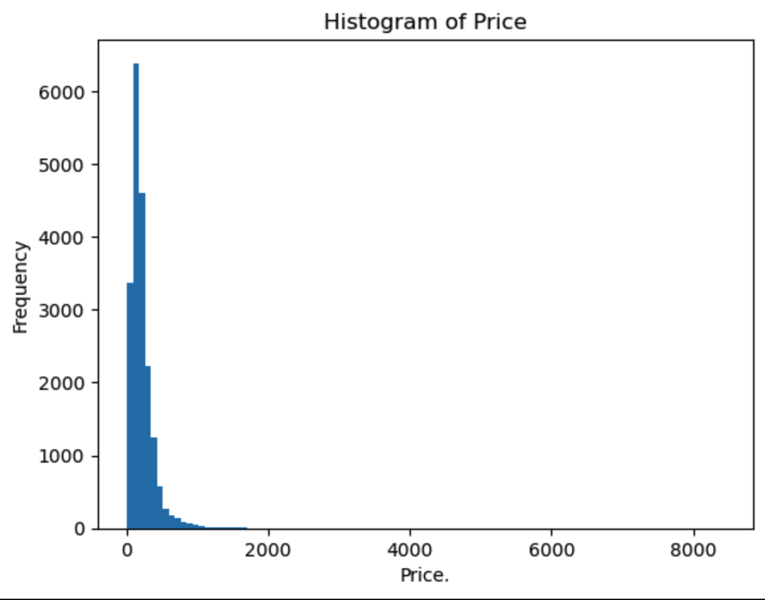
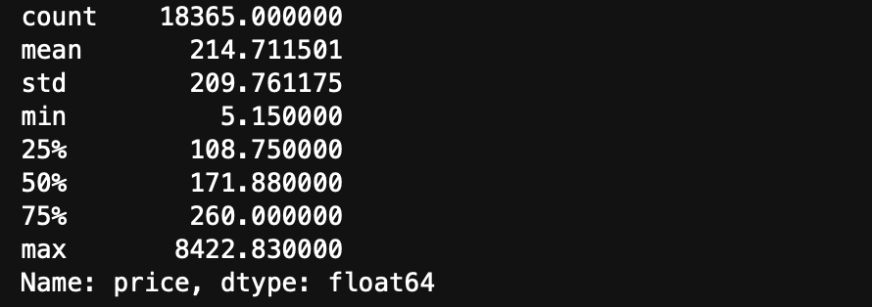
Kitap fiyatlari
Max:8000 tl
Min: 50 try
Mean:
Oldukca Carpik

Slide 6
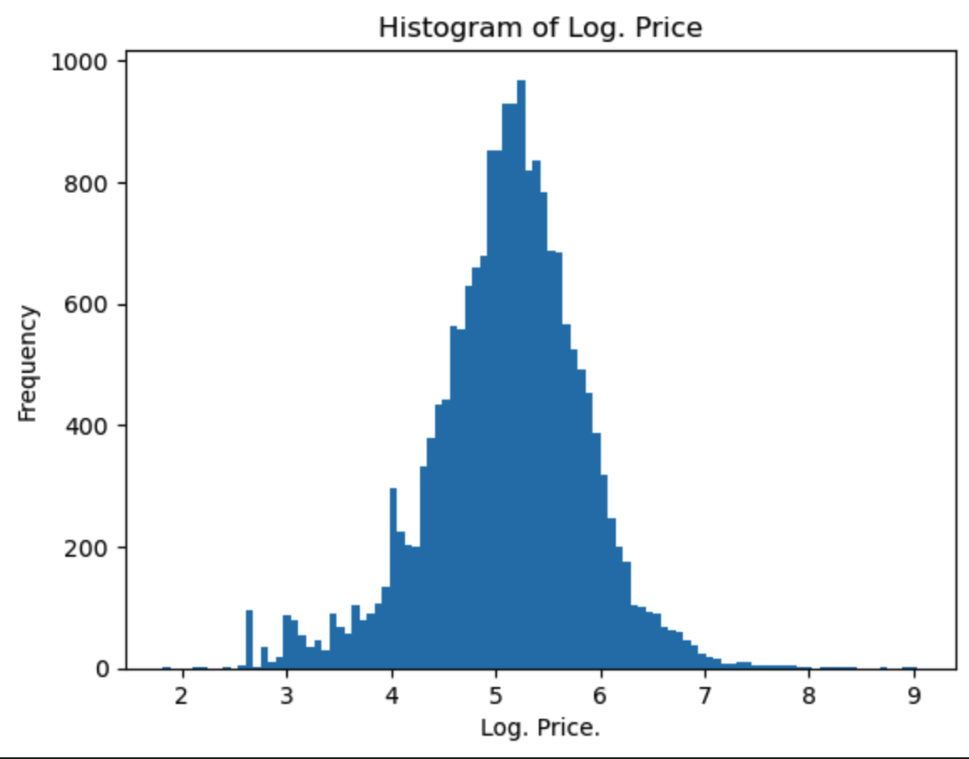

Slide 7
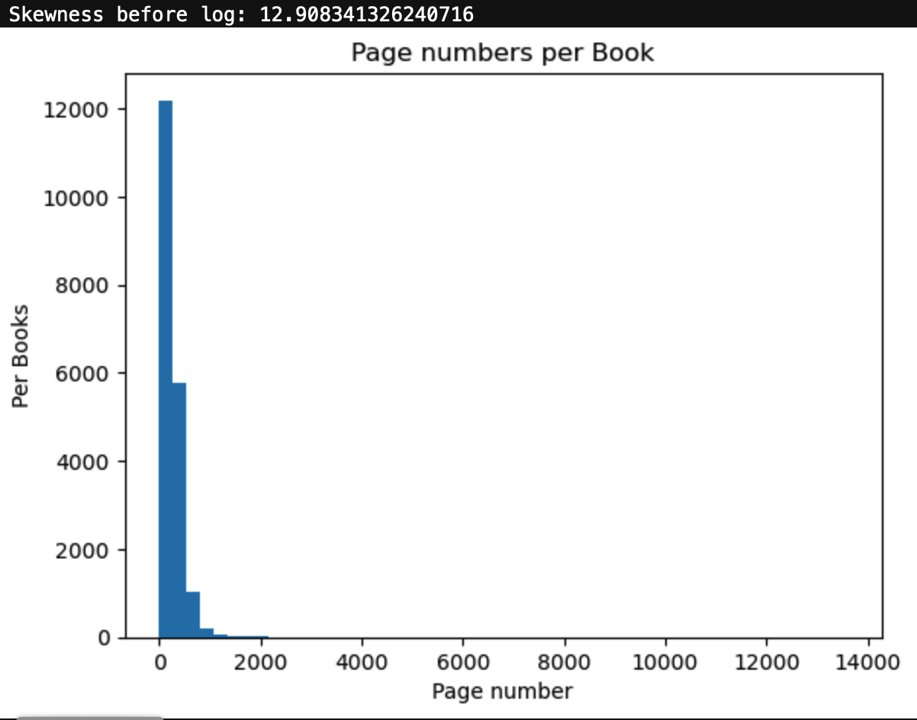
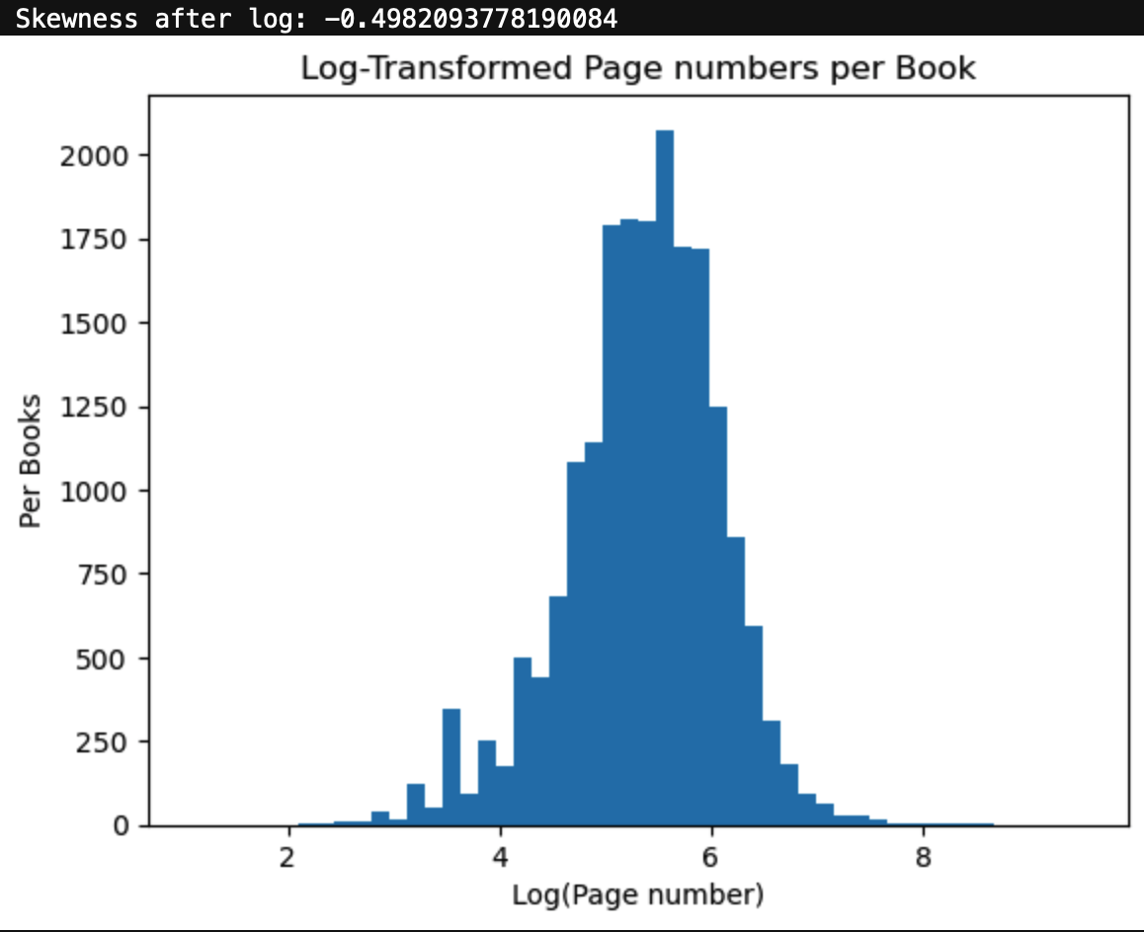

Slide 8
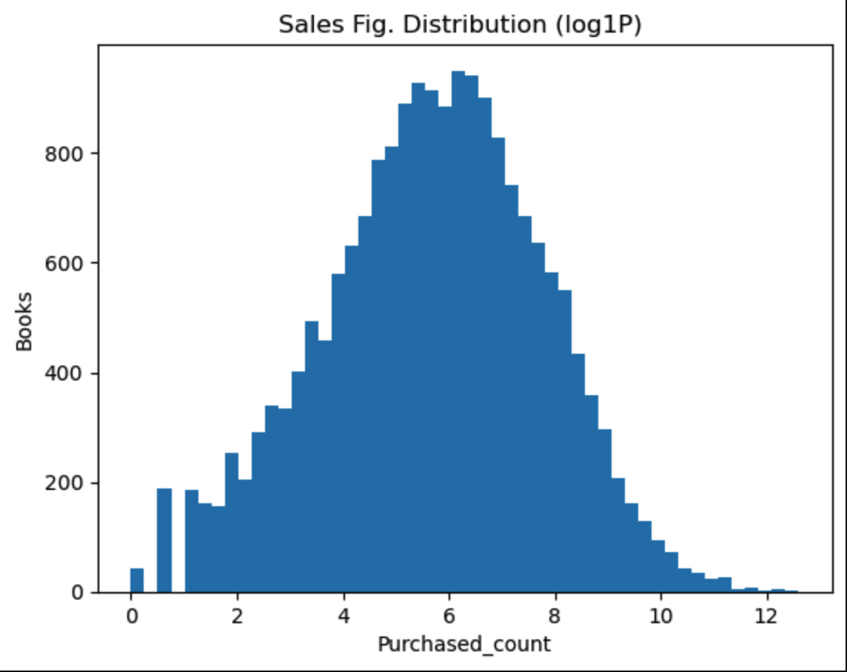
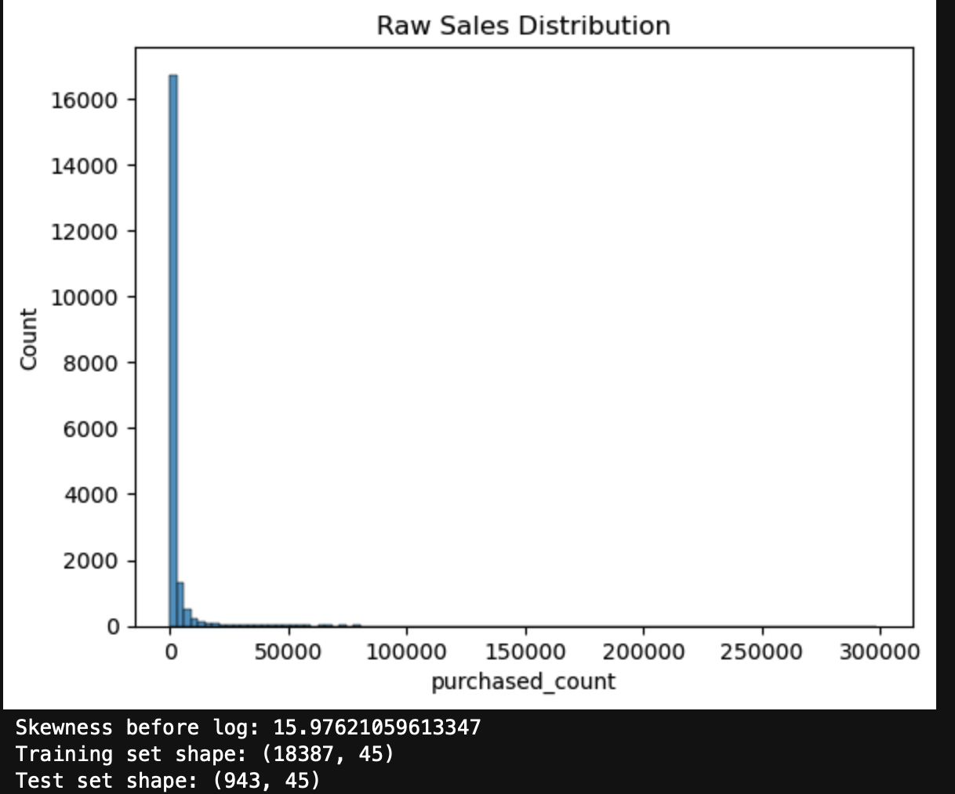

Slide 9
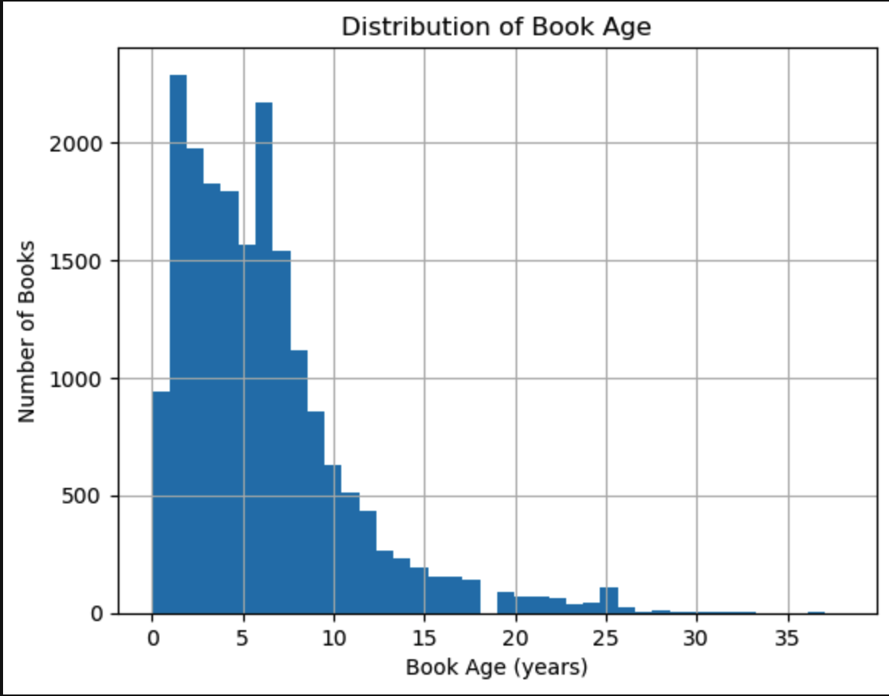
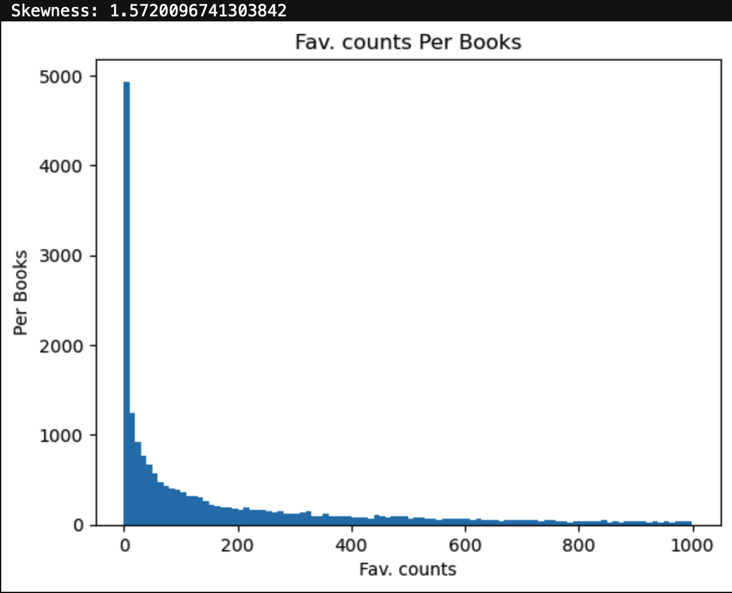

Slide 10
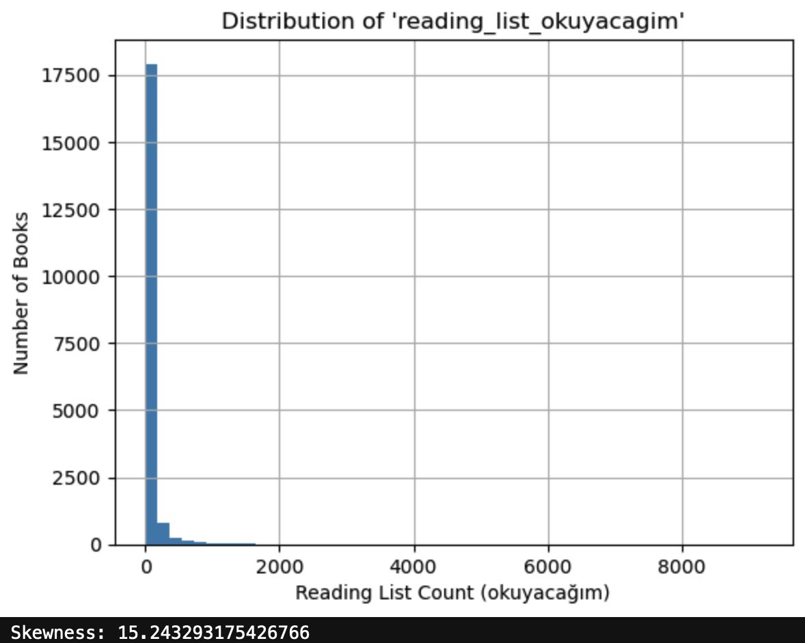

Slide 11
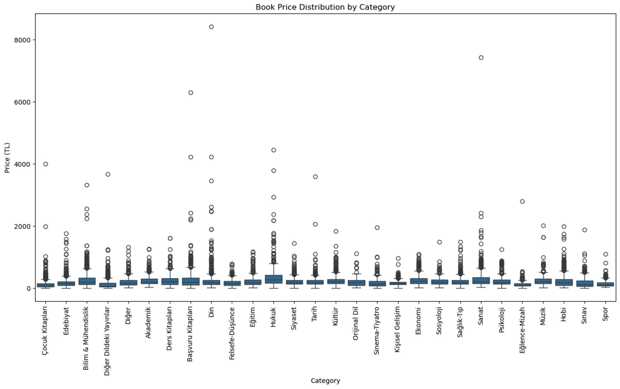
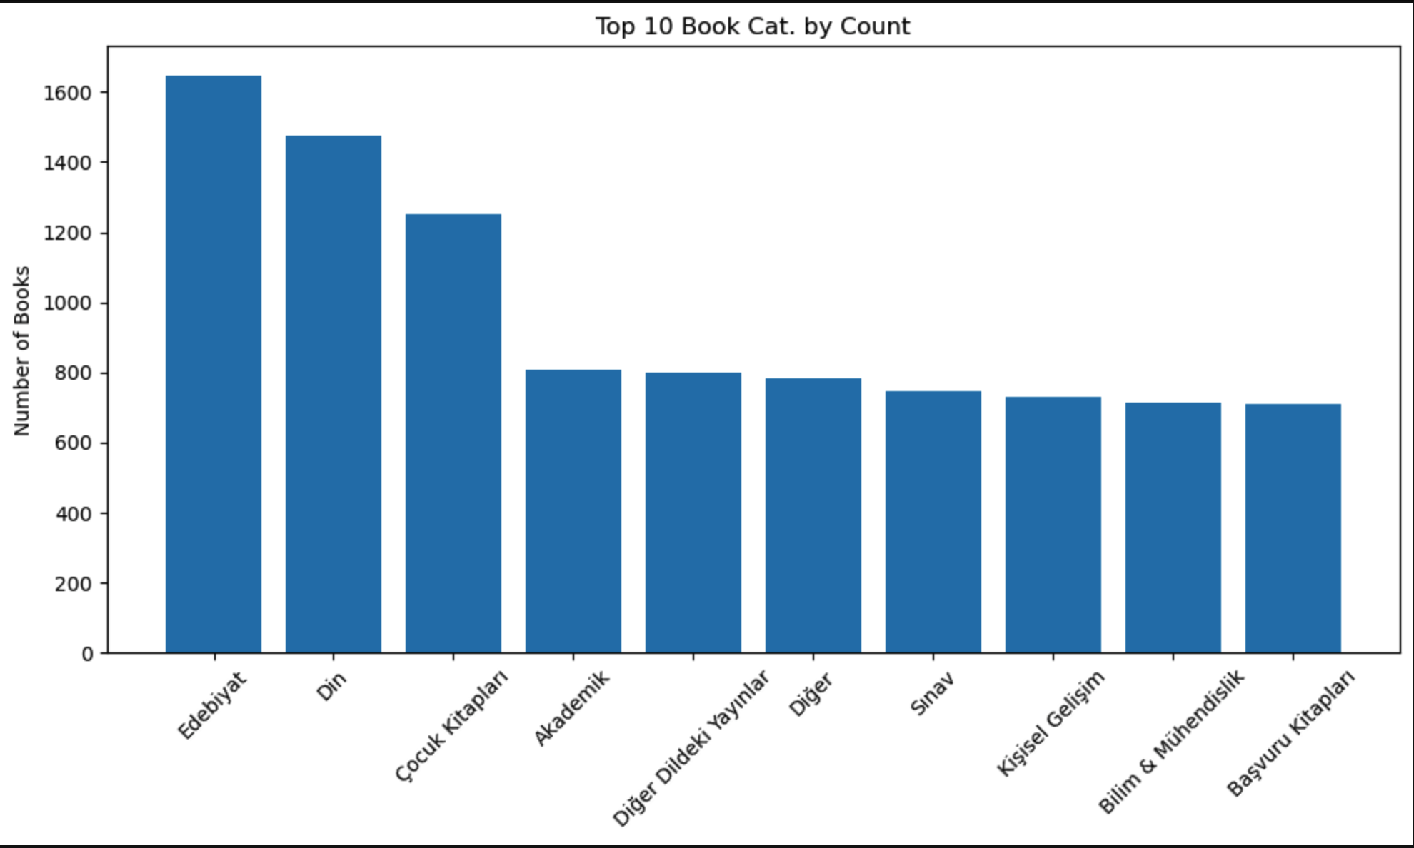

Slide 12
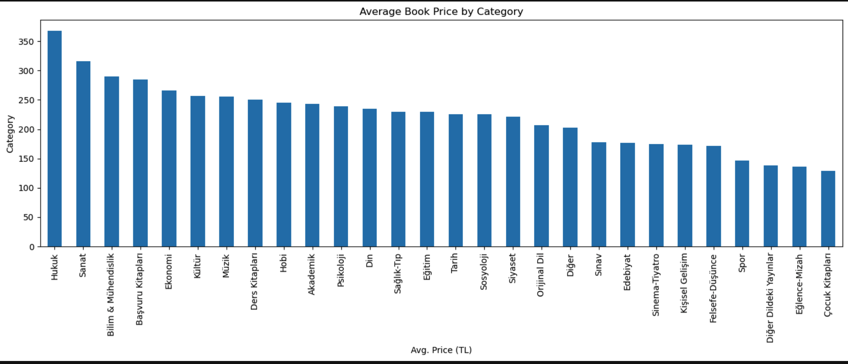

Slide 13
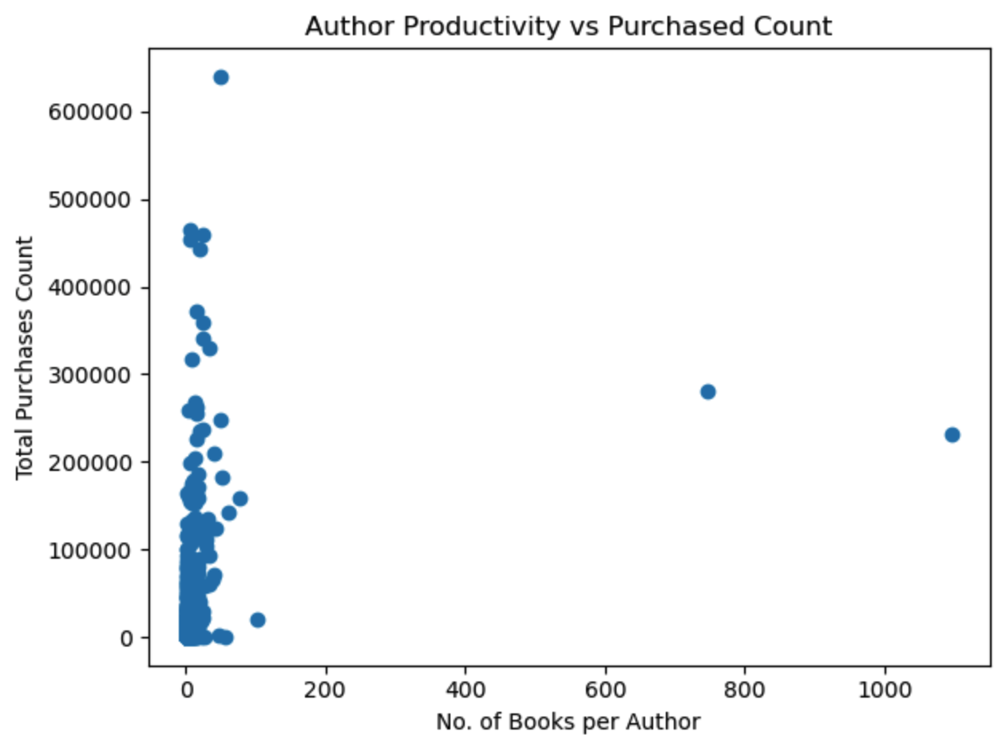
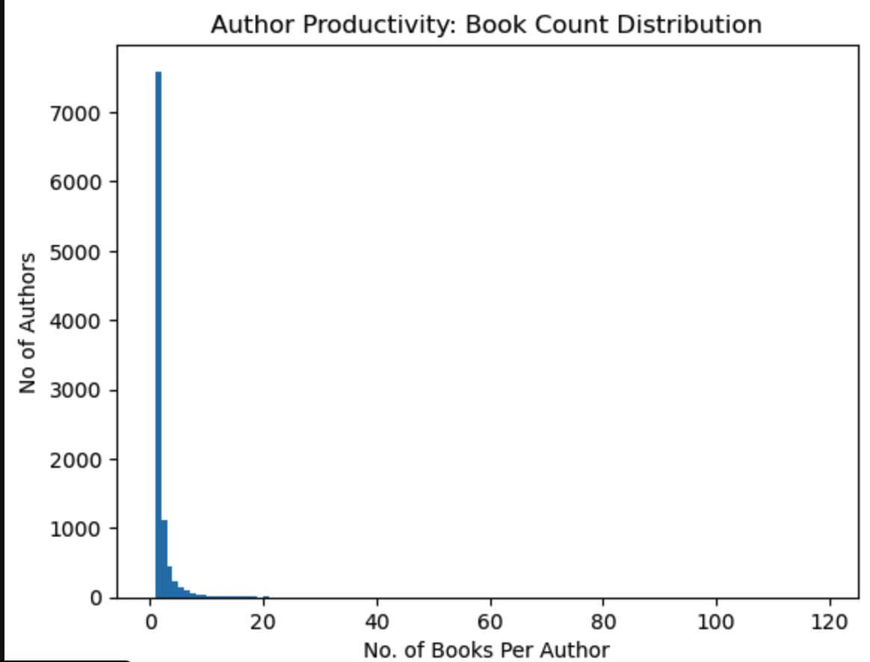

Slide 14
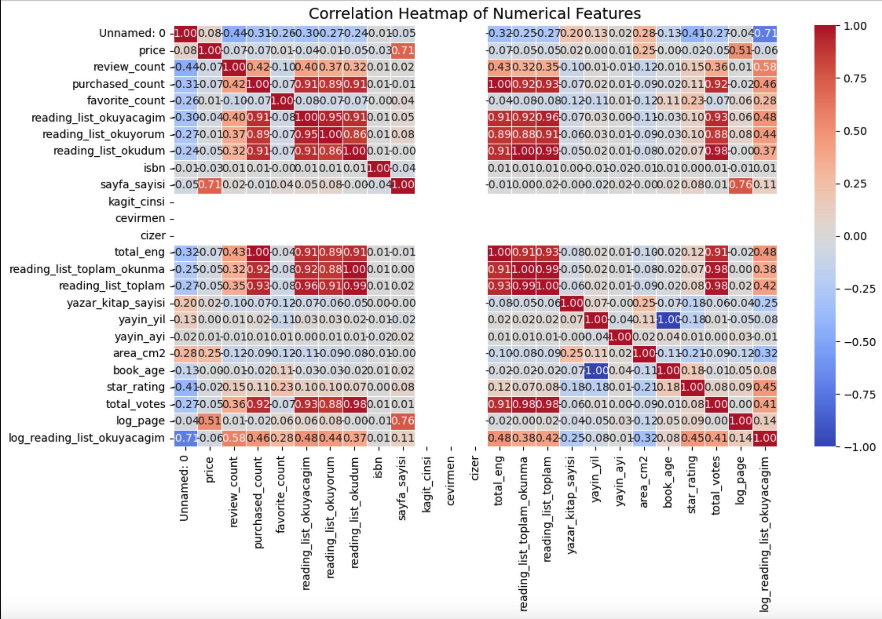

Slide 15
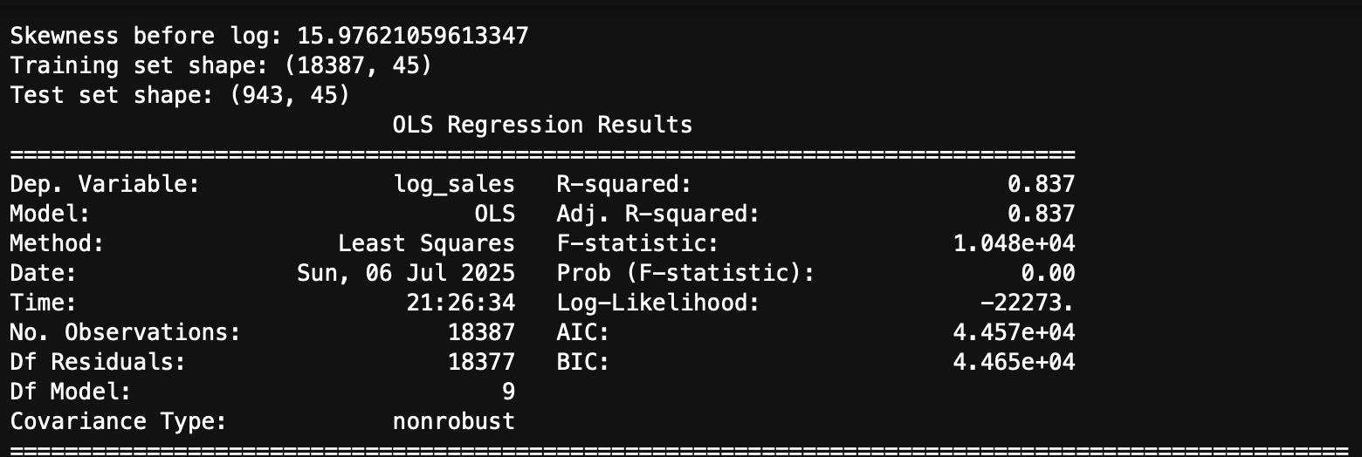
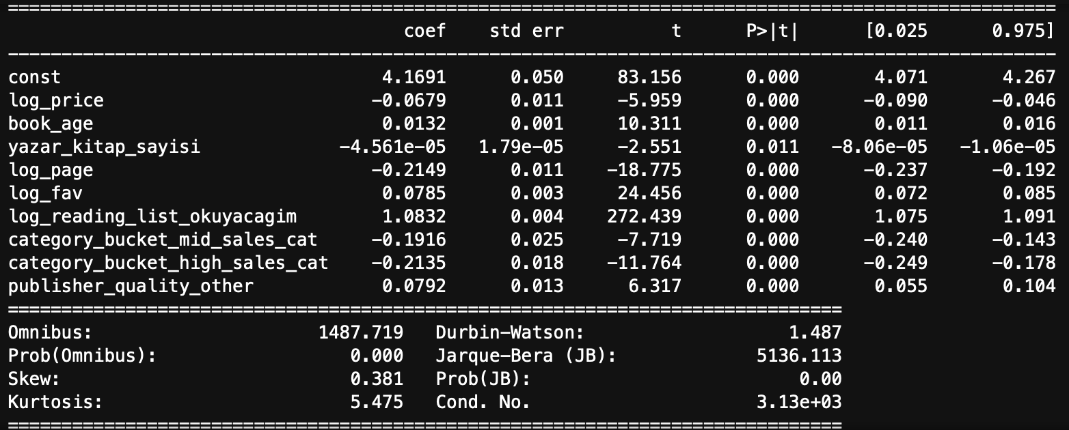
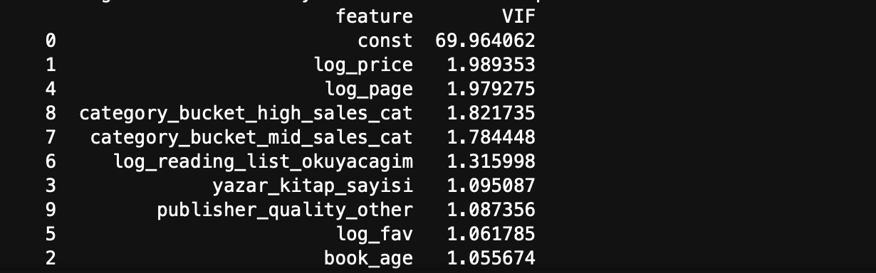

Slide 16
Feature Engineering
3. Feature Engineering
To improve model performance and reduce skewness, we transformed and created the following features:
Log Transformations:
log_price, log_sales, log_review, log_fav, log_page, log_reading_list_okuyacagim
→ Reduced right skewness and stabilized variance.
Binary Flags:
has_review, has_vote, has_star
→ Captures book visibility or rating presence.
Book Age:
Calculated as 2025 - publish_year
→ Reflects how long the book has been available on the market.

Slide 17
Category Bucketing & Encoding
4. Categorical Bucketing & Encoding
To simplify high-cardinality categorical features and mitigate multicollinearity:
Category Reduction:
Merged ~30 book categories into 3 buckets based on total sales:
low_sales_cat, mid_sales_cat, high_sales_cat
Assigned via quantile-based binning of total sales per category.
Publisher Quality:
Reduced publisher feature into:
high_quality: Top 50 most frequent publishers
other: All remaining publishers
One-Hot Encoding:
Applied to reduced categorical features using pd.get_dummies(..., drop_first=True)
Avoids dummy variable trap and keeps model interpretable

Slide 18
Train-Test Split
Objective: Predict 2025 book sales based on past data.
Train Set: Books published before 2025
Test Set: Books published in 2025
Split Sizes:
Train shape: (18,387 rows, 45 columns)
Test shape: (943 rows, 45 columns)
This temporal split ensures a realistic forward-looking prediction and avoids data leakage.

Slide 19
6. Model Building: Linear Regression (OLS)
Model: Ordinary Least Squares (StatsModels)
Target: log_sales
Features Used:
6 numerical features (e.g. log_price, book_age)
3 encoded categorical features
R² Score: 0.837
→ Model explains 83.7% of the variance in log-transformed sales on the train set.
Adjusted R²: 0.837
→ Suggests good generalization without overfitting.
✅ Model shows strong performance, even with simple linear assumptions.

Slide 20
7. Multicollinearity Check (VIF)
All VIF values < 2, except intercept (const)
No major multicollinearity among predictors
Ensures stable, interpretable coefficients.

Slide 21
Coefficient Interpretation
Feature | Coefficient | Interpretation
log_price | -0.068 | Higher price is associated with lower sales, holding other factors constant.
book_age | +0.013 | Older books tend to sell slightly more, possibly due to sustained visibility.
yazar_kitap_sayisi | -0.0000456 | A very small negative effect — possibly multicollinear or weakly relevant.
log_page | -0.215 | Longer books are negatively correlated with sales.
log_fav | +0.079 | Popularity (measured by favorites) correlates positively with sales.
log_reading_list_okuyacagim | +1.08 | Strong positive correlation — books in reading lists strongly predict sales.
category_bucket_mid_sales_cat | -0.191 | Compared to low-sales category, mid-tier categories sell less in 2025.
category_bucket_high_sales_cat | -0.214 | Surprisingly, even high-sales categories from past years perform worse.
publisher_quality_other | +0.079 | Non-top publishers do slightly better in 2025 — perhaps due to niche appeal.

Slide 22
Model Evaluation on Test Set
Metrics on Log-Transformed Target:
RMSE (log): 0.9719
MAE (log): 0.7505
R² (log): 0.8607
Metrics on Original Scale:
RMSE: 1763.98
MAE: 461.82
R²: 0.7953
The model generalizes well to unseen 2025 data.
Strong performance in both log scale and actual sales.
No overfitting observed — train/test R² are similar.

Slide 23
Summary ,Final Comments & Next Steps
Summary:
Successfully predicted 2025 book sales using 2024 data.
Feature engineering and log transformations helped reduce skew and improve accuracy.
Key drivers: reading list presence, category type, page count, and book age.
Next Steps:
Investigate time-based models or seasonality trends.
Test ensemble models (e.g., Random Forest, XGBoost) for further improvement.
Explore external features: social media mentions, promotions, etc.

