Slide 1

Exploring the Data: An EDA of Subway Usage in New York City For WTWY Gala
Prepared by: Goksu Gorkem Ayhan
08-May-2025

Slide 2
Introduction
Problem
For the upcoming WTWY gala, the goal is to get as many people as possible involved—especially those passionate about supporting women in tech.
To help with that, we want to figure out the best subway stations in NYC where our street teams should go to talk to people and spread the word.
Basically, the challenge is choosing the most strategic spots based on where the foot traffic is high and where the right crowd is likely to be.
Objective
We’re trying to find the best subway stations, days, and times to place the WTWY street teams.
The idea is to focus on high-traffic stations with the kind of demographics that match the mission—so we can get more people to sign up and show up at the gala.

Slide 3
Methodology
Used data sources and a brief overview of the dataset.
Data source: MTA Subway Hourly Ridership: 2020-2024
Dataset Timeline: January 1, 2022 to January 1, 2023
Original Dataset: It had over 7.3 million rows and 12 columns, with info like ridership, timestamps, station names, and geographic coordinates. I had to manually download and combine two CSVs because the full dataset wasn’t available in one place—neither API call nor manually downloading works as it was quite huge dataset.
Data Tools
Working Env.: Jupyter Notebook, VS Code, Python version: 3.12.7
Data Analysis: Pandas version: 2.2.2, NumPy version: 1.26.4
Data Visualization: Matplotlib, Seaborn, Plotly
Data Cleaning & Preprocessing
After merging the files, I checked for duplicates and dropped anything unnecessary.
I also cleaned up the date/time columns and broke them into day, month, and hour so I could analyze patterns more easily.

Slide 4
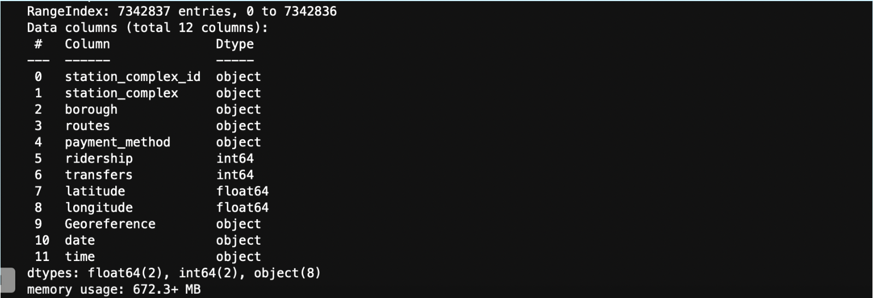
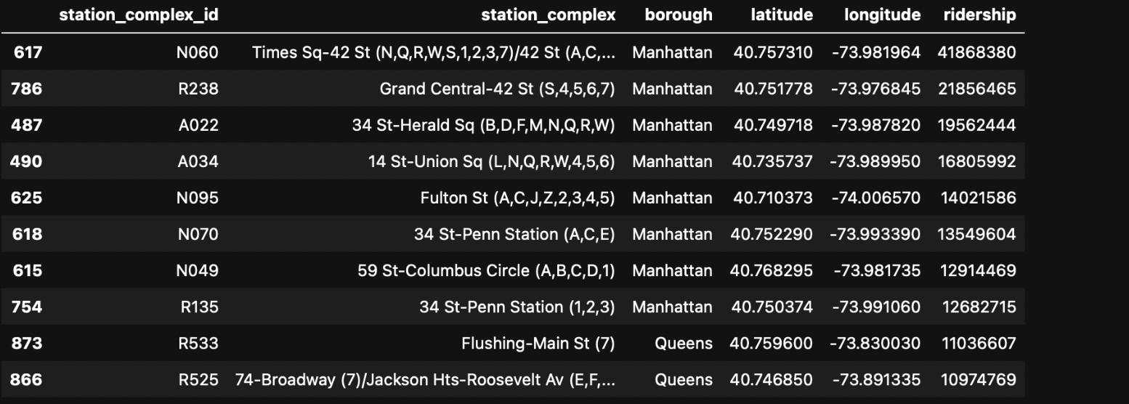
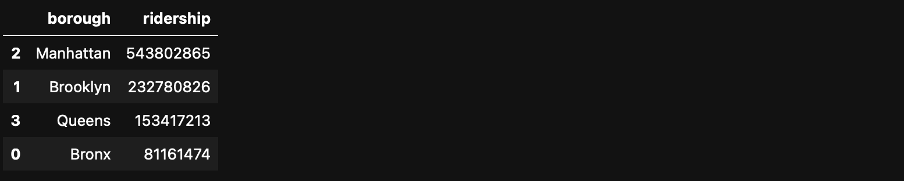
About the Data
Dataset Overview: Columns & Data Types
Top Stations by Total Ridership
Ridership By Borough

Slide 5
Subway Coverage and Total Ridership by Borough
Subway stations per borough
Bronx: 73
Brooklyn: 166
Manhattan: 144
Queens: 87
Total=470
Total Ridership: 1.01 billion rides

Slide 6
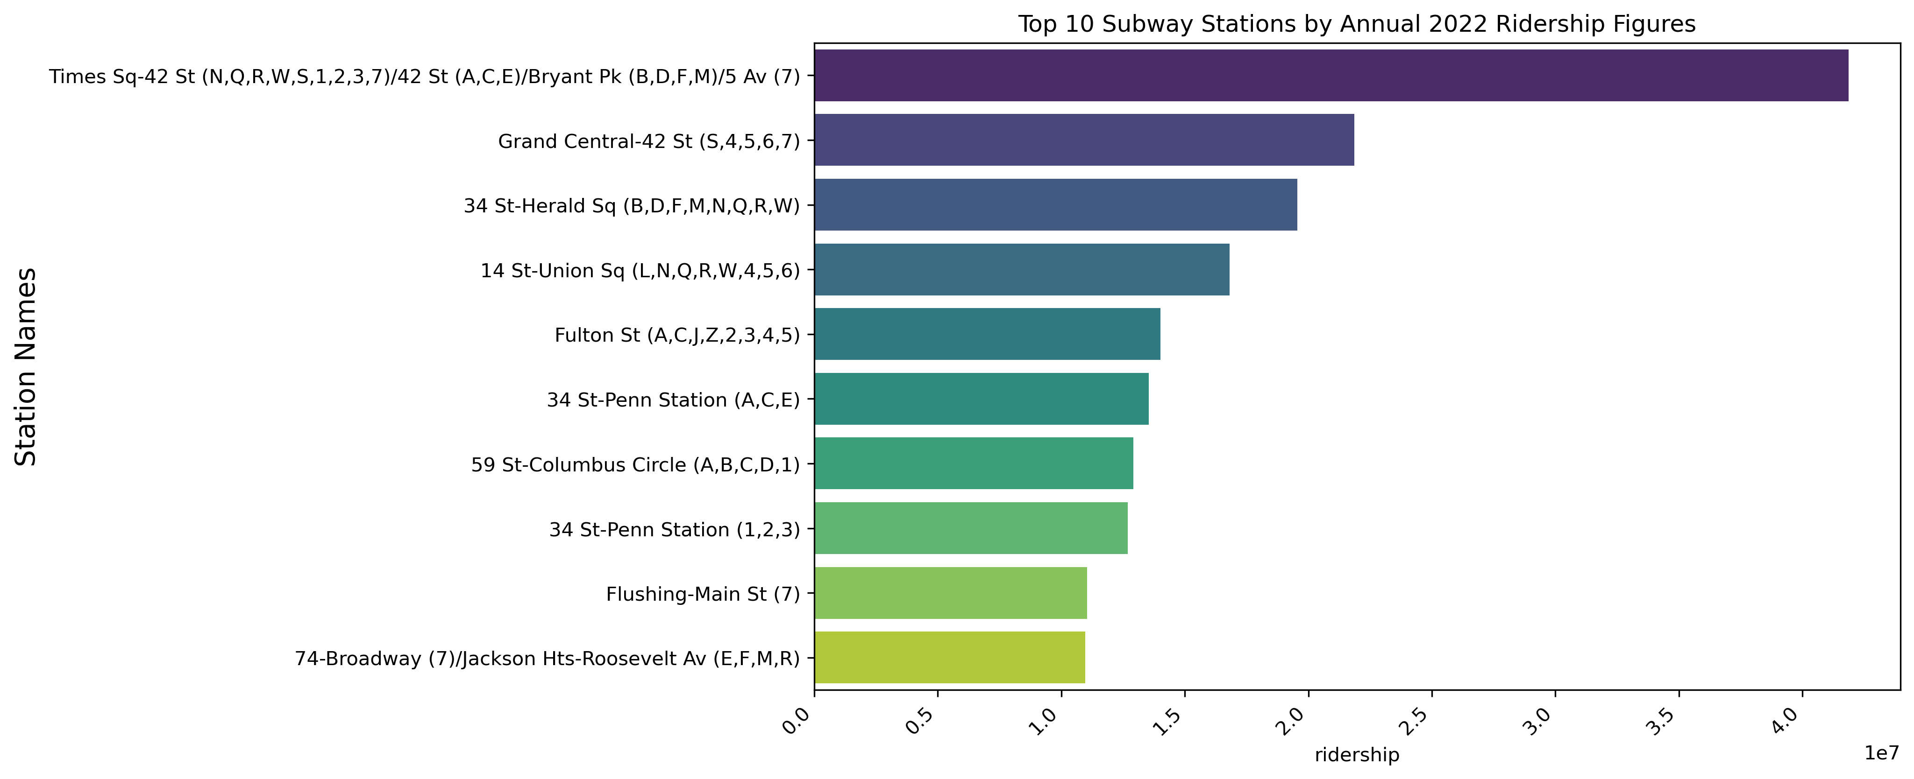

Slide 7
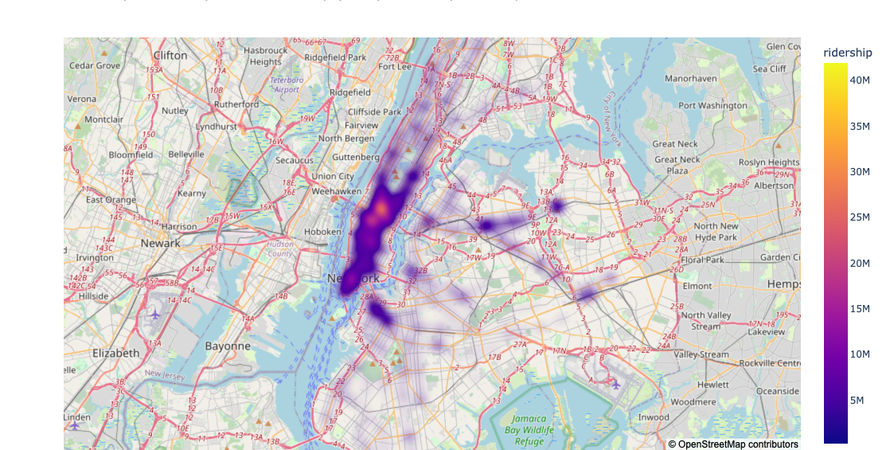

Slide 9
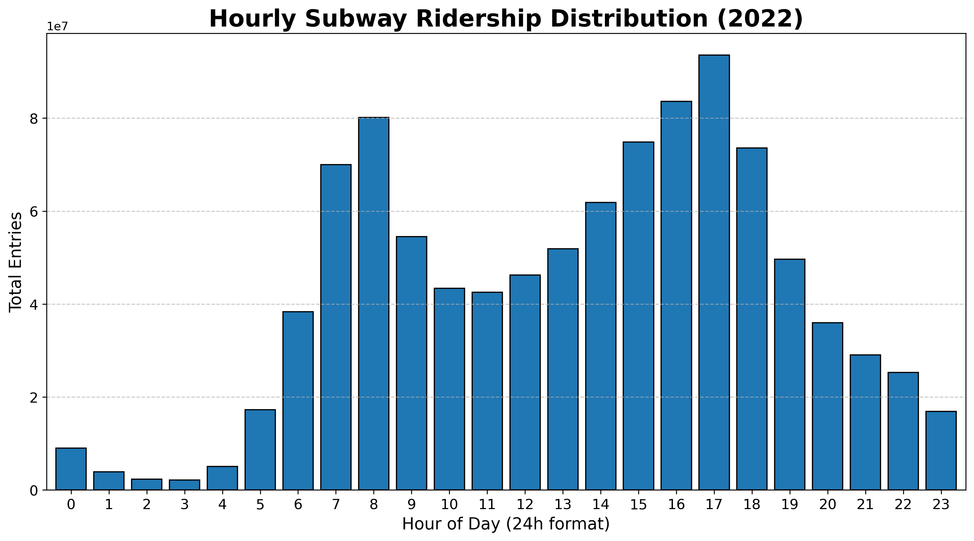
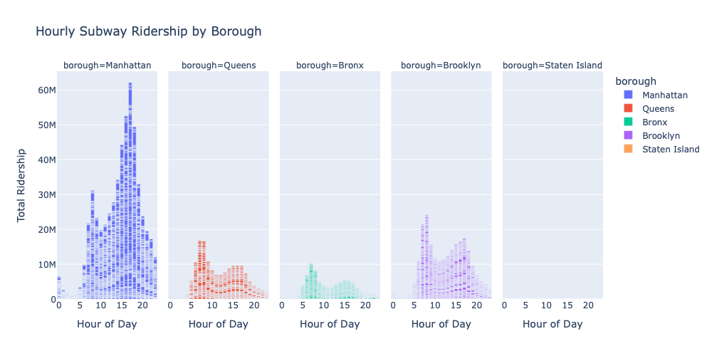

Slide 10
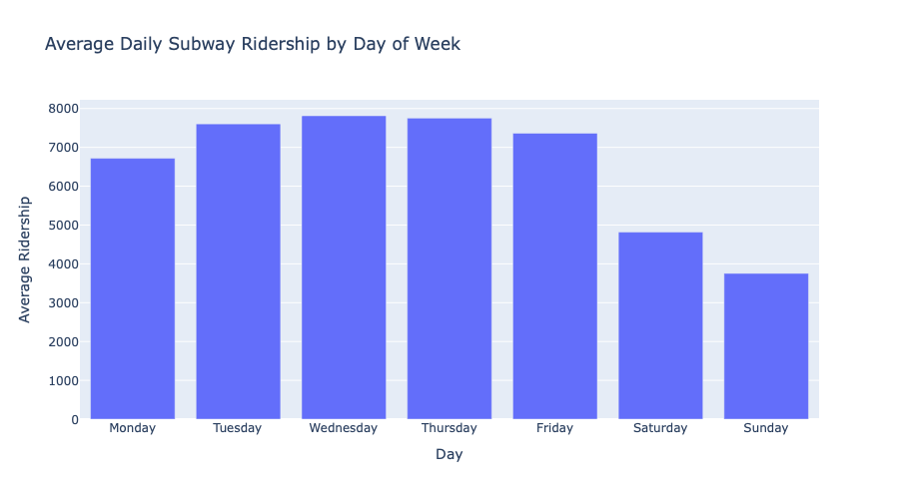
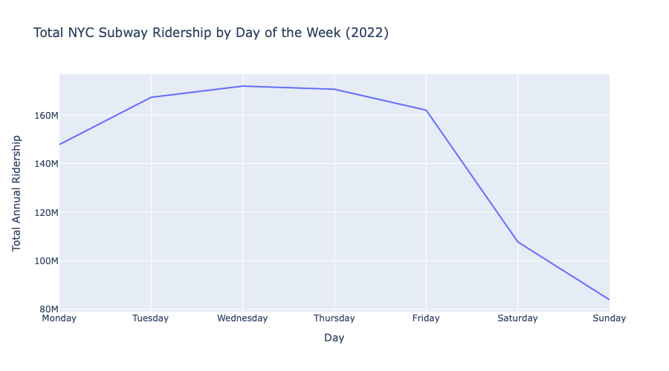
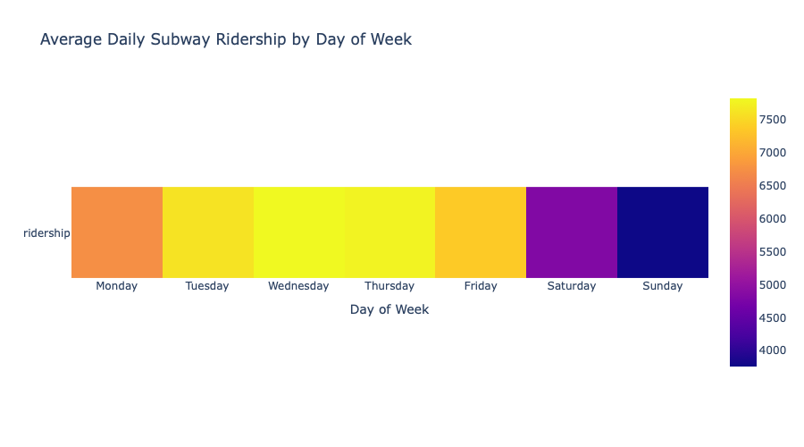

Slide 11
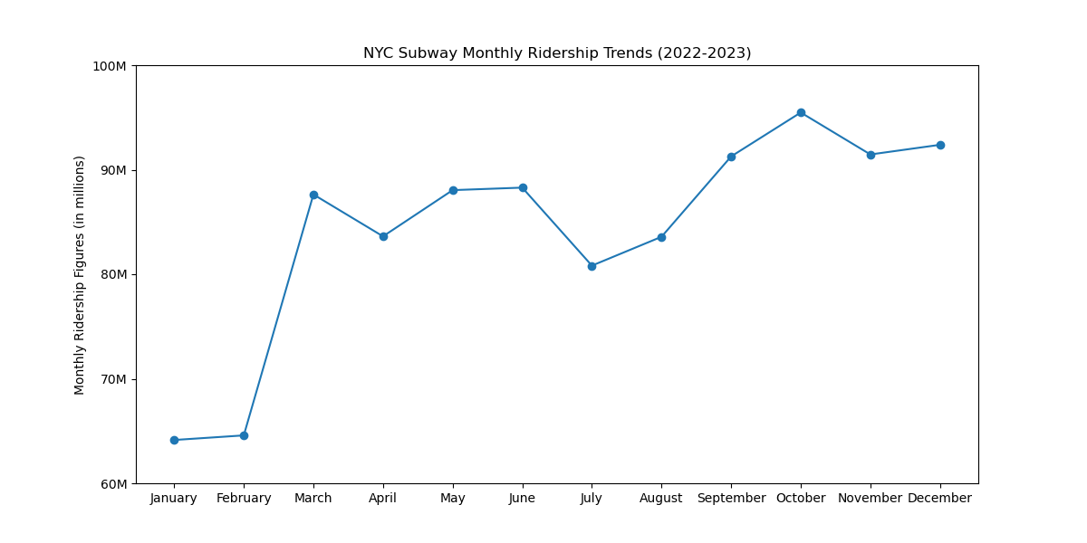
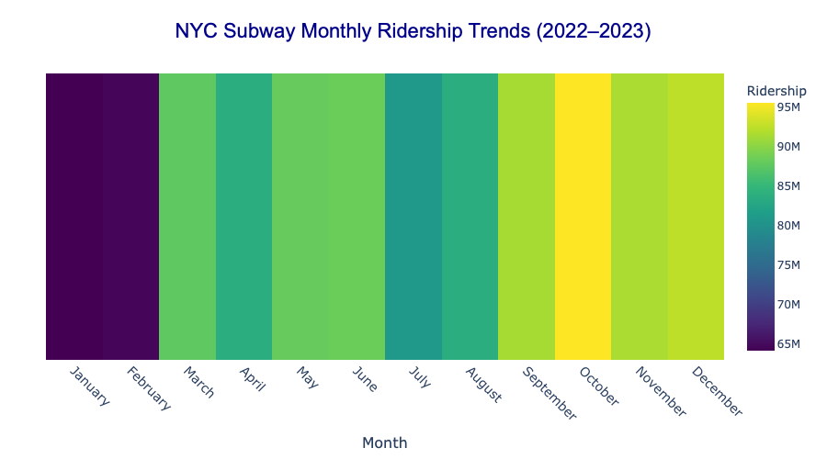

Slide 12
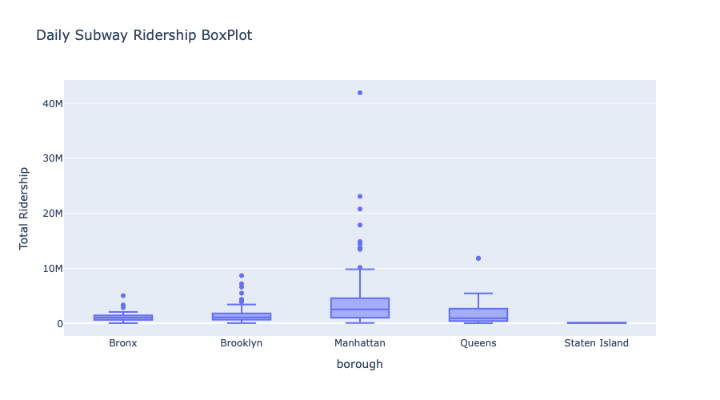
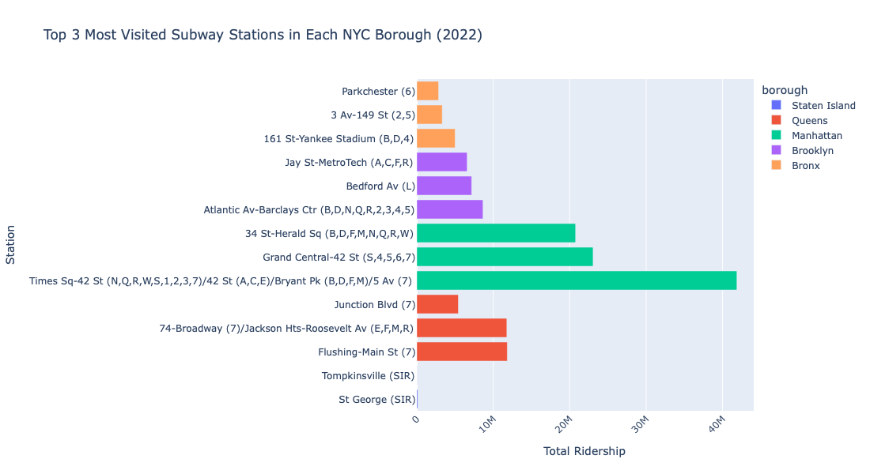
Manhattan max. outlier is Times Sq-42 St (N,Q,R,W,S,1,2,3,7)

Slide 13
Data Accuracy Check
Compared borough-level annual ridership figures with official MTA data (2022).
Accuracy rate: approximately 99.78%
Missing rate: approximately 0.22% (around 2.26 million rides)
Minor discrepancies observed:
Manhattan: underreported by about 2.8 million
Brooklyn, Queens, Bronx: slightly overreported
Total in the dataset: 1.01 billion rides
Official total: 1.013 billion rides
Given the dataset size (around 7 million rows), the margin of error is minimal.

Slide 14
Results
Best Locations for Outreach
Times Sq–42 St and Grand Central–42 St are consistently the busiest subway stations, with the highest annual ridership.
Recommendation: Deploy street teams at these locations for maximum foot traffic and visibility.
Best Days for Outreach
Thursday consistently showed the highest daily ridership, followed closely by Tuesday through Thursday.
Recommendation: Focus outreach efforts on Thursday, or during midweek (Tuesday–Thursday) for strong results.
Best Times of Day
Ridership peaks are visible in:
Morning rush hours (7–9 AM)
Evening rush hours (4–7 PM)
Recommendation: Schedule teams during these time windows to capture commuters.
Best Months for Outreach
Months like October and March showed noticeably higher ridership levels.
Recommendation: Organize major campaigns in high-ridership months like March, October, and November.
Borough-Level Reach
Manhattan accounts for over half of total ridership.
Recommendation: Concentrate efforts in Manhattan borough stations for highest reach.

