Slide 1


Social Engineering
Management, Relationships and Communication in Working Groups

Slide 2
Agenda
Definition
Elaboration
Strategies
Identification
Prevention
Conclusion
Notes:
2 – characteristics; why is it important; how it works; why it works

Slide 3
Definition
Social Engineering - the use of deception to manipulate individuals into divulging confidential or personal information that may be used for fraudulent purposes.
- oxforddictionaries.com

Slide 4
Elaboration
What it actually means

Slide 5
Characteristics
Definition
Elaboration
Strategies
Identification
Prevention
Conclusion
Manipulates human psyche
Exploits common human tendencies
A type of Confidence trick (Con, Scam)
The most common way to break security

Slide 6

Why is it important
Definition
Elaboration
Strategies
Identification
Prevention
Conclusion
A chain is only as strong as its weakest link
Proverb

Slide 7
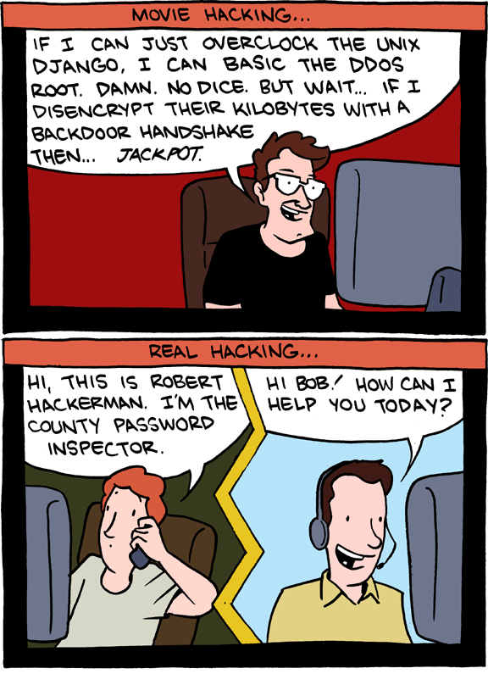
Why is it important
Definition
Elaboration
Strategies
Identification
Prevention
Conclusion
Humans are the weakest link in security
Kevin Mitnick

Slide 8
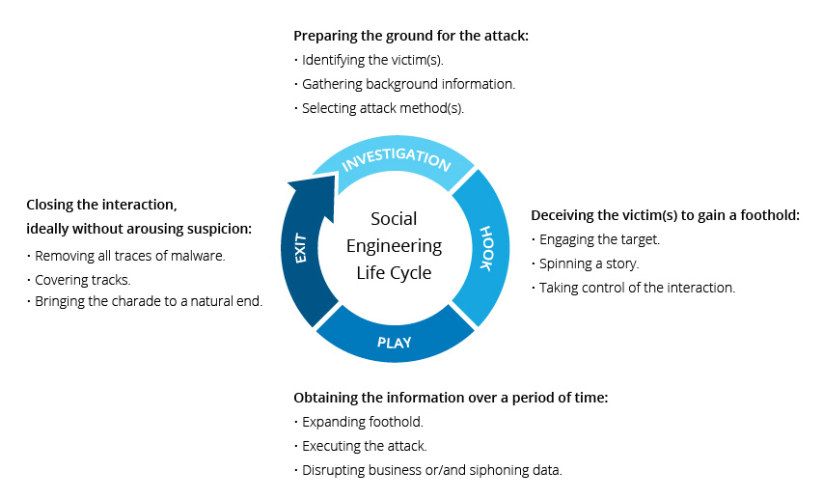
Life Cycle
Definition
Elaboration
Strategies
Identification
Prevention
Conclusion

Slide 9
Why it Works
Definition
Elaboration
Strategies
Identification
Prevention
Conclusion
Six Principles:
Authority
Social Validation
Reciprocation
Consistency/Commitment
Scarcity
Liking

Slide 10
Strategies
General approaches and Common types
of social engineering attacks

Slide 11
Common Strategies
Definition
Elaboration
Strategies
Identification
Prevention
Conclusion
Posing as someone else
Authority, Coworker, Partner Company
Using insider lingo & terminology
Pretending to offer software patch
Sending free software
Offering prizes for registering
Etc.

Slide 12
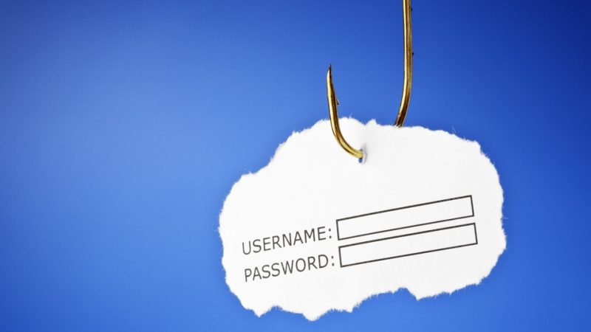
Common Attack Types
Definition
Elaboration
Strategies
Identification
Prevention
Conclusion
Phishing

Slide 13

Common Attack Types
Definition
Elaboration
Strategies
Identification
Prevention
Conclusion
Phishing
Pretexting

Slide 14

Common Attack Types
Definition
Elaboration
Strategies
Identification
Prevention
Conclusion
Phishing
Pretexting
Baiting and Quid Pro Quo

Slide 15

Common Attack Types
Definition
Elaboration
Strategies
Identification
Prevention
Conclusion
Phishing
Pretexting
Baiting and Quid Pro Quo
Tailgating

Slide 16
Identification
How to see if Social Engineering is used

Slide 17
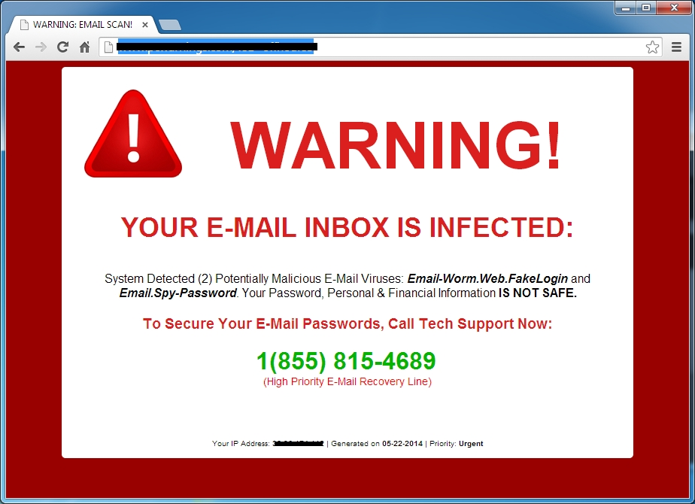
Warning Signs
Definition
Elaboration
Strategies
Identification
Prevention
Conclusion
Unusual request
Refusal to give callback number
Claim of authority
Stress on urgency

Slide 18

Warning Signs
Definition
Elaboration
Strategies
Identification
Prevention
Conclusion
Threat of negative consequences
Discomfort when questioned or challenged
Name dropping
Compliments or flattery
Flirting

Slide 19
Prevention
How to avoid Social Engineering

Slide 20
Generally
Definition
Elaboration
Strategies
Identification
Prevention
Conclusion
Pay attention to warning signs
Don’t open emails and attachments from suspicious sources
Use multifactor authentication
Be wary of tempting offers

Slide 21
More Specifically
Definition
Elaboration
Strategies
Identification
Prevention
Conclusion
Procedures for suspicious requests
Training of staff
Explain reason for procedures
Verify the identity of a caller/visitor
Train staff to challenge authority

Slide 22
Conclusion
Summing it up

Slide 23
Recap
Definition
Elaboration
Strategies
Identification
Prevention
Conclusion
Many non-technical ways to gain access to information
Humans - relatively easy to exploit
Very often - most successful attacks
Training – only viable solution

Slide 24

Just as a warning…
Definition
Elaboration
Strategies
Identification
Prevention
Conclusion

Slide 25
Thank you
Any questions?

Slide 26
References
https://www.incapsula.com/web-application-security/social-engineering-attack.html
http://www.inf.unibz.it/dis/teaching/INFSEC1718/slides/chapter11.pdf
https://resources.infosecinstitute.com/common-social-engineering-attacks/
https://en.wikipedia.org/wiki/Social_engineering_(security)
https://www.tripwire.com/state-of-security/security-awareness/6-common-phishing-attacks-and-how-to-protect-against-them

