Slide 1

AI- ENABLED LOGISTICS OPTIMIZATION AND COURIER TRACKING SYSTEM
COURIER TRACKING SYSTEM
REVIEW 4 — FINAL IMPLEMENTATION & EVALUATION
A final-review presentation aligned to the five 10-mark evaluation components.
Accuracy of Results
Technical Competence
F
Innovative & Sustainable Features
Utility to Society
Presentation Skills
Final review • implementation • validation • demonstration

Slide 2
1. Project Overview
Problem → proposed system → end-to-end workflow
Problem
Manual logistics operations can create delays, weak visibility and coordination gaps.
Proposed Solution
A centralized platform for customers, packages, warehouses, drivers, vehicles and shipments.
Core Workflow
BOOK → REGISTER → PICK UP → PROCESS → TRANSIT → DELIVER → CONFIRM
Final-review focus
Show the system as one connected workflow rather than separate modules.
Review 4 • Smart Logistics & Courier Tracking System
2

Slide 3
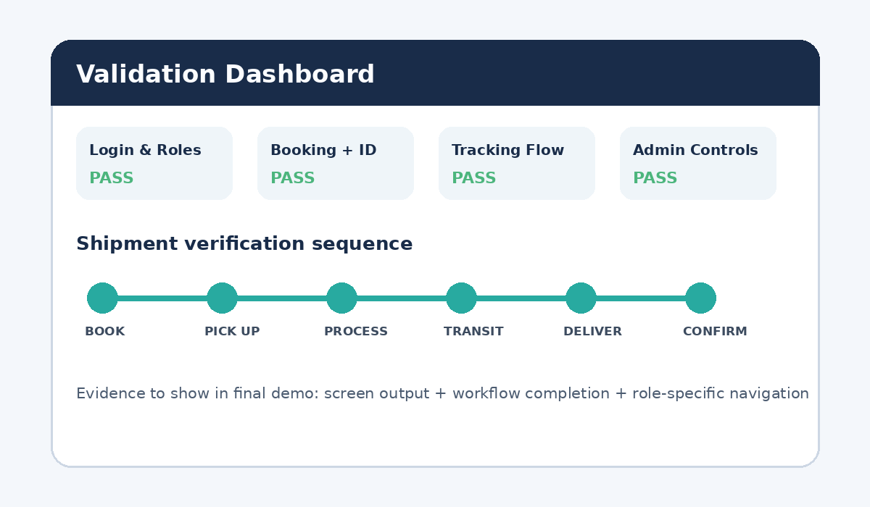
2. Accuracy of Results (10)
Validation evidence to present during the final review
Login & Roles
Customer/Admin entry and role-aware navigation.
Booking & Tracking ID
Create shipment and generate a tracking identity.
Tracking & Status
Show status timeline, shipment history and location.
Admin Verification
Show monitoring, exceptions, capacity and operational actions.
Accuracy message: demonstrate input → processing → visible output for each major function.
Review 4 • Smart Logistics & Courier Tracking System
3

Slide 4
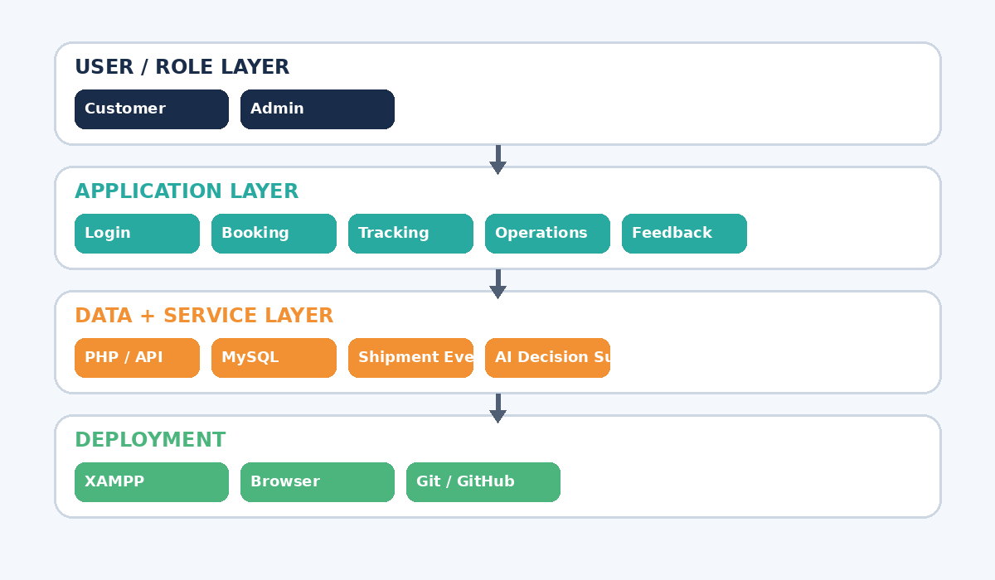
3. Technical Competence (10)
Implementation stack, modular architecture and role-based operation
Frontend
HTML • CSS • JavaScript
Backend / API
PHP-based integration for application workflows
Database
MySQL with modular entities for users, shipments, events and operations
Development / Deployment
XAMPP • VS Code • Git/GitHub
Review 4 • Smart Logistics & Courier Tracking System
4

Slide 5
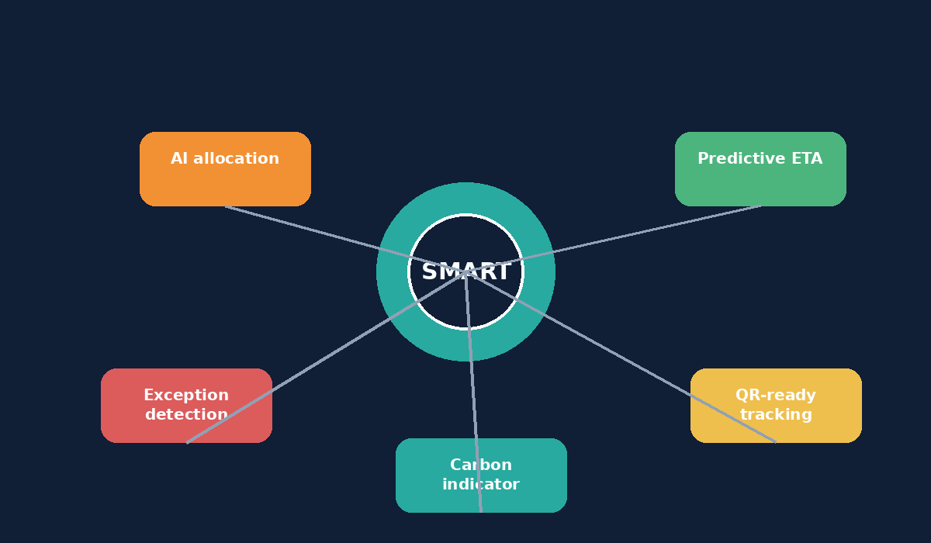
4. Innovative & Sustainable Features (10)
Features that extend basic courier tracking
AI-assisted allocation
Matches priority, load, location and availability.
Predictive ETA support
Prototype delivery-time estimate for decision support.
Exception detection
Flags delayed or anomalous operational cases.
QR-ready identity
Tracking payload foundation for QR-based lookup.
Sustainability insight
Carbon-related indicator for greener decisions.
Review 4 • Smart Logistics & Courier Tracking System
5

Slide 6
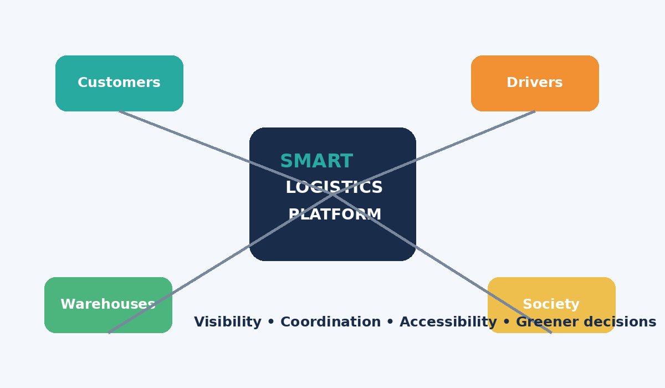
5. Utility to Society (10)
How the system improves visibility, coordination and accessible logistics
Customer value
Booking, tracking, history and clearer delivery visibility.
Operational value
Warehouse, driver/vehicle allocation, monitoring and reports.
Community value
Better coordination and shipment transparency support dependable service.
Sustainability value
Carbon-related indicators support greener logistics decisions.
Review 4 • Smart Logistics & Courier Tracking System
6

Slide 7
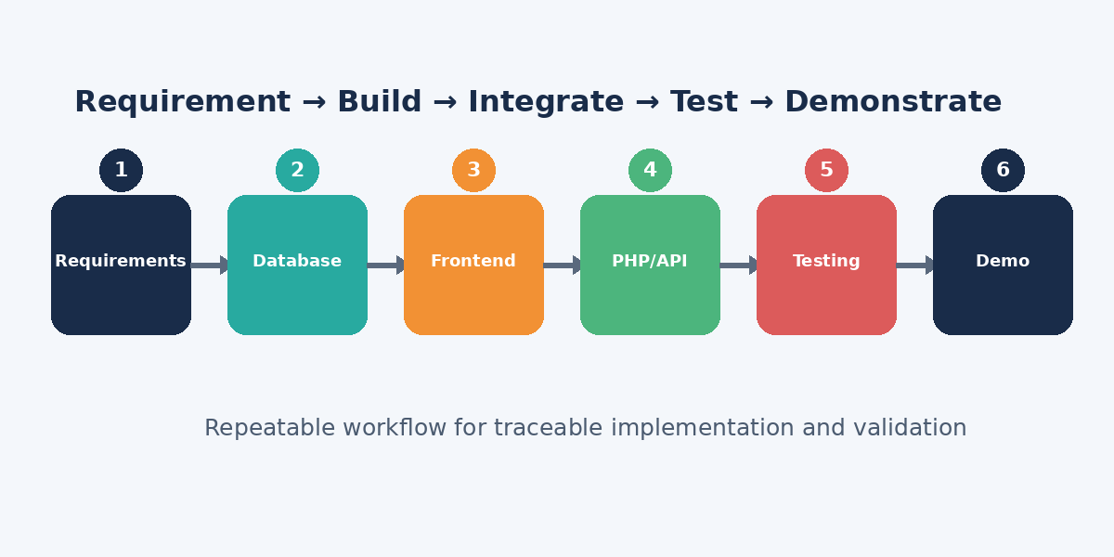
6. Methodology & Validation
Requirement analysis → database → frontend → PHP/API → testing → demonstration
Validation principle
For every module, show the input, implemented behavior, output and test evidence.
Review 4 • Smart Logistics & Courier Tracking System
7

Slide 8
7. Final System Implementation
Functional components included in the upgraded website
Login & Roles
Courier Booking
Tracking
Admin / Customer entry and role-aware navigation
Shipment creation and tracking ID generation
Status timeline and shipment history
Operations
Admin Dashboard
Feedback & Returns
Warehouse, inventory, driver / vehicle allocation
Monitoring, reports, analytics and actions
Ratings, feedback and reverse logistics
Final-review tip: open the live system and connect each screen to one rubric component.
Review 4 • Smart Logistics & Courier Tracking System
8

Slide 9
8. Location Visibility & User Experience
Traceability plus clear status communication
ORIGIN
→
WAREHOUSE
→
TRANSIT
→
DESTINATION
Pickup location
Processing
In motion
Delivery
UX / Animation
Responsive & Accessible UI
Animated dashboard cards, progress indicators, smooth navigation and status timeline.
Readable labels, contrast, responsive layouts and keyboard-friendly controls.
Future Location Upgrade
Operational Benefit
Browser/device geolocation or mapping API can support live driver position and route visualization.
Location information can support ETA prediction, exception detection and route optimization.
Review 4 • Smart Logistics & Courier Tracking System
9

Slide 10
9. Dissemination, Accessibility & Sustainability
How the project can be demonstrated, documented and extended
Live Demonstration
Documentation
Academic Dissemination
Run on XAMPP and demonstrate login, booking, tracking, operations and admin flows.
README, database schema, workflow, module descriptions and setup instructions.
Screenshots, architecture/workflow diagrams, test results and review material.
Accessibility
Transparency
Future Sharing
Simple navigation, consistent labels, responsive layout and readable status indicators.
Explain AI decision-support rules rather than presenting them as unexplained predictions.
GitHub repository, hosted demo, user manual and walkthrough video.
Sustainability direction: carbon tracking + smarter allocation + future route optimization.
Review 4 • Smart Logistics & Courier Tracking System
10

Slide 11
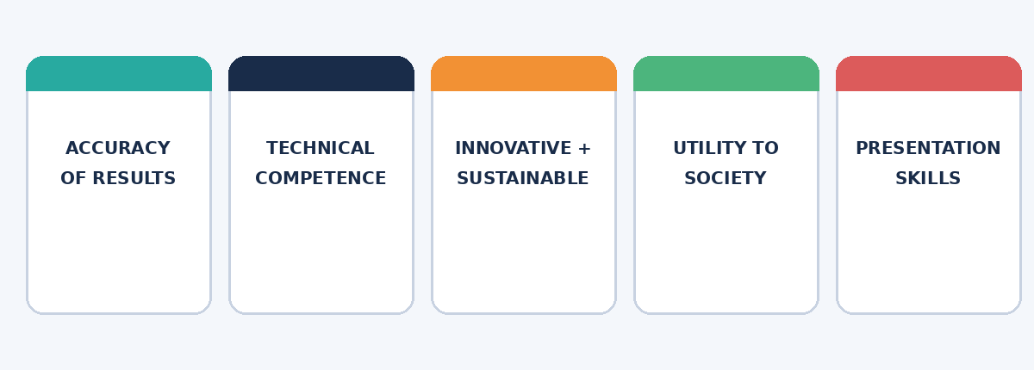
10. Review 4 Rubric Mapping
Direct evidence for the five 10-mark components shown in your Review 3 rubric
Accuracy of Results
Functional workflow + visible outputs + validation evidence
Technical Competence
Architecture + technology stack + modular database + role-based flows
Innovative & Sustainable Features
AI allocation + ETA + exceptions + QR + carbon indicator
Utility to Society
Customer visibility + operational coordination + accessible service
Presentation Skills
Structured story + live demo + diagrams + clear outcomes
Review 4 • Smart Logistics & Courier Tracking System
11

Slide 12
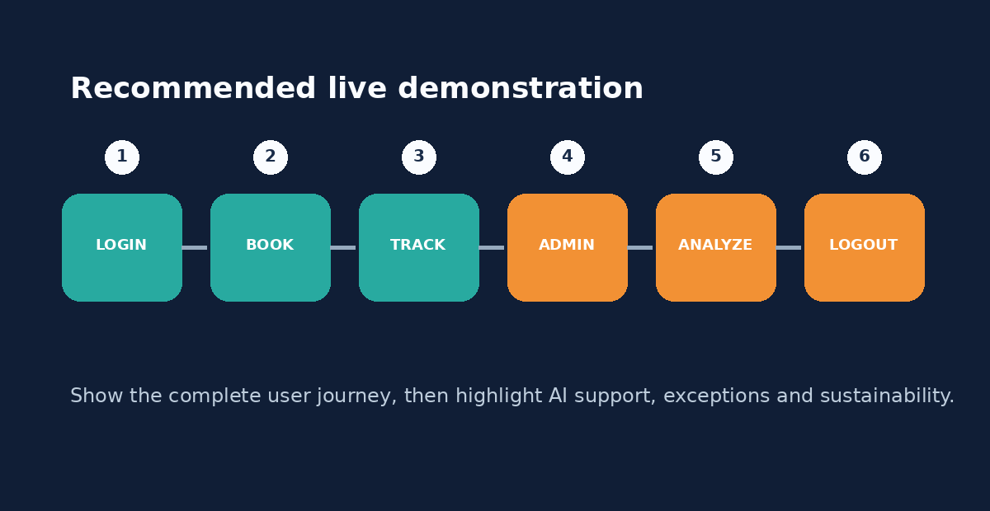
11. Final Live Demonstration Sequence
End the review with a complete, connected story
Key closing message
A modular logistics platform that combines traceable workflows, technical implementation, intelligent decision support and sustainability-oriented extensions.
Review 4 • Smart Logistics & Courier Tracking System
12

