Slide 1
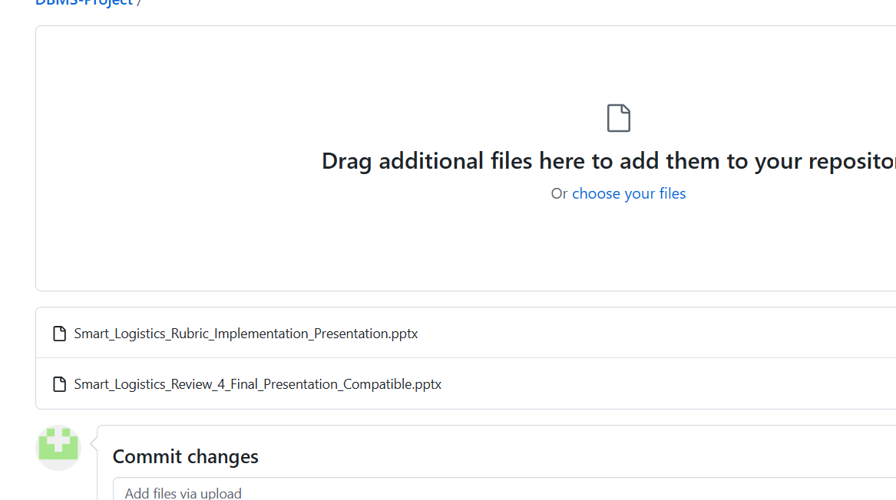
AI –ENABLE LOGISTICS OPTIMIZATION AND COURIER
TRACKING SYSTEM
Implementation aligned to the five evaluation components
NOVELTY
ADAPTABILITY
METHODOLOGY
DISSEMINATION
PRESENTATION
Smart Logistics & Courier Tracking System | 1

Slide 2
1. Project Overview
From courier booking to delivery confirmation
Problem
Proposed System
Technology
Manual logistics operations can cause delays, weak visibility and coordination gaps.
Centralized platform for customers, packages, warehouses, drivers, vehicles and shipments.
HTML • CSS • JavaScript • PHP • MySQL • XAMPP • VS Code • Git/GitHub
• BOOK → REGISTER → PICK UP → PROCESS → TRANSIT → DELIVER → CONFIRM
• Dashboard shows shipment counts, progress bars and operational indicators.
• AI decision-support demonstrates allocation, ETA, exception detection and sustainability.
Smart Logistics & Courier Tracking System | 2

Slide 3
2. Novelty of Developed Methodology
Implementation features that extend basic courier tracking
AI-assisted allocation
Predictive ETA support
Exception detection
Matches priority, load, location and availability.
Prototype delivery-time estimate for decision support.
Flags delayed or anomalous operational cases.
Location-aware tracking
QR-ready identity
Sustainability insight
Origin, destination and event-location visibility.
Tracking payload foundation for QR-based lookup.
Carbon-related indicator for greener decisions.
Smart Logistics & Courier Tracking System | 3

Slide 4
3. Adaptability of Methodology
Modular design supports future logistics extensions
Customer
Operations
Warehouse
Delivery
Admin
• Modular database: users, shipments, events, warehouses, drivers, vehicles, returns and feedback.
• Role-based navigation separates customer and administrator workflows.
• Future scope: smart routing, advanced ETA prediction, capacity alerts, reverse logistics, feedback and carbon tracking.
• Local XAMPP deployment can later be adapted to hosted PHP/MySQL infrastructure.
Smart Logistics & Courier Tracking System | 4

Slide 5
4. Methodology Evaluation
Development and validation workflow
1. Requirement analysis
2. Database design
3. Frontend development
Defined inputs, implemented module, tested workflow.
Defined inputs, implemented module, tested workflow.
Defined inputs, implemented module, tested workflow.
4. PHP/API integration
5. Testing & validation
6. Demonstration & reporting
Defined inputs, implemented module, tested workflow.
Defined inputs, implemented module, tested workflow.
Defined inputs, implemented module, tested workflow.
Smart Logistics & Courier Tracking System | 5

Slide 6
5. System Implementation
Functional components in the upgraded website
Login & Roles
Courier Booking
Admin / Customer entry and role-aware navigation
Shipment creation and tracking ID generation
Tracking
Operations
Status timeline and shipment history
Warehouse, inventory, driver/vehicle allocation
Admin Dashboard
Feedback & Returns
Monitoring, reports, analytics and actions
Ratings, feedback and reverse logistics
Smart Logistics & Courier Tracking System | 6

Slide 7
6. Login → Dashboard → Logout Navigation
Role-based user journey
LOGIN
CUSTOMER
ADMIN
LOGOUT
Choose Admin or Customer
Book • Track • History
Monitor • Allocate • Reports
End session → Login
Navigation principle
Only functions relevant to the active role are shown; logout ends the session and returns to login.
Smart Logistics & Courier Tracking System | 7

Slide 8
7. Location Tracing & Shipment Visibility
Location-aware features for customers and operations
• Shipment records store origin and destination for traceability.
• Tracking events store status, location and operational messages.
• Upgrade path: browser/device geolocation or mapping API for live driver position and route visualization.
• Location information can support ETA prediction, exception detection and route optimization.
ORIGIN
Pickup location
WAREHOUSE
Processing
TRANSIT
In motion
DESTINATION
Delivery
Smart Logistics & Courier Tracking System | 8

Slide 9
8. User Experience & Animation
Modern presentation layer for the upgraded website
Animated dashboard cards
Smooth section navigation
Counters and progress indicators
Login, Dashboard, Booking, Tracking and Admin views
Status timeline animation
Alert micro-interactions
Visual shipment progress
Capacity, delay and exception emphasis
Responsive design
Accessible UI
Desktop and smaller-screen layouts
Readable labels, contrast and keyboard-friendly controls
Smart Logistics & Courier Tracking System | 9

Slide 10
9. Dissemination & Accessibility
How the project can be demonstrated and shared
Live Demonstration
Documentation
Academic Dissemination
Run on XAMPP and demonstrate login, booking, tracking, operations and admin flows.
README, database schema, workflow, module descriptions and setup instructions.
Screenshots, architecture/workflow diagrams, test results and project review material.
• Accessibility: simple navigation, consistent labels, responsive layout and readable status indicators.
• Transparency: explain AI decision-support rules rather than presenting them as unexplained predictions.
• Future: GitHub repository, hosted demo, user manual and walkthrough video.
Smart Logistics & Courier Tracking System | 10

Slide 11
10. Evaluation Component → Implementation Mapping
Direct evidence for the five 10-mark components
Novelty
AI allocation, ETA support, exception detection, QR-ready tracking, sustainability
Adaptability
Modular roles, database entities and extensible future features
Methodology Evaluation
Requirement → DB → UI → API → testing → demonstration
Dissemination & Accessibility
README, documentation, responsive UI and clear navigation
Presentation Skills
Structured story, workflow, live demo and measurable outcomes
Smart Logistics & Courier Tracking System | 11

Slide 12
11. Recommended Live Demonstration Sequence
• Open Login → choose Customer → dashboard
• Create courier booking → generate tracking ID
• Track shipment → show status/location timeline
• Logout → Login as Admin
• Open Admin Dashboard → show bars, exceptions and warehouse capacity
• Run AI allocation / return / feedback / QR-ready tracking
• Explain future upgrades: live map, ML ETA, smart routing and capacity forecasting
BOOK
TRACK
OPERATE
ANALYZE
LOGOUT
Smart Logistics & Courier Tracking System | 12

