Slide 1
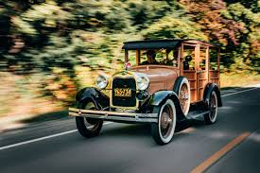
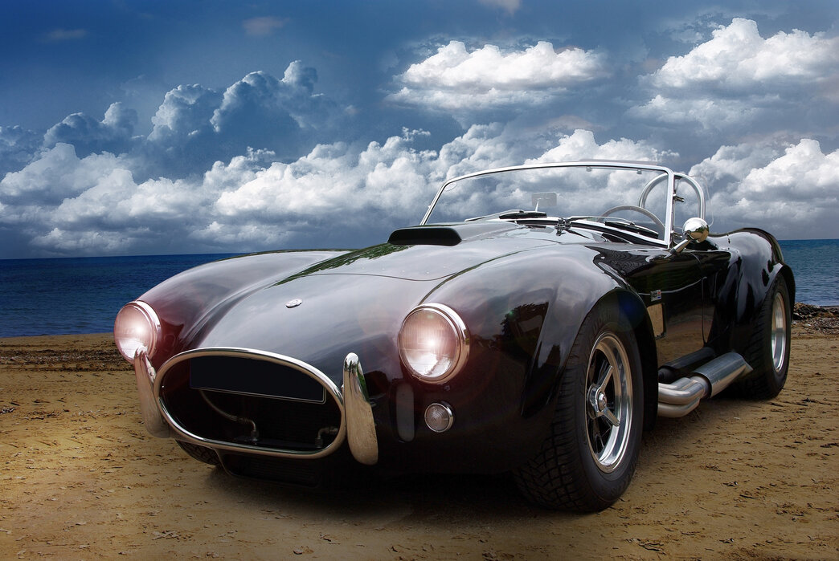
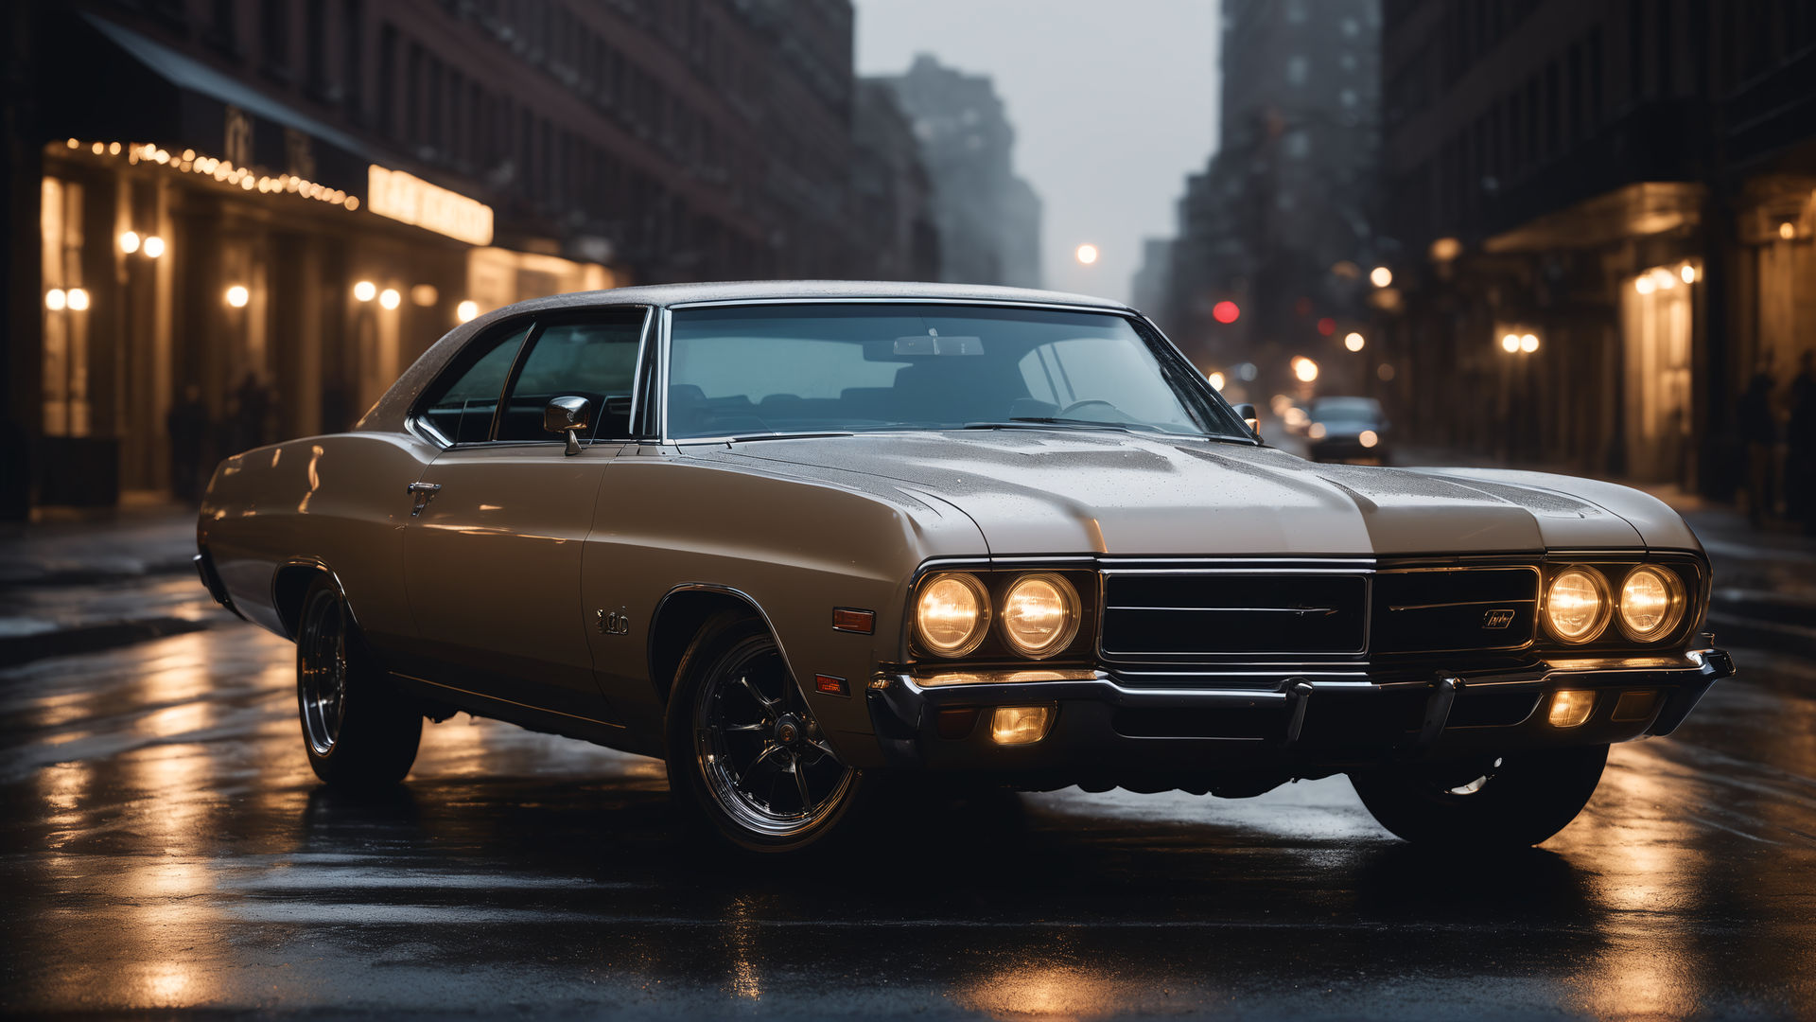
Robust Object Detection in Adverse Weather Conditions for Autonomous Vehicles

Slide 2
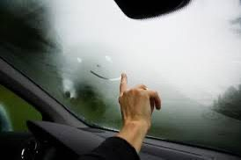
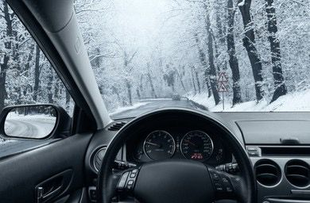
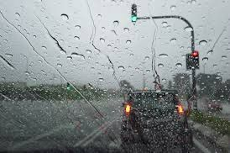
Team Members and Responsibilities
David Bettane (Data Analyst): Responsible for data preprocessing, analysis, and the creation of datasets for training the model. He also evaluates model performance using metrics like precision, recall, and mAP.
Gayatri Sanjay Gaikwad (Software Engineer): Focuses on the development and implementation of the object detection model, integrating various techniques like multi-sensor fusion, image enhancement, and dynamic retraining for better performance in adverse weather conditions.

Slide 3
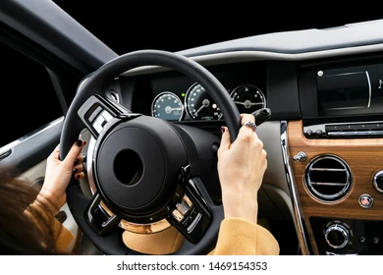
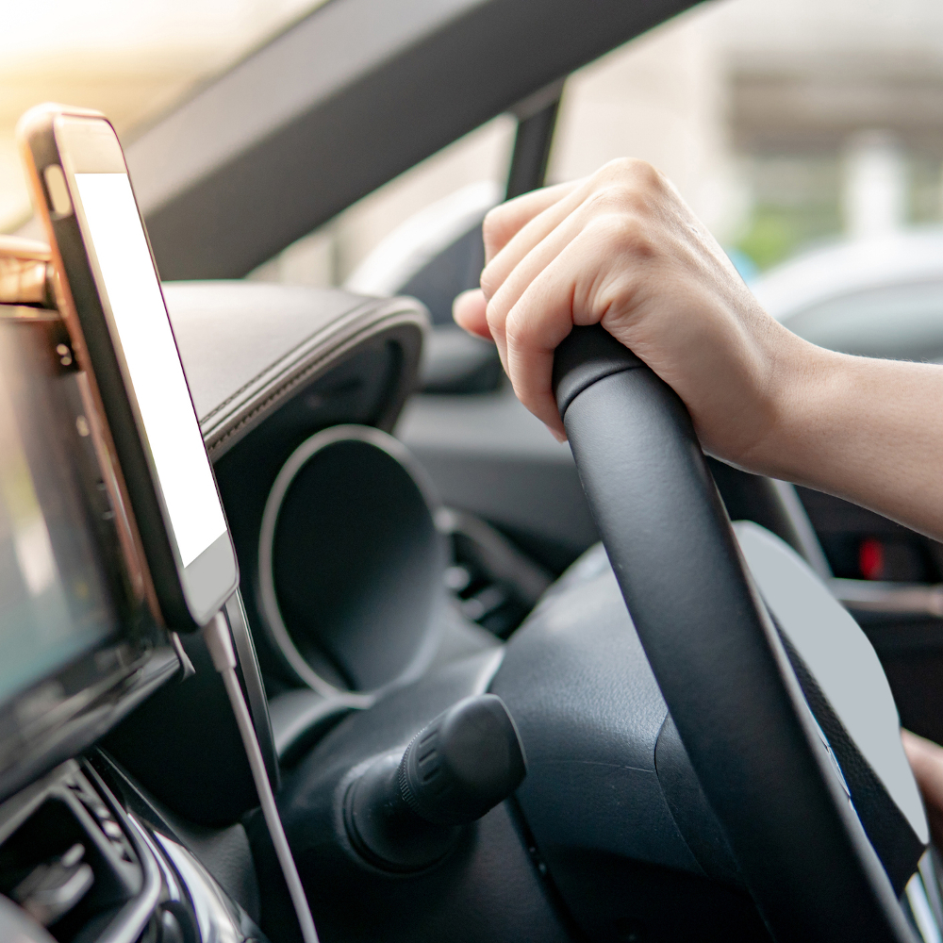
Problem Statement
Autonomous vehicles need to operate safely under various weather conditions.
Adverse weather (fog, rain, snow) reduces visibility and makes it difficult for object detection systems to work effectively.
The goal is to develop an object detection system that performs well in these challenging conditions, ensuring the safety of autonomous vehicles.

Slide 4
Background Material
Object detection is crucial for autonomous vehicles to identify pedestrians, other vehicles, and obstacles.
Weather can introduce visual noise, haze, rain, and snow, making detection harder.
Existing techniques like GANs and style-transfer networks improve accuracy but struggle with real-world variability in weather.
Image enhancement methods (de-noising, de-hazing) help improve visibility, but their impact on object detection isn’t always consistent.
There’s a need for a more robust solution that works across a range of weather conditions.

Slide 5
Dataset
The BDD100K dataset was used, which includes a variety of driving scenarios with detailed annotations (e.g., vehicles, pedestrians).
This dataset also covers different weather conditions, such as fog, rain, and snow.
It is augmented with synthetic weather effects to simulate challenging scenarios not covered in the real-world dataset.

Slide 6
Implementation Details
Software & Hardware :
Programming Language : python
Frameworks: PyTorch, OpenCV
Hardware : NVIDIA GPU

Slide 7
Proposed Solution
Our proposed solution addresses these challenges through:
Multi Sensor Fusion
Image Quality Enhancement
Dynamic Model Retraining

Slide 8
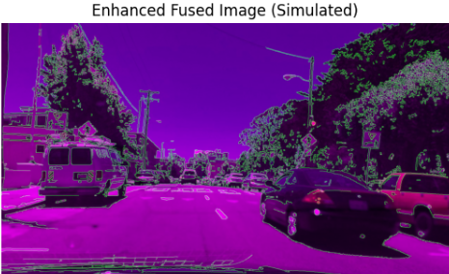
Proposed Solution
MULTI SENSOR FUSION
Combine data from different sensors (cameras, radar, LiDAR) to get a better understanding of the environment, especially when one sensor may fail under specific weather conditions.
Radar can detect objects in low visibility (e.g., fog), while LiDAR offers accurate distance measurements and cameras provide high-resolution images.
This fusion helps the model avoid over-reliance on any single sensor, improving performance in adverse weather conditions where individual sensors may fail.

Slide 9
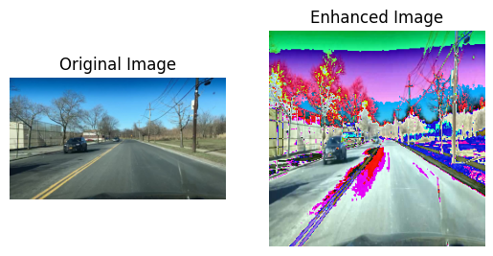
Proposed Solution
IMAGE QUALITY ENHANCEMENT:
Use neural networks to enhance images affected by adverse weather (e.g., de-hazing, de-raining, de-snowing) to improve detection accuracy.
These techniques enhance the overall quality of images, improving the input for object detection models and leading to more accurate results under challenging conditions.

Slide 10
Proposed Solution
DYNAMIC MODEL RETRAINING :
Continuously retrain the model with new weather data to adapt to evolving conditions and improve accuracy over time.
Incorporates new data in real-time, allowing the model to adjust and update without the need for manual intervention.
This method helps the system maintain its performance even as new weather conditions and environmental changes emerge.

Slide 11

Results
Evaluation metrics

Slide 12
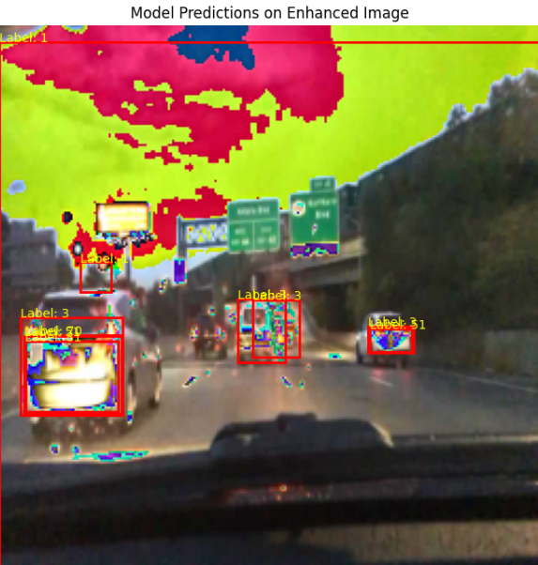
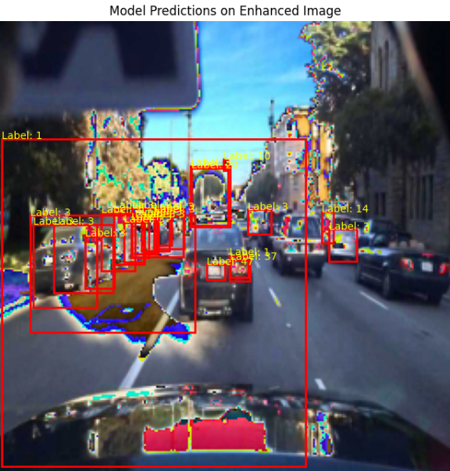
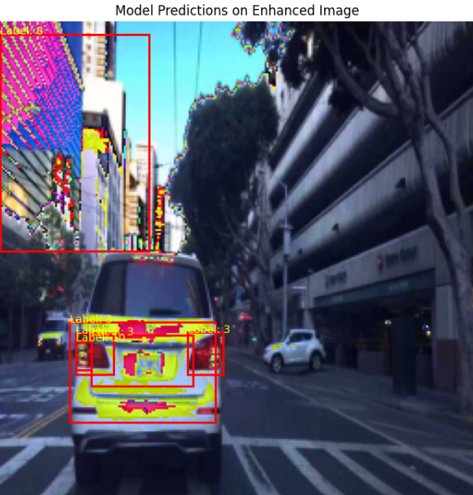
Results

Slide 13
Challenges
High computational cost for dynamic retraining.
Some GAN augmentations introduced artifacts that negatively impacted model performance.
De-noising techniques showed limited improvement for object detection.
By using PyTorch, it's important to ensure compatibility between data types, label ranges, and device placements, especially when working with CUDA (GPU) to avoid device-side errors. We had first many errors implying this so we finally had to get rid of it by moving both the model and data to the correct device (device = torch.device("cuda" if torch.cuda.is_available() else "cpu").

