Slide 1
hello!
My name is Galih Pratama Putra

Slide 2

VUE JS
The progressive JavaScript Framework

Slide 3

Another Framework?

Slide 4
What is VUE JS?
Vue (pronounced /vjuː/, like view) is a progressive framework for building user interfaces. Unlike other monolithic frameworks, Vue is designed from the ground up to be incrementally adoptable. The core library is focused on the view layer only, and is easy to pick up and integrate with other libraries or existing projects.

Slide 5
Things Vue.JS got right
Focus
Simplicity
Flexibility
Copying Competitors
Where Vue is lacking
Vue doesn’t yet have the support and widespread adoption of it’s fellow frameworks. There are far more resources for React, from NPM modules to Stack Overflow answers.
While Vue is being picked up by large organizations like Alibaba and Baidu, some more examples of high traffic websites would attest to Vue’s integrity at scale.
Maybe there’s such a thing as being too flexible.
Source: https://wiki.base22.com/display/btg/Vue+-The+Progressive+JavaScript+Framework

Slide 6
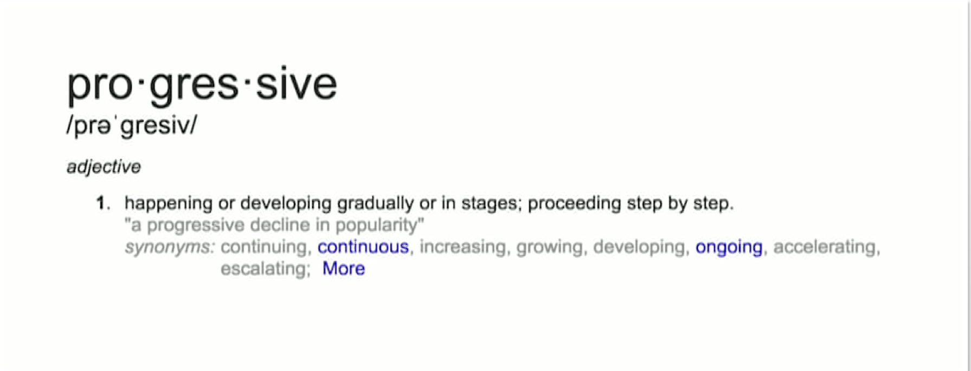

Slide 7
?
Why Vue.JS

Slide 8
?
The facts

Slide 9

The founder
Evan You
Previously worked as a Creative Technologist at Google
Core Dev at Meteor
From 2016 working full-time on Vue.JS framework.

Slide 10
History
2013.07.23 First name “Seed”
2013.12.07 Change “Seed” to Vue – as v0.6.0
2014.02.01 First public release v0.8 on HackerNews
2014.10.06 Releases v0.11
2015.03.20 Discovered by Laravel Community
2015.06.13 Releases v0.12
2015.06.23 Appear on Laracasts
2015.10.26 Releases v1.0
2015.10.28 Laracast: Vue v1.0
2016.10.01 Releases v2.0
2017.10.13 Releases v2.5.0 Level E
2017.11.27 Releases v2.5.9 (Latest Release)
Source: https://github.com/vuejs/vue/releases

Slide 11
Upcoming
v2.6+
Reactivity system will be rewritten with Proxies with various improvement
Will be targeting evergreen browser only
Planned Release: early 2018
v3.0
Drop support old browsers
A lot change in core libraries
New vue-cli 3.0
Source: https://github.com/vuejs/vue

Slide 12
Who is using it?
Gitlab
https://about.gitlab.com/2016/10/20/why-we-chose-vue/
Weex
https://weex.apache.org/ Maintained by Alibaba Group.
Baidu
Chinese search Engine
Laravel.com
Laracast.com
Bukalapak.com
Etc
Source: https://www.wappalyzer.com/applications/vue-js

Slide 13



Today (12.12.17)
VUE JS
VS REACT
VS Angular

Slide 14
?
What’s inside vue?

Slide 15


Getting Started
Using Content delivery network (cdn)
Using vue-cli

Slide 16

Creating vue instance
Every Vue application starts by creating a new Vue instance with the Vue function:

Slide 17
The power of vueJS
Declarative rendering : {{ something }}
Two way Data Bindings : v-model
Conditionals and Loops : v-if, v-show, v-for
Handling user Input: methods
Style Binding: transition, v-bind:style
Components: using template on single file, or webpacks

Slide 18
thanks!
Any questions?
You can find me at
Github.com/ggalihpp
Instagram.com/ggalihpp

Slide 19
0857-2052-4448
You could reach me on telegram

Slide 20
Credits
Special thanks to:
Presentation template by SlidesCarnival
Photographs by Unsplash
Vue.org
Mas mul14 for the insight on BandungJS-6

