Slide 1








Chai: Collaborative Heterogeneous Applications for Integrated-architectures
Juan Gómez-Luna¹, Izzat El Hajj², Li-Wen Chang², Víctor García-Flores^{3,4}, Simon Garcia de Gonzalo², Thomas B. Jablin^{2,5}, Antonio J. Peña⁴, and Wen-mei Hwu²
¹Universidad de Córdoba, ²University of Illinois at Urbana-Champaign, ³Universitat Politècnica de Catalunya, ⁴Barcelona Supercomputing Center, ⁵MulticoreWare, Inc.

Slide 2
Motivation
Heterogeneous systems are moving towards tighter integration
Shared virtual memory, coherence, system-wide atomics
OpenCL 2.0, CUDA 8.0
Benchmark suite is needed
Analyzing collaborative workloads
Evaluating new architecture features

Slide 3
Application Structure
fine-grain task
fine-grain sub-tasks
coarse-grain task
coarse-grain sub-task

Slide 4
Data Partitioning
A
B
Execution Flow
A
B
A
B

Slide 5
Data Partitioning: Bézier Surfaces
Output surface points are distributed across devices

Slide 6
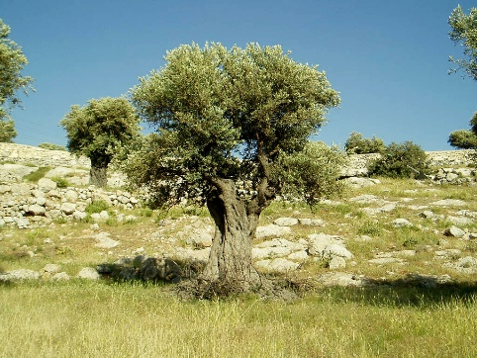
Data Partitioning: Image Histogram
Input pixels distributed across devices
Output bins distributed across devices
CPU
GPU
CPU
GPU

Slide 7
Data Partitioning: Padding
Rows are distributed across devices
Challenge: in-place, required inter-worker synchronization
CPU
GPU

Slide 8
Data Partitioning: Stream Compaction
Rows are distributed across devices
Like padding, but irregular and involves predicate computations
CPU
GPU

Slide 9
Data Partitioning: Other Benchmarks
Canny Edge Detection
Different devices process different images
Random Sample Consensus
Workers on different devices process different models
In-place Transposition
Workers on different devices follow different cycles

Slide 10
Types of data partitioning
Partitioning strategy:
Static (fixed work for each device)
Dynamic (contend on shared worklist)
Flexible interface for defining partitioning schemes
Partitioned data:
Input (e.g., Image Histogram)
Output (e.g., Bézier Surfaces)
Both (e.g., Padding)

Slide 11
Fine-grain Task Partitioning
Execution Flow
A
B
A
A
B
B

Slide 12
Fine-grain Task Partitioning: Random Sample Consensus
Data partitioning: models distributed across devices
Task partitioning: model fitting on CPU and evaluation on GPU
Fitting
Fitting
Fitting
Fitting
Fitting
Fitting
Fitting
Fitting
Fitting
Evaluation
Evaluation
Evaluation
Evaluation
Evaluation
Evaluation
Evaluation
Fitting
Evaluation
Evaluation
Evaluation
CPU
GPU
CPU
GPU

Slide 13
Fine-grain Task Partitioning: Task Queue System
Synthetic Tasks
Histogram Tasks
enqueue
read
enqueue
read
enqueue
Short
Long
Long
Short
Short
read
enqueue
read
enqueue
T_{short}
T_{long}
read
Histo.
Histo.
T_{long}
T_{short}
Histo.
empty?
T_{short}
empty?
Histo.
Histo.
CPU
GPU
CPU
GPU

Slide 14
Coarse-grain Task Partitioning
Execution Flow
A
B
A
B

Slide 15
Coarse-grain Task Partitioning: Breadth First Search & Single Source Shortest Path
small frontiers processed on CPU
large frontiers processed on GPU
CPU
GPU
SSSP performs more computations than BFS which hides communication/memory latency

Slide 16
Coarse-grain Task Partitioning: Canny Edge Detection
Data partitioning: images distributed across devices
Task partitioning: stages distributed across devices and pipelined
Gaussian Filter
Gaussian Filter
Gaussian Filter
Sobel Filter
Sobel Filter
Sobel Filter
Non-max Suppression
Gaussian Filter
Non-max Suppression
Non-max Suppression
Hysteresis
Sobel Filter
Hysteresis
Hysteresis
Non-max Suppression
Hysteresis
CPU
GPU
CPU
GPU

Slide 17
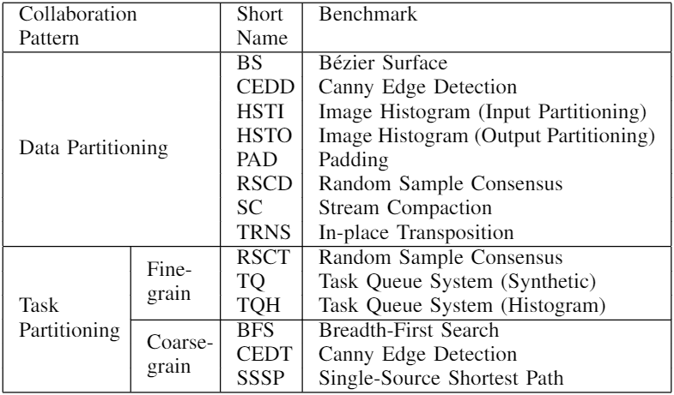
Benchmarks and Implementations
Implementations:
OpenCL-U
OpenCL-D
CUDA-U
CUDA-D
CUDA-U-Sim
CUDA-D-Sim
C++AMP

Slide 18
Benchmark Diversity
Data Partitioning
Benchmark | Partitioning Granularity | Partitioned Data | System-wide Atomics | Load Balance
BS | Fine | Output | None | Yes
CEDD | Coarse | Input, Output | None | Yes
HSTI | Fine | Input | Compute | No
HSTO | Fine | Output | None | No
PAD | Fine | Input, Output | Sync | Yes
RSCD | Medium | Output | Compute | Yes
SC | Fine | Input, Output | Sync | No
TRNS | Medium | Input, Output | Sync | No
Fine-grain Task Partitioning
Benchmark | System-wide Atomics | Load Balance
RSCT | Sync, Compute | Yes
TQ | Sync | No
TQH | Sync | No
Coarse-grain Task Partitioning
Benchmark | System-wide Atomics | Partitioning | Concurrency
BFS | Sync, Compute | Iterative | No
CEDT | Sync | Non-iterative | Yes
SSSP | Sync, Compute | Iterative | No

Slide 19
Evaluation Platform
AMD Kaveri A10-7850K APU
4 CPU cores
8 GPU compute units
AMD APP SDK 3.0
Profiling:
CodeXL
gem5-gpu

Slide 20
Benefits of Collaboration
Collaborative execution improves performance
best
best
Bézier Surfaces
(up to 47% improvement over GPU only)
Stream Compaction
(up to 82% improvement over GPU only)

Slide 21
Benefits of Collaboration
Optimal number of devices not always max and varies across datasets
best
best
Padding
(up to 16% improvement over GPU only)
Single Source Shortest Path
(up to 22% improvement over GPU only)

Slide 22
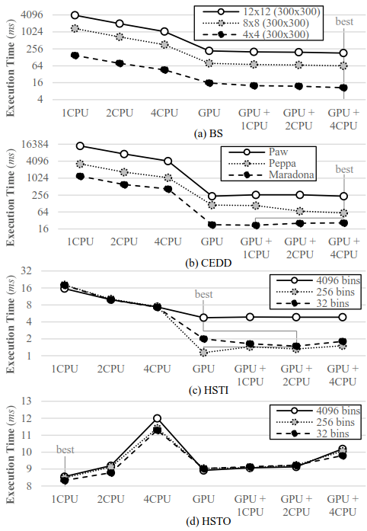
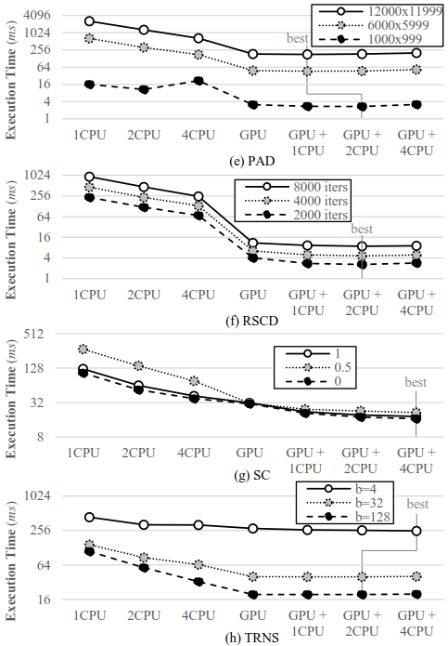
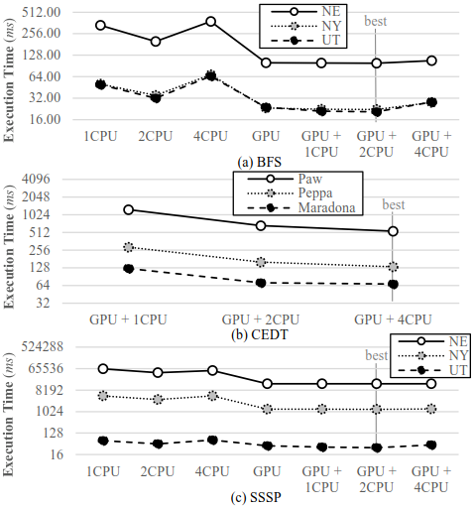
Benefits of Collaboration

Slide 23
Benefits of Unified Memory
Comparable (same kernels, system-wide atomics make Unified sometimes slower)
Unified kernels can exploit more parallelism
Unified kernels avoid kernel launch overhead

Slide 24
Benefits of Unified Memory
Unified versions avoid copy overhead

Slide 25
Benefits of Unified Memory
SVM allocation seems to take longer

Slide 26
C++ AMP Performance Results
4.37
11.93
8.08

Slide 27
Benchmark Diversity
Legend:
Occupancy
VALUBusy
MemUnitBusy
VALUUtilization
CacheHit
BS
CEDD (gaussian)
49.5
64.8
CEDD (sobel)
CEDD (non-max)
CEDD (hysteresis)
HSTI
HSTO
PAD
RSCD
SC
TRNS
RSCT
TQ
TQH
BFS
CEDT (gaussian)
CEDT (sobel)
SSSP
Varying intensity in use of system-wide atomics
Diverse execution profiles

Slide 28
Benefits of Collaboration on FPGA
Similar improvement from data and task partitioning
Case Study:
Canny Edge Detection
Source: Collaborative Computing for Heterogeneous Integrated Systems. ICPE’17 Vision Track.

Slide 29
Benefits of Collaboration on FPGA
Case Study:
Random Sample Consensus
Task partitioning exploits disparity in nature of tasks
Source: Collaborative Computing for Heterogeneous Integrated Systems. ICPE’17 Vision Track.

Slide 30
Released
Website: chai-benchmarks.github.io
Code: github.com/chai-benchmarks/chai
Online Forum: groups.google.com/d/forum/chai-dev
Papers:
Chai: Collaborative Heterogeneous Applications for Integrated-architectures. ISPASS’17.
Collaborative Computing for Heterogeneous Integrated Systems. ICPE’17 Vision Track.

Slide 31
Chai: Collaborative Heterogeneous Applications for Integrated-architectures
Juan Gómez-Luna¹, Izzat El Hajj², Li-Wen Chang², Víctor García-Flores^{3,4}, Simon Garcia de Gonzalo², Thomas B. Jablin^{2,5}, Antonio J. Peña⁴, and Wen-mei Hwu²
¹Universidad de Córdoba, ²University of Illinois at Urbana-Champaign,
³Universitat Politècnica de Catalunya, ⁴Barcelona Supercomputing Center, ⁵MulticoreWare, Inc.
URL: chai-benchmarks.github.io
Thank You! ☺

