Slide 1
MVP-SIM Architecture Introduction and Design
As architecture design reference

Slide 2
目录
01.
uArch comparison with Nvidia
CONTENTS
02.
MVPGPU-SIM Architecture
03.
Major performance target
04.
Benchmark introduction
05.
Quantitative analysis

Slide 3
uArch comparison with Nvidia
01
Only comparing SM uArch here

Slide 4

Nvidia Typical uArch vs MVP uArch
SM
SM
Instruction Cache
SP
SP
Instruction Cache
Instruction Cache
Warp scheduler
Warp scheduler
Thread controller
Thread controller
Register File
Register File
Register File
ALU
MAC
LDST
ALU
MAC
LDST
ALU
MAC
LDST
SFU
ALU
MAC
LDST
SFU
ALU
MAC
LDST
SFU
ALU
MAC
LDST
SFU
INT
INT
FP32
FP64
LDST
SFU
INT
INT
FP32
FP64
ALU
MAC
LDST
ALU
MAC
LDST
LDST
L1 Cache
L1 Cache
INT
INT
FP32
FP64
LDST
SFU
INT
INT
FP32
FP64
SP
SP
LDST
Instruction Cache
Instruction Cache
INT
INT
FP32
FP64
LDST
SFU
INT
INT
FP32
FP64
Thread controller
Thread controller
LDST
Register File
Register File
INT
INT
FP32
FP64
LDST
SFU
INT
INT
FP32
FP64
ALU
MAC
LDST
ALU
MAC
LDST
LDST
ALU
MAC
LDST
SFU
ALU
MAC
LDST
SFU
ALU
MAC
LDST
SFU
ALU
MAC
LDST
SFU
Shared Memory / L1 Cache
ALU
MAC
LDST
ALU
MAC
LDST
L1 Cache
L1 Cache
Nvidia uArchi
MVP uArchi
There are four processing blocks
No shared memory between SP and SP
LDST unit number
<<Dissecting the NVidia Turing T4 GPU via Microbenchmarking>>

Slide 5
MVP-SIM Architecture
02
Briefly introduction for MVP architecture

Slide 6
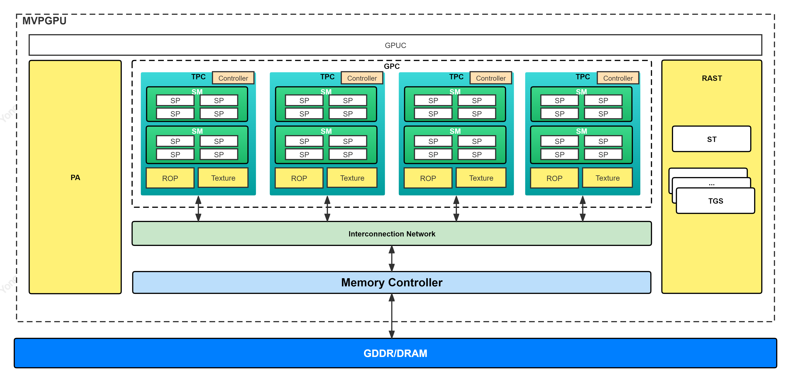
MVPGPU-SIM Architecture Overview

Slide 7
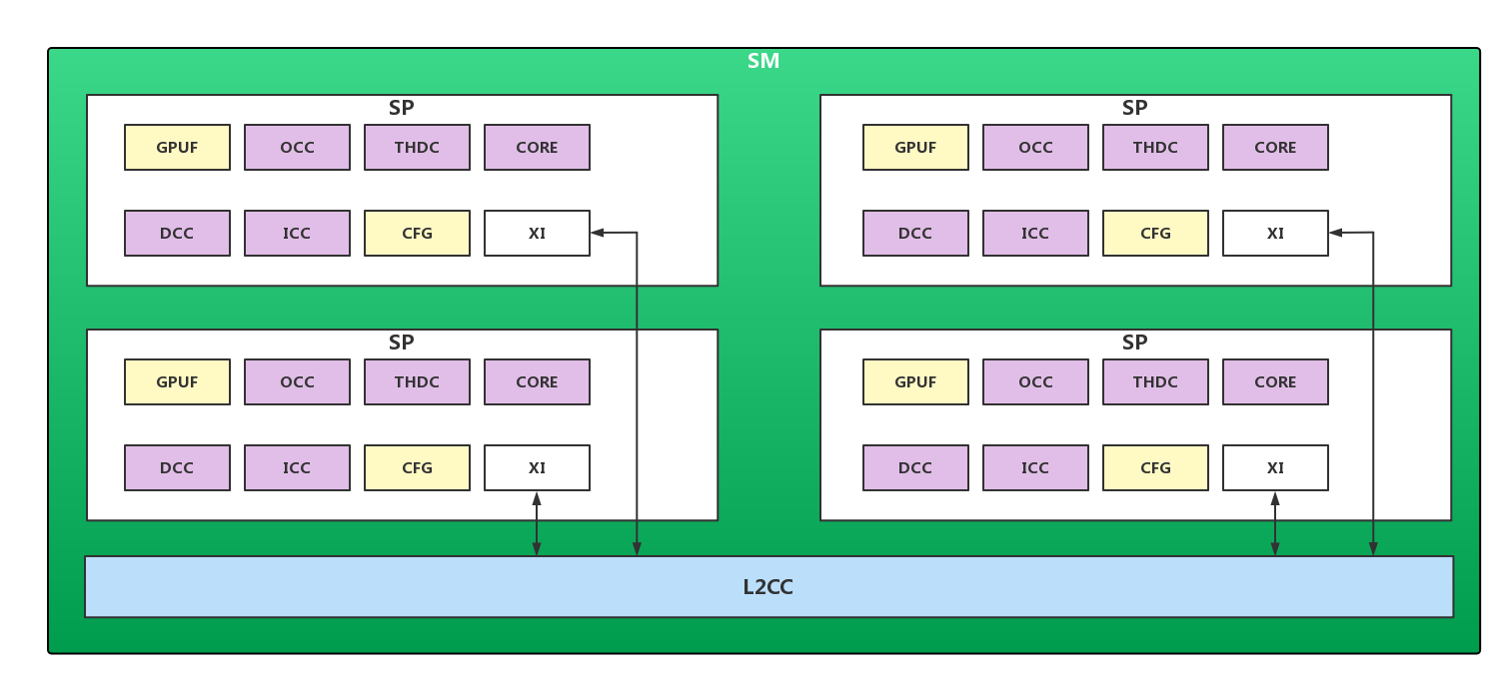
SM uArch Overview based on RTL

Slide 8
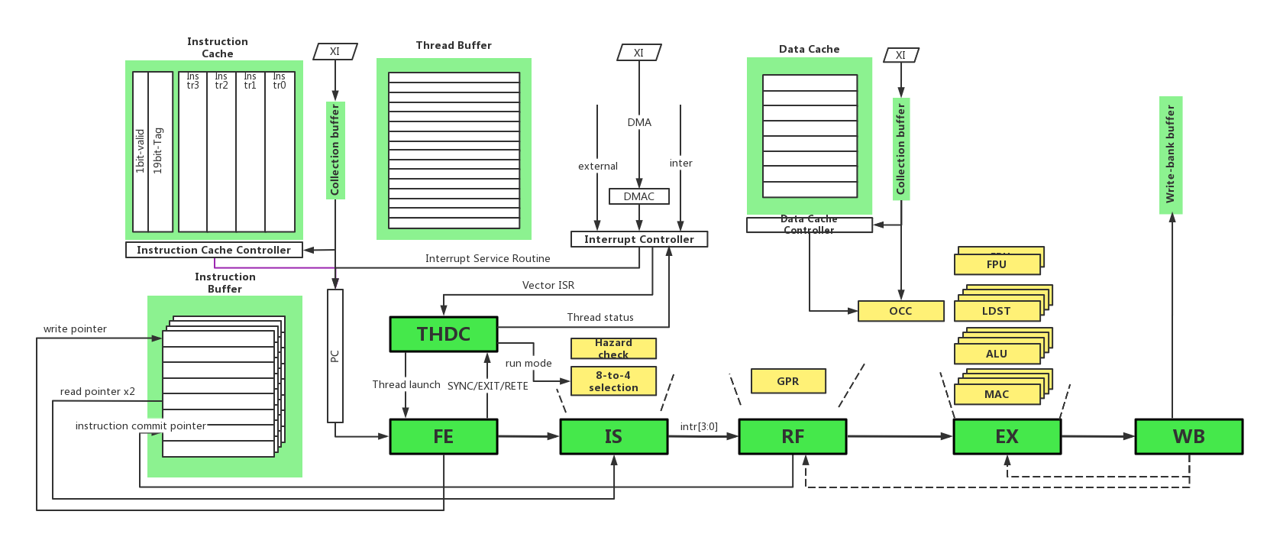
SP uArch Overview

Slide 9
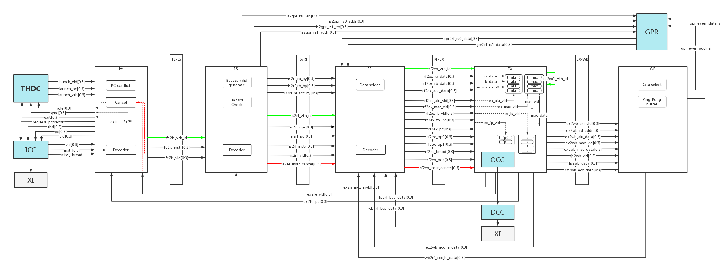
PIPELINE Overview

Slide 10
Configuration parameters design
Hardware | GPGPU-SIM | GPGPU-CONFIG | MVPGPU-SIM | MVPGPU-CONFIG
GPC | - | - | graphic_process_cluster | -mvpgpu_n_gpc
TPC | simt_core_cluster | -gpgpu_n_clusters | texture_process_cluster | -mvpgpu_n_tpc_per_gpc
SM | shader_core_ctx | -gpgpu_n_cores_per_cluster | stream_multiprocessor | -mvpgpu_n_sm_per_tpc
SP | -PB | - | stream_processor | -mvpgpu_n_sp_per_sm
Core | - | - | mvp_exec_core | -mvpgpu_n_core_per_sp

Slide 11
Configuration parameters design
Hardware | GPGPU-SIM | GPGPU-CONFIG | MVPGPU-SIM | MVPGPU-CONFIG
THDC | - | - | thread_controller | -mvpgpu_n_thdc_per_sp
Local Memory |  |  | local_memory | -mvpgpu_local_memory_size
Instruction Buffer |  |  | instruction_buffer | -mvpgpu_instr_buffer_size
Thread Buffer | - | - | thread_buffer | -mvpgpu_thread_buffer_size
 | - | - | - | -

Slide 12
SP Memory resource comparison
Vendor | MVP V2.0 | Nvidia（Turing） | AMD（Southern Islands） | ARM（mali-g71/72）
SP/SM | 4 | 4 (PB) | - | -
Core/SP | 4 | 16 | 16x4+1 | 3 (execution engine)
Register/SP | 1KB (32x32) | 64KB(256KB/4) | 4x64KB+2KB | 3.09KB (66*4*12)
Local memory/SP | 32KB | - | 64KB | -64 Byte (l1c)
Shared memory/SP | - | 24KB(96KB/4) | 64KB | -256/512KB (l2c)
Thread number/SP | 32 | 32 | 64 work-item | 12
Memory/Thread | 1K | 0.75KB | 2KB | -
Register/Thread | 32*4 Btye | 2KB | 4KB | 64*4 Byte + 8 Byte

Slide 13
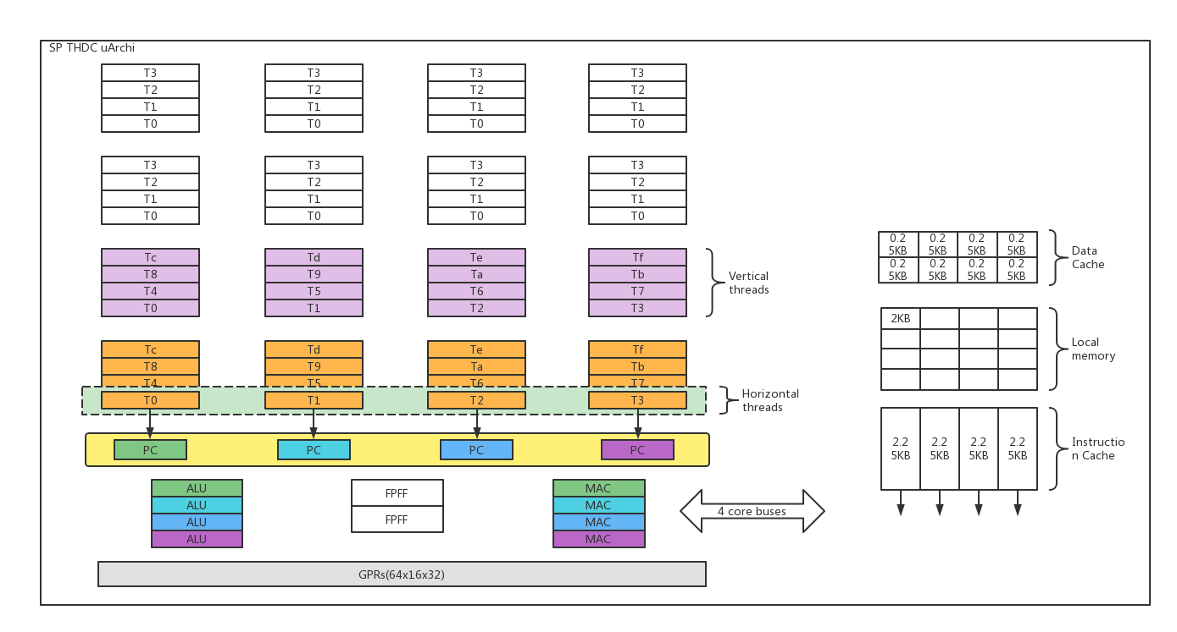
THDC
Vertical_threads=warp
Horizontal_threads
ILP
DLP
TLP

Slide 14
THDC
kernel0~kernel7
Even/Odd
Notes:
ic1_mvp_thdc_uarch_spec.doc

Slide 15
THDC-Thread Scheduling Policies
In-Order
Round-Robin
GTC

Slide 16
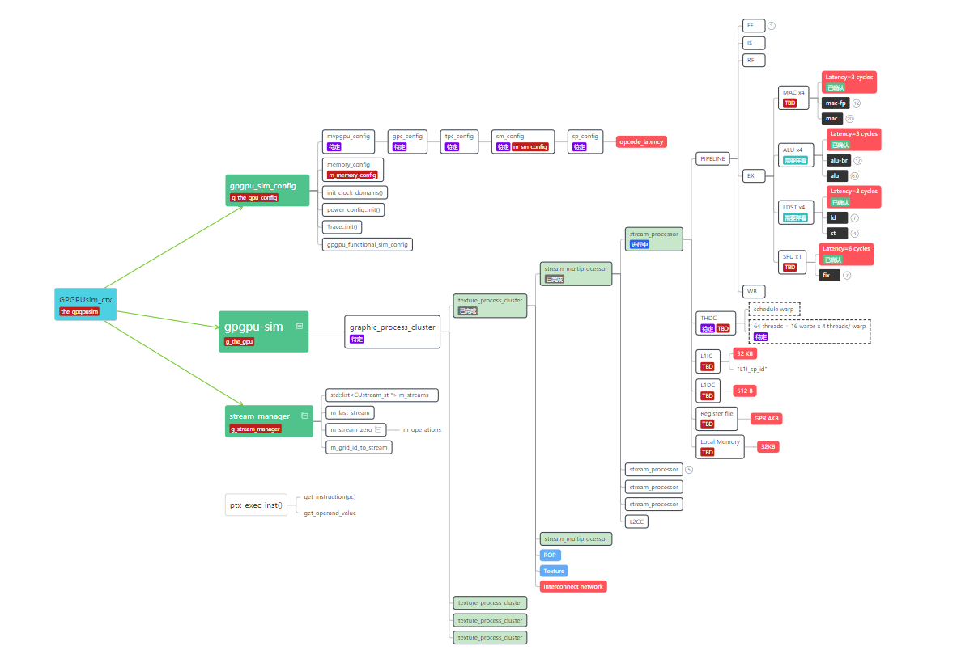
Data structure design
gpu config
gpu archi
stream manager

Slide 17
Memory hierarchy
Memory Type | Tech feature | Typical access time | prise per GB in 2008
Register
SRAM | cache, power, | 0.5-2.5 ns | $2000-$5000
DRAM | main memory, refresh | 50-70 ns | $20-$75
Magnetic disk |  | 5000000-20000000 ns
以图书馆为例
Small = Fast, Large = Slow

Slide 18
Memory Partition
To be done
DDR4
384bit
GDDR5
512bit
HBM
4096bit
PCIe
SP 0
regs
(4k)
SP 1
regs
(4k)
SP 2
regs
(4k)
SP 3
regs
(4k)
SP 4
regs
(4k)
SP 5
regs
(4k)
...
SP 31
regs
(4k)
L1$
(2KB)
L1$
(2KB)
L1$
(2KB)
L1$
(2KB)
L1$
(2KB)
L1$
(2KB)
...
L1$
(2KB)
L2 Cache (256KB)
Data location | B/W | Latency
Register |  | 0.833ns
L1 Cache
L2 Cache
DDR4
PCIe
DDR4 (2GB)
DDR4

Slide 19
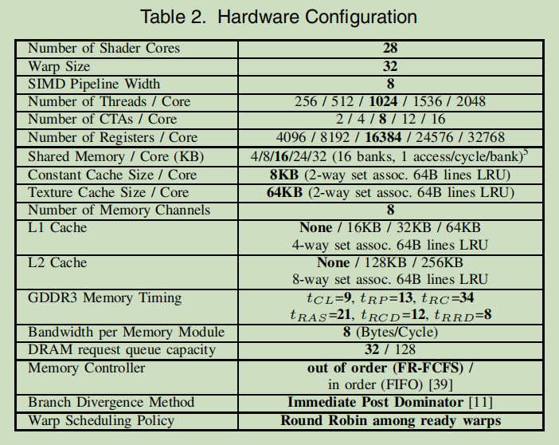
Hardware Configuration
To be done
 | MVP | NV V100
Number of SP Cores | 32
Warp size | 4
Pipeline width | 4
GPR | 4KB
L1I Cache | 9KB
L1D Cache | 2KB
Local memory | 32KB
L2D Cache | 256KB

Slide 20
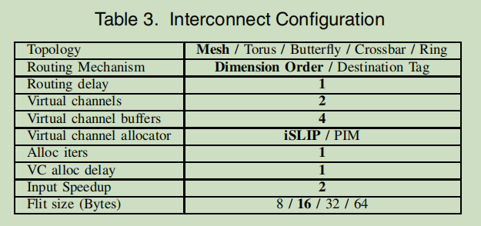
Interconnection Network
To be done

Slide 21
Major performance target
03
Basic concept of major performance

Slide 22
Processor Performance Equation
CPU time = CPU clock cycles for a program x Clock cycle time
CPI = CPU clock cycles for a program / Instruction count
CPU time = Instruction count x Cycles per instruction x Clock cycle time
CPU clock cycles =
Instruction Count and CPI

Slide 23
Major Processor performance factors
01
02
03
Clock cycle time
CPI
Instruction count
Hardware technology and organization
Organization and instruction set architecture
IPC = 1 / CPI
Instruction set architecture and compiler technology

Slide 24
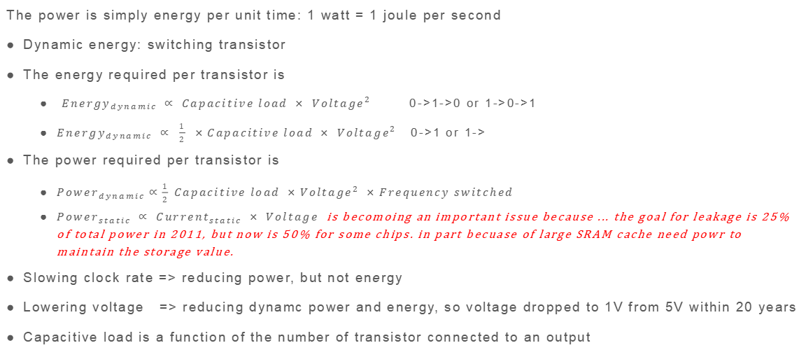
Energy and Power
The power is simply energy per unit time: 1 watt = 1 joule per second
Dynamic energy: switching transistor
The energy required per transistor is
${Energy}_{dynamic} ∝ {Capacitive load × Voltage}^{2}$ 0->1->0 or 1->0->1
${Energy}_{dynamic} ∝ \frac{1}{2} ×{Capacitive load × Voltage}^{2}$ 0->1 or 1->
The power required per transistor is
${Power}_{dynamic}∝\frac{1}{2} Capacitive load ×{Voltage}^{2} ×Frequency switched$
${Power}_{static} ∝ {Current}_{static} × Voltage$ is becomoing an important issue because ... the goal for leakage is 25% of total power in 2011, but now is 50% for some chips. in part becuase of large SRAM cache need powr to maintain the storage value.
Slowing clock rate => reducing power, but not energy
Lowering voltage => reducing dynamc power and energy, so voltage dropped to 1V from 5V within 20 years
Capacitive load is a function of the number of transistor connected to an output

Slide 25
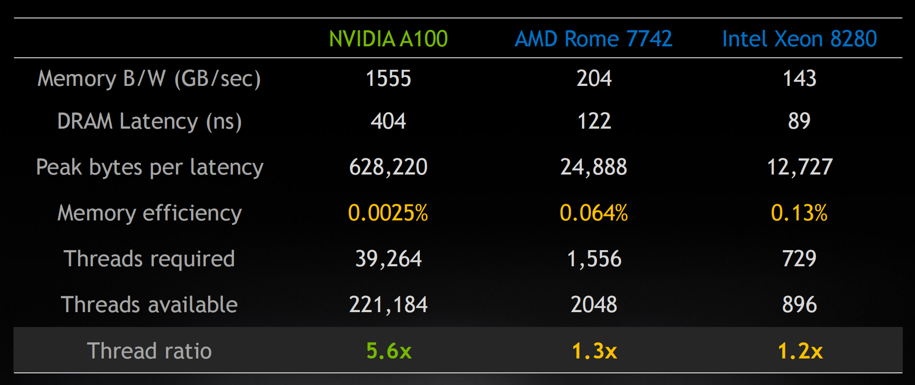
Are more threads better?
To be done
Performance, size, energy
DRAM B/W(GB/S)
DRAM latency(ns)
Peak bytes per latency
Memory efficiency => dp 16bytes
6912 INT Cores/GPU
To calculate how many threads is required in total based on memory bandwidth

Slide 26
High Bandwidth Memory
HBM: 本质上还是DDR，在存储上与DDR,GDDR,LPDDR没有太大差异，在技术上主要特定是和主芯片封装在一个芯片里，缩短了sdram与主芯片之间的通信距离，同时跨越了封装对芯片引脚数目的限制，成几十倍的提高传输线数量，降低传输损耗，提高传输带宽。
HBM是3D堆叠，4层，8层的dram通过TSV打孔竖直堆叠在一起，增加了dram的容量。TSV（直通硅通孔）
DRAM和GPU封装在同一颗芯片里，在显卡上直观的体现就是没有内存芯片了。
单比特功耗会更小，因为带宽更大了，传输距离更小了，散热要求更苛刻了，因为GPU很热烤的DRAM吃不消。
AMD Example: HBM频率500MHz->600MHz 20%, 核心频率1050MHz->1145MHz 9%，在3DMark测试中，性能提升 20%，明显超过了核心的提升幅度，所以提升归功于HBM的频率提升

Slide 27
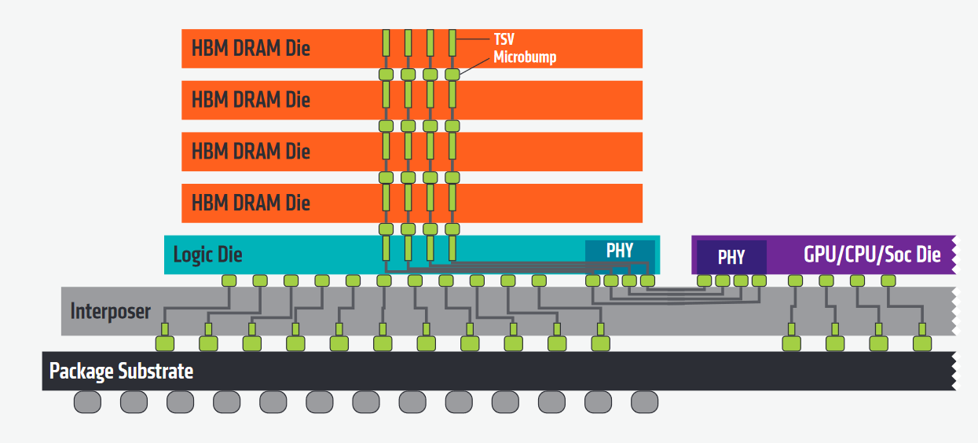
High Bandwidth Memory

Slide 28
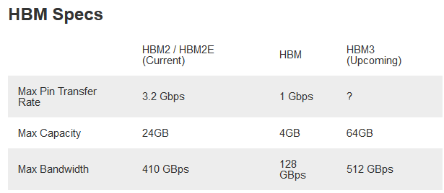
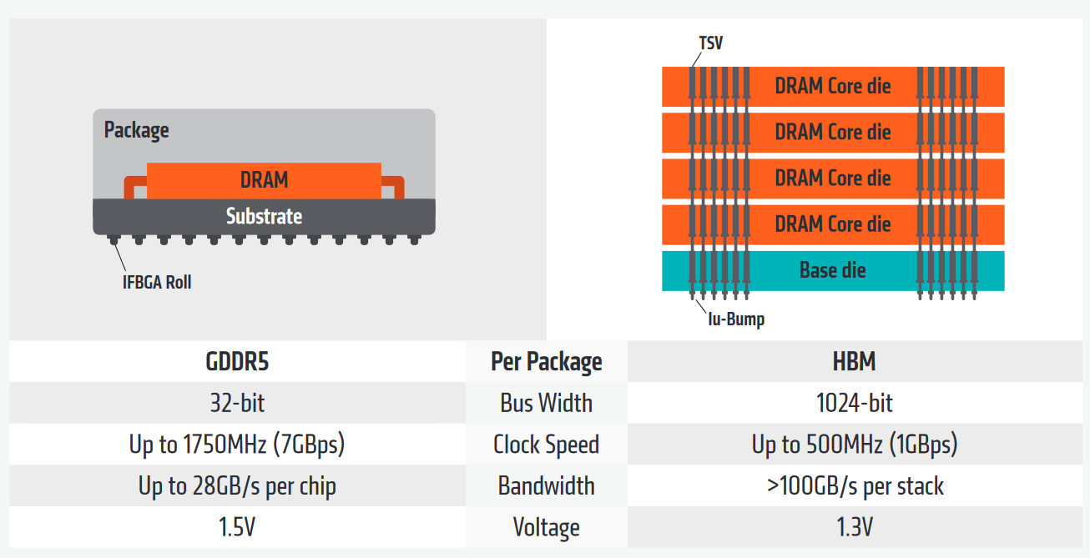
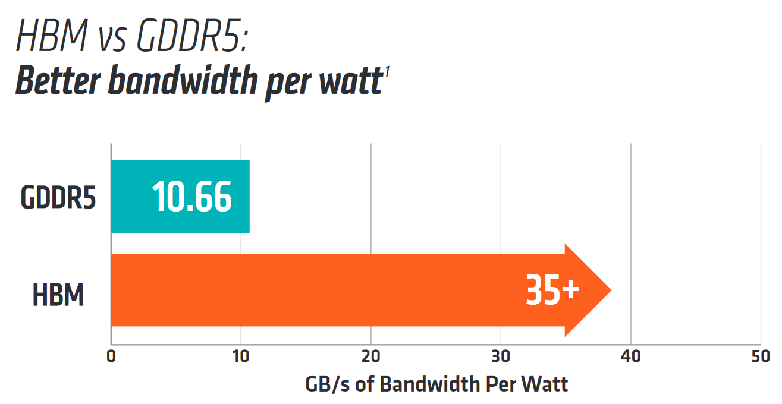
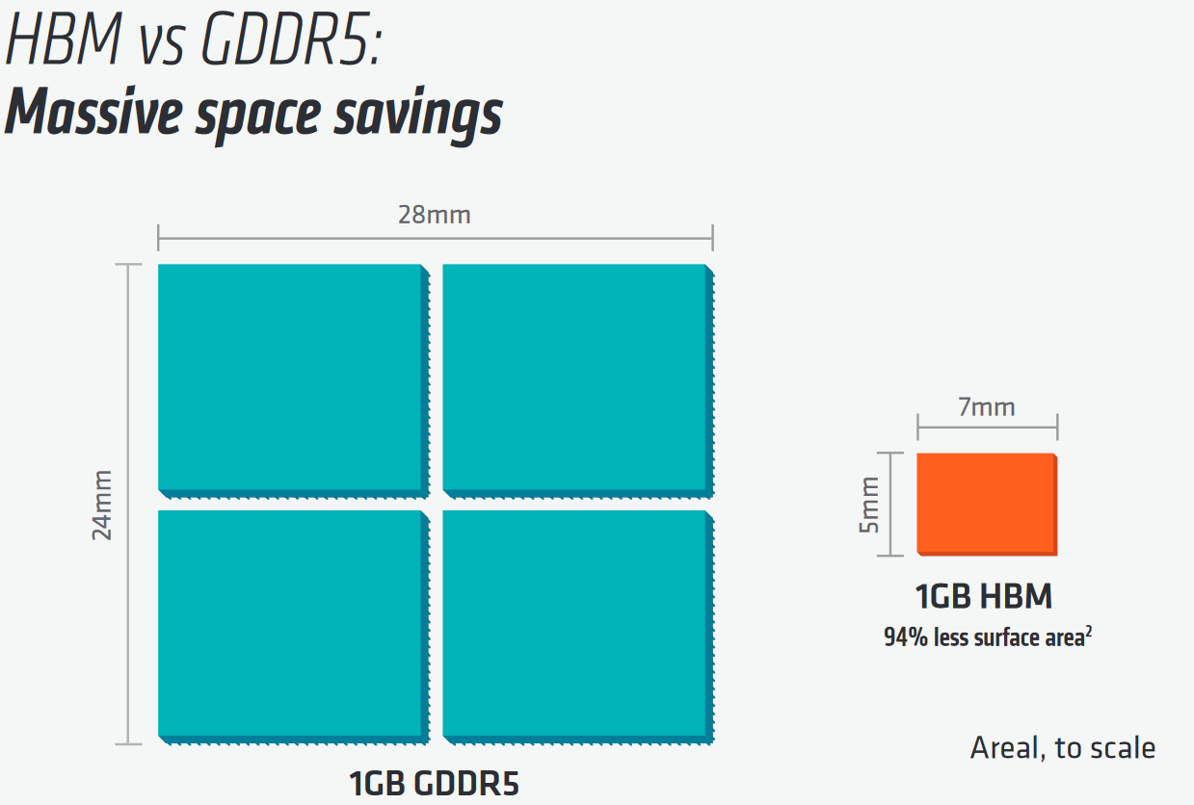
High Bandwidth Memory

Slide 29
Benchmark introduction
04
Introduce some open source benchmark

Slide 30
Benchmark
CUDA SKD: vectorAdd
Chai benchmark suite
mixbench
nvbench
ispass2009-benchmarks
geekbench

Slide 31
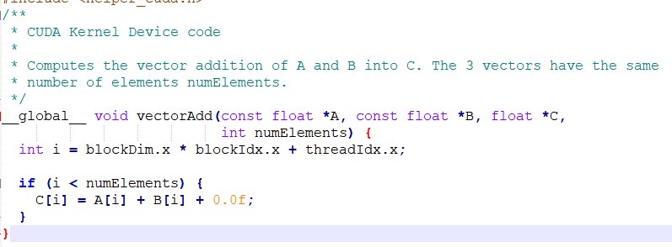
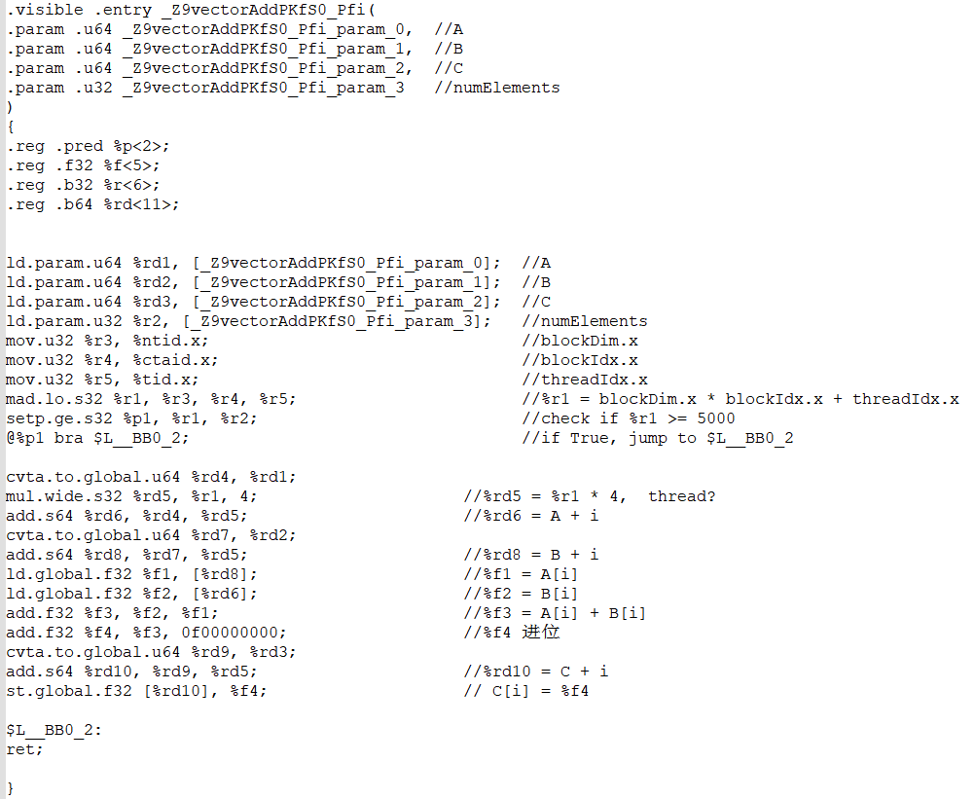
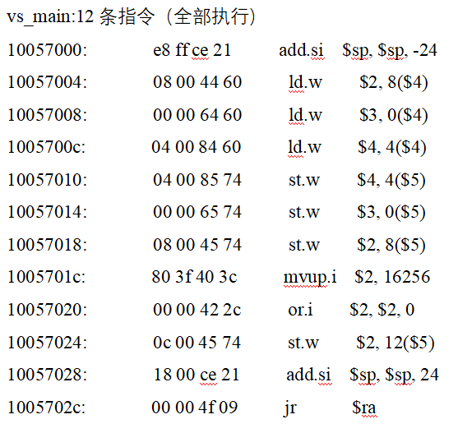
vectorAdd
ld
add
st
mvup.i=add+0

Slide 32
ispass2009-benchmarks
BFS: This application performs breadth-first search on a graph, performance loss due to heavy global memory traffic and branch divergence
LIB: LIBOR performs Monte Carlo simulations based on the London Interbank Offered Rate Market Model, Each thread reads a large number of variables stored in constant memory, memory bandwidth is still a bottleneck for it
LPS：Laplace is a highly parallel finance application，performance loss due to branch divergence
NN: Neural network uses a convolutional neural network to recognize handwritten digits
NQU: tackles a classic puzzle of placing N queens on a NxN chess board such that no queen can capture another
STO: StoreGPU is a library that accelerates hashing-based primitives designed for middleware
AES：Advanced Encryption Standard algorithm in CUDA to encrypt and decrypt files
CP: is useful in the field of molecular dynamics, stored in constant memory to take advantage of caching
DG: 是一种不连续的Galerkin时域求解器，用于电磁领域计算雷达对三维物体的散射，并分析波导、粒子加速器和EM兼容性
MUM: is a parallel pairwise local sequence alignment program that matches query strings consisting of standard DNA nucleotides
RAY: Ray-tracing is a method of rendering graphics with near photo-realism. Up to 5 levels of reflections and shadows are taken into account
WP: Numerical weather prediction uses the GPU to accelerate a portion of the Weather Research and Forcast model

Slide 33
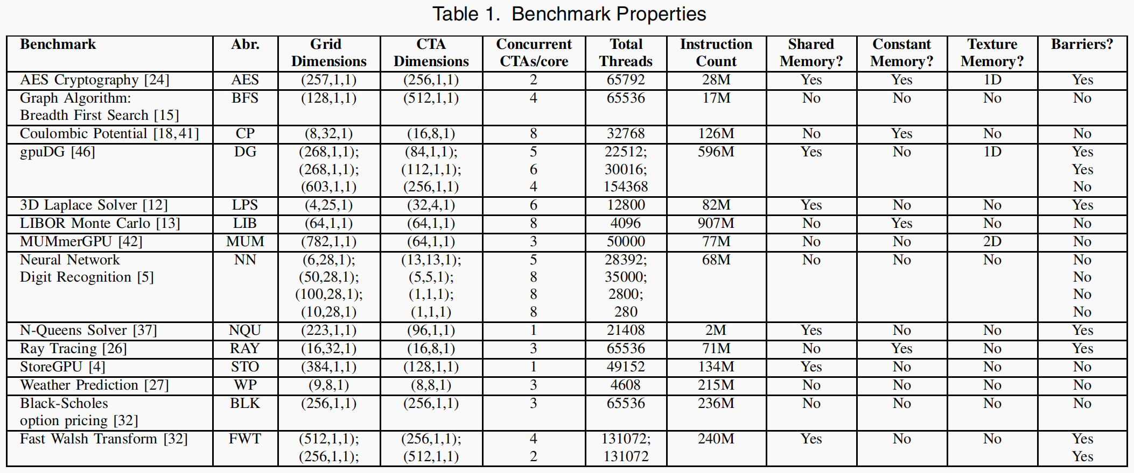
ispass2009-benchmarks

Slide 34
Quantitative analysis
05
Only some basic and the simplest introduction

Slide 35
ispass2009-benchmarks-mvpgpu
 | Exec Time | inst/sec | cycle/sec | Instruction Count | Clock Cycles | Cycle time | IPC | Comments
BFS | 1739 | 7880 | 283 | 13 703 320 | 492 137 | 0.833 ns | 27.8
LIB | 26435 | 24792 | 214 | 217,057,400 | 1,596,427 | 0.833 ns | 115.8
LPS | 2405 | 24968 | 281 | 60,049,880 | 676,638 | 0.833 ns | 88.8
NN | 21221 | 3185 | 454 | 208,058 | 92,273 | 0.833 ns | 7.0
NQU | 55 | 22831 | 660 | 1,255,730 | 36,352 | 0.833 ns | 34.5
STO | 1203 | 40755 | 127 | 49,029,120 | 152,825 | 0.833 ns | 320.9
AES
DG
MUM
RAY
WP

Slide 36
ispass2009 benchmark try
IPC
registers: 65535 -> 4096
latency fp: 4,13,4,5,39->3 cycles
Instruction
registers: 65535 -> 4096
latency fp: 4,13,4,5,39->3 cycles

Slide 37
BFS analysis
5 Shader cycle
Instruction number

Slide 38
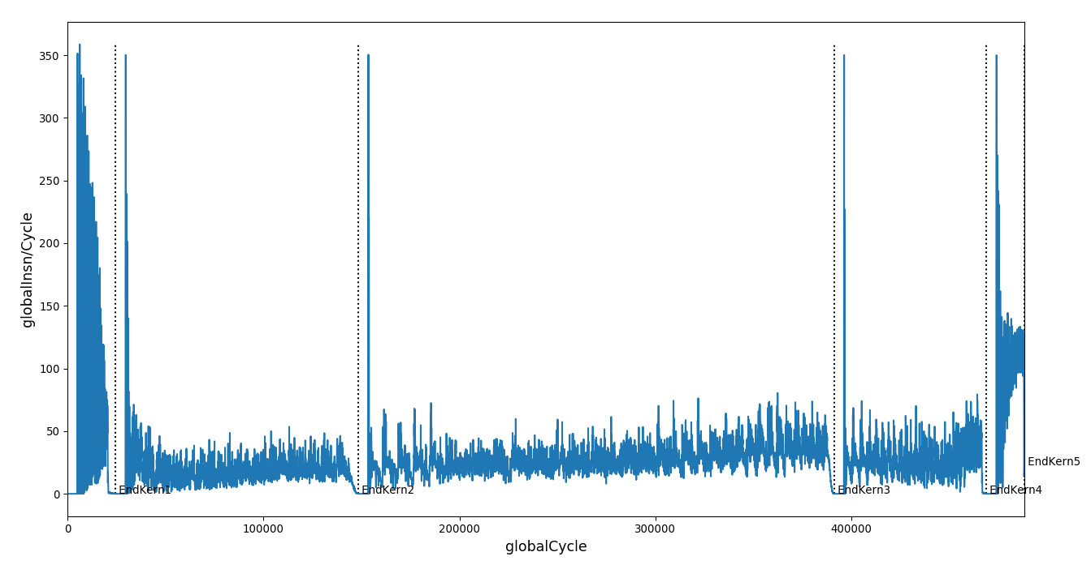
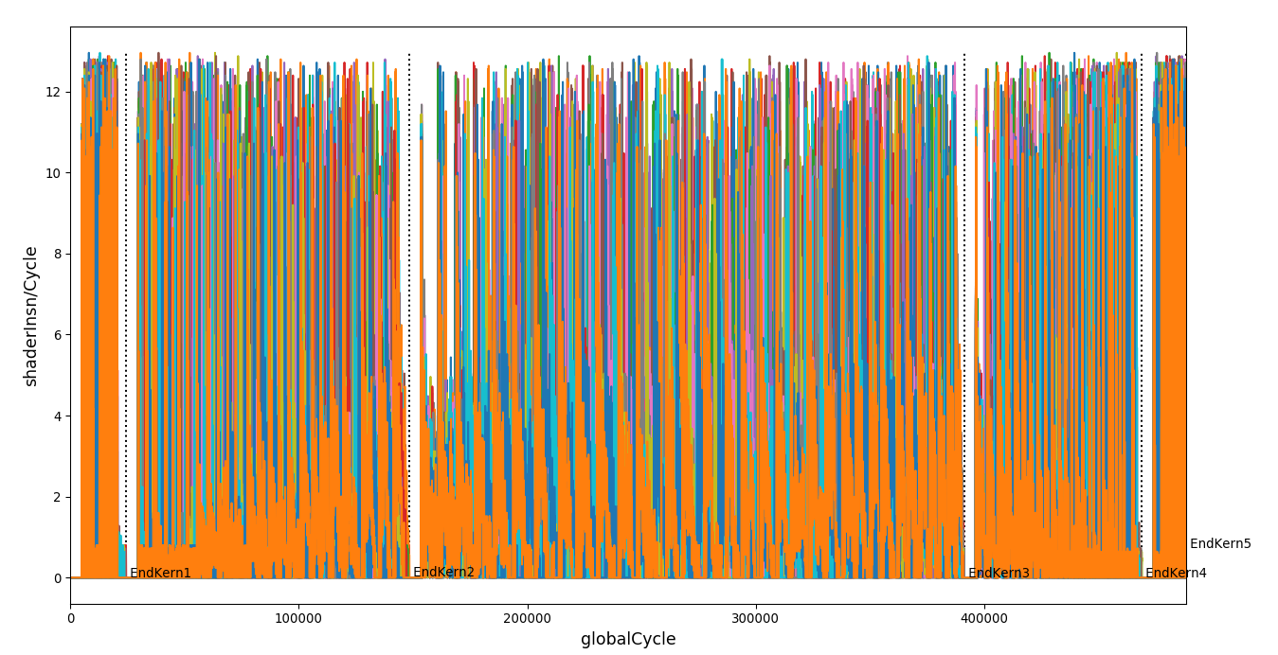
BFS analysis
globalInst/Cycle
shaderInst/Cycle

Slide 39
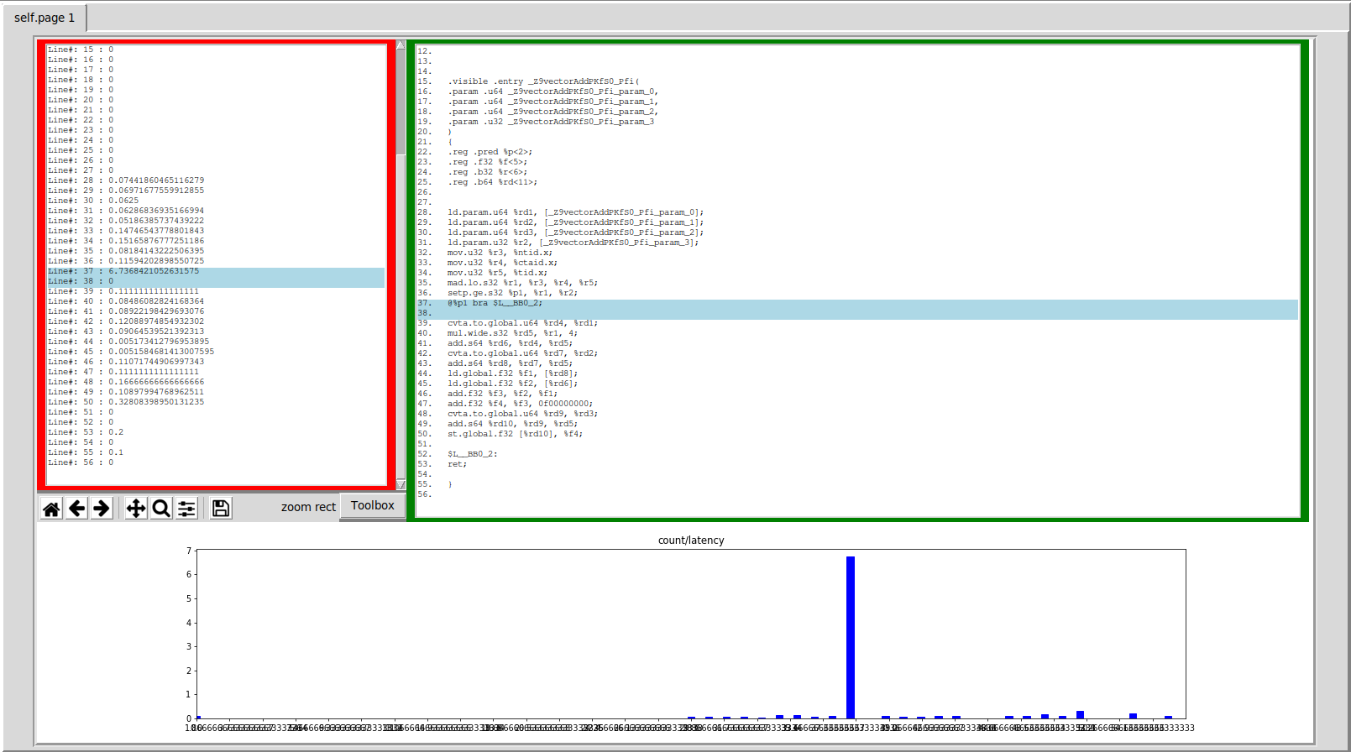
AerialVision
Architecture design
Application bottlenecks

Slide 40
PyTorch
To be done
TBD

Slide 41
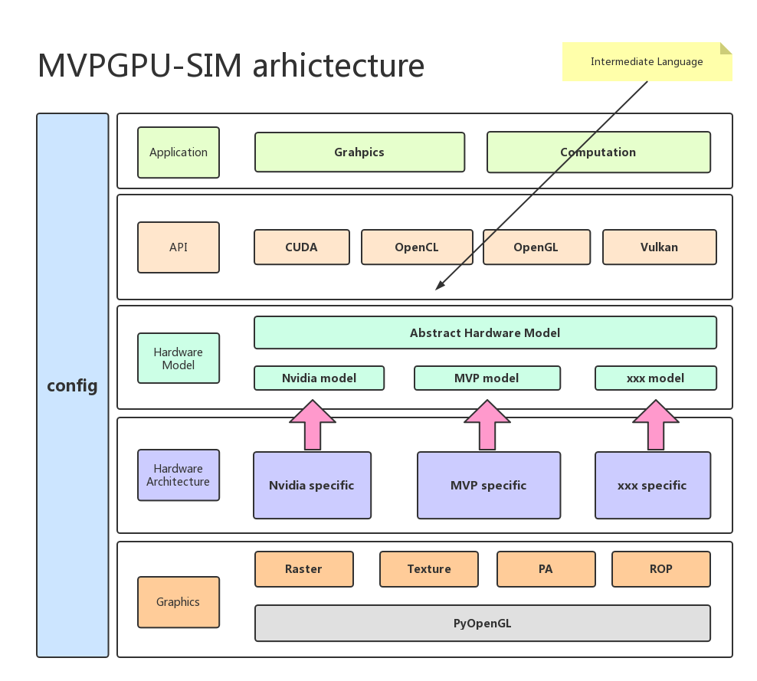
Future Architecture
Long-term

Slide 42
What improvement we can do
Register file size
>= 64x32bit/thread
32 register
Shared memory
ldst unit
一种减少对更多原始内存带宽需求的好方法是几十年来已知和使用的方法-在芯片上增加更多缓存
AMD的Infinity Cache: Navi 21 GPU使用128MB的大型L3缓存
Fetch and Decode
Hardware performance counter

Slide 43
Bottleneck
Energy has relationship with kernel scheduling
branch divergence: major source of performance loss for multithreaded SIMD architecture

Slide 44
Warp divergence
z = p ? x : y
p: a = b + c //computed only if p is true
All threads execute both conditional branches, so execution cost is sum of both branches => potentially large loss of performance
What’s important is to understand hardware behaviour and design your algorithms/implementation accordingly
From an architecture perspective, one of the main challenges is inter-warp conflict in the shared resources including I$, D$ and compute units.
Further understanding much more detailed info

Slide 45
Lex&Yacc
Notes:
https://blog.csdn.net/libinbin_1014/article/details/78833172
https://zhuanlan.zhihu.com/p/143867739

Slide 46
感谢聆听&问题讨论
硬件部 刘永刚

