Slide 1
Design of ML models from scratch
Guyen Gankhuyag 2024.

Slide 2
Unique from other training literatures?
Code exercises use none python/pip library (or minimal use).
Covers later models:
RNN (recursive) flavors, Transformer.
Not covered:
CNN

Slide 3
RNN
RNN cell – consists of 2 linear layers: input, hidden(feedback)
RNN layer – contains RNN cell, can specify multiple RNN layers.
Supports more parameters: rnn_layers, bidirectional, batch_first etc, dropout
RNN “vanilla”
RNN bidirectional (limited coverage)
RNN batch

Slide 4
Our data (not only RNN, throughout series)

Slide 5
How our data resembles language problem?
Would it helpful to map out mind between “rectangle” interpretation and “language model” interpretation of our data

Slide 6
Side by side comparison 1. basic non-recursive NN 2. LLM/RNN 3. StepbyStep
Model | Basic Neural network (I.e.linear, non-recursive) | LLM (large language model) | StepByStep
Samples | Housing data entries | ~Sentences | Rectangles
Sequences | N/A | Words in a sentences | 4 corners of rectangle
Features | Location, features | Single word meaning/encoding | Coordinates of rectangle
Label | Price | Next word | Coord. Of next corner of rectangle

Slide 8
RNN cell
Containing 2 linear layers:
Input_layer: in: [1,input_size=n_features], out: [1, hidden_dim=hidden_size]
Hidden_layer: in: [1, hidden_dim], out: [1, hidden_dim].
Weights [hidden_size, input_size]
What happens in forward() [aka: predict, inference]:
Matmul (<input>, <weights>]
How about dimensions?
Matmul( [1, input_size][hidden_size, input_size] ??? But isn’t :
Matmul ( [N,M], [M,K] ) => [N,K].
Answer (weight is transposed):
Matmul( [1, input_size][input_size, hidden_size] => [1, hidden_size] (output and also feedback to hidden_layer)

Slide 9
RNN cell
Hidden_layer math:
Input: [1, hidden_dim]
Weight: [hidden_dim, hidden_dim]
Matmul ( [1, hidden_dim], [hidden_dim, hidden_dim] = [1, hidden_dim]
Output of RNN cell:
Concatenate hidden_layer and input_layer:
[1, hidden_dim]. What do we about it??

Slide 10
Library vs. manual implementation
Library:
import torch as nn; rnn=nn.RNNCell(…) # torch provided RNN cell.
Manual:
from common.settings import *
from common.classes import *
Rnn_cell_manual=RNNCell(…):
Init: takes library version of nn.rnnCell as input and clones its internal datas: weight/bias of two linear layers (for the purposes of comparison)

Slide 11
Conclusion
We fed just a single sample [1,4,2] which is a single rectangle to RNN cell.
But wait, we only fed 1st corner:
therefore [1,4,2] => [4,2] => [:1, 2] => [1,2].

Slide 12
Now we feed full sequence
Full sequence: X=[1,4,2]=[4,2]
But we don’t do rnn(X)
Instead:
For i in range (X.shape[0]=4): # iterating over first dim of X which is 4.
rnn_cell( X[i] )
But this is one at a time.
Review back: input:
254, 4, 2=[samples, corners (sequence), coord (features)
254, 4, 2=[4-word sentences, words in a sentence, word meaning)

Slide 13
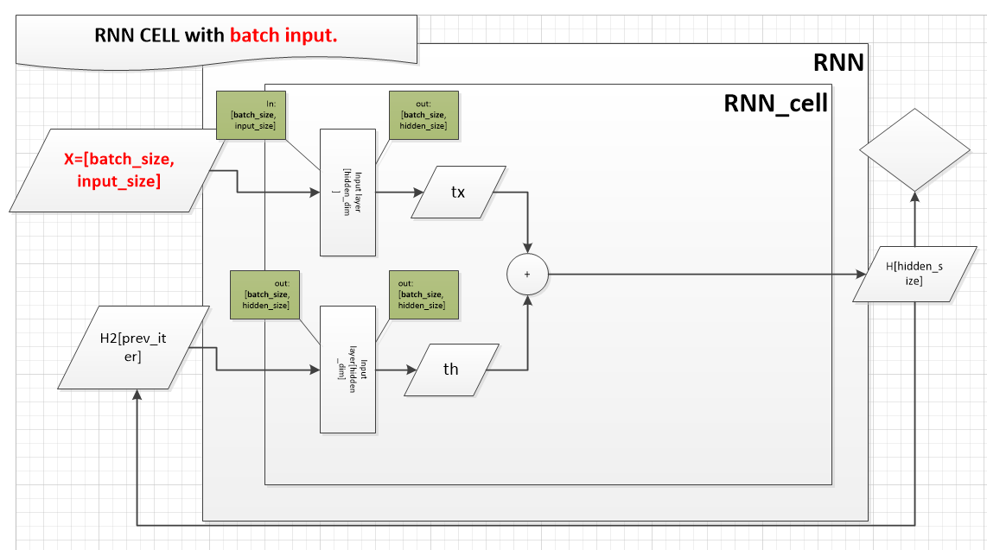
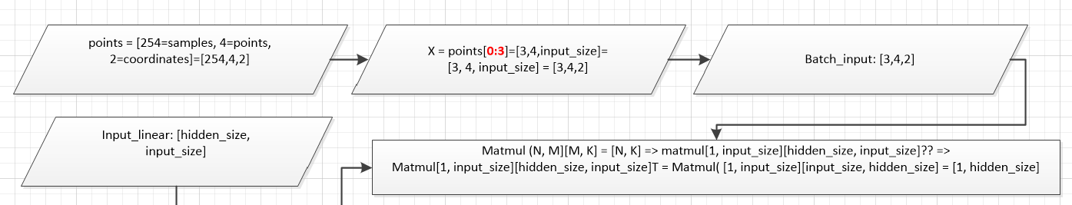
Batch input

Slide 14
Batch: inputs..
But why diagram shows [batch_size, input_size=features] when input is: [batch_size, 4, input_size]?
Becaues we iterate through 4, that is the essence of sequence… (feeding to cell one corner at a time or in case of LLM feeding one word at a time (to predict next word). If we feed all, this is not sequence!
In a nutshell (to alleviate the confusion of feeding one word at a time but sending in batches???)…
1st dim: Batch_size = 3 samples (3 rectangles, 3 sentences)
2nd dim: sequence data = 4 (4 corners, one corner at a time, pred. next corner, 4 words in a sentence, one word at a time)
3rd dim: features/input_size = 2 (x,y coord of corners, encoded value of particular word).

Slide 15
Batch: outputs..
No batch:
[1, input_size] [hidden_size, input_size]T = [1, hidden_size]
Batch (per iteration of sequence)
[3, input_size] [hidden_size, input_size]T = [3, hidden_size]
What does [3, hidden_size] mean?
State of RNN cell at a particular iteration of corner (word) that helps to predict next corner (word), 3 rectangles at a time (3 sentences at a time).

Slide 16
Bit about batch_first parameter
Defaut input at RNN: [L,N,F]=[seq.length, batch, features]
Actual input: [batch, seq.length, features] = [N,L,F]
Option 1: permute input before feeding into RNN cell:
[N,L,F]->[L,N,F]
Option 2:
Use batch_first parameter so that RNN cell accepts input as non-default shape: [N,L,F] = [batch, seq. length, features]

