Slide 1

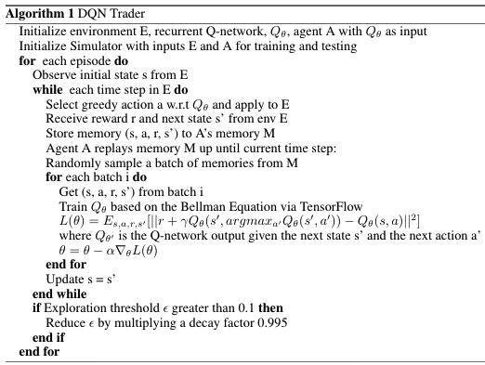
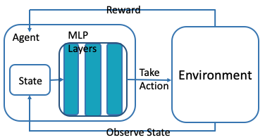
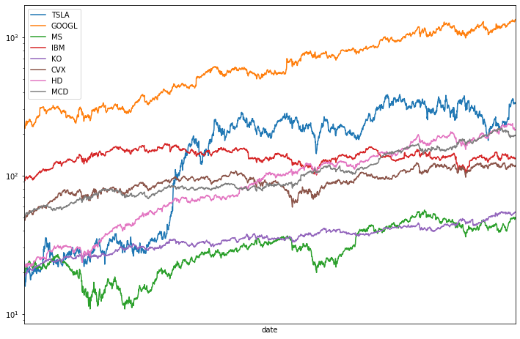

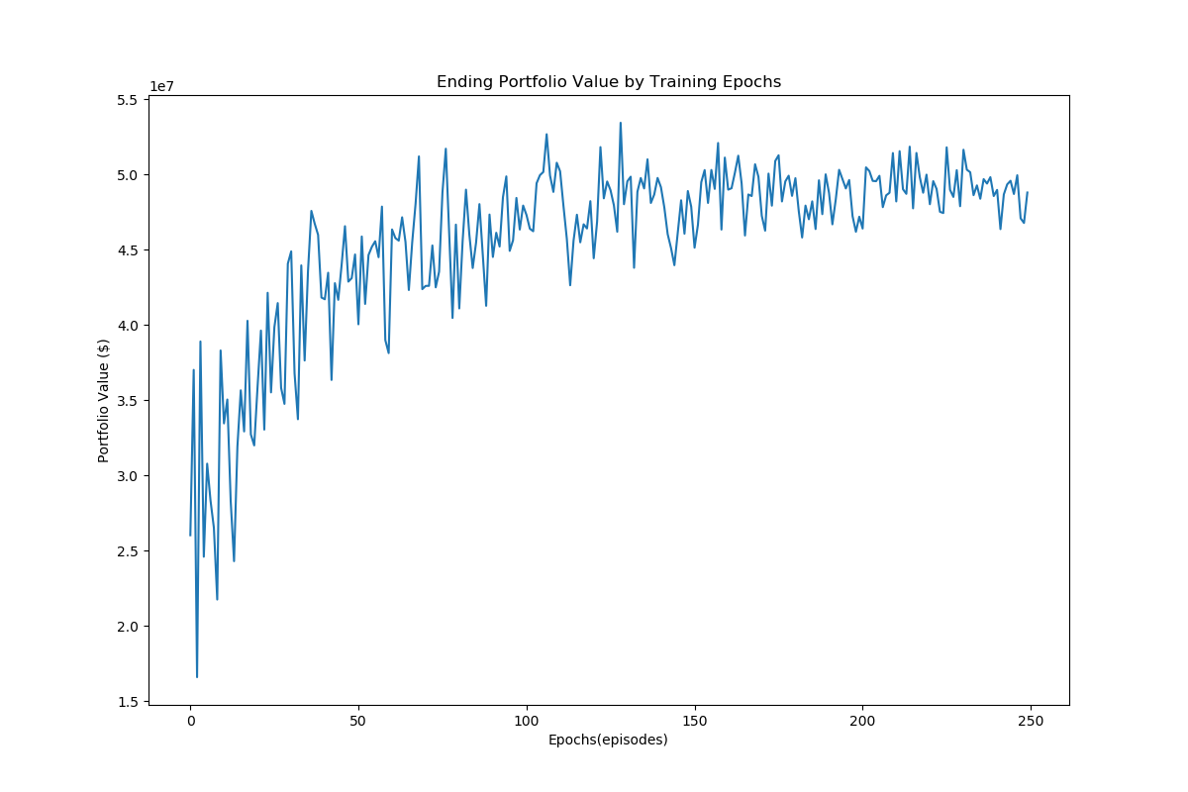
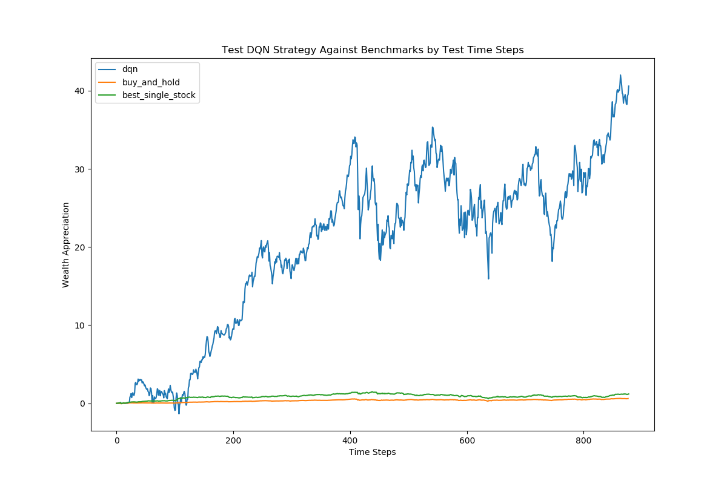
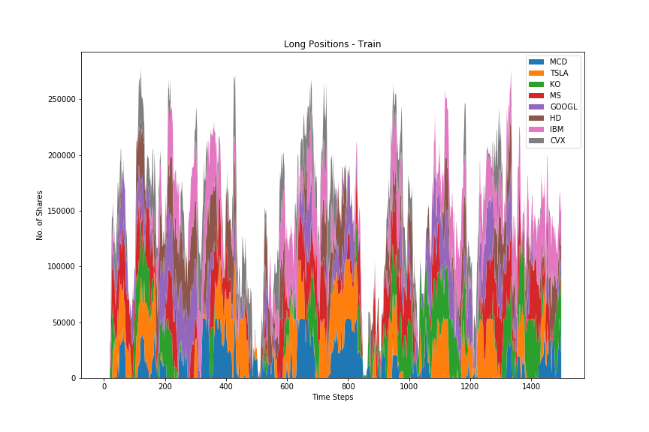
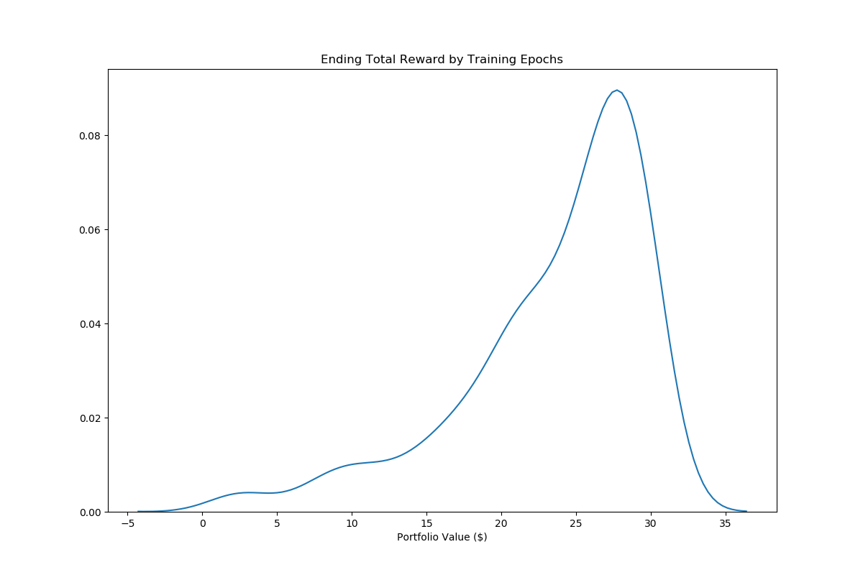
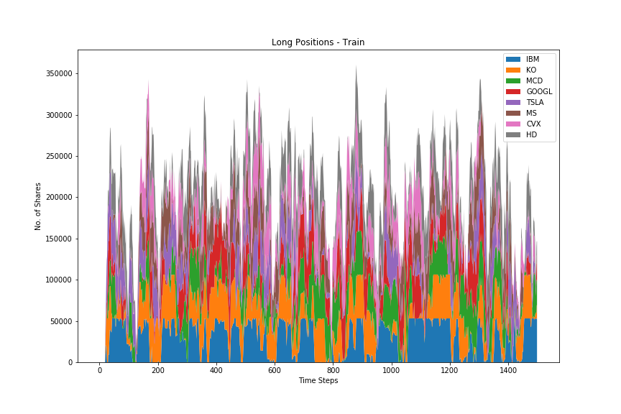
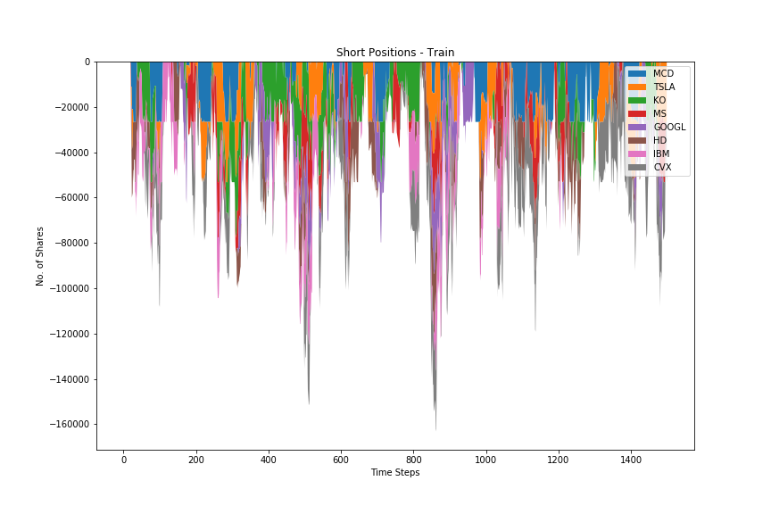
Deep Q-Networks For Multi-Asset Trading Decisions
Shen Gao | shengao@stanford.edu
Presentation Link https://youtu.be/OfwSZlaAims
Motivation
Dataset and Feature
Method
Computers are replacing highly paid traders on Wall Street. Trading in its essence is a decision making process in an environment of information flow.
Unlike many other problems, financial data is very fluid. Relationships and patterns are short-lived and hard to generalize in particular.
Deep Q-Network (DQN) by definition trains an agent that acts upon observation of sequential information. Promising for trading problems.
Daily adjusted close price time series for 8 stocks from alpha-vantage API: Tesla, Google, Morgan Stanley, IBM, Coca Cola, Chevron, Home Depot, Mcdonald’s
Training set: 2010/06/29 – 2016/6/13
Testing set: 2016/6/14 – 2019/12/01
Reward is not directly evaluated on the raw time series, but rather using exponentially weighted average price for reduced noise in volatility.
State Space (S): (20-day lookback time series, 8 stocks). State is normalized by window mean and standard deviation.
Action Space (A): {-1000, 100, 0, 100, 1000}, 8 stocks)
Reward Function:
Reward is normalized by initial cash. For long only strategy, allocate cash by buy cost across assets. Negative reward is penalized 10% more.
References
[1] Kavukcuoglu K. Silver D. et al Mnih, V. Human-level control through deep reinforcement
learning. Nature, 518:529–533, 01 2015.
[2] Gordon Ritter. Machine learning for trading. SSRN Electronic Journal, 01 2017.
[3] Xiang Gao. Deep reinforcement learning for time series: playing idealized trading games. Arxiv Quant, 03 2018.
[4] Chien Huang. Financial Trading as a Game: A Deep Reinforcement Learning Approach , 07 2018.
[5] Yang Wang, et el. Q-trading, CSLT Technical Report, 01 2017.
[6] Taewook Kim and Ha Kim. Optimizing the pairs-trading strategy using deep reinforcement learning with trading and stop-loss boundaries. Complexity, 2019:1–20, 11 2019.
Results
Discussion & Future Work
Model performs greatly and outperforms simple buy and hold strategy by orders of magnitude.
Judging from Fig 2, the DQN seems to have learned a strategy that makes money most of the time and lose money occasionally. It’s surprisingly good considering both transaction costs and risk aversion further penalizes rewards.
DQN network tends to overfit to training environment. We use experience replay and random exploration to reduce it.
When short trade and cash borrow is allowed in Fig 5&6, the model seems to take full advantage of the extra leverage to deliver outsized gains.
Further tests needed to show if the strategy is robust in a bear market condition since data is drawn from last decade of bull market.
It’s interesting to use other metrics to assess model performance, such as Sharpe Ratio, Max Drawdown, etc.
There might be survivorship bias as the stocks selected for testing are all well-known large cap stocks. It’s interesting to test against worse-performing assets, assets significantly affected by random events and other asset classes.
Test other neural network structure other than MLPs, such as GRU, LSTM, attention layers, etc.
Explore other deep reinforcement learning frameworks such as double q-learning, policy gradient, etc.
Reward
Agent
MLP Layers
Environment
Fig top to bottom, then left to right:
Portfolio value over training set (model metric)
Average reward distribution (training set)
Portfolio value over test period, compared with simple hold strategy
Long only strategy trades over time (color for assets)
Long-short strategy buy trades over time (color for assets)
Long-short strategy sell trades over time (color for assets)
State
Take Action
Observe State
Notes:
Script:
Hello and Welcome.
Today we’re going to talk about a deep Q-network for making invest decisions.
The motivation of this project mostly come from my working experience and observation of how algorithm has transformed the world of investing.
In terms of the algorithm itself, we would start with the Q-agent which observes the past 20-day price history as input to a 3-layer fully connect NN with ReLu activation in the hidden layers and Hard Sigmoid in the output layer. The NN then spits out probabilities of 5 actions for each stock. The Action space is defined as selling 1000, 100 shares, hold, buying 100 and 1000 shares, respectively. The reward of such action is evaluated based on each stock’s contribution to the overall portfolio return since inception. There’s a few nuances with respect to the reward function. Long only or long-short. Long only means you can only buy stock, can’t short them. There’s also cash borrow restrictions dictating if you can borrow cash to buy stocks. Also trading restrictions on min max number of shares you can hold in each stock. Lastly we’ve considered a fixed transaction cost for each trade.
Training steps are pretty typical, where at each time step, you get a current state, run through NN to predict a best action, then get a reward, save all these in the memory, then train the network by experience replay and augment Q function output with reward
In the results section, upper left graph would be the training progress, we can see portfolio value goes up as it trains more with less variability toward the end of the training. In terms of average rewards distribution, we could see most of the rewards are positive. Next middle upper graph shows the performance of our model. It actually returns like 40 times the initial wealth. This is a multitude better than a simple equally weighted strategy or single stock buy and hold strategy you could hope for. Bottom middle plot is the trades it generates (caveat this is a long-only portfolio and no cash borrow allowed). The right two plots are the trades generated for a long-short strategy and allows cash borrows. As you can see clearly when the algo directs the portfolio to reduce long positions, it also adds short positions to profit on market downturns.
In the future I’d like to 1) test this framework in bear markets as the training and testing all happened in the recent decade of longest running bull market. 2) It might be interesting to use other metrics other than portfolio returns, such as sharpe ratio, max drawdown to consider the risk of such strategy. I’d also like to use other deep reinforcement learning approaches such as attention mechanism or policy gradients for a similar task.
That’s it and thank you for viewing.

