Slide 1
Team Charter

Slide 2
Team Info
Team: The High Rollers
Project: High Rollers
Members: Abhi, Gary, Harman, Joseph, Seth
Contact: Seth

Slide 3
Team Philosophy
Collaboration and mutual learning
Focus on technical polish & user experience
Respect skill levels, open communication
Support each other through challenges

Slide 4
Roles & Responsibilities
Seth: Development Lead, Org Lead
Gary: Presentation & Version Control Lead
Joseph: Game Design, QA Lead
Harman: Documentation Lead
Abhi: Technical Implementation Lead
Understudy roles assigned to balance workload

Slide 5
Meetings & Communication
Weekly meeting: Tuesday 2:30–3:30 PM
Discord for general communication
Agendas by Org Lead, Notes by Documentation Lead
Updates at start of each meeting (2–3 minutes each)

Slide 6
Deliverables & Deadlines
Work completed 48 hours before deadlines
Peer review before submission
Tuesday meetings for planning and check-ins

Slide 7
Conflict Resolution & AI Policy
Conflicts: open discussion, team vote, lead decides tie
AI for grammar/editing only
Follow VIU Student Code of Conduct

Slide 8
Strengths & Weaknesses
Strengths: strong programming, presentation, documentation
Weaknesses: new to Godot engine, limited networking/testing experience
Strategies: early prototyping, code reviews

Slide 9
Project Proposal

Slide 10
Project Overview
Strategic 1–2 player dice game
Combines luck and tactical decision-making
Dice 'destruction' mechanic
Winner: highest score when all spaces filled

Slide 11
Motivation & Target Audience
Inspired by games like Knucklebones, Yahtzee, Splendor, King of Tokyo
Fast matches
Casual to intermediate players
Friends and family

Slide 12
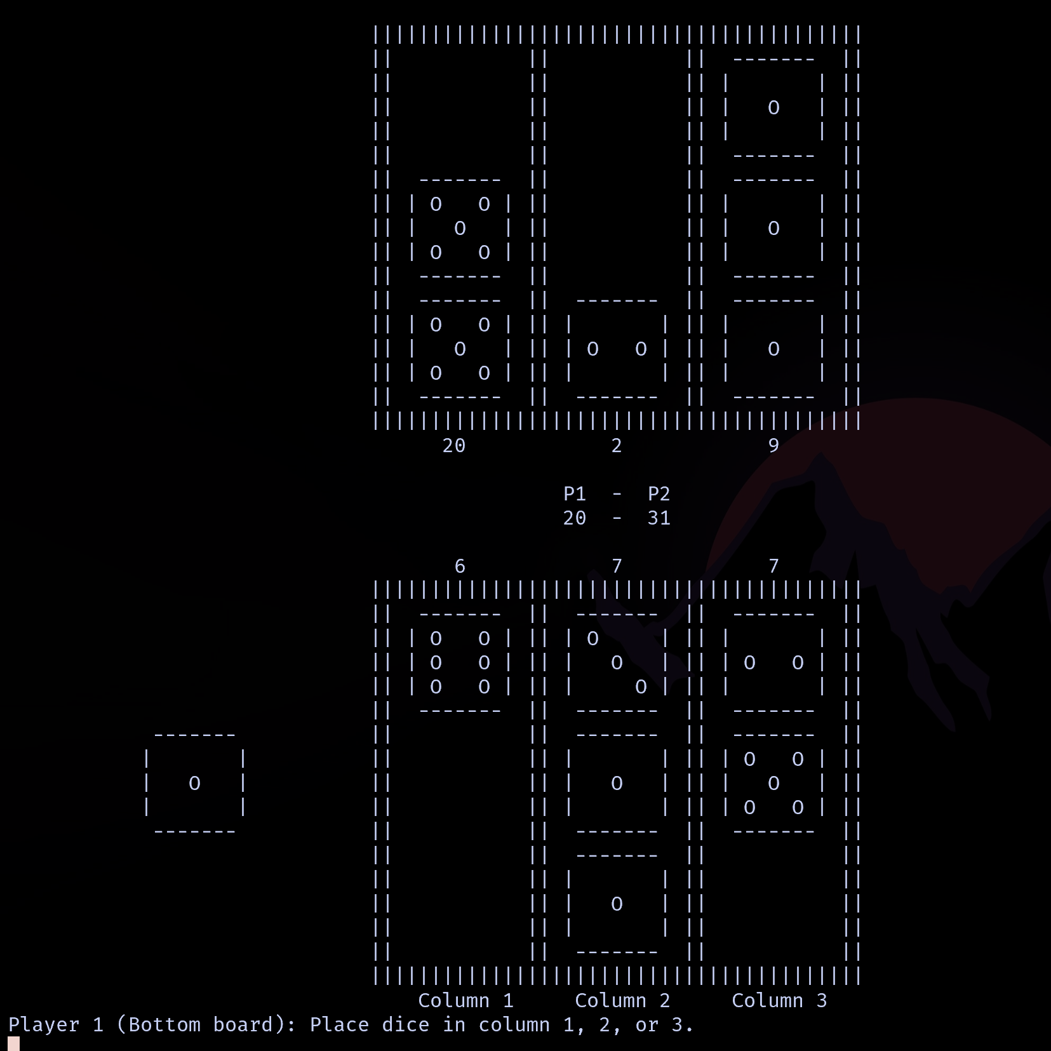
User Interface
Clean, accessible interface Prototype
Turn and score display
Random dice rolls
Multiple strategic choices

Slide 13
Core Gameplay Mechanics
Turn-based dice rolling with placement
Board columns for dice placement
Destruction: matching dice in opponents column to destroy opponent’s die
Scoring: multipliers for matching dice

Slide 14
Multiplayer Experience
Play vs AI or another player
(MVP) Local multiplayer (1–2 players)
(Mid range goal) Lan multiplayer
(Final goal) Online multiplayer

Slide 15
Technical Implementation
Godot engine, mobile app, 2D graphics
Build upon existing C++ prototype
Enhanced AI system
Modular code structure

Slide 16
Scaling & Future Features
MVP: Single player vs AI, 1–2 local multiplayer
Possible features: Online multiplayer, player profiles
Stretch goals: 3D graphics

Slide 17
Risks & Challenges
Learning curve: Godot engine
Networking/multiplayer implementation
Balancing game mechanics / difficulty of ai
Scope management

Slide 18
Next Steps
Build core game in Godot
Playtest and balance mechanics
Add enhancements if time allows

Slide 19
Closing / Q&A
Thank you for listening
Any questions?

