Slide 1



Can machine learning distinguish ethical, unethical, and illegal content online, and what does that mean to educators Gg Berg, researcher, University of San Francisco
www.usfca.edu

Slide 2
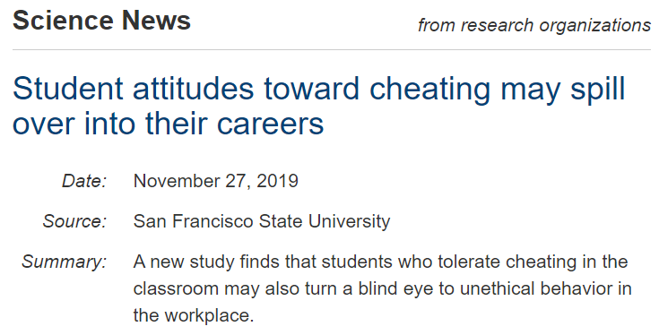
Students’ Changing attitudes
"If [students] have this attitude -- that it's OK to cheat in school -- that attitude unfortunately will carry over to the corporate boardroom," Foo Nin Ho, SF State Professor and Chair of Marketing
BIG implications for student’s online social profiles
In addition …
The results revealed that group-oriented students, or collectivists, had a more laissez-faire attitude toward cheating than individualistic classmates.
https://www.sciencedaily.com/releases/2019/11/191127121235.htm
Notes:
The survey found that students who were more tolerant of cheating in a classroom also demonstrated an openness to unethical behavior on the job.

Slide 3
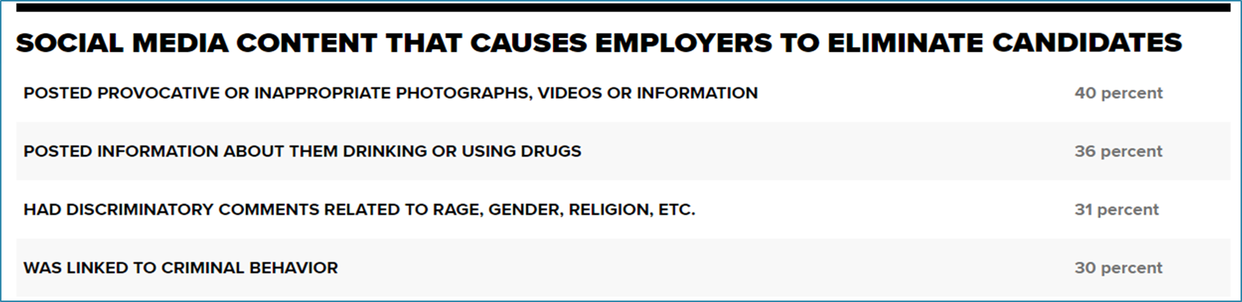
Business’ increasing sophistication
Over 70% of companies use social media checks to screen job candidates(2018)
BIG implications for students’ future jobs and careers
Can Natural Language Processing and modeling distinguish the nuances between unethical and illegal behaviors online
https://www.cnbc.com/2018/08/10/digital-dirt-may-nix-that-job-you-were-counting-on-getting.html
Notes:
such as ScrubberSocial and BrandYourself )
A simple way to determine this is by understanding what the meaning of ethical is. An ethical post would contain something that has moral principle. Meaning, if an employee utilizes social media on a daily basis, they should be certain to maintain an online persona that pleases the public in a way that does not harm either them or their place of employment in any way. Respecting the values of a company in and out of the workplace would be ensuring that any online posts would be considered ethical and appropriate to viewers.
https://blog.o2employmentservices.com/should-employers-monitor-employees-social-media-activity

Slide 4

Model ethical, unethical and illegal behaviors posted online
Reddit is a network of communities based on people's interests. Members find communities they’re interested in, and become part of an online community!
Members/ posters are self selecting
Subreddits are a good source of categorical data
front page of the internet

Slide 5



Data sources
Tips that improve your life one way or another.
7,613
… perhaps at the expense of others …
6,447
… illegally ….
7,128

Slide 6
Modeling ‘ethical’, ‘unethical’, and ‘illegal’ life pro tip subreddits
Modelling techniques:
CountVectorizer
TfidfVectorizer
Logistic Regression
NB Binomial/ Multinomial
Support Vector
Decision Tree
DATA1
14,060 posts
Unethical = 1
Ethical = 0
Data2
13,575 posts
Illegal = 1
Unethical = 0
DATA3
14,741 posts
Illegal = 1
Ethical = 0

Slide 7
Initial results
Overall results for all 3 data
Titles more accurate than selftext
Tvec more accurate than Cvec
Stopwords not an influence
LogReg most accurate model!
Multinomial Naïve Bayes slightly less accuracy than LogReg but consistently higher Specificity
Support Vector similar accuracy to LogReg, but with higher overfit and HUGE Time/CPU cost.
Decision Tree slightly less accuracy than LogReg and highest overfit.
DATA1
DATA3
DATA2
Stopword ethical is found 7 times in Data3 title
Stopword unethical is found 3 times in Data3 title
Stopword legal is found 153 times in Data3 title
Stopword illegal is found 86 times in Data3 title
Stopword evil is found 5 times in Data3 title
Stopword bad is found 107 times in Data3 title

Slide 8
Best modeling Results
Dataset | Base | Best model | Results*
Data1 Unethical Vs Ethical | 54.1% | TfidfVectroizer ‘tvec__max_features': 1500, 'tvec__min_df': 1, 'tvec__ngram_range': (1, 1), 'tvec__stop_words': None LogisticRegression
Data2 Illegal vs Unethical | 52.5% | TfidfVectorizer 'tvec__max_features': 1200, 'tvec__min_df': 2, 'tvec__ngram_range': (1, 1), 'tvec__stop_words': None LogisticRegression
Data3 Illegal vs Ethical | 51.6% | TfidfVectorizer tvec__max_features': 2000, 'tvec__min_df': 2, 'tvec__ngram_range': (1, 1), 'tvec__stop_words': None LogisticRegression
Accuracy =78.2%
Sensitivity =71.5%
Specificity =83.8%
Accuracy =76.0%
Sensitivity =80.0% Specificity =71.7%
Accuracy =89.8%
Sensitivity =89.2% Specificity =90.4%
* MultinomialNB very similar results, but with much higher SPECIFICITY

Slide 9

Conclusions
Conclusions
Simple modeling yields reasonable accuracy in predicting if a post/ behavior is unethical or Illegal
More data and more modelling will increase accuracy.
Reasonable to assume employers are capable of screening students / job candidates based on nuanced language.
Next steps
Expand on current study to : 1) ensure modelling accuracy, and 2) refine how online groups influence students’ ‘collectivism’
Advise University Career Services to enact stricter guidance to graduating students about cleaning social profiles.
Approach University staff to urge investigation on including the subject of Ethics in required curriculum

Slide 10
Thank you

